Slide 1
Spring 2018
SC READY / SCPASS Pretest Workshop
February 28, 2018

Slide 2
Table of Contents
TOPIC | SLIDE NUMBER
What’s New | Slides 4-9
Updates | Slide 10
Grade 3 Reading Rosters | Slide 11
Key Dates | Slide 12
Resources | Slide 13
Calculators | Slide 14
Seating Charts | Slide 15
Test Security | Slide 16
Online Testing | Slides 17-31
Paper/Pencil Testing | Slides 32-67

Slide 3
Contacting DRC
Direct Line: 1-800-451-7834
Fax: 1-866-237-9314
Email: SCProject@datarecognitioncorp.com
eDIRECT: https://sc.drcedirect.com
  Note: For any technical online testing questions, STCs, TAs, and Technology Coordinators may contact DRC, with the DTC’s approval.

Slide 4
What’s New
Testing Window
  The SC READY and SCPASS test administration window is April 16-June 8. The assessments must be administered during the last twenty school days as determined by each district’s instructional calendar.
  For grade 3 students, ELA must be administered in the first week of the 20-day window.
SCPASS Reduction in Testing
  Science grades 4, 6, and 8
  Social studies grades 5 and 7
Test Materials
  Online graphing tool available for mathematics grades 7 and 8
  No longer alternating ABCD/FGHI for SCPASS response options in answer document.

Slide 5
What’s New (cont.)
EL Policy Change
  All EL students must take the SC READY ELA test in their first year of U.S. enrollment.
  There will be no more exemption from the SC READY ELA test for EL students.
  Report Cards (accountability) will show a growth component for EL students.
  The first year scores will be used as a baseline or “pretest” to show growth for subsequent years.

Slide 6
What’s New (cont.)
Oral Administration
  For ELs, Session 1 of ELA test is a standard accommodation for grades 4-8.
  Options to ensure that students receive oral administration for Session 1 only include:
    For paper testing: Use Audio CD-ROMs or scripts for Session 1 only.
    For online testing: TAs should not allow students to wear headphones for ELA Session 2.
    For individual online administration: TAs should mute testing device for ELA Session 2.
    The Test ticket will now inform the TA which test session the student has the oral accommodation for.

Slide 7
What’s New (cont.)
Customized Materials
  SL DVDs are no longer produced
  Braille OAS no longer produced; special notes included in OAS.
  Large-Print test booklet will be enlarged 13 x18
  Loose-Leaf online accommodation no longer available
    All items are presented one at a time in the online test
  Secure, Large-Print Supplements for Online & Paper/Pencil Testers (ELA grades 3 and 8; social studies grades 5 and 7)
    Contain item descriptions for some graphics
    Formerly called “TA Notes for Online Testers”

Slide 8
What’s New (cont.)
ELA Passage Booklets for Online Testers
  Secure documents; sign out and in on security checklist
  Provide to students who take the ELA test online
  Passage Booklets are produced by grade level.
  Booklet will include the reading passage for the TDA item, as well as all reading passages for ELA Session 2.
  Students may highlight or mark the texts on the paper copy but will type their reading answers and TDA responses online.
  Large-print versions of the passage booklets will not be provided; students will receive the LP packet of materials.

Slide 9
What’s New (cont.)
Precode Changes
  Districts will receive New Student Precode Labels for students who were changed from online to paper testing between the January and March precode files.
  Schools must use overage materials or place an additional material order for the test booklets needed for these students.
eDIRECT
  DTCs may Force Submit tests within eDIRECT
  Multiple Student Upload functionality is available.

Slide 10
Updates
Return Grade 3 ELA Answer Documents for Accelerated Reporting: Deadline extended to May 22.
A new version of the Test Administration Manual was posted to eDIRECT with updated Index pages.
In the print version of the ADM, the last “SAY” instruction on page 15 should be ignored, and not read to the students. Instead, the first instruction on page 16 should be read to all students (not just the students in grades 5, 6, 7, and 8). The ADM on eDIRECT has been updated to reflect these updated instructions.
Score ranges for Lexiles and Quantiles will continue to be provided.

Slide 11
Grade 3 Reading Rosters
Grade 3 Reading – Accelerated Reporting
  Two separate answer documents: ELA and Math
  ELA Session 1 and Session 2 must be completed in the same test mode to receive results
  Results are preliminary and could change based on post-testing psychometric review
  Rosters will be posted to eDIRECT at 5:00pm EST:
    For online testing: within 3 business days of submitting ELA Session 1 and Session 2 online tests
    For paper/pencil testing: within 6 business days of DRC receiving answer documents
      Use fluorescent orange return shipping label
      Deadline for returning for accelerated reporting: May 22 via UPS Next Day Air

Slide 12
Key Dates
Deliverable | SC READY/SCPASS
OTTs & Tutorial Available Accommodated version available by Feb. 13 | Available
TAMs, ADMs, & Brochures Delivered | February 27
eDIRECT Test Setup Available | March 26
Secure Materials Delivered | By April 16
Testing Window (online and paper/pencil) | April 16-June 8*
Return Grade 3 ELA Answer Documents for Accelerated Reporting | April 18-May 22
Return all other material | June 12
* The testing window is determined by the last twenty days of a district’s instructional calendar.

Slide 13
Resources
Resource | For online testing? | For P/P testing? | Posted to eDIRECT | Delivered
Test Administration Manual (TAM) | Yes | Yes | Now | Feb 27
Administration Directions Manual (ADM) | Yes | Yes | Now | Feb 27
STC/TA Training Tool | Yes | Yes | Mar 2 | N/A
eDIRECT User Guide | Yes | Yes | Yes | N/A
DRC INSIGHT Tech User Guide | Yes | No | Yes | N/A
Online Testing Tech Training Presentation | Yes | No | Yes | N/A
Materials Receipt & Return Supplement* | Yes** | Yes | Mar 5 | N/A
Security Checklists | Yes** | Yes | Yes | N/A
Packing Lists | Yes** | Yes | Yes | N/A
*For ship-to sites only; formerly known as the DTC Supplement
**Due to ELA Passage Booklets for Online Testers

Slide 14
Calculators
Mathematics grades 6–8
  Calculator and No-Calculator sections
  Graphing Tool available for Grades 7 & 8
Science grades 6 & 8 – Students may use calculators
  Online – built in four function
  School- or student-owned calculators may be used
Calculator policy is located in the TAM beginning
on p. 31

Slide 15
Seating Charts
Seating Charts
  Required for each paper/pencil and online test session
  Include district, school, test date, subject, grade level,
  TA name, all student first initials and last names, and
  seating locations
  PowerPoint seating chart templates available on eDIRECT
  Can be created using graph paper or other paper
  Options for returning after testing:
    Via hard copy (in school boxes of nonscorable materials)
    Electronically via email (from STCs to DTCs, and from DTC to SC Project Team)
    Electronically posted to SFTP site (instructions on eDIRECT)

Slide 16
Test Security
All personnel involved in paper and online testing must be familiar with South Carolina test security legislation and State Board test security regulations.
All district and school personnel who will have access to secure test materials (including online tests) are required to sign a new Agreement to Maintain Test Security and Confidentiality form. These forms have been updated for 2018.
The 2018 TAM provides updated guidance on test security. Be sure to review this information including the sections on Student and School Responsibilities for Maintaining Test Security (p. 29) and Student Cheating (p. 30).
Schools and districts are required to use security checklists to track the distribution and return of all secure test materials.
For online testing: schools and districts are required to use the online testing rosters to track the distribution and return of all secure online test tickets.
DTCs, STCs, TAs, and monitors are responsible for ensuring that all test materials and student responses for online tests are handled in accordance with security procedures outlined in the TAM.

Slide 17
Online Testing

Slide 18
Security for Online Testing
Test tickets are secure.
Use testing roster, in lieu of security checklist, to account for tickets.
Online tests may not be viewed by anyone prior to the
test session.
TAs are expected to ensure that visible online tests are not left unattended.
  TAs should set up seating for online testing to provide maximum privacy for each student.
  It is the responsibility of the STC and TA to ensure partitions/folders, privacy filters, spacing, and other measures are implemented as needed.
  Student use of computers must be monitored to ensure students do not activate software or other resources that could interfere with the integrity of the test.

Slide 19
Online Testing
Training and Support
Review the following materials:
  DRC INSIGHT Technology User Guide
  Presentation for Online Training Technical workshop from October, 2017
  eDIRECT User Guide
If automatic updates were enabled, no action is needed for the 2017-18 school year testing.
  As of Fall 2017: New version of Test Engine (INSIGHT). Version 8.0.x
  As of Fall 2017: New version of the Testing Site Manager (TSM). Version 9.2.x
A TSM is only mandatory for HVA and/or VSL accommodated tests.

Slide 20
Online Testing
Training and Support
Tutorial
  Guides TAs and students through testing experience,
  including testing tools and navigation
  Review prior to Online Tools Training (OTT)
  Access Tutorial via:
    eDIRECT under General Information (no login required)
    Link on DRC INSIGHT homepage
  Includes audio narration
  May be used in a large-group setting

Slide 21
Online Testing
Training and Support
Online Tools Training (OTT)
  Simulates the student testing experience and allows students to become familiar with online testing tools and functionality; correct answers and scores not provided
  Items in the OTT are not representative of the actual test content. The purpose of the OTT is for students to learn how to use the tests and navigate the online testing engine.
  Highly recommended that students use the OTTs as much as needed prior to testing
  Access via:
    Link on eDIRECT home page (accommodated versions not available)
    Link on DRC INSIGHT homepage
  Accommodated versions include oral administration (HVA) and video sign language (VSL)
    Available now
    Access via link on DRC INSIGHT homepage
    Use of TSM Required

Slide 22
Online Testing
Preparation
Testing Software
  Review technical documentation
  Install the software
  Prepare TSM (if TSM is needed)
    Select checkboxes for oral administrations (HVA and TTS), if needed
    Select checkbox for video sign language administrations (VSL), if needed
    Update Content when notified by DRC (week of April 2)
Precode
  Information from the March Update Precode File will be used
  to populate test setup
  All students will be loaded into test setup, regardless of online testing designation flag

Slide 23
Online Testing
Preparation
Reference eDIRECT User Guide to:
  Provide permissions to STCs and TAs (chart on following page)
  Ensure all students are included in a test session
    Add students as needed
    Update demographics and accommodations as applicable
  Print testing rosters and student test tickets
    Use roster to create seating charts
    Two separate test tickets are used for ELA Session 1/Session 2 and Grades 6‒8 Math Calculator/No-Calculator
    Do not distribute test tickets to students until indicated to do so in the administration directions.

Slide 24
Online Testing
Permissions
Permission | Allows Users To:
Documents – View
Online Testing – Secured Resources | View secured online testing downloads
Test Setup – Device Toolkit | Set up organizational units for testing devices (all Tech Coordinators)
Test Setup – Primary Window | Access test setup
Students – Add/Edit | Add/edit students and student data for online testing
Students – Download Students | Download list of student information for all students in a school
Students – Search/View | Search/view student data and download search results
Teachers – Add/Edit | Add/edit teachers who have students testing online
Teachers – Search/View | Search/view teacher data and download search results
Test Session – Add/Edit | Add, edit, and delete test sessions
Test Session – Search/View | Search/view test session data and download search results
Test Session – Status Summary | View testing status summary information
Test Setup – View Student Status | View status of Not Started, In Progress, or Complete
Test Tickets – View/Print | Print student test ticket and view individual ticket status
Test Tickets – View Questions Attempted | See questions attempted by students against total number of test questions
SC Project assigns permissions to DTCs. DTCs assign to STCs, TAs, and Tech Coordinators as needed.

Slide 25
Online Testing
Accommodations
Online Accommodation
Oral Administration* Human Voice Audio (HVA) for directions and items (same as audio CD-ROM) Text-to-Speech (TTS) for tools and Help content Schools must provide headphones
Oral Administration + Large-Print
Large-Print Fully scalable; students can view items in larger format by testing at workstation with larger monitor Text and graphics approximately 30% larger, depending on monitor size and screen resolution
If ESOL – Oral Administration is checked for a student, the Online – Oral Administration accommodation must also be checked to turn on the audio/HVA feature in DRC INSIGHT.
Oral Administration is not available for students testing ELA grade 3.
*Oral Administration for ELA Session 1 or Session 2 can be indicated in Test Setup.
This does not change the functionality of DRC INSIGHT, but helps the TA know which ELA session the student should have the accommodation.

Slide 26
Online Testing
Accommodations
Online Accommodation
Sign Language
Sign Language + Signed Administration Sign language form with Video Sign Language (VSL) for directions and items
Oral/Signed Administration is not available for students testing ELA grade 3.

Slide 27
Online Testing
Rosters
Testing Rosters:
  Contain form number, username/password, and accommodations assigned to each student
  Are used for signing out/in secure test tickets and creating seating charts
  Should not be transmitted via email or non-secure fax
  Should be treated as a secure material; they must be accounted for at all times and securely destroyed after testing

Slide 28
Online Testing
Test Tickets
Student Test Tickets
  Contain username and password needed for students to login to an online test
  Contain the Form Number for students utilizing ELA Passage Booklets
  TAs should verify that each student has the correct ticket by carefully following the administration directions
  Should not be transmitted via email or non-secure fax
  Should be treated as a secure material; they must be accounted for at all times and securely destroyed after testing
  Separate test tickets are provided for:
    ELA Session 1
    ELA Session 2
    Mathematics (separate tickets provided for grades 6-8 calculator and no-calculator sections)
    Science
    Social Studies

Slide 29
Online Testing
Regenerating a Test
Automated Process
  If a student’s accommodations are updated, the test ticket will be updated automatically, if needed.
  eDIRECT message will notify user if a new test ticket needs to be printed.
  If accommodations are updated for a student who has started testing,
  the ticket will not automatically regenerate. Refer to the information found on pages 19 and B-3 of the TAM for instructions on how to proceed.

Slide 30
Online Testing
Restarting a Test
Students can “Pause” their own test; they have 20 minutes to resume testing. A test can also automatically end due to inactivity (fire drill, etc.)
  If student does not return within 20 minutes, they can log in later that same day using the same test ticket.
  Student responses, sticky notes, highlighters, and flags, will be saved.

Slide 31
Online Testing
Restarting a Test, cont.
Follow the instructions included in the chart on page B-3 of the TAM for handling the following testing scenarios:
  A student does not have enough time to complete testing.
  A student does not finish testing because of illness or internet/power outage.
  A student “Submits” a test by accident.
  A student begins testing, but is missing accommodations.

Slide 32
Paper/Pencil Testing

Slide 33
Security Checklists
Security Checklists
  Electronic format only; available on eDIRECT
  Posted by April 9
  Used to track and monitor receipt and distribution of
  secure paper/pencil test materials & ELA Passage Booklets for Online Testers, and Large Print Supplements for Online and Paper Testers
    STCs and TAs sign out and sign in all secure test materials
    Record notes, as needed
    Record any additional material orders
    Indicate date materials were packaged to return
  Options for returning after testing:
    Via hard copy (in school boxes of nonscorable materials)
    Electronically via email (from STCs to DTCs, and from DTC to SC Project Team)
    Electronically posted to SFTP site (instructions on eDIRECT)

Slide 34
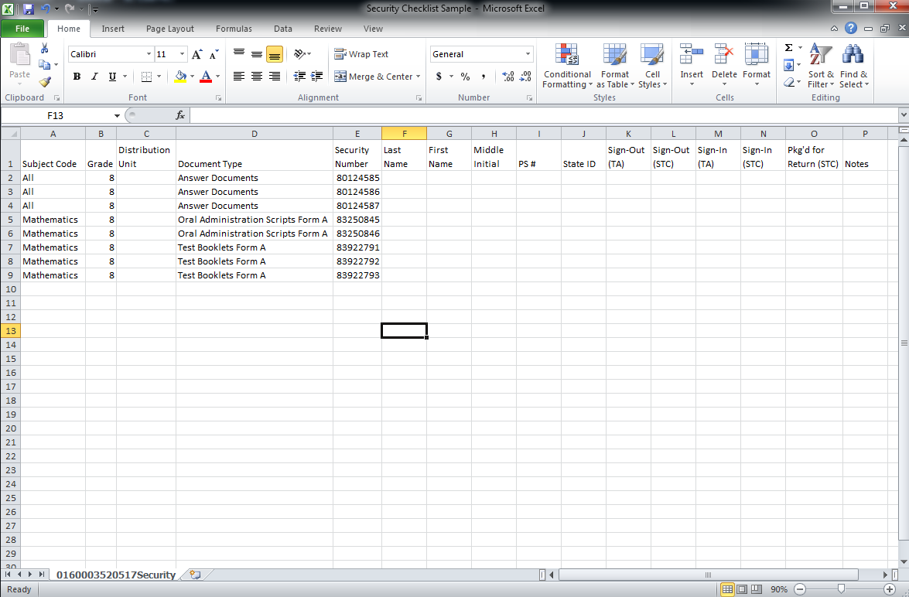
Security Checklists
There is additional information regarding the security checklists and how to return them available on eDIRECT under Documents.

Slide 35
Paper/Pencil
Inventory Materials
Retain original shipping boxes
District Boxes: White
School Boxes: Brown
Verify materials received
Refer to packing lists
Compare security numbers on range sheets to security checklists
Record any missing material
Use “Notes” column on electronic security checklists
Email discrepancies to DRC

Slide 36
Paper/Pencil Additional Materials
Consider whether any materials can be reused before ordering additional materials.
  Oral administration scripts and audio CD-ROMs may be reused.
Use the Intra-district Transfer Form to transfer materials between schools in your district.
  Use this form before placing an additional materials order.
  Note the transfer on electronic security checklist.
  Form is available on eDIRECT under Documents—General.
If additional materials are required, submit orders via eDIRECT
  All Applications—Materials—Additional Materials
  Orders received before 4:00 pm Eastern time will be processed on the same day and shipped via overnight delivery.

Slide 37
Paper/Pencil Answer Documents
Answer Documents
  SC READY (combined) document for both ELA & Mathematics, except for grade 3 (separate for ELA and Mathematics)
  SCPASS separate documents for Science and Social Studies
  Preprinted with student name, based on January precode file
  Packaged by grade and distribution unit
  Used for all test booklets

Slide 38
Paper/Pencil Materials
Test booklet
  All subjects have one form per grade level
  All items have been reviewed for use by students who are blind or visually impaired and students who are deaf or hearing impaired (no separate Form A & C)

Slide 39
Paper/Pencil Materials
Loose-Leaf (LL)
  Single-sided pages bound in a 3-ring binder for each subject
  One item per page
  Preprinted answer documents are provided separately
Large-Print (LP)
  Digitally enlarged to a finish size of 13 x 18 with approximately
  19-point font
  TA Notes
  ELA – TDA response pages for final drafts
  Preprinted answer documents are provided separately
  Student marks or writes all answers in large-print booklet;
  the TA must transcribe responses (including TDA) into the answer document
  The new, larger booklet size should be considered when planning, e.g., for larger desks, room setup, and seating arrangements.

Slide 40
Paper/Pencil Oral Administration
Oral Administration Script (OAS)
  Produced for all grades in math, science, and social studies and grades 4-8 for ELA
Audio CD-ROMs
  Produced for all grades in math, science, and social studies and grades 4-8 for ELA
  For use with a computer (paper/pencil test booklet needed)
  Can be used for make-up testing
  Expires the day after the last day of make-up testing, June 9
  Note: All oral administrations must begin with the Paper/Pencil Administration Directions in the ADM.

Slide 41
Paper/Pencil Materials—BR and SL
Braille (BR)
  Test booklet
  Print version of test booklet
  TA Notes
  Preprinted answer documents are provided separately
  TA must transcribe all responses into the answer document
    Brailled TDA response may be returned and transcribed by vendor
Sign Language
  No separate sign language test booklet; all items in regular test booklet have been reviewed.
Signed Administration Script (SAS)
  Produced for all grades in math, science, and social studies and grades 4-8 for ELA for use with a test booklet
  Used for Pidgin Signed English (PSE), Signed Exact English (SEE), and American Sign Language (ASL) administrations
  Note: All oral and signed administrations must begin with the Paper/Pencil Administration Directions in the ADM.

Slide 42
Paper/Pencil Testing –
Answer Document Labels
  Answer documents must have pre-printed information or a label applied in order to be scored.
  The various types of labels available will be reviewed on the following slides.

Slide 43
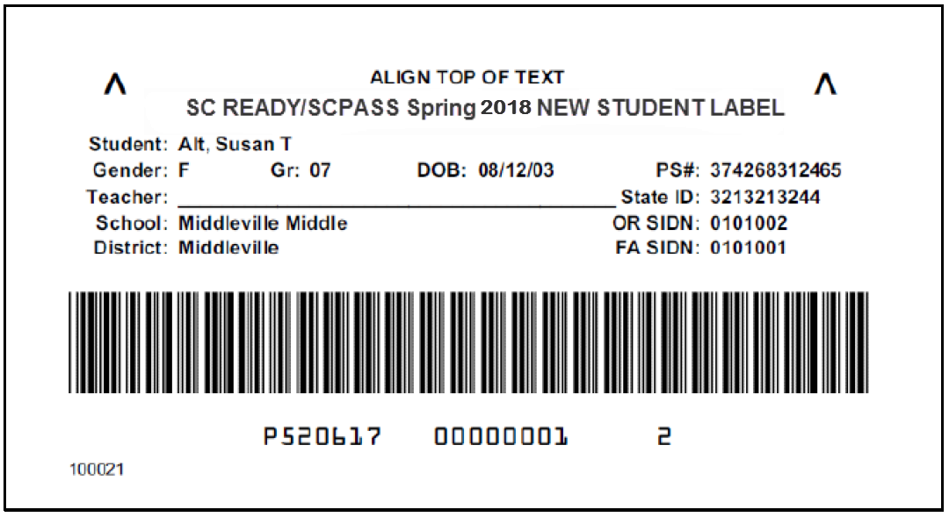
Paper/Pencil New Student Labels
  Contain preprinted information for new students from the March Precode Update file and for students whose online testing designation has changed to paper/pencil
  Contain student identification information
  Printed 10 pink-striped labels per sheet

Slide 44
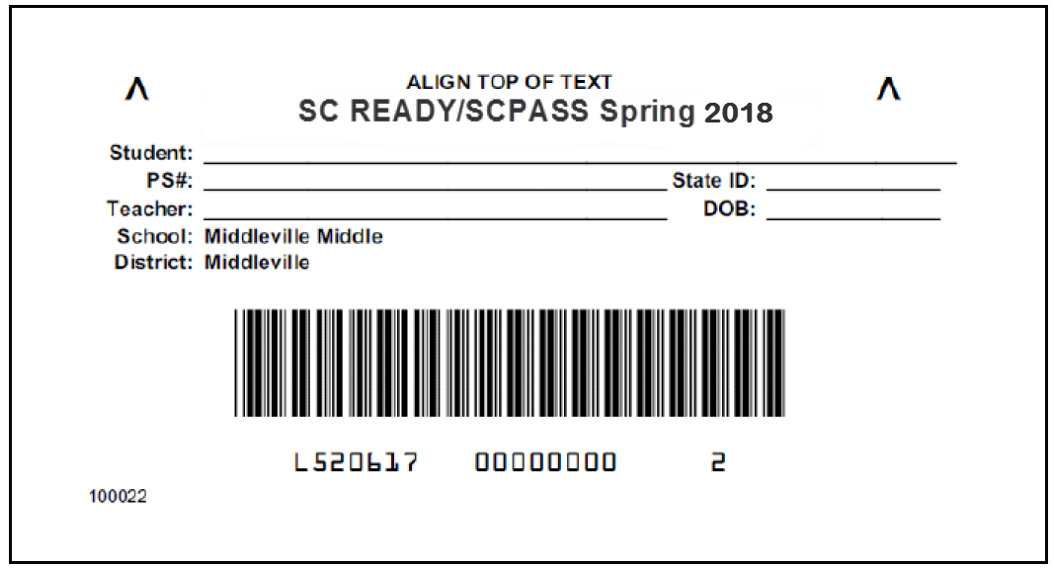
Paper/Pencil Override Labels
  For any student without a preprinted answer document or
  new student precode label
  For answer documents with incorrect information
  Student information must be written on spaces provided
    Coding student name and applicable demographic information is mandatory on the answer document
  Printed 10 white labels per sheet

Slide 45
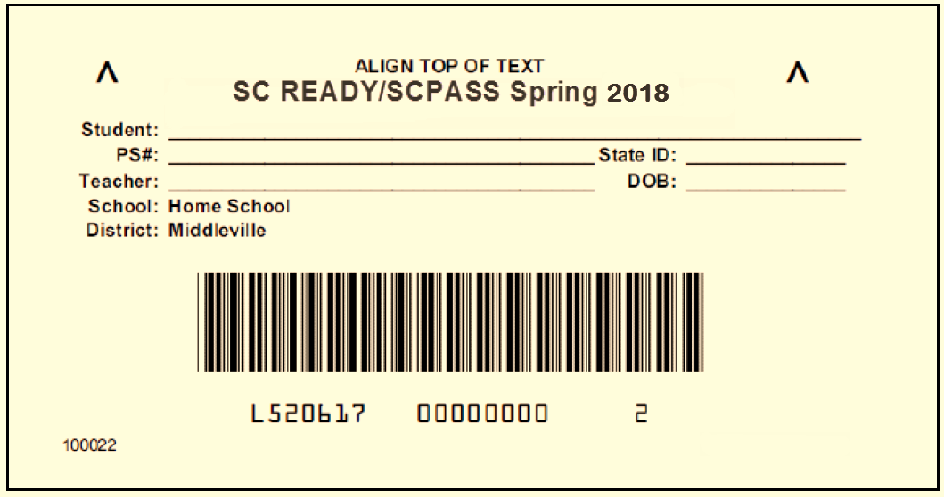
Paper/Pencil Home School Override Labels
  Function similar to override labels
  Packaged in district boxes
  Printed 10 ivory labels per sheet

Slide 46
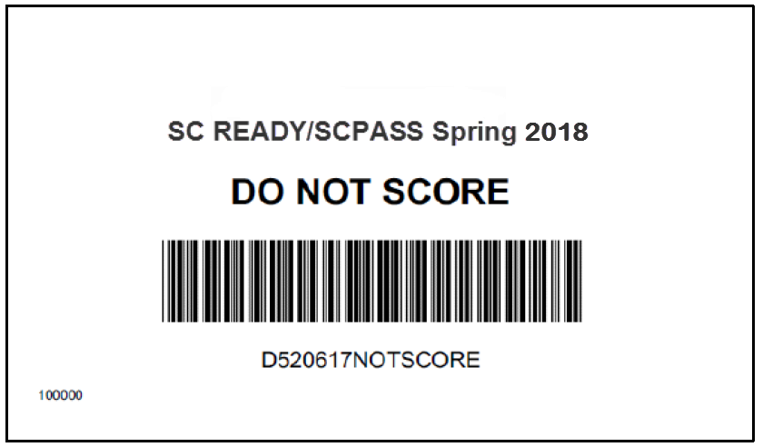
Paper/Pencil Do Not Score Labels
  Apply to preprinted, used, or mislabeled answer documents that DRC should not score
  Printed 10 tan labels per sheet
  Do not place labels on any answer documents with
  the IEP Invalidation bubble marked
  Not needed on unused overage answer documents

Slide 47
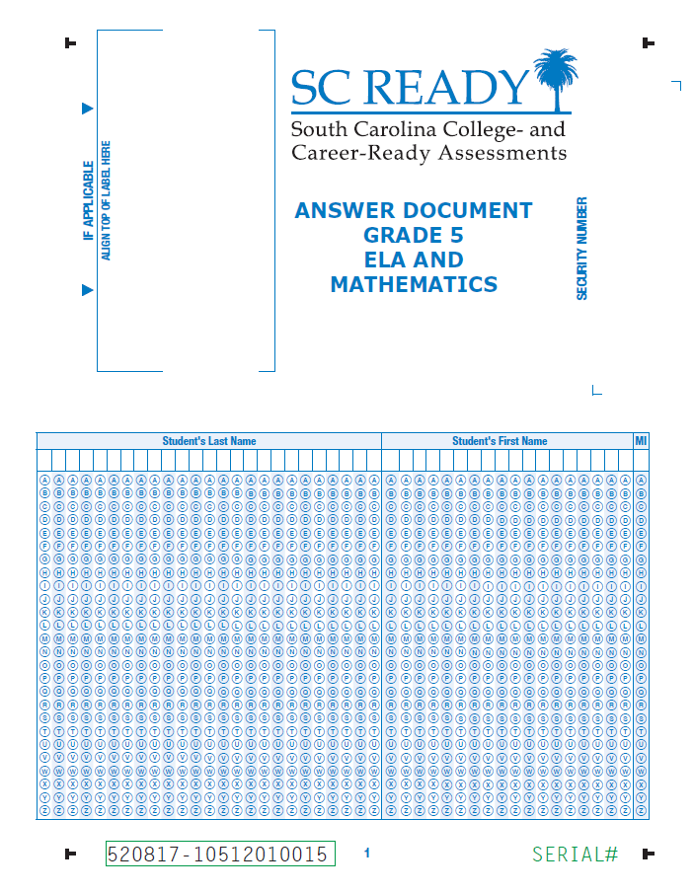
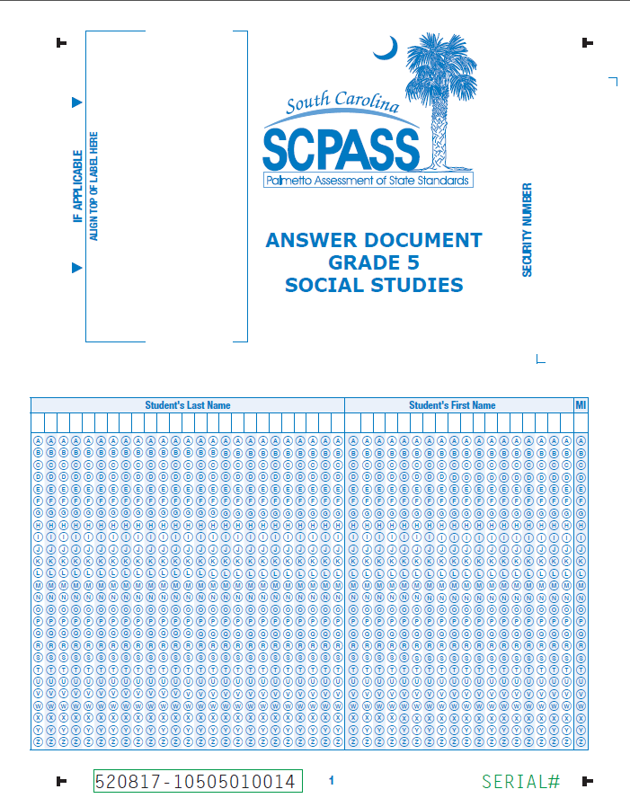
Paper/Pencil
Answer Documents

Slide 48
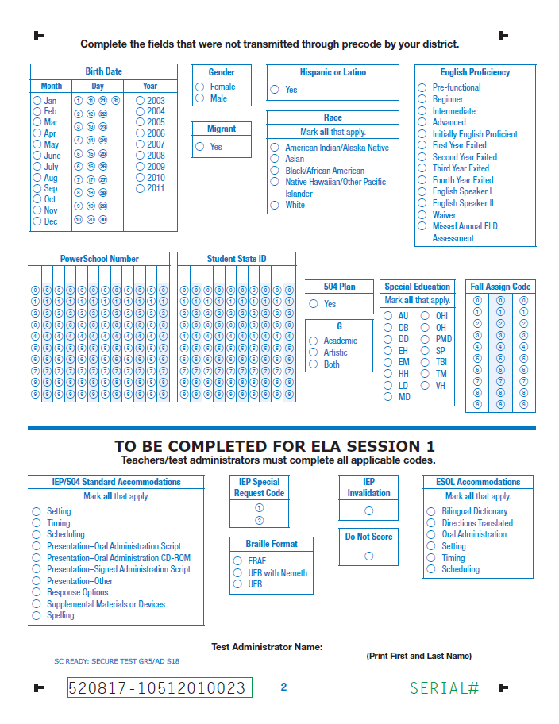
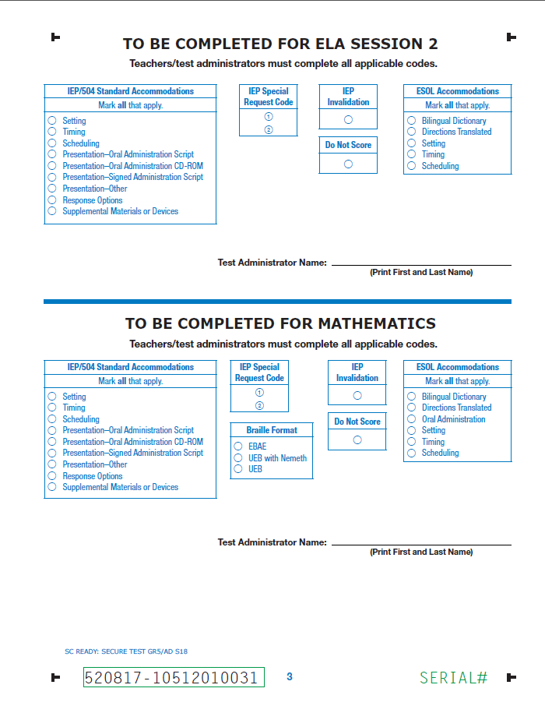
Paper/Pencil
Answer Documents – Samples in TAM

Slide 49
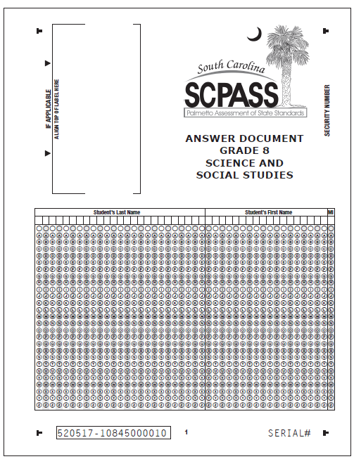
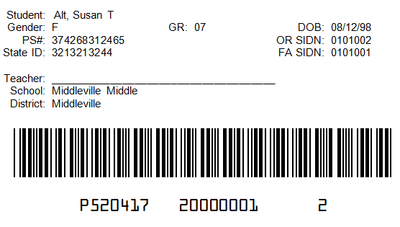
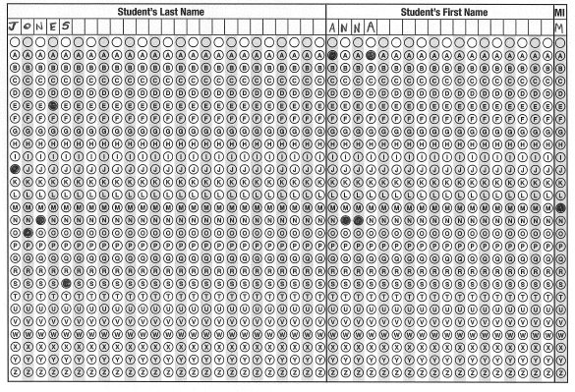
Paper/Pencil
Coding Answer Documents—Precoded*
Sample of preprinted data
Handcoding student name
is optional for precoded answer documents, but is recommended.
*Precoded documents are those that are preprinted or have a new student precode label applied.

Slide 50
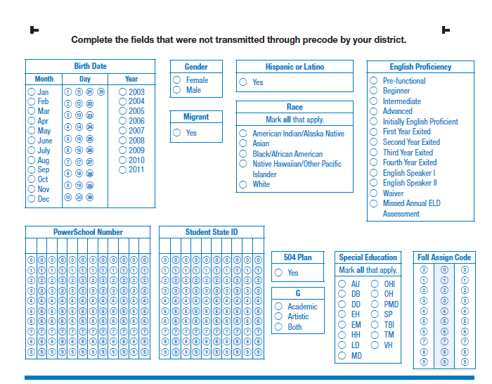
Paper/Pencil
Coding Answer Documents—Precoded
Code any fields not submitted via precode.

Slide 51
Paper/Pencil
Coding Answer Documents—Non-Precoded
Write information on override label and apply to designated area.
Handcoding student name is mandatory for non-precoded answer documents.

Slide 52
Paper/Pencil
Coding Answer Documents—Non-Precoded
Code all applicable fields.

Slide 53
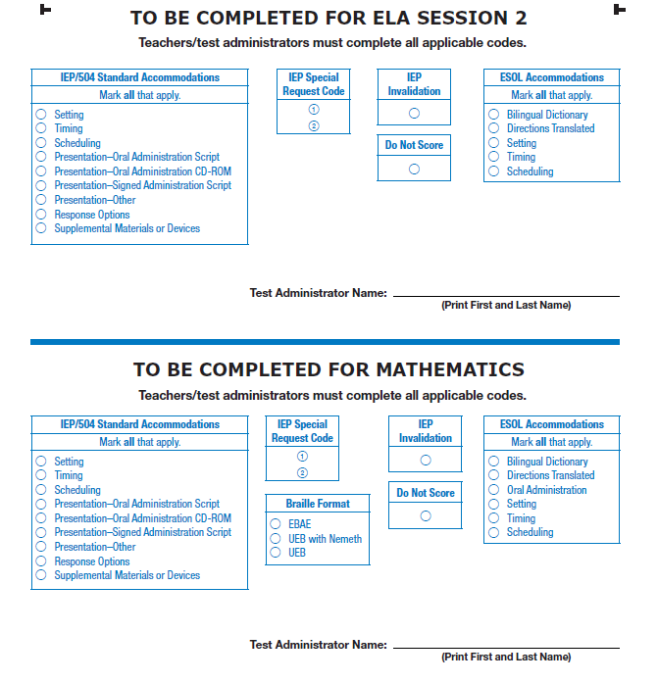
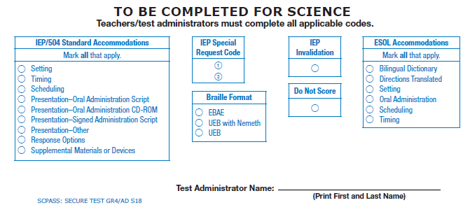
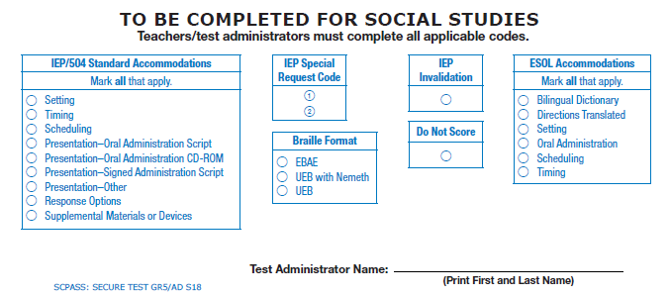
Paper/Pencil
Coding Answer Documents
Code all applicable fields, per subject.
Test Administrator name must be printed on line for each subject.

Slide 54
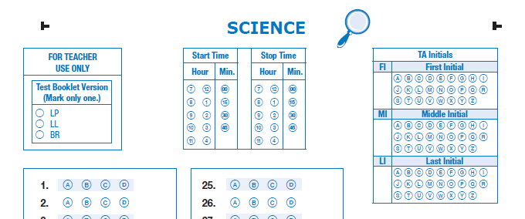
Paper/Pencil
Coding Answer Documents
NEW: Test Booklet Version should be coded correctly for reporting purposes.
Students bubble the first, middle, and last initial of the test administrator (TA) for each subject.

Slide 55
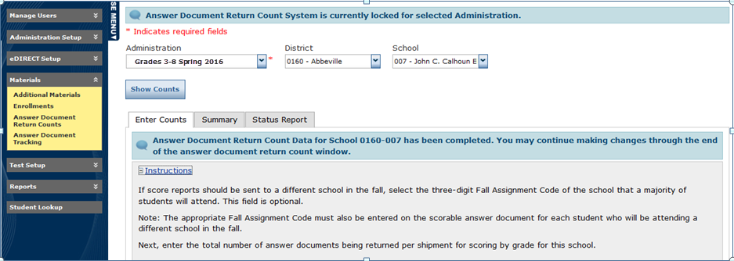
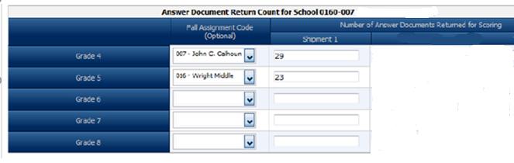
Paper/Pencil
Answer Document Return Form (ADRF)
The ADRF is used to indicate the number of answer documents being returned.
Enter the quantity of answer documents for return.
Complete Fall Assignment info,
if necessary.
There will be also be a separate row for grade 3 math.

Slide 56
Paper/Pencil
Fall Assignment
VALUE If coded as this, then…. |  |  |  |  | FINAL VALUE reported as this
Precode | ADRF | Student’s Answer Doc | Online |  | Test School’s ID | Precode | ADRF | Student’s Answer Doc | Online
 |  |  |  |  | 
 |  |  |  |  |  |  |  | 
 |  |  |  |  |  |  | 
 |  |  |  |  |  |  |  | 
 |  |  |  |  |  | 
 |  |  |  |  |  |  |  | 
 |  |  |  |  |  |  | 
 |  |  |  |  |  |  |  | 
 |  |  |  |  |  |  |  |  | 

Slide 57
Paper/Pencil
STC Return Procedures
  Read and follow return procedures in TAM.
  Confirm all scorable answer documents have preprinted information or a label applied.
  Confirm that student name is bubbled on all non-precoded answer documents.
  For SC READY: Ensure that accommodations on pages 2 and 3, as well as Test Booklet Version and TA Initials on subsequent pages, have been accurately bubbled.
  For SCPASS: Ensure that accommodations on page 2—as well as Test Booklet Version and TA Initials on page 3 have been accurately bubbled.

Slide 58
Paper/Pencil
STC Return Procedures
Do Not Score Labels
Place on any unused preprinted answer documents or used answer documents that should not be scored.
Security Checklists
Use security checklists located on eDIRECT and return via email or SFTP site to DTC.
(If security checklists were printed and used, return in nonscorable
boxes.)
Seating Chart
Return seating charts via paper (in nonscorable boxes) or send via email/SFTP site to DTC.
ADRF
Complete ADRF on eDIRECT.

Slide 59
Paper/Pencil
Materials Return—Braille
Return answer documents for Braille with scorable materials (except as noted for ELA below).
Return all other Braille materials in the plastic bag
and place with nonscorable materials.
If transcription is needed for TDA response, return all ELA Braille materials for student together in plastic bag in the scorable box.

Slide 60
Paper/Pencil
DTC Return Procedures – Grade 3 ELA
All materials will be returned via UPS.
  For Grade 3 reading accelerated reporting: Return deadline is Tuesday, May 22; call UPS to arrange pickup (if not already scheduled) by Friday, May 18.
  Collect boxes of test materials from schools.
  Collect home school test materials (if being returned in district box).
  Store materials in a secure place until they are picked up.

Slide 61
Paper/Pencil
DTC Return Procedures—All other material
All materials will be returned via UPS.
  Material return deadline is Tuesday, June 12.
  Collect all remaining boxes of test materials from schools.
  Collect remaining home school materials.
  Package district materials into scorable and nonscorable boxes.

Slide 62
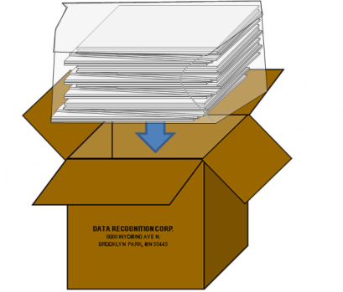
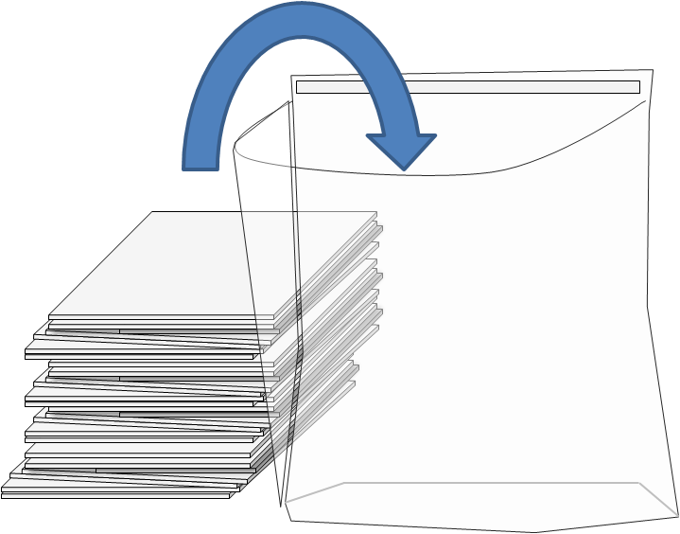
Paper/Pencil
Packaging Procedures
Place all scorable
test materials in
plastic return bags provided by DRC.
Seal the bags tightly and place in scorable boxes.

Slide 63
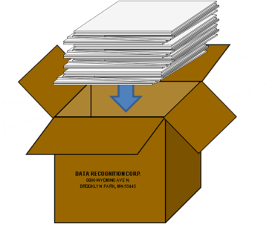
Paper/Pencil
Packaging Procedures
Place all nonscorable test materials in nonscorable boxes (plastic bags are not needed for nonscorable materials).

Slide 64
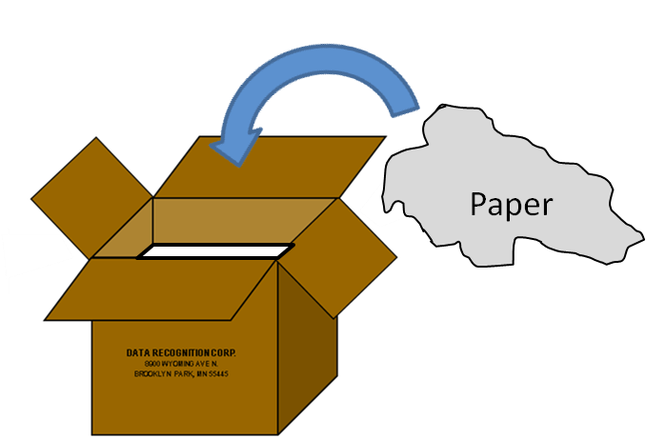
Paper/Pencil
Packaging Procedures
Fill any empty space in each box with crumpled paper or bubble wrap
to ensure that testing materials do not shift during transit.
Fill any voids to the top of the box.

Slide 65
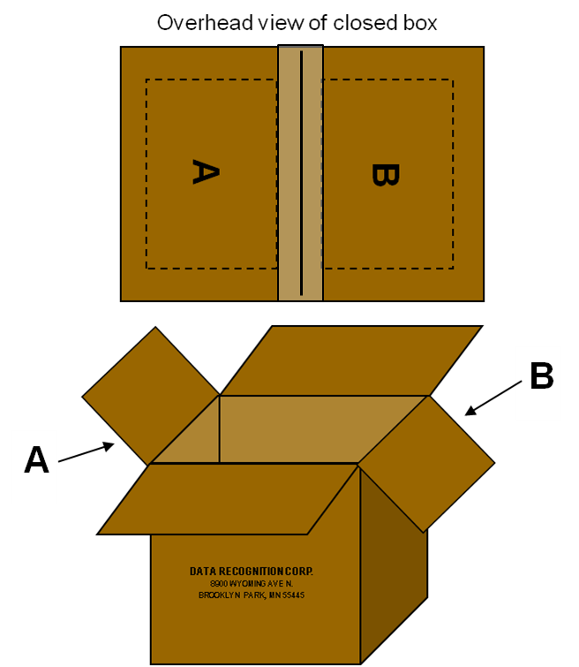

Paper/Pencil
Packaging Procedures
Fold in the outer flaps (with old shipping labels), exposing the A & B flaps.

Slide 66


Paper/Pencil
Packaging Procedures
Tape boxes securely
using three pieces of packaging tape on
BOTH the top and the bottom.
Overlap the tape, and
make sure it wraps around
the sides at least two inches.

Slide 67
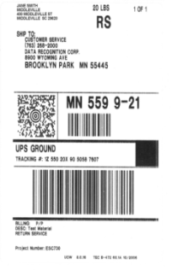
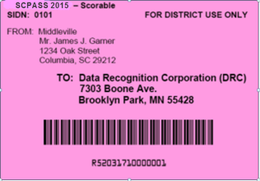

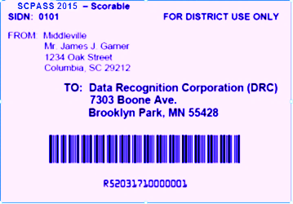
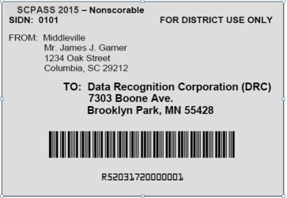

Paper/Pencil
Packaging Procedures
Place appropriate colored DRC label on Flap A (orange for grade 3 ELA, pink for scorable, and white for nonscorable.)
Overhead view of closed box
Place the UPS-RS label on Flap B (NDA for scorable, Ground for nonscorable.)

Slide 68
Contacting DRC
Direct Line: 1-800-451-7834
Fax: 1-866-237-9314
Email: SCProject@datarecognitioncorp.com
eDIRECT: https://sc.drcedirect.com
  Note: For any technical online testing questions, STCs, TAs, and Technology Coordinators may contact DRC, with the DTC’s approval.

