Slide 1


Programmatic and Finance Personnel Regional Meeting
Title I and
Title II

Slide 2
Agenda
Federal Programs Background
Maintenance of Effort
Comparability
Title I Allowable Use of Funds
Title II Allowable Use of Funds
SCDE Financial Services Update
Regulations and Important Items
Risk Assessment /Audit Findings
Supplement, Not Supplant
Inventory
Equitable Services to Private Schools under Title I, Part A

Slide 3
Elementary and Secondary Education Act of 1965
Roy Stehle
Director, Federal and State Accountability

Slide 4
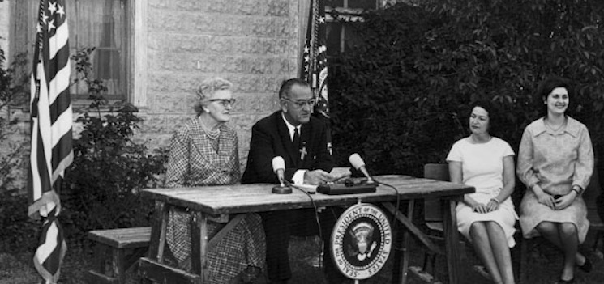
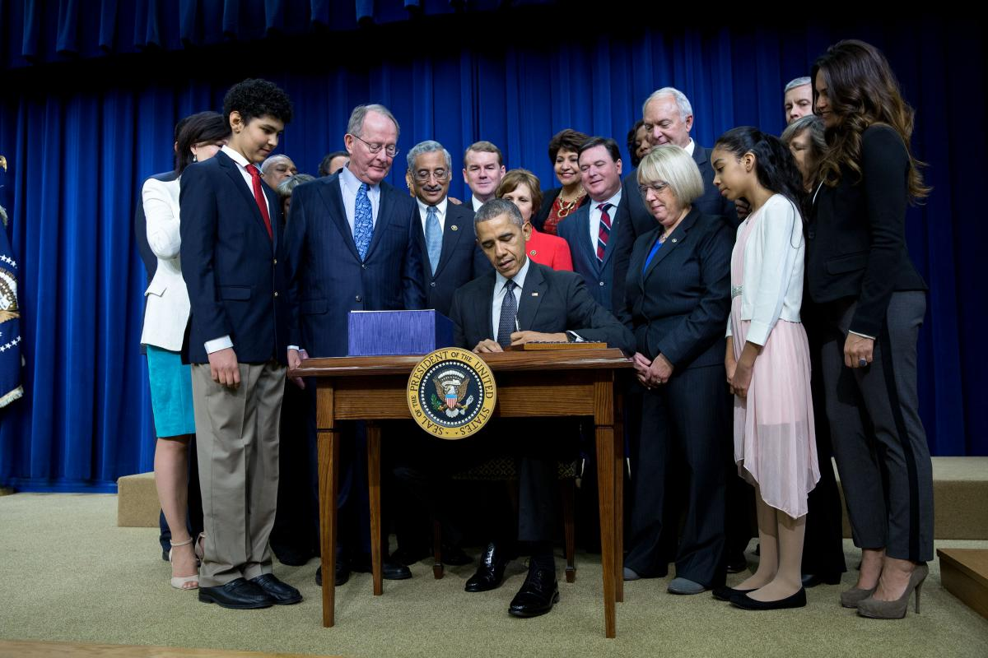
Title I is the first title in the ESEA of 1965 as reauthorized as the NCLB Act of 2001 and now as ESSA of 2015.
Title I is the largest federal aid program for K-12 schools.
The purpose is to ensure that all students have a fair, equal, and significant opportunity to obtain a high-quality education and reach, at a minimum, proficiency on challenging state academic achievement standards and assessments.
President Lyndon B. Johnson signing ESEA of 1965.
President Barack Obama signing ESSA in December 2015.

Slide 5

Title I
South Carolina receives about $250 million in Title I funds.
The vast majority of funds are allocated to districts, and through districts, to schools.
Title I is designed to support state and local school reform efforts.
Title I is designed to support teaching and learning for students who are most at risk of not meeting state standards.

Slide 6

Title II
Title II provides funding to states for professional development and for class size reduction teachers.
ESSA places emphasis on professional development of teacher leaders and school and district administrators.
Class size reduction teachers are allowed, but must be supported by research.
S.C. receives about $27 million in Title II funding, but the formula is going to change under ESSA. The state may see a reduction in the future.

Slide 7
Title I/ Title II
Coordinators have a major responsibility to see that the funds that flow to the districts are used for the educational purposes intended in the law.
Coordinators have a major role in overseeing that the funds which are spent are in compliance with applicable laws, regulations, and guidance.
Coordinators need to be well versed in both program and compliance.

Slide 8
Title I/Title II
Coordinators need to be up-to-date on the latest in education reform efforts and to understand curriculum and instruction.
Coordinators need to know the law, the regulations, and guidance related to Title I.
Coordinators also need to be familiar with EDGAR (Education Department General Administrative Regulations).

Slide 9
Title I
Tips to survive:
Learn federal programs from multiple perspectives.
Evaluate your program activities.
Understand and control your budgets.
Tap outside resources.
Train your staff and those you work with.
Be visible – be the Title I expert.
Seek help from veterans.
Work with your SEA staff.

Slide 10

Questions

Slide 11
Budget Updates
Jennifer Rhodes
Education Associate, Title I

Slide 12
Budget Updates
19 Title I Carryover- Uploaded into GAPS-slight increase
Revised GAN- Reflecting additional funding and amended deadlines
Processes and procedures for Revised GANS in the future
Spending down to the 15%- based on initial regular allocations
19 Title I Regular Final Allocations- GEMS/GAPS information

Slide 13
Title I Program Office – Finance Duties
Karen Cook
Allocations
    Title I
    Title II
    Title IV
    CSI
    TSI
    Direct Student Services
    N&D
GEMS Uploads
GAPS Uploads
Jennifer Rhodes
GANs (all as listed under allocations)
15% Carryover Waivers
Closeout/De-Obligations
Refunds
Carryover Determinations

Slide 14
Questions

Slide 15
Maintenance of Effort
Greg King
Education Associate

Slide 16

What is MOE?
Maintenance of Effort (MOE) is a federal requirement that requires grant recipients and/or sub-recipients to maintain a certain level of state/local fiscal effort to be eligible for full participation in federal grant funding.

Slide 17
In Other Words
MOE requires LEAs to demonstrate that the level of state and local funding remains relatively constant from year-to-year.
Consistency is critical.
An LEA may receive Title I funds only if the LEA has maintained its fiscal effort.

Slide 18
The Underlying Principle
The district is responsible for maintaining their efforts in providing a free public education to all students from year to year.
Title I is in addition (supplemental) to the required education that all students receive.

Slide 19
Purpose
To ensure the recipients of federal funds do not spend those funds in place of state and local dollars (supplanting)
To ensure the recipients spend their state and local funds for the same activities that would be provided if federal dollars were not available

Slide 20
Step 1:
Preceding Year Audit Report Total Expenditures:
(Refer to the audited Location Reconciliation Schedule) | $ 15,200,000
Step 2:
Items Subtracted From Total Expenditures in Step 1:
(List page number for each data source from Audit Report.)
Federal Expenditures (SEFA) Page | $595,000
Capital Outlay (Attach Report) | 170,000.00
Debt Service Page | 73,500.00
Community Services Page | 1,600.00
Pupil Activity Fund Page | 45,000.00
Intergovernmental Page | 9,800.00
Total Amount Excluded: | $ (894,900.00)
Total Expenditures for MOE Calculation: | $ 14,305,100.00
Step 3:
135 ADM: | 2,105
The per pupil MOE calculated for the preceding year
from Audit Year 2017 : | $ 6,795.77
Step 4:
The per pupil MOE calculated for the second preceding year
from Audit Year 2016 : (Attach Worksheet) | $ 6,576.98
Met MOE Requirements? * | Met MOE
*Compare the per pupil MOE in step 3 to the per pupil MOE of step 4. The per pupil amount in step 3
must be not less than ninety percent of the per pupil amount in step 4 to meet the MOE requirement.

Slide 21
Items Removed From MOE Calculation
Expenditures for
  Community Services
  Capital Outlay
  Debt Service
  Pupil Services (272 & 273)
  Supplementary expenses as a result of a presidentially declared disaster
  Funds provided by the Federal Government

Slide 22
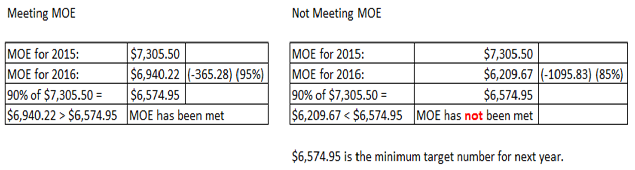
“Meeting” MOE
MOE is based on the two previous years.
Districts meet MOE for 2017.
2017 state/local effort = is at least 90% of 2016.
2016:
2016:
2017:
2017:

Slide 23
Waiver Requests
The state has no authority to waive the MOE requirement. The U.S. Dept. of Education may waive the requirement for the following:
  Exceptional or uncontrollable circumstances, such as natural disaster or
  A precipitous and unforeseen decline in the financial resources of the State…
  basically, situations that you would not want to be in

Slide 24
ESSA Changes
An LEA may fail to meet the Maintenance of Effort (MOE) test once every five years without penalty. 20 USC 7901 (b)(1)
Waivers may now include “a change in the organizational structure of the LEA”. 20 USC 7901 (c)

Slide 25
ESSA Changes
    Waivers are getting tougher to obtain.
    Make every effort to meet your MOE.
    We are here to help you…Let us.

Slide 26
Tips To Meeting and Reviewing MOE
Don’t reinvent the wheel.
    Use and fully complete the form from the SCDE website…The form works! Do not use “custom” forms.
    http://ed.sc.gov/policy/federal-education-programs/title-i/title-i-administration/maintenance-of-effort-moe-and-comparability/maintenance-of-effort-moe/
Program directors work closely with your finance directors.
Review in December (Give yourself time to make adjustments.)
Ask questions.

Slide 27
Greg King
803-734-0025 gking@ed.sc.gov
Questions

Slide 28
Comparability
David Boison
Education Associate

Slide 29
Comparability
Comparability tests for FAIRNESS.
Fairness in funding
Required by ESSA, Section 1120A(c)

Slide 30
Comparability
Required every year you receive Title I funding
  Unless one school per grade span
  Or one large school and one small school

Slide 31
Comparability
Complete by NOVEMBER 15
Comparable by JANUARY 15

Slide 32
Comparability
Federal criteria:
District-wide salary schedule
District policy to ensure equivalence of staff
District policy to ensure equivalence in materials and supplies
Assurance # 27!!!

Slide 33
Comparability
Federal criteria (continued)
Test
SCDE picks the test
In SC, the test = student : teacher

Slide 34
Comparability
If student:teacher ratio does not work:
    Adjust funding source
    Use another method (contact SCDE first)
    Move people

Slide 35
Comparability
PROCEDURE:
Must count students and teachers ON SAME DAY!
Compare Title I schools by grade spans you serve,
Compare non-Title I to Title I schools, or
If all Title I schools, compare least poor to most poor.

Slide 36
Comparability
PROCEDURE: (continued)
Count students using the district’s ADM program.
Count allowed staff using best possible system
(ex. personnel or finance).
Do not count three year olds or four year olds.

Slide 37
Comparability
PROCEDURE: (continued)
Source data must be verifiable by an auditor.
Social security numbers and salaries are not needed.
A K-8 school can be counted as one K-5 and one 6-8 school.
A K-2, 3-5 or similar school can be excluded if only one in district.

Slide 38
Comparability
PROCEDURE: (continued)
Use SCDE form
or
District produced form (as long as all information is included)

Slide 39
Comparability
School | Grade Span |  |  | Student Enrollment |  | FTE Instructional Staff |  | Student/ Instructional Staff Ratio |  |  | Comparable?
Title I Elementary Schools
Beaufort Elementary | KG - 5 |  |  | 528 |  | 70.2 |  | 7.5 |  |  | Yes
Broad River Elementary | KG - 5 |  |  | 510 |  | 49.4 |  | 10.3 |  |  | Yes
Davis Elementary | KG - 5 |  |  | 417 |  | 38.7 |  | 10.8 |  |  | Yes
Shanklin Elementary | KG - 5 |  |  | 726 |  | 59 |  | 12.3 |  |  | Yes
Port Royal Elementary | KG - 5 |  |  | 189 |  | 16 |  | 11.8 |  |  | Yes
St. Helena Elementary | KG - 5 |  |  | 808 |  | 56 |  | 14.4 |  |  | No
Shell Point Elementary | KG - 5 |  |  | 673 |  | 60 |  | 11.2 |  |  | Yes
Non-Title I Elementary Schools
Hilton Head |  | KG - 5 |  |  | 1,764 |  | 114.5 |  |  | 15.4
Lady's Island |  | KG - 5 |  |  | 757 |  | 70.0 |  |  | 10.8
MC Riley |  | KG - 5 |  |  | 1,005 |  | 88.0 |  |  | 11.4
Mossy Oaks |  | KG - 5 |  |  | 484 |  | 42.0 |  |  | 11.5
Total |  |  | 4,010 |  |  | 314.5 |  |  | 12.8
110% of Student/FTE ratio for non-Title I schools * |  |  |  |  |  |  |  |  |  | 14.08
*

Slide 40
Questions

Slide 41

Title I Allowable Use of Funds
Jewell Stanley
Title I and Title II, Team Leader

Slide 42

What are the allowable costs in the federal grants?
Levels of Complexity:
2 CFR Part 200– Basic allowability
34 CFR Part 76 – General allowability for the USDE
ESEA Law and Regulations
ESEA Program Guidance
USED Policy Letters
Notes:
There are levels of complexity to determine allowability.
You may need to review all of these documents to find the answer you are looking for.

Slide 43
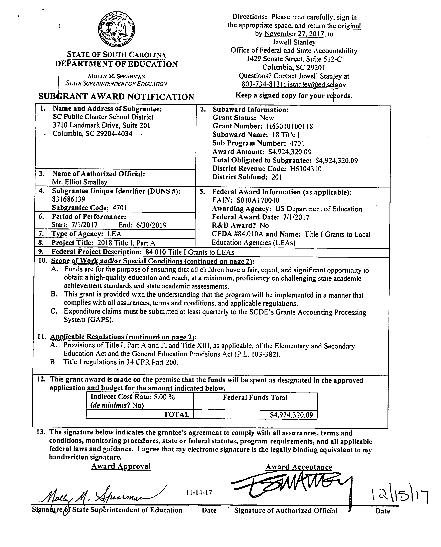
Understanding EDGAR
(Education Department General Administrative Regulations)
Know what parts of EDGAR are applicable to your program. Look closely at the Grant Award Notice.
Notes:
When looking for allowability, you will need to know what parts of EDGAR are applicable to the grant. To find out , carefully review your Grant Award Notice or GAN.

Slide 48

Determining Allowability
2 CFR Part 200.403
Cost must be:
  Necessary
  Reasonable
  Allocable
  Conform to EDGAR
  Meet Terms and Conditions of the Grant Award
  Consistent with State and Local Policies
  Provided Consistent Treatment
  Adequately Documented
  Supplemental
Notes:
Is the cost included and identified in the plan? Is it included in the needs assessment?
Was the item purchased consistent with procurement/purchasing procedures?
Will the item benefit Title I in proportion to the percentage paid through Title ?
Is the cost permitted under EDGAR? 2 CFR 200.420-200.475?
Is the cost allowed under the GAN?
Is it allowable under state/local law?
Is the item not included in your indirect cost rate?
Did you maintain documentation of need, purchase and use the item as intended?
Is it supplemental? Are you supplanting?

Slide 49

First Test of Allowability
2 CFR Part 200.403
To be allowable, a cost must generally
a.) be necessary and reasonable for the performance of the Federal award and allocable thereto under these principals.
Necessary
Reasonable
Notes:
NECESSARY AND REASONABLE –
Must be necessary for the performance or administration of the grant
Must follow sound business practices
Fair market prices
Act with prudence under the circumstances
No significant deviation from established prices
PRACTICAL ASPECTS OF NECESSARY –
Do I really need this?
Is this the minimum amount I need to spend to meet my need?
PRACTICAL ASPECTS OF REASONABLE –
Do I have the capacity to use what I am purchasing?
Did I pay a fair rate?
If I were asked to defend this purchase, would I be comfortable?

Slide 50

Documentation
2 CFR Part 200.403
g.) Be adequately documented.
34 CFR 76.730-76.731
LEAs must keep records to show compliance with the program requirements
  The amount of funds;
  How funds were used;
  Total cost of project activity;
  Other records to facilitate and effective audit

Slide 51
Allowable Costs in an LEA Plan

Slide 52
Types of District Set-Asides
Required Set-Asides:
Parent Involvement - One percent (1%) of the current year allocation must be reserved (if current allocation is $500,000 or more).
    Ninety (90) percent of the 1% for Parent Involvement must be allocated to Title I schools.
Homeless - District must set aside funds for homeless (no pre-determined percentage is required).

Slide 53
Non-required Set-Asides:
LEA Administration: Used for funding administrative staff, supplies, equipment, travel, etc. at the district level for Title I administrative purposes.
Other – Summer school, pre-school programs, additional professional development, school improvement, etc.
  * Activities must be in Title I schools only, except pre-school programs.

Slide 54
District Set- Asides
Reflects:
District’s total requested amount
District’s set-asides
Amount available to allocate to schools
$ 2,460,545.00
326,215.00
$2,134,330.00

Slide 55
Consultation
LEAs must consult with teachers, pupil services personnel (where appropriate), principals, and parents of children in participating schools in determining, as a part of the LEA plan, what reservations are needed.

Slide 56

Remember that poverty is the only factor on which a district may determine funding. In other words, an LEA may not allocate funds based on the instructional model, educational need, or any other non-poverty factor.

Slide 57
Supplemental District Set-Asides
Guiding principles- All plans should be examined to determine if supplement, not supplant will be violated.
Examine activities, programs, or interventions to see if they fit best in a school allocation or as a district set-aside.
Have rationale or justification for placing the funding for programs, activities, or interventions in a district set-aside instead of allocating funds directly to the schools.

Slide 58
Supplemental District Set-Asides
USED monitoring of states has resulted in findings of district set-asides where funds were used or distributed to schools without regard to poverty or per pupil allocation (PPA).

Slide 59
Supplemental District Set-asides
Rationale for set asides should be apparent. (Examples- LEA Administration, district sponsored Title I summer school program held at one site serving several schools, Pre-K).
Note: If the district is serving private schools, then these schools need to be consulted as well when planning supplemental set-asides.

Slide 60
Supplemental District Set-asides
Examples of Allowable District Set-Asides:
LEA administration including indirect cost
Preschool programs
Parent Involvement above the 1%
Specific program strategies at Title I schools
District wide staff to work at Title I schools
Supplemental nurses/social workers
District interventions at Title I schools that are Comprehensive Support and Improvement (CSI) or Targeted Support and Improvement (TSI) (Formerly known as Priority, Focus, or Support Schools)

Slide 61
Supplemental District Set-Asides
Set-asides for the purchase of supplies and technology without being tied to an allowable activity, program, or intervention are not allowable.

Slide 62
Allowable Use of Funds in
School Wide Plans

Slide 63

Implementing a Schoolwide Program
There are three components of a schoolwide program that are essential to effective implementation:
  Comprehensive needs assessment of the entire school,
  Comprehensive schoolwide plan; and
  Annual review of Title I plan.

Slide 64

Make the Connection
The schoolwide activities must tie back to the comprehensive needs assessment.
Do not include an activity or expenditure if the school cannot demonstrate a need for it in the comprehensive needs assessment.

Slide 65

Questions to Ponder
When determining if expenditures are appropriate, ask the following questions:
How does this expenditure directly support student achievement for at-risk students?
How does this expenditure directly support meaningful professional development?
How does this expenditure increase the participation of parents in school activities or assist parents to support student achievement?
How does this expenditure foster continuous improvement and evaluate activities to modify or discontinue?
Notes:
Title I, Part A funds may be used for any activity that supports the needs of students, particularly the lowest achieving students, in the school that are identified through a comprehensive needs assessment and included in the schoolwide plan.
Title I funds are to be used for the purpose of student achievement, staff development and to build parent capacity to better support their child’s educational attainment. In general, Title I funds are to be used to enhance the regular school program and should be consistent with the School Improvement Plan.

Slide 66
Allowable Costs
There is no single list of allowable Title I or ESEA activities.
The most inclusive guidance is the Title I Use of ARRA Funds Guidance from September 2009.
Check with your district’s policies. District policies can be more restrictive than Title I regarding allowability.

Slide 67
Allowable vs Non-allowable
Allowable
Non- allowable
Salaries and Benefits (teacher to reduce class size or to provide remediation services)
Professional Development (conference attendance or bringing in a speaker or consultant)
Instructional Supplies and Materials (purchasing supplemental reading or math programs; books for PLCs) Funding can be used for items to support more than ELA and Math
Family Engagement Activities
Extended Day Programs
Student Incentives * -academic nature (capped at 1% of school allocation)
Entertainment Costs (including amusement, social activities, and ceremonials and any associated costs )
Some Field Trips (amusement parks; fairs)
Gift Certificates/Gift Cards
Notes:
Edgar pp256-290

Slide 68

The next few slides contain examples of non-allowable expenditures from districts in South Carolina which could include your district. All names of schools and districts are kept anonymous.

Slide 69
Examples from the Field
Educator is in Texas attending a conference
                Dinner: $40 steak
          $17 soup
          $19 salad
Reasonable?
Per diem for out-of-state is $32/day. This educator spent $76 on one meal. NOT REASONABLE!
Notes:
In State Per Diem:
Breakfast- $6
Lunch - $7
Dinner- $12
Total $25
Out of State Per Diem:
Breakfast- $7
Lunch - $9
Dinner- $16
Total $32

Slide 70
Examples from the Field
Four educators are attending a conference in Louisiana
                Dinner for four people totaled $362.72
State Per Diem for Out-of-State meals is $32/day.
Four people x $32 = $128 (IF they claim no other meals for the day)
Over by $234.72……..NOT REASONABLE!

Slide 71
Examples from the Field
District paid $1,292 for one teacher to take a Gifted and Talented course at Converse College.
First mistake – paying for the course upfront
Second mistake – no documentation the teacher completed or passed the course
Documentation of passing the course must be in place before the district can reimburse the teacher.

Slide 72
Examples from the Field
District paid the expenses for four teachers to attend the SCIRA conference – registration, hotel, meals and travel.
Professional development is not in the approved plan.
While activities may be allowable for the program, if they are not in the approved plan, the activity cannot be funded with federal dollars.
District should have amended plan prior to the PD taking place.

Slide 73
Examples from the Field
Student Incentives
School spent $236.13 at the Dollar Tree
Lip gloss
Frozen cups
Nail polish
Mexican Jumping Beans
Paddle ball
Bubble wands
Student Incentives must be educational in nature.

Slide 74
Examples from the Field
District passed a wellness policy that removed food from the list of allowable incentives for students.
School reading challenge
Each class winner receives an age-appropriate book pack and book poster.
Each grade winner will receive a new bike.
Title I had to say no because the incentive is not academic in nature and could be perceived as entertainment.

Slide 75
Examples from the Field
School is holding a parent and family engagement event – Fall Festival
The following expenses are charged to Title I:
DJ $300
Photo Booth $400
Balloon Artists $400
Sam’s Club Membership $ 45
While parent and family engagement is encouraged and is an allowable Title I expense, federal dollars can not be used for entertainment purposes.

Slide 76
Examples from the Field
Principal at a Title I school forged signatures to make it appear that the school held a stakeholder meeting. This meeting in fact did not take place.
The forgery was detected on an audit visit.
As a result of the falsification, the principal came before the State Board of Education and her license was revoked.

Slide 77

Allowable Costs
If you are unsure about whether a cost is allowable – program and finance office should consult with each other. Contact your Title I Program Manager (SCDE) if you have questions.

Slide 79
Title II Allowable Use of Funds
Karen Cook
Title II, Part A State Coordinator

Slide 80
Necessary and Reasonable
Reasonable means costs:
  Should not exceed that which would be incurred by a prudent person under similar circumstances.
  Should be in the LEA plan.
  Reflect sound business practices.
  Reflect market prices for comparable goods and services for the geographic area.

Slide 81
Supplement, Not Supplant
Title II funds may be used only to supplement educational program activities provided with state and local funds.
The LEA may not use Title II funds to pay for activities that, in the absence of these funds, would be provided with state and local funds.
Title II funds may be used to fund only the PD activities that supplement those mandated locally or by the state, and can supplement those discretionary PD activities that the LEA would fund in the absence of other local and/or state funding.

Slide 82
Supplement, Not Supplant
In the following instances, supplanting is presumed to have occurred if
  The LEA used Federal funds to provide services that were required under other Federal, State or local laws.
  The LEA used Federal funds to provide services that were provided with non-Federal funds in the prior year.

Slide 83
Allowable Uses of Funding
Initiatives to recruit and retain highly effective (HE) teachers
Professional development to increase teacher knowledge and improve instruction in the classroom
Professional development to improve the quality of instructional leadership teams, principals and other school leaders
Multiple career paths
Teacher advancement initiatives

Slide 84
Cost Principles
Travel
Travel costs are allowable for approved expenses for transportation, lodging, subsistence, & related items incurred. Such costs may be charged on an actual cost basis, on a per diem or mileage basis in lieu of actual costs incurred, or on a combination of the two, provided the method used is applied to an entire trip, and results in charges consistent with those normally allowed in like circumstances in non-federally-sponsored activities.
Lodging – GSA rates (www.gsa.gov/perdiem)
MEALS | DEPART BEFORE | RETURN AFTER | IN-STATE | OUT- OF-STATE
Breakfast | 6:30 AM | 11:00AM | $ 6.00 | $ 7.00
Lunch | 11:00 AM | 1:30 PM | $7.00 | $9.00
Supper | 5:15 PM | 8:30 PM | $12.00 | $16.00
DAILY MAXIMUM ALLOWANCE |  |  | $25.00 | $32.00

Slide 85
Non-Allowable Activities
Food
General substitute teachers
Instructional materials
MAP testing and other benchmark testing
Technology /equipment
Recruitment giveaways with district logo

Slide 86
Big News!
The period of availability for grants moving forward will be a full 27 months.
2019 Title II Grant: July 1, 2018 – September 30, 2020

Slide 87
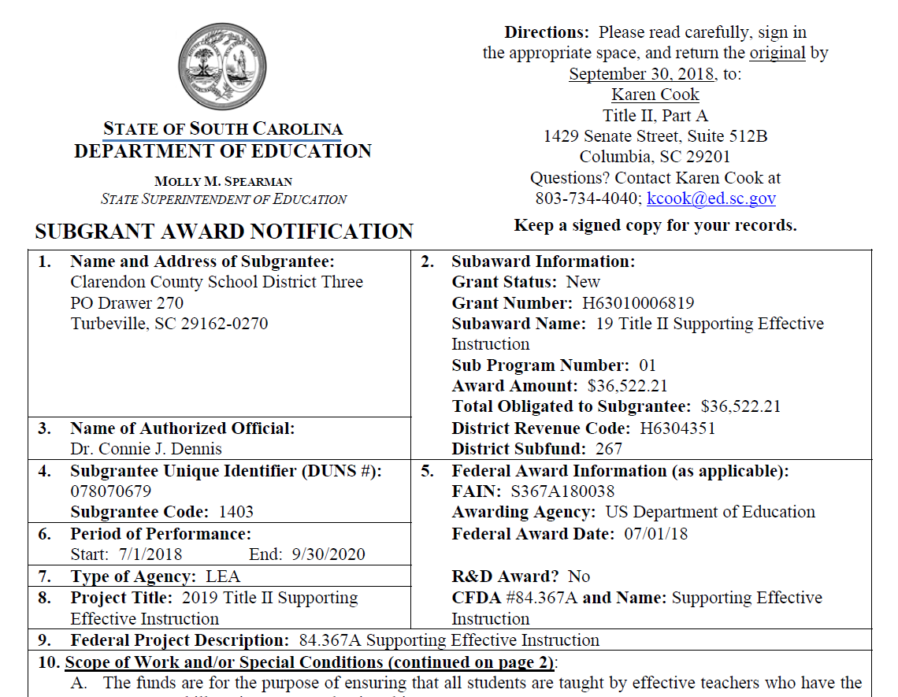

Slide 88
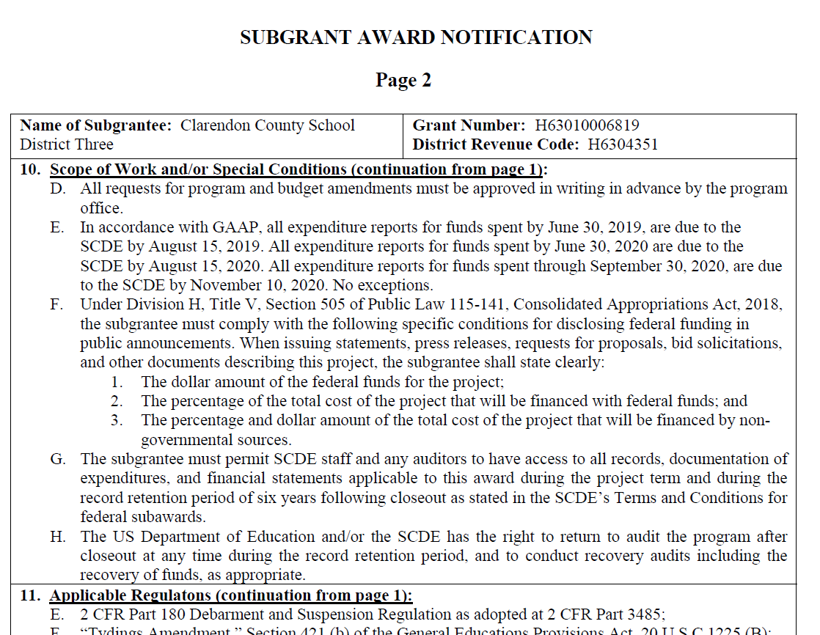

Slide 89
Carryover
Does not exist for Title II, Part A
Funds are available for two grants simultaneously:
  2018 Title II: July 1, 2017-June 30, 2019
  2019 Title II: July 1, 2018-September 30, 2020
  Continue to spend 2018 Title II money on activities that were approved in the 2018 Plan.
  Spend “old money” first.
Notes:
Source - LEA Identification and Selection of School Attendance Areas and Schools and Allocations of Title I Funds to Those Areas and Schools, Non-Regulatory Guidance

Slide 90
Questions

Slide 91

SCDE Finance Update
Michael Thom
Director of Finance

Slide 92


SCDE Grants Accounting & GAPS
Statewide Program on District Fiscal Practices and Budgetary Conditions
Questions & Answers

Slide 93


Grants Accounting & GAPS
Title I Coordinators Request Grant Coordinator Role for GAPS
- Regardless of whether they are the individual entering budget or not
  Quarterly Expenditure Reporting Required
  Due by end of month following end of quarter once budget has been approved
  If these aren’t submitted timely, risk assessment score will go up
Budget amendments must be submitted prior to expenditures being obligated – federal regulations state that expenditures must be approved prior to obligation. If not, you’re out of federal compliance.
Please Note: General deadline for budget amendments is three weeks prior to end of expenditure period unless noted differently in GAN.
Notes:
Who is in the audience?
How often do you run reports?
How often do you receive reports from Finance?
Do you assist in the amendment process?

Slide 94


  Grants Accounting and GAPS (continued)
  Final submission deadline for June 30, 20XX , Expenditures will always be August 15, 20XX, regardless of the award period of the grant and/or the day of the week that this date falls on.
  General Due Dates
  7/1/18 – 9/30/18 Due 11/10/18
  10/1/18 – 12/31/18 Due 2/10/19
  1/1/19 – 3/31/19 Due 5/10/19
  4/1/19 – 6/30/19 Due 8/15/19
  But… Some grants have other “deadlines”
Notes:
Please review reports to verify that all line items have been submitted to SCDE Finance – items can’t be in “Presubmittal” or “Submitted to Finance Approver Status”. If they are, they haven’t been submitted to the SCDE for payment and will not be paid.

Slide 95
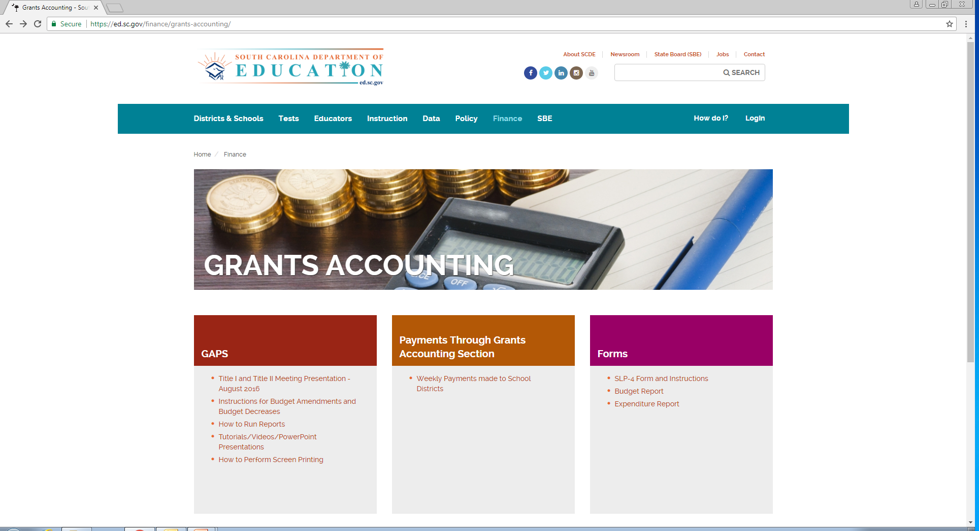

GAPS Tutorials and Training

Slide 96
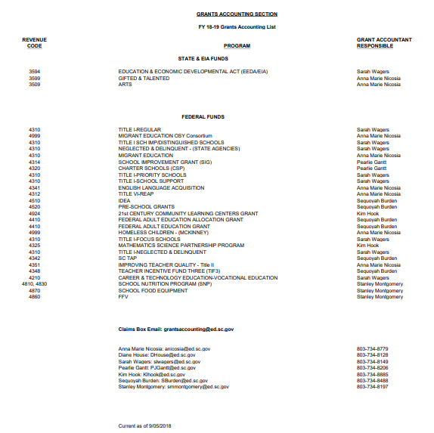
Grants Assignment Contact List

Slide 97

Who do I contact if I have problems accessing my grants or have a new employee to load into GAPS?
School district IT Staff have SCDE Web Application Access and can set up new users or make changes to GAPS user roles.
Who do I contact if my original budget or amendment is not approved timely?
Questions related to Budget/Budget Amendment Status need to go to the specific SCDE Program Office – Grants Accounting Staff cannot approve or return these items.
Who do I contact if my expenditure claim is not approved timely?
Questions related to Expenditures/Expenditure Refund Status need to be sent to the SCDE Grants Accounting Office at grantsaccounting@ed.sc.gov.

Slide 98


What do I do if I have an issue running a GAPS report?
The Grants Accounting Office is available for technical assistance. Please explain your issue and send screenshots of each step to the Grants Accounting Office at grantsaccounting@ed.sc.gov
You’re always welcome to copy your assigned Grants Accountant on email submissions. However, the Grants Accounting email box is monitored all day and chances are you will hear back from someone more quickly when your question is submitted through this box. Also, this allows SCDE to maintain a tracking system so that we can watch for potential issues affecting multiple users and our office can begin trouble shooting the issue.

Slide 99

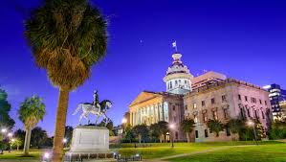
The Legislative Mandate
Statewide Program on District Fiscal Practices and Budgetary Conditions
On May 9, 2017, Governor McMaster approved Act 23, which directs the South Carolina Department of Education (SCDE) to develop and adopt a statewide program on fiscal practices and budgetary conditions.
The SCDE shall work with district superintendents and finance officers to develop and adopt a statewide program with guidelines for:
  (1)identifying fiscal practices and budgetary conditions that, if uncorrected, could compromise the fiscal integrity of a school district; and
  (2) advising a district identified under item (1) to take appropriate corrective actions.
S.C. Code Ann. § 59-20-90(A) (2017).

Slide 100
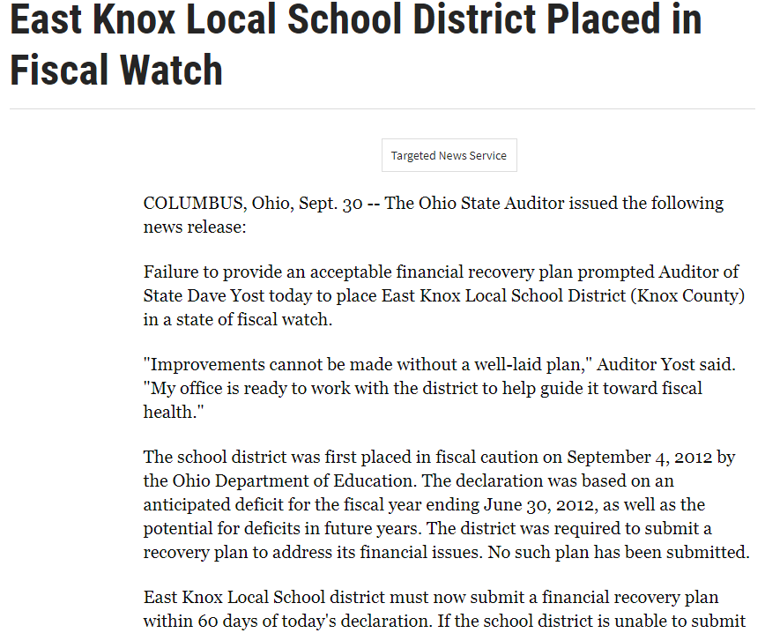
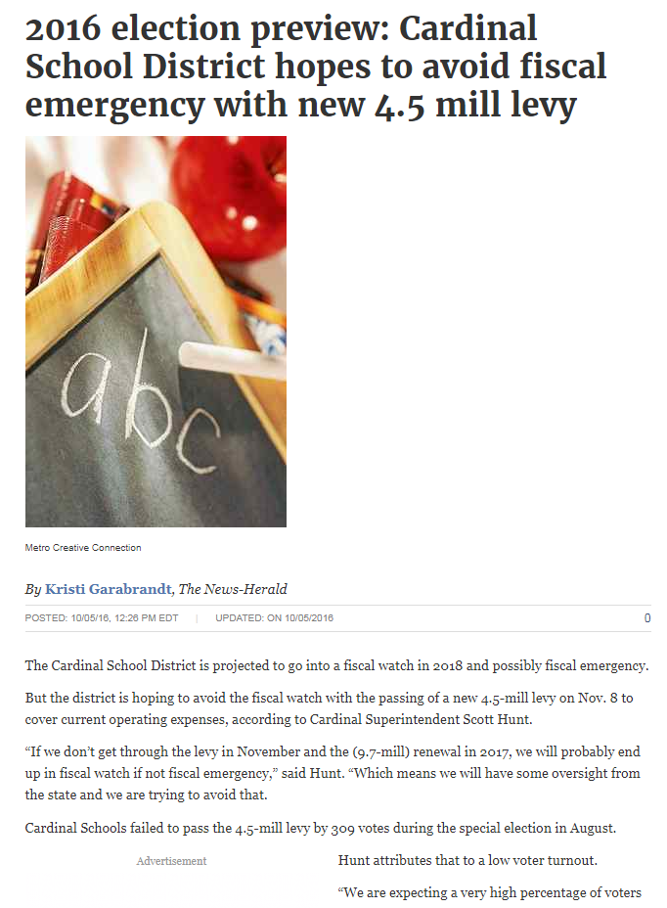








Notes:
Ohio
California
Pennsyvannia

Slide 101

Escalating Levels of Concern
The statute identifies three “escalating levels of fiscal and budgetary concern” that must be defined in the statewide program:
  Fiscal Watch, the lowest level of concern;
  Fiscal Caution, an intermediate level of concern; and
  Fiscal Emergency, the most severe level of concern.

Slide 102

Escalating Levels of Concern
Each level has some similarities.
Each has conditions under which the State Superintendent “shall” or “may” declare a level of concern.
Each requires the district to develop and submit a fiscal recovery plan to the SCDE.
All levels allow the local board to appeal a declaration of the level of concern to the SBE.
Previous version allowed appeal only at watch.

Slide 103
What Changed???
(C) (2)(b) Fiscal Watch
The district does not maintain a general reserve fund of at least one month of general fund operating expenditures of the previous two completed fiscal years, or has not made progress in increasing the general reserve fund balance in accordance with department guidelines to meet at least one month of general fund operating expenditures within the previous two completed fiscal years.
(D) (2)(c) Fiscal Caution
The department reviews a district's annual audit and determines the district is not maintaining the mandatory minimum of one month of general fund operating expenditures in its general reserve fund or has not made progress in increasing the general reserve fund balance in accordance with department guidelines to meet at least one month of general fund operating expenditures within the previous two completed fiscal years;

Slide 104
What Changed???
(H)The requirements to place a district on fiscal watch, caution, or emergency must be suspended for the two fiscal years following any state-implemented midyear budget cut, if:
    (1) the district fails to maintain a general reserve fund of at least one month of general fund operating expenditures;
    (2) the State continues to fund at the current base student cost;
    (3) the State reduces the base student cost below the appropriation provided in the previous fiscal year; or
    (4) the State increases the base student cost appropriation provided in the previous fiscal year but the increase is less than the previous fiscal year's appropriation as adjusted by the Consumer Price Index.

Slide 105

Fiscal Recovery Plan & TA
Fiscal Recovery Plan required at all levels
SCDE provides TA at all levels
SCDE required to visit and inspect districts under Fiscal Caution & Fiscal Emergency

Slide 106


Slide 107
School District Website
Transparency Requirements
Michael Thom
Director of Finance

Slide 108
School District Websites
School District websites are a resource to communicate with local communities and they have statewide and national outreach.
These websites include some content that is required by state and federal regulation.

Slide 109
School District Website Transparency Requirements
Disclosure
Information contained in this presentation is based on provisos from the 2017-18 Appropriation Act.
For additional information visit:
http://www.scstatehouse.gov/

Slide 110
School District Website Transparency Requirements
Funding Flexibility
Transaction Register (Monthly Statements)
  Check
  Purchasing Card
Administrative Cost Reporting
Other Website Requirements

Slide 111


Slide 112
Proviso 1.26. & (1A.14.)
(SDE-EIA: School Districts and Special Schools Flexibility):
Website posting must include quarterly district and special school certification of non-instructional or nonessential program suspensions and specific flexibility actions taken.
Notes:
Funding Flexibility
Example: Aiken County School District “Fund Flexibility” :https://www.acpsd.net/Page/1549
Form: https://ed.sc.gov/finance/financial-services/information-memos-and-forms/fy-2017-2018/fy-2017-2018-funding-flexibility-form/
Instructions: https://ed.sc.gov/finance/financial-services/information-memos-and-forms/fy-2017-2018/fy-2017-2018-funding-flexibility-procedures/

Slide 113
Proviso 1.26. & (1A.14.)
(SDE-EIA: School Districts and Special Schools Flexibility)-CONT.
Website posting must include a transaction register. The transaction register must include a complete record of all funds expended over one hundred dollars, from whatever source, for whatever purpose. The register must be prominently posted on the districts internet website and made available for public viewing and downloading.
Notes:
Example: Aiken County School District: https://www.acpsd.net/Page/1549
Refer to “Accounts Payable Report”, Check Registry Example

Slide 114
Proviso 1.26. & (1A.14.)
(SDE-EIA: School Districts and Special Schools Flexibility)-CONT.
The register must include for each expenditure:
(i) the transaction amount;
(ii) the name of the payee; and
(iii) a statement providing a detailed description
of the expenditure.
Notes:
Example: Aiken County School District: https://www.acpsd.net/Page/1549
Refer to “Accounts Payable Report”, Check Registry Example

Slide 115
Proviso 1.26. & (1A.14.)
(SDE-EIA: School Districts and Special Schools Flexibility)-CONT.
The register must not include an entry for salary, wages, or other compensation paid to individual employees. The register must not include any information that can be used to identify an individual employee.
Notes:
Example: Aiken County School District: https://www.acpsd.net/Page/1549
Refer to “Accounts Payable Report”, Check Registry Example

Slide 116
Proviso 1.26. & (1A.14.)
(SDE-EIA: School Districts and Special Schools Flexibility)-CONT.
The register must be accompanied by a complete explanation of any codes or acronyms used to identify a payee or an expenditure. The register must be searchable and updated at least once a month.
Notes:
Example: Aiken County School District: https://www.acpsd.net/Page/1549
Refer to “Accounts Payable Report”, Check Registry Example

Slide 117
Proviso 1.26. & (1A.14.)
(SDE-EIA: School Districts and Special Schools Flexibility)-CONT.
Each school district must also maintain on its internet website a copy of each monthly statement for all of the credit cards maintained by the entity, including credit cards issued to its officers or employees for official use.
Notes:
Example: Aiken County School District: https://www.acpsd.net/Page/1549
Refer to “Accounts Payable Report”, Purchasing Card Statement Example

Slide 118
Proviso 1.26. & (1A.14.)
(SDE-EIA: School Districts and Special Schools Flexibility)-CONT.
The credit card number on each statement must be redacted prior to posting on the internet website. Each credit card statement must be posted not later than the thirtieth day after the first date that any portion of the balance due as shown on the statement is paid.
Notes:
Example: Aiken County School District: https://www.acpsd.net/Page/1549
Refer to “Accounts Payable Report”, Purchasing Card Statement (Online )Example

Slide 119
Proviso 1.26. & (1A.14.)
(SDE-EIA: School Districts and Special Schools Flexibility)-CONT.
The Comptroller General must establish and maintain a website to contain the information required by this section from a school district that does not maintain its own internet website. The internet website must be organized so that the public can differentiate between the school districts and search for the information they are seeking.

Slide 120
Proviso 1.26. & (1A.14.)
(SDE-EIA: School Districts and Special Schools Flexibility)-CONT.
School districts that do not maintain an internet website must transmit all information required by this provision to the Comptroller General in a manner and at a time determined by the Comptroller General to be included on the internet website.

Slide 121
Proviso 1.26. & (1A.14.)
(SDE-EIA: School Districts and Special Schools Flexibility)-CONT.
The Comptroller General’s School District Expenditure Transparency Methodology.
Notes:
Refer to handout “CG School District Methodology Model”
SCDE Website:
https://ed.sc.gov/about/chief-operating-officer-executive-offices/chief-information-office/total-quality-management/district-web-requirements/methodology/

Slide 122
Proviso 1.44.
(SDE-EIA: Administrative Costs Report Posting):
School districts must post the amount of funds spent in the prior fiscal year on administrative cost defined by the financial analysis model, “In$ight,” for education programs utilized by the South Carolina Department of Education.
Notes:
Refer to handout “Administrative Cost Report_I$ite Model”
https://ed.sc.gov/about/chief-operating-officer-executive-offices/chief-information-office/total-quality-management/district-web-requirements/in-ight-financial-analysis-model/
Example: Aiken County School District: https://www.acpsd.net/Page/1549
Refer to “Administrative Cost Reporting”

Slide 123
Pop Quiz
District transaction registers must include a complete record of all funds expended over ________ dollars.
    $1.00
    $100
    $1,000
    $10,000
Notes:
$100.00

Slide 124
Pop Quiz
Must all transparency reports be available for public viewing via the school district website?
    Yes
    No
Notes:
Yes

Slide 125
Pop Quiz
Should website posting containing credit card statements include Personal Identifiable Information (PII) and account numbers?
    Yes
    No
Notes:
No

Slide 126
Pop Quiz
Registers must include an entry for salary, wages, or other compensation paid to individual employees.
    True
    False
Notes:
False-Only the Administrative Cost Report

Slide 127
Other Requirements
(State/Federal)
State Proviso and Laws
Federal Regulations
Notes:
Additional Resources: South Carolina School District Website Requirements (Handout) and Checklist

Slide 129
Questions?
Valarie Byrd, MA
Total Quality Management
District Services
vbyrd@ed.sc.gov
(803) 734-1434

Slide 130


Slide 131
Grant Management
Audrey Shifflett
Grants Program
Division for Legal Services

Slide 132

Show of hands…
Notes:
How many of you participated in this training last year, either in Berkeley, or in Lexington, or in Greenville? OK – keep you hands up. How many of you have consulted the federal regulations – any of the federal regulations – in conducting your work since that session?

Slide 133
Agenda
Expectations for School Districts
Subgrant Agreement & Actions to Take
Required Written Policies & Procedures
New: Procurement Thresholds
Audit Findings & How to Avoid Them
Mitigate Risks
Resources
Notes:
- and throughout, I’m going to point out changes and give you tips for grants management

Slide 134

Disclaimer
This presentation is designed to help you understand grant management to comply with federal regulations including parts of 2 CFR Part 200, the Uniform Grant Guidance.
This presentation is not a substitute
for reading the regulations.
Notes:
Be mindful that this presentation in no way is a substitution for you reading and gaining an understanding of the federal regulations that apply to your subgrant program. My role today is to give you some insight on important matters and to give you some resources to help you find what you need to be compliant with the law, with regulations, and with the requirements of your program. And my little friend here on this slide is to remind you that “ignorance of the law is no excuse.”

Slide 135
Districts are Expected to
Adhere to all funding requirements
Have adequate internal control systems
Comply with state laws, federal laws, and regulations
Meet performance expectations
Meet all reporting requirements (i.e., reports are complete and on time).
Notes:
Here are the expectations that the state has for school districts. These have been presented to school boards across the state and at the boot camp for finance officers in August. For some of you, it may not be the first time you’ve seen them – They’re the five expectations of school districts [slide contents]. All of these expectations are grounded in law, regulations, or terms of a contract. Understand that if you’re doing these things, your school district will not have a high risk assessment score.

Slide 136
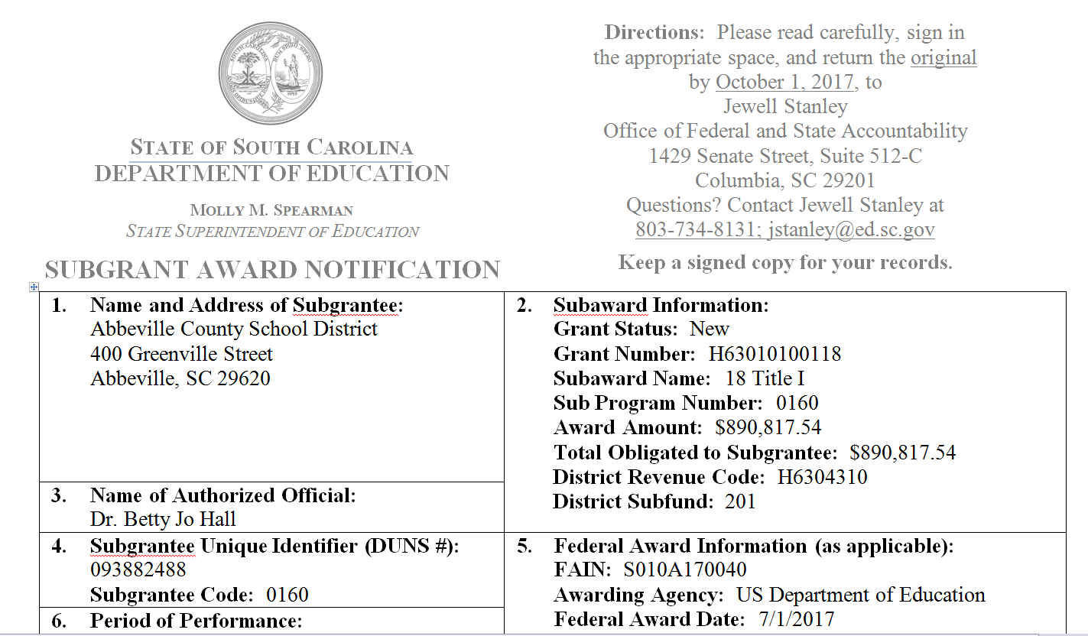
Start with your subgrant agreement
Notes:
It all starts with your Subgrant award notification – your subgrant agreement – and understanding what it means

Slide 137
Subgrant Agreement
Legally binding contract
Superintendent’s signature binds district to
  use funds as outlined in agreement
  act with integrity when reporting actual use of funds
  properly track use of funds
  maintain adequate supporting documentation
    all expenditures (POs, proof of purchase, etc.)
    inventory control
  comply with all requirements and regulations.
Notes:
A subgrant agreement is essentially a legally binding contract that your district is going to receive funds to carry out the stated scope of work in the agreement. Let me pause right here to clarify – this means that if you take the money, we expect your district to do the work. If your Title I Coordinator leaves the district, your district is still contractually obligated to do the work. You must take action to ensure that the work gets done, regardless of staff turnover.
A subgrantee is contractually obligated to use their subgrant funds as outlined in the agreement and to act with integrity when requesting reimbursements and reporting their actual use of funds. Subgrantees are also obligated to properly track the use of funds and maintain adequate supporting documentation.

Slide 138
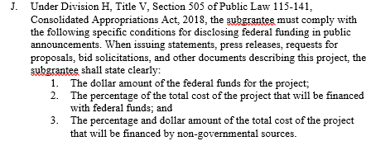
New Requirement: Public Disclosure
Notes:
A new requirement under the Consolidated Appropriations Act of 2018 applies to some federal subgrants. It will be stated in section 10 – Scope of Work. Check your GANs (next slide)

Slide 139
Public Disclosure Requirement
When issuing statements, press releases, requests for proposals, bid solicitations, and other documents describing this project,
the subgrantee shall state clearly:
The dollar amount of the federal funds for the project;
The percentage of the total cost of the project that will be financed with federal funds; and
The percentage and dollar amount of the total cost of the project that will be financed by non-governmental sources.

Slide 140
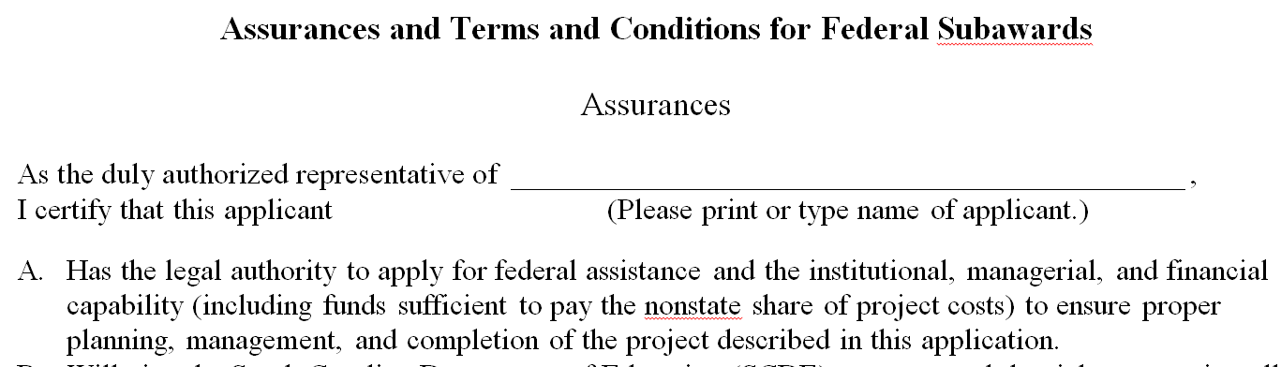
SCDE’s Assurances and Terms and Conditions for Federal Subawards
Legally binding
“Promises” LEA makes
Updated annually

Slide 141
Take Action: Understand
Read subgrant award completely (all documents)
Review all applicable regulations
  Use ecfr.gov (browse “Title”= number before “CFR,” then go to “Part”); for example:
    34 CFR Part 76
    2 CFR Part 180
    2 CFR Part 200
Compile any questions or concerns
Contact SCDE program office for clarification
Notes:
When you receive a subgrant award, take action. Your first step is to read the document and any attachments in their entirety. This includes researching all of the applicable regulations and laws.

Slide 142
READ Subgrant Agreement and Assurances & Terms and Conditions
Program manager/coordinator
ALL signatories
Finance staff
“Can I use funds for…?”
“Let’s use Title I funds for…”
Notes:
Reminder – do not neglect the Assurances and Terms and Conditions – please reinforce to people in your district the need to read these important documents and understand them. Not only should the program manager or the Title I coordinator read and understand them, but all the signatories and your finance staff who is working with the subgrant funds. The assurances and terms and conditions are designed to support your compliance with federal regulations and will be one of the tools in your tool box to address questions like (on slide) when someone comes to you wanting to use Title I funds for unallowable expenses (i.e., things not in your approved plan).

Slide 143
Take Action: Organize
Set timeframes and calendars for actions
  procurements
  inventory controls
  reporting deadlines (set reminders)
  closeout (target 30 days after end date)
Communicate with all involved (program, finance, administration)

Slide 144
Grant Manager’s Activities
  Programmatic: to achieve goals and objectives
  Financial: to achieve prudent and fiscal management of subgrant funds
  Record keeping: to ensure accurate documentation
  Compliance: to fulfill all subgrant program requirements, including accurate reporting and closeout
Notes:
Remember: the grant manager’s role is multifaceted. You must manage administration of specific grant program, which includes :

Slide 145
Change: Cannot Work in Silos
Effective grants management and internal control over federal awards requires
  Program
  Finance
  Administration
communicate regularly and work together.
Must ensure allowable uses of funds!
Notes:
The days of everyone working in their own little silos is gone; working that way will lead to audit findings. If your Finance Office is known as the “fortress of No!” then you need to talk with them and with your district administration about needed changes because you must be able to use the funds for their federally allowable purposes. And ensuring that you’re using the funds for allowable purposes is EVERYONE’s responsibility

Slide 146
Ensure Allowable Use of Subgrant Funds
Check approved application
Follow procedures for determining allowability of costs (required written procedures)
Check federal cost principles (2 CFR Part 200, subpart E) for exclusions
Ask SCDE program officer.

Slide 147
Examples: Not Allowable!
Dinner for four totaling $500+
  Remember state per diem limit for meals
Bottles of wine and a corkscrew
  See 2 CFR Part 200.423 Alcoholic beverages
Admission for 15 to Carowinds
  See 2 CFR Part 200.428 Entertainment costs
Notes:
Recall the questions from Jewell’s presentation on how to determine if expenditures are appropriate: 1) How does this expenditure directly support student achievement for at-risk students? 2) How does this expenditure directly support meaningful professional development? 3) How does this expenditure increase the participation of parents in school activities or assist parents to support student achievement? 4) How does this expenditure foster continuous improvement and evaluate activities to modify or discontinue?

Slide 148
2 CFR Part 200
“Uniform Grant Guidance” (UGG)
Effective for federal grant awards and subawards as of 12/24/14
Incorporates administrative regulations, cost principles, and audit regulations into one set of regulations
Goals - streamline federal regulations and strengthen oversight to reduce risk of waste, fraud, and abuse.

Slide 149
Written Policies and Procedures
UGG requires them!
2 CFR Part 200
Notes:
Now – I keep mentioning written policies and procedures; they’re required by the federal regulations. These will increasingly be “low hanging fruit” for auditors.

Slide 150
For Cash Management and Allowability of Cost
2 CFR Part 200.302 – Financial Management
  Must have written policy for Cash Management § 200.302(b)(6) and §200.305
  Must have written procedures for Allowability of Cost
    § 200.302 (b)(7),
    Cost Principles in 2 CFR Part 200 Subpart E, and
    34 CFR Part 76.707 When Obligations are Made
    Tip – include questions from Jewell’s slide.
Notes:
Section 302, Financial Management in the UGG is very important. Get to know this section! It spells out the regulatory requirements that your district’s financial management system must meet. And among the required items are written policies and procedures for certain things. One of these is cash management. Another is to have written procedures on how you determine whether a cost is allowable

Slide 151
For Procurement
2 CFR Part 200.318 – General Procurement
  Must oversee contactors (b)
  Must have written standards of conduct covering Conflicts of Interest (c)
  Must maintain records of history of the procurement (i)
2 CFR Part 200.319 – Competition
  Written procedures for procurement transactions (c)
Notes:
Other requirements for policies and procedures to be in writing – your district must maintain written standards of conduct covering conflicts of interest and governing the actions of its employees engaged in the selection, award, and administration of contracts. You are also required to have written procedures for procurement transactions; these procedures are to ensure that all solicitations incorporate clear and accurate descriptions of the technical requirements in a manner that does not restrict competition, and that the solicitations identify all requirements that must be fulfilled and all other factors that will be used in evaluating bids or proposals.

Slide 152
Must Have Compliant Travel Policy
2 CFR Part 200.474 – Travel Costs
  References compliance with the nonfederal entity’s written travel policy § 200.474(b)
Note: SC limits subgrant funds for travel
See Terms and Conditions for Federal Subawards, item J
Notes:
One last written policy is referenced in the cost principles for Travel Costs; also, note the language of part J of the SCDE’s terms and conditions for subawards places limits on the amount of subgrant funds that can be used for travel.

Slide 153
Procedures define…
Who performs the procedure?
What steps are performed?
When are the steps performed?
How are the steps performed?
Internal Controls webinar
http://ed.sc.gov/finance/grants/scde-grants-program/subgrant-summer-training/
Notes:
Knowing that you need to have procedures in place

Slide 154
Changes to Two Procurement Methods
2 CFR Part 200. 320 has
Micro-purchase: “the acquisition of supplies or services, the aggregate dollar amount of which does not exceed” threshold ($3,500) and no quotes needed if NFE “considers the price to be reasonable.”
Small purchase: under $150,000 and requires simple competitive process (2 or more quotes from qualified suppliers).
Notes:
Recent changes to allowable procurement methods mean that you need to take a look at your current written procurement policy and the written procedures you follow.

Slide 155
But then, National Defense Authorization Act of 2017 and 2018
Raised micro-purchase threshold to $10,000
  2017 Act: for IHEs only
  2018 Act: for all NFEs
Raised simplified acquisition threshold to $250,000.
Great - Flexibility!

Slide 156
Note District’s Thresholds
Most NFEs (non-federal entities) have lower thresholds than currently allowed by federal government.
Remember - most restrictive threshold applies.
Whatever district’s thresholds are, they must be consistent with
District’s policies and procedures (§200.318)
State law.

Slide 157
To Take Action: Examine Processes
What do staff say about current threshold?
Is it burdensome? (Are they using workarounds?)
Listen to staff
Test internal controls (Are they compliant?)
Determine if change is needed or not.
Notes:
Your procurement processes may be appropriate for the size of your district, but given that these flexibilities are available regarding the use of federal funds, it’s worth examining.

Slide 158
Ensure consistency!
If you change a threshold, update policies and procedures
be consistent
avoid audit finding!

Slide 159
Mitigate Risks: Procurement
Follow a fair and transparent procurement process
  Ensure no conflict of interests
  Ensure rate of pay is reasonable and justified
  Ensure work product is well-defined and documented
  Oversee all contracts
  Keep policies and procedures up to date.

Slide 160
Actual Audit Finding
“Of the 40 employees that were required to have either a semi-annual certification or a personnel activity report (PAR), 31 of them did not have the required document to certify their time being charged to the federal program for the second semester of the year.”

Slide 161
Must: Time and Effort Reports
After-the-fact records of actual activity of anyone paid in part or in whole by federal funds
Must account for 100% of person’s time
Must charge specific federal award for which work was actually done
Must be signed by the individual employee or supervisory official who has first-hand knowledge of activities performed.
2 CFR Part 200.430 (i) Standards for Documentation of Personnel Expenses
Notes:
This is just a reminder because we’re still seeing audit findings (as you’ll hear from Melissa in a few minutes!
Not just time spent working on federal award

Slide 162
Actual Audit Finding
“The District claimed reimbursement for federal funds under Title I for which program costs were not expended prior to the reimbursement request.”

Slide 163
Must: Expend Funds Properly
Follow procedures for purchases (i.e., have a purchase order prior to making purchase)
Have documentation of expenditure before making claim for reimbursement
Must retain documentation for all expenditures for six years after closeout
Must comply with any request to see documentation by SCDE, auditors, or US Department of Education representatives.
2 CFR Part 200.302 Financial Management;
§ 200.303 Internal Control
Notes:
Assurances and Terms and Conditions for Federal Subgrants
Assurances E. Will approve all expenditures, document receipt of goods and services, and record payments on the applicant’s accounting records prior to submission of reimbursement claims to the SCDE for costs related to this grant.
T&C I. Documentation. The grantee must provide for accurate and timely recording of receipts and expenditures. The grantee’s accounting system should distinguish receipts and expenditures attributable to each grant. The grantee must review the memo regarding “Guidelines for Retaining Documentation to Support Expenditure Claims.”
If you cannot comply with all above for a claim for reimbursement, do not submit it until you can.

Slide 164
Actual Audit Finding
“The School District did not maintain complete detailed property records of all Career and Technology Education Equipment during the fiscal year, in accordance with SC Department of Education guidelines.”
Notes:
Know that if it is a finding for one federal program, all the federal programs come under scrutiny. We have to look at them all to comply with the federal regulations

Slide 165
Must: Inventory Control
Maintain property records
Conduct physical inventory regularly
Have a control system
Investigate any loss, damage, or theft promptly.
  2 CFR Part 200.313 (d) Management Requirements
Notes:
Greg King will provide more information on this later today, but understand that for any equipment you purchase using federal funds, you must log it in an internal inventory control document and you must regularly conduct a physical inventory (I advise annually) and you must take prompt action on “any loss, damage, or theft.”
Examine your district’s written procedures for inventory control and make sure all principals are know the procedures for inventory control.

Slide 166
Must: Detailed Property Records
Maintain property records that include
  Description
  Serial number or other identification number
  Source of funding (including FAIN)
  Title holder, Acquisition date, Purchase price
  Percentage of federal participation in project
  Location, Use, and Condition
  Any ultimate disposition (date and sale price).
  2 CFR Part 200.313 (d) Management Requirements
Notes:
Your inventory control document must be detailed and the Office of Federal and State Accountability provides a template for you to use. Word to the wise – when your funding agency provides a template, use it. Please understand that you’re supposed to know the location of the equipment at all times so have a sign-in/sign-out procedure for equipment like laptops or iPads that will be your lifesaver when the monitor shows up and asks to see your inventory control document. And let me reiterate – you must take prompt action when you find instances of missing equipment, damaged equipment, or stolen equipment (police report).

Slide 167

“…strengthen oversight to reduce the risk of waste, fraud, and abuse”
Notes:
So, remember when I said we’d get back to one of the goals of the new regulations in the UGG, which is to strengthen oversight to reduce the risk of waste, fraud, and abuse? Well, let’s look at some examples of why stronger oversight is needed. And let’s start with the big one - Fraud

Slide 168
Why?
“Each year individuals steal federal education dollars or misuse them for their own personal use.”
Submit your complaint via the web at:
www2.ed.gov/about/offices/list/oig/index.html
Notes:
USED’s Office of Inspector General states it plainly -

Slide 169
Fraud
University Director
  Falsified documents to get federal grant funds
  Approved contracts and payments totaling approximately $336,000 to shell corporations for work not done
    Friends
    Family members
    Self
  Sentenced: 27 months, 3 years supervised release, more than $335,000 in restitution.
Notes:
State’s Office of inspector general investigated this –Involved a CEO for a charter school in SC who previously had a non-profit in partnership with an individual who also became a CEO of a charter school in another state. Basically they were contracting with each other. For example, the charter school CEO in SC set up a shell company to consult with other state’s charter school ($289,963) in return, their non-profit received a contract to provide tutoring and consulting services for the SC charter school and the person named in that contract – surprise – is the CEO of the charter school in the other state. (tit for tat) These contracts lacked sufficient details that you’d expect in a contract (about the scope of work and deliverables) but one did guarantee that the CEO of the charter school in the other state would make $1- $3 millon over 10 years
Also falsified Title I documents

Slide 170
Could be fraud, could be abuse…
Unilaterally redirecting use of funds in a manner different than in approved plan/subgrant award
Failing to adequately account for, track, or support transactions.
2 CFR Part 200.303 Internal Controls
Notes:
I shouldn’t have to tell you that appearances are everything, and if you’re doing things like using funds for purposes outside of your approved plan and the terms of your subaward, it can appear to be abuse of fund (if not fraud). Likewise, if you do not keep adequate records to support how you’re spending the subgrant funds, it will look like you’re hiding something that could be abuse or at the worst, could be instances of fraud.

Slide 171
Ways to Mitigate Risks
“Run a tight ship”

Slide 172
Internal Controls
Maintain a well designed and tested system of internal controls
Examine operations to determine vulnerabilities
    Use of P-Card, credit cards
    Lack of separation of duties
Implement specific fraud prevention strategies
    Educate staff about risks
    Think authorization and monitoring.
Notes:
Theft is the most common issue in almost all organizations, including those managing federal grant funding. People who embezzle funds can be extremely creative and appear very trustworthy – precisely why they can do so much damage to an organization and remain undetected for extended periods of time. These are some ways to mitigate the risk of waste, fraud, and abuse of federal funds and the first is a strong system of internal controls. Common weaknesses include loose or no procedures for the use of p-cards or credit cards/debit cards and when finance offices lack and adequate separation of duties. Have careful control and robust oversight for checks routinely written to employees as “reimbursement” of expenses and the use of ATM/Debit/Credit Cards (even gift cards). Implement specific fraud prevention strategies
Educate staff about risks so that you increase awareness to increase prevention and detection. Internal controls are everyone’s responsibility.

Slide 173
Procurement Issues
Unethical relationship in procurement
  Example: bidder is inappropriately close to member of procurement selection team
  Example: bidder helped write specifications
Identify any potential conflicts of interest issues
Act to mitigate risk (disqualify bidder; remove team member)
Disclose to funder for specific guidance.
Notes:
Procurement of goods and services is one of the biggest areas where waste, fraud, and abuse occur because that’s where the money is. You must have competition in procurements and under the regulations, you have to document the full procurement process. Examples above indicate risks of uncompetitive practices, conflict of interest violations, and noncompliance with federal regulations

Slide 174
Recordkeeping Issues
Improper time recording/charging processes
  Example: timecards completed by managers or administrative staff instead of by individual employees
  Example: charges for absent employees
Follow proper procedures
Ensure all records, reports, and other certifications are adequately supported with documentation & evidence.
Notes:
Examples indicate risks of mischarging costs to federal subgrant, false statements and claims

Slide 175
Questions

Slide 176
Resources
Code of Federal Regulations www.ecfr.gov
USED’s Technical Assistance on UGG http://www2.ed.gov/policy/fund/guid/uniform-guidance/index.html
USED’s EDGAR web site http://www2.ed.gov/policy/fund/reg/edgarReg/edgar.html
U.S. Government Accountability Office (GAO)’s “Greenbook” (internal control) www.gao.gov/greenbook
USED’s Grants Training and Management Resources https://ed.gov/fund/grant/about/training-management.html?src=grants-page
USED’s Fraud Prevention web site https://ed.gov/about/offices/list/oig/hotline.html
Notes:
Helpful resources – explore these!! Especially the last one – the USED provides online courses on grants management topics including cash management, internal controls, procurement, and property management.

Slide 177
Contact Us
The Grants Program
grants@ed.sc.gov
803-734-5810

Slide 178
Risk Assessment/ Audit Findings
Melissa Myers
Director of Auditing Services

Slide 179
Federal Awarding Agency
Review of Risk Posed by Applicants
2 CFR Part 200.205
a. Prior to making a federal award, the federal awarding agency is required to review information available through any OMB-designated repositories of government-wide eligibility qualification or financial integrity information as appropriate.
Notes:
Section 200.205 require federal awarding agencies to review the risk posed by applicants prior to making federal awards.
That is, The federal awarding agency is required to review SAM.gov and the Federal Awardee Performance and Integrity Information System (FAPIIS)) prior to making a Federal award.

Slide 180
Federal Awarding Agency
Review of Risk Posed by Applicants
2 CFR Part 200.205, cont.
b. the federal awarding agency must have in place a framework for evaluating the risks posed by applicants before they receive federal awards.

Slide 181
Federal Awarding Agency
Review of Risk Posed by Applicants
2 CFR Part 200.205, cont.
In evaluating risks posed by applicants, the federal awarding agency may use a risk-based approach and may consider any items such as the following:
Financial stability;
Quality of management systems and ability to meet the management standards prescribed in 2 CFR Part 200;

Slide 182
Federal Awarding Agency
Review of Risk Posed by Applicants
2 CFR Part 200.205, cont.
History of performance. The applicant's record in managing federal award, including timeliness of compliance with applicable reporting requirements, conformance to the terms and conditions of previous federal awards, and if applicable, the extent to which any previously awarded amounts will be expended prior to future awards;
Notes:
The federal agency may also consider an applicant’s history of performance. This would include the applicants timeliness of compliance with applicable reporting requirements, conformance to the terms and conditions of prior federal awards, and the extent to which any previously awarded amounts will be expended prior to future awards.

Slide 183
Federal Awarding Agency
Review of Risk Posed by Applicants
2 CFR Part 200.205, cont.
Reports and findings from audits performed under Subpart F—Audit Requirements of this part or the reports and findings of any other available audits; and
The applicant's ability to effectively implement statutory, regulatory, or other requirements imposed on non-federal entities.
Notes:
The federal awarding agency may also consider reports and findings from single audits or reports and finding from any other available audits
The federal agency may also consider the applicant’s ability to effectively implement statutory, regulatory, or other requirements imposed on non-federal entities.

Slide 184
Risk Assessment
2 CFR Part 200.331
Evaluate each subrecipient's risk of noncompliance with federal statutes, regulations, and the terms and conditions of the subaward which may include consideration of such factors as:
The subrecipient's prior experience with the same or similar subawards;
The results of previous audits including whether or not the subrecipient receives a Single Audit in accordance with Subpart F—Audit Requirements of this part,
Notes:
A similar requirement for conducting risk assessments is included in the pass-through entity’s requirements of the uniform grant guidance found in section 200.331.
Each pass through entity is responsible for evaluating…

Slide 185
Risk Assessment
2 CFR Part 200.331, cont.
Whether the subrecipient has new personnel or new or substantially changed systems; and
The extent and results of federal awarding agency monitoring (e.g., if the subrecipient also receives federal awards directly from a federal awarding agency).
Notes:
The risk assessment may consider whether…

Slide 186
SCDE’s Risk Assessment
Developed specific risk assessment criteria, tiers, and weightings
Solicited input from all federal program grant managers and Office of Finance
Formulated total risk score for all LEA and non-LEA subgrantees of federal funds and determined which are high, medium, and low risk
Notes:
Prior to the effective date for 2 CFR Part 200 on December 26, 2014 and shortly thereafter, SCDE worked understand and communicate the requirements of the Uniform Grant Guidance. As it relates specifically to the requirement for risk assessment, SCDE formed working groups to address the requirements, solicited input from program areas and communicated the requirements for risk assessment and SCDE’s process at several conferences around the state including the South Carolina Association of School Business Officials semi-annual conference and the Education and Business Summit.
After forming the work groups, the agency developed….
The scores from each program area are averaged by criteria to determine the risk score for each criteria and the total overall risk score.
Risk scores will be used to make monitoring decisions, award decisions for discretionary awards, and help determine the level of technical assistance that should be provided.

Slide 187
Risk Criteria
Criteria 1 – Key Personnel Turnover
  Experience of key personnel
Criteria 2 – Required Reporting
  Required program reporting submitted and timeliness of submission
Notes:
SCDE’s risk assessment contains 10 criteria. The criteria expand across three tiers and all criteria do not carry the same weight. Of all the criteria, timeliness of audit report submission has the lowest potential weighting and Fiscal compliance, Quality of Management Systems (Internal Controls), and Other Material factors have the highest potential weighting.
The next few slides lists each criteria. Criteria 1 –key personnel turnover which considers the experience of key personnel. the failure to retain high quality finance or program personnel increases your risk score.
Criteria2 –Required reporting considers the timely submission of program reports. So, the failure to submit required programmatic reporting on time by established due date increases your risk score.

Slide 188
Risk Criteria, cont.
Criteria 3 – Programmatic Compliance
  Instances of programmatic noncompliance
  Minimal or significant deficiencies noted
Criteria 4 – Fiscal Compliance
  Level of fiscal deficiencies noted during monitoring visits
Criteria 5 – Performance
  Were performance requirements, expectations, and outcomes met?
Notes:
Criteria 3- having minimal and significant programmatic noncompliance results in an increased risk score.
Criteria 4-unallowable use of funds as it relates to your approved plan or budget narrative noted during monitoring visits increases your risk score. Infrequent drawdowns (less than quarterly expenditure reimbursements in GAPS) increases your risk score so can budget amendments submitted after the due date.
Criteria 5-Failure to meet the established performance requirements, expectations and outcomes can increase your risk score.

Slide 189
Risk Criteria, cont.
Criteria 6 – Technical Assistance
  Frequency and need for technical support and assistance
Criteria 7 – Financial Stability
  The percentage of general fund unassigned balance to general fund total expenditures
Criteria 8 – Management Systems
  Internal control findings or federal award noncompliance findings noted in annual audit report
Notes:
Criteria 6- the frequency need of technical assistance can impact your risk score.
Criteria 7 relates to financial stability – for LEAs we review your most recent audit report and failure to maintain less than 10% of total expenditures or less than 30 days of operating funds increases your risk score. For non-leas that do not have a audit report, we review financial statements, a copy of your 990, or when nothing else is available to provide, we review bank statements to gauge your financial stability.
Criteria 8 relate to the quality of your management systems- namely your internal controls. material weaknesses in your internal controls and federal award noncompliance increase your risk score.

Slide 190
Risk Criteria, cont.
Criteria 9 – Audit Report Submission
  Submission of annual audit in the LEA Audit Reporting System (LARS) by December 1st
Criteria 10 – Other Material Factors
  LEAs – accreditation, cheating/test security violations, etc.
  Non-LEAs – litigation, bankruptcy, etc.
Notes:
Criteria 9- For LEAs failure to submit your annual audit report by December 1st increases your risk score. For our non-lea subrecipients failure to submit your federal program questionnaire by the established due date increases your risk score
Criteria 10- accreditation deficiencies at the district level and at the school level can increase your risk score. So can cheating and test security violations.
For non-lea’s factors such as ligitgation and bankruptcy can impact your risk score.

Slide 191
Risk Criteria Scoring
All criteria do not carry the same weight
Fiscal Compliance, Fiscal Stability, Quality of Management Systems, and Other Material Factors carry the greatest weight
Audit submission carries the lowest weight
Notes:
Criteria 9- For LEAs failure to submit your annual audit report by December 1st increases your risk score. For our non-lea subrecipients failure to submit your federal program questionnaire by the established due date increases your risk score
Criteria 10- accreditation deficiencies at the district level and at the school level can increase your risk score. So can cheating and test security violations.
For non-lea’s factors such as ligitgation and bankruptcy can impact your risk score.

Slide 192
Risk Criteria Scoring
The lowest score one can receive in any category is a “1” except for “Other Material Factors”.
The highest score one can receive in the categories with the highest weight is a “10”
Overall scores of 9-18 - low risk
Overall scores of 19-28 - medium risk
Overall score of 29 or greater – high risk
Notes:
Criteria 9- For LEAs failure to submit your annual audit report by December 1st increases your risk score. For our non-lea subrecipients failure to submit your federal program questionnaire by the established due date increases your risk score
Criteria 10- accreditation deficiencies at the district level and at the school level can increase your risk score. So can cheating and test security violations.
For non-lea’s factors such as ligitgation and bankruptcy can impact your risk score.

Slide 193
LEA Risk Assessment Results
 | FY 2014-15 | FY 2015-16 | FY 2016-17
HIGH | 1 | 3 | 5
MEDIUM | 10 | 11 | 7
LOW | 70 | 68 | 70
Notes:
Criteria 9- For LEAs failure to submit your annual audit report by December 1st increases your risk score. For our non-lea subrecipients failure to submit your federal program questionnaire by the established due date increases your risk score
Criteria 10- accreditation deficiencies at the district level and at the school level can increase your risk score. So can cheating and test security violations.
For non-lea’s factors such as ligitgation and bankruptcy can impact your risk score.

Slide 194

Now What?
How can you reduce your risk score?
Notes:
So what can you do to reduce your risk score?

Slide 195
Subrecipient Responsibilities
Submit all required reports, both financial and programmatic, on time.
Ensure all new personnel are high quality and are properly trained.
Understand all programmatic regulations, requirements, performance measures, and expected outcomes; and comply.
Notes:
If you have questions, review your GAN (grant award notification) for requirements, due dates, and regulations, along with the agency’s assurances and terms and conditions. If you are unclear about anything, talk with the program office contact here at the SCDE.

Slide 196
Subrecipient Responsibilities, cont.
Ensure all costs charged to federal programs are allowable.
Submit at least quarterly expenditure reports in GAPS.
Document all policies and procedures related to financial management.
Ensure proper segregation of duties.
Strengthen internal controls related to federal award management
Notes:
To comply with the UGG, the program office must work with the finance office. Program and Finance must work together and communicate regularly to ensure that you’re meeting due dates for required reports, for example.

Slide 197
Subrecipient Responsibilities, cont.
Maintain sufficient operating funds
Correct all accreditation deficiencies
Ensure test security procedures are followed
Notes:
For LEAs correct…

Slide 198
Notification and Next Steps
The State Superintendent will notify all subgrantees identified at risk of noncompliance (i.e., high risk).
As allowed under CFR Part 200.207(b), specific conditions will be imposed on affected subgrants and can include
  withholding authority to proceed to the next phase until receipt of evidence of acceptable performance
  requiring additional, more detailed financial reports
  requiring additional project monitoring
  requiring subgrantee obtain technical or management assistance
  establishing additional prior approvals.
Notes:
All subrecipients who are identified at risk of noncompliance (which we call high risk) will be notified directly by the Office of the State Superintendent. The SCDE can and will impose specific subaward conditions allowable under 2 CFR Part 200.207(b), on the federal funds that pass-through the SCDE to the subrecipient. These specific conditions can include…

Slide 199
Notification and Next Steps, cont.
Subgrantees identified as medium and low risk should
  review 2 CFR Part 200
  take immediate action to come into compliance.
Risk will be assessed on an annual basis.
Notes:
Please be aware that risk will be assessed on an annual basis.

Slide 200
Remedies for Noncompliance
If imposing specific conditions do not remedy asubgrantee’s risk of noncompliance, the SCDE can take further actions allowable under 2 CFR Part 200.338:
Temporarily withhold cash payments pending correction of the deficiency…or more severe enforcement action
Disallow (i.e, deny both use of funds and any applicable matching credit for) all or part of the cost of the activity or action not in compliance
Wholly or partly suspend or terminate the subaward
Notes:
If the SCDE determines that the subrecipient’s risk of noncompliance cannot be remedied by imposing special condition(s) as outline in a previous slide, the SCDE may take one or more of the following actions, that are allowable under 2 CFR Part 200.338, as appropriate in the circumstances:

Slide 201
Remedies for Noncompliance, cont.
Recommend the federal awarding agency (US Department of Education or US Department of Agriculture) initiate suspension or debarment proceedings as authorized under 2 CFR part 180 and federal agency regulations
Withhold further federal awards for project or program
Take other remedies that may be legally available
Notes:
These allowable actions under 2 CFR Part 200.338, continue. The action to be taken would depend on the circumstances of the subgrantee’s noncompliance. So it is possible that SCDE could recommend….

Slide 202
LEA Requirement for Charter Schools
A school district that is a charter school’s sponsor (i.e., authorizer) is responsible for oversight.
Oversight includes assessing the charter school’s risk of noncompliance with established statutes, regulations, and the terms and conditions of all federal grant awards (i.e., subgrants to the charter school).
Notes:
As mandated by the SC Charter Schools Act of 1996, the sponsor (i.e., authorizer) is responsible for annual oversight of their charter schools. This oversight includes assessing that charter school’s risk of noncompliance with established statutes, regulations, and the terms and conditions of their federal subgrant awards. This means the responsibility to assess the risk of noncompliance for a charter school rests with its authorizing or sponsoring school district.

Slide 203
Common Audit Findings

Slide 204
Lack of Written Procedures
Cash Management Procedure- § 200.302(b)(6) & § 200.305
Allowability Procedures - § 200.302(b)(7)
Conflicts of Interest Policy - § 200.318(c)
Procurement Procedures - § 200.319(c)
Travel Policy— § 200.474(b)
Notes:
Lack of written procedures. So, what is required. Procedures over the financial management functions of the district are required. UGG, specifically require the following written procedures.

Slide 205
Lack of Time and Effort Reporting
Personnel Activity Reports
Semi-Annual Certifications

Slide 206
Lack of Segregation of Duties
Separate authorization, recording, and custody functions.

Slide 207
Additional Audit Findings
Inadequate or no supporting documentation for expenditures
Reconciliations of accounts not performed or not performed timely
Expending funds on unallowable or unapproved purchases
Account usage not in accordance with the SCDE Accounting Handbook
Failure to determine whether vendors are suspended or debarred from receiving federal funds

Slide 208

Questions?

Slide 209
Supplement, Not Supplant
Roy Stehle
Director, Federal and State Accountability

Slide 210
Supplement, Not Supplant
As a general rule, Federal Funds may only be used to supplement state and local funds.
Title I Part A has a new standard for supplement, not supplant.
Title III has a special supplement, not supplant rule.
Title II, Title IV Part A and Title V follow the current presumptions of supplanting.

Slide 211
Supplement, Not Supplant
Another way to look at supplement, not supplant is to ask the question - what would districts and schools be required to offer in the absence of any federal funding? For example – the state required Defined Minimum Program for elementary schools.
Title I funds (and most federal funds) should be used in addition to state and/or local funding and not in the place of state or local funding.
Title I funds should not be used to meet other federal requirements (Title III, IDEA, etc.)

Slide 212
How to Determine if Activities are Supplemental
Testing for Presumptions of Supplanting:
  Is it required by the state, district, or federal statute or regulation?
  Are the same services provided for in non-Title I schools or students with (non-supplemental) state/local funds?
  Were these activities paid for in prior years with state/local funds?

Slide 213
Other Questions to Consider
Are the Title I schools receiving similar services provided for by state/local funding as non-Title schools?
Are Title I schools receiving their “fair share”?
Are the Title I schools being treated comparably (similar positions, technology, etc.)?

Slide 214
Supplanting Defense/Rebuttals
Similar activity is funded in a non-Title I school with supplemental funding, such as the following:
  State At-Risk Funding
  Discretionary Grant
  Possibly, other funds that all schools are not eligible
  This is generally known as the “exclusion” rule to supplement, not supplant.
  An example might be an afterschool program funded with Title I funds at Title I schools and funded with state At Risk funding at non Title I schools.

Slide 215
Supplanting Defense/Rebuttals
Activities funded in prior year with state/local funds
  However, the state/local funds used to pay for activities were reduced/eliminated, and during budget prioritization the activities are to be eliminated.
    Document in Board agendas, minutes, etc.
    Document via directives from the state (funding levels, allocations, etc.)
    Budget reports/meetings

Slide 216
Supplanting Defense/Rebuttals
Activities required by local, state, or federal statute
This presumption of supplanting is almost always not rebuttable. The presumption is in the absence of federal funding, the district/school would be required to do the activity anyway.
Basic ESOL programs would be a good example of a program that districts would have to provide in the absence of any federal funding.

Slide 217
Supplemental Title I Activities
Common supplemental uses of Title I funds:
  Decreasing class size (below state requirements)
  Providing extra supplies/materials
  Providing additional professional development
  Extending learning time (before/after school or summer school)
  Funding extra support services - nurses, guidance counselors, etc.
  Always call your Title I Program Manager to get an opinion on supplement, not supplant issues.

Slide 218
Supplement, Not Supplant
Under ESSA, Title I supplement, not supplant has changed.
“Specifically, it requires that a district “demonstrate that the methodology used to allocate State and local funds to each [Title I school] ensures that such school receives all of the State and local funds it would otherwise receive if it were not receiving assistance under [Title I].” A district must meet this requirement beginning with the 2018-19 school year.

Slide 219
Supplement, Not Supplant
The Office of Federal and State Accountability will require each district to submit a written methodology for the 2018-19 school year.
The “exclusion rule” may be applied to the methodology.
LEAs with a single school per grade span may be excluded.
Elements of the methodology will include MOE and Comparability.
Staffing ratios and weighted per pupil allocations to schools should be neutral with respect to Title I and non-Title I schools.
The OFSA will work with LEAs to determine the best way(s) to present a written methodology and ways to review methodologies.

Slide 220
Questions

Slide 221
Inventory and Procurement
Greg King
Education Associate

Slide 222
Federal Emphases
Inventory
Procurement

Slide 223

What is Inventory?
Come on! Give it your best guess!

Slide 224
Equipment vs. Supplies vs. Computing Devices
Equipment – 2 Categories (§ 200.313 & 33)
  Under $5,000 cost
  Over $5,000 cost
Supplies - (§ 200.314 & 200.94)
  $5,000 Aggregate Value
Computing Devices - (§ 200.20)
  “Computing devices means machines used to acquire, store, analyze, process, and publish data and other information electronically, including accessories (or ‘‘peripherals’’) for printing, transmitting and receiving, or storing electronic information”.
  Graphing Calculators?

Slide 225
Equipment vs. Supplies vs. Computing Devices
(Simple Definition)
Equipment
  Any durable item (a projected lifetime of more than one year) that costs $100.00 or more
    Examples include a projector or desk top printer
      Note…Graphing calculators should be counted as inventory
Supplies
  Any item that will be consumed/expensed within a year and cost less than $100.00 individually
    Examples include projector bulbs and ink for printers.
      These items may cost more than $100.00
Question
  $49.00 Kindle readers – count or don’t count?

Slide 226
Exception - A gift from the Feds!
Kits (LLI, math, etc.)
  Some kits contain dozens or hundreds of books and various materials
  Districts do not have to count everything in a kit at each inventory
  Assign a Title I inventory number to the kit (1 number) and that is it.
  Count the kit for as long as the district use it (project a five year life, count the kit for five years then properly dispose of it).

Slide 227
Inventory Requirements
§ 200.313 (d)(1-5)
(1) “Property records must be maintained that include a description of the property, a serial number or other identification number, the source of funding for the property (including the FAIN), who holds title, the acquisition date, and cost of the property, percentage of Federal participation in the project costs for the Federal award under which the property was acquired,
the location, use and condition of the property, and any ultimate disposition data including the date of disposal and sale price of the property.”

Slide 228
Inventory Requirements (continued)
(2) “A physical inventory of the property must be taken and the results reconciled with the property records at least once every two years.” (Once a year for SCDE)
(3) “A control system must be developed to ensure adequate safeguards to prevent loss, damage, or theft of the property. Any loss, damage, or theft must be investigated.” Police reports required for missing items.
(4) “Adequate maintenance procedures must be developed to keep the property in good condition.”
(5) “If the non-Federal entity is authorized or required to sell the property, proper sales procedures must be established to ensure the highest possible return.”

Slide 229
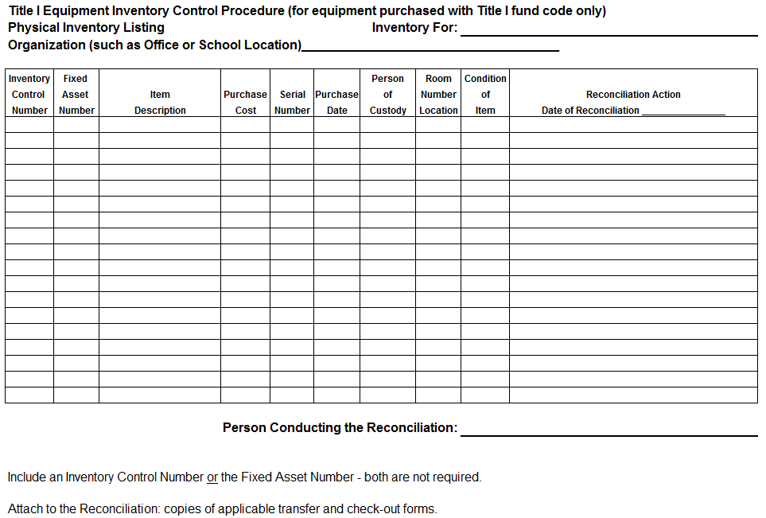
Required Form

Slide 230
Electronic Inventory System
Destiny
All information still required
Format may be different – that is okay
GIGO
The system must be regularly maintained
Do not allow too many hands in the system
Take time to ensure accuracy

Slide 231
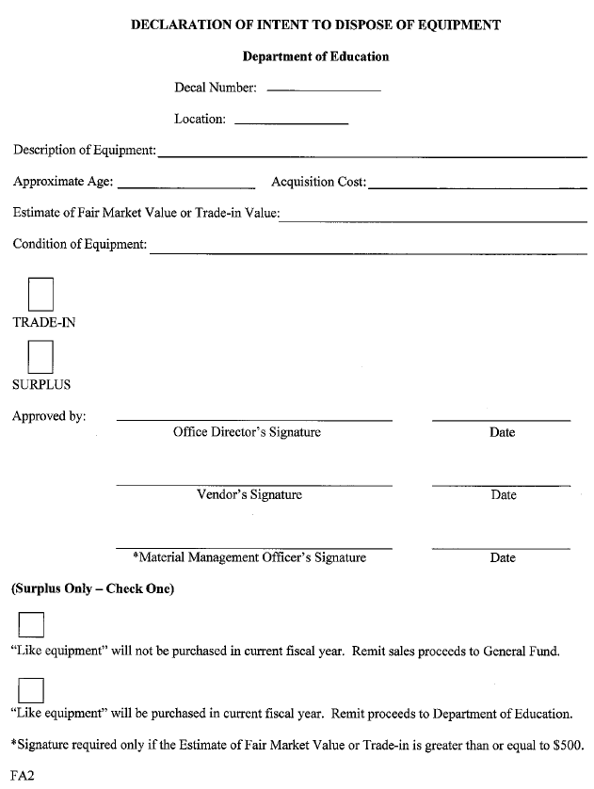
Important Note
SCDIS-501 Information Media Disposal Procedure
The data on computing devices storage media must be professionally wiped/sanitized according to the specifications in SCDIS-501.
Surplus Companies
Large amounts of the same items may be combined on one form.
Equipment Disposal Form

Slide 232
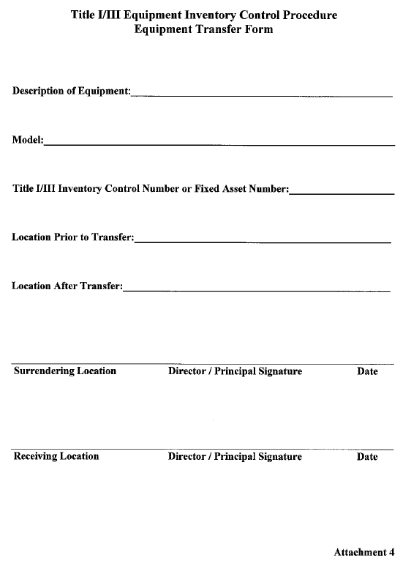
Inventory Transfer
This can go several different directions
The best thing to do is call SCDE and the office will review situations on an individual basis

Slide 233
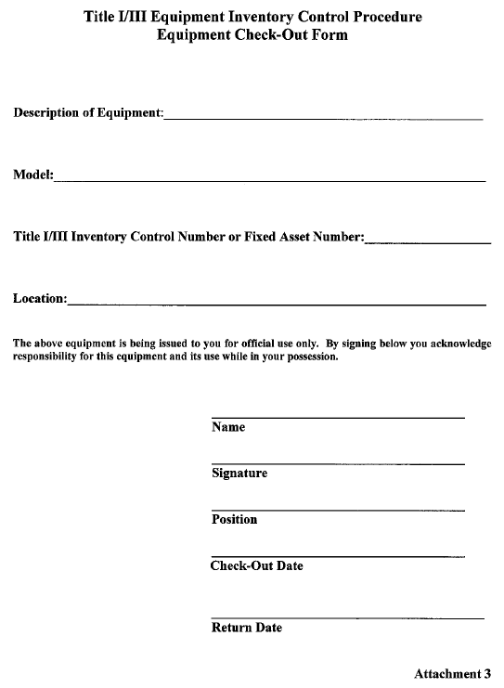
Inventory Checkout
Students –
  Anything that is portable that leaves the classroom should be “checked out”
Staff/Administration
  Anything that is portable that leaves the main holding area for portable devices should be checked out. This includes superintendents, principals, teachers, etc.

Slide 234
Common Questions
How long do I keep Title I Inventory?
If an item is broken, do I continue to carry it on the inventory?
If I am unable to receive the help and/or support I need, what do I do? Who do I call?
If I have questions, who do I call?

Slide 235
Summary
The Title I coordinator is responsible for the inventory procured with Title I dollars, even if they do not have positive control over it.
It is impossible to maintain a clean and accurate inventory without support from district and school leadership.
Title I Directors must be conscientious and assertive.
School level personnel must support Title I Directors in controlling the inventory. School level personnel must know that the Title I Directors will follow through with checking and maintaining inventory.

Slide 236
Questions

Slide 237
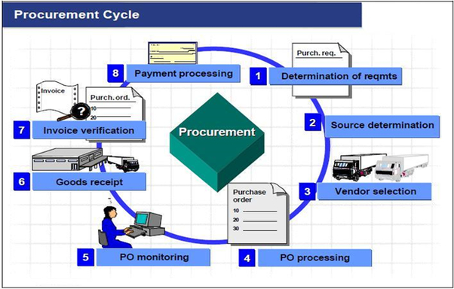
Procurement

Slide 238
Procurement
Federal Emphasis
Contracts are procurements
The vast majority of contract procurements are incomplete
Contracts and other procurements must follow State procurement policies
LEAs are bound to adhere to State procurement policies

Slide 239
Procurement
2 CFR §200.317(a)(b)(c)(1)
(a) The non-Federal entity must use its own documented procurement procedures which reflect applicable State and local laws and regulations, provided that the procurements conform to applicable Federal law and the standards identified in this section [Title I Law].
(b) Non-Federal entities must maintain oversight to ensure that contractors perform in accordance with the terms, conditions, and specifications of their contracts or purchase orders.
(c)(1) The non-Federal entity must maintain written standards of conduct covering conflicts of interest and governing the performance of its employees engaged in the selection, award and administration of contracts…

Slide 240
Sole Source
Sole Source Procurement (Section 11-35-1560 and Regulations 19-445.2105)
A contract may be awarded for a supply, service, information technology, or construction item without competition if, under regulations promulgated by the board, the chief procurement officer, the head of a purchasing agency, or a designee of either officer, above the level of the procurement officer, determines in writing that there is only one source for the required supply, service, information technology, or construction item.

Slide 241
Resources & Legal Citations
https://procurement.sc.gov/about_us
https://www.scstatehouse.gov/code/t11c035.php
2 CFR §200.212, 2 CFR §200.318(a), 2 CFR §200.320, 2 CFR§200.319(c), 2 CFR §200.320(d)(3),
General Procurement - 2 CFR §200.317-321
Competition 2 CFR §200.319
Appendix II to Part 200
Conflict of Interest Policy - 2 CFR§200.318(c), 2 CFR 200.112

Slide 242
Questions

Slide 243
Equitable Services to Private Schools under Title I, Part A
David A. Boison
Private Schools Ombudsman

Slide 244
Eligibility
Student who would have attended an LEA Title I school
Student who lives in poverty
Private school wishes to participate

Slide 245
Changes under ESSA
SCDE Ombudsman
Obligation of funds
Notification of allocation
State Services
Consultation
Allocating Funds

Slide 246
Changes under ESSA
Other than these changes, the existing guidance remains applicable.

Slide 247
Allocating Funds for Equitable Services
Big Change: LEA must determine funding for equitable services prior to any expenditures or transfer of funds.

Slide 248

Proportionate Funding
LEA Title I Allocation =
Number of Private School Low Income Children
Total number of Low Income Children in Attendance area
Share for Private School

Slide 249
Proportionate Funding
= 10%
150 private school low income children
1500 (1350 public + 150 private ) low income children in attendance area

Slide 250
Proportionate Funding
10% x $1,000,000 (LEA allocation) = $100,000 for Equitable Services
(LEA controls the funds)

Slide 251
Equitable Services Parent and Family Engagement
ESEA requires 1% for the activity
1% X $100,000 = $1,000
(for parent and family engagement activity at the private school)

Slide 252
Equitable Services Instruction and Professional Development
$ 100,000
- 1,000 (for parent and family engagement)
$ 99,000 for instruction and PD

Slide 253
Guidance
Fiscal Changes and Equitable Services … as Amended by ESSA
Title I Services to Eligible Private School Children

Slide 254
Questions ?
David Boison
803.734.0594
dboison@ed.sc.gov

