Slide 1

Introduction to Student Learning Objectives (SLOs)
Facilitated Teacher Training

Slide 2
Outcomes
Explain how SLOs support your students’ growth and your own professional development
Identify key tasks associated with the development and implementation of SLOs
Identify the components of a high quality SLO
Begin planning for the development and implementation of SLOs

Slide 3
SLOs Within the Expanded ADEPT Support and Evaluation System

Slide 4


Slide 5
Expanded ADEPT System Purpose
Inform Professional Growth and Development
Provide ongoing feedback

Slide 6

Evaluated with Expanded ADEPT Support and Evaluation System
Evaluated with 2006 ADEPT Guidelines
Educator
(Certified classroom-based teachers who plans, delivers, and assesses instruction)
School Counselors
Speech and Language Therapists
Library Media Specialists

Slide 7
Major Shifts
Isolation to collaboration
Management to Instructional Leadership
Highly Qualified to Highly Effective
Practice to Outcomes

Slide 8



Growth vs. Proficiency
Student growth models are DIFFERENT from proficiency models
Advantage to growth models
allow the educator to determine precisely the amount of growth seen in each student related to his/her instruction

Slide 9
Growth vs. Proficiency

Slide 10
Student Growth Measures
Based on and determined by student academic growth during an interval of instruction
Two collection methods
Statewide Test-Score-Based Measures
Student Learning Objectives

Slide 11
Student Growth Measures
All educators should calculate student growth in 2016-17 as good teaching practice and as required by ESEA waiver
2016-2017, SC Board of Education approved:
Test-score based measures (EVAAS value added measures) are no longer a required part of educator evaluation
Student growth will continue to be collected through the SLO process

Slide 12
SLO Definition
A vehicle for collecting and analyzing student growth
Academic growth goals a teacher sets for students
Data based, Standards based
Collaborative development and monitoring

Slide 13



SLOs = Product + Process
SLO should reflect the duration of time
Year-long, Semester, Quarter
Course interval should be adjusted accordingly
SLOs are appropriate within a classroom setting where teachers are responsible for planning, delivering, and assessing students over time

Slide 14
Types of SLOs
Individually developed SLOs
are formed by one teacher and
are unique to their context.
The teacher, is responsible
for his/her own outcomes.
Team developed SLOs
are formed by a group of teachers with the same SLO objectives. They are each responsible for their own outcomes. Student data is unique to the individual teacher.

Slide 15
Approaches to SLOs
HS: (2) sections of Art History and (2) Pottery classes
Student population comes from one section of one subject.
All students are included in the student population.
Class
Course
Student population comes from both sections of Art History.

Slide 16

Approaches to Growth Targets
Targeted Approach
Sub population(s) of students are the focus of the SLO Goal.
Appropriate for course approach as a second SLO when the first includes all students.

Slide 17
Approaches to Growth Targets
Tiered Approach
A teacher writes a single class SLO
All students are included in the SLO, BUT have varying degrees of expected growth
Tier 1:
5 Advanced Students
Goal is final assessment score of 90 or above, plus in-depth project.
Tier 2:
15 Basic Students
Goal is final assessment score of 80 or above.
Tier 3:
4 Below Basic Students
Goal is final assessment score of 70 or above.

Slide 18

Approaches to Growth Targets
Individualized Growth Targets
Should reflect students’ various starting points and previous performance and expectations.
Appropriate for class or course-based SLOs
Student A
will show a 27+ point growth
Student B
will show a 38+ point growth
Student C
will show a 22+ point growth

Slide 19
SLO Business Rules for SC
District Business Rules Will Vary

Slide 20
Parameters
Teachers must be present for 85% of the teaching interval.
Focus of the goal must be academic in nature NOT behavioral.
Suggested Parameters
IEP goals can inform BUT should not be used as SLO goals.
Students must be present for 75% of the teaching interval.

Slide 21
Parameters
SLO Approved by building principal or designee (trained evaluator).
Three Required Conferences
The Preliminary Conference
The Mid-Course Conference
The Summative Conference

Slide 22
Parameters
Minimum of 6 students
RECOMMENDED
Some service delivery models make it challenging to write SLOs
6 students must be included in student population
Less than 6 students, contact your building principal
Select the class/course with the greatest number of students
Elementary teachers should select reading/literacy or math as the focus

Slide 23
District Flexibility Spectrum
Teacher Autonomy
District Standardization

Slide 24
District Level Decisions
Content Alignment
Assessments
Growth Targets
Feedback/Scoring Rubric

Slide 25

What Makes a High Quality SLO
Product and Process

Slide 26
Product The Anatomy of a SLO
Objective- The goal statement. Identifies content; focused enough that it is measurable.
Student Population- Specific population targeted by the SLO; includes information about student learning.
Standards-Identifies the content standard(s) and indicators that align to the SLO objective.
Post Assessment- Indicate what assessment will be used as a post assessment and how it is aligned to the baseline assessment.
Progress Monitoring- Describes type and frequency of interim assessments to measure student progress.
Baseline Data- Describes students’ baseline knowledge for learning and patterns in data.
Instructional Strategies- Describes research-based instructional strategies that will be used during interval.
Growth Targets- Describes teacher’s expectations for student growth at end of interval; tiered for all students. Gives a rationale for the growth targets
Historical and Trend Data- Describes applicable past data for the students.

Slide 27
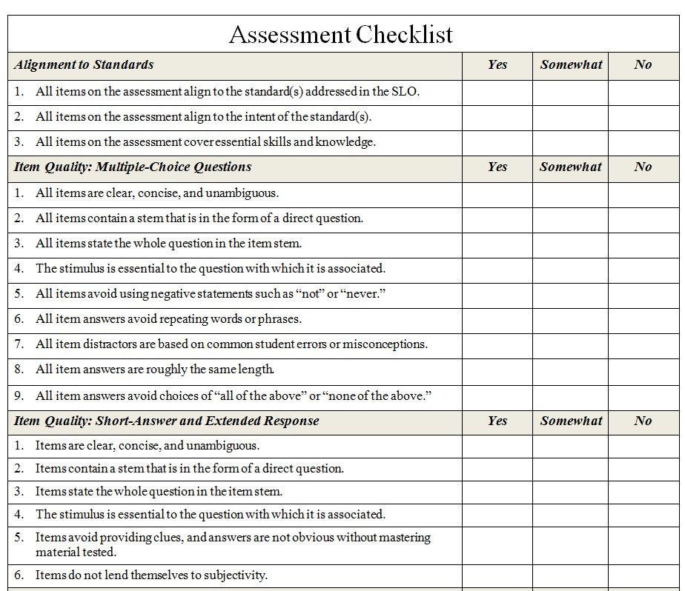
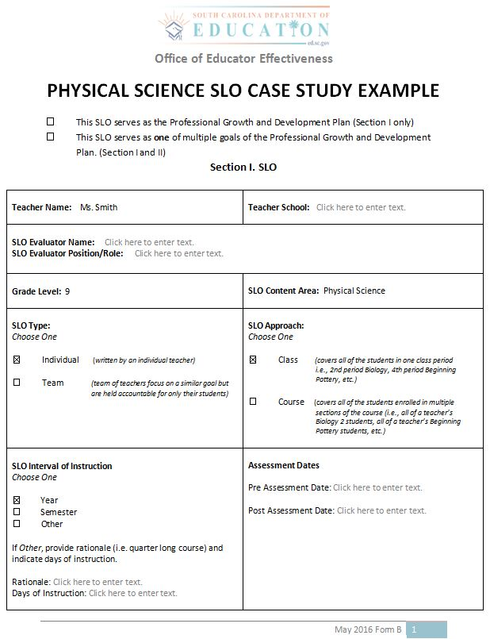
A Case Study: Reviewing the Anatomy of the SLO
Assessment Checklist
Ms. Smith
Grade 9
Physical Science

Slide 29


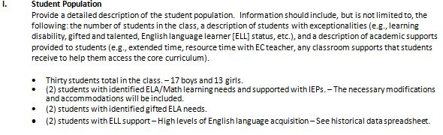
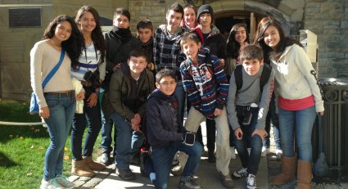
Student Population
Describes what students are included in the SLO goal
Drills deeper into student population
Includes information that may impact growth goals

Slide 30
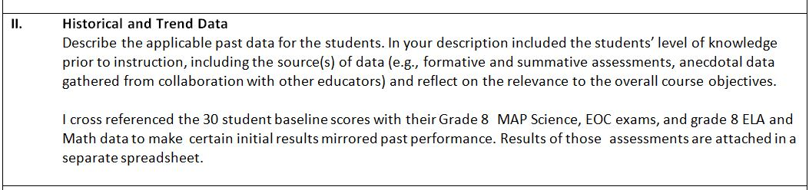

Historical & Trend Data
Review performance and historical data
Examples of Historical Data
Past performance on similar assessments
Attendance records
Student specific learning needs (IEP)
Conferences with student’s previous teachers

Slide 31
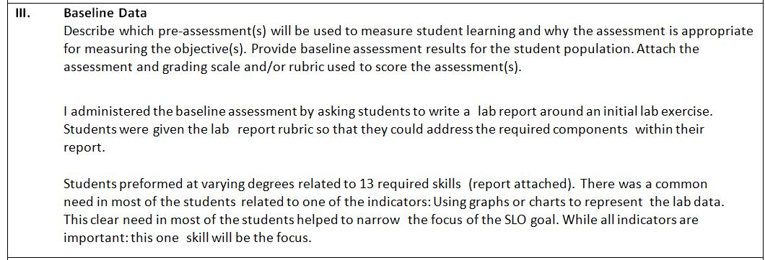
Baseline Data
Make sure Pre and post – assessments are aligned
If possible, use 2-3 assessment measures
Approved in Preliminary Conference
Refer to SCDE Assessment Checklist
State Standardized Assessments
Common Assessments
District Standardized Assessments
Teacher Created Assessments

Slide 32
Baseline Data
State Standardized Assessments
Common Assessments
District Standardized Assessments
Teacher Created Assessments
Integration of standardized test scores
Example: MAP
Teachers without Standardized Tests
Consider available resources for assessment
Develop baseline and post assessment
Work with teacher teams to create common assessments

Slide 33
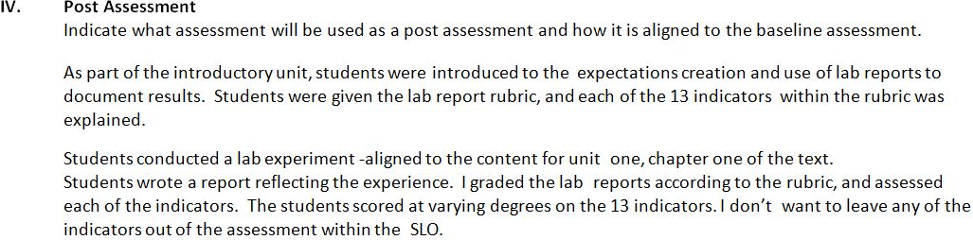

Post Assessment
Describe how pre- and post assessment are aligned
Alignment is Important

Slide 34
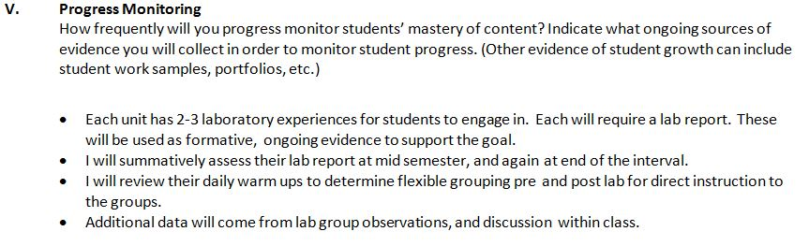

Progress Monitoring
SLO is a living, breathing document
SLO is continually monitored
Periodic assessments informing instructional strategies and adjustments to strategies

Slide 35
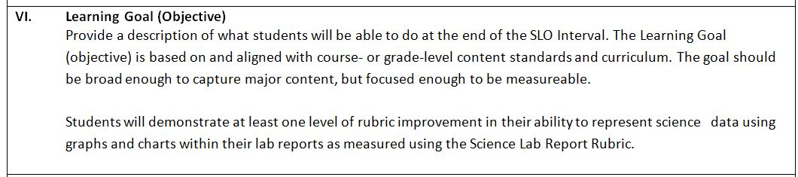

Learning Goal
Based on content standards
Identifies and describes an important and meaningful learning goal
Captures major content
Focused enough to be measureable

Slide 36
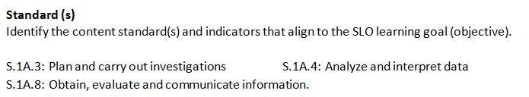

Standards
Enduring content and skills
Focus represents the time of instruction
Avoid unit specific content
Focus on a few standards with relevant meaning to the SLO

Slide 37
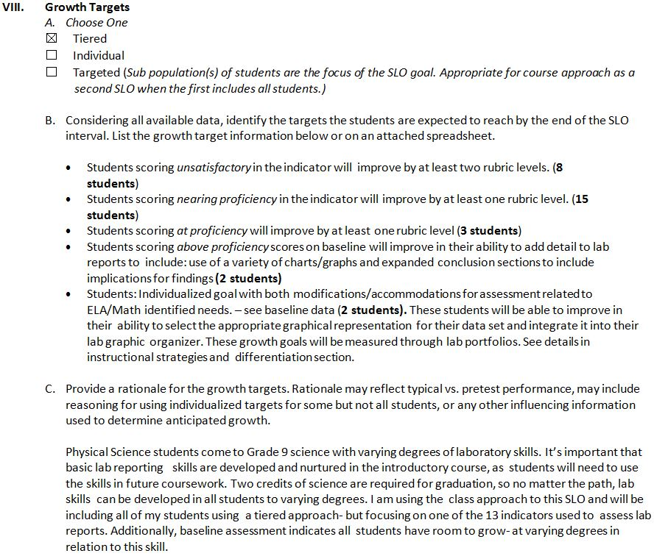

Growth Targets
Teacher selects approach to growth targets
Growth targets should be rigorous and appropriate

Slide 38
Growth Targets
Identifies specific growth targets
Setting growth targets may be challenging in the beginning
Goals should not be set arbitrarily

Slide 39

Growth Targets
Provide rationale
Include data:
Historical
Trend
Baseline

Slide 40


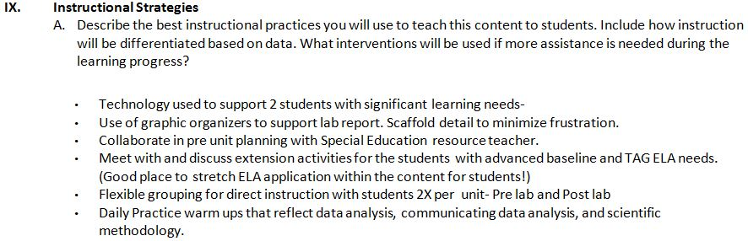
Instructional Strategies
HEART of the work related to SLOs
Should be revisited throughout instruction
Outlines plans to move students forward
Should engage in reflection
Consider PD needed to effectively implement strategies

Slide 41
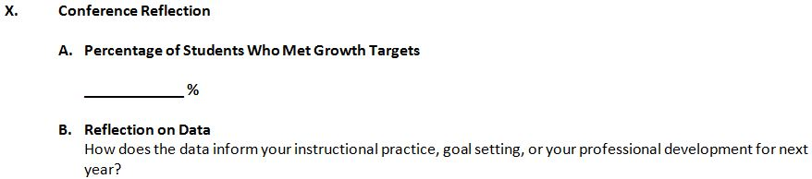

Conference Reflection
Growth target calculations
SLO reflection

Slide 42
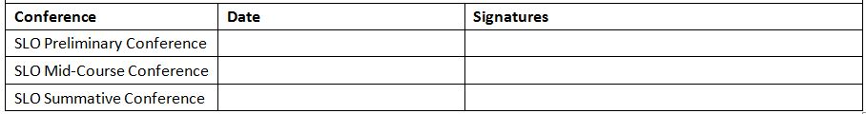
Required Conferences
Collaborative process
Provides documentation of required meetings
Preliminary Conference
Mid Course Conference
Summative Conference

Slide 43
SLOs Promote
Collaboration (among teachers and teacher/administration/support staff).
Teachers’ enhanced capacity for data driven instruction.
Clear connection between curriculum, assessment, and student data.
A process of measuring student growth outcomes.
Teacher input and ownership in his/her evaluation.

Slide 44
Process: The SLO Cycle
SLO
Development
Summative Conference and Reflection
Preliminary Conference – SLO Approval
Final Review and Score
Mid-Course
Conference

Slide 45
Process: The SLO Cycle
SLO Development generally includes the following steps:
SLO Development
Final Review and Score
Summative Conference and Reflection
Mid-Course Conference
Preliminary Conference-SLO Approval
1
Identify core content and standards
2
Gather and analyze student data
3
Determine the focus of the SLO
4
Select or develop an assessment
5
Develop a growth target and rationale

Slide 46
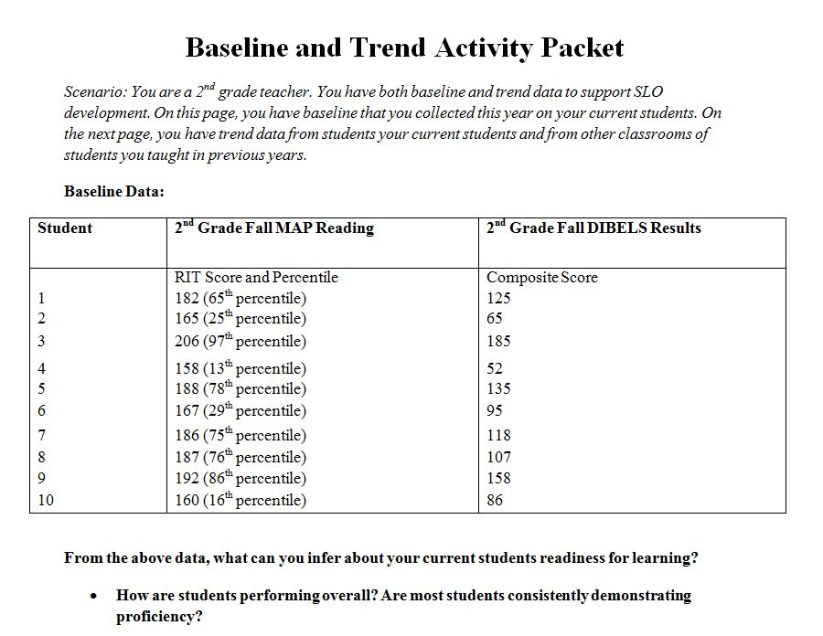
Baseline Assessment
& Trend Data Activity

Slide 47
Activity Part I:
Analyzing Baseline Data
Are there clear groups of students? If so, what are they?
What students are included in each grouping?
How would you describe the performance of each grouping?
Are there any students that are not easily assigned to a group?

Slide 48
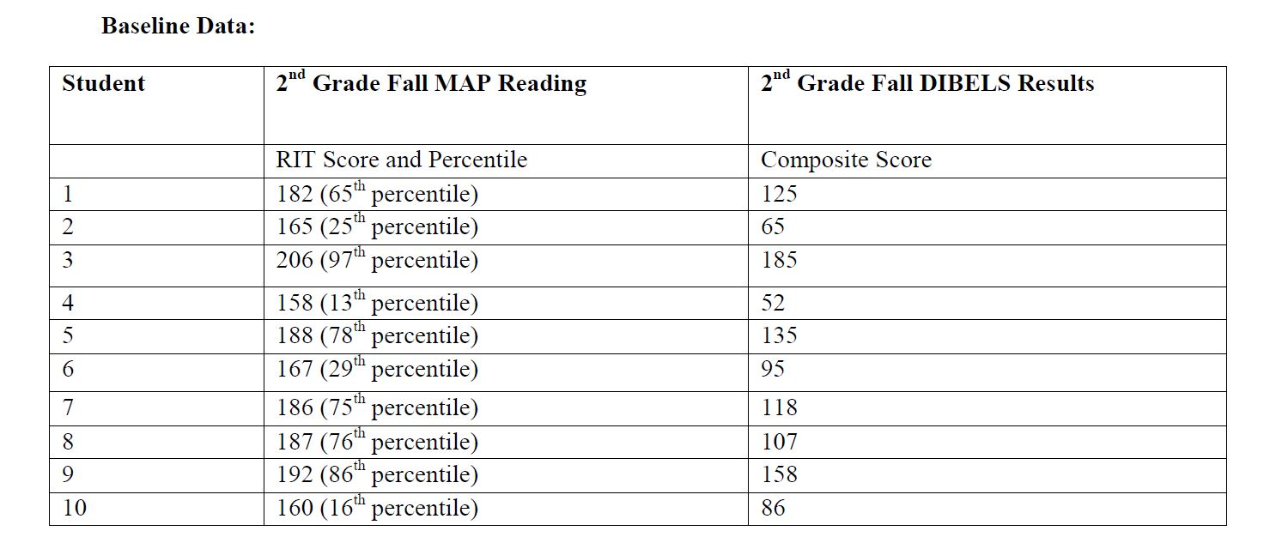
Below Proficiency
Below Proficiency

Slide 49
Above Proficiency
Above Proficiency

Slide 50
At Proficiency
At Proficiency

Slide 51
Baseline Assessment
Administered at the beginning of the SLO interval
Aligned to the content standards in the SLO and to post assessment
Can be a performance assessment using a teacher-created rubric

Slide 52
Baseline Assessment Data
Describe students in terms of groups.
Describe student performance over time.
Inform
growth
targets.
Inform
instructional
strategies.

Slide 53
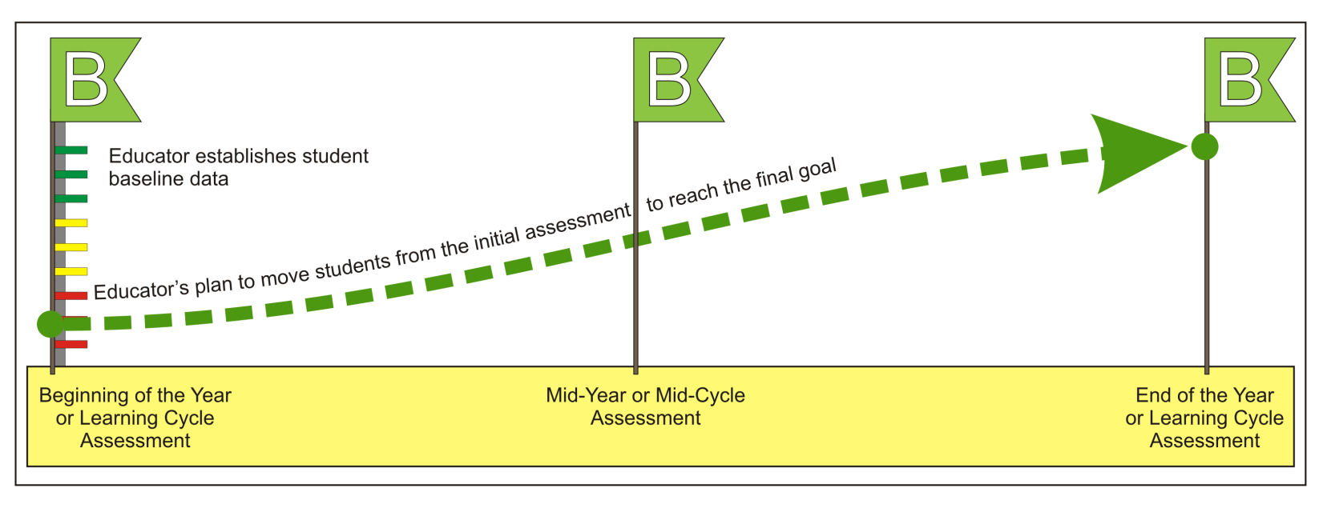
Benchmark Assessments
Graphic courtesy of WI Department of Public Instruction.

Slide 54

Activity Part II:
Historical/Trend Data
Trend and other student data help educators determine how much growth each student is likely to make.
Identify and gather trend data
Examples of trend data include:
Test scores from prior years
Current and past grades
Formative assessment data past & present
Reading and math conferences
Data about student population
Attendance records or 504 plans
Results from diagnostic assessments

Slide 55
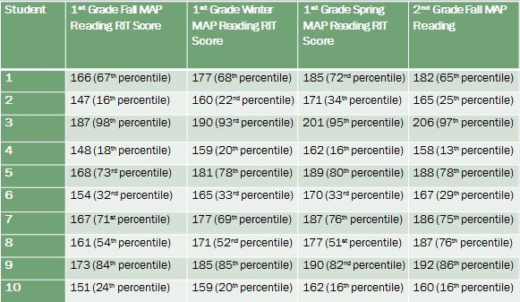
Historical /Trend Data

Slide 56
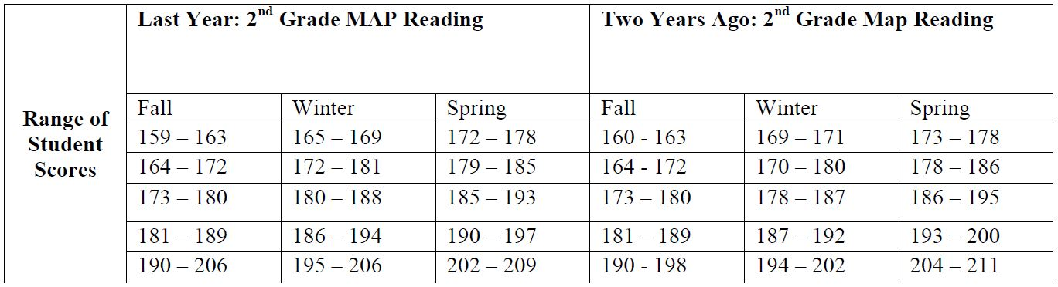
Historical/Trend Data

Slide 57
Activity Part III:
Setting Growth Targets
Baseline Performance Level | Growth Target
Below Proficiency
+ 15 points or more
At Proficiency
+ 7 points or more
+ 2 points or more
Demonstrates ability to transfer skills to authentic situations
Above Proficiency

Slide 58

Refining Growth Targets
Set Initial Growth Targets
What growth have students made in previous years?
What is the minimum score at which students can be proficient?
Adjust Growth Targets
Are there contextual factors that are likely to affect students’ growth in positive and negative ways?
Are these factors reflected in students’ previous growth or are they new?
Review Targets
Are these targets rigorous and attainable
Does the initial growth target allow students to make progress toward proficiency?
What growth have students with similar factors made in the past?

Slide 59
SLO Approval:
Preliminary Conference
SLO
Development
Who?
Final approval is issued by the building principal.
Summative Conference & Reflection
Preliminary Conference – SLO Approval
When?
Prior to the start of the SLO Interval.
Final Review and Score
Mid-Course Conference

Slide 60
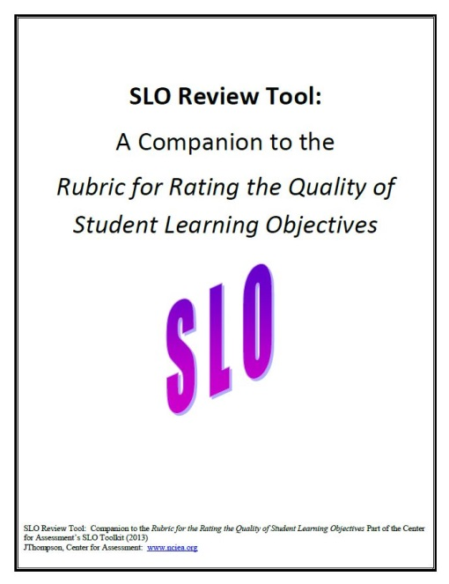
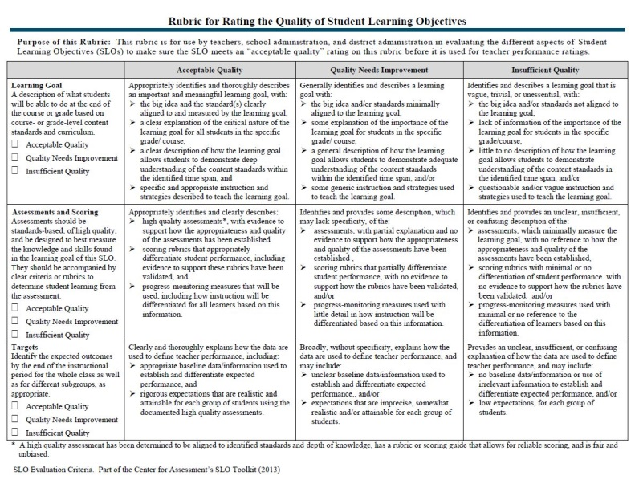
SLO Quality Review
Three critical areas:
The Content
The Assessment
The Rigor
The Center for Assessment
Rubric for Rating SLO Quality Tool
is designed to:
Provide teachers, principals, evaluators and district administration guidance for evaluating SLOs
Ensures SLO meets “acceptable quality”

Slide 61
Content, Assessment,
& Rigor
Alignment of district/building initiatives
Whether or not the content reflects enduring understandings over time
Content
Assessments and Scoring
It cannot be stressed enough!
The SLO is only as good as the assessment used to track student growth
Rigor of Target
Reflects analysis and reflection in prep
Tied directly to the data analysis and rationale presented in the SLO

Slide 62
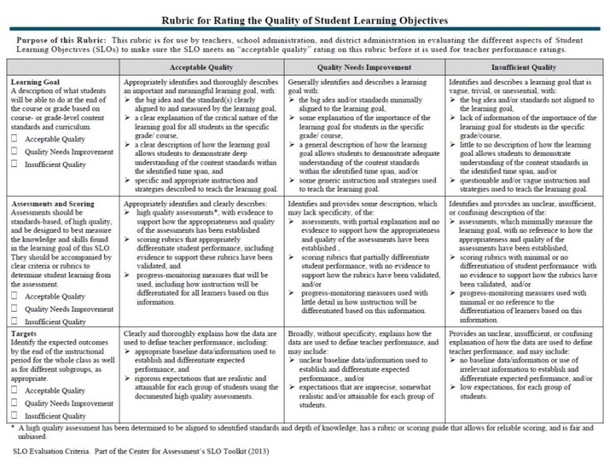
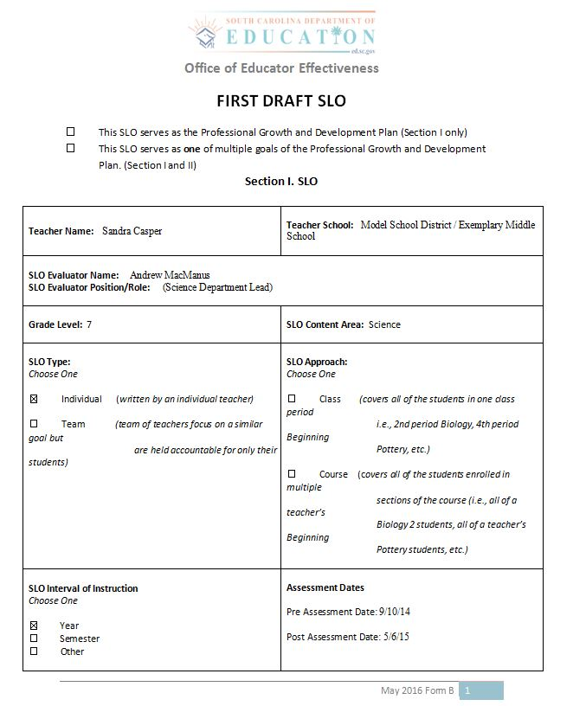

SLO Review Activity
Before and After Review Packet
SLO Rating Rubric
SLO Rubric Companion Guide

Slide 63


SLO Review Activity
STEP ONE
Review the First Draft SLO and make notes of:
areas of strengths
questions you have
noticeable areas for improvement
STEP TWO
Read the Draft SLO with Reviewer Comments
Determine if you were on the same track as the reviewer
Read the Final SLO

Slide 64
SLO Implementation
Begins after SLO approval and lasts the duration of time the teacher is leading instruction
Includes regular review of data to determine progress and adjust instruction accordingly
Evidence is collected throughout the interval to include assessment results and other evidence of student learning

Slide 65
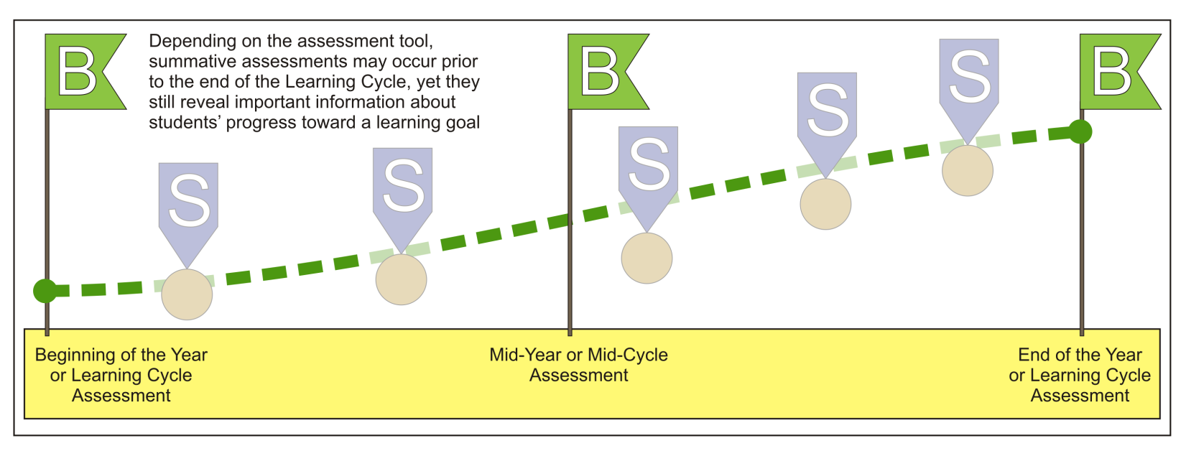
Assessment & Evidence:
Monitoring Progress
Graphics courtesy of WI Department of Public Instruction

Slide 66
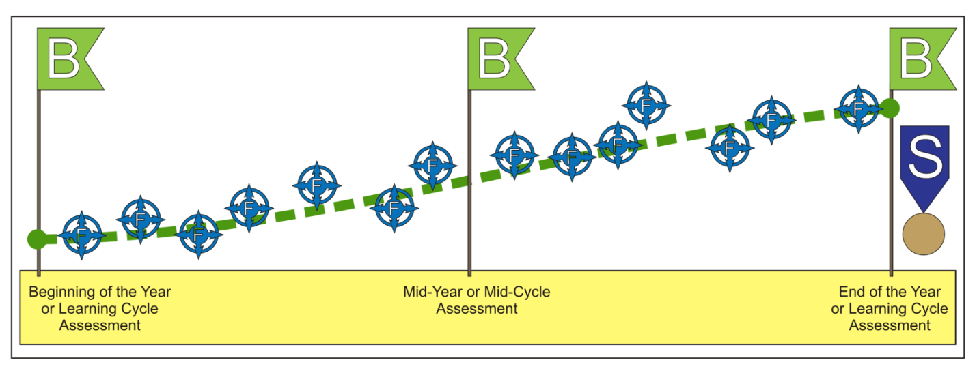
Assessment & Evidence:
Monitoring Progress
Graphics courtesy of WI Department of Public Instruction

Slide 67
Mid-Course Conference
Takes places mid-way through the SLO interval
Teacher reviews data to date
Goals may be adjusted
Adjustments are not made arbitrarily
Must be approved
SLO
Development
Summative Conference & Reflection
Preliminary Conference – SLO Approval
Final Review
and Score
Mid-Course Conference

Slide 68
SLO Scoring
Teacher
gathers
evidence of student growth
Teacher
administers
post assessment at end of interval
Teacher
implements
strategies
Teacher
self-scores the
SLO
Mid-Course Conference

Slide 69
Final Review and Score
SLO
Development
Teacher uses the district’s scoring rubric
Reflects the percentage of students meeting their goal
Student Attendance
Students not in attendance 75% of interval are removed
Teachers need to provide supporting documentation
Summative Conference & Reflection
Preliminary Conference – SLO Approval
Final Review
and Score
Mid-Course Conference

Slide 70
SLO Feedback Rubric
Score | Criteria
4 | 90% - 100% of students have met their growth target.
 | Educator set up rigorous, superior goals(s); skillfully used appropriate assessments, continuously monitored progress; and strategically revised instruction in response to ongoing progress monitoring.
3 | 75% - 89% of students have met their growth targets.
 | Educator set up attainable goals(s); used appropriate assessments, consistently monitored progress; adjusted instruction in response to progress monitoring.
2 | 51% - 74% of students have met their growth targets.
 | Educator set up goals(s); used assessments that were not appropriate for the goal, inconsistently monitored progress; inconsistently or inappropriately adjusted instruction
1 | 0% - 50% of students have met their growth targets.
 | Educator Inconsistently used assessments, failed to monitor progress; failed to adjust instruction based on progress monitoring data.

Slide 71
Summative Conference
& Reflection
SLO
Development
Teacher and principal meet to review results of SLO goal
Discuss
What Worked
Next Steps
Summative Conference & Reflection
Preliminary Conference – SLO Approval
Final Review
and Score
Mid-Course Conference

Slide 72
Teacher Next Steps:
Consider sources for assessment and evidence
Develop assessments for use with SLOs
Consider your context and any unique challenges
Support your district in SLO process decisions

Slide 73
Continued development of teacher SLO resources
SLO Evaluator
training
resources
SCDE
Next Steps
Expansion of SLO Repository
Monitor feedback and adjust process accordingly

Slide 74
SLO Support
SLO@ed.sc.gov
Questions and SLO examples
http://ed.sc.gov/educators/educator-effectiveness/measuring-student-growth/slo/

