Slide 1


The Evaluator's Role in the SLO Process Module Two Mid-Course Conference
Presented by the SCDE Office of Educator Effectiveness

Slide 2

Connector
Think of a time that you tried something new….
Was it a successful experience? Or was it a frustrating experience?
What contributed to the success or failure of the experience?
Take one minute to process independently
Turn and talk to your neighbor to discuss your thoughts
Be prepared to share out with the group

Slide 3
Welcome
and
Introductions

Slide 4
Group Norms
Be present (physically and mentally)
Please use electronic devices responsibly
Ask questions when in doubt
Honor the time schedule
Participate actively

Slide 5
Key Topics
Welcome and Introductions
SLO Module Review
SLO Conference Cycle
Coaching Conversations & the Mid-Course Conference
Case Study: Mid-Year
Next Steps: Districts, Evaluators, Teachers

Slide 6
Overarching Objectives
Develop an understanding of SLOs and their role in the Expanded ADEPT Support and Evaluation System
Become proficient in evaluating SLO components to ensure successful implementation
Identify methods to support teachers in the development and monitoring of SLOs
Identify resources to facilitate the evaluation of SLOs at the school level

Slide 7
SLO Module Review

Slide 8


SLO Evaluator Modules
Approval Conference
Mid-Course Conference
End of the Year
Conference

Slide 9
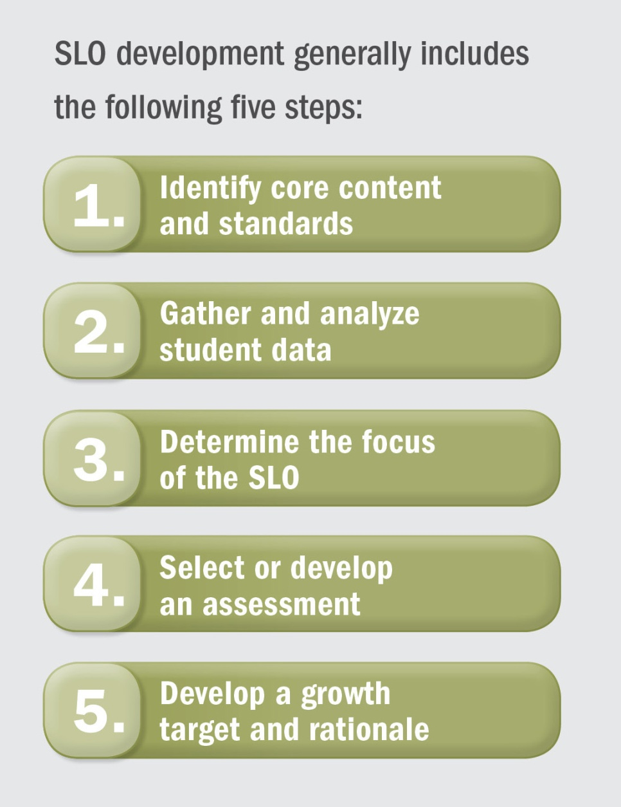
The SLO Process
SLO Development
Mid-Course Conference
Final Review and Score
Preliminary Conference- SLO Approval
Summative Conference and Reflection

Slide 10
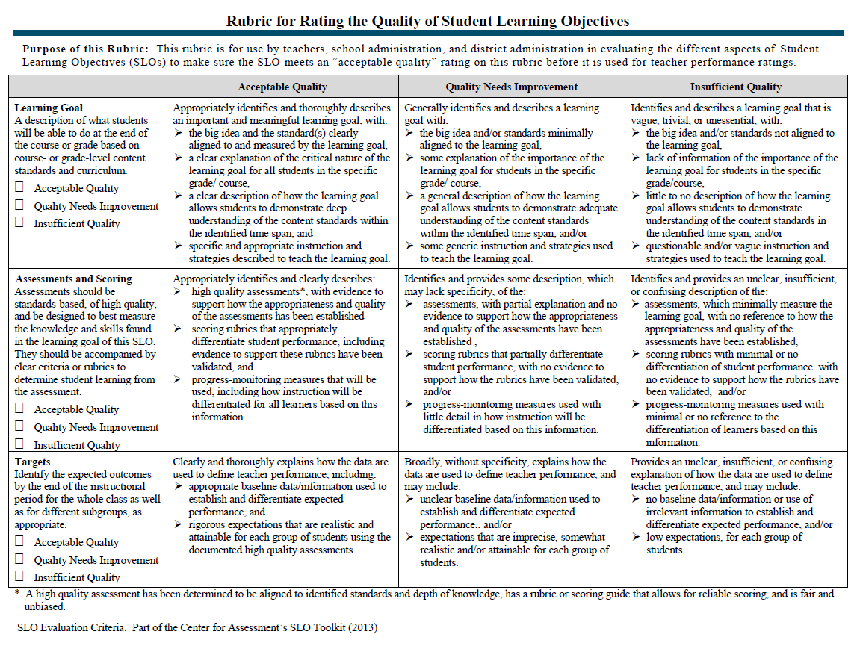
The Quality Review Tool

Slide 11
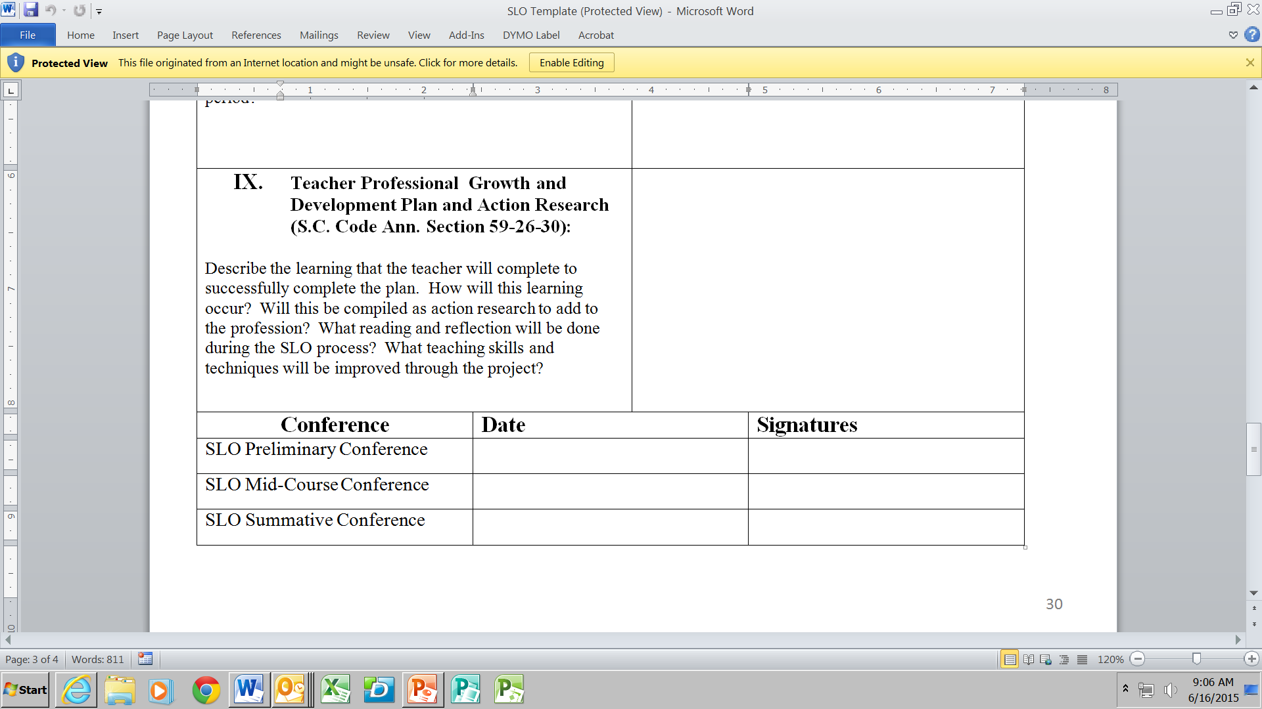

Slide 12
Table Topics
What are some strengths of the SLO Process in your district so far?
List your strengths individually.
Share as a table team.
Be prepared to share whole group.
What are the challenges with the SLO Process in your district? What are some of your solutions so far?
List your strengths individually.
Share as a table team.
Be prepared to share whole group.

Slide 13
SLO Conference Cycle
Approval Conference
Mid-Course Conference
End of the Year
Conference

Slide 14
Mid Course Conference
SLO Development
Mid-Course Conference
Final Review and Score
Preliminary Conference- SLO Approval
Summative Conference and Reflection

Slide 15


Ongoing SLO Process
Monitoring the Process of the SLO
Ongoing Review of Student Data

Slide 16
Mid-Course Conference
Adjustments to growth targets are allowable at mid-course conference should data support an adjustment.
Be careful to determine whether the data includes appropriate alignment and responsiveness to instructional strategies.
Teachers are to come to the conference with reflections on
how they have identified root causes for off-track
performance.
Adjustments are likely.
Chronic absence students are not removed at this time.

Slide 17
What Do You Need To Do?
Teacher
What are the things you will want your teachers to do to prepare for the Mid-Course Conference?
How will you communicate these things with the teacher prior to the conference?
Administrator/Evaluator
What are the things you will want to do to prepare for the Mid-Course Conference?
How will you schedule the conference time with the teacher to prior to the conference?
?
?
?
?

Slide 18

Questions to Consider for Mid-Course Conference
Tell me about your students’ progress relative to the goals you’ve set for their learning this year?
What evidence/data do you have to support your thinking about student progress?
What have been some of your challenges?
Are there additional supports or professional development that I can provide?
What are you learning about your practice that is helping you to grow as a teacher?

Slide 19

Please be ready to begin the next session in 10 minutes.
Thank you!

Slide 20


Slide 21
Coaching Protocol
Validate
Clarify
Stretch &Apply

Slide 22
Coaching Protocol
Validate
Clarify
Stretch &Apply

Slide 23

Reviewing Case Study SLO Plan

Slide 24
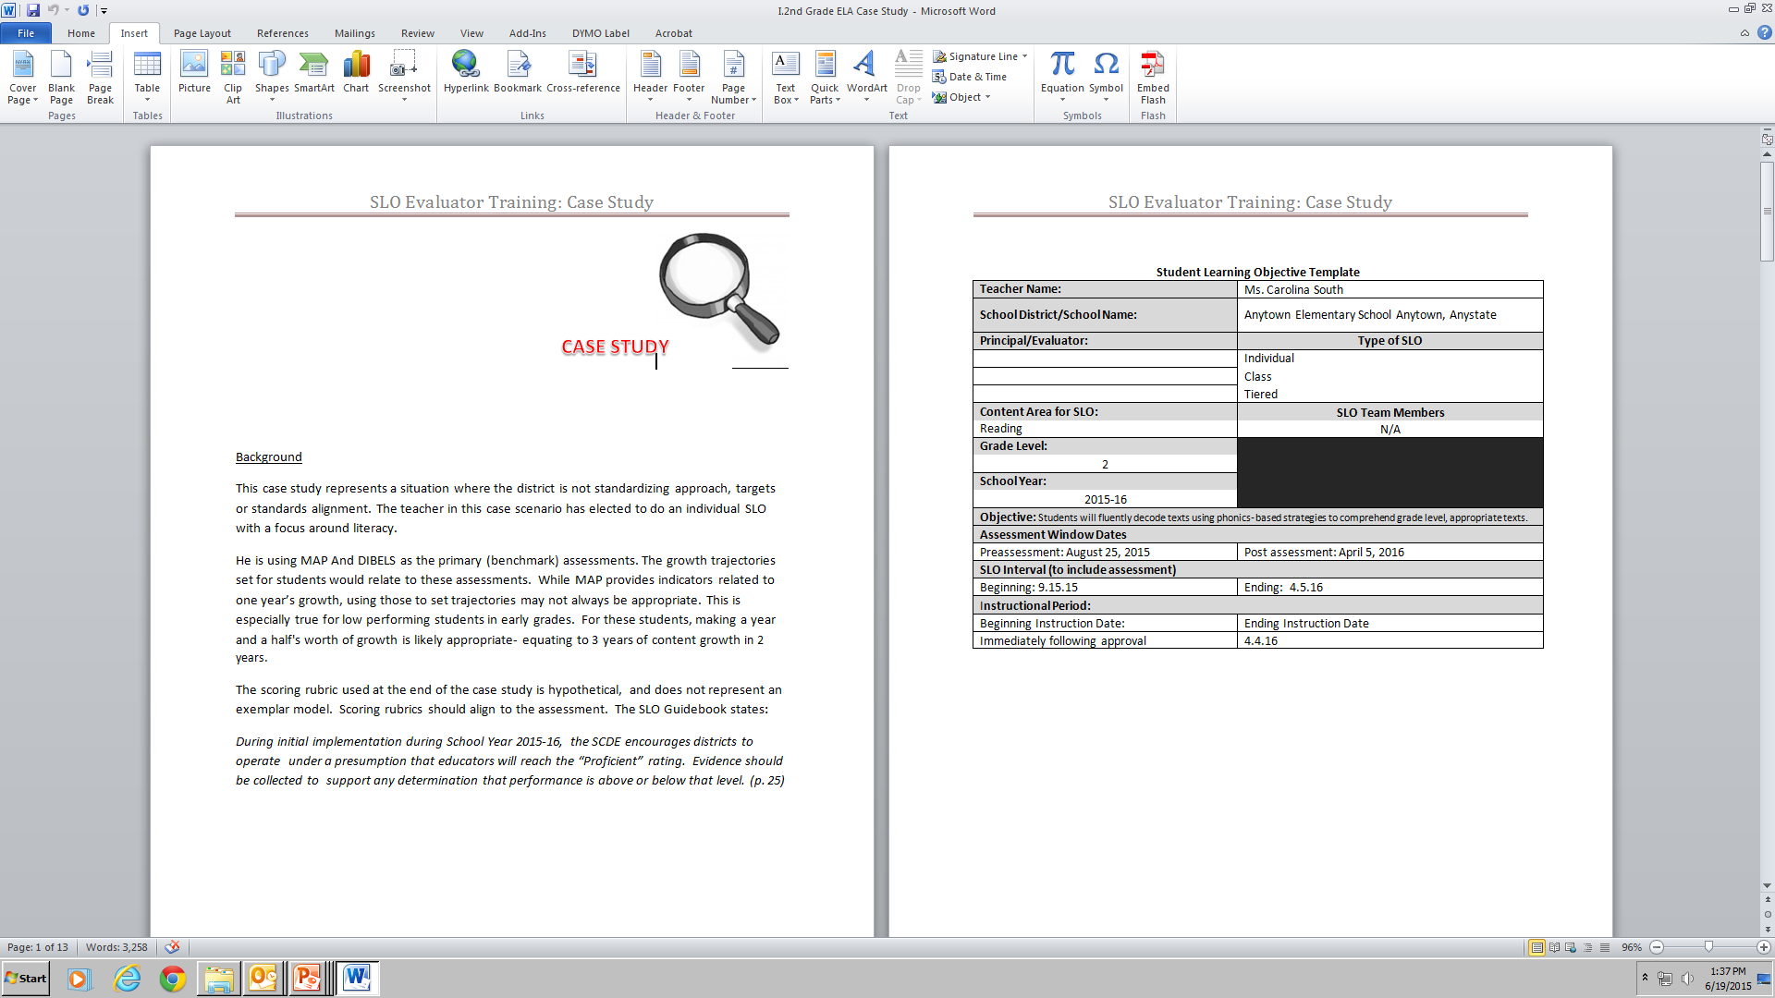
Grade 2 SLO Case Study

Slide 25
Mid Course Conference
Find the mid-course data
Review the data
pose 2 validating statements
Pose 2 clarifying questions and
Pose 1 statement what will stretch or encourage application of new learning
After 10 minutes, compare findings with an elbow partner
Using a post it note, post one validating statement, one clarifying question and one stretch and apply statement to the posters around the room.
SLO Development
Mid-Course Conference
Final Review and Score
Preliminary Conference- SLO Approval
Summative Conference and Reflection

Slide 26
Poster Activity
Sharing

Slide 27
coaching conversations
Supporting Development of High Quality SLOs

Slide 28
SLO Mid-Course Conference Video
Count off 1-3. During the video capture language stems that demonstrate your assigned area of the protocol.
#1) Validate: Affirms strength, or rationale
#2) Clarify: Asks for greater detail, probes deeper
#3) Stretch: Pushes the educator to think about next steps growth and development
Video Link: http://www.kaltura.com/tiny/xdlnx

Slide 29

SLO Mid-Course Conference
Coaching Conversation Video Recap

Slide 31

Coaching Conversations Practice
Using your stems and our poster activity, practice your coaching conversation with a partner
Remember to use your coaching stems
Reverse Roles
Validate
Clarify
Stretch &Apply

Slide 32

What is your “Take-Away?”
Instagram
This

Slide 33
Overarching Objectives
Develop an understanding of SLOs and their role in the Expanded ADEPT Support and Evaluation System
Become proficient in evaluating SLO components to ensure successful implementation
Identify methods to support teachers in the development and monitoring of SLOs
Identify resources to facilitate the evaluation of SLOs at the school level

Slide 34
Mid Course Conference
SLO Development
Mid-Course Conference
Final Review and Score
Preliminary Conference- SLO Approval
Summative Conference and Reflection

Slide 35
Next Steps
SLO Evaluator Training (for appropriate staff)
Materials available on SCDE Website http://ed.sc.gov/slo
SLO Teacher Training
SLO Toolkit
SLO Online Module
District SLO Trainings

Slide 36
Office of Educator Effectiveness Team
Kris Joannes Director | kjoannes@ed.sc.gov 803-734-0443
Joseph Tadlock Team Leader | jatadlock@ed.sc.gov 803-734-8368
Rinice Sauls Education Associate | rsauls@ed.sc.gov 803-734-0663
Tria Grant Education Associate | tgrant@ed.sc.gov 803-734-9642
Libby Ortmann Education Associate | oortmann@ed.sc.gov 803-734-4424
David Damm Education Associate | ddamm@ed.sc.gov 803-734-8046
Dr. Sheila Quinn Deputy Superintendent, Division of Innovation & Effectiveness squinn@ed.sc.gov 803 734 7897

Slide 37

Don't judge each day by the harvest you reap, but by the seeds you plant.
Robert Louis Stevenson

