Slide 1
Efforts to Retain and Support Educators
February 10, 2023
Ellen E. Weaver
State Superintendent of Education
Lilla Toal Mandsager, Director
Office of Educator Effectiveness and Leadership Development
1. Data | 2. Support for New Teachers | 3. Support for New Principals and Leadership Teams |
4. Creating a Culture That Retains Great Educators

Slide 2
SCDE Office of Educator Effectiveness and Leadership Development
SCDE
Office of Educator Effectiveness & Leadership Development
Professional learning
& coaching
  educator effectiveness,
  new teacher & principal induction,
  instructional leadership
WHAT WE DO
  Personalized Learning
  Collective Leadership
  Equitable access
HOW WE DO IT
OUR FOCUS
  Culture & Environment
  Instruction
Growing educators to lead schools where ALL students have equitable access to effective instruction.
  More effective teachers & leaders stay
  More students & educators grow
DESIRED RESULTS
Notes:
Federal: TITLE II: PREPARING, TRAINING, AND RECRUITING HIGH-QUALITY TEACHERS, PRINCIPALS, OR OTHER SCHOOL LEADERS, Improving equitable access to effective teachers
State:

Slide 3
Retention and Effectiveness Data

Slide 4
Teacher Turnover and Vacancies
% of Teachers Returning
% of Vacancies > 9 weeks

Slide 5
New Teachers and Principals
Notes:
% Induction 1 Teachers % Induction Principals Induction 1 Teachers Total Teachers Beginning Principals Total Principals
2015-16 6.0% 10.2% 3212 53175 125 1230
2016-17 5.7% 10.9% 3131 54991 134 1230
2017-18 6.0% 11.5% 3414 56443 141 1230
2018-19 6.3% 12.9% 3538 55965 159 1230
2019-20 3401 55111 121 1223
2020-21 3236 55667 115 1240
2021-22 3497 57765 118 1240
137 1240

Slide 6
Teacher Performance Principal Performance
2021-22
Strengths
Areas of Growth
Standard 2: Instructional Leadership
Standard 3: Effective Management
Standard 4: Climate
Standard 6: Ethical Behavior
Standard 1: Vision
Standard 8: Staff Development
Strengths
Respectful Culture
Environment
Content Knowledge
Areas of Growth
Thinking
Assessment
Questioning
Grouping
Notes:
In a growth system, allows us to look at areas of strength and growth
Averages aren’t that far apart
Q, 5,230 area of refinement
Of the 12181 observations where Questioning was scored, the average score (1-4) was 3.07, the Standard Deviation was .49 (see full range from 1-4).
The # of observations scoring at level 4 exemplary was 1588 or 13% ,80% scored 2, 6%, 1 <1%

Slide 7
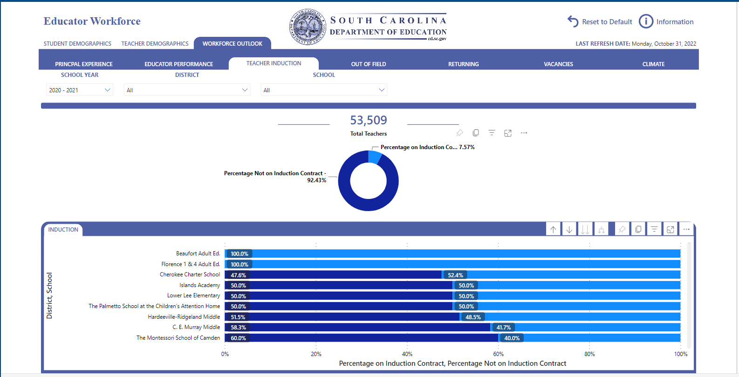
Human Capital Data Dashboard
Principal Experience
Educator Performance
Induction Teachers
Out of Field
Teachers returning
Teacher Vacancies
Climate Survey
School1
School 2
School 3
School 4
School 5
School 6
School 7
School 8
School 9
Notes:
Pop Out to Demo at personal site: https://app.powerbi.com/groups/me/apps/fdad4b44-7c94-458e-b691-91c24ab52646?ctid=2704e2c5-29f5-4f7e-b91c-bd56f0685995

Slide 8
Often injustice lies in what you aren't doing, not only in what you are doing.
Marcus Aurelius, Meditations, 9.5.

Slide 9
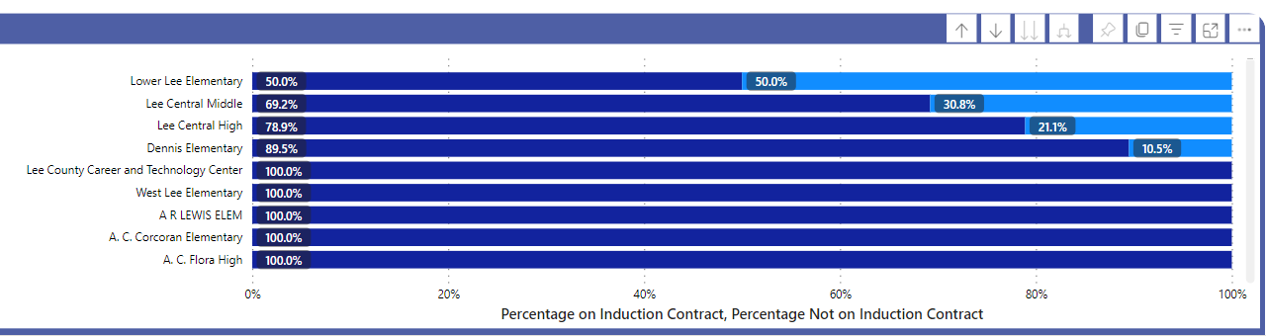
Human Capital Data Dashboard:
District Drill Down, % of Induction Teachers
Elementary 1
Middle
High School
Elementary 2
CTE Center
Elementary 3

Slide 10
Support for New Teachers

Slide 11

Teacher Induction and Mentoring
59-26-30 (2000) and 43-205.1
Induction for up to 3 years through district
Required Mentor in Year 1
Standardized Mentor Training
Yearly Plan and Data Collection
Updated Guidelines (2017)
EIA: $873,909 to districts
(same level 2012-2023)
Notes:
Under these mandates, South Carolina’s induction and mentoring initiative exists as a collaborative effort among the state’s school districts, the teacher education programs in the state’s colleges and universities, the SBE, the SCDE (through the Office of Educator Effectiveness and Leadership Development (OEELD)), and CERRA. Implemented by the individual school districts statewide, these induction and mentoring programs will have one overriding objective: to inform, encourage, and support beginning teachers for the purpose of improving the quality of teaching in the state, raising the level of student achievement and reducing the rate of attrition among our newest teachers.
2017 revisions: Clarity Roles and Responsibilities
Alignment: Expanded ADEPT Evaluation System, Profile of the South Carolina Graduate, Revised SC Mentor Training

Slide 12
Support for New Principals and Leadership Teams

Slide 13
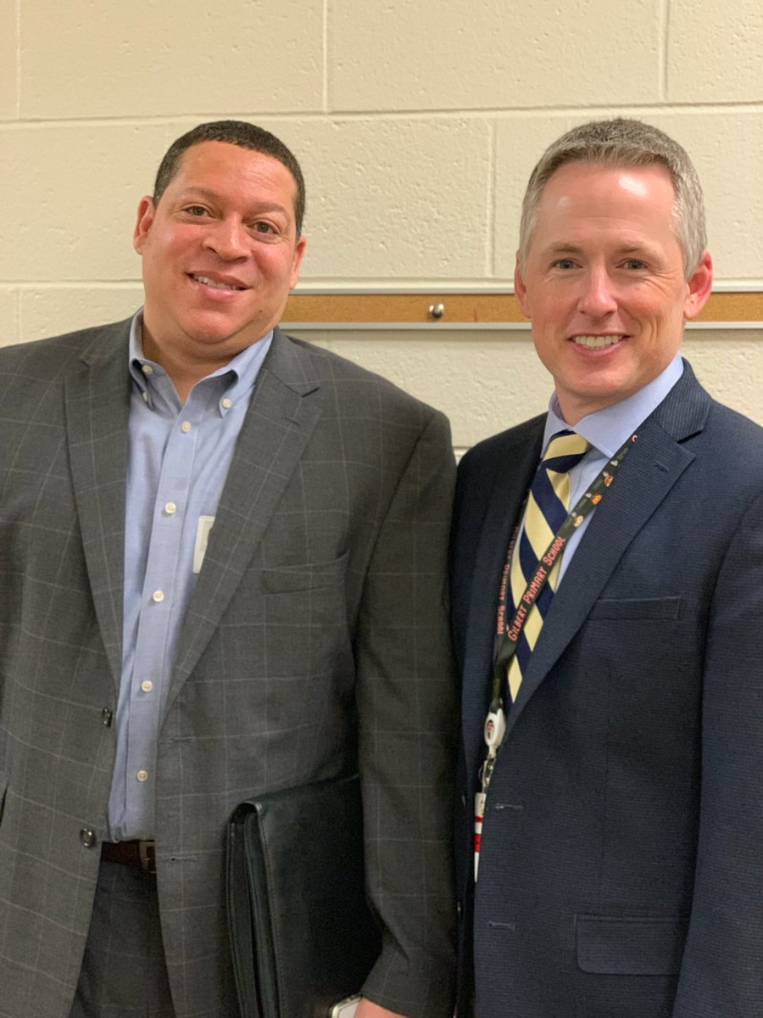
Principal Induction and Mentoring
59-24-80, 43-167 (2000), 43-165.1
Year-long Induction Cohort and leadership coach through SCDE
Orientation, local induction, and mentor provided through district
Focused: Instructional leadership, effective management, school culture

Slide 14

Instructional Leadership Continuum
Cohorts
Veteran Principals
District Staff
APs, Coaches, Teams
Teachers, Librarians, & Counselors
Notes:
Access to Effective Instruction, Personalized Learning, Collective Leadership

Slide 15
Creating a Culture that Retains Great Educators
Notes:
I am also committed to empowering great principals with the tools they need to create school cultures in which great teachers thrive. My goal is nothing less than making South Carolina the best place to teach in the country.

Slide 16
Theory of Action
IF we prioritize creating resources that help schools create a culture that attracts, develops, sustains, and optimizes great talent
THEN schools will be more intentional about addressing disparities
AND EVENTUALLY disparities in access to effective teachers will decrease.
Principals as Human Capital Managers
Supports for Early Career Teachers and Principals
Targeted Support for High Needs Schools and Districts
Using Data to Decrease Disparities in Access to Effective Teachers

Slide 17
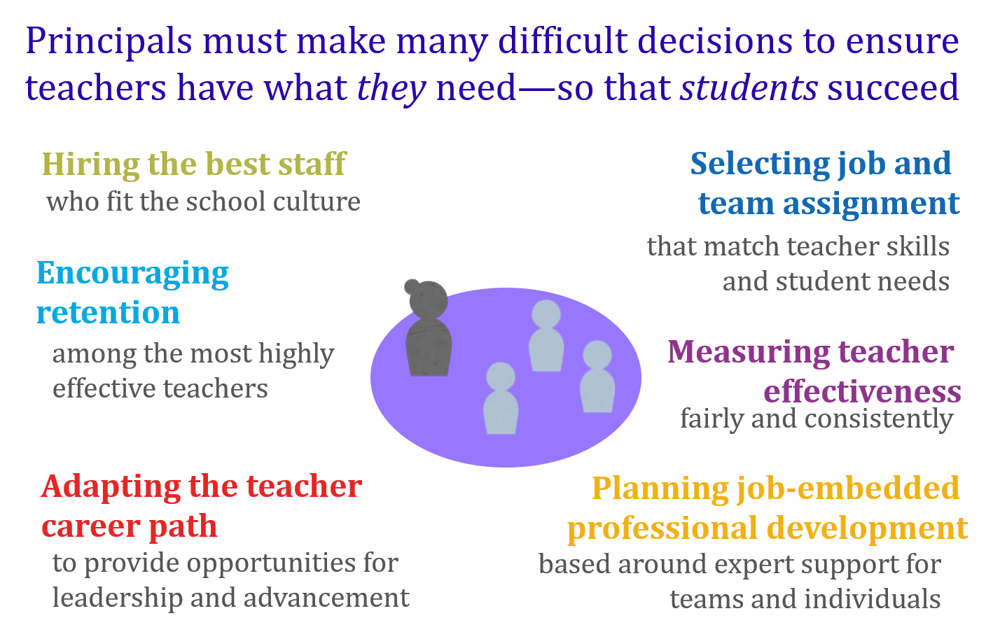
Human Capital District and School Networks
From: Education Resource Strategies, Talent Decision Planner 2016
Notes:
40% of teachers who left cited dissatisfaction with school leadership Boyd, et al., 2009
80% of principals’ current HR work is dealing with administrative procedures or with the lowest performers Milanowski & Kimball, 2010

Slide 18
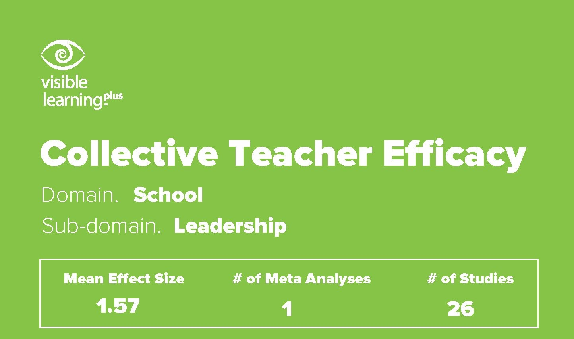
Teacher Efficacy =
the collective belief of the staff of the school in their ability to positively affect students.
John Hattie
Notes:
https://visible-learning.org/2018/03/collective-teacher-efficacy-hattie/

Slide 19
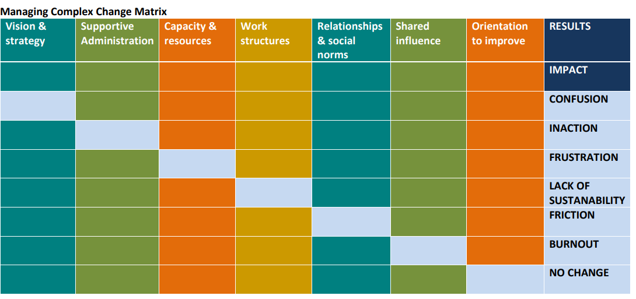
SC Collective Leadership Conditions Matrix

Slide 20
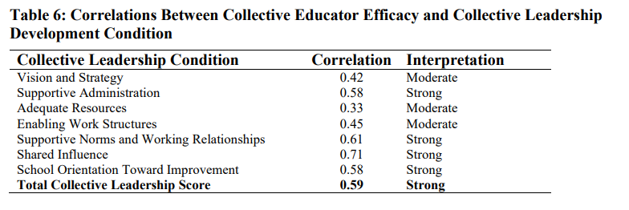
Comparing Efficacy and the Conditions

Slide 21
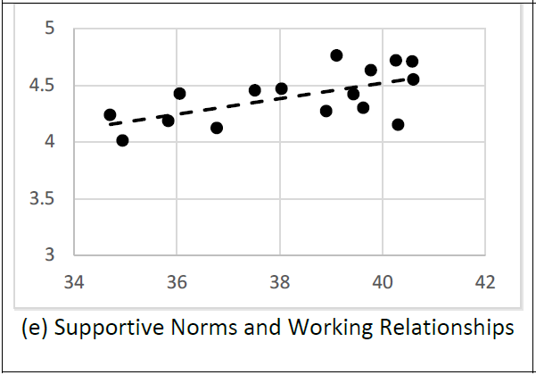
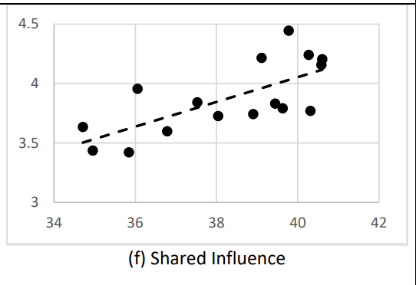
Collective Leadership (Efficacy) Score Compared to 7 Conditions Score
(n = 16 Collective Leadership schools)
Notes:
The correlation between collective leadership and collective educator efficacy is strong (.058) and is moderate to strong for all seven conditions. This is particularly promising as John Hattie and colleagues (2018) have found collective teacher efficacy to be the most influential factor on student outcomes. Supportive Norms and Relationships and Shared Influence are the strongest predictors of efficacy.

