Slide 1
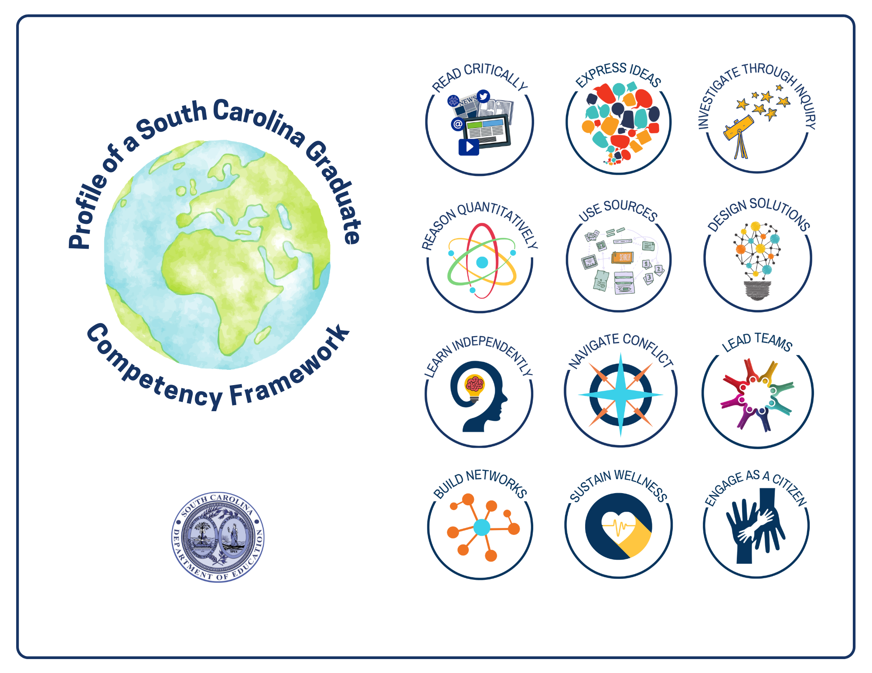
Profile of a South Carolina Graduate
Competency Framework
(internal source document)
REVISED Aug 2021

Slide 2



ACKNOWLEDGEMENTS
The Profile of a South Carolina Graduate Competency Framework was made possible by the South Carolina Department of Education, the leadership of the Office of Personalized Learning, and critical input from diverse stakeholders across the state who collaborated with our competency framework design partners, reDesign.
The competencies and skill continuums detailed in this document were created to make the Profile of a South Carolina Graduate actionable in every learning environment throughout our state. It is grounded in the belief that the Profile of a South Carolina Graduate is not simply an aspiration for the state, but a commitment to every child.
Special thanks to the trailblazers who have led the work of bringing the PSCG competencies to South Carolina’s students and providing feedback to inform updates to the framework.

Slide 3
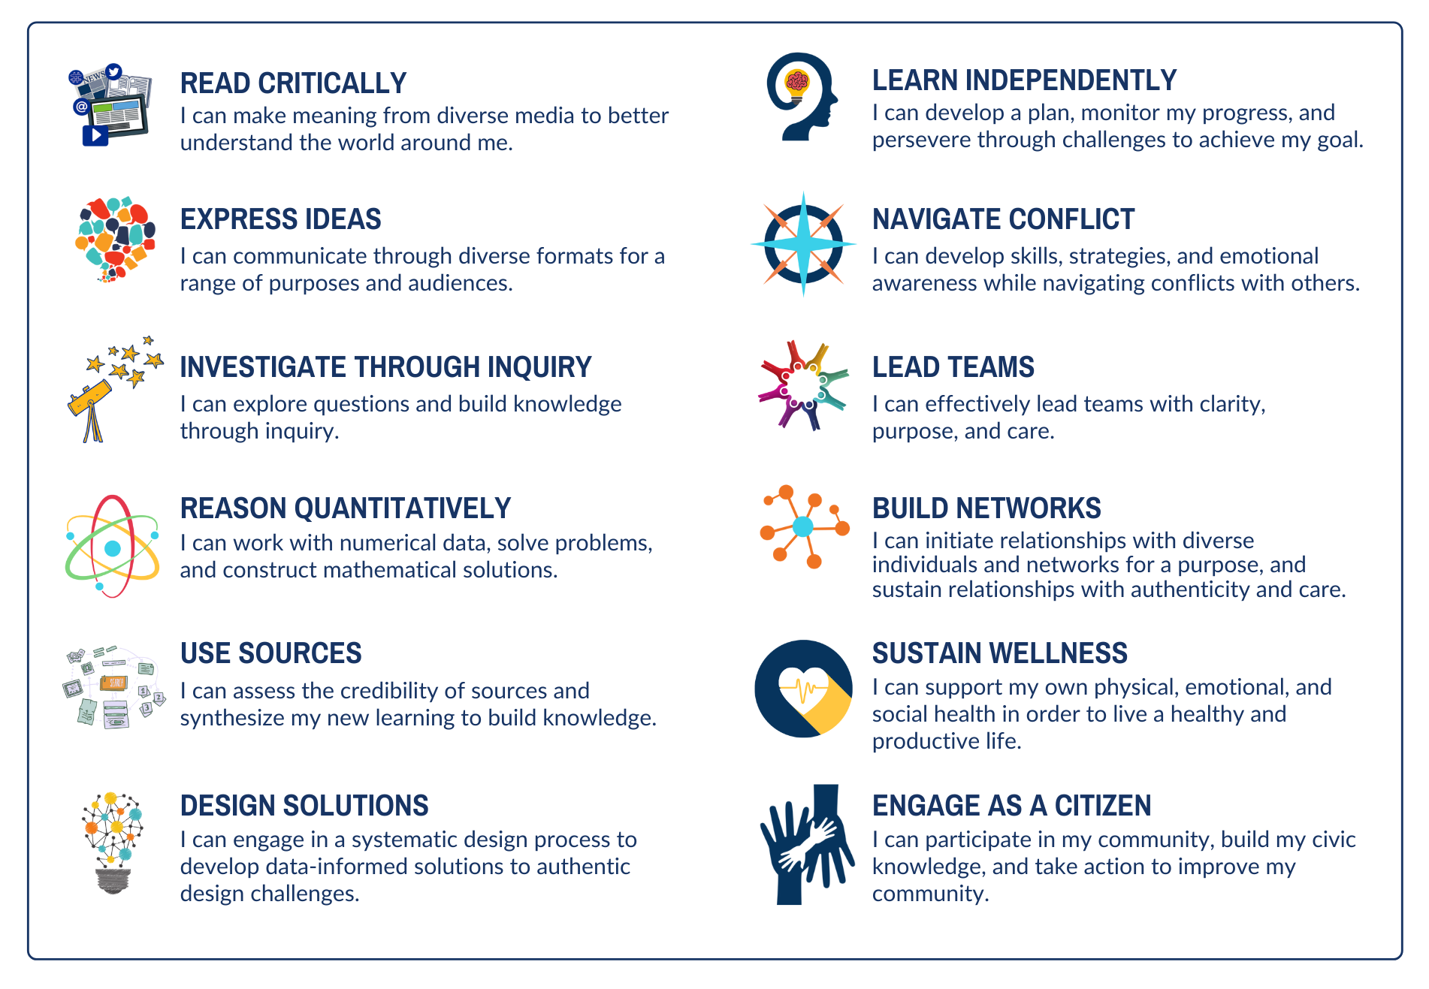
Profile of a South Carolina Graduate
COMPETENCY STATEMENTS

Slide 4
Profile of a South Carolina Graduate
COMPETENCIES & SKILLS MAP
READ CRITICALLY 1.1 Choose and apply strategies to make meaning 1.2 Evaluate main ideas or themes 1.3 Evaluate context, point of view, and purpose 1.4 Evaluate craft | EXPRESS IDEAS 2.1 Engage in academic discussion with others 2.2 Determine purpose and audience 2.3 Choose and develop my message 2.4 Develop craft 2.5 Prepare the medium 2.6 Finalize, practice, or prepare 2.7 Engage, respond, and reflect | INVESTIGATE THROUGH INQUIRY 3.1 Frame a research question 3.2 Form a hypothesis 3.3 Develop and strengthen the plan 3.4 Collect and analyze data 3.5 Share findings | REASON QUANTITATIVELY 4.1 Analyze and interpret data 4.2 Model and represent mathematical information 4.3 Solve problems 4.4 Construct explanations
USE SOURCES 5.1 Select and contextualize sources 5.2 Use systems to organize information gathered 5.3 Synthesize multiple sources | DESIGN SOLUTIONS 6.1 Define and explore a design challenge 6.2 Generate and select ideas for prototyping 6.3 Test and iterate | LEARN INDEPENDENTLY 7.1 Set goals and make plans 7.2 Monitor progress and adjust | NAVIGATE CONFLICT 8.1 Recognize and process my feelings 8.2 Recognize the feelings and perspectives of others 8.3 Work toward resolution
LEAD TEAMS 9.1 Build shared purpose and clarity 9.2 Mobilize the team to work effectively 9.3 Manage challenging issues 9.4 Reflect on learning and leadership | BUILD NETWORKS 10.1 Initiate purposeful connections 10.2 Nurture and sustain relationships | SUSTAIN WELLNESS 11.1 Understand my identity 11.2 Practice positivity and gratitude 11.3 Advocate for myself 11.4 Build physical health 11.5 Build life practices that foster health and wellness | ENGAGE AS A CITIZEN 12.1 Participate in community 12.2 Investigate enduring problems 12.3 Take action to improve my community

Slide 5

PROFILE OF A SOUTH CAROLINA GRADUATE CONNECTIONS
KNOWING HOW TO LEARN
COMMUNICATION, INFORMATION, MEDIA, & TECHNOLOGY
CRITICAL THINKING AND PROBLEM-SOLVING
INTEGRITY
SELF-DIRECTION
GLOBAL PERSPECTIVE

Slide 6

READ CRITICALLY 1.1
Choose and apply strategies to make meaning
LEVEL 1 | LEVEL 2 | LEVEL 3 | LEVEL 4 | LEVEL 5 | LEVEL 6
With guidance, I can make a connection between the story/source and my own life, ideas, or wonders. | I can make connections between the story/source and my own life, ideas, or wonders. With guidance, I can choose a fix-up strategy to help me if I get stuck (e.g., reread, use pictures or headings, read the words before and after). | I can make connections among one or more stories/sources, my own ideas, values, perspectives, or experiences. I can use learning strategies (e.g., question, synthesize, infer, determine importance) to make meaning of one or more stories/sources. If I get stuck, I can choose a fix-up strategy to help me get unstuck. | As I engage with “just-right” texts and other sources, I can actively use learning strategies to help me make meaning. I can notice when I’m struggling to make meaning (e.g., distracted, confused), and I can choose a strategy to help me adjust. | As I engage with middle or high school-level texts and other sources, I can use learning strategies to help me make meaning, self-monitor, and achieve my purpose (e.g., identify bias through questioning, draw key lessons for a book discussion by determining importance). | As I engage with a range of texts and sources that I encounter in the world (e.g., news articles, legal contracts, professional texts, advertisements, websites, books), I can use learning strategies to help me make meaning, self-monitor, and achieve my purpose.
Notes:
BACK TO MAP >>

Slide 7
READ CRITICALLY 1.2
Evaluate main ideas or themes
LEVEL 1 | LEVEL 2 | LEVEL 3 | LEVEL 4 | LEVEL 5 | LEVEL 6
I can give a summary of what the story/source is about. | I can give a summary of what the story/source is about. I can share my opinion about the main idea/topic/theme, and talk about or show how it connects to my own ideas and experiences. | I can give a summary of what the story/source is about, using details to help paint a picture. I can share my opinion about the main idea/claim/theme, and discuss how it connects to my own ideas and experiences, other sources I've read, or issues/events in the world. | I can use important details to summarize the story/source as I describe the main idea/claim/theme. I can share my opinion about the main idea/claim/theme, and the values it reflects. I can discuss how it connects to my own ideas and experiences, other sources I've read, or issues/events in the world. I can use details to talk about how well the main idea/claim/theme was developed through the content/plot/characters. | I can cite the most relevant and important evidence to summarize the story/source and explain the main idea/claim/theme. I can take a position about the main idea/claim/theme and its underlying values/beliefs/theories. I can draw on textual evidence, as well as personal experience or historical or contemporary issues/ events to defend my position. I can use evidence to analyze how well the main idea/claim/theme was developed through the content/plot/characters. | I can cite the most relevant or important evidence to present the main ideas/ claims/themes of a high school level story/source while succinctly summarizing its developments. I can critique the main idea/claim/theme, its underlying values/ beliefs/theories, and its potential or actual influence on society. I can draw on textual evidence to discuss issues of power within and beyond the text, making connections to contemporary issues, historical events, and/or institutional structures (e.g., political, religious, cultural, racial). I can critique how well developments engage readers and compel readers to espouse a particular way of thinking.
Notes:
BACK TO MAP >>

Slide 8
READ CRITICALLY 1.3
Evaluate context, point of view, and purpose
LEVEL 1 | LEVEL 2 | LEVEL 3 | LEVEL 4 | LEVEL 5 | LEVEL 6
I can share why I think the author created this story/source. | I can share my ideas about why the author created this story/source (e.g., persuade, inform, entertain). In stories, I can share reasons why the main character does or says things like I do (or unlike I do). | I describe what the author is trying to get me to think/feel, and I can think critically about whether I agree or disagree. I can use details from the text to talk about ways that I do/don't identify with the author or main character(s). I can discuss whose perspective is missing and possible reasons why. | I can figure out which values, beliefs, or ideas the author is trying to get me to agree with, and I can think critically about whether I agree or disagree. I can contrast the author or main characters' point of view with other points of view presented in or excluded by the source. I can discuss how different audiences may experience this story/source differently from me and why (e.g., social identity markers, such as race, religion, language, gender, class). | I can draw from textual evidence to analyze which values, beliefs, or ideas the author is trying to get me to agree with, evaluating sources for credibility (when applicable). I can contrast the author or main characters' point of view with other points of view or information presented, excluded, or misrepresented by the source. I can analyze examples of bias in the author's presentation of information, and assess the reliability of the author as a source. I can discuss how different audiences may experience this story/source differently from me and why. | I can draw from textual evidence to critique the values, beliefs, or ideas promoted by the author, evaluating sources for credibility (when applicable). I can contrast the author or main characters' point of view with others, and discuss the author's intent related to inclusion of different or conflicting information or points of view, and discuss the impact on the reader's perspective. I can analyze examples of bias in the author's presentation of information as well as other sources by or about this author, and argue for or against the reliability and credibility of the author as a source of information. I can discuss how different audiences may experience this story/source differently and why. I can analyze the relationship between the source and the historical or contemporary context in which it was created.
Notes:
BACK TO MAP >>

Slide 9
READ CRITICALLY 1.4
Evaluate craft
LEVEL 1 | LEVEL 2 | LEVEL 3 | LEVEL 4 | LEVEL 5 | LEVEL 6
With guidance, I can notice when the author made something stand out. I can share if it helped me or not. | I can look for ways the author/creator made something from the story/source stand out (e.g., bold text, something within a picture). I can talk about or show why I think they did that, and if it helped me or not. | I can talk about how certain words or phrases from the source stood out to me and had me thinking in a certain way. I can talk about how the text structure (e.g., problem-solution, cause and effect, time sequence) helped with my understanding | I can use examples to analyze specific techniques (e.g., words and phrases, text structure, soundtrack, lighting, casting) used by the author to focus my attention and/or make me think or feel a certain way. I can analyze how well the organizing structure of the source supports its purpose. | I can use examples to evaluate the most impactful techniques (e.g., rhetorical devices) used by the author to focus my attention, influence the way I think or feel, and advance a certain point of view. I can analyze how well the organizing structure and specific techniques used aligned to purpose. | I can critique the author's use of a variety of techniques to focus the audience's attention, develop a point of view, and advance her/his purpose. I can evaluate the effectiveness of the techniques employed, and how they contribute to the power, persuasiveness, or beauty of the source.
Notes:
BACK TO MAP >>

Slide 10

PROFILE OF A SOUTH CAROLINA GRADUATE CONNECTIONS
COLLABORATION & TEAMWORK
COMMUNICATION, INFORMATION, MEDIA, & TECHNOLOGY
INTERPERSONAL SKILLS
CREATIVITY & INNOVATION
CRITICAL THINKING AND PROBLEM-SOLVING

Slide 11

EXPRESS IDEAS 2.1
Engage in academic discussion with others
LEVEL 1 | LEVEL 2 | LEVEL 3 | LEVEL 4 | LEVEL 5 | LEVEL 6
When it's my turn, I can share what I think about the topic, or ask questions of my own. | I can come to the discussion ready to share. When it's my turn, I can share what I think about the topic, respond to others' comments, or ask questions of my own. I can respectfully listen without interrupting when others are speaking. | I can come prepared to the discussion. I can follow the established norms, respectfully listening without interrupting when others are speaking, and making sure I don't talk too much or too little. I can pose a question, or respond to a question or comment, in a way that shows my knowledge of the topic. | I can come prepared to the discussion. I can follow established norms for the discussion. I can pose one or more questions, or respond to a question or comment, about the topic to get more information about other people's ideas. I can respond to a question or comment by using evidence in a way that shows my knowledge of the topic or source. I can reflect on how well the discussion went and what I learned. | I can come prepared to the discussion. I can follow established norms for the discussion. I can pose one or more questions to get more information about other people's ideas. I can use evidence to support my perspectives or to clarify, confirm, or challenge those of others. I can reflect on how the reasons or evidence provided by others inform or change the way I am thinking. | I can come to the discussion having completed the prep work necessary, as well as extra reading or research on the topic or issue. I can co-create and follow established norms for the discussion. I can deepen and propel the discussion by posing insightful questions and by using specific evidence to support my perspectives or to clarify, confirm, or challenge those of others. I can integrate my additional reading and research by providing the group with new information, perspectives, insights, or relevant connections that build on my or others' ideas. I can reflect on how the reasons, evidence, insights or perspectives of others expand or evolve my thinking.
Notes:
BACK TO MAP >>

Slide 12
EXPRESS IDEAS 2.2
Determine purpose and audience
LEVEL 1 | LEVEL 2 | LEVEL 3 | LEVEL 4 | LEVEL 5 | LEVEL 6
With guidance, I can decide what I want to share and why it is important to me. | I can say who my audience is and why what I want to share is important. | I can determine my audience and state my purpose for expressing my ideas to my audience. | I can determine my audience and purpose. I can generate specific ideas for tailoring my message or delivery for my particular audience and purpose. | I can determine my audience and purpose. I can articulate the impact I hope to have on my audience. I can generate specific ideas for tailoring my message, format, or delivery for my audience and purpose, and for achieving my desired impact. | I can determine my audience and purpose. I can articulate my desired impact, and anticipate the impact these ideas will have on different audiences and/or my community, and craft my message in a responsible way. I can generate specific ideas and strategies for tailoring my approach for my audience and purpose, and for achieving impact.
Notes:
BACK TO MAP >>

Slide 13
EXPRESS IDEAS 2.3
Choose and develop my message
LEVEL 1 | LEVEL 2 | LEVEL 3 | LEVEL 4 | LEVEL 5 | LEVEL 6
I can choose the main thing I want to share about. I can choose the details I want to share. I can put the details in the order that makes sense. | I can choose the details I want to share. I can put the details in order. I can choose details that get my audience's attention. | I can choose a central message for my product/performance. I can use details and information that will help me achieve my purpose (e.g., inform, persuade, entertain). I can organize my work in a way that is easy for my audience to follow. I can use details to get my audience's attention and leave the audience with something to think about. I can express my idea(s) so my audience can relate. | I can choose a central message (e.g., thesis, claim, story, idea) for my product/performance. I can choose important details and/or evidence to develop my ideas (e.g., claims, characters, plot) in support of my purpose. I can organize my ideas to support my message and purpose, meet the needs of my audience, sustain my audience's attention, and leave my audience with something to think about. I can choose tools and techniques (e.g., word choice, phrasing, pictures, sound effects, tone) to help my audience connect with my message. | I can develop a central message for my product/performance that connects to an important theme, idea, or issue in the world. I can choose the most relevant or meaningful and important details, descriptions, and/or evidence to develop my ideas in support of my purpose, addressing conflicting or alternative ideas or perspectives (when applicable). I can organize my ideas and supporting content to get and sustain my audience's attention while encouraging them to think differently about familiar ideas, and provide my audience with a memorable conclusion/resolution. I can apply elements of author's/creator's craft (e.g., rhetorical devices, foreshadowing, dialogue, cinematic techniques) that help amplify my message for my audience. | I can develop a central message for my product/performance that connects to an important theme, idea, or issue in the world. I can choose the most relevant and important details, descriptions, and/or evidence to add depth or complexity to my ideas in support of my purpose (addressing conflicting or alternative ideas or perspectives when applicable). I can organize my ideas and supporting content to get and sustain my audience's attention while challenging or subverting their expectations and to provide the audience with an insight or implication in the conclusion/resolution. I can apply sophisticated elements of author's/creator's craft (e.g., artistic pacing, complex reflection, engaging dialogue) that illustrates my creativity and command of the genre, and helps amplify my message.
Notes:
BACK TO MAP >>

Slide 14
EXPRESS IDEAS 2.4
Develop craft
LEVEL 1 | LEVEL 2 | LEVEL 3 | LEVEL 4 | LEVEL 5 | LEVEL 6
With guidance, I can play, tinker, and experiment with materials, tools, and techniques for sharing my ideas. | I can play, tinker, and experiment with materials, tools, and foundational techniques to explore. I can observe models and mentor works to prepare for my own work. If I don't get the results I want, I can keep trying with support. | I can play, tinker, and experiment with materials, tools, and techniques to learn more about the craft. I can analyze models and mentor works and artifacts to learn more about the craft and the processes that underlie it. I can use specific vocabulary to describe the process used by me or others when creating a piece of work. If I don't get the results I want, I can keep trying or try a new approach, with support. | I can play, tinker, and experiment with materials, tools, and techniques to learn more about the craft, and develop my own sense of craft. I can evaluate models and mentor works and artifacts to learn more about the craft and the processes that underlie it. I can use specific terminology to describe the process I used and demonstrate it to others. If I don't get the results I want, I can keep trying or try a new approach. | I can play, tinker, and experiment with materials, tools, and techniques to develop a unique style or approach that represents my own voice and vision. I can adapt tools, conventions, and techniques to new/innovative uses. I can use precise terminology to describe the process I used and justify the choices I made, and demonstrate the process to others. I can critique models, exemplars, and mentor works to develop a critical stance toward the craft. If I don't get the results I want, I can use a variety of strategies to keep myself engaged in the task. | I can tinker, experiment, explore, and play, embracing the opportunity to create for its own sake and to learn from mistakes and happy accidents as I develop my unique style or approach that represents my voice and vision. I can move beyond convention to find new/innovative ways to use tools, conventions, and techniques and discover fresh means of expression. I can use precise terminology to situate my work in the larger context of my body of work and the craft itself. I can critique models, exemplars, and mentor works to develop a critical stance toward the craft. If I don't get the results I want, I can use a variety of strategies to keep myself engaged in the task until I achieve my desired results
Notes:
BACK TO MAP >>

Slide 15
EXPRESS IDEAS 2.5
Prepare the medium
LEVEL 1 | LEVEL 2 | LEVEL 3 | LEVEL 4 | LEVEL 5 | LEVEL 6
With guidance, I can create a draft. | With guidance, I can choose the best way to share my message with my audience (i.e., speaking, writing, showing). With guidance, I can learn from an example to get ideas for my own product/performance | I can choose the best format for reaching my audience (e.g., written story, presentation, video). With others, I can learn from high-quality examples and get ideas for my own product/performance | I can choose the most effective format for my specific purpose and audience. With others, I can learn from high-quality examples and get ideas for specific aspects of my product/performance. I can make choices about the features of my product/performance (e.g., data, pictures, music, software tools) and use of technology that help strengthen my message for my specific audience. | I can choose the most effective format for my specific purpose and audience. Using criteria, I can learn from high-quality examples and get ideas for specific aspects of my product/performance. I can make choices about the features of my product/performance and use of technology that help me strengthen or elaborate my message and positively impact my specific audience. | I can choose the most effective format for my specific purpose and audience. Using criteria, I can source and learn from exemplars, draw inspiration, and analyze format choice relative to purpose and audience. I can make choices about the features of my product/performance and use of technology that help me strengthen or elaborate my message and positively impact my specific audience. I can incorporate design decisions that show evidence of my original thinking.
Notes:
BACK TO MAP >>

Slide 16
EXPRESS IDEAS 2.6
Finalize, practice, or prepare
LEVEL 1 | LEVEL 2 | LEVEL 3 | LEVEL 4 | LEVEL 5 | LEVEL 6
I can use feedback to improve my work. | With guidance, I can use criteria to identify areas for improvement. I can use feedback to improve my work. I can make sure I've used complete sentences and punctuation in my speaking or writing. | I can self-assess against criteria to identify areas for improvement. I can use feedback to improve my product/performance. I can edit my final product to ensure it meets the guidelines provided by my teacher. I can practice or rehearse my performance before I share (when applicable). | I can self-assess against criteria to identify areas for improvement. I can use feedback to improve my product/performance for my specific audience and purpose. I can edit my final product to ensure it follows conventions and standards for the chosen genre. I can practice or rehearse my performance, and make one or more adjustments to prepare for my performance (when applicable). | I can self-assess against criteria to identify areas for improvement. I can gather and selectively use feedback from others, to improve my product/performance for my specific audience and purpose. I can edit my final product to ensure it follows conventions and standards for the chosen genre. I can practice or rehearse my performance, and make adjustments to prepare for my performance and to ensure supporting materials or supplies are ready (when applicable). | I can solicit general as well as targeted feedback based on my self-assessment, and selectively integrate feedback to improve my product/performance for my specific audience and purpose. I can edit my final product to ensure it follows conventions and standards consistent with the professional world, or breaks from standard conventions for a specific purpose or effect. I can participate in sufficient practice or rehearsal rounds to ensure a high quality performance, make adjustments to prepare for my performance, and ensure supporting technologies, supplies, and materials are ready (when applicable).
Notes:
BACK TO MAP >>

Slide 17
EXPRESS IDEAS 2.7
Engage, respond, and reflect
LEVEL 1 | LEVEL 2 | LEVEL 3 | LEVEL 4 | LEVEL 5 | LEVEL 6
I can share my ideas or work with others. With guidance, I can think about one thing I did well, and one thing I could improve for next time. | I can present or perform for an audience. I can reflect on what I did well, and identify one or more things I could improve for next time. | I can engage, present or perform for an audience, using what I know about my audience to tailor my approach. When applicable, I can respond to questions about my product or performance with clarity. I can reflect on strengths, as well as what I could improve for next time. | I can engage, present, or perform for an audience, drawing on my knowledge and preparation to tailor my approach. When applicable, I can respond to a range of questions (e.g., clarify, elaborate, critique) with clarity, selecting relevant details and supportive details. I can use criteria to evaluate my process, product, and/or presentation to identify areas of strength and areas for improvement. | I can engage, present, or perform for an audience, drawing on my knowledge and preparation to tailor my approach. I can use specific techniques or strategies that I’ve planned to help me achieve my purpose. When applicable, I can respond to a range of questions with clarity, selecting relevant data and supportive details. I can use criteria to evaluate my process, product, and/or presentation to identify areas of strength and areas for improvement. | I can engage, present, or perform for an audience, drawing on my knowledge, preparation, and experience to tailor my approach. I can use or adapt specific techniques or strategies that I’ve planned to help me achieve my purpose, making adjustments as needed to compel or connect. When applicable, I can respond to a range of questions with clarity and composure, selecting relevant data and supportive details that demonstrate responsiveness to my audience and help me achieve my purpose. I can collect and analyze feedback from my audience and/or use other relevant data or tools to determine whether my work achieved its desired impact.
Notes:
BACK TO MAP >>

Slide 18

PROFILE OF A SOUTH CAROLINA GRADUATE CONNECTIONS
PERSEVERANCE
KNOWING HOW TO LEARN
COMMUNICATION, INFORMATION, MEDIA, & TECHNOLOGY
SELF-DIRECTION
GLOBAL PERSPECTIVE
CRITICAL THINKING AND PROBLEM-SOLVING

Slide 19

INVESTIGATE THROUGH INQUIRY 3.1
Frame a research question
LEVEL 1 | LEVEL 2 | LEVEL 3 | LEVEL 4 | LEVEL 5 | LEVEL 6
Working together, I can notice things around me and ask questions about the way something works. | With guidance, I can notice things around me and then come up with a question that will help me learn more about a topic or about the way something works. | I can use observation to come up with a specific question that relates to a problem or situation that I am exploring. | I can use observations to come up with a testable/researchable question that addresses a problem or topic I am investigating. I can cite one or more relevant sources that I've used to explore the problem or topic. | I can use observations to come up with a testable/researchable question that addresses the problem or issue I am investigating. I can cite one or more relevant sources that I've used to explore the problem or topic, and provide a rationale for the inquiry in a way that shows my depth of knowledge on the topic | I can draw on diverse sources, including observational data, to formulate a testable/researchable question that addresses an enduring problem or issue in the field. I can provide a compelling rationale for the inquiry, citing relevant scientific theories/models, current academic research (including its limitations), and my own observations. My question challenges or advances current thinking on the topic or issue.
Notes:
BACK TO MAP >>

Slide 20
INVESTIGATE THROUGH INQUIRY 3.2
Form a hypothesis
LEVEL 1 | LEVEL 2 | LEVEL 3 | LEVEL 4 | LEVEL 5 | LEVEL 6
I can come up with ideas about why I think it works the way it does. | I can guess what I think will happen. | I can make a prediction about what will happen if a variable is changed. | I can formulate a hypothesis (e.g., "If...then..."), about what will happen when a variable is changed. | I can formulate a testable hypothesis that accurately describes relationships between dependent and independent variables. | I can formulate a testable hypothesis that accurately describes relationships between dependent and independent variables, and that is based on observations and/or scientific models, theories, or existing research.
Notes:
BACK TO MAP >>

Slide 21
INVESTIGATE THROUGH INQUIRY 3.3
Develop and strengthen a plan
LEVEL 1 | LEVEL 2 | LEVEL 3 | LEVEL 4 | LEVEL 5 | LEVEL 6
Working together, I can help create a step-by-step plan to help me gather new information to help us answer our question. We can review our plan and make improvements to it together. | With guidance, I can create a step-by-step plan to help me gather new information to help answer my question. I can use feedback to help me improve my plan. | Using a template or example provided, I can create a step-by-step plan for collecting data that will help me answer my question. From options provided for me, I can identify the best tools that will help me gather the data I need. I can use feedback to help me improve my plan. | Using a template or example provided, I can create a detailed and complete step-by-step plan for collecting the data that will help me answer my research question. With support, I can identify the best available tools and methods for collection. I can give and receive feedback to strengthen my plan and help others, too. | I can create a detailed and complete step-by-step action plan (e.g., lab procedures, primary research methods) that directly addresses my research question. I can identify the best available tools and methods for data collection and recording. I can give, receive, and integrate criterion-referenced feedback to strengthen my plan. | I can design a detailed, replicable investigation that directly addresses my research question. I can identify the best available tools and methods for data collection and recording, while addressing the level of accuracy these tools and methods involve. I can discuss the limitations of the study's design (e.g. number of trials, cost, risk, time). I can give, receive, and integrate criterion-referenced feedback to strengthen my plan.
Notes:
BACK TO MAP >>

Slide 22
INVESTIGATE THROUGH INQUIRY 3.4
Collect and analyze data
LEVEL 1 | LEVEL 2 | LEVEL 3 | LEVEL 4 | LEVEL 5 | LEVEL 6
Working together, we can follow our plan to gather data and record it. | I can follow my plan and record new information (e.g., observations, thoughts, ideas, using words or pictures). With guidance, I can notice and discuss important or interesting details in the new information. | I can follow my plan to collect data and record information. With guidance, I can organize my data into tables or graphs. I can point out and discuss important or interesting details about my data (e.g., patterns, outliers). | I can implement my data collection plan, while avoiding significant data collection errors (e.g., missed steps, insufficient samples, inaccurate recording) I can organize my data using graphical displays (e.g., maps, charts, graphs, tables). I can identify patterns and outliers in my data set, and explain what they mean in the context of my research question. | I can implement my data collection plan, while avoiding significant data collection errors. I can organize and represent my data using graphical displays, relevant digital tools, and basic mathematical analysis (e.g., mean, median, mode, variability). I can use a range of tools or strategies to identify and explain important relationships among variables/factors in the data. | I can implement my data collection with precision, gathering data from multiple diverse sources or repetitions of the experiment, and avoiding errors. I can organize and represent my data sets using graphical displays, statistical analysis tools and functions (e.g., slope, intercept, correlation coefficient for linear fits), and other relevant technologies. I can use a range of tools or strategies to identify and explain important relationships among variables/factors in the data, and to make sense of disconfirming data.
Notes:
BACK TO MAP >>

Slide 23
INVESTIGATE THROUGH INQUIRY 3.5
Share findings
LEVEL 1 | LEVEL 2 | LEVEL 3 | LEVEL 4 | LEVEL 5 | LEVEL 6
Working together, we can use details from our observations to answer our question. I can talk about what I learned from our experience. | With guidance, I can use details from my observations to help answer my question. I can explain what I learned from this inquiry process. I can share my finding orally or using pictures that I've organized in a purposeful way. | I can use evidence from my data (e.g., observations, measurements, patterns, outliers) to construct an answer to my research question. I can explain what I have learned through this experience, including how the new information has changed my thinking about the topic. I can present my ideas in a clear and logical order, and follow formatting and referencing guidelines. | I can explain my findings by citing evidence from my data set, as well as from other relevant sources. I can discuss the limits of the evidence I've used to support my findings. I can explain how my findings relate back to my research question. I can use formal language and present my ideas in a logical order, following formatting and referencing guidelines. | I can formulate an evidence-based claim about my findings, citing my data set and other relevant sources and using a formal, domain- specific language. I can present my ideas in a logical order, while following formatting and citation norms for my final product (e.g., MLA, APA). I can identify and discuss key limitations of my research design (e.g., single trial) or process (e.g., measurement error). | I can formulate an evidence-based claim about my findings, citing my data set and other relevant sources and using a formal, domain- specific language. I can justify my claim/s using evidence and reasoning, carefully distinguishing cause and effect and correlational relationships in the data. I can discuss key limitations of my research design and/or process, and possible implications for future research. I can follow the norms and conventions of technical writing in the field.
Notes:
BACK TO MAP >>

Slide 24

PROFILE OF A SOUTH CAROLINA GRADUATE CONNECTIONS
CREATIVITY & INNOVATION
CRITICAL THINKING AND PROBLEM-SOLVING
PERSEVERANCE
KNOWING HOW TO LEARN

Slide 25

REASON QUANTITATIVELY 4.1
Analyze and interpret data
LEVEL 1 | LEVEL 2 | LEVEL 3 | LEVEL 4 | LEVEL 5 | LEVEL 6
I can describe the patterns I see in a source of information. | I can describe the patterns I see in a data set. I can explain or show what I think it means and why. | I can identify and describe patterns and outliers in a data set. I can use reasoning and contextual information to explain what the data means. | I can identify patterns and outliers in one or more sources of data. I can use reasoning, math skills, and contextual information to draw inferences about the data and/or explain phenomena. | I can analyze data sets involving linear or nonlinear relationships, and use details about the data to explain relationships among variables. I can draw evidence-based inferences about the data to support a claim. | I can use systematic methods to identify and analyze patterns and outliers in one or more data sets. I can draw evidence-based inferences about the data, question others' conclusions, and/or make valid and reliable evidence-based claims. I can apply concepts of statistics and probability (e.g.,slope, intercept, correlation coefficient for linear fits) to analyze and characterize data from an investigation. I can determine the significance of the data as it relates to a hypothesis, working explanation, or relevant theory, as well as limitations of my analysis.
Notes:
BACK TO MAP >>

Slide 26
REASON QUANTITATIVELY 4.2
Model and represent mathematical information
LEVEL 1 | LEVEL 2 | LEVEL 3 | LEVEL 4 | LEVEL 5 | LEVEL 6
I can draw a picture that shows what I think the data means. | I can record what I see, and use and share pictures to explain my observations. | With guidance, I can identify important quantities in a situation and represent these relationships using such tools as diagrams, tables, graphs, flow charts, and formulas. I can explain how I have organized the data and what it shows. | I can accurately organize and display important quantities using correctly titled and labeled tables, charts, or graphical displays. I can explain my approach and rationale for how I have organized the information as well as what it shows. I can identify and describe important patterns observed in data. | I can accurately organize and display data using tables, charts, and/or graphs in print and electronic form, in order to represent either linear or nonlinear relationships. I can use descriptive vocabulary and appropriate analytical tools (e.g. best-fit functions, measures of central tendency) to discuss and analyze mathematical patterns. | I can accurately organize and display data using organizing tools and visual displays most relevant for the type of data generated. I can use descriptive vocabulary and appropriate analytical tools to discuss and analyze mathematical patterns, make evidence-based claims, or evaluate others’ conclusions. My representation of data is well-suited to a specific audience and purpose, and demonstrates insightful mathematical portrayal in a way that contributes to a deeper understanding by others.
Notes:
BACK TO MAP >>

Slide 27
REASON QUANTITATIVELY 4.3
Solve problems
LEVEL 1 | LEVEL 2 | LEVEL 3 | LEVEL 4 | LEVEL 5 | LEVEL 6
I can explain the problem in my own words. With guidance, I can try a way to solve it. | I can rephrase a problem in my own words (or gestures), and ask questions about the problem that help me break it down into smaller parts. I can try using a strategy (tinkering, pattern detection, visualizing) to come up with a solution. I can explain or show my approach. | I can organize the important information in a useful way (chart, table, graph) and ask questions about the problem to help me identify a starting point for solving it. I can choose and apply at least one problem-solving strategy to begin testing out a solution. I can explain why my answer is reasonable or not reasonable. | I can organize the important information in a way that helps me better understand the information, the problem, and/or how I should approach solving it. I can break down a problem into smaller parts, or use a simpler problem, to understand the underlying structure of the problem. I can use problem-solving strategies to come up with a solution to the problem, and test my solution, making corrections so that my solution is reasonable. | I can identify underlying mathematical structures in a real-world problem, organize important information, and identify additional information that would be helpful. I can apply one or more problem-solving strategies to build an effective and efficient solution, and test my solution using multiple numerical cases. I can make any needed corrections so that my solution is reasonable and free from computational errors. | I can identify underlying mathematical structures in a real-world problem, and gather and organize important information about the problem (e.g., assumptions, constraints, goals) to help me determine my approach. I can use relevant tools and problem-solving strategies to investigate the problem and develop a solution pathway, rather than rushing a solution attempt. I can develop an effective and efficient solution, and test my solution using multiple numerical cases, while attending to precision and to the meaning of quantities. When applicable, I can test conjectures using formal logic in connection to different representations in order to show proof.
Notes:
BACK TO MAP >>

Slide 28
REASON QUANTITATIVELY 4.4
Construct explanations
LEVEL 1 | LEVEL 2 | LEVEL 3 | LEVEL 4 | LEVEL 5 | LEVEL 6
I can explain the steps that I or someone (else) took to solve a problem. | I can state my answer to the problem. I can show the steps that I took to come to my answer. | I can state my answer to the problem using precise vocabulary and/or notation. I can explain the steps I took to come to my answer, and why my answer is reasonable or not reasonable. | I can state my answer to the problem using precise vocabulary and/or correct notation. I can explain the steps I took to come to my answer, the assumptions or limitations of my solution, and why my answer is reasonable. When applicable, I can evaluate someone else’s solution or steps. | I can provide important contextual information about the problem and state my solution to the problem, using precise language and/or correct notation. I can use details or evidence to construct an argument to support my solution to the problem. When applicable, I can evaluate others’ solutions and provide an explanation when a different solving process is also correct. | I can provide important contextual information about the problem and state my solution to the problem, using precise language and/or correct notation. I can use details or evidence to construct an argument to support my solution to the problem. I can respond to questions and critique about my solution directly and persuasively in a work-based or professional setting. When applicable, I can evaluate someone else's argument for a solution and determine whether there is evidence to support their argument.
Notes:
BACK TO MAP >>

Slide 29

PROFILE OF A SOUTH CAROLINA GRADUATE CONNECTIONS
KNOWING HOW TO LEARN
COMMUNICATION, INFORMATION, MEDIA, & TECHNOLOGY
SELF-DIRECTION
CRITICAL THINKING AND PROBLEM-SOLVING
CREATIVITY & INNOVATION

Slide 30

USE SOURCES 5.1
Select and contextualize sources
LEVEL 1 | LEVEL 2 | LEVEL 3 | LEVEL 4 | LEVEL 5 | LEVEL 6
I can choose a story or source to read or watch. With guidance, I can ask questions about the author or illustrator. | With guidance, I can choose a story or source that relates to a topic or question of interest. With guidance, I can pose questions to learn about the author/creator and how the story or source was created. | With guidance, I can learn and practice basic search methods (e.g., keywords/categories; databases; websites) to help me choose relevant and credible sources for my particular purpose. I can generate questions about the source (e.g., Who created it? Why was it created?) and practice ways to evaluate the accuracy of the source (e.g., look for supporting evidence, verify using other sources, check for bias) to determine whether it’s reliable. | I can use basic search methods to help me choose relevant and credible sources for my particular purpose. I can gather important information about the source(s) to evaluate their currency, relevance, authority, accuracy, and purpose (i.e., CRAAP test) and determine their reliability and usefulness for my particular purpose. | I can use criteria, relevant search methods, and tools to identify relevant and credible sources reflecting multiple points of view, for my particular purpose. I can assess the credibility of sources to determine their reliability and usefulness for my particular purpose, and note important gaps or limitations. | I can use advanced search criteria (e.g., affiliate institutions, times cited) and advanced search methods (e.g., academic journals, phrase searching, boolean operators) and tools to identify and select relevant and credible sources that reflect multiple points of view, for my particular purpose. I can assess the credibility of sources to determine their reliability and usefulness for my particular purpose, and note important gaps or limitations in my sources and their implications. I can attend to the impacts of bias in conventional research methods, and employ methods to help me gain a more global perspective and/or culturally inclusive sources (e.g., international searches, local community research) relevant to my purpose.
Notes:
BACK TO MAP >>

Slide 31
USE SOURCES 5.2
Use systems to organize information gathered
LEVEL 1 | LEVEL 2 | LEVEL 3 | LEVEL 4 | LEVEL 5 | LEVEL 6
With guidance, I can use pictures or notes to help me remember something important. | I can use pictures or words to note the key information that I have identified from a source. | I can make notes and organize key information that I have identified from multiple sources. | I can choose and apply a specific note-taking system to help me gather and organize important information (e.g., key facts, ideas, details, quotes) from multiple sources relevant to my purpose. My notes include complete citations. | I can choose and apply an effective note-taking system to help me gather, organize, and easily search important information across multiple sources to support my research purpose. My notes are organized in a purposeful way (e.g., distinguish between paraphrases, quotations, summaries, and personal thoughts) and include complete citations. | I can choose, apply, and adapt an effective note-taking system and set of relevant digital tools to help me gather, organize, search my research materials, and systematize aspects of my research process (e.g. Google Drive, Noodlebib, Asana) to help me achieve my research goals. My notes are purposefully organized, judiciously taken, and include complete citations.
Notes:
BACK TO MAP >>

Slide 32
USE SOURCES 5.3
Synthesize multiple sources
LEVEL 1 | LEVEL 2 | LEVEL 3 | LEVEL 4 | LEVEL 5 | LEVEL 6
With guidance, I can share something I learned that I didn't know before. | I can share what I learned about the topic from the source. | I can compare information from different sources about the same topic or question. I can make one or more new connections between the topic/question and the key information I have identified from one or more sources. | I can compare information from different sources that directly inform my research question. I can select key ideas and details to support an argument, explanation, solution, or artistic work. I can cite my sources. | I can synthesize ideas, claims, and supporting details and evidence from multiple, diverse sources. I can select key ideas and details to support an argument, explanation, solution, or artistic work that attends to diverse perspectives, counterclaims, and the breadth of available evidence with integrity. I can cite my sources using formatting consistent with the discipline. | I can synthesize ideas, claims, and supporting details and evidence from multiple, diverse sources, generating original insights relevant to my research question. I can select key ideas and details to support an argument, explanation, solution, or artistic work that attends to diverse perspectives, counterclaims, and the breadth of available evidence with integrity. I can cite my sources using formatting consistent with the discipline.
Notes:
BACK TO MAP >>

Slide 33
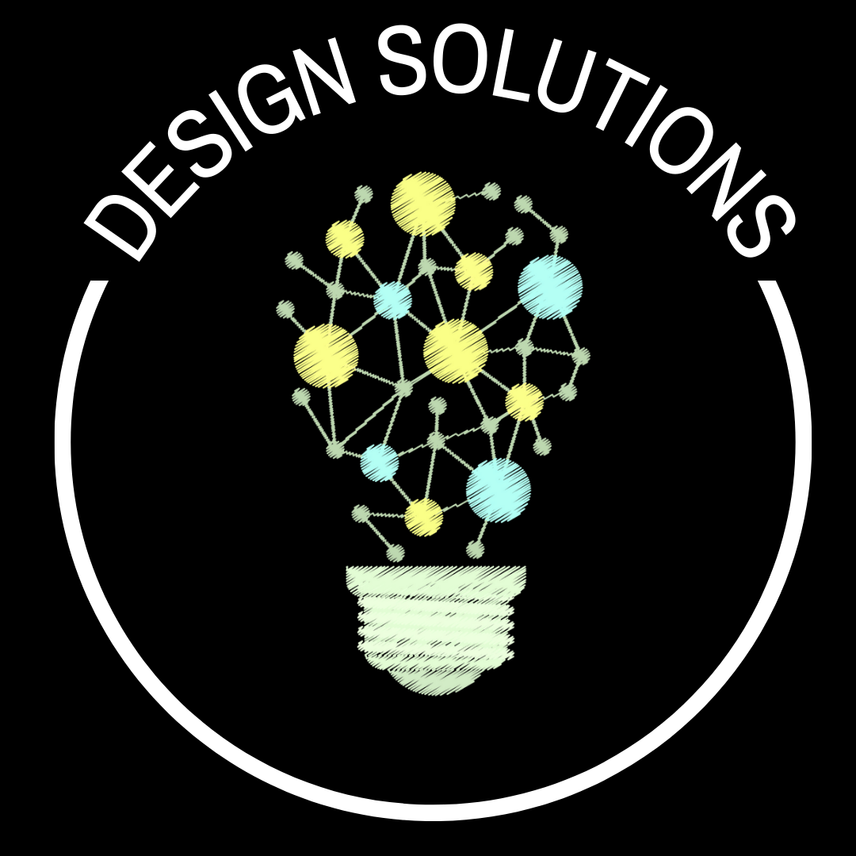
PROFILE OF A SOUTH CAROLINA GRADUATE CONNECTIONS
CRITICAL THINKING AND PROBLEM-SOLVING
COMMUNICATION, INFORMATION, MEDIA, & TECHNOLOGY
CREATIVITY & INNOVATION
GLOBAL PERSPECTIVE
SELF-DIRECTION
WORK ETHIC

Slide 34

DESIGN SOLUTIONS 6.1
Define and explore a design challenge
LEVEL 1 | LEVEL 2 | LEVEL 3 | LEVEL 4 | LEVEL 5 | LEVEL 6
I can work with others to notice and describe something around us that isn't working well and that could be improved. We can work together to create criteria for how well we can solve the problem. | I can identify and define a design problem or challenge. I can use information provided to help me understand the problem, and I can explain the problem and its importance in my own words. With guidance, I can create criteria for a successful design solution. | I can identify and define a design problem that has significance in my community. I can gather, record, and analyze information that will help me understand the problem and key design constraints (e.g., time, budget, ethical factors, impact on others). I can create criteria for a successful design solution. | I can identify and define a design problem that significantly impacts one or more communities. I can gather, record, and analyze information to help me understand the problem and its context, and to articulate key design constraints. I can draw on multiple relevant sources to inform my research (e.g., online data, user experience data).. I can create and prioritize design criteria. | I can identify, define, or reframe, an enduring and significant design problem. I can gather, record, and analyze information to help me understand the problem and its context from multiple perspectives, and to articulate key design constraints. I can draw on multiple relevant and diverse sources to inform my research, including original user experience data. I can create and prioritize detailed design criteria, while acknowledging important trade-offs. | I can identify, define, or reframe, an enduring and significant design problem that others have tried to address with limited success, using compelling, user-centered language. I can gather, record and analyze information to help me understand the problem, context, and stakeholders' concerns from multiple perspectives, and to articulate key design constraints. I can draw on multiple relevant and diverse sources to inform my research and strategically add depth to my understanding, including original user experience data that I've gathered independently or with a team. I can create and prioritize design criteria with critical detail and precision that minimize the impacts of trade-offs.
Notes:
BACK TO MAP >>

Slide 35
DESIGN SOLUTIONS 6.2
Generate and select ideas for prototyping
LEVEL 1 | LEVEL 2 | LEVEL 3 | LEVEL 4 | LEVEL 5 | LEVEL 6
I can work with others to make a list of possible ways to solve the problem, and pick one idea to try. I can work with others to build one prototype/model that aims to meet our success criteria. | I can come up with a list of different ways to solve the problem. I can select one realistic idea from the list that I plan to test out. I can build one prototype/model that aims to meet my success criteria. | I can generate a list of ideas for solving the problem, from practical to seemingly impossible. I can select one or two realistic ideas to prototype, while attending to my design criteria and constraints. I can build one prototype/model that meets most or all of my success criteria. I can select and use the best available materials or tools for developing the prototype. | I can use divergent thinking processes to come up with a diverse set of ideas and concepts for solving the problem. I can select one or two realistic ideas to prototype, while attending to my design criteria and constraints. I can build a prototype/model that meets my design criteria and constraints, drawing on additional research or mentorship support as needed. I can select and use the best available materials or tools for developing the prototype. | I can use divergent thinking processes to come up with a diverse set of ideas and concepts for solving the problem. I can select several realistic ideas to prototype with input from multiple stakeholders, to ensure they reflect the needs of the community, while attending to my design criteria and constraints. I can build a prototype/model that meets my design criteria and constraints, drawing on additional research or mentorship support as needed. I can design my prototype in a way that enables me to test or study different variables that impact the design. I can select and use the best available materials or tools for developing the prototype. | I can use divergent thinking processes to come up with a diverse set of ideas and concepts for solving the problem. I can select several realistic, diverse ideas to prototype with input from multiple stakeholders, to ensure they reflect the needs, values, or assets of the community, while attending to my design criteria and constraints. I can build a prototype/model that meets my design criteria and constraints, drawing on additional research, mentorship support, or my professional or academic network as needed. I can design my prototype in a way that enables me to test or study different variables that impact the design and its efficacy. I can select and use the best available materials or tools for developing the prototype.
Notes:
BACK TO MAP >>

Slide 36
DESIGN SOLUTIONS 6.3
Test and iterate
LEVEL 1 | LEVEL 2 | LEVEL 3 | LEVEL 4 | LEVEL 5 | LEVEL 6
With guidance, I can test our prototype/model to see how it works. With guidance, I can come up with ideas about how to improve our design. | I can test my prototype/model. I can make one or more improvements, based on what I learned during testing, and record results. | I can test my prototype/model. I can engage in improvement cycles (e.g., concept, feasibility), recording detailed data and documenting results. | I can test my prototype/model in different contexts and/or with diverse users. I can engage in improvement cycles, recording detailed data and results. I can eliminate one or more significant flaws through testing and modification. I can synthesize my findings and reflect on my design process. | I can test and iterate my prototype/model in different contexts with diverse users. I can engage in improvement cycles, recording detailed data, results, and key insights. I can eliminate one or more significant flaws and/or limitations through testing and modification, and produce a design that is inclusive of diverse users. I can synthesize my findings, and reflect on the design process and implications for future iterations. | I can test and iterate my prototype/model in a range of contexts that represent different ways to meet diverse user needs. I can engage in improvement cycles, recording detailed data, results, and insights, and drawing input from my community, key stakeholders, and/or professional or academic networks. I can eliminate all significant flaws and/or limitations through testing and modification, and produce a design that is inclusive of diverse users. I can synthesize my findings, and reflect on the design process and implications for future iterations.
Notes:
BACK TO MAP >>

Slide 37

learn independently
PROFILE OF A SOUTH CAROLINA GRADUATE CONNECTIONS
COLLABORATION & TEAMWORK
CRITICAL THINKING & PROBLEM SOLVING
INTERPERSONAL SKILLS
INTEGRITY
Notes:
BACK TO MAP >>

Slide 38

LEARN INDEPENDENTLY 7.1
Set goals and make plans
LEVEL 1 | LEVEL 2 | LEVEL 3 | LEVEL 4 | LEVEL 5 | LEVEL 6
With guidance, I can set a goal and determine the steps to reach the goal. | I can set a goal for a specific task or project. With guidance, I can create a step-by-step plan to achieve the goal. | I can create or co-create a SMART goal for a task or project, and describe success criteria in my own words. I can create a detailed plan for a project or task that breaks down the work into key milestones and dates. | I can create or co-create a SMART goal for a task or project, and describe success criteria in my own words. I can create a detailed plan for a project or task that breaks down the work in a detailed way, such as: milestones, dates, tasks and task owner/s, and estimated times. I can assess resources needed for successful completion (e.g., time, people, equipment). | I can create or co-create SMART goal(s) and success criteria for a task or project. I can anticipate challenges (e.g., limited resources, interpersonal or cultural "misses," decision-making protocols) and determine tools or processes to mitigate or avoid them. I can create a detailed plan for our project or task that breaks down the work in a detailed way. I can assess resources needed for successful completion, and implement progress- monitoring tools or routines. | I can create or co-create SMART goal(s) and success criteria for a task or project. I can anticipate challenges and determine tools or processes to mitigate or avoid them, while using data to make adaptations as needed. I can create a detailed plan for a project or task, and establish norms, routines, and protocols to optimize my workflow. I can assess resources needed for successful completion, and implement progress-monitoring tools or routines.
Notes:
BACK TO MAP >>

Slide 39
LEARN INDEPENDENTLY 7.2
Monitor progress and adjust
LEVEL 1 | LEVEL 2 | LEVEL 3 | LEVEL 4 | LEVEL 5 | LEVEL 6
With guidance, I can stop to check in with myself and see how I'm doing. With guidance, I can make one change that will help me reach my goal. | With prompting or support, I can stop to ask myself how I'm doing. Am I stuck? Do I need anything? Am I closer to my goal? With guidance, I can choose and make a helpful change. | I can pause to reflect on my learning process and progress toward my goal. I can choose and make a helpful change. If/when I get stuck, I can ask for help in a positive way. | I can regularly pause to reflect on my learning process and progress toward my goal. If I get stuck or distracted, I can recognize it quickly, and generate ideas about how to change my approach, environment, or get help. I can implement helpful change(s) and make additional adjustments as needed. | I can use personal routines and daily tools to monitor my learning process and progress toward my goal. If I get stuck or distracted, I can recognize it quickly, and generate ideas about how to change my approach, environment, or get help. I can implement helpful change(s) and make additional adjustments as needed. I can support others around me by contributing to a positive, productive work environment. | I can use personal routines and daily tools to monitor my learning process and progress toward my goal. I can anticipate and carefully avoid distractions or issues caused by my environment or approach, making adjustments as needed. I can use techniques to maintain my focus, energy, and motivation in healthy ways, and/or access the resources that I need. I can support others around me by contributing to a positive, productive work environment.
Notes:
BACK TO MAP >>

Slide 40

navigate conflict
learn independently
PROFILE OF A SOUTH CAROLINA GRADUATE CONNECTIONS
COLLABORATION & TEAMWORK
COMMUNICATION, INFORMATION, MEDIA, & TECHNOLOGY
INTERPERSONAL SKILLS
INTEGRITY
CREATIVITY & INNOVATION
Notes:
BACK TO MAP >>

Slide 41

NAVIGATE CONFLICT 8.1
Recognize and process my own emotions
LEVEL 1 | LEVEL 2 | LEVEL 3 | LEVEL 4 | LEVEL 5 | LEVEL 6
I can practice a way to calm myself (e.g., count to 10, separate myself, take a deep breath), with guidance. I can say how I feel. | With prompting, I can use a strategy to calm myself when I am feeling upset. I can identify the specific emotion(s) I am feeling. I can say why I feel what I feel. | I can use one or more strategies to calm myself when I am feeling upset. I can identify the specific emotion(s) I am feeling. With support, I can determine when I feel ready to talk to others about how I'm feeling. I can identify specific stressors or triggers that can cause me to be upset. | I can pause to notice and identify the specific emotion(s) I am feeling (e.g., What am I feeling? When did I start feeling this way? What is causing this feeling?), and I can use one or more strategies to calm myself. I can locate where in my body I feel my emotional response. I can determine when I feel ready to talk to others about how I'm feeling. I can anticipate specific stressors or triggers that can cause me to be upset. | I can pause to notice and identify the specific emotion(s) I am feeling without judgement, and I can use one or more strategies to calm myself down or prevent myself from feeling overwhelmed. I can locate where in my body I feel my emotional response. I can determine when I feel ready to talk to others about how I'm feeling, while continuing to monitor my emotional response. I can anticipate specific stressors or triggers, and practice healthy ways to process or avoid them. | I can pause to notice and identify the specific emotion(s) I am feeling without judgement, and I can use one or more strategies to calm myself down or prevent myself from feeling overwhelmed. I can locate where in my body I feel my emotional response. I can determine whether my emotional response is connected to a common stressor or trigger, and take into account what I need in order to process or differentiate external factors from the current situation. I can determine when I feel ready to talk to others about how I'm feeling, while continuing to monitor my emotional response. I can anticipate specific stressors or triggers, and develop healthy practices for processing or avoiding them.
Notes:
BACK TO MAP >>

Slide 42
NAVIGATE CONFLICT 8.2
Recognize the feelings and perspectives of others
LEVEL 1 | LEVEL 2 | LEVEL 3 | LEVEL 4 | LEVEL 5 | LEVEL 6
With help, I can listen to the reasons another person is feeling upset. I can show that I am listening. | When prompted, I can listen to the reasons another person is feeling upset. With guidance, I can show my understanding of what they've said (e.g., restate, paraphrase). | I can listen and observe body language to identify how another person is feeling. I can show understanding by expressing in my own words how the other person feels and why they feel that way. | I can listen without interrupting, and observe body language, to identify the feelings and perspectives of others. I can ask clarifying questions to better understand the other person's views or feelings, and to better understand the source of the conflict. I can show understanding by expressing in my own words how the other person feels and why they feel that way. | I can practice active listening and careful observation to use verbal, physical, and/or situational cues to identify the feelings and perspectives of others. I can ask clarifying and/or exploratory questions to better understand the other person's views or feelings, the source of the conflict, and any cultural or social identity factors that might be at play (e.g., values, language, gender-related or racial power dynamics). I can demonstrate empathy by connecting to, and expressing understanding of, the feelings and perspectives of others involved. | I can practice active listening and careful observation to use verbal, physical, and/or situational cues to identify the feelings and perspectives of others. I can ask clarifying and/or exploratory questions to better understand others' views or feelings, the source of the conflict, and any cultural or social identity factors that might be at play, using wait time as needed to ensure all relevant parties have had the opportunity to share. I can demonstrate empathy by connecting to, and expressing understanding of, the feelings and perspectives of others involved. I can work with others to fairly contextualize the conflict, differentiate intention from impact, and explain and/or validate the different experiences and/or perspectives among those involved, while surfacing interpersonal or institutional biases at play.
Notes:
BACK TO MAP >>

Slide 43
NAVIGATE CONFLICT 8.3
Work toward resolution
LEVEL 1 | LEVEL 2 | LEVEL 3 | LEVEL 4 | LEVEL 5 | LEVEL 6
I can say what happened. With guidance, I can share an idea for resolving the conflict. I can say (or show) I am sorry if/when I do something wrong or hurt someone. | I can use "I" statements to share what happened. I can share an idea for resolving the conflict that will be fair to everyone involved. I can say (or show) I am sorry if/when I do something wrong or hurt someone. | I can use "I" statements to explain the conflict. I can work together with others to determine fair and constructive ways to address a conflict. I can take responsibility for my actions by making amends to those I have hurt, and/or help implement a solution. | I can explain the conflict from multiple points of view. I can work together with others to determine and implement the most fair and constructive ways to address a conflict. I can take responsibility for my specific role in the conflict and make amends for anything I have done that has caused harm. | I can explain the conflict from multiple points of view, and help others understand the perspective of those harmed by the conflict. I can work together with others to determine and implement the most fair and constructive ways to address or process the conflict. I can take responsibility for my specific role in the conflict and make amends for anything I have done that has caused harm. | I can explain the conflict from multiple points of view, and help others understand the perspective of those harmed by the conflict. I can work together with others to determine and implement the most fair and constructive ways to address or process the conflict. I can help deescalate a situation by modeling, facilitating, and/or encouraging constructive language and actions in others. I can take responsibility for my specific role in the conflict and make amends for anything I have done that has caused harm.
Notes:
BACK TO MAP >>

Slide 44

Lead Teams
PROFILE OF A SOUTH CAROLINA GRADUATE CONNECTIONS
COLLABORATION & TEAMWORK
CRITICAL THINKING & PROBLEM SOLVING
COMMUNICATION, INFORMATION, MEDIA, & TECHNOLOGY
INTERPERSONAL SKILLS
INTEGRITY
Notes:
BACK TO MAP >>

Slide 45

LEAD TEAMS 9.1
Build shared purpose and clarity
LEVEL 1 | LEVEL 2 | LEVEL 3 | LEVEL 4 | LEVEL 5 | LEVEL 6
With guidance, I can help create a common goal. | I can help create a common goal. With guidance, I can explain the goal and what we hope to accomplish. | I can facilitate a team goal-setting process, using tools or information provided. I can work with my team to set a timeframe for our project. | I can facilitate a team goal-setting process, using tools or information provided, and ensure a shared understanding of the goal. I can work with my team to define key milestones and set due dates for each milestone. | I can facilitate a team goal- setting process, using tools or protocols I’ve selected, and ensure a shared understanding of the goal. I can work with my team to build a project plan that includes milestones, due dates, and key tasks by role. I can lead the team in assessing resources needed (e.g., time, people, equipment) for successful completion. | I can facilitate a team goal-setting process, using tools or protocols I’ve selected, and ensure a shared understanding of the goal and our collective purpose. I can work with my team to build a detailed and feasible project plan (e.g., milestones, due dates, and key tasks, roles). I can lead the team in assessing our readiness for the project, as well as assessing resources needed and establishing processes for monitoring our progress individually and collectively.
Notes:
BACK TO MAP >>

Slide 46
LEAD TEAMS 9.2
Mobilize the team to work effectively
LEVEL 1 | LEVEL 2 | LEVEL 3 | LEVEL 4 | LEVEL 5 | LEVEL 6
With guidance, I can help make sure we each understand our special job/role. | I can make sure each teammate understands their role or job before we begin. I can check in to see how my teammates are doing and if anyone needs help. | I can facilitate a process to make sure each team member has a role in which they can be successful. I can check in to see how my teammates are doing, and use criteria to give feedback. | I can facilitate a role identification and matching process to make sure each teammate is set up for success. I can check in to see how my teammates are doing, and I can use criteria to give specific, affirming, and actionable feedback. I can support and encourage team members. | I can facilitate a role identification and matching process to make sure each teammate is set up for success. I can regularly check in to see how my teammates are feeling and progressing, use criteria to give feedback. I can support and encourage team members. I can use data (e.g., progress data, team input) to monitor and make adjustments as needed,while reiterating shared expectations and goals. | I can facilitate a role identification and matching process to make sure each teammate is set up for success. I can regularly check in to see how my teammates are feeling and progressing, use criteria to give feedback, and norms, routines, and tools to optimize our collaboration. I can support and encourage team members in personalized ways, while creating ongoing, meaningful team-building opportunities. I can use data to monitor progress and make adjustments as needed, reiterating shared expectations and goals.
Notes:
BACK TO MAP >>

Slide 47
LEAD TEAMS 9.3
Manage challenging issues
LEVEL 1 | LEVEL 2 | LEVEL 3 | LEVEL 4 | LEVEL 5 | LEVEL 6
With guidance, I can stop and think about how we're doing as a team. If something isn't working right or we get stuck, we can ask for help from our teacher. | If I notice a problem, I can think about a helpful way to solve it. If we can't solve it together, I can ask my teacher for help. | If I notice a problem, I can analyze it to figure out its cause. I can work with others to determine and implement a solution or approach to try. If we can't solve it together, I can ask my teacher for help. | If I notice a problem or problem pattern, I can gather and analyze key data to determine the root cause(s). I can work with others to determine and implement a solution or approach. If we can't solve the problem, I can get advice or help from a trusted adult or peer. | If I notice a problem or problem pattern, I can gather and analyze diverse data to determine the root cause(s) (e.g., observation, discussion with team members). I can work with others to come up with several strategies for solving the problem, and select and implement the most promising solution or approach. If we can't solve the problem, I can get advice or help from a trusted adult or peer. | I can anticipate issues or complexities, based on my assessment of the team, project, or project parameters, and implement a prevention strategy. If I notice a problem or problem pattern, I can gather and analyze diverse data to determine the root cause(s). I can work with others to come up with several strategies for solving the problem or mitigating its impact, while effectively engaging and communicating with the team. I can engage in or facilitate difficult conversations with team members to resolve conflict.
Notes:
BACK TO MAP >>

Slide 48
LEAD TEAMS 9.4
Reflect on learning and leadership
LEVEL 1 | LEVEL 2 | LEVEL 3 | LEVEL 4 | LEVEL 5 | LEVEL 6
At the end of our project, I can say what I learned. I can explain what I liked and/or didn't like about our project. | As a team, we can talk about how well we did, and things we can do better next time. As the leader, I can think about how well I led the team, and what I could do better next time. | As a team, we can identify strengths in our final product or process of working together. We can identify several changes we would make if we could do the project again. As the leader, I can use specific examples or data from the project to identify strengths and area of growth. | As a team, we can discuss and reflect on the strengths and opportunities for growth in both our product and our process of working together. As the leader, I can reflect on strengths and opportunities for growth that relate to specific aspects of my leadership (e.g., communication, decision-making, problem-solving, team-building, project management). | As a team, we can discuss and reflect on the strengths and opportunities for growth in both our product and our process of working together. As the leader, I can reflect on strengths and opportunities for growth that relate to specific aspects of my leadership, as well as specific next steps I can take to build my skills or strategies in this area. | As a team, we can discuss and reflect on the strengths and opportunities for growth in both our product and our process of working together. I can create structured opportunities for team expressions of support, acknowledgement, or praise. As the leader, I can reflect on strengths and opportunities for growth that relate to specific aspects of my leadership, as well as specific next steps I can take to build my skills or strategies in this area.
Notes:
BACK TO MAP >>

Slide 49
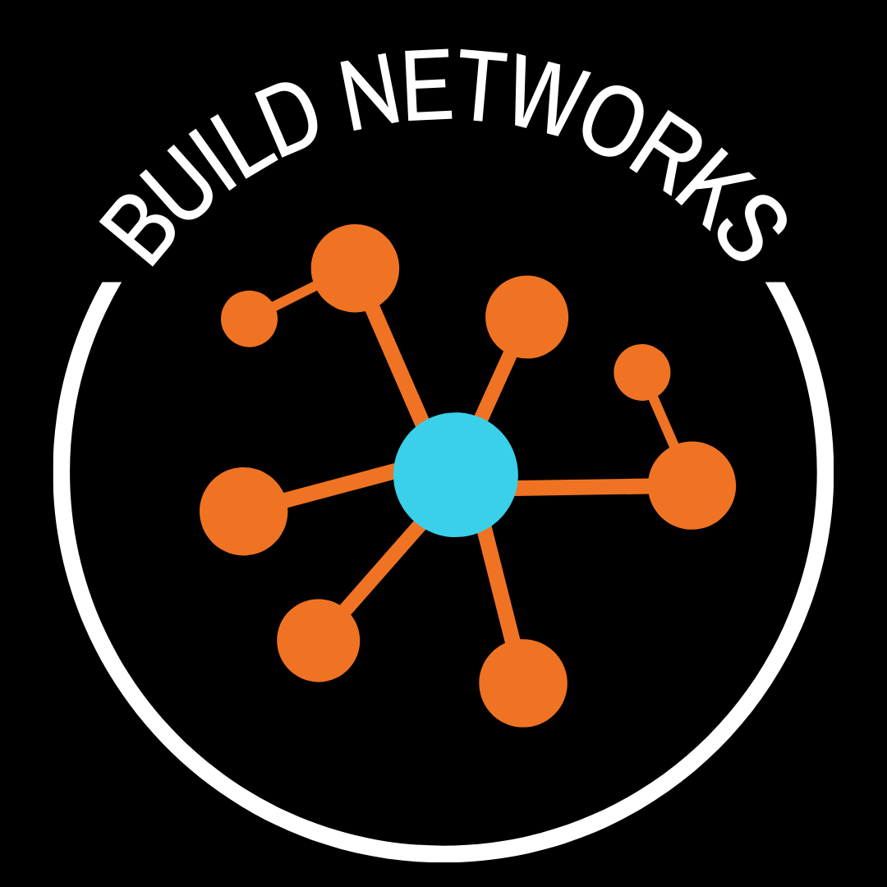
build networks
PROFILE OF A SOUTH CAROLINA GRADUATE CONNECTIONS
CREATIVITY & INNOVATION
COMMUNICATION, INFORMATION, MEDIA, & TECHNOLOGY
INTERPERSONAL SKILLS
INTEGRITY
SELF-DIRECTION
Notes:
BACK TO MAP >>

Slide 50

BUILD NETWORKS 10.1
Initiate purposeful connections
LEVEL 1 | LEVEL 2 | LEVEL 3 | LEVEL 4 | LEVEL 5 | LEVEL 6
In a safe setting, I can greet and play with other kids I don't know well. | With guidance, I can introduce myself to a new classmate or playmate whom I haven't met before. | I can kindly ask a classmate or teacher for help on something that I have noticed she or he knows how to do well. | I can intentionally initiate new relationships with peers who share my interests, as well as with peers who have different backgrounds or interests from mine. I can go out of my way to make sure someone feels included. | I can intentionally initiate new relationships with others who have interests, perspectives, or strengths that I can learn from. When opportunities arise, I can safely participate in experiences that help me meet new people with shared interests. | I can purposefully participate in diverse formal and informal networks of people who have interests, perspectives, experiences, or strengths that I can learn from. When opportunities arise, I can respectfully initiate contact with key individuals who could serve as a resource to me that relates to one of my goals, or with whom I may have a mutual interest. I can make a specific, reasonable request and respond to their reply with appreciation and understanding.
Notes:
BACK TO MAP >>

Slide 51
BUILD NETWORKS 10.2
Nurture and sustain relationships
LEVEL 1 | LEVEL 2 | LEVEL 3 | LEVEL 4 | LEVEL 5 | LEVEL 6
I can share my things (e..g, toys, supplies, snacks) with new friends. I can do something nice for a friend. | With guidance, I can invite a new friend to play a game or do an activity with me. I can share my toys or supplies with others. | I notice when a classmate or friend needs help, and I can offer my help to them, or find someone whom I think can help them. | I notice when someone around me needs help, and I can initiate a conversation, listen attentively, offer my help, and/or find someone whom I think can help them. | I notice when someone around me needs help, and I can initiate a conversation, listen attentively, offer my help, or find someone whom I think can help them. I can engage in regular acts of kindness to show my friends that I care. | I can use systems or tools to keep track of friends, colleagues, and acquaintances in my networks, and reach out periodically to stay in touch. I can respond when I notice someone around me needs help, while balancing personal and professional boundaries. I can develop a practice of reaching out to people in my life to acknowledge important life moments (e.g., birthdays, losses, life transitions) with thoughtful messages or acts of kindness.
Notes:
BACK TO MAP >>

Slide 52

sustain wellness
PROFILE OF A SOUTH CAROLINA GRADUATE CONNECTIONS
SELF-DIRECTION
CRITICAL THINKING & PROBLEM SOLVING
PERSEVERANCE
KNOWING HOW TO LEARN
Notes:
BACK TO MAP >>

Slide 53

SUSTAIN WELLNESS 11.1
Understand my identity
LEVEL 1 | LEVEL 2 | LEVEL 3 | LEVEL 4 | LEVEL 5 | LEVEL 6
I can say what I like to do in my free time. | I can share ways that I am similar to members of my family or community (e.g., the way I look, talk, think, act, believe). I can share about the things I like to do in my free time, and why I like them. | I can talk or write about different aspects of my identity and how they are expressed in my daily life (e.g., I'm an athlete, I love to spend time playing sports; I am part of the Deaf community, I use sign language to communicate with my family members; I am bilingual, I can speak with people in two different languages). | I can talk or write about the most central aspects of my identity, how they are expressed in my life, and how different aspects of my identity connect to one another. I can learn about and practice a new way to celebrate, express, or explore an aspect of my identity. | I can articulate multiple aspects of my identity, how they are expressed in my life, and how different aspects of my identity intersect and impact one another. I can examine a stereotype that relates to aspects of my identity, and counter it with truths about my life and experiences. I can practice and reflect on ways to celebrate, express, or further explore one or more aspects of my identity. | I can articulate multiple aspects of my identity, how they are expressed in my life and relationships, and how different aspects of my identity intersect and have evolved over time and with pivotal life experiences or decisions. I can examine and confront stereotypes that relate to aspects of my identity, and begin to pursue ways I could make contributions to the literary traditions, research, and/or seminal works of my cultural background. I can regularly practice ways to celebrate, express, and/or explore aspects of my identity with others, based on how my needs and interests evolve over time.
Notes:
BACK TO MAP >>

Slide 54
SUSTAIN WELLNESS 11.2
Practice positivity and gratitude
LEVEL 1 | LEVEL 2 | LEVEL 3 | LEVEL 4 | LEVEL 5 | LEVEL 6
I can think of things I am thankful for. | I can think of things I am thankful for. When I think someone did a good job, I can tell them. | I can think of things I am especially thankful for in my life. I can use details and examples to tell others what I like or admire about them. | I can reflect on a range of things I'm grateful for from different aspects of my life (e.g., friendships, school, family, new learning, access to resources). I can regularly express appreciation of positive things I notice or experience in others. I can reflect on something I like about myself. | I can regularly reflect on a range of things I'm grateful for from different aspects of my life. I can regularly express appreciation of positive things I notice or experience in others. I can reflect on something I appreciate about myself and/or that I have recently done well. I can identify the positive opportunity in a new or difficult situation, and practice positive self-talk. | I can develop a daily gratitude practice through which I regularly reflect on and remember that which I'm grateful for, and express appreciation to others in diverse ways. I can reflect on attributes I appreciate about myself or things I have recently done well. I can regularly practice positive framing, and seize the positive opportunity in a new or difficult situation.
Notes:
BACK TO MAP >>

Slide 55
SUSTAIN WELLNESS 11.3
Advocate for myself
LEVEL 1 | LEVEL 2 | LEVEL 3 | LEVEL 4 | LEVEL 5 | LEVEL 6
When I need something, I can nicely ask someone for help (without being too shy to ask). | I can make friends who make me feel happy. When I need something, I can nicely ask someone for help (without being too shy to ask). If someone says or does something to hurt me, I can step away and ask a trusted adult for help. | I can seek out and make friends with people who make me feel happy and good about myself. When I need something or need help, I can ask. If I think I'm in an unsafe situation that doesn't feel right, I can stop to notice how I'm feeling, step away, and go find the right person to help me. | I can notice which relationships in my life feel positive or negative, and I can make needed changes (e.g., speak up to address the problem directly, spend less time with negative people) to help me stay in a more positive environment. I can build my knowledge to help me advocate for my needs and interests. If I feel unsafe or treated unfairly, I can take action promptly (e.g., address the issue, leave the situation, inform the appropriate adult). If I am feeling anxious or sad, and I have trouble overcoming it, I can talk to someone I trust about it (e.g., counselor, teacher, parent). | I can regularly reflect on and evaluate my relationships, and I can make needed changes to help me stay in a more positive environment. I can build my knowledge to help me advocate for my needs and interests clearly and effectively. If I feel unsafe or treated unfairly, I can take action promptly. If/when I don't feel well physically or emotionally (e.g., anxious, intensely stressed, depressed), I can promptly seek out the resources, trusted adults, or experts who can help me. | I can prioritize positive, healthy relationships and employ strategies to improve or minimize the impact of difficult and necessary relationships. I can build my knowledge and relationships with key individuals to help me advocate for my needs and interests effectively. If I feel unsafe or treated unfairly, I can take action promptly and escalate the issue if needed through proper channels. I can monitor my own physical and mental health and promptly seek out the resources, trusted adults, or experts who can help me whenever I need it.
Notes:
BACK TO MAP >>

Slide 56
SUSTAIN WELLNESS 11.4
Build physical health
LEVEL 1 | LEVEL 2 | LEVEL 3 | LEVEL 4 | LEVEL 5 | LEVEL 6
I can play active games with others. | I can play active games that I like to play with my friends or family members. | I can play active games that I like to play with my friends or family members. I can talk about the benefits of physical activity. | I can engage in active play, sports, or exercise on my own or with others. With guidance, I can help create and follow a fitness plan based on the results of a health-related fitness assessment. I can analyze the connections between fitness and overall physical and mental health. | I can engage in active play, sports, or exercise on my own or with others. I can design and implement a program to address one or more goals or areas of weakness based on the results of a health-related fitness assessment. I can analyze and explore the connections between fitness and overall physical and mental health in my own life. I can develop a plan for overcoming a new physical challenge | I can engage in physical activity that aligns to my goals or interests, and/or gives me a way to express an aspect of my identity. I can use data and self-knowledge to design and share with others an exercise program that supports specific physical and mental health goals. I can develop and implement a plan for overcoming a new physical challenge, and I can monitor and reflect on my progress. I can use my own approach to physical challenges to assist and coach others.
Notes:
BACK TO MAP >>

Slide 57
SUSTAIN WELLNESS 11.5
Build life practices that foster health and wellness
LEVEL 1 | LEVEL 2 | LEVEL 3 | LEVEL 4 | LEVEL 5 | LEVEL 6
With guidance, I can try something new and see how I like it. | With guidance, I can try something new and see how I like it. I can notice if I eat something and I don't feel well after (e.g., stomach ache, rash, headache), I can tell someone. | I can try new things (e.g., foods, activities, books) to find out what I like and don't like. I can start noticing patterns if something around me or something I've eaten makes me feel sick (e.g., stomach ache, headache), and I can tell my caregiver and/or another trusted adult. | I can set a personal goal related to exercise, healthy eating, or improving the quality of my sleep, and I can monitor my progress toward it. I can recognize triggers that lead to unhealthy thoughts or behaviors. I can make time for activities that make me feel joy or pride. I can start tracking if/when certain food or environmental allergens (e.g., pollen, pets) start to make me feel sick, and I can actively avoid them, speaking up when I need to to let people know. | I can set a personal goal related to exercise, nutrition, or sleep, and implement one or more new strategies or routines to help me achieve my goal. I can recognize triggers and/or negative influences that lead to unhealthy thoughts or behaviors. I can regularly invest time in the relationships and activities that make me feel joy, pride or a sense of purpose. I can investigate which specific foods, ingredients, or food groups might be incompatible with my particular body chemistry (e.g., allergens, sugars, gluten), and I can actively try to avoid them. | I can develop and implement healthy routines in my life that help me achieve my goals related to exercise, nutrition, sleep, social engagement, and financial independence. I can monitor my own overall sense of wellness, recognize triggers and/or negative influences that lead to unhealthy thoughts or behaviors, and implement strategies to help me avoid them and/or build circles of relational support. I can regularly invest time in the relationships, practices, and activities that make me feel joy, pride or a sense of purpose. I can investigate which foods, ingredients, or food groups might be incompatible with my particular body chemistry (e.g., allergens, sugars) and follow a dietary plan to optimize my health.
Notes:
BACK TO MAP >>

Slide 58

engage as a citizen
PROFILE OF A SOUTH CAROLINA GRADUATE CONNECTIONS
COLLABORATION & TEAMWORK
CRITICAL THINKING & PROBLEM SOLVING
COMMUNICATION, INFORMATION, MEDIA, & TECHNOLOGY
CREATIVITY & INNOVATION
GLOBAL PERSPECTIVE
INTERPERSONAL SKILLS
SELF-DIRECTION
INTEGRITY
Notes:
BACK TO MAP >>

Slide 59

ENGAGE AS A CITIZEN 12.1
Participate in Community
LEVEL 1 | LEVEL 2 | LEVEL 3 | LEVEL 4 | LEVEL 5 | LEVEL 6
With guidance, I can learn and practice one or more ways to help make those around me feel welcome. | I can help lead or participate in an activity with others in a way that ensures each person is included and treated with fairness. I can reflect on what worked well, and what could be done differently next time to make sure everyone felt included and treated fairly. | I can plan and implement specific ways to lead or participate in an activity or project with others in a way that promotes a sense of fairness, belonging, and an appreciation for different ideas or points of view (e.g., norms, initial framing, reminders, structured opportunities for everyone to share or contribute). I can reflect on what worked well and what could be improved. | I can develop and practice a set of personal strategies for helping to promote fairness, belonging, and appreciation for difference among my different peer groups (e.g., classmates, extracurriculars, sports teams). I can practice opportunities to acknowledge the unique value of someone's contributions that stem from a perspective, life experience, or cultural identity different from my own. | I can develop and practice a set of personal strategies for promoting fairness, inclusivity, and appreciation for difference in a range of social or cultural contexts. I can practice opportunities to acknowledge the unique value of someone's contributions that stem from a perspective, life experience, or cultural identity different from my own. I can recognize and reflect on an experience when cultural differences in a group or team create benefit to the group. I can notice when one or more differences (e.g., related to identity, culture, language, life experience, ability) might lead to misunderstanding or discomfort in the group, and I can make or encourage adjustments to ensure inclusivity. | I can develop and practice a set of personal strategies and commitments for building my own cultural and historical knowledge across lines of difference, and for promoting fairness, inclusivity, and appreciation for difference in both personal and professional contexts. I can develop a practice of acknowledging the value of the contributions and perspectives of those from a cultural identity different from my own. I can encourage and participate in the formation of culturally diverse teams to ensure representation and to create opportunities to leverage the strengths in diversity. I can notice when one or more differences might lead to misunderstanding or discomfort in the group, and I can make or encourage adjustments to ensure inclusivity.
Notes:
BACK TO MAP >>

Slide 60
ENGAGE AS A CITIZEN 12.2
Investigate enduring problems
LEVEL 1 | LEVEL 2 | LEVEL 3 | LEVEL 4 | LEVEL 5 | LEVEL 6
I can learn about different ways to solve the problem. | I can learn about different ways to solve the problem. I can talk about (or show) the different roles (e.g., teacher, parents, classmates, principal) that could help solve the problem in different ways. | I can learn about the different roles of government and community groups/members as it relates to the problem. I can learn about possible solutions to the problem, and what roles different parties would play in solving the problem. | I can learn about the different roles of government, businesses, and community groups/members as it relates to the problem, and examine different levers of power for making change. I can learn about possible solutions to the problem, and analyze how different solutions involve and impact different parties. I can synthesize the main lessons that can be drawn from my investigation. | I can evaluate the roles of government, private sector, and citizen sector in creating or enabling the problem, and I can evaluate their different levers of power for solving the problem. I can study similar change efforts to help me identify viable solutions to the problem, and analyze how different solutions involve and impact different parties. I can synthesize key insights that can be drawn from my investigation. | I can evaluate the historical and contemporary roles of government, private sector, and citizen sector in creating or enabling the problem, and I can evaluate their different levers of current power for solving the problem. I can evaluate past efforts to solve this problem, or a problem like it, to help me identify viable solutions and effective strategies for facilitating change. I can synthesize key insights and cautionary or inspirational lessons that can be drawn from my investigation.
Notes:
BACK TO MAP >>

Slide 61
ENGAGE AS A CITIZEN 12.3
Take action to improve my community
LEVEL 1 | LEVEL 2 | LEVEL 3 | LEVEL 4 | LEVEL 5 | LEVEL 6
With guidance, I can take steps to solve the problem. I can reflect on how well it worked out. | I can come up with a plan for how I can help solve the problem or improve the issue. With guidance, I can take action to help others by implementing my plan. I can reflect on what I learned through implementation of my plan, and how my actions impacted the situation. | Drawing on insights from my investigation, I can come up with a plan for solving the problem or improving the situation for specific community members. My actions taken are positive and constructive. I can reflect on what I learned through implementation, how my actions impacted the situation, and what next steps I could take. | Drawing on insights from my investigation, I can come up with a plan that engages other stakeholders in solving the problem or improving the situation. My actions taken are positive, constructive, and demonstrate my understanding of my community. I can reflect on what I learned through implementation as well as what I could have done differently, how my actions impacted the situation, and what next steps I or others could take. | Drawing on insights from my investigation, I can come up with a plan that engages multiple stakeholder groups, including community leaders, elders, and other officials, in solving the problem or improving the situation. My actions taken are positive, constructive, and advance the values of my community. I can reflect on key learnings through implementation, and evaluate the impact of my actions on the issue, the effectiveness of my strategy, and what next steps I or others could take. | Drawing on insights from my investigation, I can come up with a plan that engages multiple stakeholder groups, including community leaders, elders, and others beyond the local community (e.g. government officials and private sector entities), in solving the problem or improving the situation. My actions taken are positive, constructive, and embody the values of my community. I can reflect on key learnings through the experience, and evaluate the impact of my actions on the problem, the effectiveness of my strategy, and the steps that different stakeholders should take to continue to impact or resolve the problem.
Notes:
BACK TO MAP >>

