Slide 1

Office of Career and Technical Education
Fall Update 2021
October 5, 2021

Slide 2

CTE Without Limits
  Principle 1: Each Learner Engages in a cohesive, flexible, and responsive career preparation ecosystem.
  Principle 2: Each learner feels welcome in, is supported by, and has the means to succeed in the career preparation ecosystem.
  Principle 3: Each Learner skillfully navigates their own career journey
  Principle 4: Each learner’s skills are counted, valuable, and portable.
  Principle 5: Each learner can access CTE without borders.

Slide 3
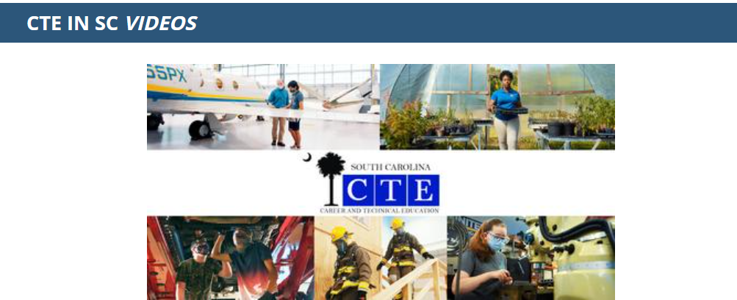
CTE PR Campaign
  Main Video
  Global Logistics and Supply
  Aerospace Engineering
  Health Science
  Agriculture
  Automotive Technology

Slide 4




Office Career and Technical Education & Student Transition Services
Anna Duvall, School Counseling
Jimmy Deal, SCOIS
Heather Goff, SCOIS
Laura McNair, Accountability

Slide 5
CTE in Numbers 2020-2021
There were 14,906 CTE Completers which is a decrease of 7% from 2019-2020.
There were 15,604 CTE programs completed with is a decrease of 7%.
56% of the 9,858 CTE Completers attained at least one industry certification which is an increase of 10% in 2019-2020.
93% of all 12th grade CTE completers graduated with a SC High School Diploma.

Slide 6
CTE in Numbers 2020-2021 (cont’d.)
55% of CTE Completers attained a “Silver” on the WIN Career Readiness Assessment which is an increase of 16% from 2019-2020.
17% of all high school students in grades 9-12 earned an industry credential which is an increase of 3% from 2019-2020.
South Carolina ranked as one of the top 2 in the nation in broadening the participation in Computer Science which is an increase from 80% in participation in 2019-2020 to 92% participation in 2020-2021.

Slide 7
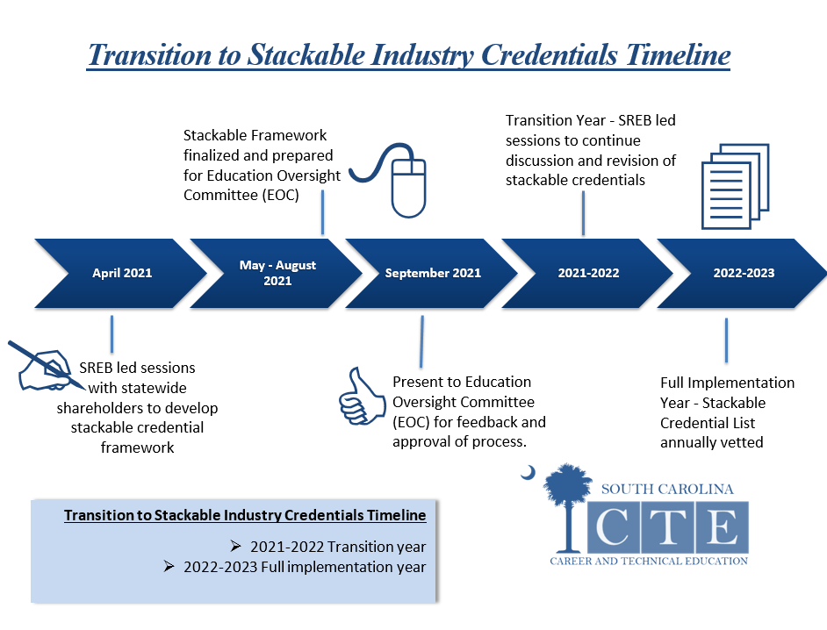
Transition to Stackable Industry Credentials Timeline

Slide 8
The Overarching Goal
Postsecondary
Career Advancement
Additional Credentials
Create a tiered system that communicates the value of advanced credentials
Provide an organized public facing system that can be used to communicate expectations by pathway and/or occupation
Career Pathway
Program of Study
Career Advancement
Bachelor’s Degree
Relevant WBL Experiences
Career Advancement
Associate Degree
Career Advancement
Certificate Program
Secondary
Employment
High School Diploma & Related Certifications
Middle School
Career Exploration

Slide 9
South Carolina’s Proposed Tiering Language
Tier 1—Introductory
1. The credential measures basic skills.
Tier 2—Intermediate
Tier 3—Career Ready
There is transparent evidence the competencies held by the credential holder align with the anticipated job opportunities.
2. The credential is recognized by local/regional industries.
3. The credential can be obtained in the early stages (first or second course) of a program of study.
The credential is aligned with industry-recognized standards.
The credential is endorsed by a national industry or trade association or a major employer in the state.
The credential holder is given job consideration.
The credential leads to improved social outcomes such as improved health and well-being.
The credential is required for employment or advanced training.
The outcomes for credential holders are wage gains, promotion, or retention. (Family sustaining wage for South Carolina)
The credential leads to additional education and training. (Stackable)
The credential is granted to those that complete a training program, and related assessments are administered by a third party with no connection to the test-taker.

Slide 10
WINLEARNING CAREER READINESS ASSESSMENT
WIN Career Readiness Assessment will be administered during the Fall of 2021. This will be the final administration. A new test will be procured for Spring 2022.
Districts and schools should consult with the State Department of Education Office of Finance for any payment to WINLearning for assessments.
Districts and schools should consult the Office of Career and Technical Education for questions regarding the usage of the WINLearning Software and/or any additional funding allocated for the use of other materials in preparation for the WIN Career Readiness Assessment.

Slide 11
CTE PRIORITIES 2021-2022
Elevating Career and Technical Education Statewide
High Quality CTE Programs
Student Transition into Post Secondary Opportunities:
  School Counseling
  Accountability
  Student Interest
Work-Based Learning
Stackable Framework for Industry Recognized Credentials
Emerging Technologies aligned with labor market needs across career clusters:
  Artificial Intelligence & Data Sciences
  Micro-Credentialing in Computer Science

