Slide 1
2018 Education and Business Summit Career Readiness Accountability
Kama. J. Staton
South Carolina Dept. of Education

Slide 2
Career Readiness Indicators for Accountability
Weight
Only meet ONE to get 25 Points for weighting

Slide 3
Completion of SC approved WBL experience (40 hrs. or more) with positive employer evaluation score, 3 or higher;
40 hrs. or more on the job experience aligned to the career pathways in the student’s Individual Graduation Plan (IGP).
A mutually developed training agreement outlining the skills and objectives to be mastered during the WBL experience.
A positive evaluation conducted by the employer on a mutually developed performance evaluation tied to the training agreement as indicated by a score of 3 or higher on a scale of 5.
An internship that is included within a credit-bearing course.
**All of the above are required in order to count**

Slide 4
WBL experiences considered for the career readiness accountability system
Registered Apprenticeship
Youth Apprenticeship
Cooperative Education (Co-Op)
Internship
*Refer to SC Dept. of Education Work-Based Learning Implementation Guidelines for established criteria and guidelines

Slide 5
Training Agreement/Evaluation Tool
Mutually developed training agreement defining objectives/skills to be mastered and a minimum of 40 practical experience hours or highest number of hours required by industry-defined competencies in a career pathway at worksite
Aligned with career pathway in student’s IGP
Positive evaluation created from the training agreement as defined by a score of 3 or higher on 1-5 scale that includes world class skills and characteristics from the Profile of the SC Graduate
Is included in a unit of credit in the pathway related to the work-based learning placement or completed a personal pathway of study
All documentation is maintained at the school level for two years after the student graduates from high school
Academic credit, compensation, and activities are district specific and may vary with course of study

Slide 6
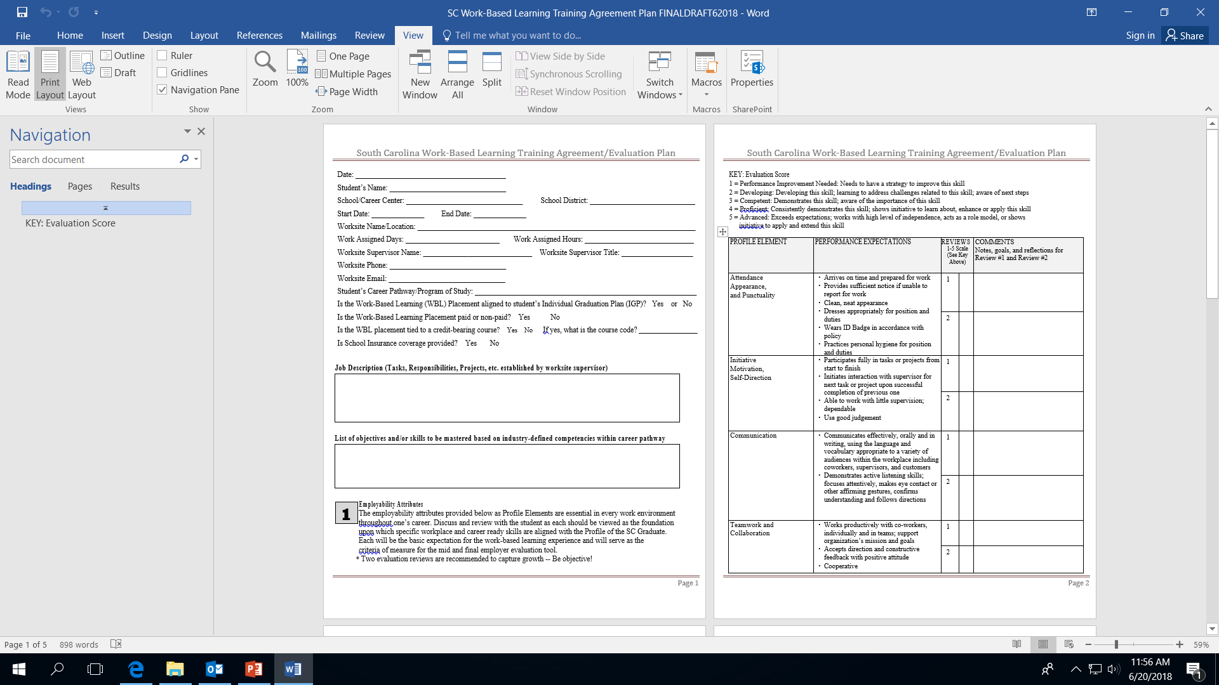
Statewide Template
https://ed.sc.gov/instruction/career-and-technology-education/career-guidance/work-based-learning/

Slide 7
Unit of credit aligned to WBL placement
This is a course the student is or has taken within their career pathway and the WBL qualifier is embedded within course standards.
Examples
State Approved Courses
CATE Internship WBL Credit-Bearing Courses
Local Board Approved Courses

Slide 8
CATE Internship Work-Based Credit-Bearing Course Codes
Agriculture, Food, and Natural Resources (Work-Based Credit) Code 5690
Architecture and Construction (Work-Based Credit) Code 6690
Arts, Audio-Video Technology, and Communications (Work-Based Credit) Code 5290
Business Management and Administration (Work-Based Credit) Code 5490
Education and Training (Work-Based Credit) Code 6390
Finance (Work-Based Credit) Code 6190
Health Science (Work-Based Credit) Code 5590
Sports Medicine (Work-Based Credit) Code 5591
Hospitality and Tourism (Work-Based Credit) Code 5190
Family and Consumer Sciences (Work-Based Credit) Code 5890
Human Services (Work-Based Credit) Code 5790
Information Technology (Work-Based Credit) Code 5390
Law, Public Safety, Corrections, and Security (Work-Based Credit) Code 6590
Manufacturing (Work-Based Credit) Code 6490
Marketing (Work-Based Credit) Code 5091
Science, Technology, Engineering and Mathematics Code 6890
Pre-Engineering/ Industrial Technology Education (Work-Based Credit) Code 6090
Transportation, Distribution, and Logistics (Work-Based Credit) Code 6790

Slide 9
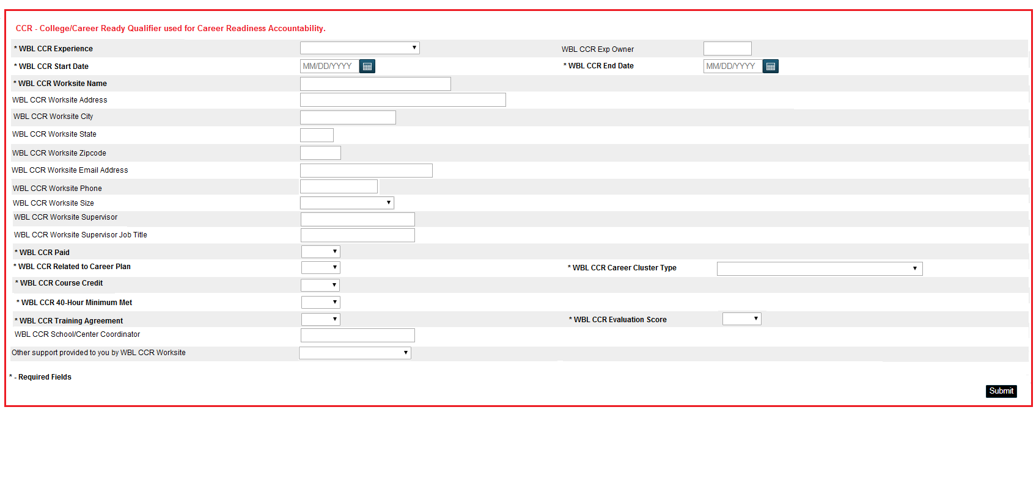
How are we going to report this?
This field is at the first field of entry at the top of the WBL page in PowerSchool. The only reporting experiences for this field is Registered Apprenticeship, Youth Apprenticeship, Internship, or Co-Op for graduating students for accountability purposes only! Need to only report one!

Slide 10
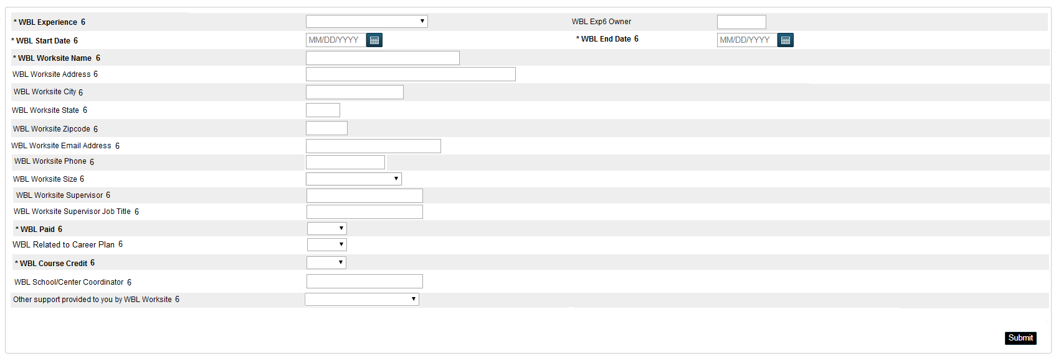
2018-19 WBL Page Updates
Same required fields with a total of 10 experience fields for entry

Slide 11
How are we going to train?
2018 Fall Regional Workshops
Target Audience: Administrators, School Counselors, CDFs, Career Guidance Personnel, and Work-Based Learning Coordinators
Sept. 12, 2018 Oct. 11, 2018
Horry –Georgetown Technical College Anderson University
(Conway Campus)
Sept. 21, 2018 Oct. 17, 2018 ( Full)
Winthrop University Midlands Technical College
(Harbison Campus)
Oct. 5, 2018
Spartanburg Community College Nov. 8, 2018
Colleton County High School
* On-line registration will be released soon*
* CDFs, Career Guidance Personnel, and WBL Coordinators – Mandatory to attend*

Slide 12
Train the Trainer
Statewide deliver system will occur through OCTE and each SC Regional Career Specialist
RCS will provide district requested training
RCS will design WBL opportunities for students through school/district partnerships, Local Advisory Councils, Chambers, etc.
RCS will continue to work closely with school counseling and career guidance personnel

Slide 13
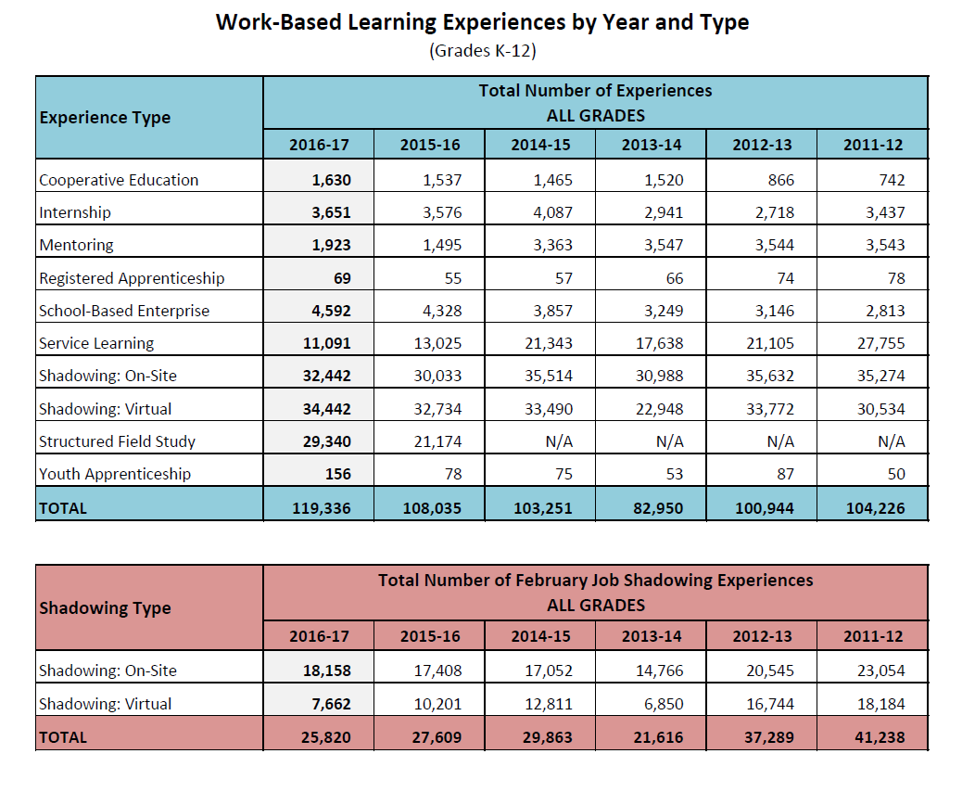
43% increase since 2013-14

Slide 14
Deadline to enter all WBL experiences into PowerSchool is
Friday, May 24, 2019

Slide 15
Reporting Microburst Soft Skills in PowerSchool
Code: A94 – Microburst EmployABILITY Soft Skills Certification
Employers require their workforce to demonstrate soft skills in order to be an effective team member in the business/industry environment. Based on over 30 years of soft skills training in the global private business sector, the Microburst Learning Soft Skills certification program cultivates students’ soft skills by directly reengineering it from the business world to the world of education. The blended learning approach includes on–line pre–assessments with individualized evaluation reports, highly interactive online lessons, program instructor certification, comprehensive instructor guides with flexible classroom activities to meet a variety of schedules and class sizes, post–assessments, and student certification. With completion of all on–line modules, along with face–to–face classroom instruction and group activities, each completer receives the Employer’s Choice Certification. The EmployABILITY Soft Skills certificate program is supported and promoted by SC Future Makers, STEM Premier, SC Manufacturing Alliance, SC Chamber of Commerce, Mechanical Contractor’s Association of South Carolina and the SCDE. This soft skills certification is in alignment with the Profile of the SC Graduate. [MICROBURST]
** Report in PowerSchool on the CATE page under certifications. It is a state recognized industry certification that meets career readiness accountability qualifier for a CATE Completer.

Slide 16
Contact Me
Kama J. Staton
Education Associate
Career Guidance/ Work-Based Learning
(803) 734-8415
kstaton@ed.sc.gov

