Slide 1
Finance Bootcamp
Office of Federal and State Accountability
Jennifer Rhodes, Team Lead
August 2025

Slide 2
Agenda
Planning
Evaluating
Fiscal Expectations
Notes:
Left aligned
Title font is 88pt
Numbered line item 66 pt
Detail/slide item 36 pt

Slide 3


“Fund your plan, rather than planning your funds”

Slide 4
Key Components to Grant Implementation
Planning
Evaluating
Improving

Slide 5

Plan Development
Each LEA plan shall be developed in consultation with teachers, principals, administrators (include administrators of programs described in other parts of this title) and other appropriate school personnel, and with parents of children in schools served under this part. (Section 1112)
What does this look like?
The Title I Coordinator should meet with stakeholders to plan based on need (timely manner).
Sign In, Agenda, and Meeting Minutes should correlate with information within GEMS.
Needs Assessment should tie directly to activities within the GEMS plan.

Slide 6
LEA Assurances
The LEA plan must ensure that it will:
Ensure that migratory children and former migratory children are selected to receive Title I services on the same basis as other children.
Provide equitable services to private school children.
Coordinate and integrate Title I services with other educational services such as MLs, children with disabilities, migratory children, and homeless children and youth.
Designate a point of contact with DSS. Establish procedures for transporting foster care students to the school of origin.
Ensure that teachers and paraprofessionals working in Title I programs meet state certification and licensure requirements.

Slide 7
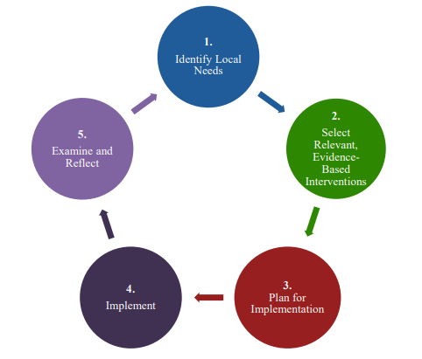
Program Evaluation Process
Strengthening ESEA Investments:
Identify local needs
Choose evidence-based interventions
Plan and support implementation
Monitor and reflect on results
Set and evaluate goals throughout the year
Together, these steps drive continuous improvement and support better student outcomes.
Notes:
Header font 50pt
Content/body text font 26pt

Slide 8
Examine and Reflect
Monitor and Improve Your Activity
Track progress using data and specific goals
Check implementation: Is it going as planned?
Assess milestones: Are key targets being met?
Adjust as needed to improve results and impact
Use data to guide continuous improvement.

Slide 9

Examine and Reflect - continued
Evaluate Effectiveness and Impact
Measure success: Did the activity achieve its goals?
Assess impact: Is it making a difference in the target areas?
Key questions to answer:
  Did the program work?
  Are we reaching our desired outcomes?
  Use evaluations to confirm results and adjust if needed.

Slide 10

Examine and Reflect (continued)
Decision-Making for Future Investments
Use insights from monitoring and evaluations to guide decisions
Decide whether to:
  Continue, modify, or scale the activity
  Try a different approach if needed
Informed decisions = Better strategies and improved outcomes
Adjust strategies to maximize long-term success.

Slide 11

Key Questions for Evaluating Success
What are reasonable expectations of success?
How can success be measured (e.g., milestones, outcomes)?
What are the progress and performance milestones to track?
What have participants (students, educators) shared about their experience?
How can insights from this intervention be shared and used in future decision-making?
Did the program meet its goals?
Should the intervention continue, be modified, or discontinued?
Use these questions to guide reflection and decision-making.

Slide 12
Fiscal Compliance

Slide 13

Documentation
2 CFR § 200.403(g) – Cost Principles
All costs must:
  Be adequately documented
  Have clear supporting records
34 CFR §§ 76.730 – 76.731 – USDE Requirements
LEAs (Local Education Agencies) must maintain detailed records that show:
Compliance with all applicable program requirements
The amount of funds received
How funds were used
The total cost of each project or activity
Other records needed to support a clear and effective audit trail
Strong documentation ensures accountability, supports monitoring, and protects funding integrity.

Slide 14
GEMS Application Expectation- Escalation Model
Thirty days prior to submission deadline:
Team Lead provides deadline reminder to Federal Programs Point of Contact in District.
Two weeks before submission deadline:
Program Manager contacts the District Program Coordinator to determine if assistance is needed.
Program Manager contacts District Program Coordinator to determine if an extension or assistance is needed.
One week after submission deadline or extension deadline:
Two weeks after submission deadline or extension deadline:
1st Level - Escalate to Team Leader to make contact with the District Program Coordinator or District Program Coordinator's next level.
One week after 1st level of escalation:
The district’s risk assessment rating is negatively affected for failure to adhere to timely submission of federal program application.
Two weeks after 1st level of escalation:
2nd Level - Deputy Superintendent or State Superintendent contacts District Superintendent.
Director apprises Deputy Superintendent.

Slide 15
Claiming Deadline Reminder
Reporting Period | Deadline for submitting claims
July 1-Sept 30 | November 15
Oct 1-Dec 31 | February 15
Jan 1-March 31 | May 15
April 1-June 30 | August 15
Districts must submit quarterly claims.
Submitting timely claims is not only a good fiscal practice but can save from problems at the end of a grant.
Claims will be tracked on a quarterly basis.
The GAPS system shuts down automatically on Aug 15.
OFSA has no power over this automatic shutdown.

Slide 16

Claiming Expectation Emails
Quarterly Tracking by OFSA
The Office of Federal and State Accountability (OFSA) will track claims quarterly to ensure:
Funds are being expended responsibly
Timely use of federal grant allocations
Compliance with grant requirements
District Notification Emails
Districts will receive an email each quarter from Sharay Mosley indicating one of the following:
a) “Your district has not made any claims for this quarter.”
b) “Your district has failed to meet the claiming criteria for this quarter.”
c) “Your district has met the claiming criteria for this quarter.”
Why This Matters
OFSA monitors claiming patterns across districts
Helps ensure districts spend funds effectively and on time
Supports strong fiscal management and audit readiness
Watch for quarterly emails from Sharay Mosley—your compliance may depend on it!

Slide 17
Claiming Expectations
GRANT | CLAIMING PERCENTAGE QUARTER 1
Grant | Claiming Percentage Expectation Y1/Q1 (July 1 - Sept 30) | Claiming Percentage Expectation Y1/Q2 (Oct 1 - Dec 31) | Claiming Percentage Expectation Y1/Q3 (Jan 1 - March 31) | Claiming Percentage Expectation Y1/Q4 (April 1 - June 30)
 | Deadline for Claiming – November 15 | Deadline for Claiming – February 15 | Deadline for Claiming – May 15 | Fiscal Year End Deadline for Claiming – August 15
Title I | - | 40% | 60% | 85%
Title II | - | 15% | 30% | 50%
Title IV | - | 15% | 30% | 50%
Title V | - | 0% | 0% | 50%
Grant | Claiming Percentage Expectation Y2/Q1 (July 1 - Sept 30) | Claiming Percentage Expectation Y2/Q2 (Oct 1 - Dec 31) | Claiming Percentage Expectation Y2/Q3 (Jan 1 - March 31) | Claiming Percentage Expectation Y2/Q4 (April 1 - June 30)
 | Deadline for Claiming – November 15 | Deadline for Claiming – February 15 | Deadline for Claiming – May 15 | Fiscal Year End Deadline for Claiming – August 15
 |  |  |  | Grant Closing Deadline for Claiming – December 30
Title I | 85% | 90% | 95% | 100%
Title II | 60% | 75% | 90% | 100%
Title IV | 60% | 75% | 90% | 100%
Title V | 60% | 75% | 90% | 100%

Slide 18

Carryover Restrictions
15% Carryover Limitation
At the end of the project period, carryover is calculated based on the final Expenditure Report
For districts receiving $50,000 or more, the carryover limit is 15% of the next year’s allocation
Waiver Option
A district may submit a waiver request to the Office of Federal and State Accountability (OFSA)
Waivers can be granted only once every three years, even if a district exceeds the limit multiple times
Plan ahead and monitor expenditures to avoid exceeding the carryover cap.

Slide 19
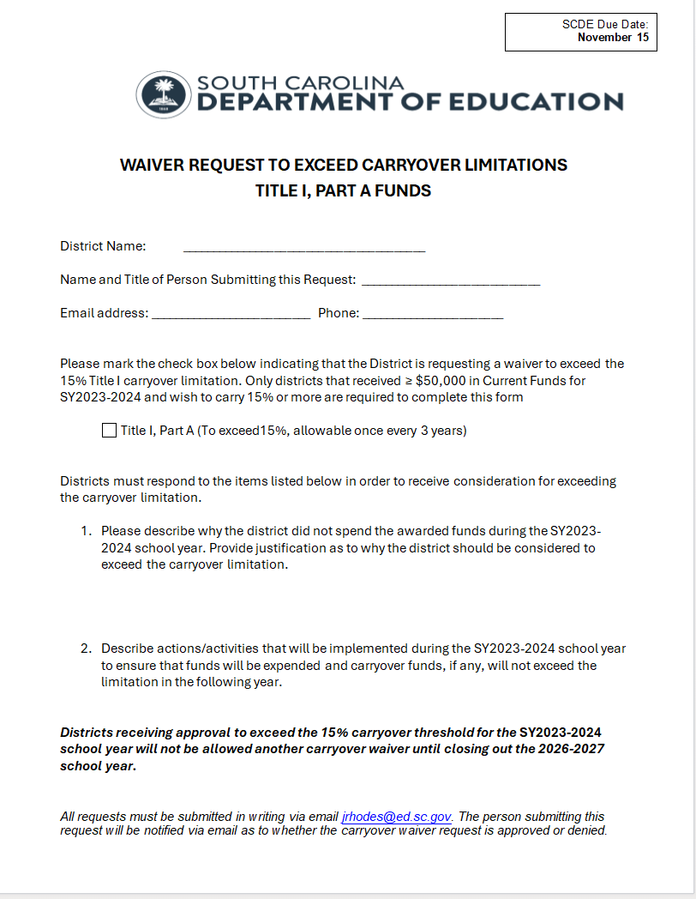
Waiver Request Form
The official Title I Waiver Request Form is available on the South Carolina Department of Education (SCDE) website.
SCDE Title 1 Carryover Request Form

Slide 20
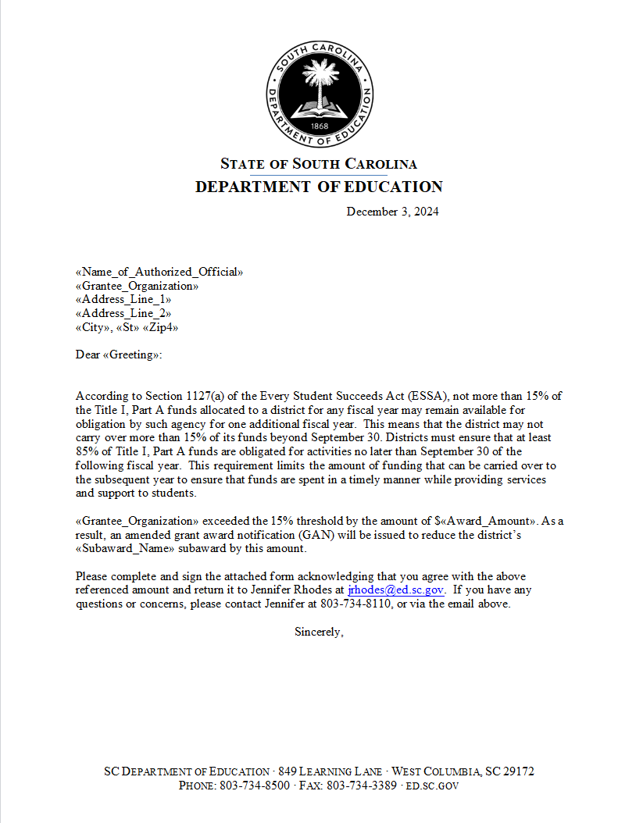
SAMPLE SUPERINTENDENT LETTER

Slide 21
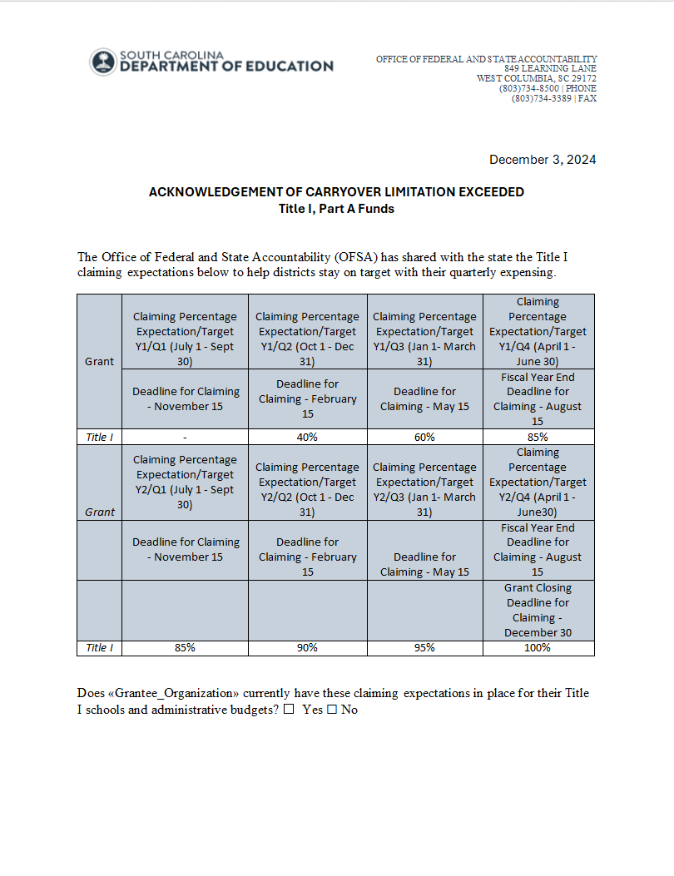
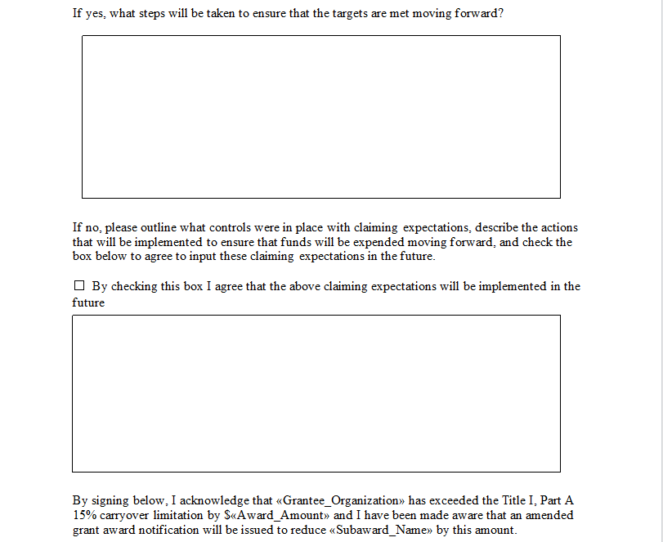
SAMPLE ACKNOWLEDGMENT FORM

Slide 22
Fiscal Process and Procedures as related to final allocations (Title I, II, IV, V and N&D)
  OFSA completes and releases final allocations for Title I, II, IV, V and N&D prior to attending the SCATA Fall Conference in October of each year.
  Grant Award Notifications are loaded into the agency’s internal routing system for review (ART).
  OFSA awaits completion of ART routing. Superintendents then receive the GAN and Assurances/Terms and Conditions to be signed and returned.
  OFSA loads the final allocations into the GEMS application system for coordinators to then complete revisions.
  The SCDE Grants Accounting Office loads the final allocations into GAPS.
  Upon Director Approval of GEMS, coordinators may load final allocation budgets into GAPS for review.
  Jennifer Rhodes reviews and approves GAPS budgets once in receipt of signed award documents.

Slide 23
New Change to Fiscal Process
Indirect cost rates will no longer be updated during the second year of Title I, II, III, IV, V and N&D grants as of the fall of 2025.
LEAs must make updated changes to their indirect cost budgets within GAPS to reflect the newly negotiated rates.
GEMS warning messages will remain in place under “Validation Messages” on the sections page.

Slide 24
Program Manager Assignments
Jennifer Rhodes | Leslie Bloss | Makesia Sumpter | Theresa Gregory | Sharay Mosley | Sarah Wagers | Martha Walker
Kershaw | Aiken | Abbeville | Anderson 1 | Dillon 3 | Barnwell 45 | Allendale
Laurens 55 | Clarendon Consolidated | SC School for Deaf and Blind (T2 only) | Anderson 2 | Dillon 4 | Barnwell Consolidated | Bamberg Consolidated
Marlboro | Erskine | DJJ | Anderson 3 | Fairfield | Chester | Beaufort
Richland 1 | Florence 2 | Edgefield | Anderson 4 | Horry | Dorchester 2 | Berkeley
Spartanburg 1 | Florence 5 | Florence 1 | Anderson 5 | Lee | Dorchester 4 | Charleston
 | Greenville | Florence 3 | Calhoun | McCormick | Marion | Cherokee
 | Greenwood 52 | Greenwood 50 | Colleton | Oconee | Newberry | Chesterfield
 | Hampton | Greenwood 51 | Darlington |  | Union | Laurens 56
 | Limestone | Palmetto Unified | Georgetown |  | York 4 | Lex/Rich 5
 | Pickens | Saluda | Lancaster |  |  | Lexington 1
 | Richland 2 | Spartanburg 5 | Orangeburg |  |  | Lexington 2
 | SC Public Charter | Spartanburg 6 | Spartanburg 3 |  |  | Lexington 3
 | Spartanburg 7 |  | Spartanburg 4 |  |  | Lexington 4
 | Williamsburg |  | Sumter |  |  | Spartanburg 2
 | York 1 |  |  |  |  | York 3
 | Jasper

Slide 25
Resources
https://ed.sc.gov/policy/federal-education-programs/title-i/scde-title-1-carryover-request-form/
https://ed.sc.gov/policy/federal-education-programs/title-i/
https://ed.sc.gov/policy/federal-education-programs/title-i/updated-claiming-expectations/
https://ed.sc.gov/policy/federal-education-programs/esea-title-ii-part-a1/allowable-use-of-funds/

Slide 26

Do you have any questions?
Notes:
Do not pin more than 5 locations per slide
Header font 50pt
Content left is 26pt

Slide 27
Thank you for participating!
Please reach out to us if you have any questions:
Leslie Bloss, lbloss@ed.sc.gov
Theresa Gregory, tgregory@ed.sc.gov
Sharay Mosely, smosely@ed.sc.gov
Jennifer Rhodes, jrhodes@ed.sc.gov
Makesia Sumpter, msumpter@ed.sc.gov
Sarah Wagers, slwagers@ed.sc.gov
Martha Walker, mwalker@ed.sc.gov

Slide 28


Federal Programs Monitoring
Finance Bootcamp
August 2025
Barret Leviner, Team Lead

Slide 29
Districts Being Monitored
2025 – 2026
Abbeville Erskine
Allendale Fairfield
Barnwell Lexington 4
Berkeley Lexington/Richland 5
Chesterfield Limestone
Colleton Saluda
Darlington Spartanburg 2
Dorchester 4 Spartanburg 5
Edgefield

Slide 30
Monitoring Process Overview
What is it?
SCDE monitors requirements / compliance of ESEA
SCDE provides technical assistance
SCDE works with LEAs to support programs and meet requirements
When is it?
SCDE is currently utilizing a four-year cycle (with exceptions for consolidating or high-risk districts)
LEAs being monitored have been contacted by the SCDE
How is it done?
SCDE reviews evidence previously collected and LEA-submitted materials
Desk, Hybrid, On-Site, or Re-visit as determined by SCDE

Slide 31
Federal Programs Monitoring
Federal programs monitoring has implemented a consolidated approach in which Titles I, II, III, IV, V, and N&D are reviewed simultaneously.
All district level federal programs directors received an email with the 2025-2026 monitoring schedule in August.
Districts selected for review also received a detailed email that included the protocol.

Slide 32
Overarching Requirements
Student identification and coordination of services
Program needs assessment, services, and evaluation
Family and community engagement
School improvement
Teacher and paraprofessional qualifications, and professional development
Fiscal accountability
Report card reporting
Equitable services to private schools

Slide 33
Federal Programs Monitoring Documentation
Emails | Record of physical inventory of equipment and real property
Memos | Fiscal documentation
Dated meeting agendas | Websites
Dated sign-in sheets | Other forms of documentation
Checklists with comments

Slide 34
Common Challenges
Not providing an adequate level of documentation
Use the most current forms
  For example, Home Language Survey & Enrollment Survey, Best Interest Determination (BID) Form, etc.
Expenditures & procurements
  For example, when the school procured a math program, what they expect from it, how they will evaluate the results, and ensure that this is aligned with their DSSR plan.
Up-to-date policies and procedures (must be reviewed at least every two years)

Slide 35

Internal Controls
Demonstrating the LEA has internal controls in place to prevent waste and fraud
Updated Internal Controls

Slide 36
Time and Effort
Charges to Federal awards may include reasonable amounts for activities contributing and directly related to work under an agreement.
Be necessary, reasonable, and allocable for the performance of the Federal award 200.403(a).
Documentation is critical.
  Must be supported by internal controls to ensure that the charges are accurate, allowable, and allocable.
  Be part of the official records.
  Include all activities (federal and non-federal) based on reasonable amounts.
  Reflect the total activity of employees.
  Comply with established accounting practices and policies.

Slide 37
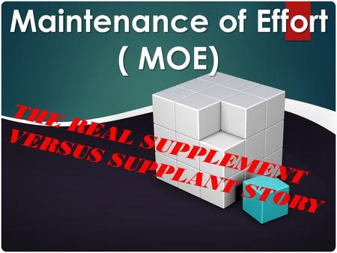
What is Maintenance of Effort?
Maintenance of Effort (MOE) is a federal requirement that requires grant recipients and/or sub-recipients to maintain a certain level of state/local fiscal effort to be eligible for full participation in federal grant funding.

Slide 38
Purpose of MOE
Title I is in addition (supplemental) to the minimum education that all students receive.
To ensure the sub-recipient of federal funds does not spend those funds in place of state and local dollars (supplanting)
To ensure the sub-recipient spends their state and local funds for the same activities that would be provided if federal dollars were not available

Slide 39

Time for Questions

Slide 40
Contact Information
Dr. Greg King: gking@ed.sc.gov, 803-734-0025
Barret Leviner: bleviner@ed.sc.gov, 803-734-3477
Clint Palmer: cpalmer@ed.sc.gov, 803-734-6010
Peggy Scott: pescott@ed.sc.gov, 803-734-4040
Daniel Ashley: daashley@ed.sc.gov, 803-734-8373

Slide 41
ed.sc.gov
Notes:
Slide title is hidden from display

