Slide 1

CTE in South Carolina: Focus on Finance
Maria Swygert, Office of Career Readiness
August 2025
Notes:
Slide title should be Aptos Bold font, left-aligned, not smaller than 44pt
Audience – To whom/group you are presenting to
Speaker – Who is giving the presentation (may be by name or by department)
Date – Date of presentation

Slide 2
Agenda
Career Readiness in SC
Federal CTE Funding
State CTE Funding
LEA Monitoring
Data Definitions & Resources
Notes:
Left aligned
Title font is 88pt
Numbered line item 66 pt
Detail/slide item 36 pt

Slide 3
Career Readiness
Career and Technical Education
Notes:
Agenda is 88 pt
Line item is 66 pt

Slide 4

South Carolina - Vision 2030
South Carolina has a vision for 2030 that focuses on science and technology education, workforce development, and economic growth.
Key aspects include increasing postsecondary attainment, improving education standards, and expanding high-tech industries.
The South Carolina Department of Education's (SCDE) 2030 plan, aims to ensure every student graduates college, career, or military-ready, with a focus on literacy and math proficiency.

Slide 5
Office of Career Readiness
Newly formed combination of K-12 Computer Science, School Counseling, Career and Technical Education, & Adult Education
Mission
The Office of Career Readiness exists to ensure that every learner in SC can access a high-quality, workforce - aligned education pathway that leads to personal success and economic mobility.
#FutureReadySC

Slide 6
The South Carolina economy is experiencing a skills gap…
Career Readiness in South Carolina
57% of jobs in South Carolina require skills training – more education than high school but less than a four-year degree
42% of South Carolina workers are trained at this level

Slide 7

Advanced Manufacturing
Agribusiness
Automotive
Health Care
Distribution & Logistics
Career and Technical Education (CTE) can fill these gaps, particularly in South Carolina’s key industries, like:
High-quality Career Technical Education (CTE) programs impart critical academic, technical and employability skills. Skills preparing students for career success.
CTE is your career strategy
#FutureReadySC

Slide 8



Our Strategy
Increase access and awareness in career opportunities among students, educators, parents, counselors and policy makers.
Increase engagement and commitment of business and industry partnerships.
Increase the number of students who graduate from high school, career- or college ready.

Slide 9
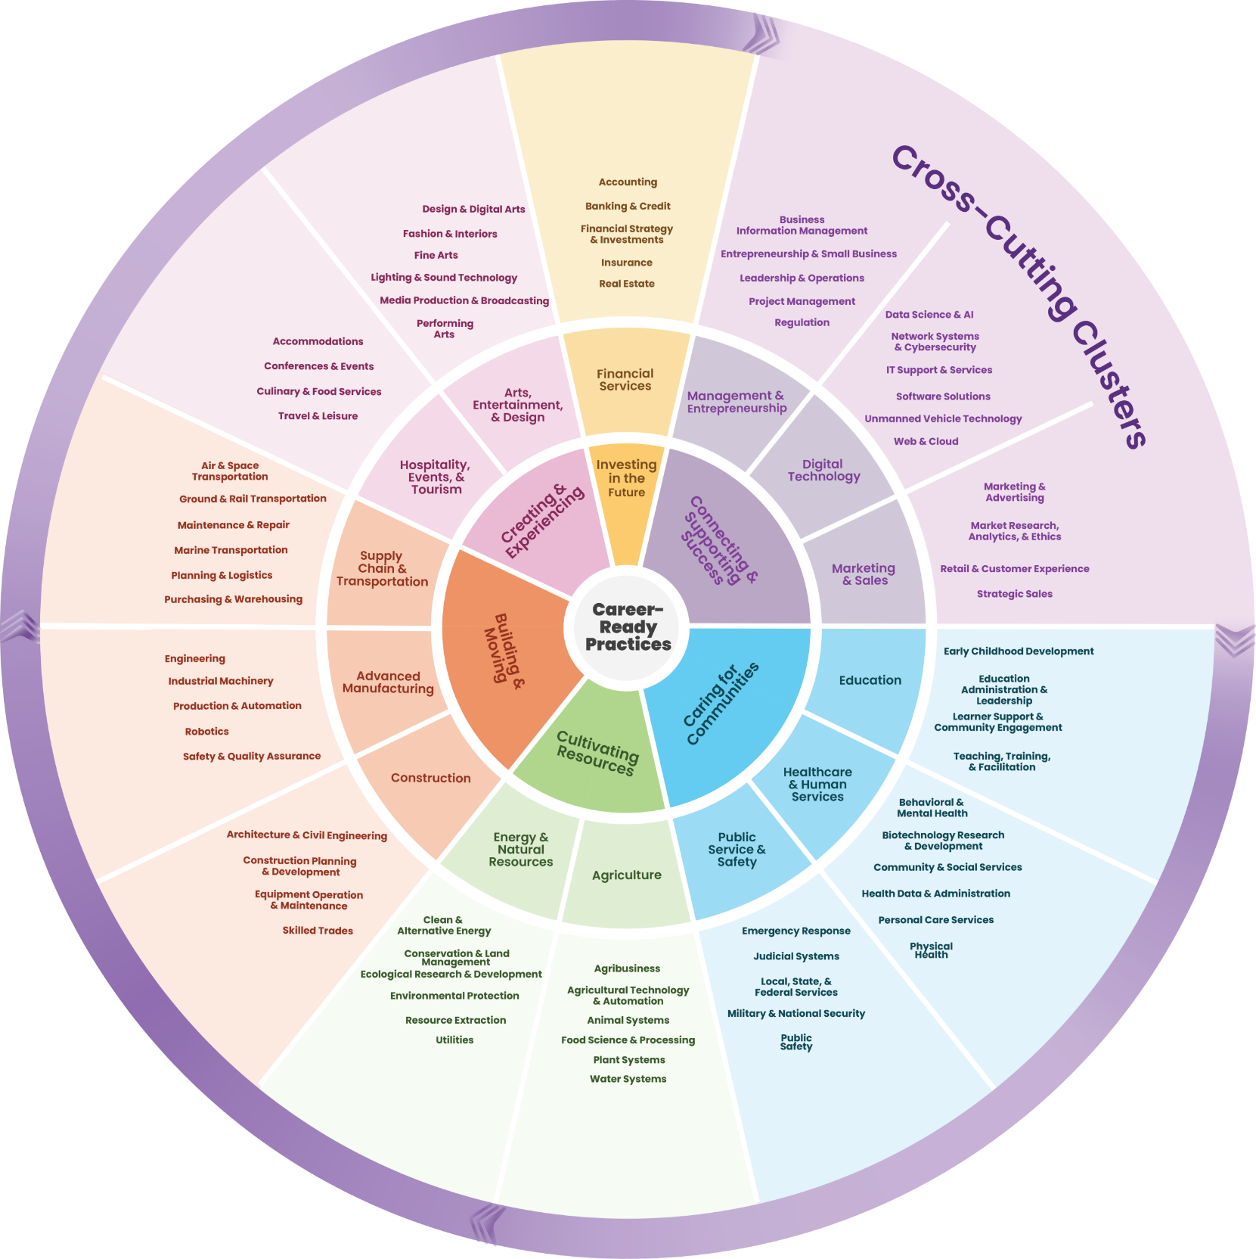
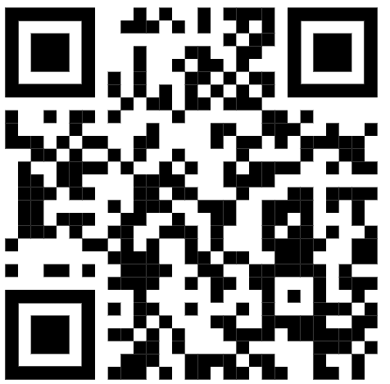
New Career Cluster Framework
All learners deserve to participate in meaningful career exploration and preparation experiences through Career Technical Education (CTE) that prepare them for the changing and interconnected world of work.
This requires systems and structures that are accessible, responsive to evolving industry needs, and flexible for the needs of each state and community.

Slide 10
Perkins V Federal Funding
The Strengthening Career and Technical Education for the 21st Century Act (Perkins V) enables students to explore and follow career and technical education pathways, earning valuable credentials.

Slide 11



Perkins V Federal CTE Funding
Perkins is a federal education program that invests in secondary and postsecondary CTE programs in the US and the territories
Perkins is dedicated to increasing learner access to high-quality CTE programs
Perkins is critical to ensuring programs meet the ever-changing needs of learners and employers
Notes:
The on-going strategic work for the state is being accomplished through five workgroups:
Advancing CTE- Providing avenues for increasing awareness and strategic communication of the value of CTE
Career-Connected Learning- Designing and supporting quality programs and programs of study that include authentic work experiences, leaderships, and connections to local industry needs.
Integrated Network- Activate a deliberate coalition charged to build, reinforce and maintain relationships of trust with other organizations to further support CTE goals as part of a workforce development system
Equity and Inclusion-Identify key issues that impact success of special populations and inequities in access and opportunities for these learners in CTE
Knowledgeable Experts- Provide professional development to our coordinators, our partners, our faculty and teachers to support student success

Slide 12
CTE in SC – How does it Flow?
Federal to state =
TOTAL GRANT AWARD
RESERVE (10%)
STATE LEVEL ACTIVITIES (15%)
LOCAL LEVEL ACTIVITIES (85%)
SECONDARY
(68%)
POSTSECONDARY (32%)
* STATE ADMINISTRATION (5.0%)
** STATE
LEADERSHIP (10.0%)
Notes:
The on-going strategic work for the state is being accomplished through five workgroups:
Advancing CTE- Providing avenues for increasing awareness and strategic communication of the value of CTE
Career-Connected Learning- Designing and supporting quality programs and programs of study that include authentic work experiences, leaderships, and connections to local industry needs.
Integrated Network- Activate a deliberate coalition charged to build, reinforce and maintain relationships of trust with other organizations to further support CTE goals as part of a workforce development system
Equity and Inclusion-Identify key issues that impact success of special populations and inequities in access and opportunities for these learners in CTE
Knowledgeable Experts- Provide professional development to our coordinators, our partners, our faculty and teachers to support student success

Slide 13
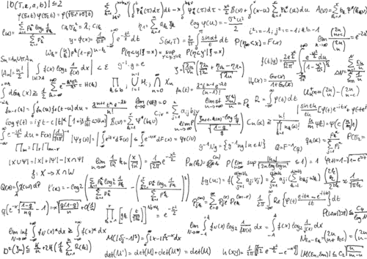
Federal Perkins Allocations
A simple formula…
70% is distributed based on the number of individuals aged 5-17 residing in a school district who are from families living below the poverty line.
The remaining 30% of the funds are allocated based on the total number of individuals aged 5-17 residing within the school district, regardless of their poverty status.

Slide 14
What Does Perkins Support?
CTE Programs
Certifications & Credentials
Career exploration and guidance
Professional development
Technical assistance
Data collection and analysis
Program and plan evaluation and monitoring
Notes:
The on-going strategic work for the state is being accomplished through five workgroups:
Advancing CTE- Providing avenues for increasing awareness and strategic communication of the value of CTE
Career-Connected Learning- Designing and supporting quality programs and programs of study that include authentic work experiences, leaderships, and connections to local industry needs.
Integrated Network- Activate a deliberate coalition charged to build, reinforce and maintain relationships of trust with other organizations to further support CTE goals as part of a workforce development system
Equity and Inclusion-Identify key issues that impact success of special populations and inequities in access and opportunities for these learners in CTE
Knowledgeable Experts- Provide professional development to our coordinators, our partners, our faculty and teachers to support student success

Slide 15
Federal Perkins Allocations - Subfund 207
TITLE I – CAREER AND TECHNICAL EDUCATION BASIC GRANTS TO STATES
Allocation Formula:
Federal Career and Technical Education (CTE) funds are distributed to the SCDE based on a statutory formula to develop more fully the academic, career, and technical skills of secondary and postsecondary students who elect to enroll in CTE programs.
Funds allocated via formula are then distributed to local educational agencies (LEAs) or other eligible recipients that have currently approved local plans/applications.
Legal References:
Strengthening Career and Technical Education for the 21st Century Act (Perkins V) Title I; as amended; (PL 115–224, § 6,) 20 U.S.C. § 2301 et seq.

Slide 16
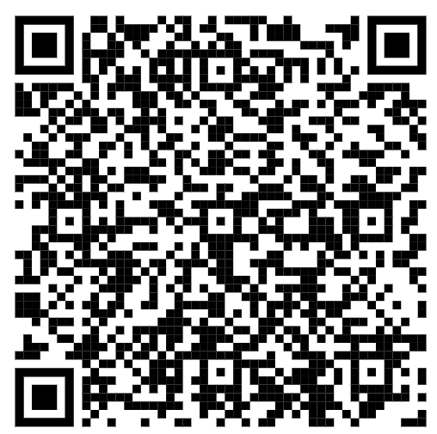
Federal Perkins Allocations - continued
Sub Fund 207 – Funding Notes:
Budget built in GAPS - connected to SCIES (South Carolina Enterprise Information System)
Funding should be tied to Local Needs Assessment
15-month grant ends on September 30th
Reimbursement only
No Consumable Items
Federal funds do not carry forward

Slide 17
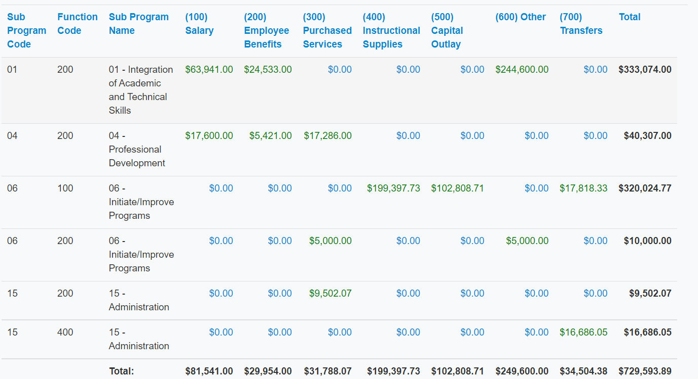
Perkins V Budget Subprogram Codes
01 / Integration of Academic and Technical Skills
02 / Career Exploration
03 / Post-Secondary and Career Readiness
04 / Professional Development
05 / Evaluation and Assessment
06 / Initiate and Improve Programs
11 / Equipment
15 / Administrative Cost (less than 5%)

Slide 18
Federal CTE Funding Timeline (15 month)
July-August
Finance Section opens
September 15
Application & Finance Sections due
October 15
Local Applications and Finance Sections approved
December 30
Prior year expenditures due
No Amendments accepted between July 1 and August 15
August 15
Prior year expenditures through June 30 due
September 30
Program year ends September 30
July – September
Amendments due September 15
July - August
Notes:
The on-going strategic work for the state is being accomplished through five workgroups:
Advancing CTE- Providing avenues for increasing awareness and strategic communication of the value of CTE
Career-Connected Learning- Designing and supporting quality programs and programs of study that include authentic work experiences, leaderships, and connections to local industry needs.
Integrated Network- Activate a deliberate coalition charged to build, reinforce and maintain relationships of trust with other organizations to further support CTE goals as part of a workforce development system
Equity and Inclusion-Identify key issues that impact success of special populations and inequities in access and opportunities for these learners in CTE
Knowledgeable Experts- Provide professional development to our coordinators, our partners, our faculty and teachers to support student success

Slide 19
Amendments & Claims
Amendments:
Due no later than June 30th (1st through 4th quarter claims) and September 15th (5th quarter claims)
Any Amendments submitted between July 1 through August 15 will not be reviewed until August 16th – no exception
Claim Your Expenditures:
All claims through June 30th must be submitted by August 15th – no exception
All claims from July 1st through September 30 are due December 30th – no exception

Slide 20
State CTE Funding
State CTE EIA (329)
Industry Credentials (328)

Slide 21
State CTE EIA 329
REVENUE 3529 CAREER AND TECHNICAL EDUCATION SUBFUND 329 EIA
Allocation Formula:
School district and multi-district career center allocations are determined based on the most recent data for students enrolled in approved career and technical education (CTE) courses.
The formula includes a minimum allocation of $50,000 for all school districts and official multi-district career centers.
Legal References
S.C. Code Ann. §§ 59-53-1950 and 59-53-1960 (2005)
General Appropriations Act for 2024-25, Proviso 1A.51

Slide 22
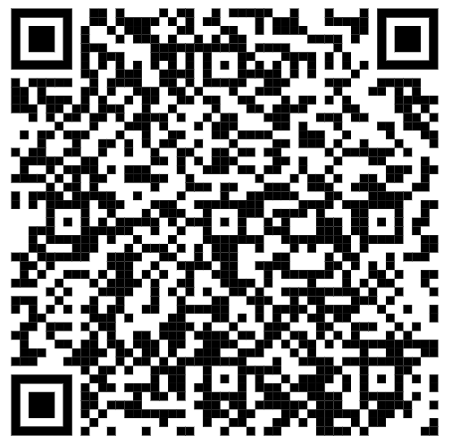
State Education Improvement Act (EIA)
Subfund 329 - Use of Funds:
The purchase of career and technical equipment
The up-fitting of facilities and the purchase of consumables
Regional career specialists
Consumable items
Evidence-based initiatives - High Schools that Work and Project Lead the Way
Funding Notes
State funds Carryover for an additional 12 months
Budget not entered into GAPS – Spreadsheet Upload

Slide 23
Industry Credentials (328)
REVENUE 3528 INDUSTRY CERTIFICATIONS/CREDENTIALS SUBFUND 328 EIA
Allocation Formula:
The funds appropriated for Industry Certifications/Credentials must be allocated to school districts based upon the number of national industry exams administered in the prior school year. (Certifications Administered to Completers entered into PowerSchool)
Each district will receive $10,000 base in October.
Additional allocation based on Proviso dispersed in February
Legal References
General Appropriations Act for 2024-25,
Proviso 1A.50
Funding Notes
State funds Carryover for an additional 12 months
Budget not entered into GAPS – Spreadsheet Upload

Slide 24
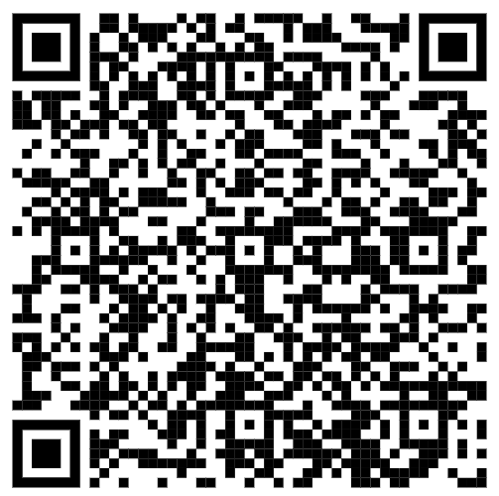
Industry Certifications & Credentials
Introduction to the South Carolina Tiered Credential List
All certifications and credentials listed in the Student Reporting Procedures Guide are allowable uses of funds
The Student Reporting Procedures Guide is available online

Slide 25
Local Education Agency (LEA) Fiscal Monitoring

Slide 26
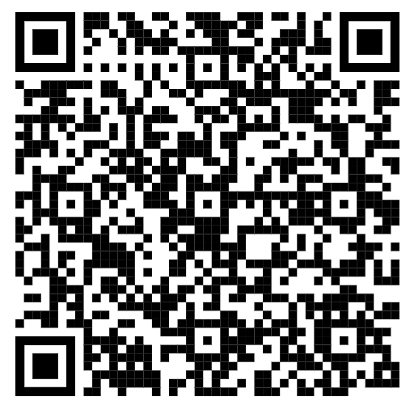
Local Application & Monitoring
On-site LEA monitoring is a process by which school districts and/or multi-district career centers (entities) are scheduled to receive an on-site visit to assure compliance with federal/state grant requirements for recipients of Perkins, EIA, and Work-Based Learning Funds, as it relates to the Entity’s CTE Local Plan.

Slide 27
Monitoring Schedule 2025-26
Abbeville
Allendale
Anderson One
Bamberg
Barnwell
Beaufort
Calhoun
Charleston
Cherokee
Colleton
Daniel Morgan
Dillon 3
Dillon 4
Dillon 80
Edgefield
Greenwood 51
Greenwood 52
Hampton
Jasper
Kershaw
Lee
Marlboro
McCormick
Oconee
Pickens
Spartanburg Seven
Spartanburg Three
Union
York Three

Slide 28
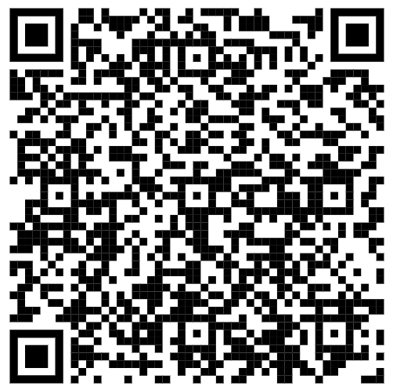
Equipment Disposition & Monitoring
Make sure inventory forms are updated for each program
Complete the Equipment Disposition form upon discontinuing a program, and if the equipment is obsolete or broken
Reminder to get signature of CTE Director/Coordinator and the District Superintendent
Scan and email the completed equipment disposition form to mbenton@ed.sc.gov for approval

Slide 29
Data Definitions & Resources

Slide 30
Student Populations
Participants
A student who completes at least one course or earns at least one credit in an eligible recipient's CTE program or program of study
Concentrators
Secondary student who has completed at least two courses in a state-recognized CTE program or program of study
Completers
Concentrator who has earned all of the required units in a state-recognized CTE program

Slide 31
Data Disaggregation in Perkins V
Accountability for results a central focus of Perkins V, setting out new performance requirements for States and local programs.
These requirements were established to assess the effectiveness of the State in achieving statewide progress in career and technical education and to optimize the return on investment of Federal funds in career and technical education.
Gender
Race/ethnicity
Career Clusters
Post-program Placement
Special Populations

Slide 32
title
Special populations, as defined by Perkins V
Individuals with disabilities
Individuals from economically disadvantaged families
Individuals preparing for non-traditional fields
Single parents, including single pregnant women
Out-of-workforce individuals
English learners
Homeless individuals as defined by the McKinney-Vento Homeless Assistance Act
Youth who are in, or have aged out of, the foster care system
Youth with a parent who is on active duty in the armed forces

Slide 33
Core Indicators of Performance - Perkins V
Secondary Level:
1S1: Four-Year Graduation Rate
2S1: Academic Proficiency in Reading/Language Arts
2S2: Academic Proficiency in Mathematics
2S3: Academic Proficiency in Science
3S1: Post-Program Placement
4S1: Non-traditional Program Concentration
5S1: Program Quality – Attained Recognized Postsecondary Credential

Slide 34
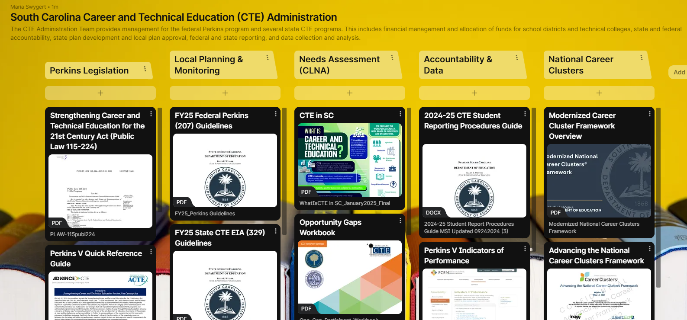

Career Readiness Administration Resource Padlet
To access the resources use the hyperlink below or the QR code. Thank you!
https://tinyurl.com/mw4jb7j3
Notes:
Do not pin more than 5 locations per slide
Header font 50pt
Content left is 26pt

Slide 35
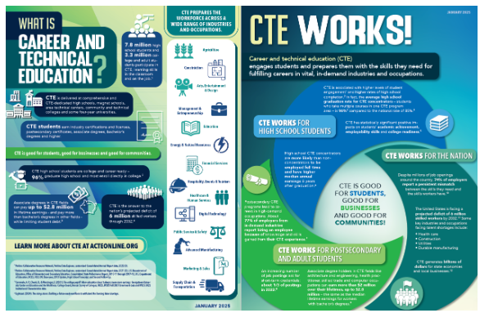
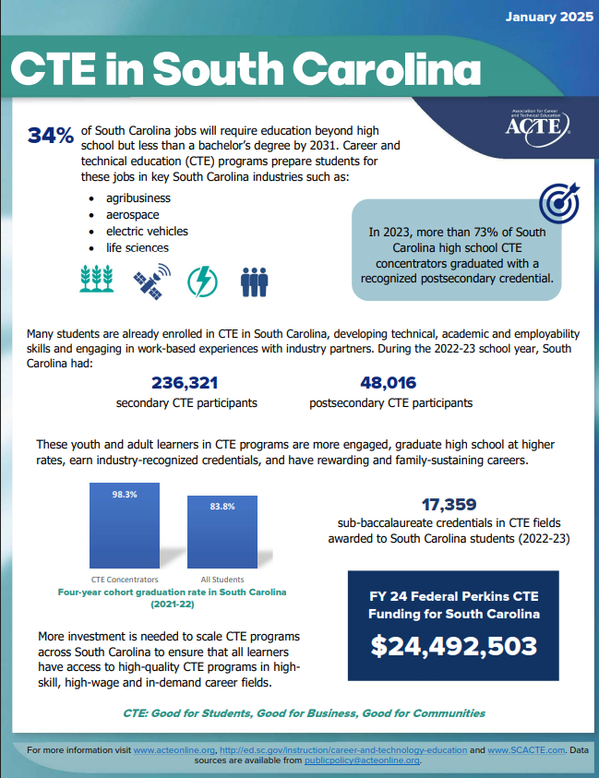
Share Your Story!
What is CTE?
Today’s cutting-edge, rigorous, and relevant career and technical education (CTE) prepares youth and adults for a wide range of high-wage, high-skill, high-demand careers. Learn more with our Basic Facts and State Fact Sheets.
South Carolina
CTE in South Carolina: ACTE State Fact Sheet (Updated January 2025)
Federal Office of Career, Technical, and Adult Education South Carolina State Profile
Advance CTE: “CTE In Your State” State Profile

Slide 36


Questions

Slide 37
ed.sc.gov
Notes:
Slide title is hidden from display

