Slide 1

Child Nutrition Finances
August 22, 2025
Ellen E. Weaver
State Superintendent of Education
Notes:
Slide title should be Aptos Bold font, left-aligned, not smaller than 44pt
Audience – To whom/group you are presenting to
Speaker – Who is giving the presentation (may be by name or by department)
Date – Date of presentation

Slide 2
CFR NSLP Codes
The requirements for financial management of the USDA’s school nutrition programs are defined by the Code of Federal Regulations (CFR) for the NSLP, SBP, and SMP, and the federal procurement standards (2 CFR Part 200).
7 CFR Part 210: National School Lunch Program
7 CFR Part 215: Special Milk Program for Children
7 CFR Part 220: School Breakfast Program
2 CFR Part 200: Uniform Administrative Requirements, Cost Principles, and Audit Requirements for Federal Awards
Notes:
Header font 50pt
Content/body text font 28pt

Slide 3
Use of Funds
Funds from the nonprofit school foodservice account (NSFSA) cannot be used for expenditures that are not directly related to operation of the USDA school nutrition programs.
Any positive balance remaining in the NSFSA at the end of the school year must be carried over to the next school year as a beginning balance in the NSFSA.
Notes:
Header font 50pt
Content/body text font 28pt

Slide 4
Nonprofit School Food Service
The school food service program must be nonprofit.
Section 7 CFR 210.9(a)(1) of the NSLP & 7 CFR 220.13(i) of the SBP regulations
SFAs to maintain a nonprofit school food service and observe the requirements for and limitations on the use of nonprofit school food service revenues (7 CFR 210.14) and the limitations on any competitive school food service (7 CFR210.11).
“Nonprofit school food service” means all food service operations conducted by the school food authority principally for the benefit of students, all the revenue from which is used solely for the operation or improvement of such food services.

Slide 5
Nonprofit School Food Service Account (NSFSA)
The SFA must maintain a NSFSA to:
1) ensure that the school food service operates on a nonprofit basis; and
2) safeguard assets of the school food service and ensure that they are used only for authorized purposes.
The SFA is the steward of the NSFSA and maintains the funds available for the school nutrition programs.

Slide 6
Nonprofit School Food Service Account (NSFSA) - continued
The SFA is responsible for ensuring that
1) only allowable costs are paid with NSFSA funds; and
2) costs are properly classified as direct or indirect. The SFA should continuously monitor costs charged to the NSFSA.

Slide 7
Revenues
All money provide to the NSFSA
Includes but not limited to:
Federal reimbursement
State matching funds
Student payments for meals
A la carte sales
Income from adult meals, catering, and vended meals

Slide 8
Expenses
Expenses must comply with the cost principles of 2 CFR Part 200 Subpart E
Costs charged to the NSFSA must be necessary, reasonable, allocable (direct or indirect), and consistently treated as direct or indirect.

Slide 9
Necessary Expenses
A cost is necessary if the SFA’s authorizing statutory provisions, resulting program regulations, or applicable FNS policy establish that the nonprofit school food service cannot be operated without incurring the cost.
For example, a school food service cannot be operated without incurring the cost of appropriate food.

Slide 10
Reasonable Cost
A cost is reasonable if, in its nature and amount, it does not exceed that which would be incurred by a prudent person under the circumstances prevailing at the time the decision was made to incur the cost. The cost must be the result of sound business practice and competitive prices.
For example, the cost of food is a reasonable cost to operate the nonprofit school food service if incurred according to these conditions.

Slide 11
Cost
Costs must meet the criteria specified in 7 CFR 403.
Costs must be consistent with policies and procedures that apply uniformly to both federally financed and other activities of the non-federal entity.
Costs must be determined in accordance with Generally Accepted Accounting Principles(GAAP).
Costs cannot be included as a cost or matching contribution of any other grant unless allowed by Federal regulations.
All costs must be adequately documented.
Notes:
All purchases from the NSFSA must comply with procurement requirements. Federal, state, and local laws and regulations specify the methods that SFAs
must follow to properly procure goods and services.

Slide 12
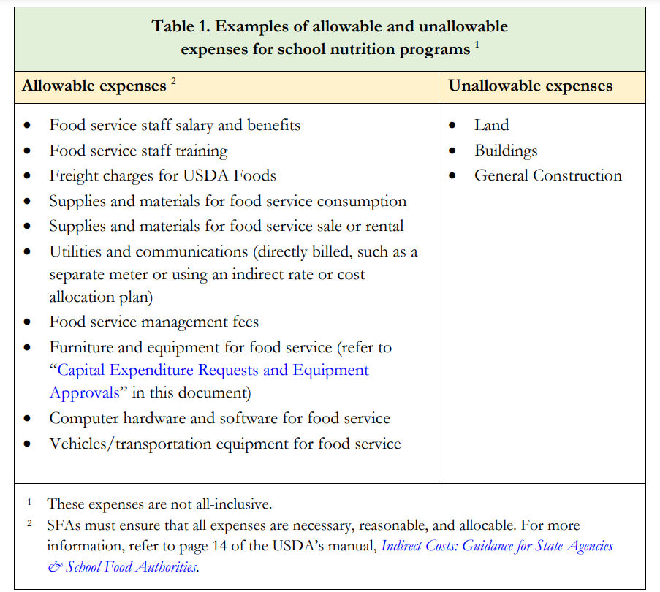
Allowable and Unallowable Expenses

Slide 13
Loans to the NSFSA
Funds transferred to the NSFSA must be designated as a loan at the time of transfer and include a loan agreement to be considered a loan
The conditions for repayment must be documented and agreed to in advance by both parties, the general fund manager, and the school nutrition programs.
Short-term or multi-year obligations are permissible provided that a bona fide loan agreement exists at the time that funds are made available.
Interest payments are not allowable program expenditures.

Slide 14
Direct Cost
Direct Cost
“those that can be identified specifically with a particular final cost objective.”
exclusively attributable to the nonprofit school food service and can be substantiated through written documentation such as timecards, invoices, and receipts.
Notes:
Section 2 CFR 200.413

Slide 15
Indirect Cost
Indirect Cost
costs incurred for the benefit of multiple programs, functions, or other cost objectives that cannot be readily and specifically identified with a particular program or other cost objective.
typically support administrative overhead functions such as fringe benefits, accounting, payroll, purchasing, facilities management, and utilities.
Notes:
Must communicate with Child Nutrition department what indirect cost rate is

Slide 16
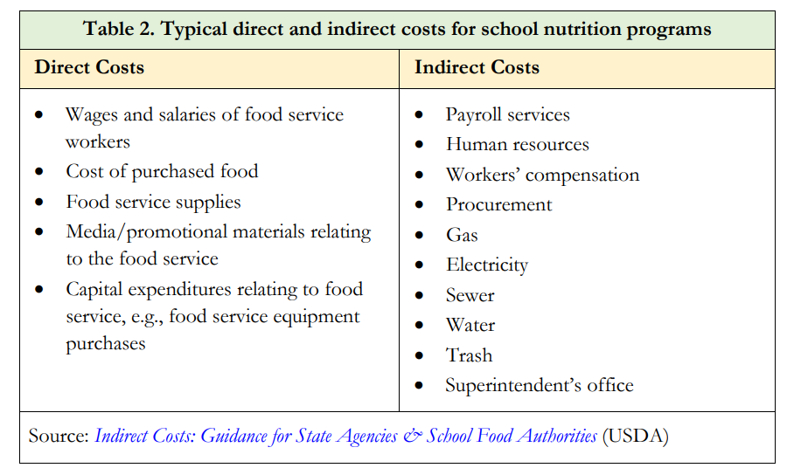
Direct vs Indirect Cost

Slide 17
State Match for the NSLP
Section 7 CFR 210.17 of the NSLP regulations requires states to appropriate a minimum level of state funds (“state match”) to be paid as reimbursement to SFAs that participate in the NSLP.
Notes:
Fringe state payments.

Slide 18
Capital Expenditure Requests and Equipment Approvals
Section 2 CFR 200.439 requires SFAs to obtain prior approval from SCDE for equipment purchases of $5,000 or more.
Can purchase items from state bids of greater than $5,000 without SCDE approval.
Notes:
USDA Memo SP 39-2016: State Agency Prior Approval Process for School
Food Authority (SFA) Equipment Purchases.

Slide 19
SLP4
SLP-4s are due in SCAPS no later than January 31st of each year. A signed copy is also required to be emailed to SCDE by January 31st.
SLP-4s should match your yearly audit.
CNP and Finance should be working closely to ensure the SLP-4s are submitted on time and are accurate.

Slide 20
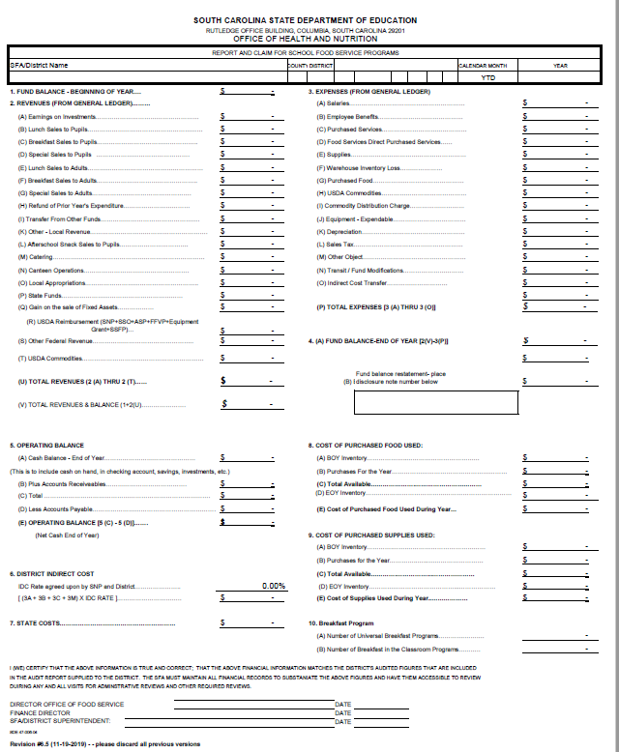
SLP4 – Office of Health and Nutrition

Slide 21
Net Cash Resources (NCR): Three-Month Operating Balance
NSLP regulations require that the fund balance (net cash resources) of the NSFSA cannot exceed three months’ average expenditures as of June 30 of each year.
“Net cash resources” means all monies, as determined in accordance with SCDE’s established accounting system, that are available to or have accrued to a SFA’s nonprofit school food service at any given time, less cash payable.
These monies may include, but are not limited to, cash on hand, cash receivable, earnings on investments, cash on deposit and the value of stocks, bonds, or other negotiable securities.
Notes:
7 CFR 210.14(b) and 7 CFR 210.19(a)(1)

Slide 22
Excessive Operating Balance (EOB)
SFAs that exceed three months’ average expenditures must submit a Plan for Reducing Excess Operating Balance to indicate how the balance will be spent
Expenditures must make improvements to the USDA school nutrition programs such as improving food quality and replacing or purchasing necessary equipment.

Slide 23
Paid Lunch Equity (PLE)
NSLP regulations requires SFAs to ensure that schools provide the same level of support for lunches served to students who are not eligible for free or reduced-price lunches (i.e., paid lunches) as lunches served to students eligible for free lunches.
SFAs are required to compare the average price charged for lunches served to students receiving paid lunches to the difference between the higher Federal reimbursement provided for free lunches and the lower Federal reimbursement provided for paid lunches.
Notes:
Section 7 CFR 210.14(e)
This is required to be completed annually by all SFAs that are not 100% CEP.

Slide 24
PLE
The USDA annually provides a PLE Tool to assist SFAs with making price adjustment calculations.
SFAs must use the USDA’s PLE Tool to ensure that paid lunch prices are set appropriately to cover the cost of a paid student meal.
If the average paid lunch price is less than the difference, the SFA must either gradually adjust average prices or provide non-Federal funding to cover the difference.

Slide 25
Free and Reduced Meal Prices
Sections 7 CFR 210.9(b)(6) and 7 CFR 220.7(e)(3) require SFAs to price reimbursable meals as a unit.
This means that students eligible for free meals receive meals at no charge; students eligible for reduced-price meals pay the current reduced-price charge; and all other students pay the full price for the meal.
The maximum amount for students who are eligible for reduced-price meals is 40 cents for lunch, 30 cents for a breakfast, and 15 cents for ASP snack.

Slide 26
Unpaid Meal Charges
“Bad debt” applies to the NSFSA when unpaid meal charges are not collected and are considered a loss.
Section 2 CFR 200.426 of Subpart E indicates that
“Bad debts…arising from uncollectable accounts and other claims, are unallowable. Related collection costs, and related legal costs, arising from such debts after they have been determined to be uncollectable are also unallowable.”
The NSFSA cannot be used to cover costs related to the bad debt, such as continued legal and collection costs.
Notes:
SFAs may charge different unit prices for different paid reimbursable meal choices. However, students eligible for free and reduced-price meals are also able to select these higher-price meals without incurring an additional charge.

Slide 27
Bad Debit
While bad debt must be written off as an operating loss, it cannot be absorbed by the NSFSA but must be restored using nonfederal funds.
These funds may come from the school district’s general fund, special funding from state or local governments, school or community organizations, private donations, or any other nonfederal sources.
Once delinquent meal charges are converted to bad debt, records relating to those charges must be maintained in accordance with the record retention requirements in 7 CFR 210.9(b)(17) and 7 CFR 210.15(b).

Slide 28
Charge Policy
SFAs must provide the policy in writing to all households at the start of each school year and to households that transfer to the school during the school year. SFAs must also provide the meal charge policy to all school or SFA-level staff responsible for policy enforcement.
The USDA encourages SFAs to:
include the policy in student handbooks and online portals used by households to access student accounts;
use multiple methods to disseminate the policy; and
the first time the policy is applied to a specific student, provide the written policy again to the household through mail or email.

Slide 29
Nonprogram Foods
“Nonprogram foods” include any nonreimbursable foods and beverages purchased using funds from the NSFSA.
This encompasses all foods sold in schools such:
as a la carte items (e.g., milk, juice, entrées, and snack foods),
second student meals,
adult meals,
foods sold outside of school hours,
and any foods used for catering or vending activities.
For most SFAs, a la carte foods offered during meal service account for the largest share of nonprogram foods.

Slide 30
Nonprogram Revenue Calculator
SFAs that sell nonprogram foods are required to determine if the percent of total revenue generated from nonprogram food sales is equal to or greater than the percent of total food costs that are attributable to the SFA’s purchase of nonprogram foods.
SFAs may use the USDA Nonprogram Revenue Calculator
Notes:
SFAs that do not sell any nonprogram foods are not required to complete the USDA’s Nonprogram Revenue Calculator.

Slide 31
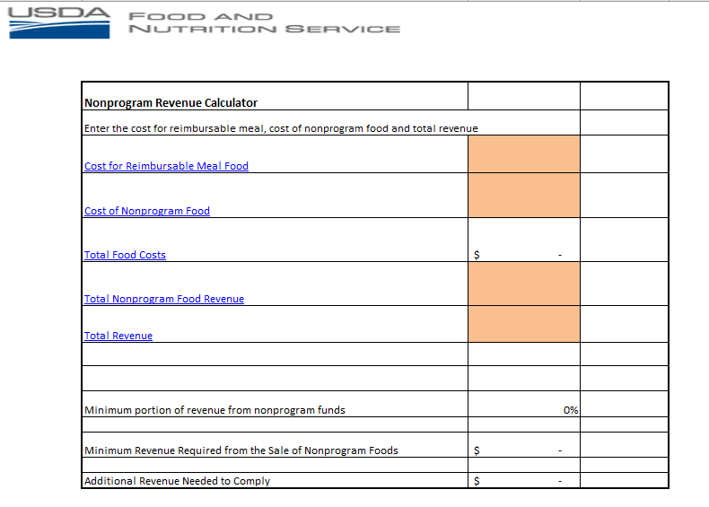
USDA Nonprogram Revenue Calculator

Slide 32
Adult Meals
Meals for school nutrition program employees
SFAs may choose to serve meals at no charge to adults directly involved in the operation and administration of the NSLP and SBP.
This includes:
staff members responsible for menu planning, purchasing, preparation, clean-up, and service of the meals.
The cost of these meals may be paid for from the NSFSA.

Slide 33
Adult Meals - Continued
Meals for non-school nutrition program employees
NSFSA cannot be used to cover the cost of meals served to:
teachers, custodians, administrative personnel, or other staff members who are not involved in the planning, preparation, clean-up, or service of meals.
Funds available to pay the cost of student meals cannot be used to supplement the cost of adult meals.
SFAs must charge these adults the adult meal price established by SCDE
If adults are served larger portions or special meals SFAs must charge more to cover the additional cost
Notes:
The cost formula for adult meals is based on the same serving size and meal as students are served. If adults are served larger portions or from a special bar or menu they must be charged a higher price. The cost must cover the free student reimbursement, commodities cost, taxes, and the additional food cost over the food cost of the student planned menu.
If the LEA includes meals as a fringe benefit or as part of the salary arrangement for non-school nutrition program personnel, the SFA must transfer enough money from other funds to the NSFSA to pay the cost of these adult meals. Funds transferred into the NSFSA for these purposes must be documented for audit purposes.

Slide 34
Do you have any questions?
Questions?

Slide 35
ed.sc.gov
Notes:
Slide title is hidden from display

