Slide 1


Educator Effectiveness
Virtual Office Hours
January 14, 2026
Welcome!
What’s something you plan to do differently this year, personally or professionally?
Notes:
Kate- @ 1:55 Welcome to our January virtual office hours. We’re so glad you could make it. Please type in the chat box your name and district. We have an open-response question posted that we’d love for you to answer in the chat. We’ll get started right at 2 PM. ​(mute)
​
@ 2 PM: Welcome again everyone! My name is Kate Berresford and I am joined by my wonderful colleagues, Ashley Cohoon, Jenny Henke, Dr. Adrienne Davenport from the leadership side of our office and Dr. Robin Amick from the Office of Educator Services. If you haven’t done so, please type your name and district in the chat box, and don't forget to click the mic icon to mute yourself. We encourage you to utilize the chat throughout this session for any questions you may. Our team will be monitoring the chat and responding accordingly. We will also hold a time at the end of this presentation for discussions. Today's VOHs will be recorded for your reference. See open question, read a few responses. Before we move into VOH let's take a look at our agenda.

Slide 2
Agenda
ADEPT Reminders
Induction Count
Mentor & Induction Virtual Support Sessions
Leadership Highlights
Occupational Experience
Q & A
Notes:
We have a few things to go over today in our January VOH. (Review Agenda). As we go, please feel free to add questions in the chat. We will respond to all that we can as we go and will address any lingering questions when we open up the room for discussion at the end.

Slide 3
ADEPT Reminders

Slide 4
Completing Preliminary Cycle
Confirm that the correct number of Preliminary evaluation cycle pre-conferences, observations, and post-conferences have taken place and signatures are present.
Request extensions, as necessary, for preliminary observations not completed according to district ADEPT timeline.
Highly Consequential: Be sure there are at least 3 people on the evaluation team.
Special Areas: Be sure the correct model is being used and all required components and signatures are present.
Notes:
(Kate) As the preliminary cycle winds down we would like to share with you a few reminders when completing the preliminary cycle (read slide).

Slide 5
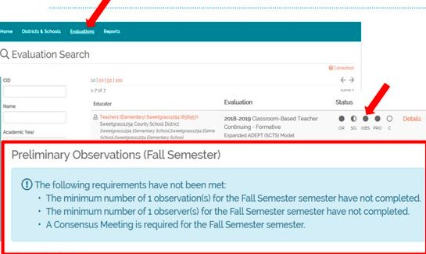
Wrapping up Preliminary Cycle & Beginning Final Cycle in SCLead
The Observation status bubble denotes that the Evaluator has signed the Post-Conference form.
A filled-in observation bubble DOES NOT indicate that the correct number of observations are loaded, nor does it indicate that the teacher has signed the post conference form.
*Teacher signatures are needed but will not prevent the evaluation from being completed or closed.
Notes:
(Kate) As we wrap up the preliminary cycle and move toward the final cycle in SCLead, there a few things to be mindful of.....(read slide)

Slide 6
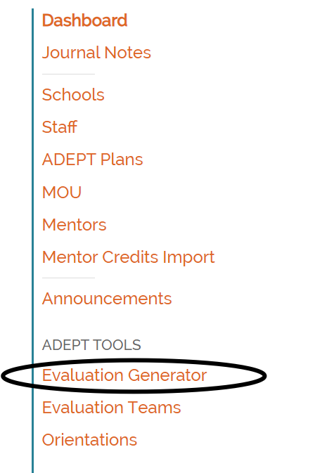

Addressing Evaluations Not Created
If an educator is identified as a Classroom-Based teacher or Special Areas educator, SCLead is expecting an evaluation to be created and completed for the educator. To identify these educators, you will use the Evaluation Generator
Go to your Districts and School dashboard
.
Select Evaluation Generator from the panel on the left.
Notes:
(Kate): The evaluation generator is a great report for you to use to determine which educators do not have evaluations created in SC Lead (read slide)

Slide 7
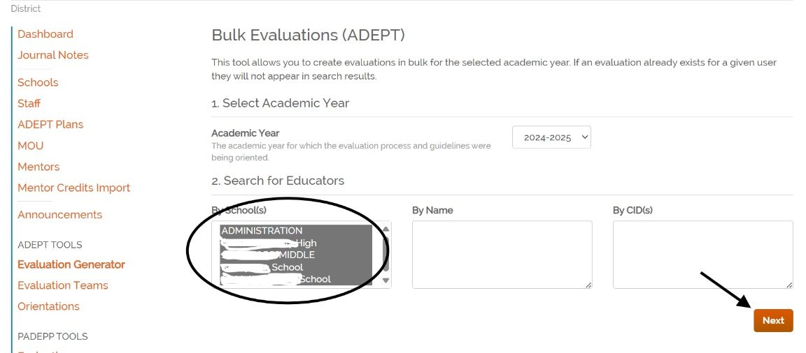
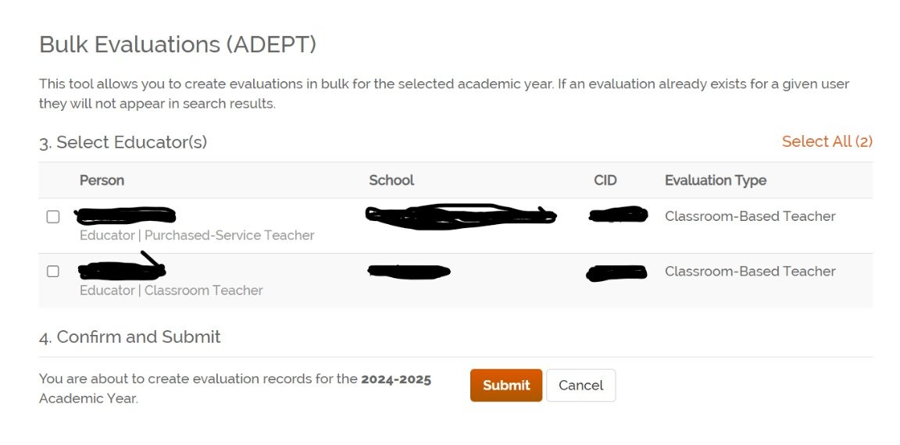
Addressing Evaluations Not Created (continued)
3. Once selected, go to the “By Schools” option, click on the first school, hold shift and the down arrow until all schools are selected. Then, click next.
4. The list that populates identifies all the educators in the district who are identified as Classroom-Based teachers or Special Areas educators who do not have an evaluation created for the 2025-26 school year. To create evaluations, click “Select All” and submit.
Notes:
(Kate) Read slide

Slide 8
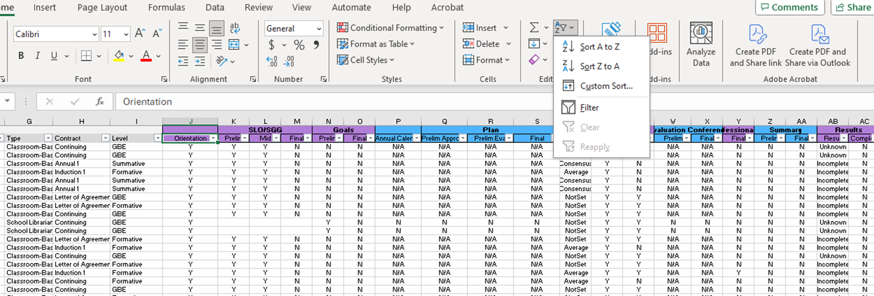
Evaluation Status Report
Notes:
(Kate) I know you all are familiar with the Evaluation Status Report in SCLead. This is a great resource that allows you to see the status overview of educators in your district.
Now, I'm going to turn it over to Jenny for Induction Counts and Mentoring/Induction virtual support sessions.

Slide 9
Induction Count

Slide 10
Induction Count Information
Induction Count is due February 1, 2026.
ADEPT funding will be issued to districts based on the number of Induction 1 teachers reported.
Evaluation records will be reviewed prior to February 1 to determine induction count.
You should have received an email to verify the accuracy of the numbers reported.
Notes:
Jenny - It’s January, so it’s time to prepare for district induction counts. (Read Slide)

Slide 11
Preparing for Induction Count
Ensure all Induction 1 teacher contract/evaluation levels are in SCLead.org
    Import Districts: upload the import spreadsheet to ensure all induction 1 educators are in the system
Use the Staff Evaluations (ADEPT) report to ensure accuracy
Reach out if you have questions or need assistance
Notes:
Read Slide:
For districts who use SCLead, use the bulk evaluations tool to assign Induction contract levels
For import districts, use the Import Spreadsheet to ensure all induction 1 educators have been assigned the correct contract level

Slide 12
Induction Count Reminders
Only certified educators will be included in the count.
Educators hired with less than 152 days should be LOA.
Evaluations for PACE educators who did not get into winter cohort should be closed/made "Incomplete."
Educators receiving PACE certificates through the winter cohort will be included in the count. Certificates should be issued by January 30, 2026.

Slide 13
Mentor & Induction
Virtual Support Sessions
Notes:
Jenny to continue

Slide 14
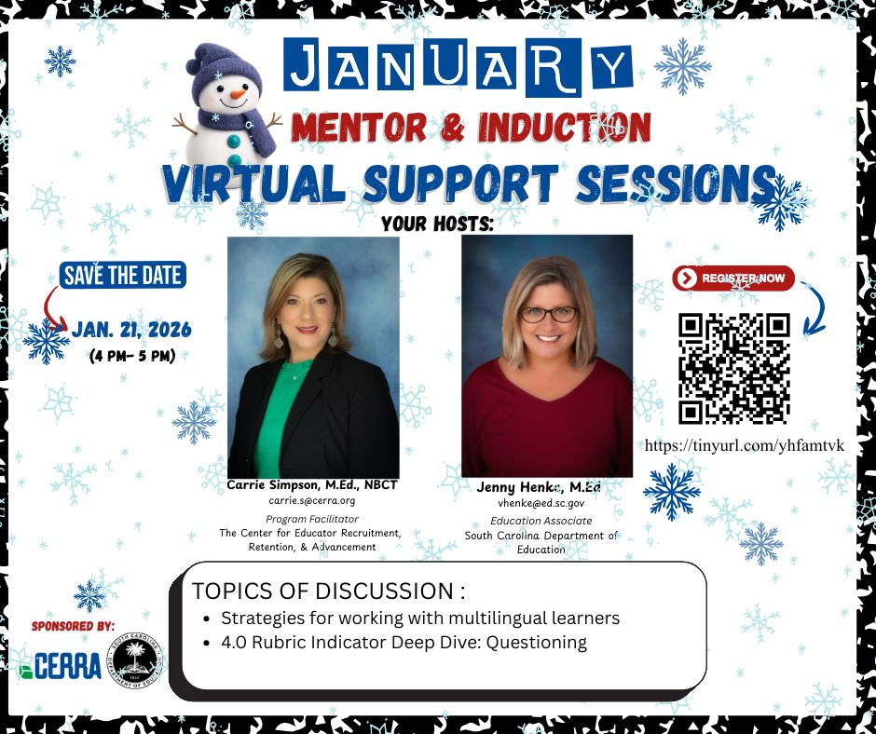

January
M&I Virtual Support Session
(4PM – 5PM)
Jan. 21, 2026
Feb. 18, 2026
March 18, 2026
April 29, 2026
May 20, 2026
Notes:
Carrie Simpson and I preparing for our January Virtual Support session that will take place on Wednesday, January 21st from 4-5 pm. Our topics for discussion include a deep dive into the questioning indicator and strategies for working with multilingual learners.
Ashley will email a shareable flyer at the end of this session for you to share with your induction teachers and current mentors. The QR code can be scanned to access the registration form. I will also drop the registration link in the chat. Please share this information with your Mentor and Induction Coordinators or anyone else who could benefit from this session.
Mark your calendars with the remaining dates for this school year's virtual support sessions.
DROP IN CHAT:
Link to Register for Jan. M&I Virtual Support Session: Mentor & Induction Virtual Support Session

Slide 15
Leadership Highlights
Notes:
(Kate) Thank you Jenny. We will now turn it over to Dr. Davenport for leadership Highlights.

Slide 16
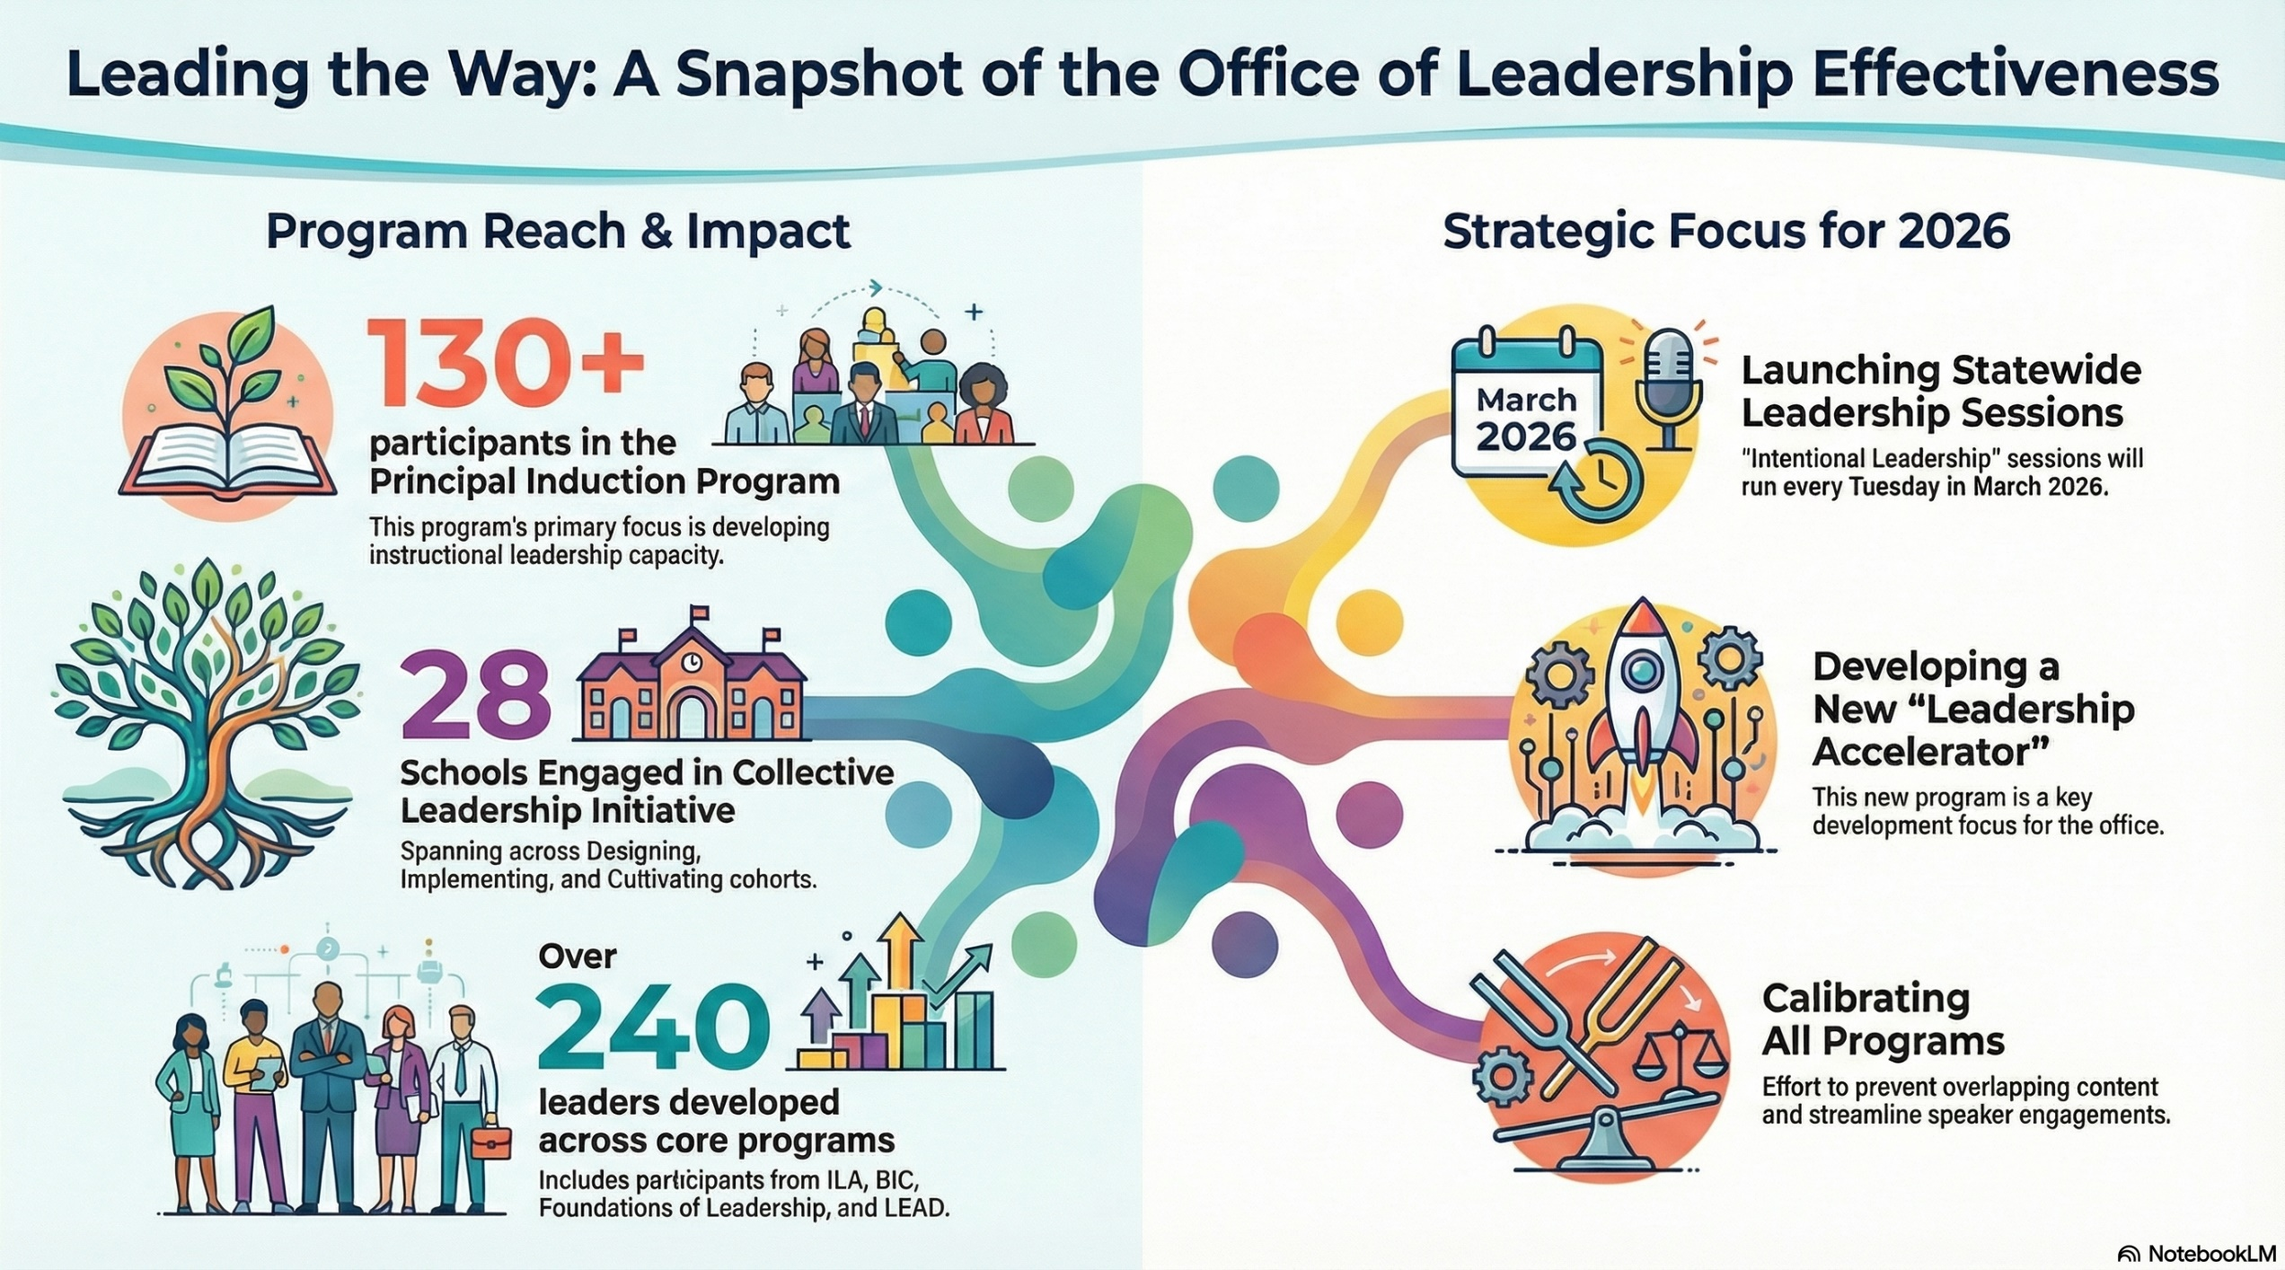

Leading the Way: A Snapshot of the Office of Leadership Effectiveness
Notes:
Ashley- add to chat
School and District Administrators - South Carolina Department of Education

Slide 17
ACT 29: Occupational Experience
Notes:
(Kate) Thank you Dr. Davenport. Dr. Amick will now share some information around occupational experience.

Slide 18
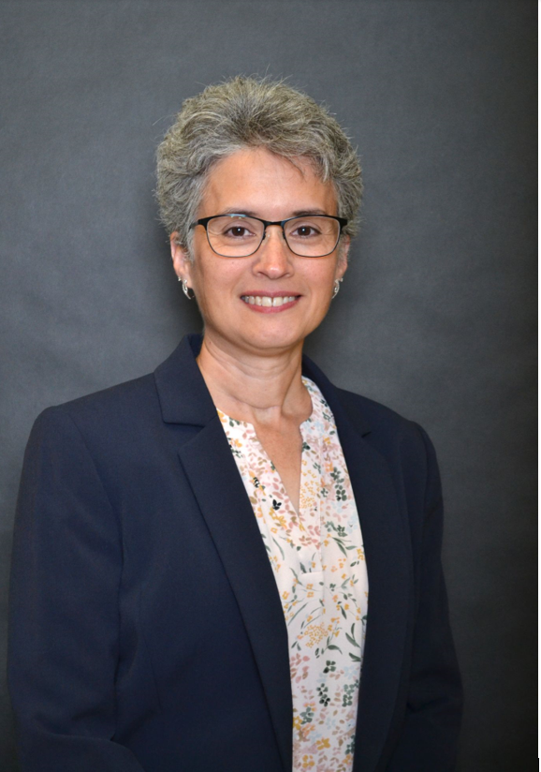
Dr. Robin Amick
SC Department of Education
Educator Services
CTE Work-Based Certification
803-896-0474
ramick@ed.sc.gov

Slide 19
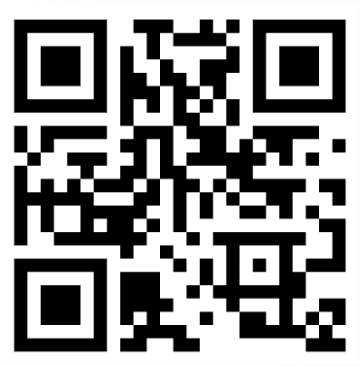
Act 29 – Occupational Experience
SCDE Occupational Experience Website
Notes:
Ashley- add to chat
Non-teaching Occupational Experience Credit - South Carolina Department of Education

Slide 20
Requirements for Occupational Experience
MUST BE:
  Fulltime (at least 35 hours per week)
  Professional work experience in the public or private sector that is directly related to the content area of the educator certificate for which the individual qualifies.
  Educators may earn one year of experience credit for every two years (24 months) of full-time, compensated non-teaching occupational experience (at least 35 hours per week).
Notes:
Ashley- add to chat
Non-teaching Occupational Experience Credit - South Carolina Department of Education

Slide 21
Steps to Add Occupational Experience
Create a request to add Non-teaching occupational experience via the My SC Educator Portal.
Complete a completed Non-teaching Occupational Experience Verification Form, verified by the employer. Submit a job description from the employer demonstrating relevance to the certification area.*
  **You do not need to complete a new form if a verified employment form was submitted when you initially applied for CTE Work-based certification.**
For an educator who is self-employed, the verification must be completed by a third party such as an accountant, attorney, or business manager affiliated with the business.
*If additional years are awarded, the educator is entitled to have his or her pay adjusted at the beginning of the next school year, from the effective date of the adjustment, to reflect the new experience step on the employing district’s salary schedule.
*An educator is not entitled to retroactive pay for the increased years of experience during prior years of teaching or for any purpose other than advancement on the teacher salary schedule.

Slide 22
Questions?
803-896-0474 ​
ramick@ed.sc.gov

Slide 23
Q & A
Notes:
(Kate) Thank you Dr. Amick. We are going to turn it over to Ashley to go over some frequently asked questions.

Slide 24
FAQ
What do we do about educators who were on leave for a large part of the preliminary cycle whose observations weren't able to be completed?
    Per ADEPT regulations, a teacher who is employed under an induction, annual, or continuing contract and who is absent for more than 20 percent of the days in the district’s SBE-approved annual evaluation cycle may, at the recommendation of the district superintendent, have his or her ADEPT results reported to the SCDE as “incomplete.”
    Teachers whose ADEPT results are reported to the SCDE as “incomplete” are eligible to repeat their contract level during the next year of employment.
    In these cases, the evaluation can be "closed" under the evaluation "Settings".
Notes:
Reach out to your ADEPT contact for individual cases

Slide 25
Questions for the OLE?
Notes:
(Team)

Slide 26
Office of Leadership Effectiveness
Effectiveness Leads
Leadership Development Leads
  Dr. Adrienne Davenport, Instructional Leadership & Assistant Principals adavenport@ed.sc.gov
  Dr. Gerard Edwards, Veteran Principals & District Leaders, gedwards@ed.sc.gov
  Keasha Grant, Certified Support & Emerging Leaders, ksgrant@ed.sc.gov
  Crystal Halma, Collective Leadership, chalma@ed.sc.gov
  Dr. Frank Robinson, New Principals & Emerging Leaders, frobinson@ed.sc.gov
Office Support
  Kimberly Mack, Director, kemack@ed.sc.gov
  Marilyn Suber, Administrative Assistant, masuber@ed.sc.gov
Kate Berresford, EPPs, skberresford@ed.sc.gov
Ashley Cohoon, Communications, ascohoon@ed.sc.gov
Dr. Roshonda Frazier, SLO and Teacher Leadership, rfrazier@ed.sc.gov
Jenny Henke, Mentoring & Induction, vhenke@ed.sc.gov
Dr. Kimberly Howard, PADEPP, khoward@ed.sc.gov
Torian Nunn, Data & Reporting, tmnunn@ed.sc.gov
  Visit our website: https://ed.sc.gov
Notes:
As we end our January VOH, this is our contact information. If you need us in any way were are here to help. Thank you for joining us today. We will hang on for a little bit incase you have any individual questions. If not, we can't wait to see you in February!

Slide 27
SCDE SEAL LOGO

