Slide 1


Educator Effectiveness
Virtual Office Hours
Welcome back!
August 8, 2024
What are you celebrating this week?
2. What are you focusing on with teachers as the year begins?
Notes:
Kim: Welcome to our educator effectiveness virtual office hours. We’re so glad you could make it. Please type in the chat box your name and district. We have two opening questions posted that we’d love for you to answer in the chat. We’ll get started right at 2 PM. ​
​
@ 2 PM: Welcome again everyone! (Introduce self and team) If you haven’t done so, please type in the chat box your name and district. First, to orient you to the Microsoft Teams platform, the control icons will be on the upper right section of your screen for most users. If you haven’t yet, please click the mic icon to mute yourself. You will click the same mic icon to unmute yourself later when we are ready for conversation. We encourage you to utilize the chat throughout this session for any questions you may have during the presentation. Our team will be monitoring the chat and responding accordingly. We will also hold a time at the end for discussion.​ ​
The purpose of Office Hours is to hold time to ensure that we share timely reminders with districts, but even more importantly to create a space where you can share feedback, questions, ideas and best practices with your peers. If you are new, there is no question too small; if you are an effectiveness veteran, don’t be shy about letting us know what you need. Before we get started, let’s consider our opening question (summarize responses or ask 1-2 districts to elaborate….)

Slide 2
Agenda
Effectiveness and Training Resources
ADEPT Reminders
SCLead Reminders
FAQs
Questions and Discussion
Notes:
We are so glad to have you here with us today. Before we get to questions and open discussion, we have a few things to share with you (state them). As we go, please feel free to add questions in the chat. We will respond to all that we can as we go and we address any lingering questions and open up the room for discussion at the end.

Slide 3
Effectiveness and Training Resources
Notes:
We realize there's been some turnover in ADEPT leads this year, so we want to start with a reminder about where to find our top resources.

Slide 4
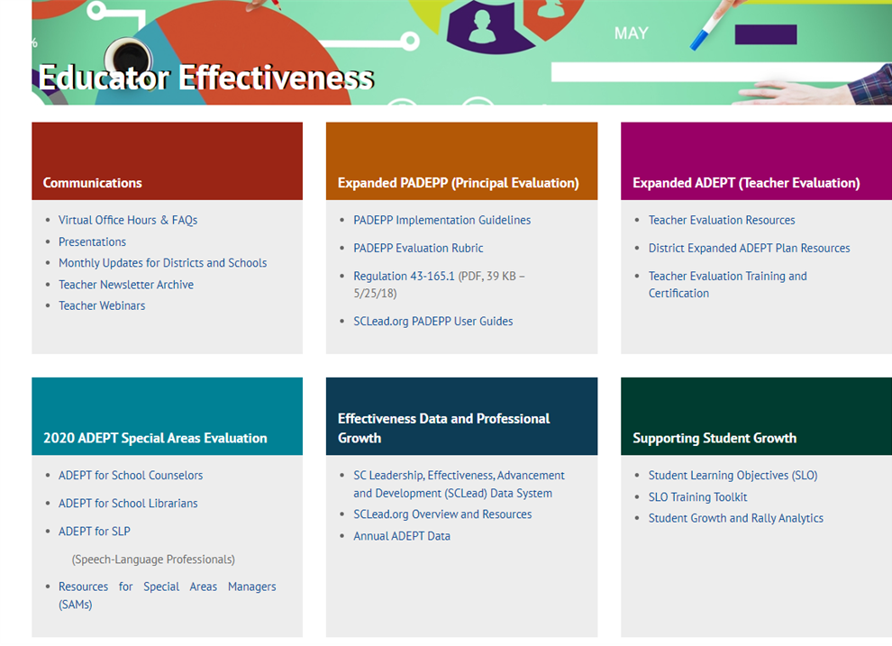
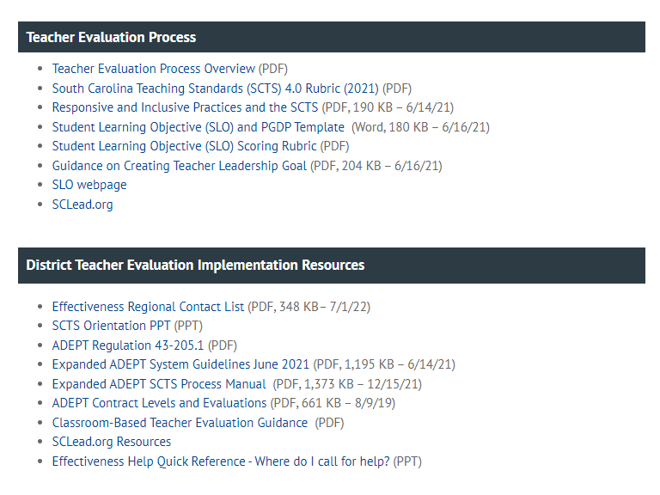
Teacher Evaluation and Support Guidance
South Carolina Department of Education
Notes:
As a district level leader, there are many resources offered to you on the website. When you visit ed.sc.gov and click on “Educators," it will take you to the Office of Educator Effectiveness site. You can see the many resources you can access. If you notice the purple box, it highlights resources related to ADEPT. This will take you to where you can find District Teacher Evaluation Implementation resources including ADEPT regulations, the process manual, and guidance for Contract levels and classroom based teacher evaluations.

Slide 5
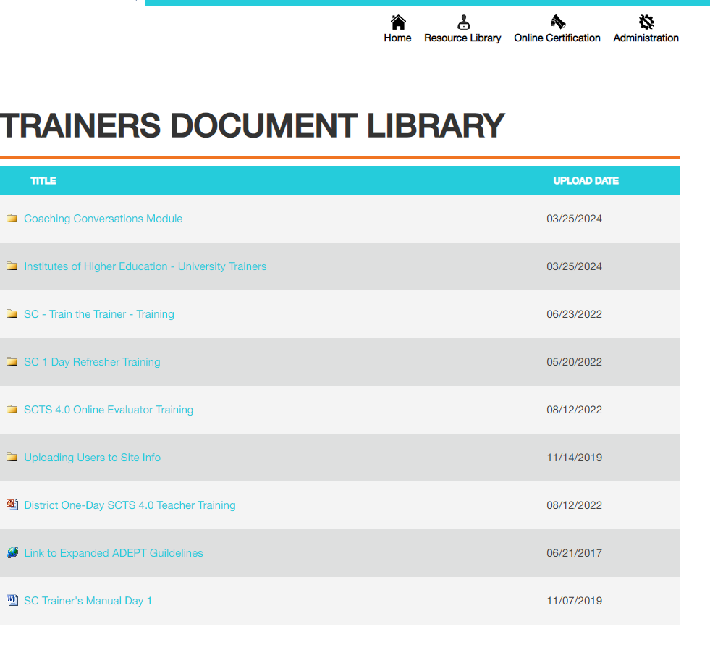
SCTS Training Resources
www.scadeptsupport.org
Notes:
To access training documents from NIET, you can visit SCadeptsupport.org and click on the resource library at the top. You can see the variety of resources you can click on and view concerning evaluator training and train the trainer training.

Slide 6
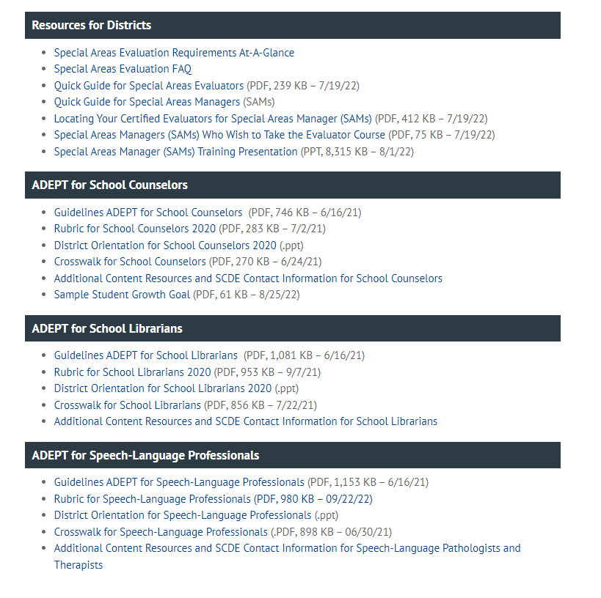
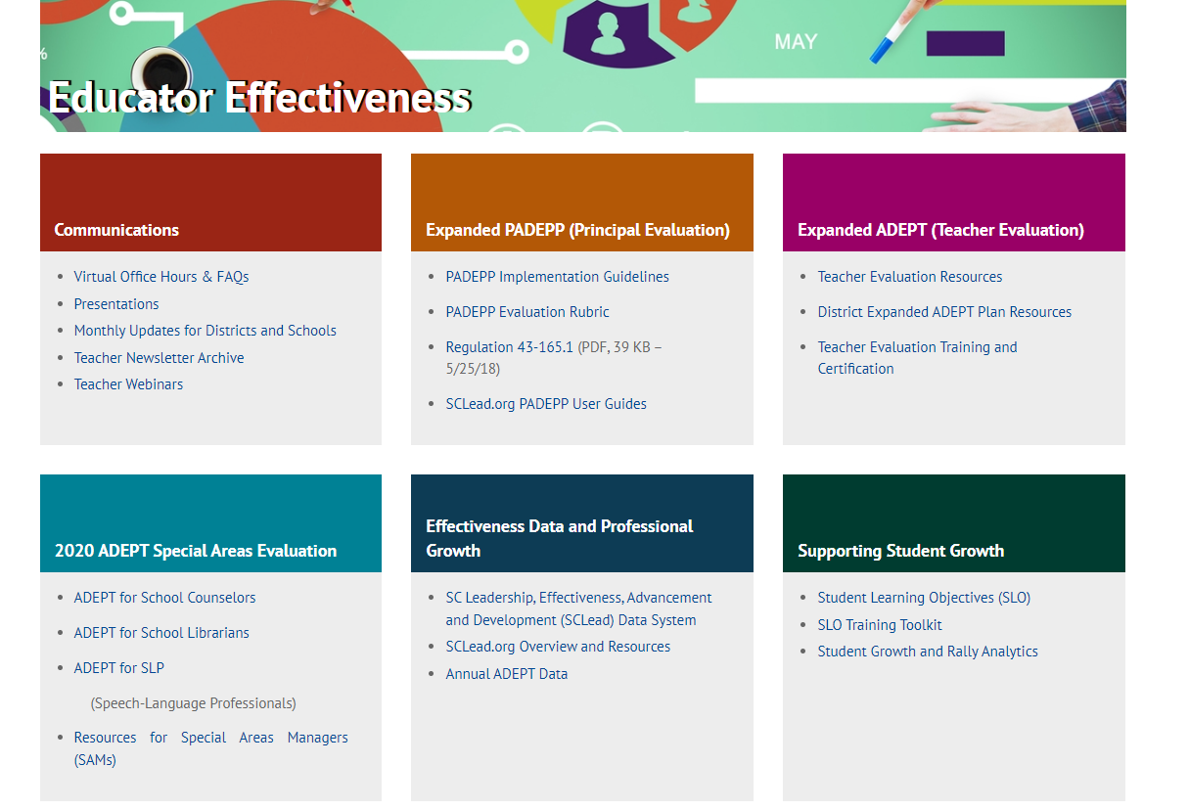
Special Areas Evaluation and Support Guidance

Slide 7
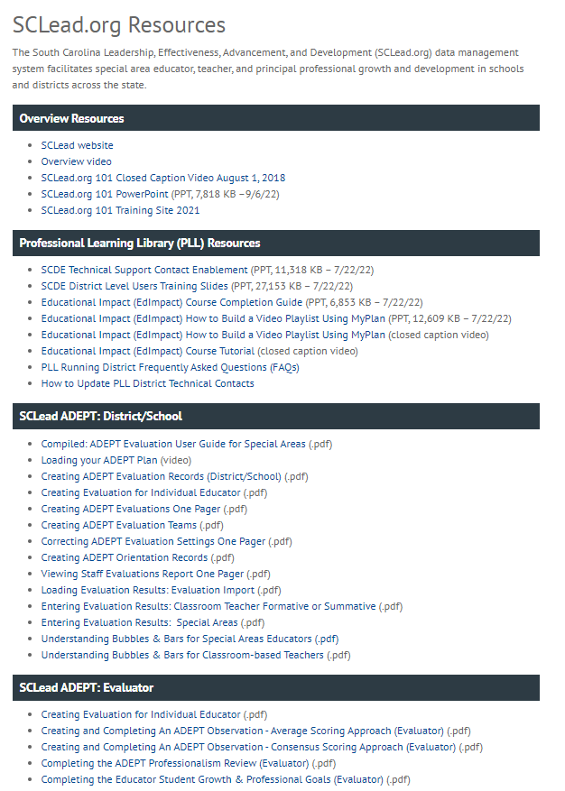
SCLead.org Resources
Notes:
We have many districts that maximize the use of SCLead.org to track the progress of evaluations. Our Effectiveness Team has uploaded resources that can help you with questions that may arise.
Many of you typically ask why the bubbles under the Evaluation Tab are not filled in or why the educator’s Status Page bars are not at 100%.
There are 2 resources in the SCLead.org ADEPT: District/School Section to help you with these questions.
We have the Understanding Bubbles & Bars for Special Areas Educators and Understanding Bubbles and Bars for Classroom-based Teachers.
Our Effectiveness Team co-created these resources along with the others you see with our partners at Randa/SCLead.org. If you have questions outside of the guide, please feel free to email support@sclead.org.

Slide 8
ADEPT Reminders

Slide 9
The When:
ADEPT Calendar of Events and
Due Dates
Date | Key Milestones and Progress Monitoring
April through June | Check to ensure enough evaluators are SCTS certified. Schedule additional SCTS evaluator and Mentor trainings at the district level to ensure availability of evaluators for next school year. Review implementation feedback and complete ADEPT Plan for next year.
July through September | Conduct district evaluator training and orientation and review how SCLead.org features will be used by the district. Conduct differentiated evaluation orientations for educators by contract level, including SCLead.org Orientation signature, review of evaluation process and team, and SCLead.org requirements​. Create evaluations in SCLead.org and confirm initial settings data (e.g., current year’s contract level and evaluation type). ​ Confirm evaluation teams are set by district or school-level personnel.​ Monitor principal/teacher signatures for SLO initial conference​. Confirm all teams have scheduled announced preliminary evaluation cycle observations.
Mid-October through January | Confirm that Preliminary evaluation cycle pre-conferences, observations, and post-conferences occur. The minimum number of required observations is defined by contract level. Conduct district evaluator trainings as needed. Conduct evaluation orientation and training on SCLead.org functionality and requirements for new hires, as needed.
February through April | Confirm initial data entry of contract levels for current academic year in SCLead.org (February 1). Confirm all data for fully certified Induction 1 teachers (February 1, Induction count for ADEPT funding) . Confirm that final evaluation cycle pre-conference(s) and observation(s) occur. Evaluators submit evaluation results in SCLead.org Issue contract notification (before May 1).
May through June | Enter or confirm current year’s evaluation results and next year’s contract and evaluation type. Confirm educators who have had two unsuccessful Annual Summative evaluations for ADEPT sanction letters. Last day to submit End-of-Year evaluation data in SCLead.org (June 20)
Insert and format picture to fit allotted box frame
Notes:
As the year get started, we know many of you may be in different places as far as with the staggered start of the school year. This calendar does give you an idea of the key milestones and monitoring steps you will take as you guide the ADEPT process this year. July through September is highlighted since this is what should be happening during this time. (READ BULLETS)
Be sure to keep this calendar handy as you progress through the school year.

Slide 10
SCLead Reminders

Slide 11
Cleaning up Staff Lists
Educators/administrators no longer with your district
Newly hired educators/administrators
Educators/administrators who moved positions or schools in your district
Notes:
The benefits of doing a clean-up are:
You avoid accidentally creating evaluation records for educators no longer at your school or district.
Your educators/administrators will show at the correct location.
You can ensure that a former SCLead.org ADEPT Administrator no longer has access to evaluation records.
You can ask your ADEPT Contact in our office to grant ADEPT Administrator Rights to newly hired administrators so they can start utilizing SCLead.org.

Slide 12
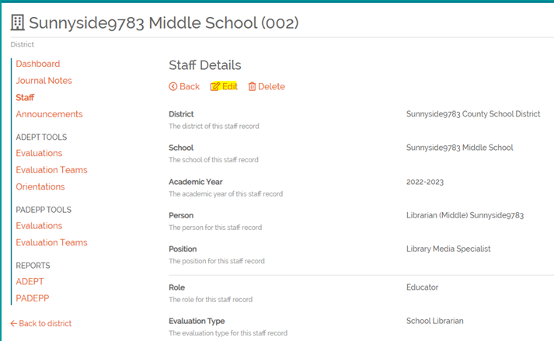
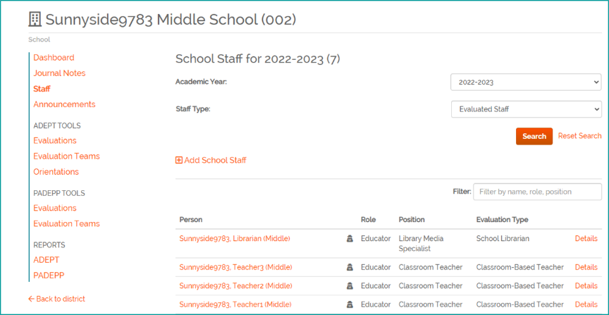
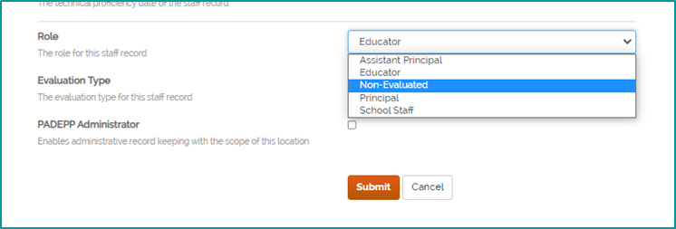
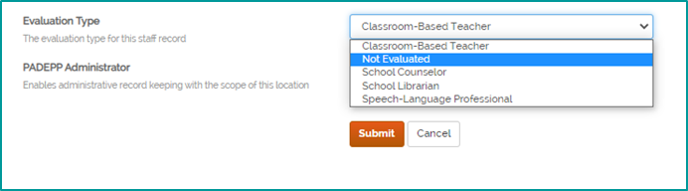
Staff Lists
Notes:
Let’s get familiar with the staff lists in SCLead.org. At the district or school level, you will see filters for the Academic Year, Evaluated Staff and Non-evaluated Staff as shown on the left. You will see a list of educators pulled from SCEducator and their corresponding roles and positions as well as evaluation types. On the right-most column you will see details.
To go about "cleaning-up" your staff lists, you can manually add and remove educators/administrators.
To remove a staff member who no longer has a teaching position, no longer at your district/school and to remove ADEPT Administrator Rights:
Go to the district or school staff list, locate the educator, click "details" then click edit on the new page that appears, that’s shown on the upper right screenshot, Edit the Role as Non-Evaluated and Evaluation Type as Not Evaluated and click Submit.
Note that Non Evaluated automatically removes the Administrator Rights as shown on the lower right screenshot. It also removes the educator from the evaluation donut.

Slide 13
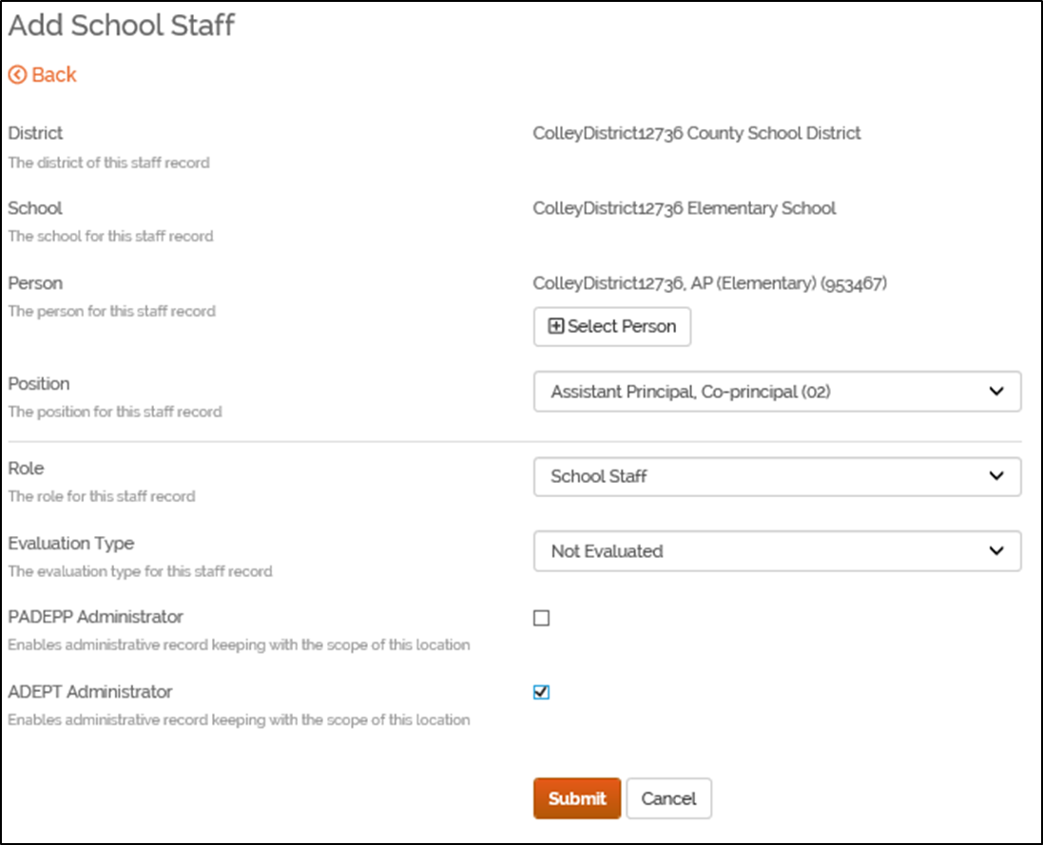
Adding New Staff for the
Purpose of Evaluations
Steps:
Go to school staff list
Click “Add School Staff"
Select the person with correct CID
Select correct position code
Enter appropriate role and evaluation type
Click “Submit"
Notes:
Read slide
District Staff can only add ADEPT administrator rights if the role you selected is either “Principal” or “School Staff”, then you can check the ADEPT administrator box.

Slide 14
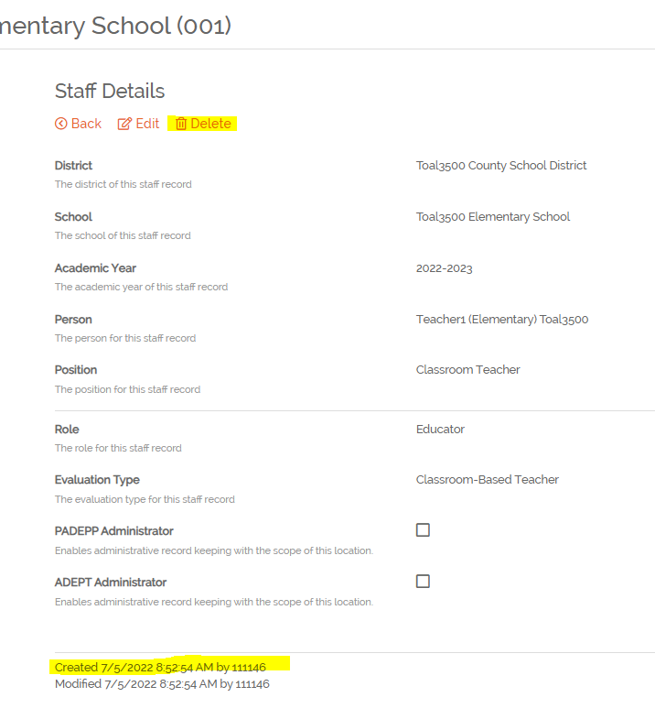
Dealing with Duplicates
"Delete" option will only show if the record was manually added to SCLead.org
Notes:
If a staff assignment has been manually added to SCLead.org, there will be a delete option when you click details for the staff assignment. If the delete option appears, it would indicate the assignment was manually added and can be deleted if desired. You can also check at the bottom where it says Created by. If it was created by number 0, then it was created by SCEducator and can’t be deleted.
Other Tips:
If you created an evaluation record and entered evaluation data under the educator’s profile without a CID, enter the same evaluation data in the evaluation record created under the educator with CID.
Remove any evaluation record from the educator Profile without CID. To remove, locate the evaluation record, go to Settings, scroll down and click “Remove”
Pro Tip- let Finance add positions in SCEducator DON'T manually add if all possible to prevent duplicate profiles.

Slide 15
Frequently Asked Questions

Slide 16
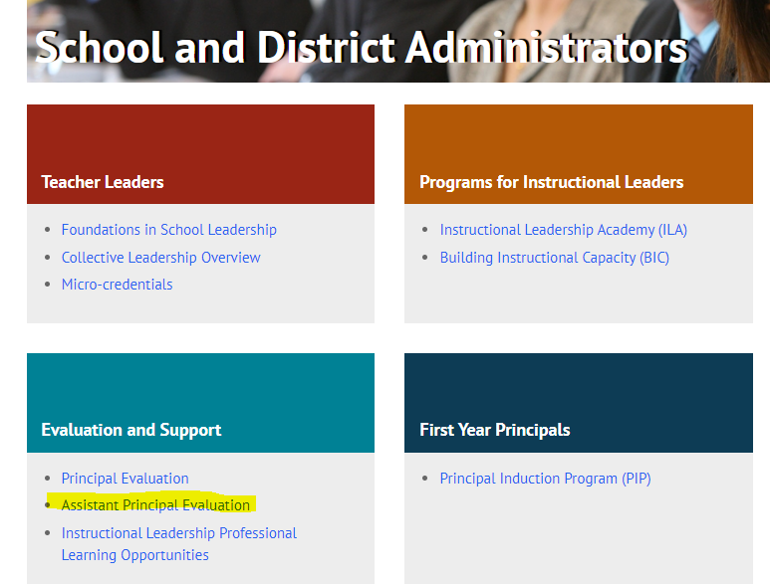
How do we set up Assistant Principal Evaluations in SCLead?
Insert and format picture to fit allotted box frame
Assistant Principal Evaluation

Slide 17
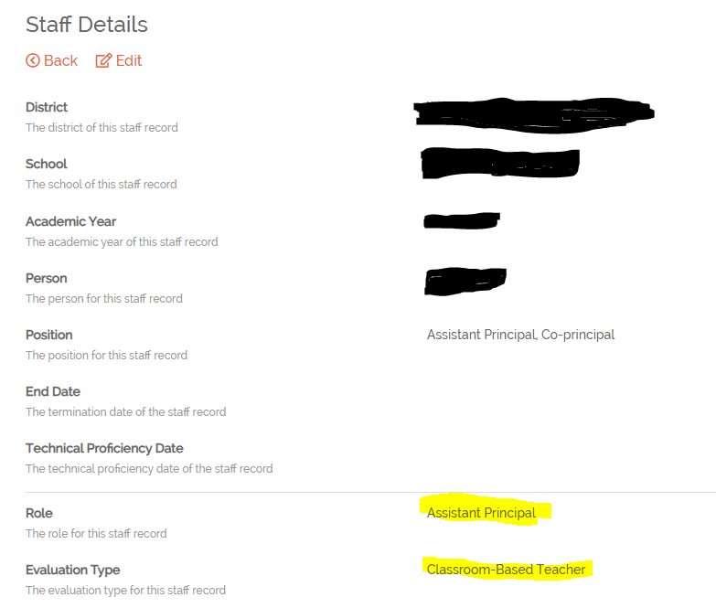
Using SCLead to Enter AP Evaluations
Ensure the proper staffing in SC Educator
2. Go to Staff List > Details > Position: AP; co-principal > Role: Assistant Principal> Evaluation Type: Classroom Based Teacher

Slide 18
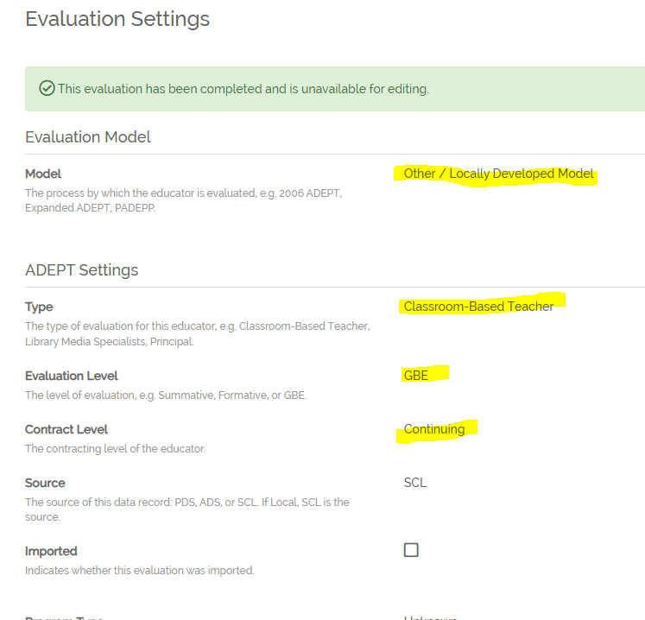
Continued: Using SCLead to Enter AP Evaluations
3. Go to Evaluation Page > Settings > Eval. Model: Locally Developed Model > Eval. Type: Classroom based Teacher > Eval. Level: GBE > Contract Level: Letter of Agreement

Slide 19
Continued 2: Using SCLead to Enter AP Evaluations
If you need the AP to be on an evaluation team, go back to Staff Details and make the following changes:
    Change Role: School Staff > Eval. Type: Not Evaluated
    Give ADEPT rights

Slide 20
Reciprocity and Contract Levels
SCDE may issue one of two certificates to out-of-state educators:
Initial or Professional
Initial certificates are issued when the educator presents less than twenty-seven months of qualifying experience and follow the same process as other Initial certificates.
Professional certificates are issued when the educator presents at least twenty-seven months of qualifying experience. This Professional certificate affects contract and evaluation levels differently. An out-of-state educator on a reciprocal Professional certificate must pass a summative ADEPT evaluation prior to being offered a Continuing contract.

Slide 21
Office Hours Dates for 2024-25
Thursday, August 8, 2024
Wednesday, September 11, 2024
Wednesday, October 9, 2024
Wednesday, November 13, 2024
Wednesday, December 11, 2024
Wednesday, January 8, 2025
Wednesday, February 12, 2025
Wednesday, March 12, 2025
Wednesday, April 9, 2025
Wednesday, May 14, 2025

Slide 22
Questions and Discussion

Slide 23
Office of Educator Effectiveness & Leadership Development
Effectiveness Leads
Leadership Development Leads
Ashley Cohoon, Communications, ascohoon@ed.sc.gov
Dr. Roshonda Frazier, SLO and Teacher Leadership, rfrazier@ed.sc.gov
Jenny Henke, Data & Reporting, vhenke@ed.sc.gov
Dr. Kimberly Howard, PADEPP, khoward@ed.sc.gov
  Visit our website: https://ed.sc.gov
  Dr. Gerard Edwards, Veteran Principals & District Leaders, gedwards@ed.sc.gov
  Keasha Grant, Certified Support & Emerging Leaders, ksgrant@ed.sc.gov
  Crystal Halma, Collective Leadership, chalma@ed.sc.gov
  Dr. Frank Robinson, New Principals & Emerging Leaders, frobinson@ed.sc.gov
  Tom Smith, Instructional Leadership & Assistant Principals, tsmith@ed.sc.gov
Office Support
  Lilla Toal Mandsager, Director, lmandsager@ed.sc.gov
  Marilyn Suber, Administrative Assistant, masuber@ed.sc.gov

Slide 24
SCDE SEAL LOGO

