Slide 1


Educator Effectiveness
Virtual Office Hours
September 11, 2024
Welcome!
Share something exciting that has happened personally or professionally in the last month.
Notes:
Jenny - Welcome to our educator effectiveness virtual office hours. We’re so glad you could make it. Please type in the chat box your name and district. We have an open-response posted that we’d love for you to answer in the chat. We’ll get started right at 2 PM. ​
​
@ 2 PM: Welcome again everyone! (Introduce self and team) If you haven’t done so, please type in the chat box your name and district. First, to orient you to the Microsoft Teams platform, the control icons will be on the upper right section of your screen for most users. If you haven’t yet, please click the mic icon to mute yourself. You will click the same mic icon to unmute yourself later when we are ready for conversation. We encourage you to utilize the chat throughout this session for any questions you may have during the presentation. Our team will be monitoring the chat and responding accordingly. We will also hold a time at the end for discussion.​ ​
The purpose of Office Hours is to hold time to ensure that we share timely reminders with districts, but even more importantly to create a space where you can share feedback, questions, ideas and best practices with your peers. If you are new, there is no question too small; if you are an effectiveness veteran, don’t be shy about letting us know what you need. Before we get started, let’s see what exciting events have happened recently in our chat. (summarize responses or ask 1-2 districts to elaborate….)

Slide 2
Agenda
ADEPT Reminders
Special Areas Reminders
SLO Highlights
FAQs
Questions and Discussion
Notes:
We are so glad to have you here with us today. Before we get to questions and open discussion, we have a few things to share with you (state them). As we go, please feel free to add questions in the chat. We will respond to all that we can as we go and will address any lingering questions and open up the room for discussion at the end.

Slide 3
ADEPT Reminders
Notes:
We want to start with a some ADEPT reminders that are important for this time of the year.

Slide 4
ADEPT Timeline Check-in
Orientation Signatures
Preliminary Conferences:
    SLO/SGG Approval
    Observation Pre-conferences
Observations
Observation Post Conferences
Use Staff Evaluation (ADEPT) Status Report to check progress
Notes:
Now that August is behind us and hopefully you have a moment to breathe, this is a great time to check the status of your educator's evaluations. Orientations should be getting signed to open the components of educators' evaluations. Preliminary conferences are taking place to include those SLO and SGG approvals along with observation pre-conferences. Some of you may already be in the midst of some observations and preparing for those post conferences. The easiest way to check evaluation progress is by downloading the Staff Evaluation (ADEPT) Status Report in SCLead.org. To locate your ADEPT report menu, simply look to the left menu on your district dashboard and select Reports under ADEPT. The Evaluation Status report is also a great way to make certain your educators are correctly identified and are assigned the correct contract and evaluation levels for the year.
If you notice an educator does not have an evaluation and no longer working for your district, you can make their role and evaluation type and "non-evaluated" until they are removed from compensation. This will ensure SCLead isn't looking for those evaluations to be completed which then skews your district dashboard data.

Slide 5
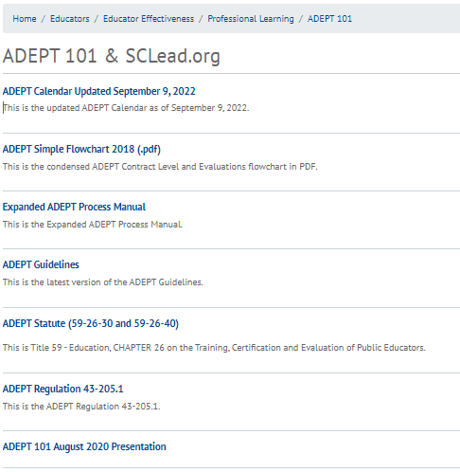
On-Demand Resources for ADEPT
Notes:
We are here to support your needs as ADEPT Coordinators. We want to make sure you are aware of our On Demand Resources. Last month we highlighted the on-demand resources for SCLead.org. This month, we want to show you where to find on-demand resources for the ADEPT process. You can access these resources that we currently have on our website. You can see what we have to offer including the Key milestones Calendar, a flowchart of the contract and evaluation levels, and more.
We will drop the link in the chat.
https://ed.sc.gov/educators/educator-effectiveness/professional-learning/adept-101/
I will now pass the mic to _______.

Slide 6
Special Areas Reminders
Notes:
We want to take a few minutes to go over some Special Areas Reminders.

Slide 7
Role Reminders for the Special Areas Managers
Assign the training of evaluators of speech-language professionals, school counselors, and school librarians in Moodle.
Deliver the required district orientation to speech-language professionals, school counselors, and school librarians.
Maintain the spreadsheet of trained evaluators and send to Ashley Cohoon (ascohoon@ed.sc.gov)
Access Google folder for updates and Quick Guides
    Link to the SAM Google Folder
Notes:
Let’s go over the role of your District Special Areas Manager.
Read List:
Bullet 3 may be a reason why your Special Areas Evaluators are not showing in your list of Special Areas evaluator drop-down. Our office is working hard to serve you in a timely manner, but we do request your patience and allow at least 3-5 business days for the Special Areas credentials to be added from the date you send the spreadsheet.
As a last reminder on Special Areas, if you have Special Areas questions, feel free to reach out to your district's ADEPT liaison.
We will also drop the link in the chat for quick access to the SAM Google Folder: ADEPT for Special Areas 2020 Managers - Google Drive

Slide 8
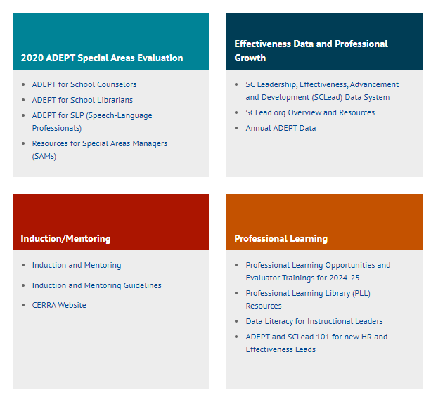
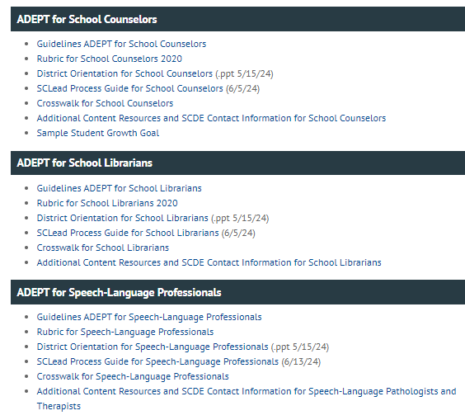
On-Demand Resources for Special Areas
Notes:
To access specific resources for Special Areas evaluations, go to our webpage and click in the block titled “2020 ADEPT Special Areas Evaluation.​"
You will find a list of resources to answer any questions you may have. Each special area has it's own section of resources.
I want to point out that we added new SCLead process guides that provide the steps and explanations of the components for each of the special areas evaluations.
I will now pass the mic over to _________.

Slide 9
SLO Highlights

Slide 10
Guest Speakers
Principal Monique Smalls- Kelly Edwards Elementary School
Principal Karen James- Carver-Edisto Middle School
Mr. Edward Jones- Colleton County District Technology Coach

Slide 11
Frequently Asked Questions
Notes:
We would like to go over some frequently asked questions we've received over the last couple weeks.

Slide 12
Why are my SCTS 4.0 Evaluators Missing in SCLead.org?
The Evaluator’s CID does not match in the NIET SC ADEPT Portal and SCLead.org.
  Email support@niet.org and provide educator’s:​
        Full Legal Name​
        Email ​
        CID​
Notes:
If you are missing SCTS 4.0 Evaluators, there are 3 possible reasons why. I am here to offer reminders on how to address them depending on the reason.
We are hearing from some districts that SCTS 4.0 evaluators are not populating for them to add to an educator’s evaluation team. As a reminder, you cannot use an evaluator to evaluate if that person does not have the right credentials. SCLead.org is programmed to look for valid evaluator credentials. Let’s go over the reasons and the solutions one by one.
1. The Evaluator’s CIDs do not match in the NIET SC ADEPT Portal and SCLead.org.
The NIET SC ADEPT Portal District Administrator should check if the evaluator’s CID matches in SCLead.org and NIET SC ADEPT Portal. If they do not match, the NIET SC ADEPT Portal District Administrator may:
a. Edit the CID
b. Email support@niet.org to request the CID to be updated. Provide the evaluator’s full legal name, email and correct CID.
It typically takes 24 hours for the credential to appear in SCLead.org after completing either step.

Slide 13
Why are my SCTS 4.0 Evaluators Missing in SCLead.org Continued?
2. The evaluator has not taken and/or passed the SCTS 4.0 Evaluator Test.
    Go to www.scadeptsupport.org and take/pass the assessment
3. The credential has expired.
    Go to www.scadeptsupport.org to take/pass the assessment to renew the credential.
Note: If the educator cannot access their account in the SCADEPT portal (i.e. changed districts, forgot username/ password), have them email support@niet.org and include:​ legal name​, CID​, and old email address/current email address.
Notes:
Remind your educator to take and pass the test by going to www.scadeptsupport.org and logging in to take the exam. Remember that completing the SCTS 4.0 Evaluator Training does not automatically grant a training participant the SCTS 4.0 Evaluator credential. The SCTS 4.0 trainer submits the list of successful training participants to NIET, then NIET creates the user accounts so that your trained educators may take the SCTS Evaluator Test.
The SCTS 4.0 Evaluator credential is only valid for 3 years. If you have an educator who has changed districts and/or can no longer access their account, have them email support@niet.org to update their account. They need to be sure to include their legal name, CID, old email address and their current email address.
If you have an educator who is having difficulty accessing there account, have them follow the directions on the screen to email NIET. They need to include their legal name, CID, their old and current email addresses and the issue that is in need of being resolved.

Slide 14
What do we do when educators can't login to SCLead.org?
Ensure your district HR/finance department has assigned the educator a position code and school within their compensation system. This will rollover into SCLead.
If the educator has an account and cannot access it, they must email support@sclead.org and include:
    Full Legal Name
    CID
    Issue (forgot username/password; update email if changed districts; register new account)
Notes:
The next frequently asked question is what do we do when an educator cannot login to SCLead.org.
They may not have an account in SCEducator or be missing a position code and school. You need to contact your district's HR department to have a position code and school assigned to the educator. This will rollover into SCLead. Do not create an account. This will result in a duplicate account and cause confusion later.
The educator may have changed districts or may have never registered their account. If this is an issue, have the educator contact SCLead by following these steps (Read Slide).

Slide 15
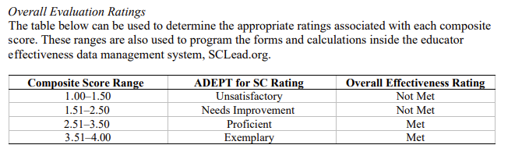
What are the scoring guidelines for Special Areas evaluation?
Notes:
Lilla
This past month when working with some of the researchers over at the SCTeacher center for Excellence on the University of South Carolina campus, we realized that there was a discrepancy between what we established in the guidelines for Special areas scoring and what SCLead programmed in for scoring. As you can see from the table, the cut scores for special area educators are slightly different than those for teachers. The reason for this was analyzing the historical data from special areas and teacher evaluations, looking at the rigor of the rubric, and working with the advisory teams that drafted the special areas models. The primary difference is that The unsatisfactory and Exemplary ranges are slightly wider (read those ranges). Upon our data review, we did not find any special educators who would have fallen into Not Met who were not already deemed Not Met on the teacher scale.
Teachers....1-1.24 unsatisfactory
1.25-2.25 needs improvement
2.26-3.75 Proficient
3.76-4.0 Exemplary

Slide 16
What are the transition plans for OEELD?
Lilla Toal Mandsager shifting into support for Division of College, Career, and Military Readiness
Kimberly Howard will continue as team lead for Educator Effectiveness, Frank Robinson will take on a role as team lead for Leadership Development
We're hiring for two open positions on the ADEPT team. Please send Kim or Lilla names of anyone you think would be a good fit.
Notes:
Lilla
We want to announce a few more transitions in our office (bullet points 1-2)
We want to thank the EE team for their patience and hard work this summer with Beverly and Vicki retiring, they have been two people down but haven't skipped a beat. I have such deep gratitude for their hard work and professionalism.
To that end, in the coming weeks, we'll posting two openings on our team in particular we are looking for expertise in program evaluation, new teacher support, and knowledge of teacher preparation pathways.

Slide 17
Questions and Discussion
Notes:
We would now like to open the mic for any questions you may have.

Slide 18
Office of Educator Effectiveness & Leadership Development
Effectiveness Leads
Leadership Development Leads
Ashley Cohoon, Communications, ascohoon@ed.sc.gov
Dr. Roshonda Frazier, SLO and Teacher Leadership, rfrazier@ed.sc.gov
Jenny Henke, Data & Reporting, vhenke@ed.sc.gov
Dr. Kimberly Howard, PADEPP, khoward@ed.sc.gov
Lilla Toal Mandsager, Executive Director, lmandsager@ed.sc.gov
Marilyn Suber, Administrative Assistant, masuber@ed.sc.gov
  Dr. Gerard Edwards, Veteran Principals & District Leaders, gedwards@ed.sc.gov
  Keasha Grant, Certified Support & Emerging Leaders, ksgrant@ed.sc.gov
  Crystal Halma, Collective Leadership, chalma@ed.sc.gov
  Dr. Frank Robinson, New Principals & Emerging Leaders, frobinson@ed.sc.gov
  Tom Smith, Instructional Leadership & Assistant Principals, tsmith@ed.sc.gov
  Visit our website: https://ed.sc.gov
Office Support
Notes:
We thank you for your time today. We will stay for a few extra minutes if anyone has any additional questions.
Feel free to reach out to us if you have questions or feedback for us. Our email addresses are shown on the slide.
Have a great rest of your day!

Slide 19
SCDE SEAL LOGO

