Slide 1



Educator Effectiveness
Virtual Office Hours
October 9, 2024
Welcome!
What habits or hobbies are you “falling” into this season?
Notes:
Ashley - Welcome to our educator effectiveness virtual office hours. We’re so glad you could make it. Please type in the chat box your name and district. We have an open-response posted that we’d love for you to answer in the chat. We’ll get started right at 2 PM. ​
​
@ 2 PM: Welcome again everyone! (Introduce self and team) If you haven’t done so, please type in the chat box your name and district. First, to orient you to the Microsoft Teams platform, the control icons will be on the upper right section of your screen for most users. If you haven’t yet, please click the mic icon to mute yourself. You will click the same mic icon to unmute yourself later when we are ready for conversation. We encourage you to utilize the chat throughout this session for any questions you may have during the presentation. Our team will be monitoring the chat and responding accordingly. We will also hold a time at the end for discussion.​ ​
The purpose of Office Hours is to hold time to ensure that we share timely reminders with districts, but even more importantly to create a space where you can share feedback, questions, ideas and best practices with your peers. If you are new, there is no question too small; if you are an effectiveness veteran, don’t be shy about letting us know what you need. Before we get started, let’s see what exciting events have happened recently in our chat. (summarize responses or ask 1-2 districts to elaborate….)

Slide 2
Agenda
ADEPT Reminders
Professional Learning Library
FAQs
Questions and Discussion
Notes:
We are so glad to have you here with us today. Before we get to questions and open discussion, we have a few things to share with you (state them). As we go, please feel free to add questions in the chat. We will respond to all that we can as we go and will address any lingering questions and open up the room for discussion at the end.

Slide 3
ADEPT Reminders

Slide 4
ADEPT Reminders for Mid-October - January
Confirm all required evaluation records are created in SCLead.org.
    Ensure all educators have a contract and evaluation level set in SCLEAD.
    For educators no longer in your district, remove them from your staff lists or mark them "non-evaluated" until a termination date is set in your district's compensation system.
Monitor completion of Preliminary Cycle evaluations. The minimum number of required observations is defined by contract level.
    Follow up with schools that do not have Student Growth Goals or Observation bubbles at least partially filled on Evaluation Tab.
    Ensure Induction 1 and Annual Formative educators have a mentor on their team.
Notes:
Read Slide

Slide 5
Professional Learning Library
Notes:
Good afternoon! We wanted to take a few moments to talk about the PLL and highlight how districts are using this resource to grow educators which impacts the academic growth of our students.

Slide 6
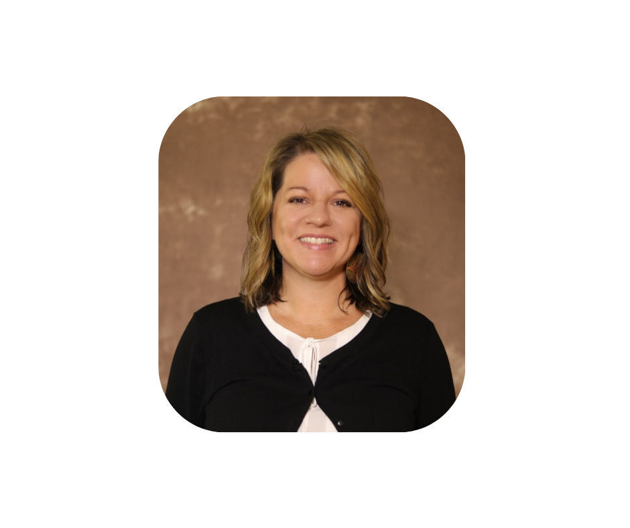
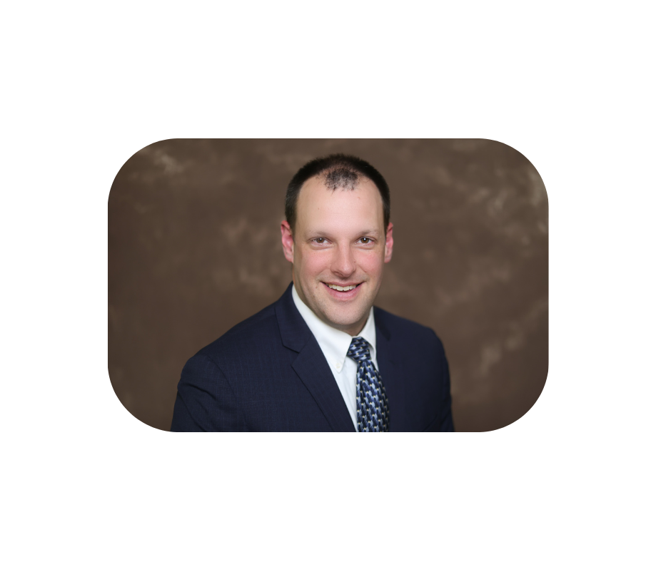

Special Guests
Jaime Dawson
Director of Literacy and Teacher Quality, Spartanburg School District Two
Coordinator for Staff Development, Math and Science,
Spartanburg School District Two
Notes:
We are excited to have special guests Jaime Dawson and Steven Olejnik from Spartanburg School District Two to share their expertise on how their district uses the Professional Learning Library to support educators.
They will be talking about:
“How their district uses the PLL to support educator growth?”
“How they assist administrative teams and school leaders in selecting meaningful professional development using the Professional Learning Library?”
"How they promote the PLL to encourage participation?"
"How has Educational Impact worked specifically with Spartanburg 2 to tailor professional development for your staff?"
We want to thank Jaime and Steven for their time and for sharing their experiences with the PLL.

Slide 7
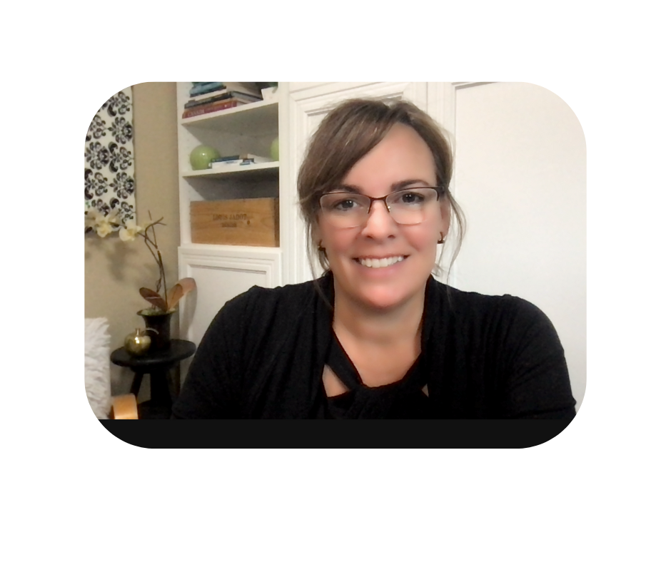
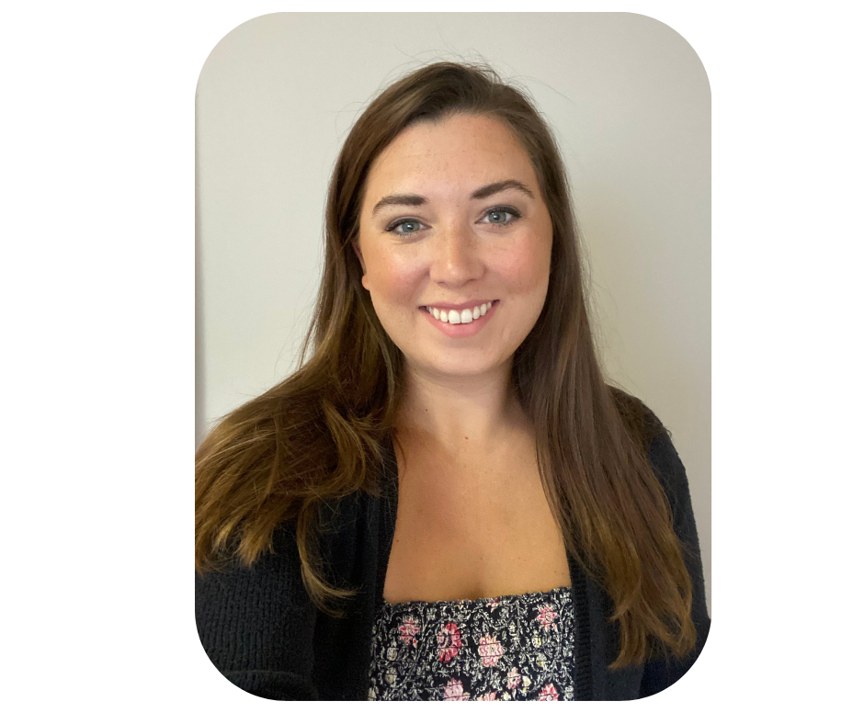
Special Guests,
Educational Impact
Deanna Maki
President,
Educational Impact
dmaki@educationalimpact.com
Melissa Hoot
Implementation Director, Educational Impact
mhoot@educationalimpact.com
PLL Course Catalog for SC
Notes:
We would like to welcome the president of Educational Impact, Deanna Maki and South Carolina's implementation Specialist Melissa Hoot to share more about the content in the PLL and how they provide tailored support for the educators and staff in your school districts.
Drop catalog in chat: FINAL SCDE Course Catalog | 2024-25 (educationalimpact.com)

Slide 8
Frequently Asked Questions

Slide 9
How Can I Recover My Username/Password in SCLead?
  SCLEAD will not allow our office to recover your password.
  You will have to send in a support ticket (support@sclead.org).
Why aren’t educators showing up when I am trying to build an evaluation team for Special Areas?
Evaluators complete assigned training in Moodle and submit certificate to their SAM
SAM sends completed spreadsheet to Ashley Cohoon for import into SCLead
When assigning evaluation teams, make sure the evaluator is staffed at the same school as the educator. If evaluator credential is missing, contact SAM.

Slide 10
Questions and Discussion
Notes:
We would now like to open the mic for any questions you may have.

Slide 11
Office of Educator Effectiveness & Leadership Development
Effectiveness Leads
Leadership Development Leads
Ashley Cohoon, Communications, ascohoon@ed.sc.gov
Dr. Roshonda Frazier, SLO and Teacher Leadership, rfrazier@ed.sc.gov
Jenny Henke, Data & Reporting, vhenke@ed.sc.gov
Dr. Kimberly Howard, PADEPP, khoward@ed.sc.gov
Lilla Toal Mandsager, Executive Director, lmandsager@ed.sc.gov
Marilyn Suber, Administrative Assistant, masuber@ed.sc.gov
  Dr. Gerard Edwards, Veteran Principals & District Leaders, gedwards@ed.sc.gov
  Keasha Grant, Certified Support & Emerging Leaders, ksgrant@ed.sc.gov
  Crystal Halma, Collective Leadership, chalma@ed.sc.gov
  Dr. Frank Robinson, New Principals & Emerging Leaders, frobinson@ed.sc.gov
  Tom Smith, Instructional Leadership & Assistant Principals, tsmith@ed.sc.gov
  Visit our website: https://ed.sc.gov
Office Support
Notes:
We thank you for your time today. We will stay for a few extra minutes if anyone has any additional questions.
Feel free to reach out to us if you have questions or feedback for us. Our email addresses are shown on the slide.
Have a great rest of your day!

Slide 12
ed.sc.gov
Notes:
Slide title is hidden from display

