Slide 1


Educator Effectiveness
Virtual Office Hours
October 8, 2025
Welcome!
What helpful habits or new hobbies are you "falling" into this season?
Notes:
Ashley- Welcome to our educator effectiveness virtual office hours. We’re so glad you could make it. Please type in the chat box your name and district. We have an open-response posted that we’d love for you to answer in the chat. We’ll get started right at 2 PM. ​
​
@ 2 PM: Welcome again everyone! (Introduce self and team: Dr. KH, Dr. RF, JH, TN, KB.
If you haven’t done so, please type in the chat box your name and district. First, to orient you to the Microsoft Teams platform, the control icons will be on the upper right section of your screen for most users. If you haven’t yet, please click the mic icon to mute yourself. You will click the same mic icon to unmute yourself later when we are ready for conversation. We encourage you to utilize the chat throughout this session for any questions you may have during the presentation. Our team will be monitoring the chat and responding accordingly. We will also hold a time at the end for discussion.​ ​
The purpose of Office Hours is to hold time to ensure that we share timely reminders with districts, but even more importantly to create a space where you can share feedback, questions, ideas and best practices with your peers. If you are new, there is no question too small; if you are an effectiveness veteran, don’t be shy about letting us know what you need. Before we get started, let’s see what exciting events have happened recently in our chat. (summarize responses or ask 1-2 districts to elaborate….)

Slide 2
Agenda
ADEPT Reminders
Professional Learning Library
District Needs Survey 2026-27
Mentoring and Induction
FAQs
Questions and Discussion
Notes:
Before we get to questions and open discussion, we have a few things to share with you (read agenda). As we go, please feel free to add questions in the chat. We will respond to all that we can as we go and will address any lingering questions and open up the room for discussion at the end.

Slide 3
ADEPT Reminders
Notes:
We want to start with a some ADEPT reminders that are important for this time of the year.

Slide 4
ADEPT Timeline Check-In
Confirm all required evaluation records are created in SCLead.org.
  Ensure all educators have a contract and evaluation level set in SCLEAD.
  For educators no longer in your district, remove them from your staff lists or mark them "non-evaluated" until a termination date is set in your district's compensation system.
Monitor completion of Preliminary Cycle evaluations. The minimum number of required observations is defined by contract level.
  Follow up with schools that do not have Student Growth Goals or Observation bubbles at least partially filled on Evaluation Tab.
  Ensure Induction 1 and Annual Formative educators have a mentor on their team.
Notes:
Torian- Now that September is behind us and hopefully you have a moment to breathe, this is a great time to check the status of your educator's evaluations. Orientations should be getting signed to open the components of educators' evaluations. Preliminary conferences are taking place to include those SLO and SGG approvals along with observation pre-conferences. Some of you may already be in the midst of some observations and preparing for those post conferences. The easiest way to check evaluation progress is by downloading the Staff Evaluation (ADEPT) Status Report in SCLead.org. To locate your ADEPT report menu, simply look to the left menu on your district dashboard and select Reports under ADEPT. The Evaluation Status report is also a great way to make certain your educators are correctly identified and are assigned the correct contract and evaluation levels for the year.
If you notice an educator does not have an evaluation and no longer working for your district, you can make their role and evaluation type and "non-evaluated" until they are removed from compensation. This will ensure SCLead isn't looking for those evaluations to be completed which then skews your district dashboard data.

Slide 5
Professional Learning Library (PLL)
Notes:
Ashley

Slide 6

What is the Professional Learning Library?
On-demand Resources
New Teacher & Principal Induction
Instructional Leadership Development
Professional Growth, Development, and Evaluation
Notes:
The Professional Learning Library is a resource provided by the Office of Leadership Effectiveness to all K-12 schools across the state of South Carolina. You can access the PLL through SCLead or through the Instruction Hub. Need directions?
The mission of OLE is “growing educators to lead schools where ALL students have equitable access to effective instruction”. The PLL addresses this mission by providing on-demand PD content to support…
new teachers and principal induction
instructional leadership development
and professional growth for all with a wide array of content, including custom courses to support SCTS 4.0 and PADEPP evaluation and development.

Slide 7




What is in the Professional Learning Library (PLL)?
SCDE Renewal*
Mini Courses
PLH Courses
My Plan
Notes:
EI has created four types of courses
SCDE Renewal Credit courses aligned to SCTS & PADEPP evaluation rubrics
Mini courses for condensed, refresher versions for SCDE courses
Professional Learning Hours (PLH) courses to address additional PD topics
And the “My Plan” tool to build a customized video playlist

Slide 8
How to Earn Renewal Credit
SCDE Renewal Matrix, Option 6 (Professional Training)
Type | Renewal Credits | Proof Required
Professional Training (Option 6) | 1 hour of direct participation = 1 renewal credit | Training objectives and/or outline A certificate or other official documentation
Notes:
FINAL SCDE Course Catalog

Slide 9
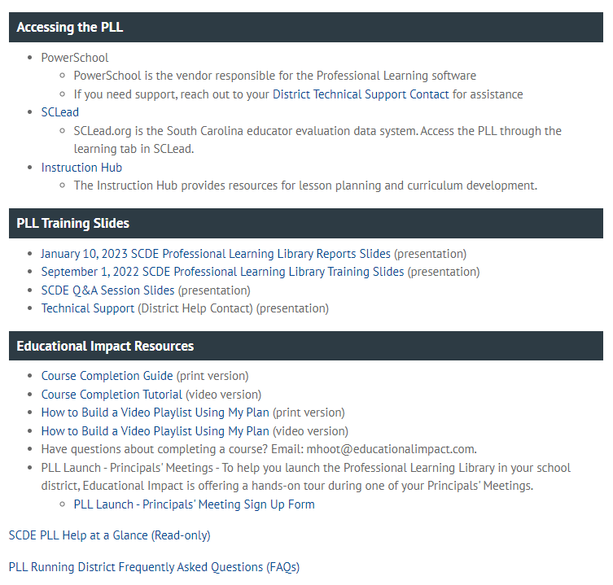
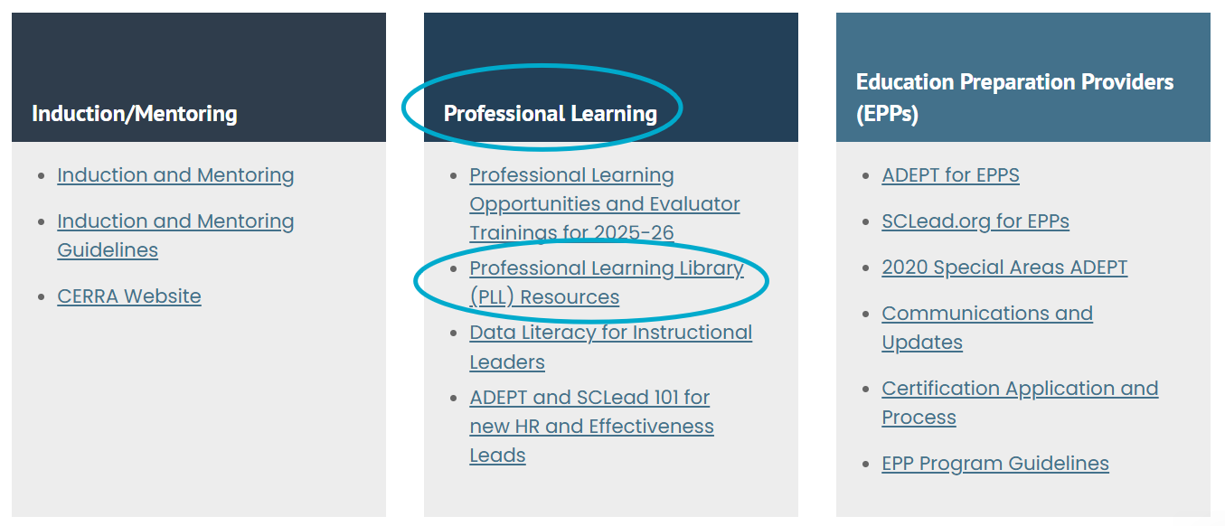
PLL Resources
Notes:
To access additional PLL resources, click on the link to the Professional Learning Library under the Professional Learning Block
You will find a list of easy to access resources to meet any needs you may have.

Slide 10

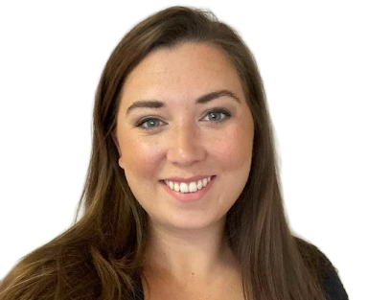
Need Course Suggestions and Implementation Support?
Contact Melissa Hoot
VP, Professional Services
South Carolina’s
Implementation Specialist
Mhoot@educationalimpact.com
Notes:
Kick-Off Kit:
Presentation Slides (force-copy template--feel free to customize with local contact information, etc.)
Presentation Guide ("Script")
Provided personalized support for:
Charleston County School District
Rock Hill Schools
Charter Institute at Erskine
Learning Pathway suggestions

Slide 11
District Needs Survey 2026-27
Notes:
Kim

Slide 12

We Need Your Feedback!
Rooms at the SCDE and at regional sites get booked quickly! The training schedule needs to be created and sent out in early 2026.
Your feedback is appreciated!
2026-27 District Needs Survey
ADEPT Coordinators please complete the survey by October 24th.
Notes:
Ashley
2026-27 District Needs Survey

Slide 13
Mentoring and Induction
Notes:
Jenny

Slide 14

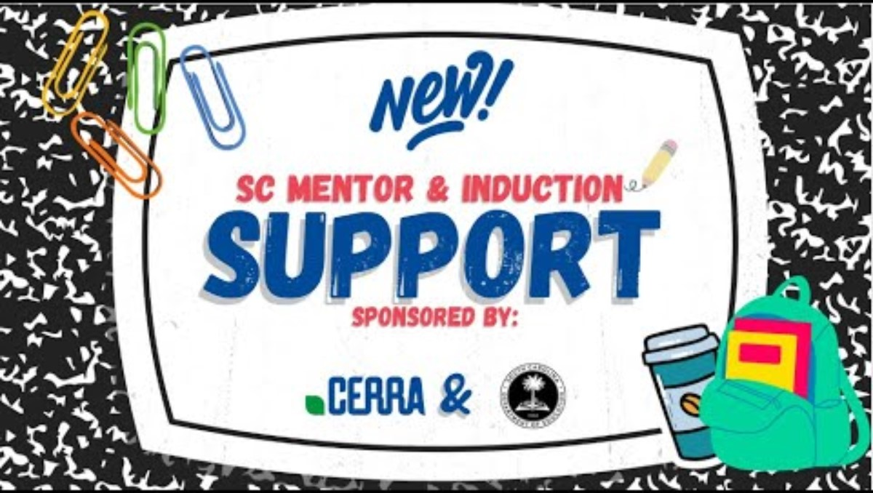
Launching on October 15, 2025!
Notes:
We are excited to announce a new initiative from CERRA in collaboration with the South Carolina Department of Education, new Mentor and Induction Virtual Support Sessions!
Starting in October, these monthly sessions will offer practical guidance on evaluations, spotlight a variety of resources and strategies to enhance learning, and—most importantly—provide a space for encouragement and connection.
These sessions are designed to uplift and empower educators as they make a lasting impact in their schools and communities.
We invite educators who are beginning their teaching journey or those who are supporting others through theirs to cultivate a network of support one conversation at a time.
Take a look at this brief introductory video...

Slide 15
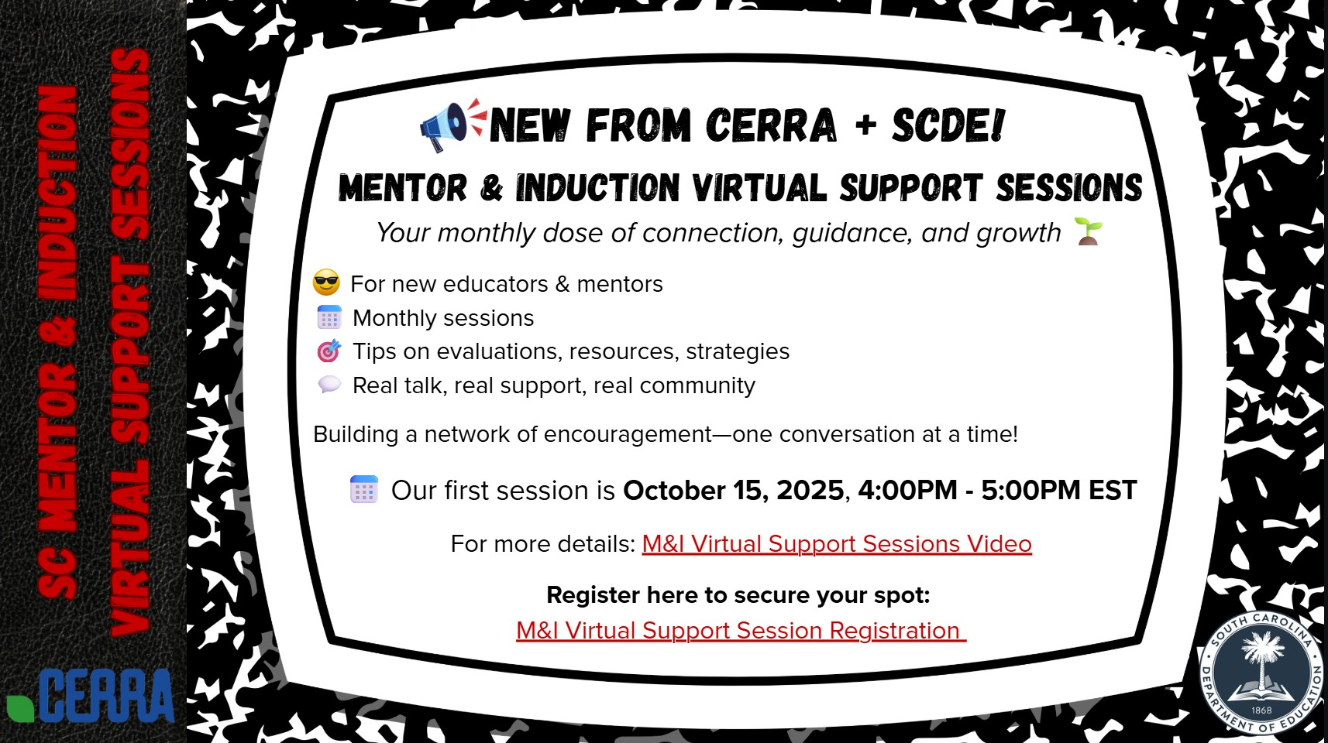
SHARE with your NEW teachers and MENTORS!
Click HERE to download the shareable flyer that includes live links to the video and registration form.
Notes:
We would love for you to share the flyer you see on the screen with your induction teachers, their mentors, and any others you think would benefit from this new resource. When you download the flyer, the links for the video and registration form are live for anyone to view them. Please do not hesitate to reach out to me if you have any questions and as always, we appreciate the support you offer to the new educators in your schools.
<copy and paste links to chat>
Link to flyer:
https://www.canva.com/design/DAG0FqD0_Ew/xARQIE_n7ndl0salsarS3Q/view?utm_content=DAG0FqD0_Ew&utm_campaign=designshare&utm_medium=link2&utm_source=uniquelinks&utlId=hadd4ea9c14
Link to video: https://www.youtube.com/watch?v=nrlqvcWiFX4
Link to Registration form: https://cerra.wufoo.com/forms/z8xuaax0ffanjc/

Slide 16
ADEPT FAQs
Notes:
Kate

Slide 17
ADEPT FAQ Responses
Why aren’t educators showing up when I am trying to build an evaluation team for Special Areas?
Evaluators complete assigned training in Moodle and submit certificate to their SAM
SAM sends completed spreadsheet to Ashley Cohoon for import into SCLead
When assigning evaluation teams, make sure the evaluator is staffed at the same school as the educator, and in a defined role, which cannot be "non-evaluated". If evaluator credential is missing, contact SAM.
Notes:
Present questions and answer.

Slide 18
Questions and Discussion
Notes:
We will open the mic now for any questions you may have for the team. At end ask: If you think of questions along the way please place them in the chat.

Slide 19
Office of Leadership Effectiveness
Effectiveness Leads
Leadership Development Leads
Kate Berresford, EPPs, skberresford@ed.sc.gov
Ashley Cohoon, Communications, ascohoon@ed.sc.gov
Dr. Roshonda Frazier, SLO and Teacher Leadership, rfrazier@ed.sc.gov
Jenny Henke, Mentoring & Induction, vhenke@ed.sc.gov
Dr. Kimberly Howard, PADEPP, khoward@ed.sc.gov
Torian Nunn, Data & Reporting, tmnunn@ed.sc.gov
  Visit our website: https://ed.sc.gov
  Dr. Gerard Edwards, Veteran Principals & District Leaders, gedwards@ed.sc.gov
  Keasha Grant, Certified Support & Emerging Leaders, ksgrant@ed.sc.gov
  Crystal Halma, Collective Leadership, chalma@ed.sc.gov
  Dr. Frank Robinson, New Principals & Emerging Leaders, frobinson@ed.sc.gov
Office Support
  Kimberly Mack, Director, kemack@ed.sc.gov
  Marilyn Suber, Administrative Assistant, masuber@ed.sc.gov

Slide 20
SCDE SEAL LOGO

