Slide 1


Educator Effectiveness
Virtual Office Hours
October 4, 2023
Welcome!
Fall is in the Air!
What are some new habits or hobbies that you are falling into?
Notes:
Welcome to our educator effectiveness virtual office hours. We’re so glad you could make it. Please type in the chat box your name and district. We have our opening questions posted that we’d love for you to answer in the chat. We’ll get started right at 2 PM. ​
RECORD
@ 2 PM: Welcome again everyone. If you haven’t done so, please type in the chat box your name and district. First, to orient you to the Microsoft Teams platform, the control icons will be on the upper right section of your screen for most users. If you haven’t yet, please click the mic icon to mute yourself. You will click the same mic icon to unmute yourself later when we are ready for conversation. We encourage you to utilize the chat throughout this session for any questions you may have during the presentation. Our team will be monitoring the chat and responding accordingly. We will also hold a time at the end for discussion.
Welcome to OEELD April 2023 virtual office hours. We’re so glad you could be here with us. I am Brandon Gantt and I am joined today by our Effectiveness Director, Lilla Toal Mandsager and Team Members: Dr. Vicki Traufler, Dr. Kim Howard, Beverly Flythe, Roshonda Frazier, and Jenny Henke.
​ ​
The purpose of Office Hours is to hold time to ensure that we share timely reminders with districts, but even more importantly, to create a space where you can share feedback, questions, ideas and best practices with your peers. If you are new, there is no question too small; if you are an effectiveness veteran, don’t be shy about letting us know what you need. Before we get started, let’s consider our opening questions (summarize responses or ask 1-2 districts to elaborate….)

Slide 2
Agenda
Welcome
Professional Learning Library
22-23 Effectiveness Data & Human Capital Dashboard
FAQ's
Questions and Discussion

Slide 3
Professional Learning Library
Notes:
Good afternoon! I am Jenny Henke and am excited to bring a few updates for the PLL. Through intense work with PowerSchool, we believe everyone should have access to the PLL at this time. If you receive an email about this as a concern, please reach out to Jenny Henke

Slide 4

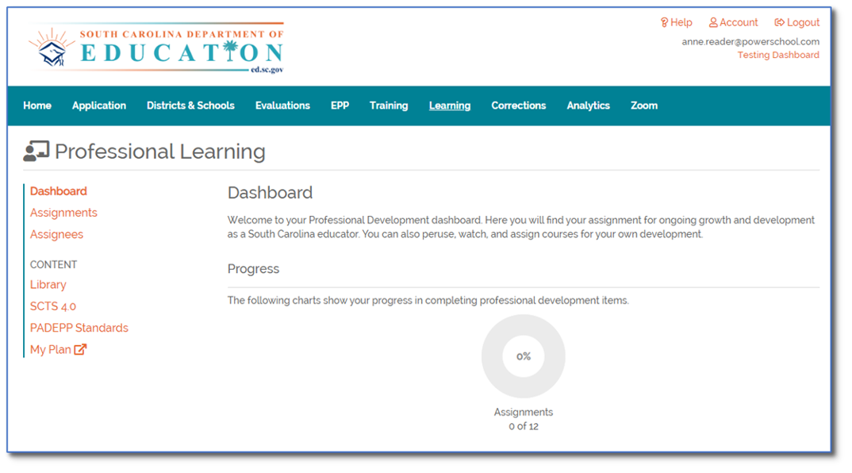
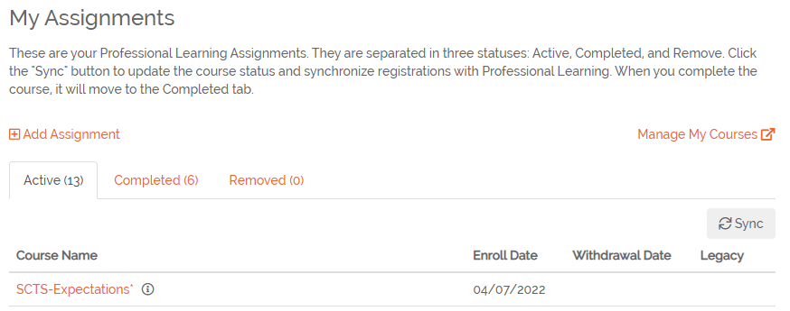
BEGIN IN SC LEAD
Log into SCLead.org > Navigate to the Learning tab > under Assignments, click Manage My Courses to open Professional Learning
Notes:
Speaker Notes: We’re excited to start by bringing you information on a new course added to the PLL that gives you more information about this premium content library that all SCLead users have access to.
To access the PLL, we begin by logging into SCLead > navigating to the Learning tab > and selecting “Assignments” and then "Manage My Courses" at the far right. You can also click on "My Plan." This will redirect learners to PowerSchool Professional Learning dashboard where you can access premium content.
**TROUBLESHOOTING TIP: If participants cannot locate the “Manage My Courses” link, have them access any course title in “Library” on the left navigation bar instead. This will bring learners into the Professional Learning Platform and allow them to access the full searching capabilities under the “Courses” tab.

Slide 5
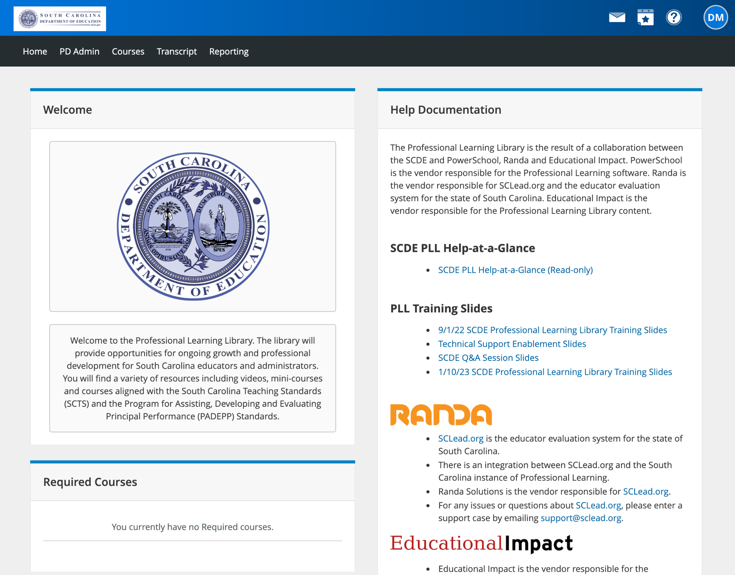
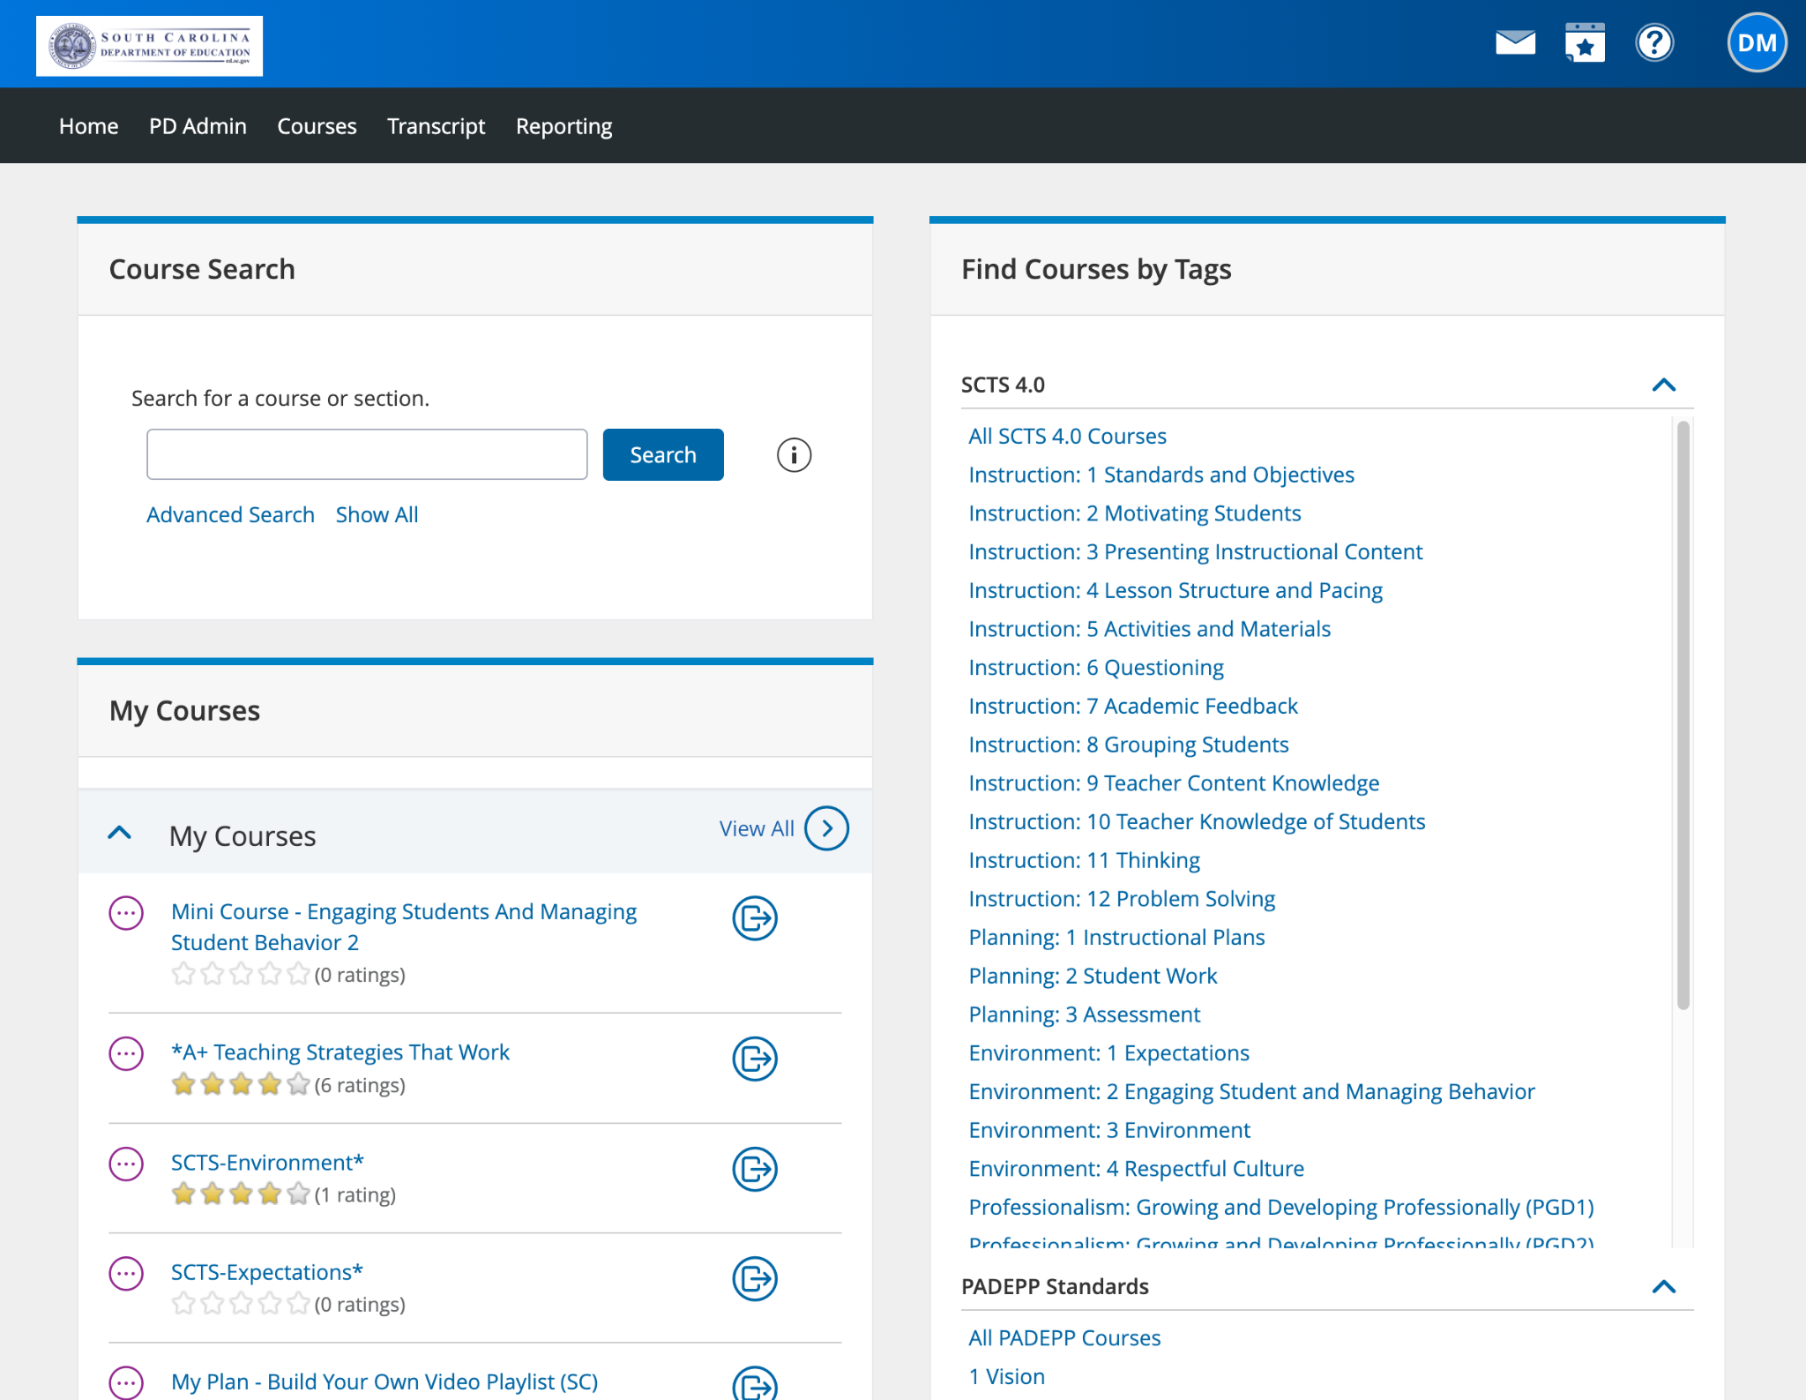
POWERSCHOOL - PLL HOMEPAGE
This will open the PLL homepage.
(Note: Help Documentation & support resources can be found on the right-hand channel of the homepage.)
Click on the Courses tab to begin searching for content.
Notes:
Speaker Notes:
Once in the PLL, learners can view the “Help Documentation” channel on the right-hand side of the page. Here, you can find support resources such as technical contacts, training slides, and troubleshooting tips.
Click the Course tab in the top menu bar to begin searching for PD content.

Slide 6
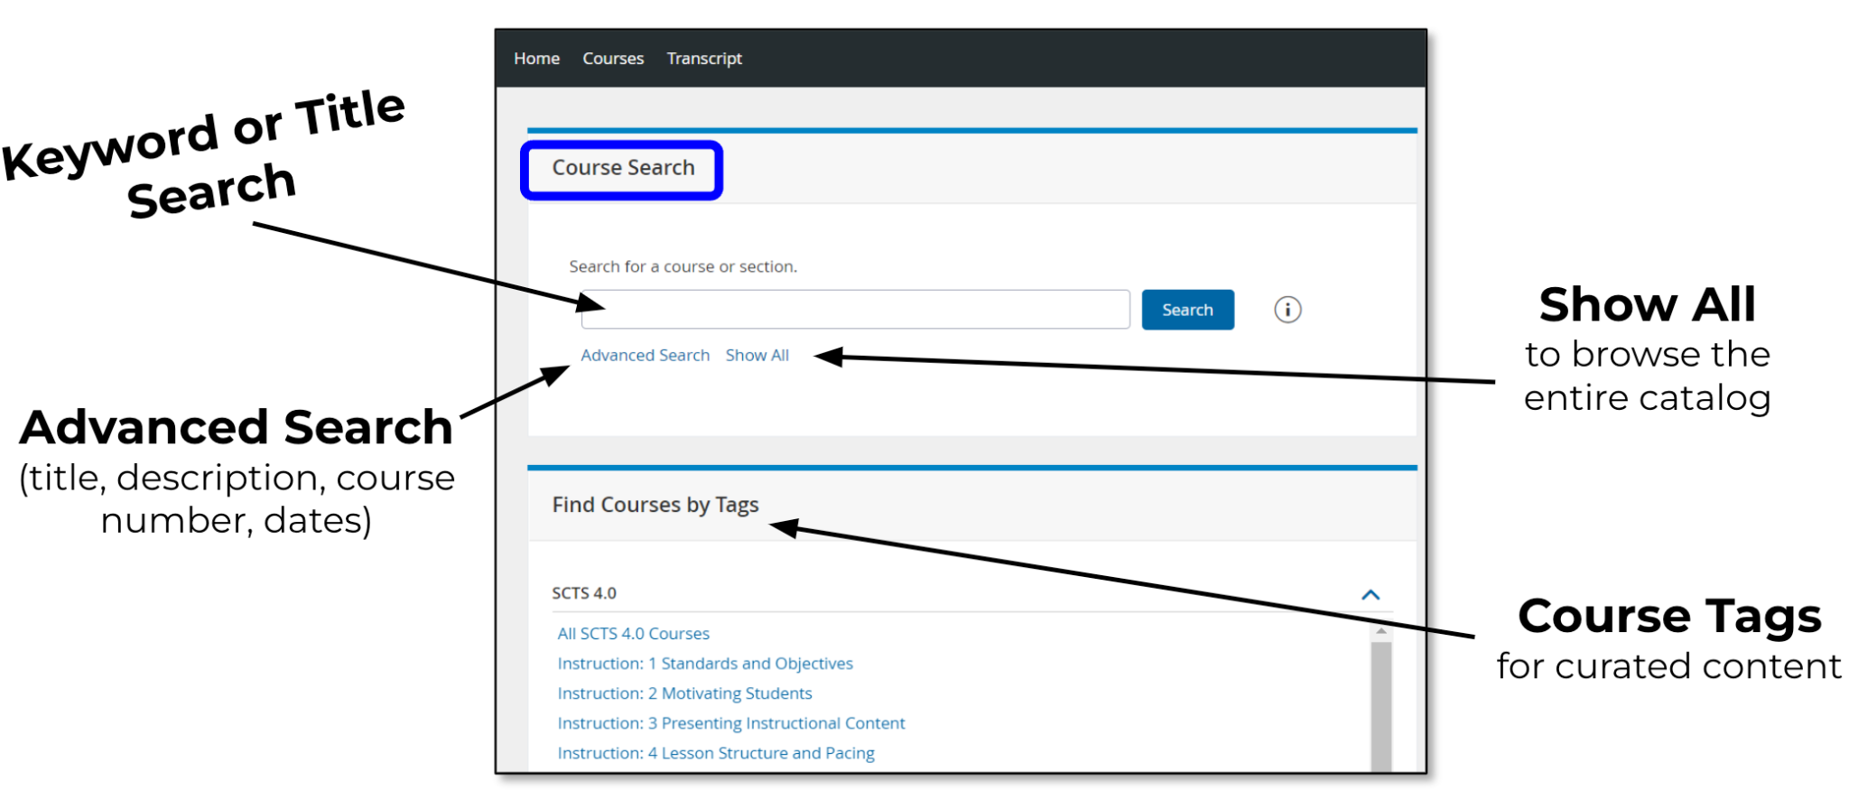
PLL SEARCH TOOLS
Notes:
Speaker Notes:
Users can utilize the robust searching tools to narrow the list of nearly 300 premium courses offered by Educational Impact. Users can search by keyword, course title, course number, or use targeted “tags” to refine their search.

Slide 7
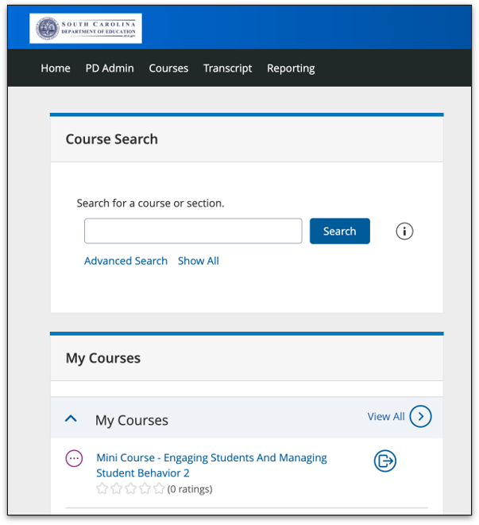
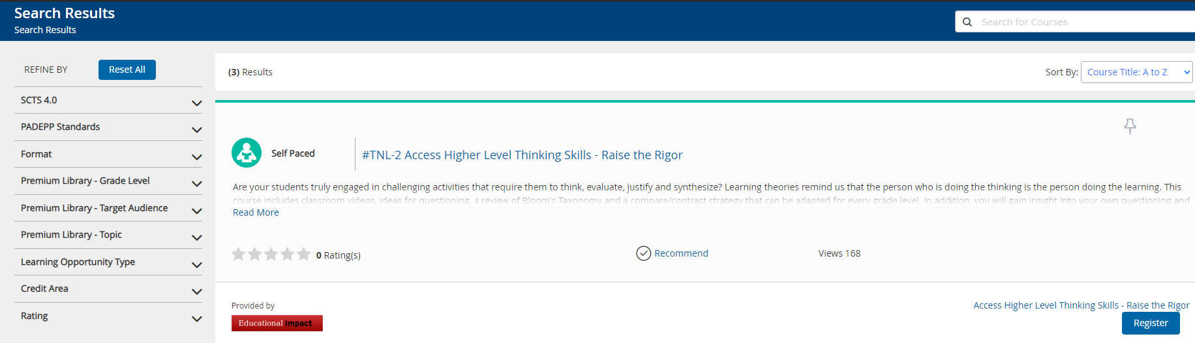
Accessing the PLL Workshop Companion Course
To access the PLL Workshop Companion Course, type PLL Workshop in the Course Search and click search.
Look for the course in Search Results. Click Register.
Confirm your course by clicking Next on the following screen.
Click Go To Course to access the Learner Dashboard.
PLL WORKSHOP
SCDE - PLL WORKSHOP 2023-24
SCDE - PLL WORKSHOP 2023-24
Notes:
To Access the PLL Workshop Companion Course, type in "PLL Workshop" in the search bar, click "search" and the course will appear in the Search Results.
Click "Register." Confirm your course by clicking "next" on the following screen.
Click "Go To Course" to access the Learner Dashboard.
The courses you register for can be found under the Courses tab and then under My Courses.

Slide 8
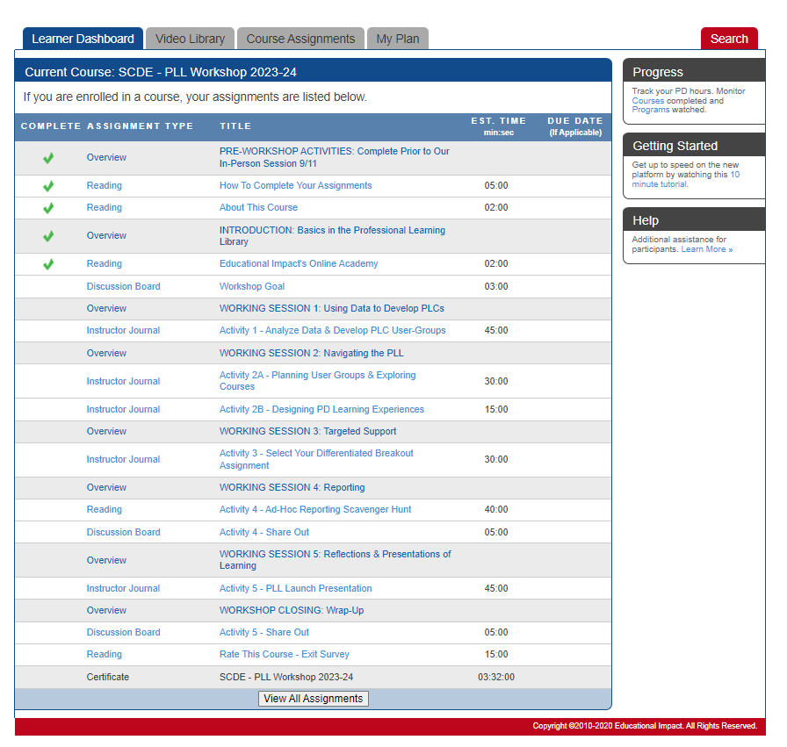
Learner Dashboard
Notes:
Speaker Notes:
You will then be redirected to Educational Impact’s “Learner Dashboard”.
Here, you will see the course laid out in a linear fashion.
Users will complete course activities in order and earn a green check once a task is complete.
This Companion Course will take you through the entire workshop that was recently presented. Learners will have digital access to the activities and participant workbook. We highly recommend this course to anyone (administrators and educators) interested in knowing more about the PLL and how to implement it within your professional learning communities.
This specific course links you to Educational Impact’s video library– a unique resource in the PLL that highlights video content ONLY. These videos can be used in a variety of ways: as a conversation starter for coaching & mentor conversations or staff meetings, a visual representation of classroom strategies, and/or a place to curate your own personal list of video content.
The other courses in the PLL feature these videos, as well as other interactive content as part of a comprehensive course experience.
****Drop email in chat

Slide 9
Effectiveness Data and the Human Capital Dashboard
Notes:
Lilla: Deep appreciation for all the work you do to gather this data. This is a bird’s eye view of the state.

Slide 10
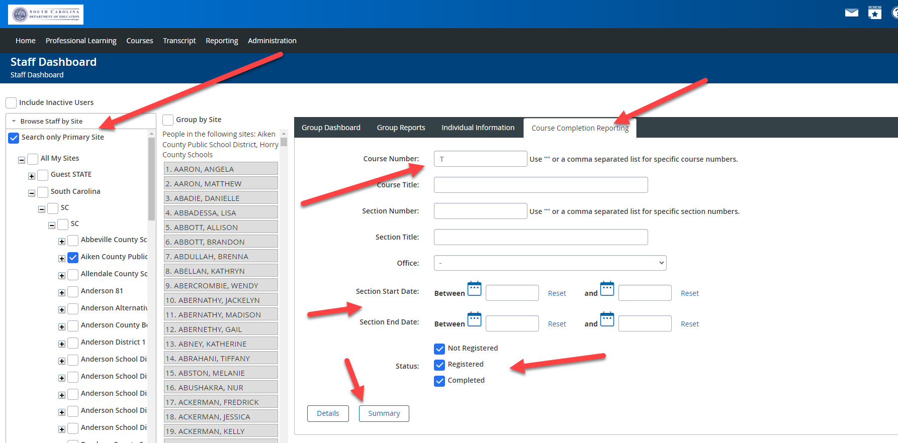
PLL Reports Update
Use this help document for a quicker path to working reports
Click Administration, Staff Dashboards
Choose your district using the ‘Browse Staff by Site’ filter in the left side bar
Choose the ‘Course Completion Reporting’ tab
Type the letter ‘T” in the Course Number field (all courses have a ‘T’ which will retrieve all results)
Choose the date range
Choose the status you wish check
Click on ‘Details’ for specific user data and download .csv
Notes:
Lilla: We’ve been working with PowerSchool over the past few weeks on some issues that districts had with pulling reports. PowerSchool is still working on some of the underlying issues with AdHoc reporting that are also impacting other districts that use this product. In the meantime, this document (https://drive.google.com/file/d/1_JtscrCmuKQA-bOu1hxc3XvurwvdQjVX/view?usp=sharing) and click path can get you some of that information more quickly.

Slide 11
ADEPT Evaluation Results
2023 vs. 2022
Sources: SCLead Title II and Yearly Evaluation Results Detail Reports
Notes:
First, ADEPT Evaluation results…
Not reported SLOs (including TLGs) 2022-23: 8406
Not reported SLOs 2021-22: 8839
Not reported SLOs 2020-21: 7935

Slide 12
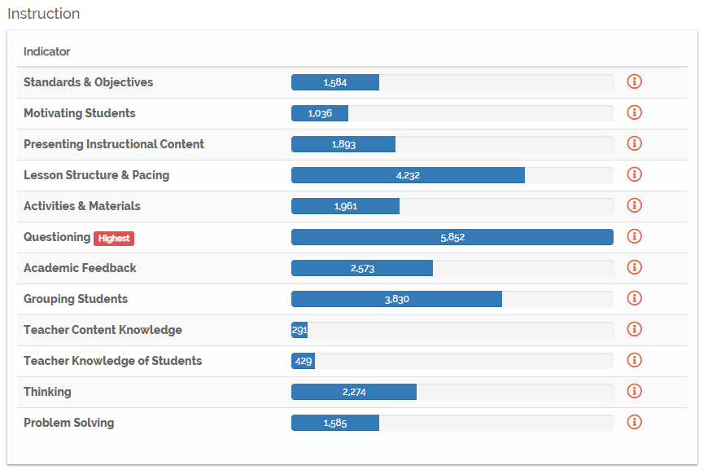
Teacher Performance
South Carolina Teaching Standards Observer Refinement 22-23
SCTS 4.0 Indicator Average Scores 22-23
Strengths
Content Knowledge
Respectful Culture
Environment
Areas of Growth
Thinking
Questioning
Assessment
Sources: SCLead Yearly Evaluation Results & Indicator, Observation Reinforcement/Refinement
Notes:
Top Areas of Reinforcement
Presenting Instructional Content
Activities & Materials
Motivating Students

Slide 13
Principal Performance
Overall Levels of Performance
PADEPP Standards Average Indicator Scores 22-23
Strengths
Areas of Growth
Standard 2: Instructional Leadership
Standard 3: Effective Management
Standard 1: Vision
Standard 9: Principal’s Professional Development
Standard 8: Staff Development
Standard 6: Ethical Behavior
Sources: SCLead PADEPP EPP Evaluation Data
Notes:
4 506
3 677
2 26
1 0

Slide 14
New Teachers and Principals
Sources: SCLead Human Capital Report, PIP Registration
Notes:
% Induction Teachers % Induction Principals Induction 1 Teachers Total Teachers Beginning Principals Total Principals
2017-18 6.0% 11.5% 3414 56443 141 1230
2018-19 6.3% 12.9% 3538 55965 159 1230
2019-20 6.2% 9.8% 3401 55111 121 1230
2020-21 5.8% 9.4% 3236 55667 115 1223
2021-22 6.1% 9.5% 3497 57765 118 1240
2022-23 6.3% 11.0% 3585 57036 137 1240
2023-24 #DIV/0! 12.4% 154 1240
Source: Induction 1 teachers, Human Capital Report
Source: Principals: Schools list + PIP registration

Slide 15
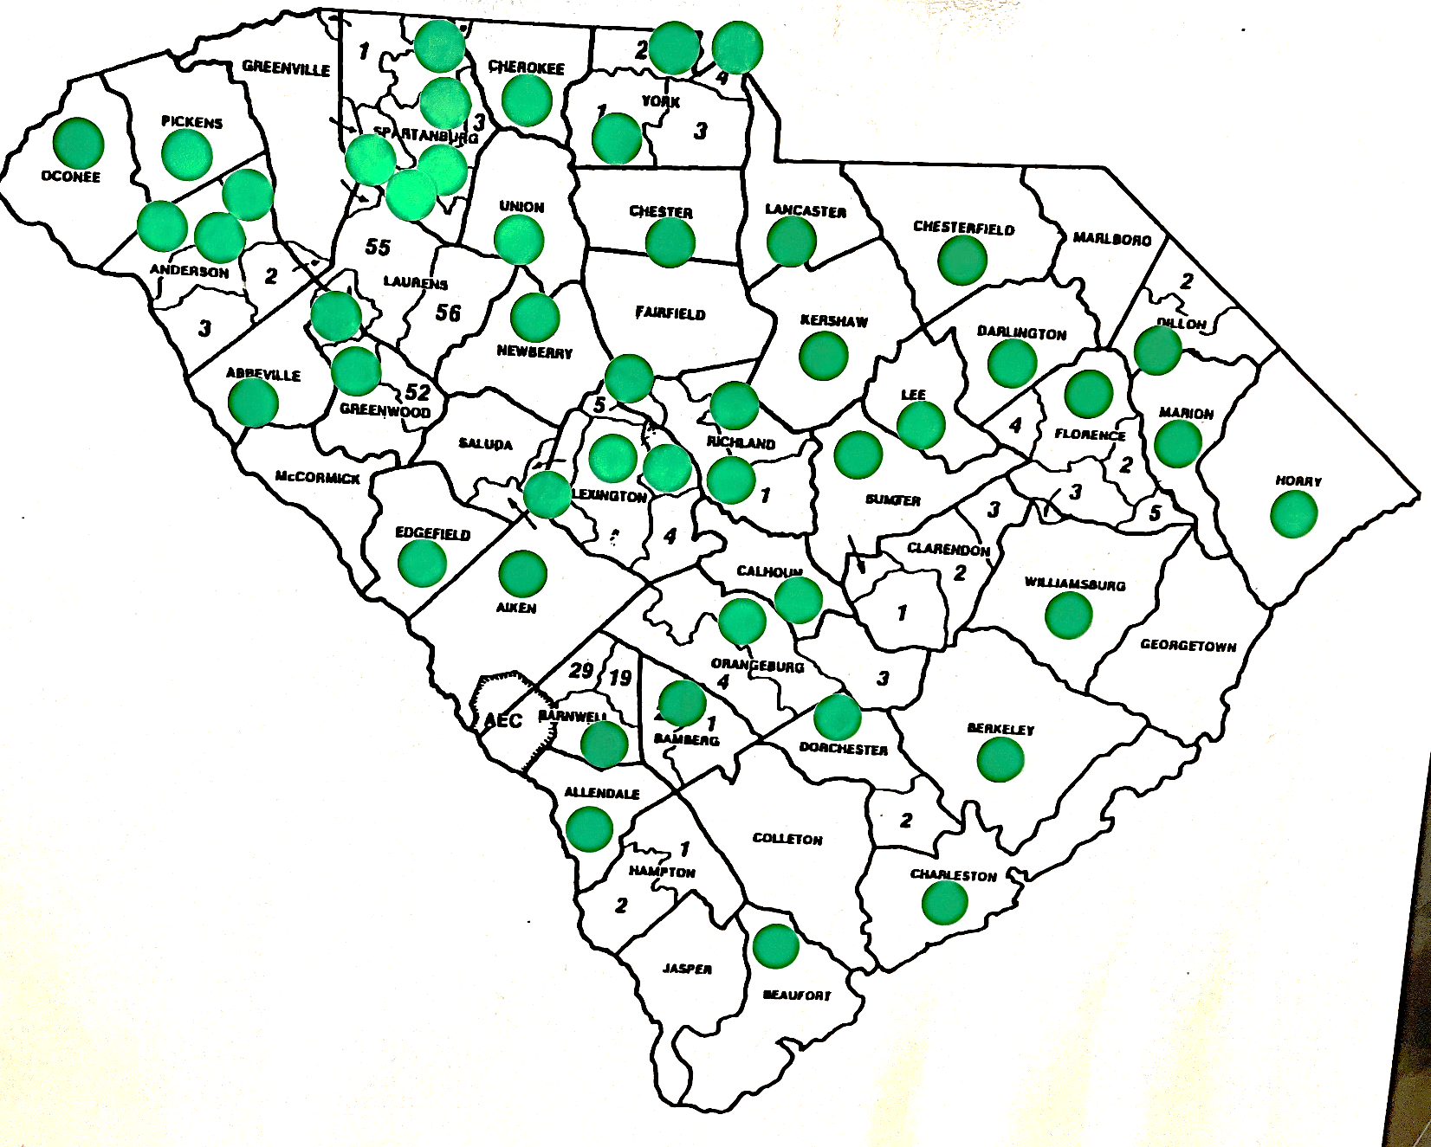
Principal Induction Program
2023-2024
Districts with ≥4 Induction Principals
16
Districts with ≥6 or more Induction Principals
5

Slide 16
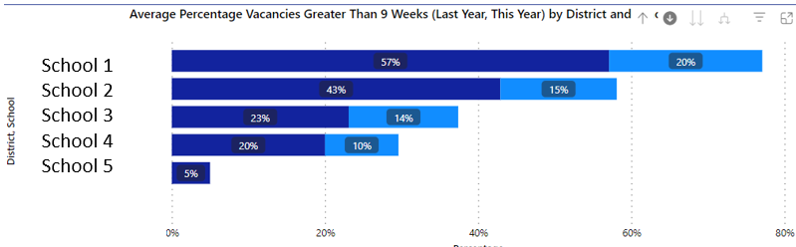
Teacher Turnover and Vacancies
% of Teachers Returning
% of Vacancies > 9 weeks
Sources: SC Report Card, SC Human Capital Dashboard
Notes:
Again, the statewide numbers do not tell the whole story, but when we disaggregate down to the school level, the school with 100% of teachers returning and the school with only 36% of teachers returning need different levels of support and different strategies. But if we drill down and look year over year, even though school 1 still has an alarming 20% vacancies, we can see that there’s been huge improvement over the previous year. The human capital dashboard can provide your district and school leaders with some of that data in one place.
HC Dashboard, % Induction over time, Highest/lowest school
Teacher vacancies unfilled for more than 9 weeks – percentage of teaching positions that remain unfilled for more than 9 weeks

Slide 17
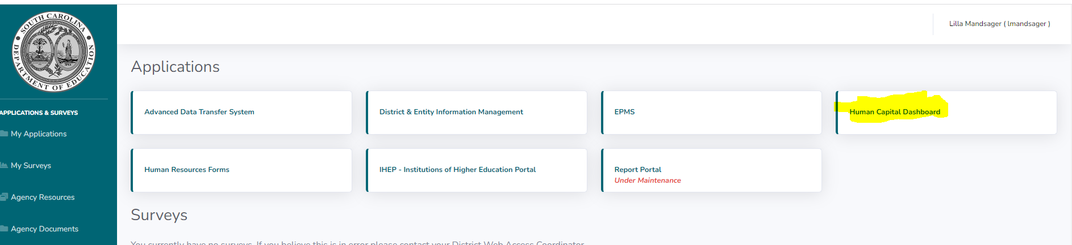
Accessing the Human Capital Dashboard
https://ed.sc.gov/>
Login (upper right) >
Human Capital Dashboard
Notes:
Pop Out to Demo, Go to Each big tab (students, teachers, workforce), then go to 2018-19 for the workforce, returning tab, demo drill down with Florence Four.

Slide 18
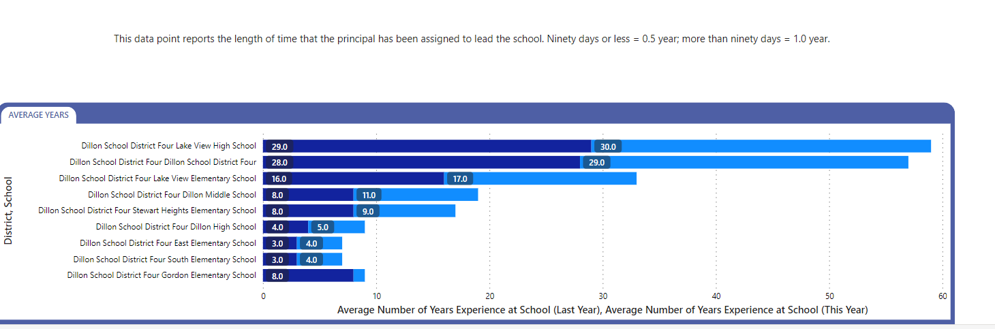
Human Capital Data Dashboard:
District Drill Down
High School 1
Elementary 1
District
Middle 1
Elementary 2
High School 2
Elementary 3
Elementary 4
Middle 2
Notes:
The drill down helps you move to a more differentiated level of analysis. If the principal at HS 1 has been there 30 years, his experience alone puts the district average way up there. If Middle School 2 principal is coming in with 0 years of experience, he or she needs different support, similarly, if you have principals who have been at it for 9, 11, 29 years, it's likely you may need to prepare a succession plan for leadership in those schools.

Slide 19
How can our systems of support catch not quite certified teachers, December grads, late hires, & purchased-service teachers?
  Sources: CERRA, SCEducator
Notes:
One question that this brings up is how we support "in between" educators. If the trend holds and you still have positions for which you made or are making some late hires, if you have a few teachers in teaching positions who are not certified or haven't completed the paperwork for their permits or alt cert applications, if on the last graph you have some teachers you need to replace who leave during the school year, none of those cases fit neatly into your existing systems. Please share with us in the chat if your team has figured out any innovative ways to support those educators.
In particular we want to draw your attention to this memo: https://ed.sc.gov/newsroom/school-district-memoranda-archive/required-reporting-certification-background-checks-and-evaluation-of-purchased-service-teachers/required-reporting-certification-background-checks-and-evaluation-of-purchased-service-teachers-memo/
School districts may choose to use the Assisting, Developing, and Evaluating Professional Teaching (ADEPT) system for Purchased-Service Teachers to ensure educator quality. In districts where Purchased-Service Teachers are offered a Letter of Agreement, ADEPT does not apply; however, districts must ensure that these teachers receive appropriate assistance and supervision throughout the school year. At a minimum, districts must provide appropriate assistance and supervision, including formal and/or informal observations of all Purchased-Service Teachers.

Slide 20
FAQ's
How can I recover my username and password?
  SCLEAD will not allow our office to recover your password. You will have to send in a support ticket (support@sclead.org). There is also a phone number and link to the online support form at the bottom of SCLead.org.
Why aren't educators showing up when I am trying to build an evaluation team for special areas?
  Your S.A.M. must submit a spreadsheet to Dr. Kimberly Howard to be added.
Notes:
*Only complete District Choice Measures if it applies

Slide 21
FAQ’s 2
I have submitted names for Special Areas Evaluators, but they have not been added.
  The names that were submitted have not completed the class or they have not been submitted correctly.
Notes:
*Only complete District Choice Measures if it applies

Slide 22
Questions
Notes:
Here are some great questions from the chat…
Please feel free to hop on the mic or drop your questions in the chat.

Slide 23
Office of Educator Effectiveness & Leadership Development
Educator Effectiveness Leads
Beverly Flythe, Ed. Prep. Programs & Special Areas, bflythe@ed.sc.gov
Roshonda Frazier, SLOs, rfrazier@ed.sc.gov
Dr. Kimberly Howard, Mentoring & Induction, khoward@ed.sc.gov
Dr. Vicki Traufler, PADEPP, vtraufler@ed.sc.gov
Jenny Henke, Data & Reporting, vhenke@ed.sc.gov
  Visit our website: https://ed.sc.gov
  Who’s my ADEPT Contact?: Click here
Leadership Development Leads
  Dr. Gerard Edwards, Experienced Leaders, gedwards@ed.sc.gov
  Crystal Halma, Collective Leadership, chalma@ed.sc.gov
  Dr. Frank Robinson, New Principals & Emerging Leaders, frobinson@ed.sc.gov
  Tom Smith, Instructional Leadership & Assistant Principals, tsmith@ed.sc.gov
  Keasha Grant, Certified Support & Emerging Leaders, ksgrant@ed.sc.gov
Office Support
  Lilla Toal Mandsager, Director, lmandsager@ed.sc.gov
  Marilyn Suber, Administrative Assistant, masuber@ed.sc.gov
Notes:
Please feel free to reach out to us if you have questions or feedback for us. Our email addresses are shown on the slide.

