Slide 1


Educator Effectiveness
Virtual Office Hours
November 13, 2024
Welcome!
What song gets you pumped up and ready for your day?
Notes:
Jenny - Welcome to our educator effectiveness virtual office hours. We’re so glad you could make it. Please type in the chat box your name and district. We have an open-response posted that we’d love for you to answer in the chat. We’ll get started right at 2 PM. ​
​
@ 2 PM: Welcome again everyone! (Introduce self and team) If you haven’t done so, please type in the chat box your name and district. First, to orient you to the Microsoft Teams platform, the control icons will be on the upper right section of your screen for most users. If you haven’t yet, please click the mic icon to mute yourself. You will click the same mic icon to unmute yourself later when we are ready for conversation. We encourage you to utilize the chat throughout this session for any questions you may have during the presentation. Our team will be monitoring the chat and responding accordingly. We will also hold a time at the end for discussion.​ ​
The purpose of Office Hours is to hold time to ensure that we share timely reminders with districts, but even more importantly to create a space where you can share feedback, questions, ideas and best practices with your peers. If you are new, there is no question too small; if you are an effectiveness veteran, don’t be shy about letting us know what you need. Before we get started, let’s see what exciting events have happened recently in our chat. (summarize responses or ask 1-2 districts to elaborate….)

Slide 2
Agenda
ADEPT Reminders
Evaluation Status Report
Staff List Clean Up
Q & A
Notes:
We are so glad to have you here with us today. Before we get to questions and open discussion, we have a few things to share with you (state them). As we go, please feel free to add questions in the chat. We will respond to all that we can as we go and will address any lingering questions and open up the room for discussion at the end.

Slide 3
ADEPT Reminders
Notes:
We want to start with a some ADEPT reminders that are important for this time of the year.

Slide 4
ADEPT Timeline Check-in
Observation
Observation Post Conferences/Consensus Meetings
Preliminary Conferences and Mid-Year SLO/GBE Conferences
Follow-up with schools that do not have SG or OBS bubbles at least partially filled on the Evaluation Tab

Slide 5
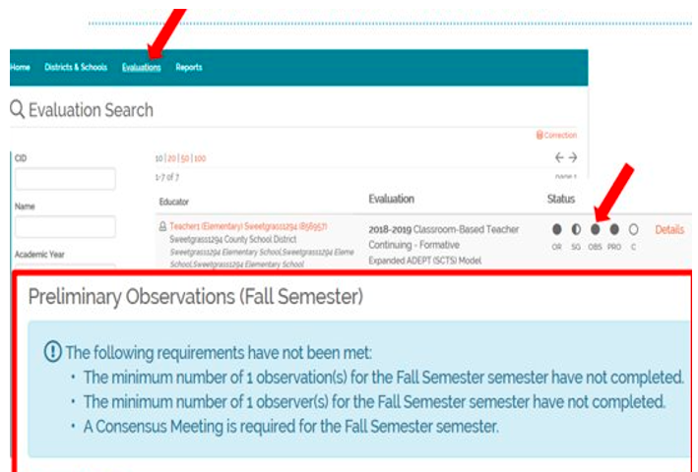
Wrapping up Preliminary Cycles and Beginning Final Cycle Evaluations
•The Observation status bubble denotes that the Evaluator has signed the Post-Conference form.
•A filled-in observation bubble DOES NOT indicate that the correct number of observations are loaded, nor does it indicate that the teacher has signed the post conference form.
•Teacher signatures are needed but will not prevent the evaluation from being completed or closed.
Notes:
A helpful tool for monitoring the progress of evaluations is using the Status Bubbles on the Evaluation Tab.
A filled bubble denotes that the evaluator has completed and signed appropriately. Partially filled bubbles denote that parts of that component have been completed.
Please note that a filled in observation bubble DOES NOT indicate that the correct number of observations are loaded, nor does it indicate that the teacher has signed the post conference form.
Teacher signatures are needed but will not prevent the evaluation from being completed or closed.
Remind evaluators to get teacher signatures during the post conference prior to closing/completing the evaluation.

Slide 6
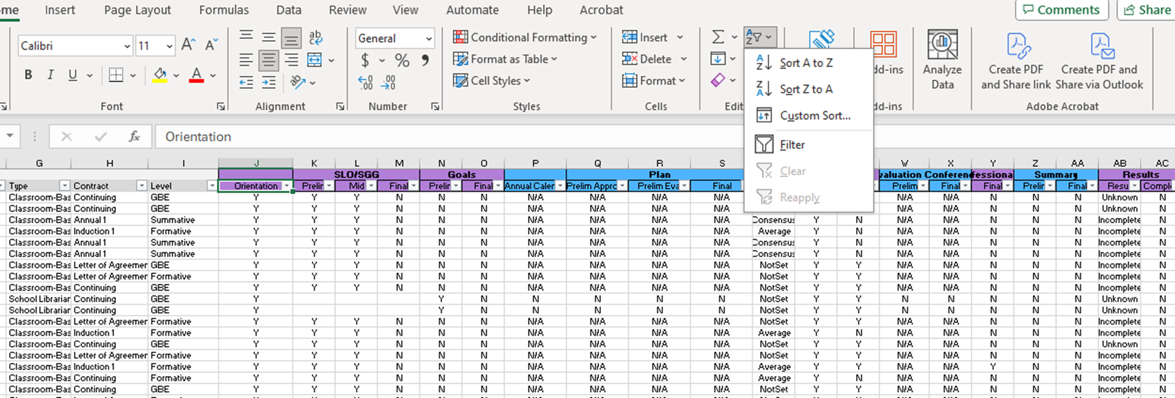
Evaluation Status (ADEPT, District) Report
Notes:
The easiest way to check evaluation progress is by downloading the Evaluation Status (ADEPT, District) Report in SCLead.org. To locate your ADEPT report menu, look to the left side on your district dashboard and select Reports under ADEPT. The Evaluation Status report is also a great way to make certain your educators are correctly identified and are assigned the correct contract and evaluation levels for the year. You can use the sort and filter tool to drill down to specifics for your district evaluations.
As you can see, I filtered the "orientation" column specifically for the YES to remove any educators who have "no" or blank. I want to see those educators who require evaluations and have signed the orientation. I can scan across the spreadsheet to see if other components of the evaluation have been completed. While this filter is in place, I can sort another column from "A to Z" or "Z to A" to see how many have completed that component as denoted with a "y" or how many have not, as denoted with an "n." This allows me to get a quick glance of completed and missing components.

Slide 7
Orientation and Staff Clean Up
Notes:
We want to take a few minutes to go over some Special Areas Reminders.

Slide 8
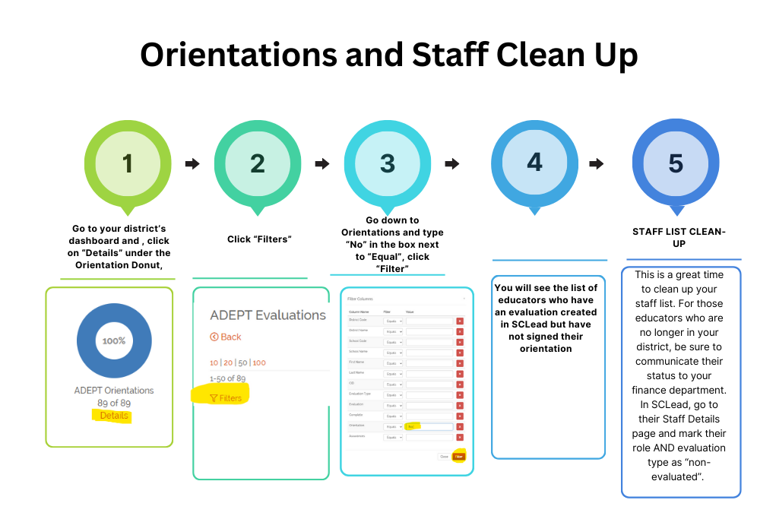
Orientations and Staff Clean Up

Slide 9
Question and Answer
Notes:
We would like to go over some frequently asked questions we've received over the last couple weeks.

Slide 10
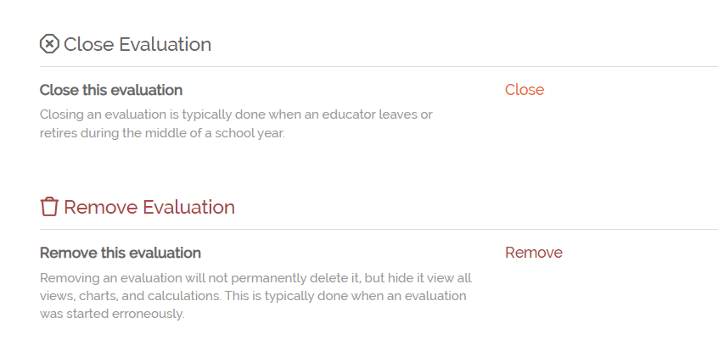
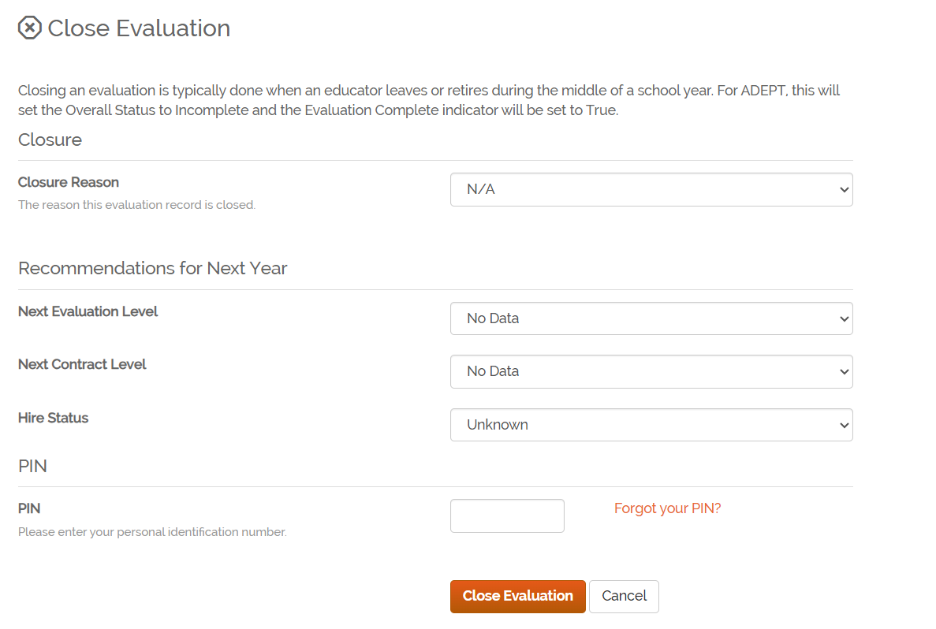
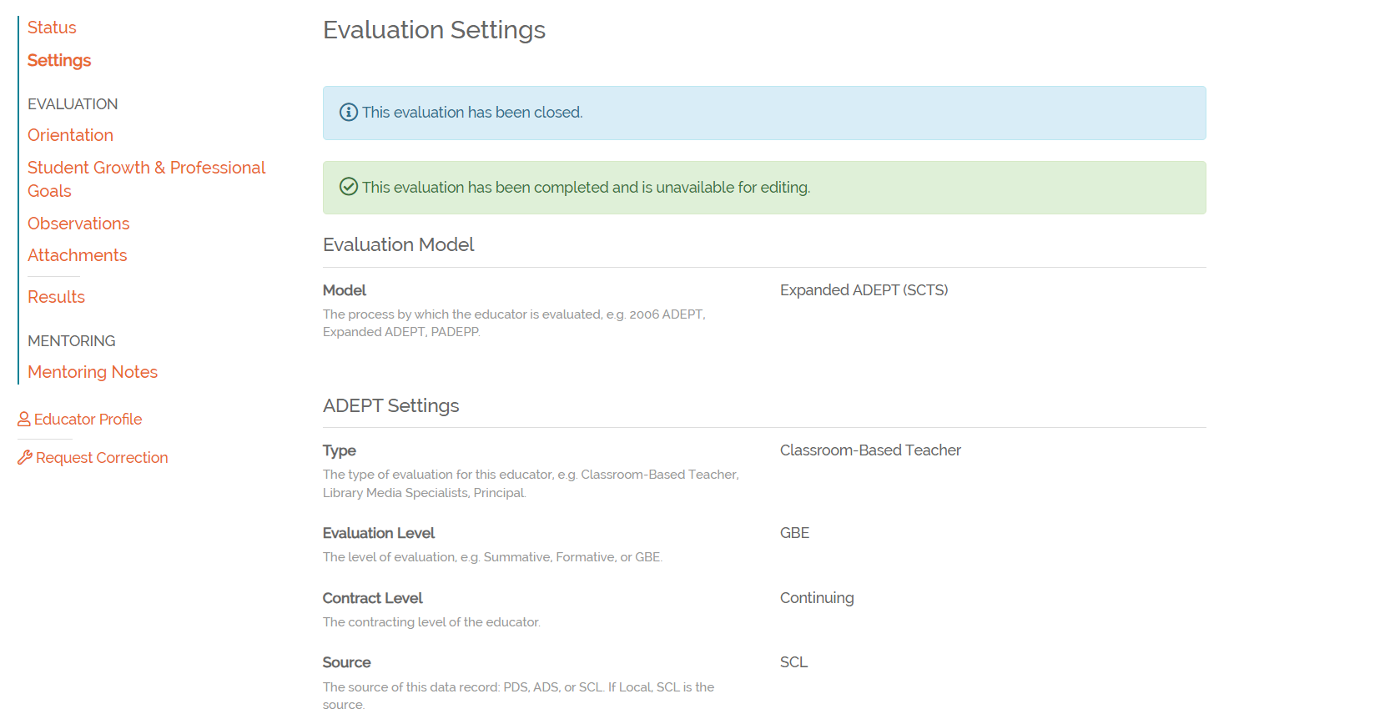
Incomplete Evaluations
Step 1.
Step 2.
Step 3.

Slide 11
OEELD Updates:
Lilla Toal Mandsager is serving as the Executive Director of the Division of College, Career, and Military Readiness
Dr. Kimberly Howard will continue as Team Lead for Educator Effectiveness; Dr. Frank Robinson is serving in the role of Team Lead for Leadership Development; Jenny Henke will be shifting into Induction & Mentoring support
We're hiring for two open positions on the ADEPT team:
ADEPT Data Role: https://www.governmentjobs.com/careers/sc/jobs/4718832/education-associate-60025165
ADEPT EPP Role: https://www.governmentjobs.com/careers/sc/jobs/4718024/education-associate-60023743
Next VOH: January 8, 2024
Notes:
Lilla
We want to announce a few more transitions in our office (bullet points 1-2)
We want to thank the EE team for their patience and hard work this summer with Beverly and Vicki retiring, they have been two people down but haven't skipped a beat. I have such deep gratitude for their hard work and professionalism.
To that end, in the coming weeks, we'll posting two openings on our team in particular we are looking for expertise in program evaluation, new teacher support, and knowledge of teacher preparation pathways.

Slide 12
Office of Educator Effectiveness & Leadership Development
Effectiveness Leads
Leadership Development Leads
Ashley Cohoon, Communications, ascohoon@ed.sc.gov
Dr. Roshonda Frazier, SLO and Teacher Leadership, rfrazier@ed.sc.gov
Jenny Henke, Data & Reporting, vhenke@ed.sc.gov
Dr. Kimberly Howard, PADEPP, khoward@ed.sc.gov
Lilla Toal Mandsager, Executive Director, lmandsager@ed.sc.gov
Marilyn Suber, Administrative Assistant, masuber@ed.sc.gov
  Dr. Gerard Edwards, Veteran Principals & District Leaders, gedwards@ed.sc.gov
  Keasha Grant, Certified Support & Emerging Leaders, ksgrant@ed.sc.gov
  Crystal Halma, Collective Leadership, chalma@ed.sc.gov
  Dr. Frank Robinson, New Principals & Emerging Leaders, frobinson@ed.sc.gov
  Tom Smith, Instructional Leadership & Assistant Principals, tsmith@ed.sc.gov
  Visit our website: https://ed.sc.gov
Office Support
Notes:
We thank you for your time today. We will stay for a few extra minutes if anyone has any additional questions.
Feel free to reach out to us if you have questions or feedback for us. Our email addresses are shown on the slide.
Have a great rest of your day!

Slide 13
SCDE SEAL LOGO

