Slide 1


Educator Effectiveness
Virtual Office Hours
May 6, 2026
Welcome!
What is your go-to summer recharge strategy –
rest, adventure, or
something in between?
Notes:
Jenny - Welcome to our educator effectiveness virtual office hours. We’re so glad you could make it. Please type in the chat box your name and district. We have an open-response posted that we’d love for you to answer in the chat. We’ll get started right at 2 PM. ​
​
@ 2 PM: Welcome again everyone! (Introduce self and team) If you haven’t done so, please type in the chat box your name and district. First, to orient you to the Microsoft Teams platform, the control icons will be on the upper right section of your screen for most users. If you haven’t yet, please click the mic icon to mute yourself. You will click the same mic icon to unmute yourself later when we are ready for conversation. We encourage you to utilize the chat throughout this session for any questions you may have during the presentation. Our team will be monitoring the chat and responding accordingly. We will also hold a time at the end for discussion.​ ​
The purpose of Office Hours is to hold time to ensure that we share timely reminders with districts, but even more importantly to create a space where you can share feedback, questions, ideas and best practices with your peers. If you are new, there is no question too small; if you are an effectiveness veteran, don’t be shy about letting us know what you need. Before we get started, let’s see what reflections we have in our chat. (summarize responses or ask 1-2 districts to elaborate….)

Slide 2
Agenda
ADEPT Reminders
Professional Learning Updates
Mentoring & Induction
Questions
Notes:
Jenny
I'll pass the mic over to Torian for the ADEPT reminders.

Slide 3
ADEPT Reminders
Notes:
Ro

Slide 4
Important Dates & Reminders
Final evaluation cycles and SLO post-conferences in process/completed
April 30 – Final evaluation conference meetings completed​
May 18 - Auto-complete begins
June 1 – ADEPT Plans due
  Complete all parts of the plan to avoid multiple resubmissions.
  Refer to the 2024-25 Effectiveness Human Capital (Schools) ADEPT Report in SCLead to respond to the questions in the Addendum.
June 20 – All evaluations completed in SCLead
Notes:
Ro
Here is a quick glance at some ADEPT reminders. Please do not hesitate to email us if you have any questions or concerns during the close-out process.

Slide 5
Auto-complete Feature for GBE Evaluations
What does this feature do?
    Completes all eligible open evaluations for the current academic year for Classroom-Based Teachers, School Counselors, Librarians, and Speech and Language Professionals who are on a GBE evaluation with a continuing contract.
When will auto-completion start?
    Auto-completion will begin on Monday, May 18th and continue every Friday thereafter until June 20th.
Why is this feature important?
    This feature allows ADEPT Coordinators to focus on educators who are Not Met and may not be rehired the next school year
What about educators without SLO scores?
    Classroom-based teacher evaluations missing a Student Learning Objective Rating/Score will not be updated or closed during the Auto-completion feature.
Notes:
Ro
READ SLIDE
I’ll now pass the mic over to ----Jenny

Slide 6
Professional Learning Updates
Notes:
Jenny

Slide 7
Professional Learning Opportunities for 2026-27
SCTS Evaluator Sessions
July 7–9, 2026
9:00 a.m.–4:30 p.m.
Location: Spartanburg County
August 18–20, 2026
9:00 a.m.–4:30 p.m.
Location: SCDE
September 15–17, 2026
9:00 a.m.–4:30 p.m.
Location: Fort Mill (York County)
January 12–14, 2027
9:00 a.m.–4:30 p.m.
Location: Dorchester County
SCTS Train-the-Trainer Sessions
July 28-29, 2026
9:00 a.m.–4:30 p.m.
Location: SCDE
November 4-5, 2026
9:00 a.m.–4:30 p.m.
Location: SCDE
ADEPT Coordinator 101 Training Session
July 14, 2026, 9:00 a.m.–12:00 p.m.
(New ADEPT Coordinators)
July 14, 2026, 1:30 p.m.–4:00 p.m.
(Working Session)
Location: SCDE
ADEPT 101 for School Administrators Training Session
September 1, 2026
9:00 a.m. - 11:00 a.m.
Virtual on Microsoft Teams
Special Areas Manager Training Session
August 13, 2026
9:00 a.m.–11:00 a.m.
Virtual on Microsoft Teams
Notes:
Sign-ups for trainings are live on our website!
Drop Link in the Chat: Professional Learning Opportunities - South Carolina Department of Education - 04/27/2026 11:24 AM

Slide 8
Programs for Instructional Leaders
Instructional Leadership Academy (ILA)
ILA Cohort 23
ILA Cohort 24
ILA Cohort 25
Building Instructional Capacity
(BIC)
BIC Cohort 17
BIC Cohort 18
For More Information Contact: Dr. Adrienne Davenport
(adavenport@ed.sc.gov)
Notes:
The leadership is inviting instructional leaders to register for the next rounds of Instructional Leadership Academy (ILA) and Building Instructional Capacity (BIC).
For more information on dates and times, you can click on the links in the chat or contact Dr. Davenport. Her contact information is on the screen.
Drop links in chat:
The Instructional Leadership Academy (ILA)
Building Instructional Capacity (BIC) - South Carolina Department of Education - 05/04/2026 10:26 AM

Slide 9
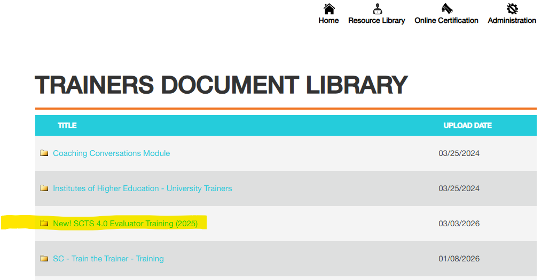
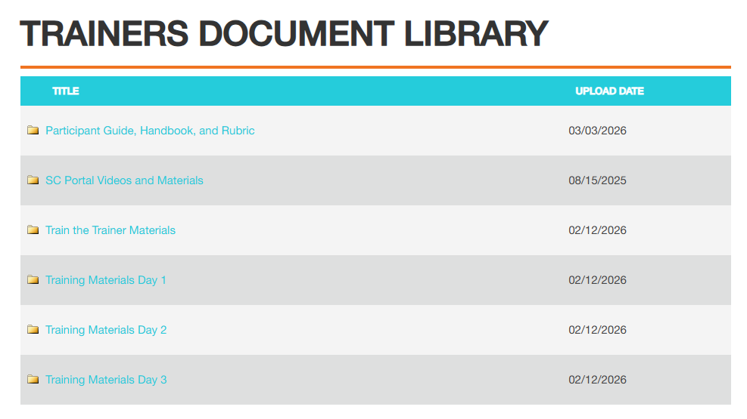
New Resources in the ADEPT Portal
South Carolina Documents
Trainers Document Library
SCTS 4.0 Teacher Evaluator and Train-the-Trainer Trainings:
Updated training materials are on the ADEPT Portal in the Resource Library under "Trainers Document Library."
You must have District Admin rights from NIET to access the Trainers Document Library
All TOTs must use the new training slides/materials beginning July 2026.

Slide 10
Opportunity for Continued Access to the PLL
As State-funded PLL access ends in August — districts can continue access through direct partnerships.
🎓 Educational Impact – Premium Academy
  Professional Learning Content
  📚 400+ online courses
  ‍‍💼 Teachers, administrators, support staff
  ✅ SC-aligned & SCDE renewal credit
    SCTS 4.0 (teachers)
    PADEPP (administrators)
  District Support
  🛠️ Customized implementation & onboarding
  🧩 Custom course design available
  📄 Certificates & reporting integration
  Connect with a South Carolina consultant:
  Educational Impact: Melissa Hoot
  MHoot@educationalimpact.com
🧩 PowerSchool Professional Learning
  Manage & Track Learning
  📝 Course assignments & registration
  ✅ Attendance & feedback
  📊 Transcripts & records
  🔗 Integrated with PowerSchool systems
  On-Demand Webinar for Additional Information:
  🛠️Plan, Manage, and Scale Professional Learning—All in One Place | PowerSchool
    Connect with a South Carolina consultant:
  PowerSchool: Tyler Armstrong
  Tyler.Armstrong@powerschool.com
Notes:
Drop in Chat:
Link to Webinar: Plan, Manage, and Scale Professional Learning—All in One Place | PowerSchool

Slide 11
Mentoring & Induction
Notes:
Jenny

Slide 12
Upcoming M&I Training Dates
SC Mentor Training: In-Person
  Date: May 12-13, 2026
  Location: SCEA Building, West Columbia, SC
  Time: 9:00AM – 4:00PM
  Registration Link (Password: cerra9090)
SC Mentor TRAINER Certification: In-Person
  Date: July 21-22, 2026
  Location: SCEA Building, West Columbia, SC
  Time: 9:00AM – 4:00PM
  Registration Link
Notes:
Jenny -Go over slide
Drop Links and info in Chat:
May 12 - 13, 2026, SC Mentor Training - (In-Person) Tickets, Tuesday, May 12-Wednesday, May 13 • 9 AM-4 PM | Eventbrite
July 21-22, 2026, Mentor Trainer Certification (MUST BE A TRAINED MENTOR) Tickets, Tuesday, July 21-Wednesday, July 22 • 9 AM-4 PM | Eventbrite

Slide 13
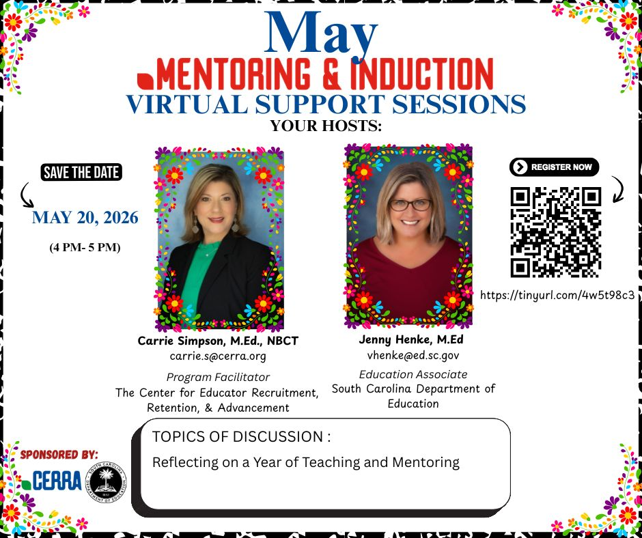
May Mentor & Induction Virtual Support Session
Notes:
Our last Mentor and Induction Virtual Support Session for the school year will be held on Wednesday, May 20 from 4:00-5:00 pm. You can register by scanning the qr code or pasting the tiny url in your browser. Please pass this along to your Induction 1 educators, mentors, or whoever else could benefit from this resource. The schedule for next year's support sessions will be made available soon.
Drop Links in the Chat:
Registration: Mentor & Induction Virtual Support Session 5.20.26
Flyer: https://canva.link/rr888zw6bcu0s3m
I'll will pass the mic to --- to go over any questions that were submitted and to open the floor for additional questions and discussion.

Slide 14
Questions

Slide 15

Q & A
Tuesdays for VOH?
Notes:
Are there any conflicts for moving next year's VOH to Tuesdays? (by conflicts, we mean do you have any standing meetings that would prevent you from attending)

Slide 16
Office of Leadership Effectiveness
Educator Effectiveness Leads
Leadership Development Leads
Kate Berresford, EPPs, skberresford@ed.sc.gov
Ashley Cohoon, Communications, ascohoon@ed.sc.gov
Dr. Roshonda Frazier, SLO and Teacher Leadership, rfrazier@ed.sc.gov
Jenny Henke, Induction and Mentoring, vhenke@ed.sc.gov
Dr. Kimberly Howard, PADEPP, khoward@ed.sc.gov
Torian Nunn, Data and Reporting, tmnunn@ed.sc.gov
Visit our website: https://ed.sc.gov
  Dr. Gerard Edwards, Veteran Principals & District Leaders, gedwards@ed.sc.gov
  Keasha Grant, Certified Support & Emerging Leaders, ksgrant@ed.sc.gov
  Crystal Halma, Collective Leadership, chalma@ed.sc.gov
  Dr. Frank Robinson, New Principals & Emerging Leaders, frobinson@ed.sc.gov
  Dr. Adrienne Davenport, Instructional Leadership & Assistant Principals, tsmith@ed.sc.gov
  Kimberly Mack, Director, kemack@ed.sc.gov
  Marilyn Suber, Administrative Assistant, masuber@ed.sc.gov
Office Support
Notes:
We thank you for your time today. We will stay for a few extra minutes if anyone has any additional questions.
Feel free to reach out to us if you have questions or feedback for us. Our email addresses are shown on the slide.
Have a great rest of your day!

Slide 17
SCDE SEAL LOGO

