Slide 1
Educator Effectiveness
Virtual Office Hours
March 6, 2024
Welcome!
How has someone on your team
been helpful to you this week?​
​
Notes:
Jenny- Welcome to our educator effectiveness virtual office hours. We’re so glad you could make it. Please type in the chat box your name and district. We have our opening questions posted that we’d love for you to answer in the chat. We’ll get started right at 2 PM. ​
RECORD
@ 2 PM: Welcome again everyone. If you haven’t done so, please type in the chat box your name and district. First, to orient you to the Microsoft Teams platform, the control icons will be on the upper right section of your screen for most users. If you haven’t yet, please click the mic icon to mute yourself. You will click the same mic icon to unmute yourself later when we are ready for conversation. We encourage you to utilize the chat throughout this session for any questions you may have during the presentation. Our team will be monitoring the chat and responding accordingly. We will also hold a time at the end for discussion.
Thank you for answering the question and sharing about how someone on your team has been helpful to you this week. We’re so glad you could be here with us. I am Jenny Henke and I am joined today by our Effectiveness Director and Team Members: Lilla Toal Mandsager, Roshonda Frazier, Beverly Flythe, Dr. Kimberly Howard, Dr. Vicki Traufler, and Ashley Cohoon.
The purpose of Office Hours is to hold time to ensure that we share timely reminders with districts, but even more importantly, to create a space where you can share feedback, questions, ideas and best practices with your peers. If you are new, there is no question too small; if you are an effectiveness veteran, don’t be shy about letting us know what you need.

Slide 2
Agenda
  Welcome
  ADEPT Reminders
  Evaluation Status Report Walkthrough
  Special Areas Pointers and Reminders
  FAQs
  District Needs Survey
  Closing Questions
Notes:
Jenny– Here’s an outline of what our time together will look like today.

Slide 3
ADEPT Reminders
Notes:
Jenny

Slide 4
ADEPT Reminders Continued
All preliminary evaluation cycles completed, final evaluation cycles in process
SLO Mid-conferences completed for all SLOs at this time
April 30 – Final evaluation conference meetings completed
June 1 – ADEPT Plans Due
June 20 – All Evaluations completed in SCLead
Notes:
Jenny - Here is a quick glance at some ADEPT reminders. Please do not hesitate to email us if you have any questions or concerns during the close-out process.

Slide 5
Report Walkthrough
Notes:
Jenny
We are going to take a moment to do a brief report walkthrough as this is the time of year to be checking the components of your educators' evaluations.

Slide 6
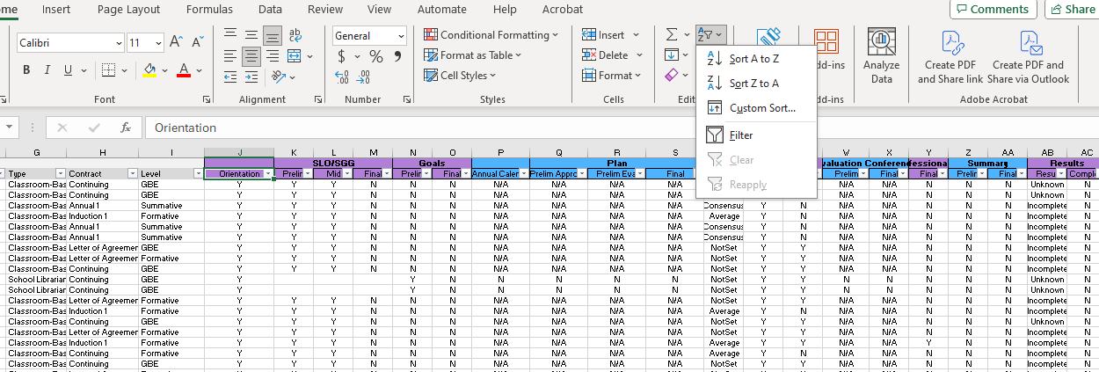
Filtering/Sorting the Evaluation Status (ADEPT, District) Report
Notes:
I have provided an example of the evaluation status report and how to use the filtering and sorting tools to view the components of your educators' evaluations. As you can see, I filtered the "orientation" column specifically for the YES to remove any educators who have "no" or blank. I want to see those educators who require evaluations and have signed the orientation. I can scan across the spreadsheet to see if other components of the evaluation have been completed. While this filter is in place, I can sort another column from "A to Z" or "Z to A" to see how many have completed that component as denoted with a "y" or how many have not, as denoted with an "n." This allows me to get a quick glance of completed and missing components.

Slide 7
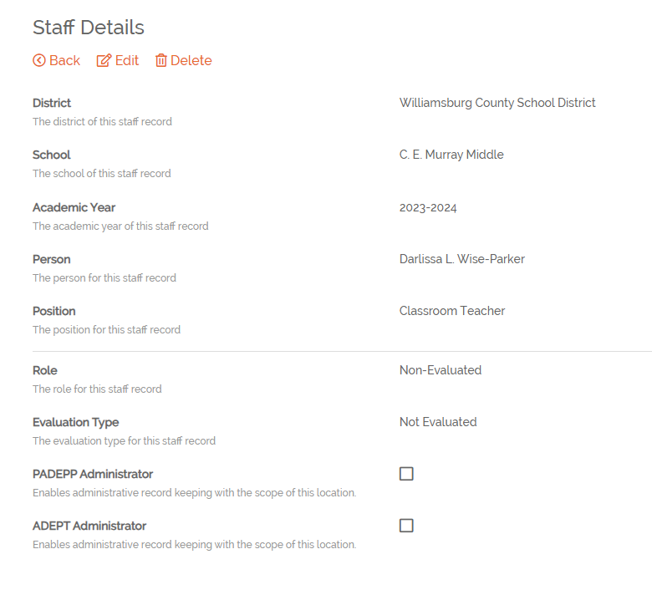
"Cleaning up" SCLead using the
Evaluation Status (ADEPT, District) Report
Educators appearing in this report should have evaluations set-up in SCLead.
If you see an educator with blanks and he/she is in a non-evaluated role, make sure the ROLE and EVALUATION are marked as "non-evaluated" on the staff details page in SCLead. This will allow the donuts on your district's dashboard to fill accurately.
Notes:
The reports in SCLead are not only beneficial for checking the status of the components within the evaluations, but also to ensure your staff list is correct. If you pull the Evaluation Status report and see names with "n's" or blanks beside them, you need to check to see if they are in a position that requires an evaluation. This is determined by the Professional Certified Staff position code list that we are providing in the chat. If you find the educator is in a position that does not require an evaluation, the role and evaluation type in SCLead needs to marked as "non-evaluated." This will ensure that your donuts are accurate on your district dashboard page. I will now turn the mic over to Beverly.
https://ed.sc.gov/finance/financial-services/pcs-information/professional-certified-staff-pcs-code-list-for-fiscal-year-2023-2024/

Slide 8
Special Areas Reminders
Notes:
Happy March! I hope everyone is doing well. Let's dig in to some Special Areas reminders.

Slide 9
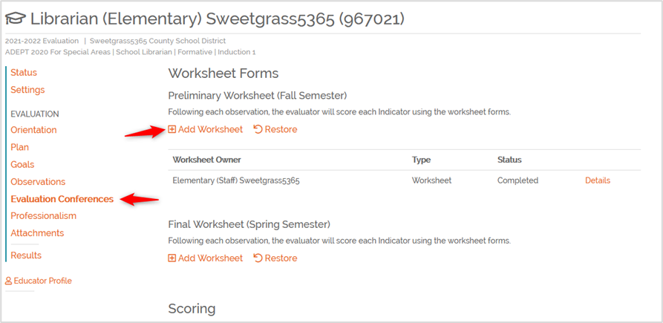
SA Worksheets Clarification
Notes:
I get a lot of questions about the worksheets, so I wanted to remind everyone that worksheets are not a required component of any Special Areas evaluation. They were created as a way for evaluators to enter and consider all sources of evidence, as they gather it, to help inform their scoring of the rubric. The worksheet is only visible to the evaluator and no one else. The scores selected in the worksheet will populate in the scoring conference form for consensus purposes; however, the educator does not see the individual evaluator scores; only the final consensus score. If an observer chooses not to use the worksheet, they will enter scores directly into the scoring conference form manually.

Slide 10
SA Reminders
Pre- and Post Conference questions are
required
aligned to specific indicators in the rubric
listed in Sources of Evidence column
Notes:
Remember that we have scripted several focused questions for the Pre- and Post conferences for our Special Areas educators. These questions are aligned to specific indicators and descriptors and are required for complete scoring in an evaluation. Evaluators may ask additional questions and have the option of scripting responses within SCLead, where the questions are displayed in the Pre- and Post Conference Planning tabs. Remember to click Save at the bottom of the page once you have entered information.

Slide 11
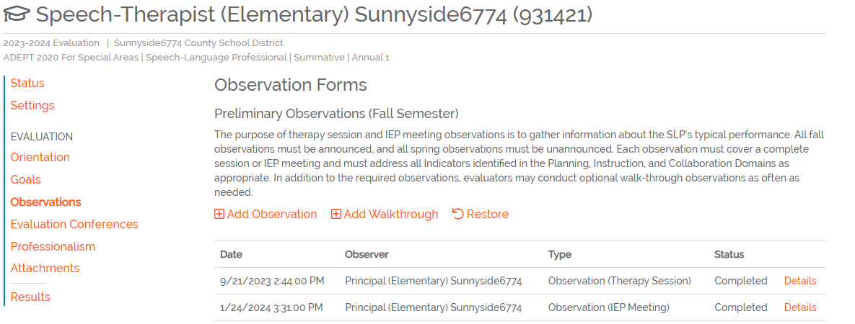
SLP Reminders
> 1 IEP Meeting and > 1 Therapy Session observations are required during the Preliminary Cycle
Based on scores, some Final Cycle observations may be waived. See the SA At-A-Glance document and Guidelines for more information.
Notes:
All SLPs on a summative or formative evaluation contract will receive at least two full observations – one each of a therapy session and IEP meeting during the preliminary cycle. These observations are announced and accompanied by a pre- and post-conference with the required scripted questions. Status and type of observations can be viewed in the Observations tab.
If all Indicators for the IEP meeting observation are scored Proficient or higher during the preliminary cycle, IEP meeting observations scheduled for the final cycle may be waived at the district's discretion. If all Indicators for the therapy session observation are scored Proficient or higher during the preliminary cycle, therapy session observations scheduled for the final cycle can be waived at the district's discretion.
Please drop in chat:
Special Areas Requirements At-a-Glance (sc.gov)
Assisting, Developing, and Evaluating Professional Teaching for Speech-Language Professionals Support and Evaluation System Guidelines for Speech-Language Professionals (sc.gov)

Slide 12
FAQs
Notes:
Kim

Slide 13
ADEPT Plans
Q: When will districts be able to enter ADEPT Plan data for 2024-25?
A: ADEPT Plan templates will be available in SCLead the beginning of April. We will walk through any changes during our April VOH.

Slide 14
Provisional Initial – Summative Evaluation
Q: If an educator is seeking advancement from a Provisional Initial to a Professional certificate and receives a "Met" on the summative evaluation but not the required score of 2.76, what would be the next steps?
A: Although the score was "Met", if the educator needs to demonstrate knowledge of pedagogy, they would either need to complete another summative evaluation with a score of 2.76 or higher or receive a qualifying score on the required pedagogy assessment to advance the certificate.

Slide 15
Reciprocity and Contract Levels
Q: When hiring an educator from out of state, what contract and evaluation level should we place him on?
A: SCDE may issue one of two certificates to out-of-state educators: Initial or Professional. Initial certificates are issued when the educator presents a limited amount of experience and follows the same progression as any other educator on Initial certification.
Professional certificates are issued when the educator presents at least twenty-seven months of qualifying experience. However, an out-of-state educator on a reciprocal Professional certificate must pass a summative ADEPT evaluation prior to being offered a Continuing contract. So you would place this educator on an Annual 1 Summative contract his first year in the state.
Notes:
We've had a few questions come up recently regarding the summative evaluation of educators new to the state.
An out-of-state educator eligible for a South Carolina certificate based on reciprocity will be issued an educator certificate either at the Initial or Professional level.
The SCDE will issue an Initial certificate to an educator who presents less than twenty-seven months of qualifying educator experience in the last seven years on the out-of-state credential. An Initial certificate is typically issued to an early career educator or to an educator without recent work experience in a regionally accredited PK-12 education setting.
The South Carolina Initial certificate is valid for up to three school years, can only be extended at the request of an employing school district if needed. To advance from the Initial to a Professional certificate, an educator must complete South Carolina’s summative ADEPT evaluation.
During the validity period of the Initial certificate, the educator must also document successful completion of a pedagogy assessment.
Professional Certificate
The SCDE will issue a Professional certificate to an educator who presents at least twenty-seven months of qualifying educator experience in the last seven years on the out-of-state credential.
While employed in a public school setting, an educator who is issued a Professional certificate by reciprocity should be placed on an Annual 1 Summative contract and must complete a full summative ADEPT evaluation in order to advance to a continuing contract.
There is no glaring notification in SCLead or SCEducator to make you aware of the pathway to Professional, so it is imperative that you check the history of any new hire's certificate and ADEPT history before setting contract and evaluation level. We should never assume that Professional automatically equals Continuing for new hires.
The only exception is for National Board certified teachers. Teachers who are employed from out of state or from a nonpublic-school setting and who are certified by the National Board for Professional Teaching Standards (NBPTS) are exempted from initial certification requirements and are eligible for continuing contract status.

Slide 16
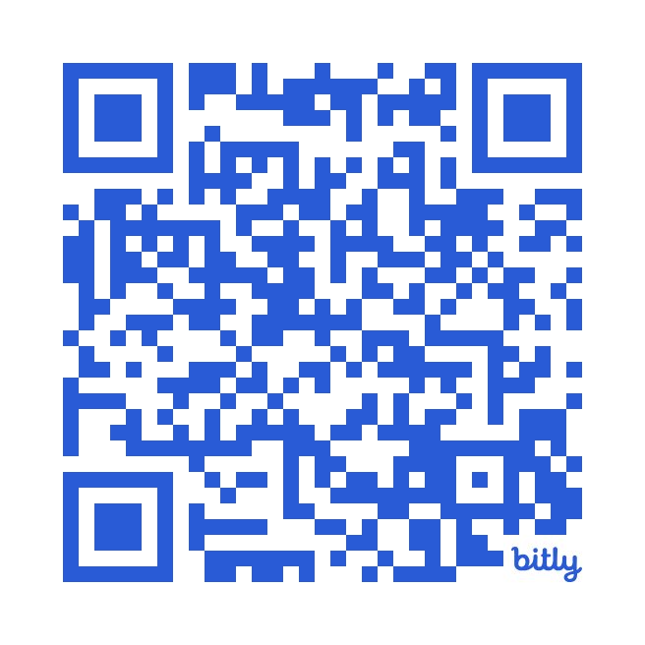
District Needs Survey 2024-25
Brief survey to receive information for needed trainings for next school year.
We want to make trainings fulfilling for the district and schools that you serve.
Do you have a facility to be a training site? Let us know!
Due March 8, 2024.
Calendar of trainings should be released mid-April.
https://bit.ly/eeld24
Notes:
Ashley
https://bit.ly/eeld24
Or
https://docs.google.com/forms/d/e/1FAIpQLSd8X4Jws_p1b26h5q593eDRAQ0fTnTclBvGa7j8KgbDtkCnWg/viewform

Slide 17
Questions
Notes:
Please feel free to hop on the mic or drop your questions in the chat.
We thank you for your time today and, as always, we are here if you have any questions or need support with anything. We hope you all have a fantastic day. We will stay on for a few minutes in case anyone has any specific questions they would like answers to.

Slide 18
Office of Educator Effectiveness & Leadership Development
Educator Effectiveness Leads
Ashley Cohoon, Communications, ascohoon@ed.sc.gov
Beverly Flythe, Ed. Prep. Programs & Special Areas, bflythe@ed.sc.gov
Roshonda Frazier, SLOs, rfrazier@ed.sc.gov
Jenny Henke, Data & Reporting, vhenke@ed.sc.gov
Dr. Kimberly Howard, Mentoring & Induction, khoward@ed.sc.gov
Dr. Vicki Traufler, PADEPP, vtraufler@ed.sc.gov
Visit our website: https://ed.sc.gov
Who’s my ADEPT Contact?: Click here
Leadership Development Leads
  Dr. Gerard Edwards, Experienced Leaders, gedwards@ed.sc.gov
  Crystal Halma, Collective Leadership, chalma@ed.sc.gov
  Dr. Frank Robinson, New Principals & Emerging Leaders, frobinson@ed.sc.gov
  Tom Smith, Instructional Leadership & Assistant Principals, tsmith@ed.sc.gov
  Keasha Grant, Certified Support & Emerging Leaders, ksgrant@ed.sc.gov
Office Support
  Lilla Toal Mandsager, Director, lmandsager@ed.sc.gov
  Marilyn Suber, Administrative Assistant, masuber@ed.sc.gov
Notes:
Please feel free to reach out to us if you have questions or feedback for us. Our email addresses are shown on the slide.

