Slide 1


Educator Effectiveness
Virtual Office Hours
March 12, 2025
Welcome!
Shout Out Time!
How has someone on your team been helpful to you this month?
Notes:
Welcome to our Educator Effectiveness virtual office hours. We’re so glad you could make it. Please type in the chat box your name and district. We have an open-response posted that we’d love for you to answer in the chat. We’ll get started right at 2 PM. ​
​
@ 2 PM: Welcome again everyone! (Introduce self and team) If you haven’t done so, please type in the chat box your name and district. First, to orient you to the Microsoft Teams platform, the control icons will be on the upper right section of your screen for most users. If you haven’t yet, please click the mic icon to mute yourself. You will click the same mic icon to unmute yourself later when we are ready for conversation. We encourage you to utilize the chat throughout this session for any questions you may have during the presentation. Our team will be monitoring the chat and responding accordingly. We will also hold a time at the end for discussion.​ ​
The purpose of Office Hours is to hold time to ensure that we share timely reminders with districts, but even more importantly to create a space where you can share feedback, questions, ideas and best practices with your peers. If you are new, there is no question too small; if you are an effectiveness veteran, don’t be shy about letting us know what you need. Before we get started, let’s see what exciting events have happened recently in our chat. (summarize responses or ask 1-2 districts to elaborate….)

Slide 2
Agenda
South Carolina Educator Talent Pool
ADEPT Reminders and ADEPT Plan Preview
Special Areas Reminders and SCLead Pointers
FAQs
Questions
Notes:
We are so glad to have you here with us today. Before we get to questions and open discussion, we have a few things to share with you (state them). As we go, please feel free to add questions in the chat. We will respond to all that we can as we go and will address any lingering questions and open up the room for discussion at the end.

Slide 3
South Carolina Educator Talent Pool

Slide 4
South Carolina Educator Talent Pool Information
The South Carolina Department of Education maintains a file of emerging classroom leaders including distinguished teachers and principals. These educators may be considered for recognition programs and membership on advisory groups, and task forces. Your recommendations will identify educators who we can recognize as experts in your community and our state.
Who can nominate? Anyone in education!
More information: Recommendation Request for South Carolina Educator Talent Pool
Notes:
Recommendation Request for South Carolina Educator Talent Pool

Slide 5
ADEPT Reminders and ADEPT Plan Preview

Slide 6
ADEPT Reminders
Final evaluation cycles and SLO post-conferences in process/completed
​
April 30 – Final evaluation conference meetings completed​
June 1 – ADEPT Plans due
June 20 – All evaluations completed in SCLead
Notes:
Here is a quick glance at some ADEPT reminders. Please do not hesitate to email us if you have any questions or concerns during the close-out process.

Slide 7
ADEPT Plan Preview
The ADEPT Plan template will be available soon in SCLead.
Completed ADEPT plans for the 2025-26 school year are due
June 1, 2025, in SCLead.org.
Complete ALL parts of the plan to avoid multiple resubmissions.
Your district's ADEPT contact will provide feedback/approval.

Slide 8
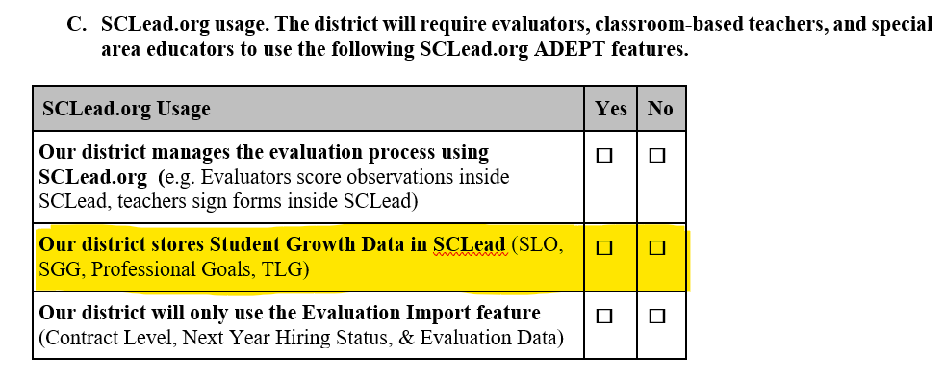
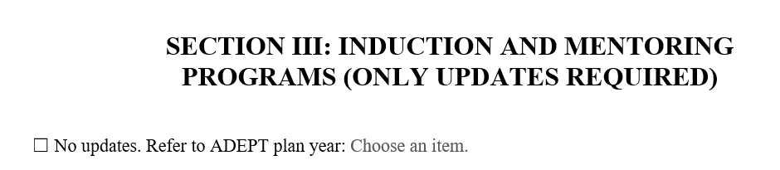
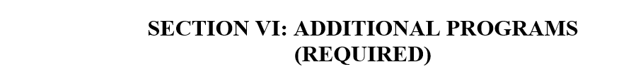
ADEPT Plan Updates
SECTION I: C. SCLead Usage:
If your district stores Student Growth Data in SCLead, mark "Yes."
If your district stores Student Growth Data outside SCLead, mark "No."
SECTION III: Induction and Mentoring Programs:
Only updates required
Refer to the ADEPT plan year "2024-2025"
SECTION VI: Additional Programs (REQUIRED)
Update your district's charter school participation
Update your district's CATE centers
Mark the response "No" if your district has no charter schools or CTE centers

Slide 9
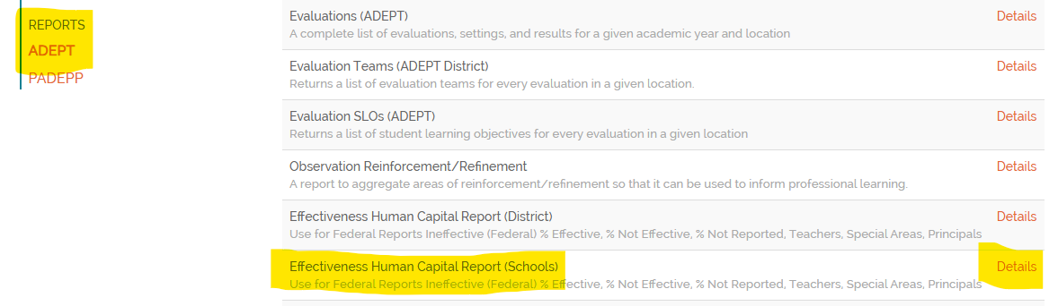
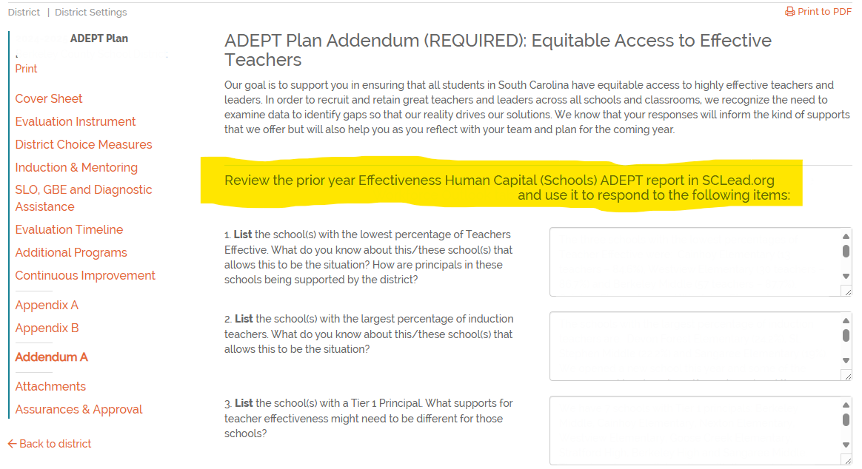
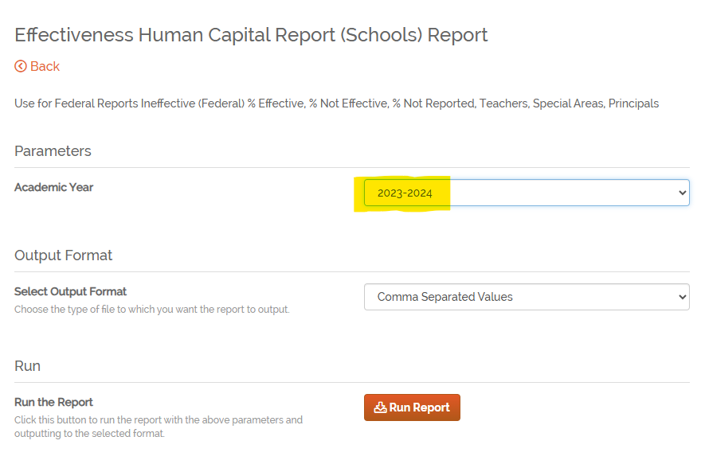
ADEPT Plan: Addendum
Review the 2023-24 Effectiveness Human Capital (Schools) ADEPT report in SCLead to respond to the questions.
Notes:
Pass mic to Ashley

Slide 10
Special Areas Reminders and SCLead Pointers
Notes:
Let's dig in to some Special Areas reminders.

Slide 11
Special Areas Reminders
Pre- and Post Conference questions are​:
required ​
aligned to specific indicators in the rubric​
listed in Sources of Evidence column
Notes:
Remember that we have scripted several focused questions for the Pre- and Post conferences for our Special Areas educators. These questions are aligned to specific indicators and descriptors and are required for complete scoring in an evaluation. Evaluators may ask additional questions and have the option of scripting responses within SCLead, where the questions are displayed in the Pre- and Post Conference Planning tabs. Remember to click Save at the bottom of the page once you have entered information. ​

Slide 12

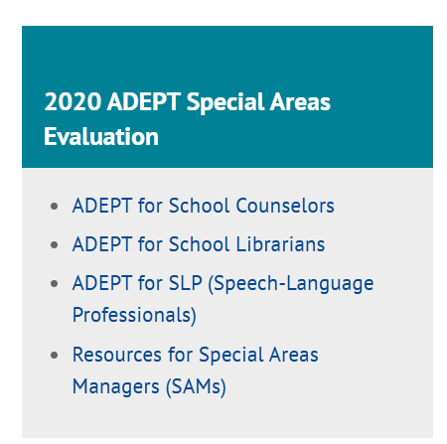
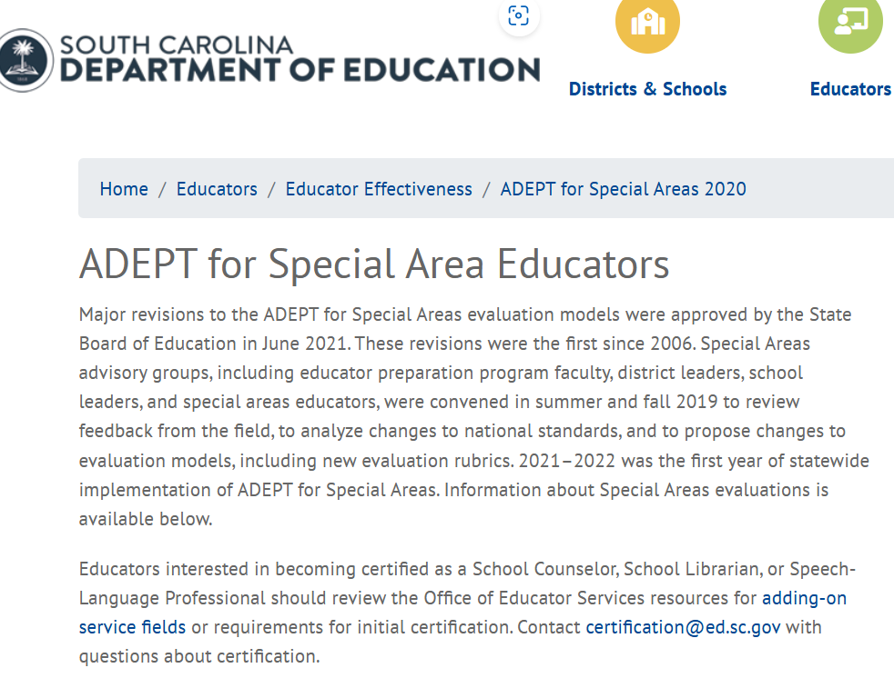
Special Areas in SCLead
How to find the Special Areas SCLead Process Guides:
Click teal "2020 ADEPT Special Areas Evaluation" box

Slide 13
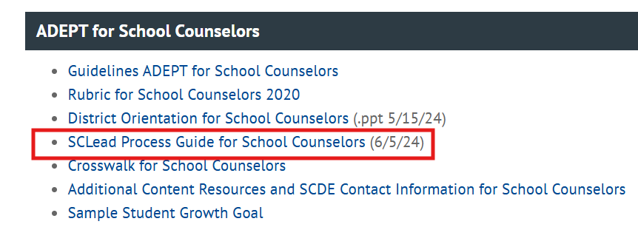
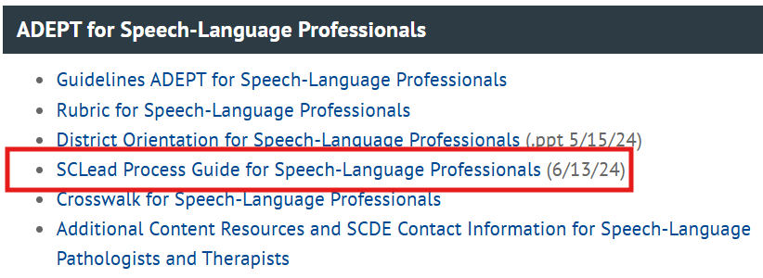
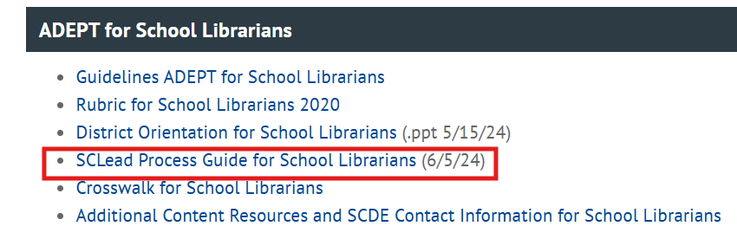
SCLead Process Guides

Slide 14
FAQs

Slide 15
Provisional Initial – Summative Evaluation
Question: If an educator is seeking advancement from a Provisional Initial to a Professional certificate and receives a "Met" on the summative evaluation but not the required score of 2.76, what would be the next steps?​
Answer: Although the score was "Met", if the educator needs to demonstrate knowledge of pedagogy, they would either need to complete another summative evaluation with a score of 2.76 or higher or receive a qualifying score on the required pedagogy assessment to advance the certificate.

Slide 16
Annual Summative – Skip Option
Question: Why am I getting the option to skip the second semester for some educators on Annual summative but not others?
Answer: The skip option for Annual Summative is only available for educators from out-of-state who have a Professional certificate based on reciprocity.
  Teachers employed from out of state who receive a South Carolina professional teaching certificate based on reciprocity are eligible for employment under an annual contract. At the annual-contract level, teachers may receive either a diagnostic-assistance year or a formal evaluation. Teachers who undergo formal evaluation and who, at the conclusion of the preliminary evaluation period, meet the formal evaluation criteria set by the State Board of Education may, at the discretion of the school district, have the final portion of the formal evaluation process waived. Teachers must successfully complete the formal evaluation at the annual-contract level before they are eligible to receive a continuing contract.

Slide 17
Questions

Slide 18
Office of Leadership Effectiveness
Effectiveness Leads
Leadership Development Leads
Ashley Cohoon, Communications, ascohoon@ed.sc.gov
Dr. Roshonda Frazier, SLO and Teacher Leadership, rfrazier@ed.sc.gov
Jenny Henke, Induction and Mentoring, vhenke@ed.sc.gov
Dr. Kimberly Howard, PADEPP, khoward@ed.sc.gov
Kimberly Mack, Director, kemack@ed.sc.gov
Lilla Toal Mandsager, Executive Director, lmandsager@ed.sc.gov
Marilyn Suber, Administrative Assistant, masuber@ed.sc.gov
  Dr. Gerard Edwards, Veteran Principals & District Leaders, gedwards@ed.sc.gov
  Keasha Grant, Certified Support & Emerging Leaders, ksgrant@ed.sc.gov
  Crystal Halma, Collective Leadership, chalma@ed.sc.gov
  Dr. Frank Robinson, New Principals & Emerging Leaders, frobinson@ed.sc.gov
  Tom Smith, Instructional Leadership & Assistant Principals, tsmith@ed.sc.gov
  Visit our website: https://ed.sc.gov
Office Support
Notes:
We thank you for your time today. We will stay for a few extra minutes if anyone has any additional questions.
Feel free to reach out to us if you have questions or feedback for us. Our email addresses are shown on the slide.
Have a great rest of your day!

Slide 19
SCDE SEAL LOGO

