Slide 1


Educator Effectiveness
Virtual Office Hours
March 11, 2026
Welcome!
Women's History Month!
Shout out a woman who has had a positive impact on your life.
Notes:
Welcome to our Educator Effectiveness virtual office hours. We’re so glad you could make it. Please type in the chat box your name and district. We have an open-response posted that we’d love for you to answer in the chat. We’ll get started right at 2 PM. ​
​
@ 2 PM: Welcome again everyone! (Introduce self and team) If you haven’t done so, please type in the chat box your name and district. First, to orient you to the Microsoft Teams platform, the control icons will be on the upper right section of your screen for most users. If you haven’t yet, please click the mic icon to mute yourself. You will click the same mic icon to unmute yourself later when we are ready for conversation. We encourage you to utilize the chat throughout this session for any questions you may have during the presentation. Our team will be monitoring the chat and responding accordingly. We will also hold a time at the end for discussion.​ ​
The purpose of Office Hours is to hold time to ensure that we share timely reminders with districts, but even more importantly to create a space where you can share feedback, questions, ideas and best practices with your peers. If you are new, there is no question too small; if you are an effectiveness veteran, don’t be shy about letting us know what you need. Before we get started, let’s see what exciting events have happened recently in our chat. (summarize responses or ask 1-2 districts to elaborate….)

Slide 2
Agenda
ADEPT Reminders and ADEPT Plan Preview
Special Areas Reminders
Induction and Mentoring
FAQs
Questions
Notes:
We are so glad to have you here with us today. Before we get to questions and open discussion, we have a few things to share with you (state them). As we go, please feel free to add questions in the chat. We will respond to all that we can as we go and will address any lingering questions and open up the room for discussion at the end.

Slide 3
ADEPT Reminders and ADEPT Plan Preview

Slide 4
ADEPT Reminders
Final evaluation cycles and SLO post-conferences in process/completed
​
April 30 – Final evaluation conference meetings completed​
June 1 – ADEPT Plans due
June 20 – All evaluations completed in SCLead
Notes:
Here is a quick glance at some ADEPT reminders. Please do not hesitate to email us if you have any questions or concerns during the close-out process.

Slide 5
ADEPT Plan Preview
The ADEPT Plan template will be available soon in SCLead.
Completed ADEPT plans for the 2026-27 school year are due
June 1, 2026, in SCLead.org.
Complete ALL parts of the plan to avoid multiple resubmissions.
Your district's ADEPT contact will provide feedback/approval.

Slide 6
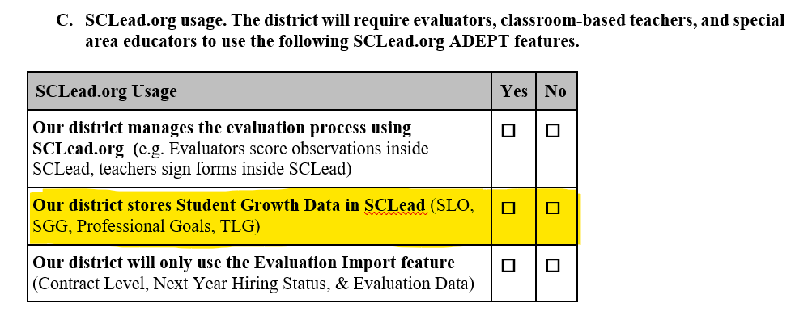
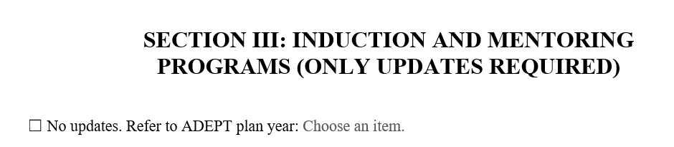
ADEPT Plan Updates
SECTION I: C. SCLead Usage:
"SGG" will not appear
SECTION III: Induction and Mentoring Programs:
Refer to the ADEPT plan year "2024-2025" & "2025-2026"
SECTION IV: SLO, GBE, and Diagnostic Assistance (REQUIRED)
SECTION VI: Additional Programs (Only Updates)
Update your district's charter school participation
Refer to ADEPT Plan option "2025-26"
Notes:
Please note that since SGGs are not embedded within the evaluation for School Counselors, they must be entered into SCLead.

Slide 7
Special Areas Reminders
Notes:
Let's dig in to some Special Areas reminders.

Slide 8
Special Areas Reminders
Pre- and Post Conference questions are​:
required ​
aligned to specific indicators in the rubric​
listed in Sources of Evidence column
SAMs- Be sure that you receive a copy of the certificate before entering names into the spreadsheet.
Notes:
Remember that we have scripted several focused questions for the Pre- and Post conferences for our Special Areas educators. These questions are aligned to specific indicators and descriptors and are required for complete scoring in an evaluation. Evaluators may ask additional questions and have the option of scripting responses within SCLead, where the questions are displayed in the Pre- and Post Conference Planning tabs. Remember to click Save at the bottom of the page once you have entered information. ​

Slide 9
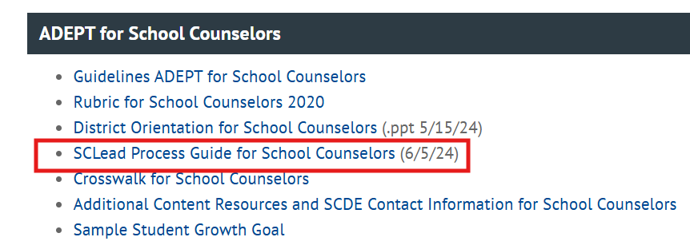
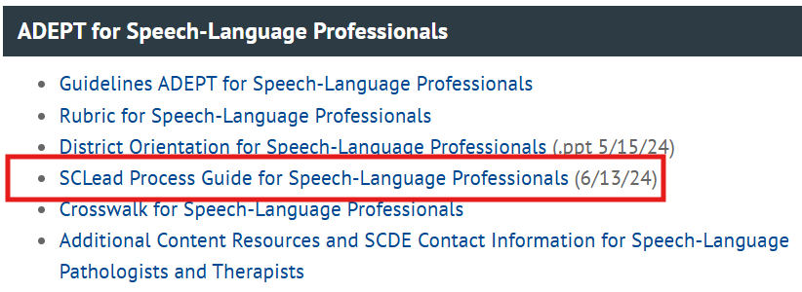
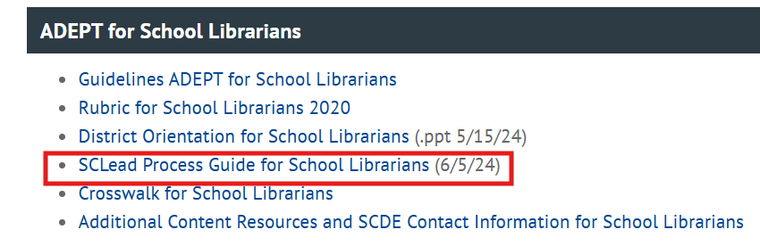
SCLead Process Guides

Slide 10
Induction and Mentoring

Slide 11
Remaining Mentor Training Dates
April 21–22, 2026
  Location: Charleston Southern University, Charleston, SC
  Registration: REGISTRATION LINK (Password: cerra2589)
May 12–13, 2026
  Location: SCEA Building, Columbia, SC
  Registration: REGISTRATION LINK (Password: cerra9090)
**These two-day sessions will be held from 9:00 a.m. to 4:00 p.m.
Notes:
Drop in chat:
Upcoming in-person Mentor Training Dates:
April 21–22, 2026
Location: Charleston Southern University, Charleston, SC
Registration: REGISTRATION LINK (Password: cerra2589)
May 12–13, 2026
Location: SCEA Building, Columbia, SC
Registration: REGISTRATION LINK (Password: cerra9090)

Slide 12
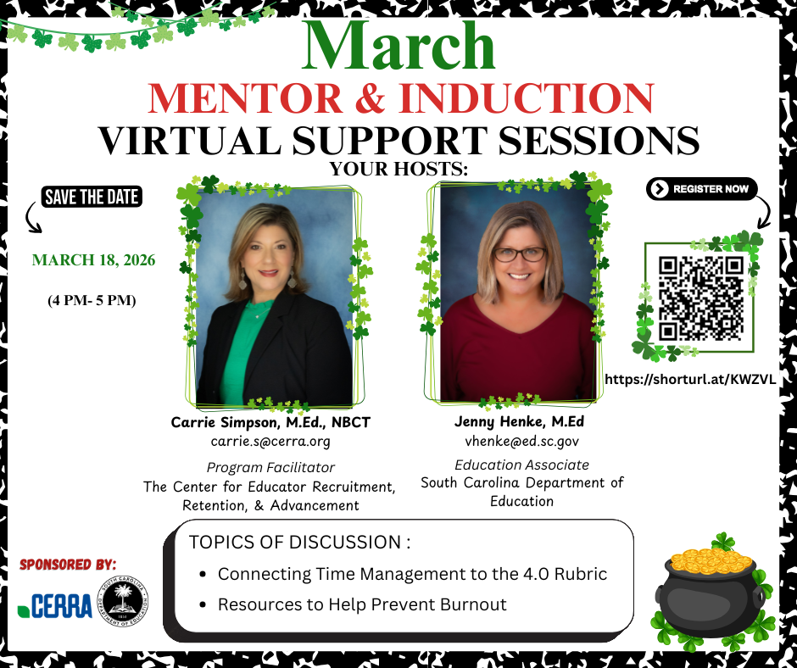
Mentor & Induction
Virtual Support Sessions
Remaining Dates
(4:00 – 5:00 PM):
March 18
April 29
May 20
Notes:
Our next Mentor and Induction Virtual Support Session is scheduled for Wednesday, March 18, from 4:00 to 5:00 pm. This session will focus on strategies to prevent burnout and will include a deeper look at how to connect the rubric to effective time management. We thank you for sharing this wonderful resource in your districts!
Drop Registration Link in the chat:
Mentor and Induction Virtual Support Session
Wednesday, March 18, from 4:00 to 5:00 pm
https://shorturl.at/KWZVL

Slide 13
FAQs

Slide 14
Annual Summative – Skip Option
Question: Why am I getting the option to skip the second semester for some educators on Annual summative but not others?
Answer: The skip option for Annual Summative is only available for educators from out-of-state who have a Professional certificate based on reciprocity.
  Teachers employed from out of state who receive a South Carolina professional teaching certificate based on reciprocity are eligible for employment under an annual contract. At the annual-contract level, teachers may receive either a diagnostic-assistance year or a formal evaluation. Teachers who undergo formal evaluation and who, at the conclusion of the preliminary evaluation period, meet the formal evaluation criteria set by the State Board of Education may, at the discretion of the school district, have the final portion of the formal evaluation process waived. Teachers must successfully complete the formal evaluation at the annual-contract level before they are eligible to receive a continuing contract.
Notes:
Read question and answer.

Slide 15
Questions
Notes:
So now we are going to turn the mic over to you all for any questions you may have.

Slide 16
Office of Leadership Effectiveness
Effectiveness Leads
Leadership Development Leads
Kate Berresford, EPPs, skberresford@ed.sc.gov
Ashley Cohoon, Communications, ascohoon@ed.sc.gov
Dr. Roshonda Frazier, SLO and Teacher Leadership, rfrazier@ed.sc.gov
Jenny Henke, Induction and Mentoring, vhenke@ed.sc.gov
Dr. Kimberly Howard, PADEPP, khoward@ed.sc.gov
Kimberly Mack, Director, kemack@ed.sc.gov
Lilla Toal Mandsager, Executive Director, lmandsager@ed.sc.gov
Marilyn Suber, Administrative Assistant, masuber@ed.sc.gov
  Dr. Gerard Edwards, Veteran Principals & District Leaders, gedwards@ed.sc.gov
  Keasha Grant, Certified Support & Emerging Leaders, ksgrant@ed.sc.gov
  Crystal Halma, Collective Leadership, chalma@ed.sc.gov
  Dr. Frank Robinson, New Principals & Emerging Leaders, frobinson@ed.sc.gov
  Dr. Adrienne Davenport, Instructional Leadership & Assistant Principals, tsmith@ed.sc.gov
  Visit our website: https://ed.sc.gov
Office Support
Notes:
We thank you for your time today. We will stay for a few extra minutes if anyone has any additional questions.
Feel free to reach out to us if you have questions or feedback for us. Our email addresses are shown on the slide.
Have a great rest of your day!

Slide 17
SCDE SEAL LOGO

