Slide 1


Educator Effectiveness Virtual Office Hours
January 8, 2025
Welcome!
What’s something you plan to do differently this year, personally or professionally?
Notes:
Kim - Welcome to our educator effectiveness virtual office hours. We’re so glad you could make it. Please type in the chat box your name and district. We have an open-response posted that we’d love for you to answer in the chat. We’ll get started right at 2 PM. ​
​
@ 2 PM: Welcome again everyone! (Introduce self and team) If you haven’t done so, please type in the chat box your name and district. First, to orient you to the Microsoft Teams platform, the control icons will be on the upper right section of your screen for most users. If you haven’t yet, please click the mic icon to mute yourself. You will click the same mic icon to unmute yourself later when we are ready for conversation. We encourage you to utilize the chat throughout this session for any questions you may have during the presentation. Our team will be monitoring the chat and responding accordingly. We will also hold a time at the end for discussion.​ ​
The purpose of Office Hours is to hold time to ensure that we share timely reminders with districts, but even more importantly to create a space where you can share feedback, questions, ideas and best practices with your peers. If you are new, there is no question too small; if you are an effectiveness veteran, don’t be shy about letting us know what you need. Before we get started, let’s see what exciting events have happened recently in our chat. (summarize responses or ask 1-2 districts to elaborate….)

Slide 2
Agenda
ADEPT Reminders
Induction Count
PLL Webinar
Q & A
Notes:
We are so glad to have you here with us today. Before we get to questions and open discussion, we have a few things to share with you (state them). As we go, please feel free to add questions in the chat. We will respond to all that we can as we go and will address any lingering questions and open up the room for discussion at the end.

Slide 3
ADEPT Reminders
Notes:
If you missed Teamwork Tuesday on yesterday, here’s some of what we shared.

Slide 4
Completing Preliminary Cycle
Confirm that the correct number of Preliminary evaluation cycle pre-conferences, observations, and post-conferences have taken place and signatures are present.
Request extensions, as necessary, for preliminary observations not completed according to district ADEPT timeline.
Highly Consequential: Be sure there are at least 3 persons on the evaluation team.
Special Areas: Be sure correct the model is being used and all required components and signatures are present.

Slide 5
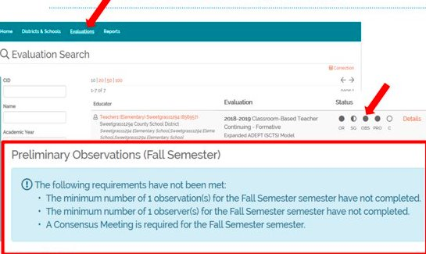
Wrapping up Preliminary Cycle & Beginning Final Cycle in SCLead
The Observation status bubble denotes that the Evaluator has signed the Post-Conference form.
A filled-in observation bubble DOES NOT indicate that the correct number of observations are loaded, nor does it indicate that the teacher has signed the post conference form.
*Teacher signatures are needed but will not prevent the evaluation from being completed or closed.

Slide 6
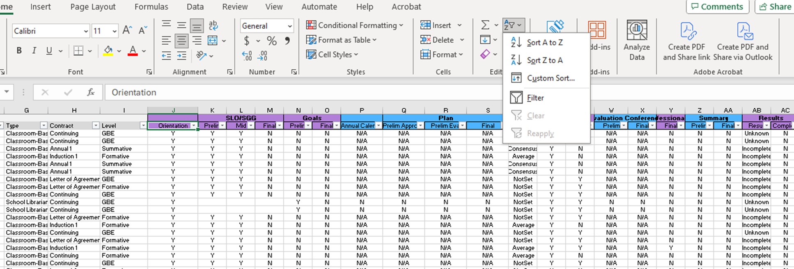
Evaluation Status Report
Notes:
This report allows you to see an overview of educators in your district.
This report can be filtered as shown in the above graphic.

Slide 7
Induction Count
Notes:
It’s January, so it’s time to prepare for district induction counts.

Slide 8
Induction Count Information
Induction Count is due February 1, 2025.
ADEPT funding will be issued to districts based on the number of Induction 1 teachers reported.
Evaluation records will be reviewed prior to February 1 to determine induction count.
Jenny Henke will reach out to you via email by January 20 to verify the accuracy of the numbers reported.
Notes:
Read Slide

Slide 9
Preparing for Induction Count
Ensure all Induction 1 teacher contract/evaluation levels are in SCLead.org
Bulk Evaluations
Import Spreadsheet
Use the Staff Evaluations (ADEPT) report to ensure accuracy
Reach out to your regional ADEPT contact if you have questions or need assistance.
Notes:
Read Slide:
For districts who use SCLead, use the bulk evaluations tool to assign Induction contract levels
For import districts, use the Import Spreadsheet to ensure all induction 1 educators have been assigned the correct contract level

Slide 10
Induction Count Reminders
Only certified educators will be included in the count.
Educators hired with less than 152 days should be LOA.
Evaluations for PACE educators who did not get into winter cohort should be closed/made Incomplete.
Educators receiving PACE certificates through the winter cohort will be included in the count.

Slide 11
Upcoming PLL Webinar

Slide 12

Leveraging the Power of the PLL Webinar
Webinar Registration - Zoom
Notes:
Save the Date
Drop in chat-
Webinar Registration - Zoom

Slide 13
Question and Answer
Notes:
We would like to go over some frequently asked questions we've received over the last couple weeks.

Slide 14
FAQ
What do we do about educators who were on leave for a large part of the preliminary cycle whose observations weren't able to be completed?
If there is still time/opportunity to complete the evaluation when school resumes, the evaluation can still be completed.
Per ADEPT regulations, a teacher who is employed under an induction, annual, or continuing contract and who is absent for more than 20 percent of the days in the district’s SBE-approved annual evaluation cycle may, at the recommendation of the district superintendent, have his or her ADEPT results reported to the SCDE as “incomplete.”
Teachers whose ADEPT results are reported to the SCDE as “incomplete” are eligible to repeat their contract level during the next year of employment.
In these cases, the evaluation can be Closed under the evaluation Settings

Slide 15
Questions

Slide 16
Office of Educator Effectiveness & Leadership Development
Effectiveness Leads
Leadership Development Leads
Ashley Cohoon, Communications, ascohoon@ed.sc.gov
Dr. Roshonda Frazier, SLO and Teacher Leadership, rfrazier@ed.sc.gov
Jenny Henke, Induction and Mentoring, vhenke@ed.sc.gov
Dr. Kimberly Howard, PADEPP, khoward@ed.sc.gov
Kimberly Mack, Director, kemack@ed.sc.gov
Lilla Toal Mandsager, Executive Director, lmandsager@ed.sc.gov
Marilyn Suber, Administrative Assistant, masuber@ed.sc.gov
Dr. Gerard Edwards, Veteran Principals & District Leaders, gedwards@ed.sc.gov
Keasha Grant, Certified Support & Emerging Leaders, ksgrant@ed.sc.gov
Crystal Halma, Collective Leadership, chalma@ed.sc.gov
Dr. Frank Robinson, New Principals & Emerging Leaders, frobinson@ed.sc.gov
Tom Smith, Instructional Leadership & Assistant Principals, tsmith@ed.sc.gov
Visit our website: https://ed.sc.gov
Office Support
Notes:
We thank you for your time today. We will stay for a few extra minutes if anyone has any additional questions.
Feel free to reach out to us if you have questions or feedback for us. Our email addresses are shown on the slide.
Have a great rest of your day!

Slide 17
SCDE SEAL LOGO

