Slide 1


Educator Effectiveness
Virtual Office Hours
Welcome back!
August 11, 2026
What advice do you wish someone had given you, in your current role, as you started a new school year?
Notes:
Welcome to our educator effectiveness virtual office hours. We’re so glad you could make it. Please type in the chat box your name and district. We have two opening questions posted that we’d love for you to answer in the chat. We’ll get started right at 2 PM. ​
​
@ 2 PM: Welcome again everyone! (Introduce self and team) If you haven’t done so, please type in the chat box your name and district. First, to orient you to the Microsoft Teams platform, the control icons will be on the upper right section of your screen for most users. If you haven’t yet, please click the mic icon to mute yourself. You will click the same mic icon to unmute yourself later when we are ready for conversation. We encourage you to utilize the chat throughout this session for any questions you may have during the presentation. Our team will be monitoring the chat and responding accordingly. We will also hold a time at the end for discussion.​ ​
The purpose of Office Hours is to hold time to ensure that we share timely reminders with districts, but even more importantly to create a space where you can share feedback, questions, ideas and best practices with your peers. If you are new, there is no question too small; if you are an effectiveness veteran, don’t be shy about letting us know what you need. Before we get started, let’s consider our opening question (summarize responses or ask 1-2 districts to elaborate….)

Slide 2
Agenda
Effectiveness and Training Resources
ADEPT Reminders
SCLead Reminders
Induction and Mentoring
SLO Feature
FAQs and Announcements
Questions and Discussion
Notes:
We are so glad to have you here with us today. Before we get to questions and open discussion, we have a few things to share with you (state them). As we go, please feel free to add questions in the chat. We will respond to all that we can as we go and we address any lingering questions and open up the room for discussion at the end.

Slide 3
Effectiveness and Training Resources
Notes:
We realize there's been some turnover in ADEPT leads this year, so we want to start with a reminder about where to find our top resources.

Slide 4
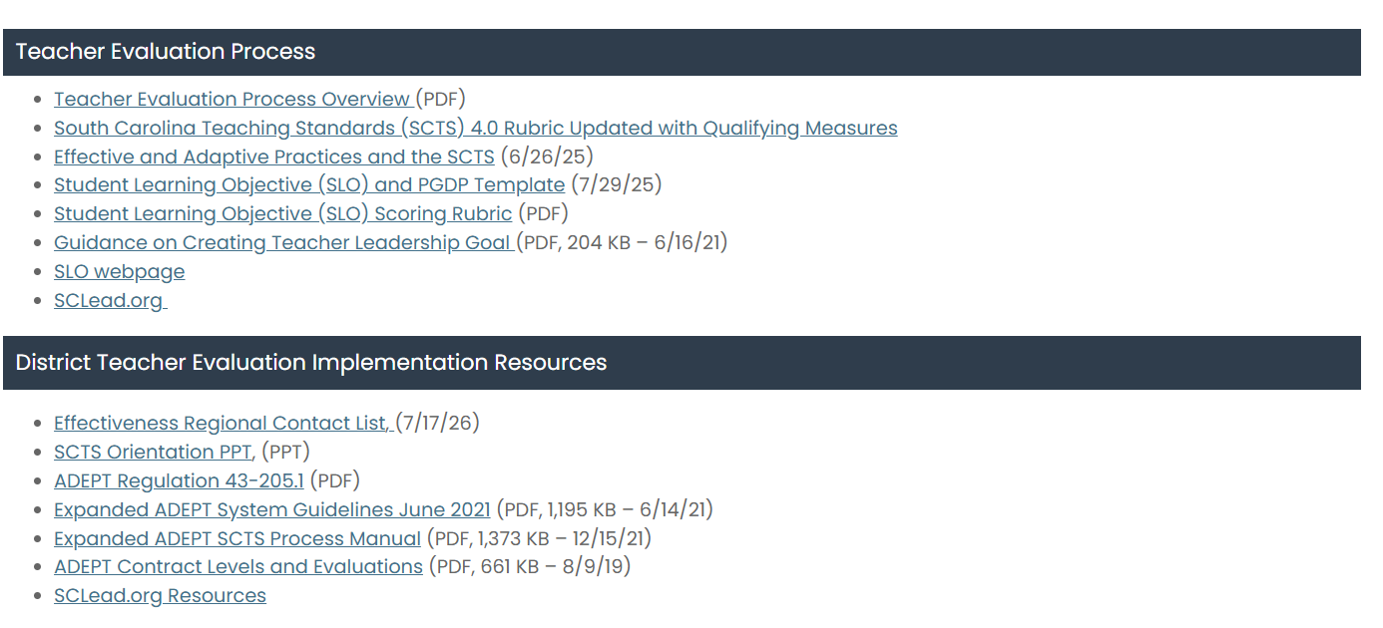
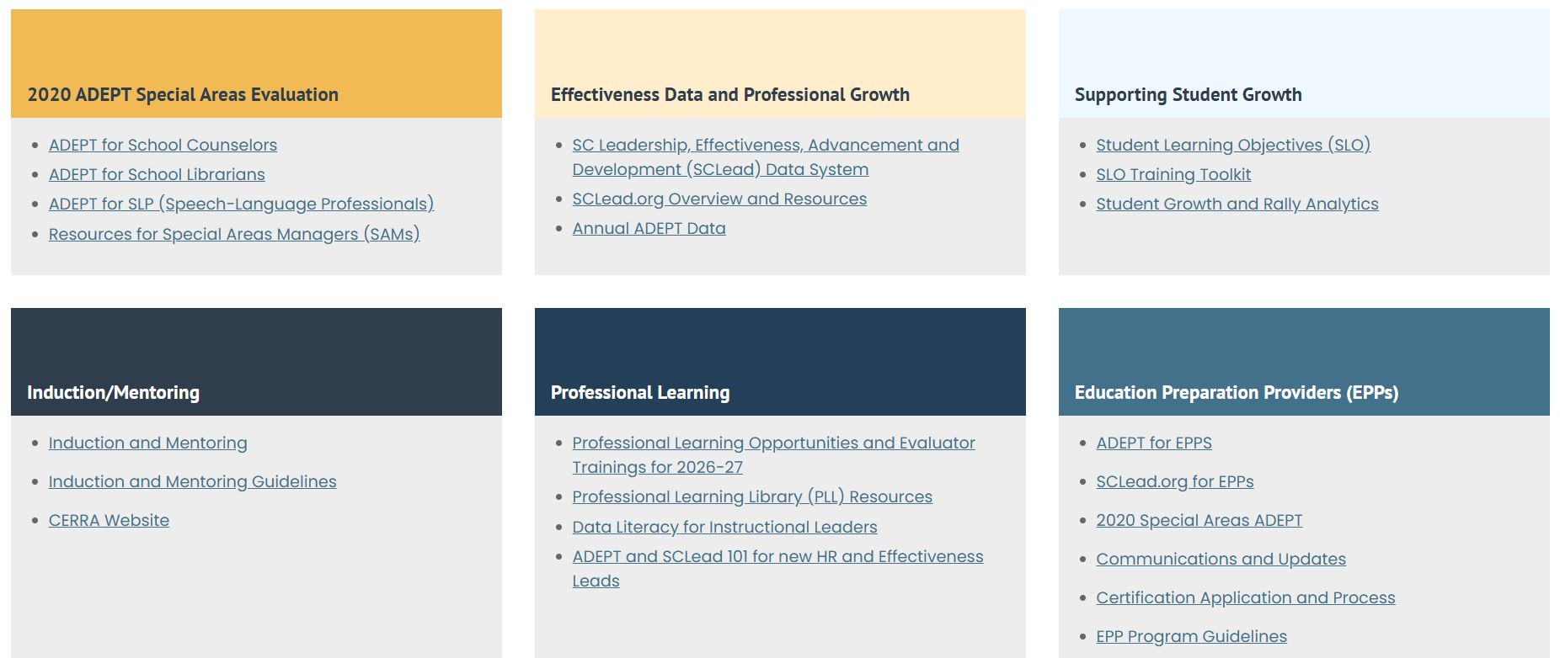
Teacher Evaluation and Support Guidance
Notes:
As a district level leader, there are many resources offered to you on the website. When you visit ed.sc.gov and click on “Educators," it will take you to the Office of Educator Effectiveness site. You can see the many resources you can access.

Slide 5
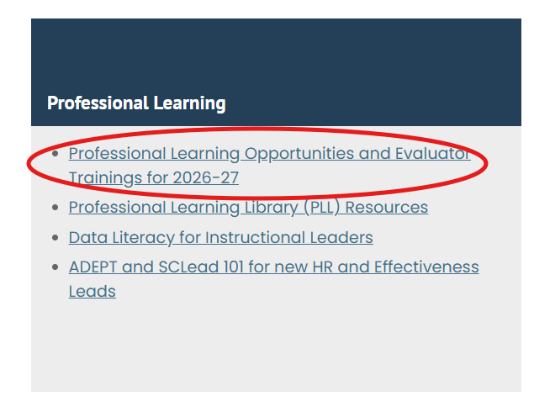
Professional Learning Opportunities for 2026-27
SCTS Evaluator Sessions
August 18–20, 2026 (FULL!)
9:00 a.m.–4:30 p.m.
Location: SCDE
September 15–17, 2026 (FULL!)
9:00 a.m.–4:30 p.m.
Location: Fort Mill (York County)
January 12–14, 2027
9:00 a.m.–4:30 p.m.
Location: Dorchester County
SCTS Train-the-Trainer Sessions
November 4-5, 2026
9:00 a.m.–4:30 p.m.
Location: SCDE
Special Areas Manager (SAM) Training
August 13, 2026
9:00 a.m. - 11:00 a.m.
Virtual on Microsoft Teams
ADEPT 101 for School Administrators Training Session
September 1, 2026
9:00 a.m. - 11:00 a.m.
Virtual on Microsoft Teams
Notes:
Sign-ups for trainings are live on our website!
Drop Link in the Chat: Professional Learning Opportunities - South Carolina Department of Education

Slide 6
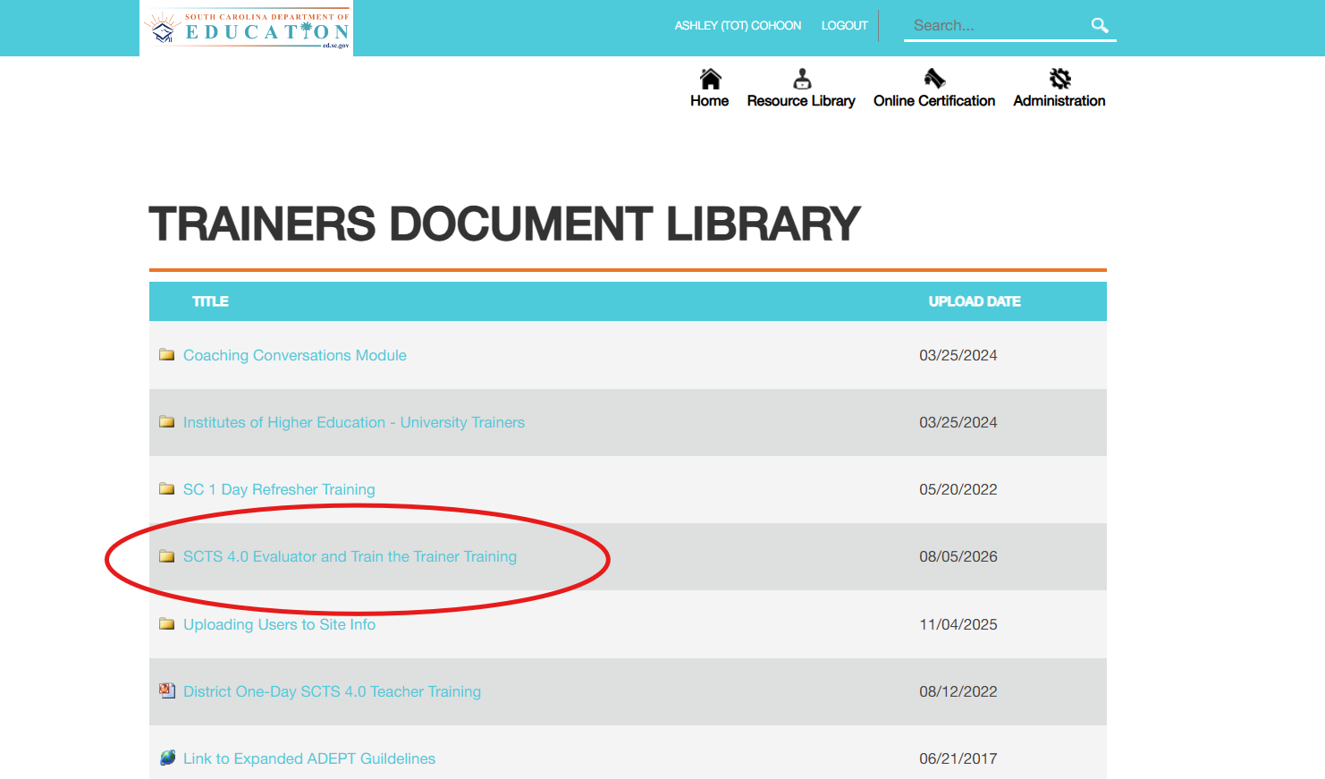
SCTS Training Resources
NIET SC ADEPT Portal
www.scadeptsupport.org
Can't remember username/password? Email support@niet.org for assistance.
Notes:
To access training documents from NIET, you can visit scadeptsupport.org and click on the resource library at the top. There are a variety of resources to click on and view related to evaluator training and train the trainer training.
Drop Link in the Chat: scadeptsupport.org

Slide 7
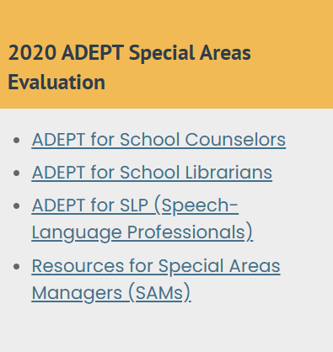
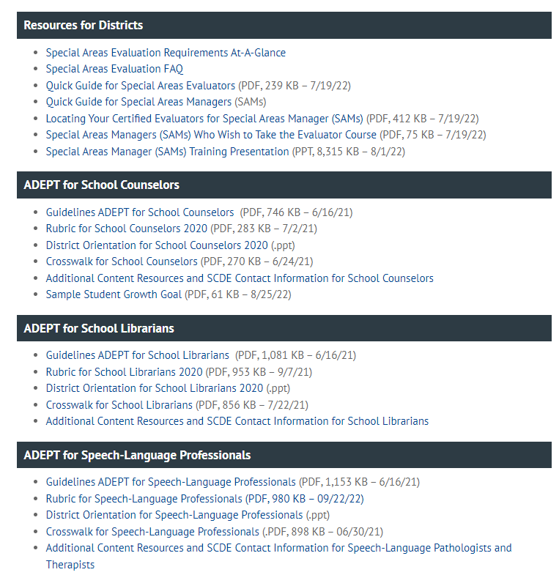
Special Areas Evaluation and Support Guidance
Does your district have a SAM?
Special Areas Manager!
Virtual training is on Thursday @ 9:00 AM!
Email Ashley Cohoon to sign up.

Slide 8
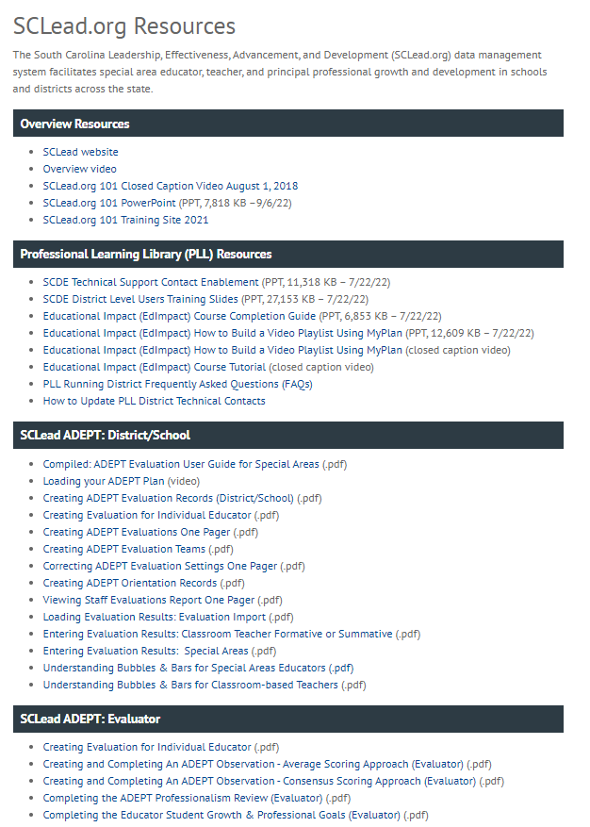
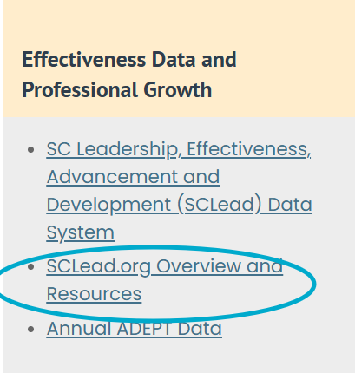
SCLead.org Resources
Notes:
We have many districts that maximize the use of SCLead.org to track the progress of evaluations. Our Effectiveness Team has uploaded resources that can help you with questions that may arise.
Many of you typically ask why the bubbles under the Evaluation Tab are not filled in or why the educator’s Status Page bars are not at 100%.
There are 2 resources in the SCLead.org ADEPT: District/School Section to help you with these questions.
We have the Understanding Bubbles & Bars for Special Areas Educators and Understanding Bubbles and Bars for Classroom-based Teachers.
Our Effectiveness Team co-created these resources along with the others you see with our partners at Level Data/SCLead.org. If you have questions outside of the guide, please feel free to email support@sclead.org.

Slide 9
ADEPT Reminders

Slide 10
The When: ADEPT Calendar of Events and Due Dates
Date | Key Milestones and Progress Monitoring
April through June | Check to ensure enough evaluators are SCTS certified. Schedule additional SCTS evaluator and Mentor trainings at the district level to ensure availability of evaluators for next school year. Review implementation feedback and complete ADEPT Plan for next year.
July through September | Conduct district evaluator training and orientation and review how SCLead.org features will be used by the district. Conduct differentiated evaluation orientations for educators by contract level, including SCLead.org Orientation signature, review of evaluation process and team, and SCLead.org requirements​. Create evaluations in SCLead.org and confirm initial settings data (e.g., current year’s contract level and evaluation type). ​ Confirm evaluation teams are set by district or school-level personnel.​ Monitor principal/teacher signatures for SLO initial conference​. Confirm all teams have scheduled announced preliminary evaluation cycle observations.
Mid-October through January | Confirm that Preliminary evaluation cycle pre-conferences, observations, and post-conferences occur. The minimum number of required observations is defined by contract level. Conduct district evaluator trainings as needed. Conduct evaluation orientation and training on SCLead.org functionality and requirements for new hires, as needed.
February through April | Confirm initial data entry of contract levels for current academic year in SCLead.org (February 1). Confirm all data for fully certified Induction 1 teachers (February 1, Induction count for ADEPT funding) . Confirm that final evaluation cycle pre-conference(s) and observation(s) occur. Evaluators submit evaluation results in SCLead.org Issue contract notification (before May 1).
May through June | Enter or confirm current year’s evaluation results and next year’s contract and evaluation type. Confirm educators who have had two unsuccessful Annual Summative evaluations for ADEPT sanction letters. Last day to submit End-of-Year evaluation data in SCLead.org (June 20)
Notes:
As the year get started, we know many of you may be in different places with the staggered start of the school year. This calendar will give you an idea of the key milestones and monitoring steps you will take as you guide the ADEPT process this year. July through September is highlighted since this is what should be happening during this time. (READ BULLETS)
Be sure to keep this calendar handy as you progress through the school year.

Slide 11
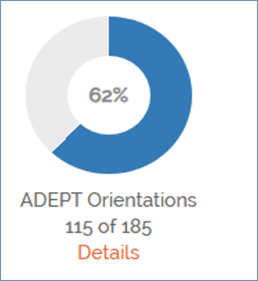
Orientations
Orientations
Filtering Staff
Cleaning up Staff list
Notes:
Orientations are a great place to start at the beginning of the year. In SCLEAD on your district's dashboard you will find your Orientation Donut. By the end of September this should be at 100%. If it is not, then you can click details and filter "No" in the completion column.
If there are educators who no longer are with the district, then this means that the staff list needs to be cleaned up.

Slide 12
SCLead Reminders

Slide 13
Cleaning Up Staff Lists
Educators/administrators no longer with your district
Newly hired educators/administrators
Educators/administrators who moved positions or schools in your district
Notes:
There are several benefits of doing a clean-up:
You avoid accidentally creating evaluation records for educators no longer at your school or district.
Your educators/administrators will show at the correct location.
You can ensure that a former SCLead ADEPT Administrator no longer has access to evaluation records.
If you need support, you can ask your ADEPT Contact in our office to grant ADEPT Administrator Rights to newly hired administrators so they can start utilizing SCLead

Slide 14
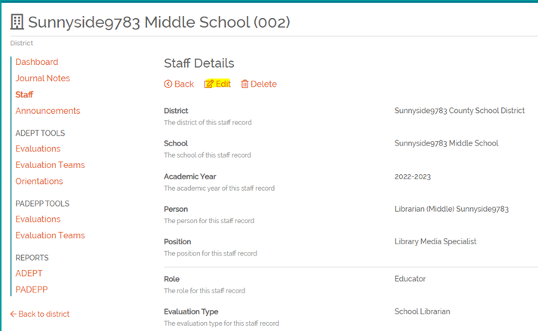
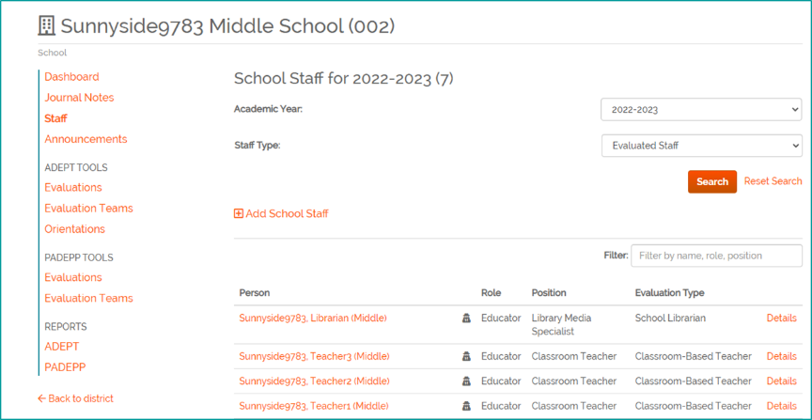
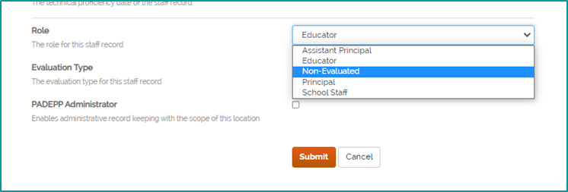
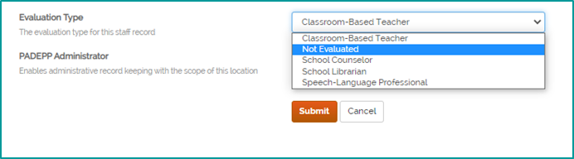
Staff Lists
Notes:
Staff lists in SCLead. At the district or school level, you will see filters for the Academic Year, Evaluated Staff and Non-evaluated Staff as shown on the left. You will see a list of educators pulled from SCEducator and their corresponding roles and positions, as well as, evaluation types. On the right-most column you will see details. To go about "cleaning-up" your staff lists, you can manually add and remove educators/administrators. You will need to remove staff members who no longer have a teaching position, or those who are no longer at your district/school. To remove ADEPT Administrator Rights: Go to the district or school staff list, locate the educator, click "details" then click edit on the new page that appears, that’s shown on the upper right screenshot, Edit the Role as Non-Evaluated and Evaluation Type as Not Evaluated and click Submit. Please note that Non-Evaluated automatically removes the Administrator Rights. It also removes the educator from the evaluation donut.

Slide 15
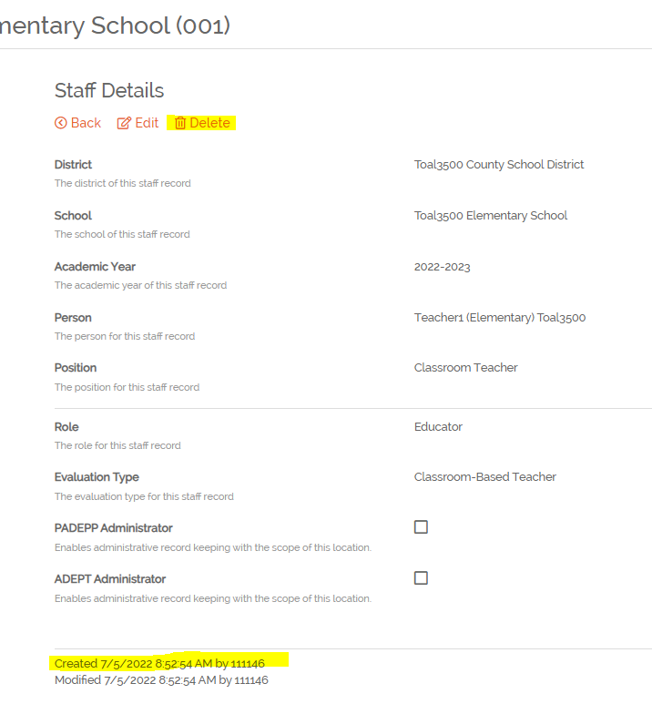
Dealing with Duplicates
"Delete" option will only show if the record was manually added to SCLead.org​
Notes:
If a staff assignment has been manually added to SCLead, there will be a delete option when you click details for the staff assignment. If the delete option appears, it would indicate the assignment was manually added and can be deleted if desired. You can also check at the bottom where it says Created by. If it was created by the number 0, then it was created by SCEducator and can’t be deleted.
Other Tips:
If you created an evaluation record and entered evaluation data under the educator’s profile without a CID, enter the same evaluation data in the evaluation record created under the educator with a CID.
Remove any evaluation record from the educator Profile without a CID. To remove, locate the evaluation record, go to Settings, scroll down and click “Remove”
Remember to let Finance add positions in SCEducator DON'T manually add if all possible to prevent duplicate profiles.

Slide 16
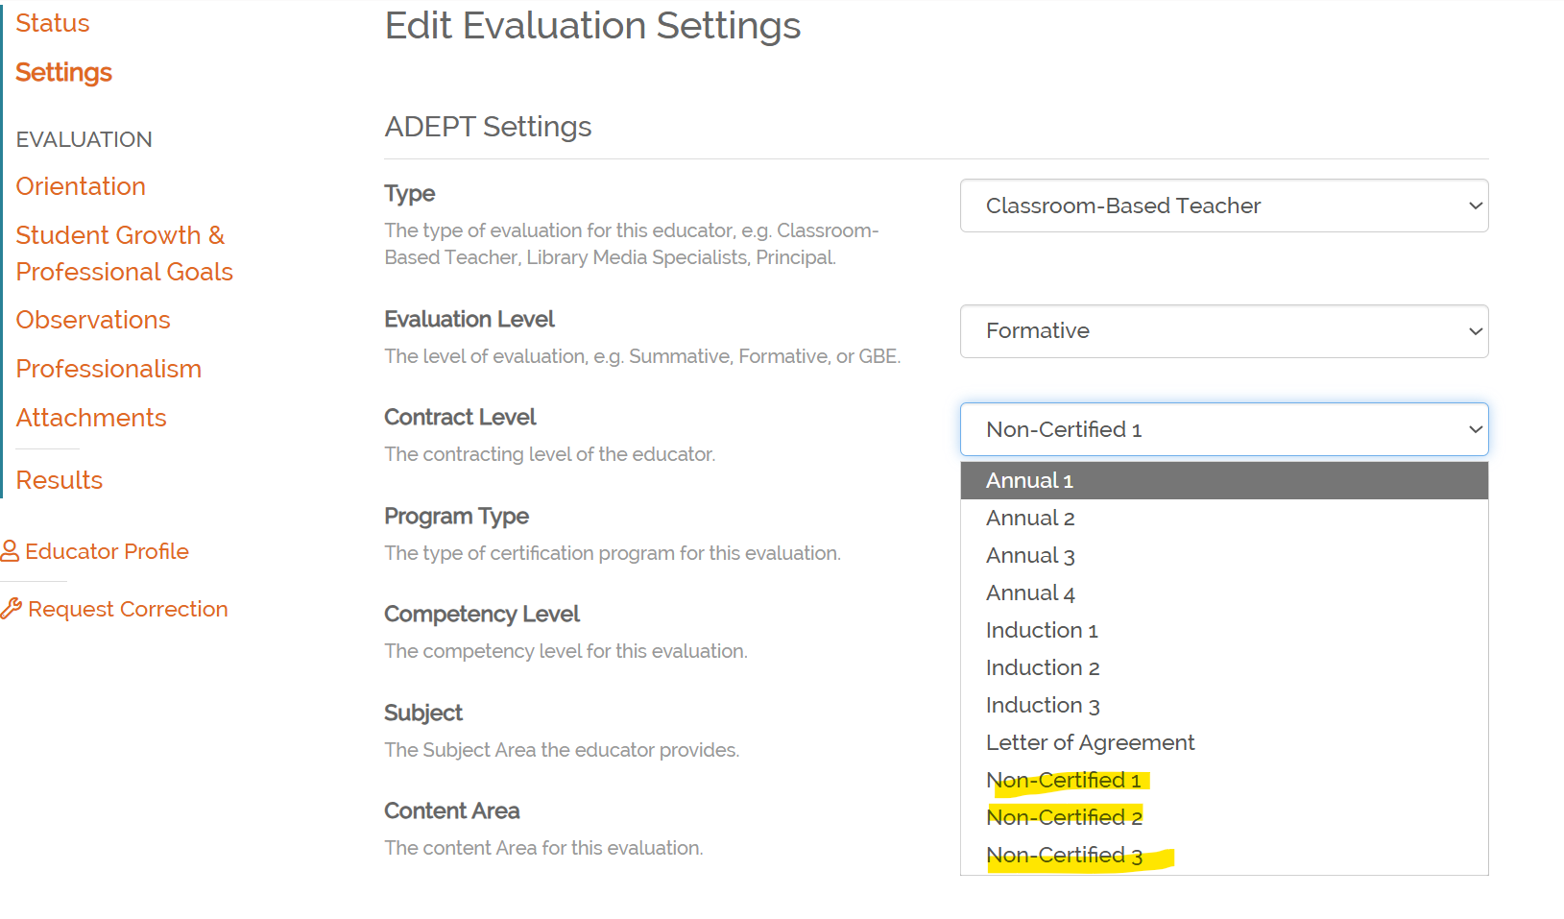
Noncertified Teacher Pilot Program
Provides for up to 3 years of noncertified teaching experience
Evaluation similar to Induction 1 with exceptions:
  All observations announced
  Exempt from Induction & Mentoring program
SCLead option ONLY applies to pilot participants
Notes:
This pilot program gives participants up to 3 years to teach w/o certification – within that time, participants must enroll in an approved educator preparation program (traditional or alt. route); participating districts apply with OES
Evaluation procedures are very similar to Induction 1 except that all observations include BOTH a pre-conference and post-conference AND participants do not participate in district's Induction & Mentoring Program. They will complete those requirements when on an Induction contract
This option in SCLead ONLY applies to teachers that are a part of this program. It is not for other educators awaiting certification.

Slide 17
Induction & Mentoring

Slide 18
A Few Reminders....
A mentor cannot serve as an evaluator or be involved in the evaluation of their assigned induction teacher.
Mentors can only score mentees for mock observation purposes intended solely for the mentee’s growth; no scores should be used for the required observations conducted as part of the mentoring process.
Mentors cannot submit any observation notes or formal feedback to the district in order to preserve the confidentiality and trust that is essential to the mentor-mentee relationship.
Mentors can submit contact logs and support documents if requested by the district.
Notes:
Read Slide

Slide 19
Upcoming M&I Training Dates
SC Mentor Training: In-Person
  Date: August 11-12, 2026
  Location: SCEA Building, West Columbia
  Time: 9:00AM – 4:00PM
  Registration Link
SC Mentor Training: In-Person
  Date: September 22-23, 2026
  Location: Anderson University
  Time: 9:00AM – 4:00PM
  Registration Link
SC Mentor Training: Virtual​
  Date: October 20-21, 2026​
  Time: 9:00AM – 4:00PM​
  Registration Link
Notes:
Drop Link in Chat:
Upcoming Mentor Trainings | Center for Educator Recruitment, Retention, and Advancement

Slide 20
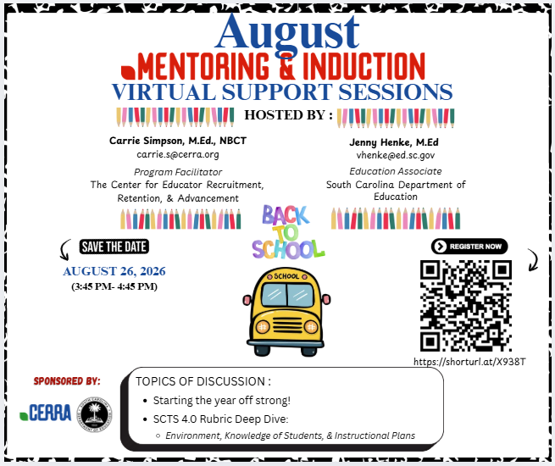
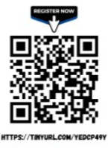
2026-27 Mentor & Induction Virtual Support Sessions
2026-27 Dates
Aug. 26, 2026
Sept. 30, 2026
Oct. 28, 2026
Nov. 18, 2026
Jan. 20, 2027
Feb. 17, 2027
March 17, 2027
April 14, 2027
May 19, 2027
Scan the QR code for all session dates and registration links.
Notes:
Our first Mentor and Induction Virtual Support Session for the school year will be held on Wednesday, August 26, from 3:45-4:45. You can register by scanning the QR code or pasting the tiny URL in your browser. Please pass this along to your Induction 1 educators, other early career educators, mentors, or whoever else could benefit from this resource. The schedule for next year's support sessions will be made available soon.
Drop Links in the Chat:
Flyer with Registration Links to All M&I Virtual Support Session Dates: https://drive.google.com/file/d/1EWzvBgDs1E9Usyz9URLEWJwCbsBz1Ise/view?usp=sharing
Flyer for August 2026 M&I Virtual Support Session: https://drive.google.com/file/d/1g57SOeZyhV2wgPJhsOdd0C7_VyrMgaAM/view?usp=sharing
Registration Link for August 2026 M&I Virtual Support Session: Mentor & Induction Virtual Support Session 8.26.26
I'll will pass the mic to Roshonda to go over SLOs.

Slide 21

Using SLO's and Observations to Drive Instruction

Slide 22
SLO's are Visual Cues!
SLO's are not something to do. It's what we do!
Setting Goals
  Assess
  Teach
  Monitor Progress
  Intervene
Goal are for?

Slide 23
Road Map
Data Dives
Lesson Plans
Assessments
Intervention/Enrichment

Slide 24
"Coaching"
"Along the way, I may need some help!"
Observations
Feedback
Coaching Cycle
Observations
Feedback
SLO Conferences-Beginning, Mid-Year, Final

Slide 25
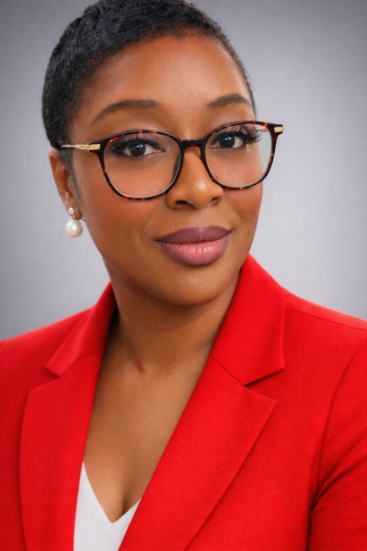
Dr. Roshonda Frazier
Rfrazier@ed.sc.gov

Slide 26
Frequently Asked Questions

Slide 27
FAQ
When do I issue an LOA?
  An LOA is issued when an educator is eligible for a contract but is hired on a date that would cause their employment to be less than 152 days.
What are the certification requirements for evaluating an educator formally?
  Educators must be employed in an area or areas in which they hold current certification at least half-time to be eligible for certificate advancement.

Slide 28
FAQ Continued
What contract/evaluation type applies to an educator with a Professional certificate that is adding on an area of certification, considering the educator has already had a Continuing contract?
  Since the educator has already had a continuing contract (considering there is no lapse in certification), the educator would remain on a Continuing contract. The educator should receive a formative evaluation so that they can be observed and given feedback in the new area.
What do we do with educators who haven't met certification requirements, but we anticipate that they will within the school year?
  The educator can start the year on the applicable contract/evaluation in anticipation of program completion, but the evaluation should be closed within a reasonable time (ie. Induction count) if the educator fails to meet the requirements.

Slide 29
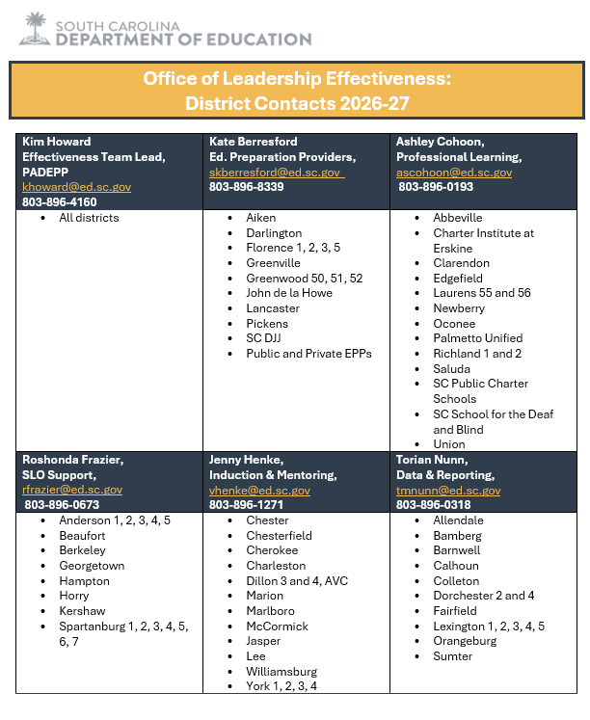
ADEPT Contact List

Slide 30
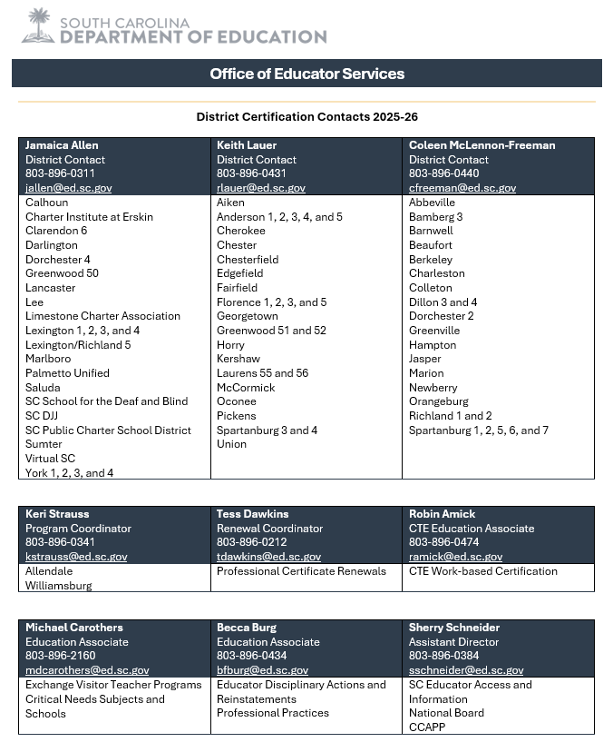
Educator Services Contact List

Slide 31
Office Hours Dates and Newsletters for 2026-27
Tuesday, August 11, 2026
Tuesday, September 8, 2026
Tuesday, October 13, 2026
Tuesday, November 10, 2026
Tuesday, January 12, 2027
Tuesday, February 9, 2027
Tuesday, March 9, 2027
Tuesday, April 13, 2027
Suscribe to our
Office of Leadership Effectiveness
Newsletter!
Notes:
Drop Link in Chat: Subscribe to the OLE Newsletter

Slide 32
Questions and Discussion

Slide 33
Office of Leadership Effectiveness
Educator Effectiveness Leads
Leadership Development Leads
Kate Berresford, EPPs, skberresford@ed.sc.gov
Ashley Cohoon, Communications, ascohoon@ed.sc.gov
Dr. Roshonda Frazier, SLO and Teacher Leadership, rfrazier@ed.sc.gov
Jenny Henke, Induction and Mentoring, vhenke@ed.sc.gov
Dr. Kimberly Howard, PADEPP, khoward@ed.sc.gov
Torian Nunn, Data and Reporting, tmnunn@ed.sc.gov
Visit our website: https://ed.sc.gov
  Dr. Gerard Edwards, Veteran Principals & District Leaders, gedwards@ed.sc.gov
  Keasha Grant, Certified Support & Emerging Leaders, ksgrant@ed.sc.gov
  Crystal Halma, Collective Leadership, chalma@ed.sc.gov
  Dr. Frank Robinson, New Principals & Emerging Leaders, frobinson@ed.sc.gov
  Dr. Adrienne Davenport, Instructional Leadership & Assistant Principals, tsmith@ed.sc.gov
  Kimberly Mack, Director, kemack@ed.sc.gov
  Marilyn Suber, Administrative Assistant, masuber@ed.sc.gov
Office Support
Notes:
We thank you for your time today. We will stay for a few extra minutes if anyone has any additional questions.
Feel free to reach out to us if you have questions or feedback for us. Our email addresses are shown on the slide.
Have a great rest of your day!

Slide 34
SCDE SEAL LOGO

