Slide 1


Educator Effectiveness
Virtual Office Hours
Welcome back!
August 13, 2025
If the beginning of the school year was a movie, what would it be?
Notes:
Welcome to our educator effectiveness virtual office hours. We’re so glad you could make it. Please type in the chat box your name and district. We have two opening questions posted that we’d love for you to answer in the chat. We’ll get started right at 2 PM. ​
​
@ 2 PM: Welcome again everyone! (Introduce self and team) If you haven’t done so, please type in the chat box your name and district. First, to orient you to the Microsoft Teams platform, the control icons will be on the upper right section of your screen for most users. If you haven’t yet, please click the mic icon to mute yourself. You will click the same mic icon to unmute yourself later when we are ready for conversation. We encourage you to utilize the chat throughout this session for any questions you may have during the presentation. Our team will be monitoring the chat and responding accordingly. We will also hold a time at the end for discussion.​ ​
The purpose of Office Hours is to hold time to ensure that we share timely reminders with districts, but even more importantly to create a space where you can share feedback, questions, ideas and best practices with your peers. If you are new, there is no question too small; if you are an effectiveness veteran, don’t be shy about letting us know what you need. Before we get started, let’s consider our opening question (summarize responses or ask 1-2 districts to elaborate….)

Slide 2
Agenda
Effectiveness and Training Resources
ADEPT Reminders
SCLead Reminders
Induction and Mentoring
FAQs and Announcements
Questions and Discussion
Notes:
We are so glad to have you here with us today. Before we get to questions and open discussion, we have a few things to share with you (state them). As we go, please feel free to add questions in the chat. We will respond to all that we can as we go and we address any lingering questions and open up the room for discussion at the end.

Slide 3
Effectiveness and Training Resources
Notes:
We realize there's been some turnover in ADEPT leads this year, so we want to start with a reminder about where to find our top resources.

Slide 4
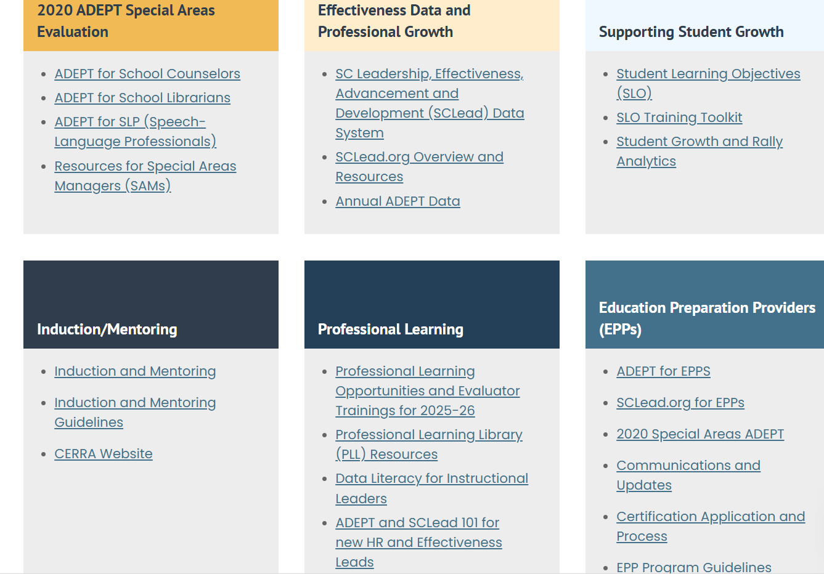
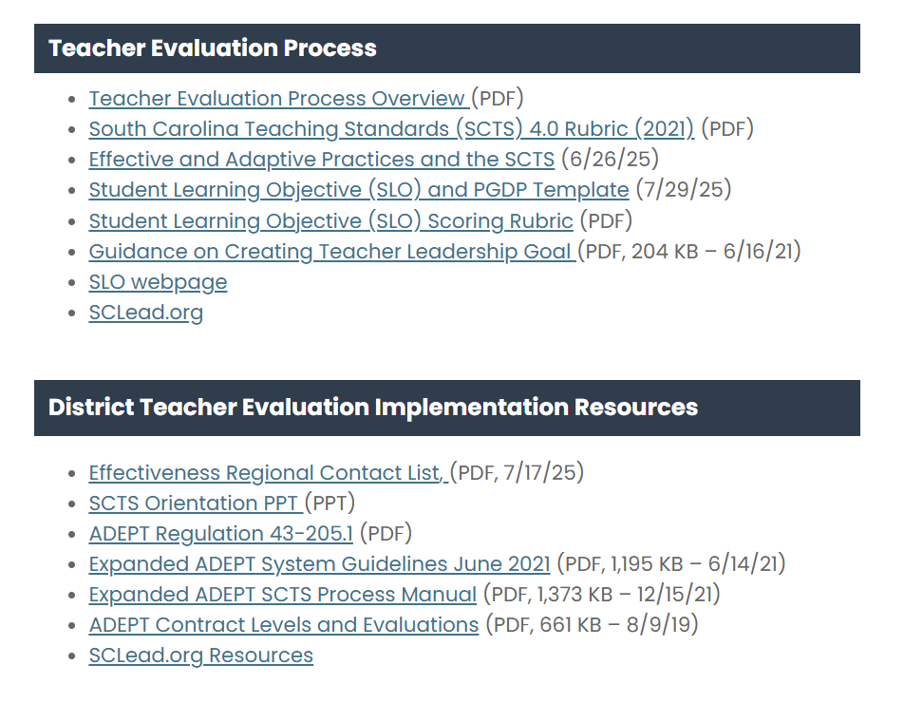
Teacher Evaluation and Support Guidance
South Carolina Department of Education
Notes:
As a district level leader, there are many resources offered to you on the website. When you visit ed.sc.gov and click on “Educators," it will take you to the Office of Educator Effectiveness site. You can see the many resources you can access. If you notice the purple box, it highlights resources related to ADEPT. This will take you to where you can find District Teacher Evaluation Implementation resources including ADEPT regulations, the process manual, and guidance for Contract levels and classroom based teacher evaluations.

Slide 5
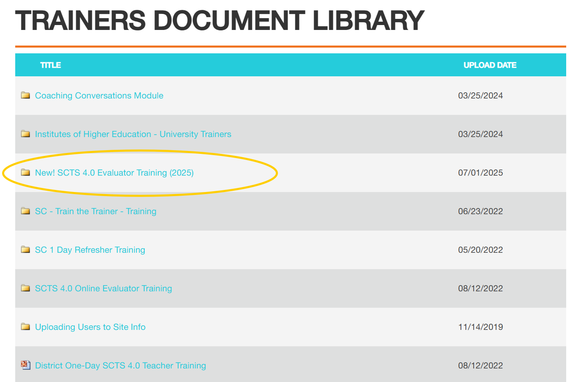
SCTS Training Resources
www.scadeptsupport.org
Can't remember username/password? Email support@niet.org for assistance
Notes:
To access training documents from NIET, you can visit SCadeptsupport.org and click on the resource library at the top. You can see the variety of resources you can click on and view concerning evaluator training and train the trainer training.

Slide 6
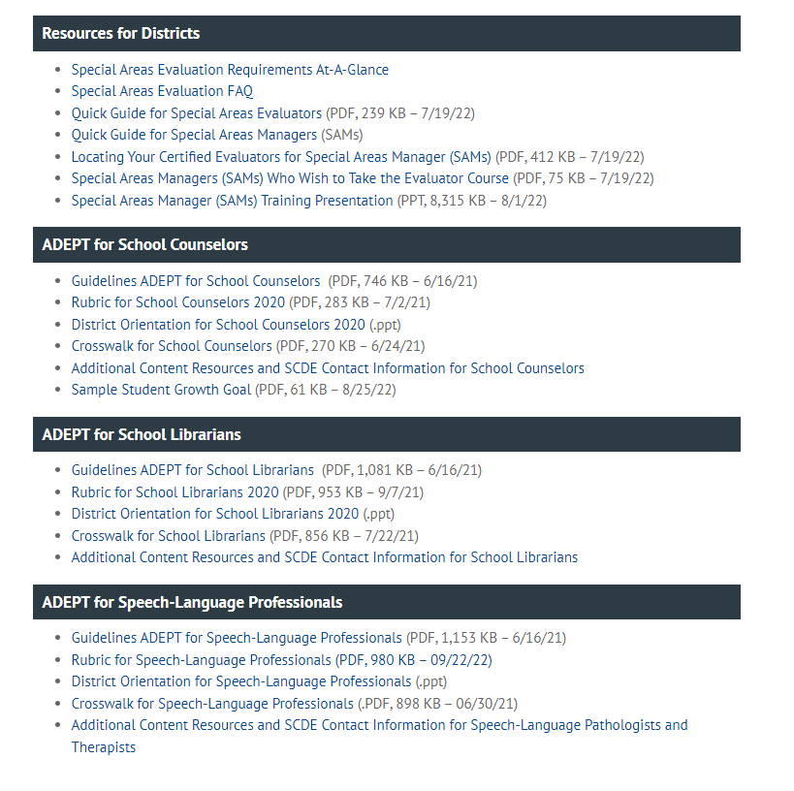
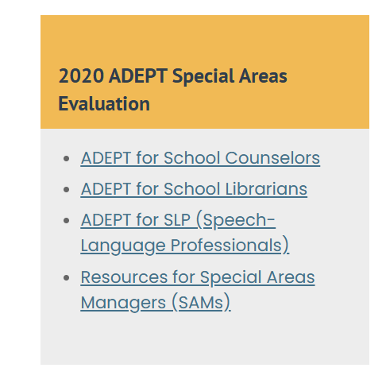
Special Areas Evaluation and Support Guidance

Slide 7
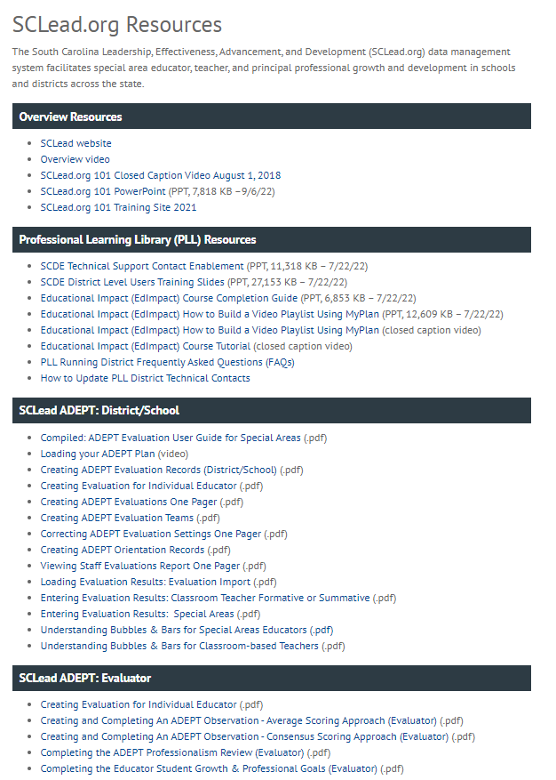
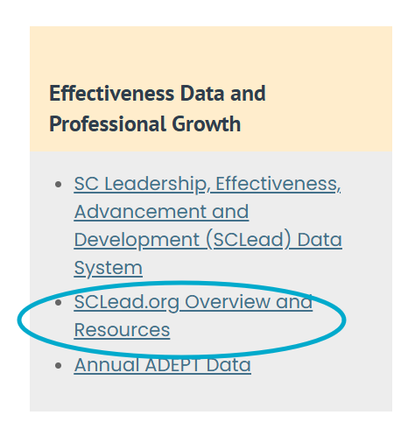
SCLead.org Resources
Notes:
We have many districts that maximize the use of SCLead.org to track the progress of evaluations. Our Effectiveness Team has uploaded resources that can help you with questions that may arise.
Many of you typically ask why the bubbles under the Evaluation Tab are not filled in or why the educator’s Status Page bars are not at 100%.
There are 2 resources in the SCLead.org ADEPT: District/School Section to help you with these questions.
We have the Understanding Bubbles & Bars for Special Areas Educators and Understanding Bubbles and Bars for Classroom-based Teachers.
Our Effectiveness Team co-created these resources along with the others you see with our partners at Randa/SCLead.org. If you have questions outside of the guide, please feel free to email support@sclead.org.

Slide 8
ADEPT Reminders

Slide 9
The When:
ADEPT Calendar of Events and
Due Dates
Date | Key Milestones and Progress Monitoring
April through June | Check to ensure enough evaluators are SCTS certified. Schedule additional SCTS evaluator and Mentor trainings at the district level to ensure availability of evaluators for next school year. Review implementation feedback and complete ADEPT Plan for next year.
July through September | Conduct district evaluator training and orientation and review how SCLead.org features will be used by the district. Conduct differentiated evaluation orientations for educators by contract level, including SCLead.org Orientation signature, review of evaluation process and team, and SCLead.org requirements​. Create evaluations in SCLead.org and confirm initial settings data (e.g., current year’s contract level and evaluation type). ​ Confirm evaluation teams are set by district or school-level personnel.​ Monitor principal/teacher signatures for SLO initial conference​. Confirm all teams have scheduled announced preliminary evaluation cycle observations.
Mid-October through January | Confirm that Preliminary evaluation cycle pre-conferences, observations, and post-conferences occur. The minimum number of required observations is defined by contract level. Conduct district evaluator trainings as needed. Conduct evaluation orientation and training on SCLead.org functionality and requirements for new hires, as needed.
February through April | Confirm initial data entry of contract levels for current academic year in SCLead.org (February 1). Confirm all data for fully certified Induction 1 teachers (February 1, Induction count for ADEPT funding) . Confirm that final evaluation cycle pre-conference(s) and observation(s) occur. Evaluators submit evaluation results in SCLead.org Issue contract notification (before May 1).
May through June | Enter or confirm current year’s evaluation results and next year’s contract and evaluation type. Confirm educators who have had two unsuccessful Annual Summative evaluations for ADEPT sanction letters. Last day to submit End-of-Year evaluation data in SCLead.org (June 20)
Insert and format picture to fit allotted box frame
Notes:
As the year get started, we know many of you may be in different places as far as with the staggered start of the school year. This calendar does give you an idea of the key milestones and monitoring steps you will take as you guide the ADEPT process this year. July through September is highlighted since this is what should be happening during this time. (READ BULLETS)
Be sure to keep this calendar handy as you progress through the school year.

Slide 10
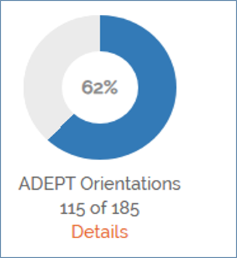
Orientations
Orientations
Filtering Staff
Cleaning up Staff list
Notes:
Orientations are a great place to start at the beginning of the year. In SCLEAD on your district's dashboard you will find your Orientation Donut. By the end of September this should be at 100%. If it is not, then you can click details and filter "No" in the completion column.
If there are educators who no longer are with the district then this means that the staff list needs to be cleaned up and we well discuss that later in this presentation.

Slide 11
SCLead Reminders

Slide 12
Cleaning up Staff Lists
Educators/administrators no longer with your district
Newly hired educators/administrators
Educators/administrators who moved positions or schools in your district
Notes:
The benefits of doing a clean-up are:
You avoid accidentally creating evaluation records for educators no longer at your school or district.
Your educators/administrators will show at the correct location.
You can ensure that a former SCLead.org ADEPT Administrator no longer has access to evaluation records.
You can ask your ADEPT Contact in our office to grant ADEPT Administrator Rights to newly hired administrators so they can start utilizing SCLead.org.

Slide 13
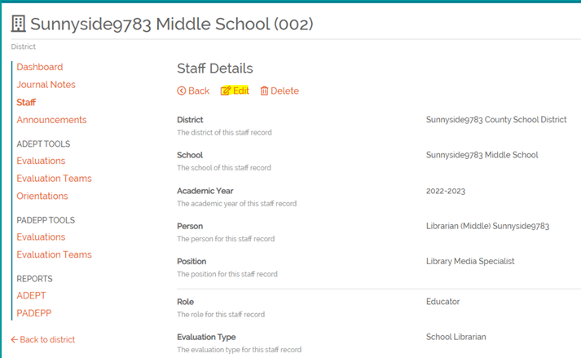
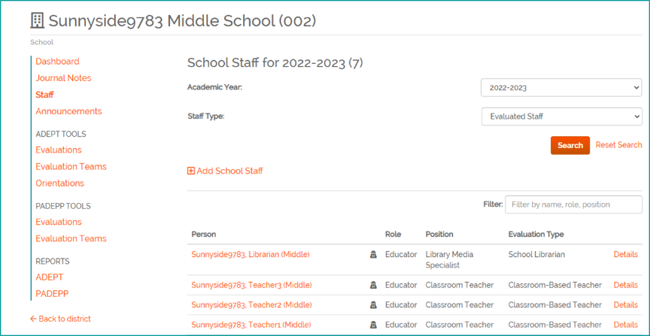
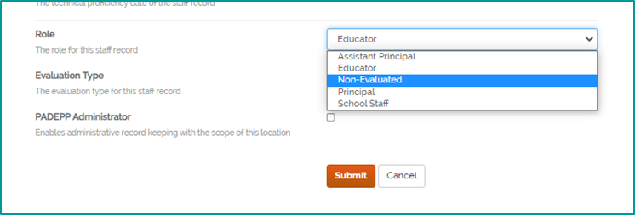
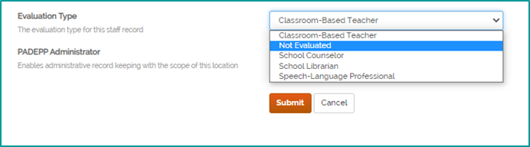
Staff Lists
Notes:
Let’s get familiar with the staff lists in SCLead.org. At the district or school level, you will see filters for the Academic Year, Evaluated Staff and Non-evaluated Staff as shown on the left. You will see a list of educators pulled from SCEducator and their corresponding roles and positions as well as evaluation types. On the right-most column you will see details.
To go about "cleaning-up" your staff lists, you can manually add and remove educators/administrators.
To remove a staff member who no longer has a teaching position, no longer at your district/school and to remove ADEPT Administrator Rights:
Go to the district or school staff list, locate the educator, click "details" then click edit on the new page that appears, that’s shown on the upper right screenshot, Edit the Role as Non-Evaluated and Evaluation Type as Not Evaluated and click Submit.
Note that Non Evaluated automatically removes the Administrator Rights as shown on the lower right screenshot. It also removes the educator from the evaluation donut.

Slide 14
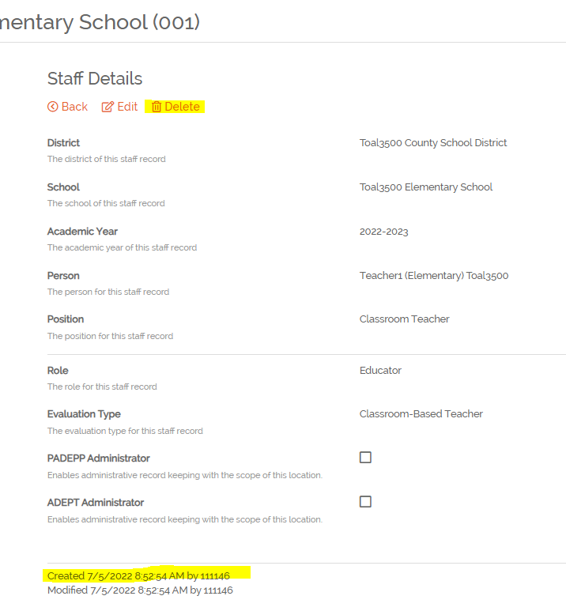
Dealing with Duplicates
"Delete" option will only show if the record was manually added to SCLead.org
Notes:
If a staff assignment has been manually added to SCLead.org, there will be a delete option when you click details for the staff assignment. If the delete option appears, it would indicate the assignment was manually added and can be deleted if desired. You can also check at the bottom where it says Created by. If it was created by number 0, then it was created by SCEducator and can’t be deleted.
Other Tips:
If you created an evaluation record and entered evaluation data under the educator’s profile without a CID, enter the same evaluation data in the evaluation record created under the educator with CID.
Remove any evaluation record from the educator Profile without CID. To remove, locate the evaluation record, go to Settings, scroll down and click “Remove”
Pro Tip- let Finance add positions in SCEducator DON'T manually add if all possible to prevent duplicate profiles.

Slide 15
Induction & Mentoring Reminders

Slide 16
Mentoring Reminders
A mentor can never serve as an evaluator for a teacher they mentored at any time during or after the induction year.
Mentors can only score mentees for mock observation purposes intended solely for the mentee’s growth; no scores should be used for the required observations conducted as part of the mentoring process.
Mentors cannot submit any observation notes or formal feedback to the district in order to preserve the confidentiality and trust that is essential to the mentor-mentee relationship.
Mentors can submit contact logs and support documents that do not include observation notes or formal feedback if requested by the district.

Slide 17
Frequently Asked Questions and Announcements

Slide 18
FAQs and Announcements
Has the SLO template in SCLead been updated to include "Effective and Adaptive Teaching Strategies and the South Carolina Teaching Standards" rather than "Responsive and Inclusive Practices". Yes! SCLead is up-to-date with the changes to the SLO template.
The Special Areas Evaluator courses will stay in Moodle until further notice.

Slide 19
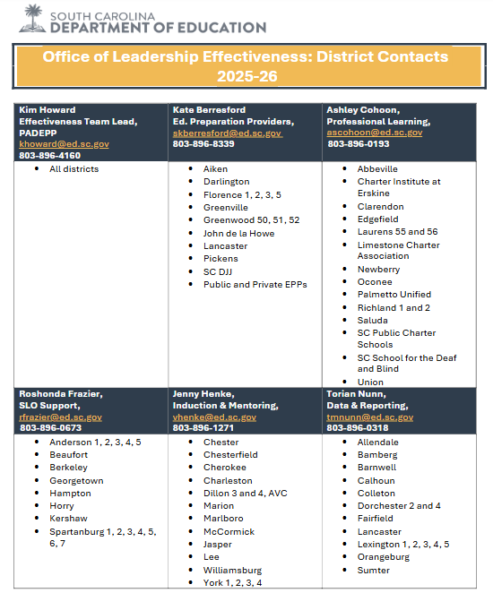
ADEPT Contact List

Slide 20
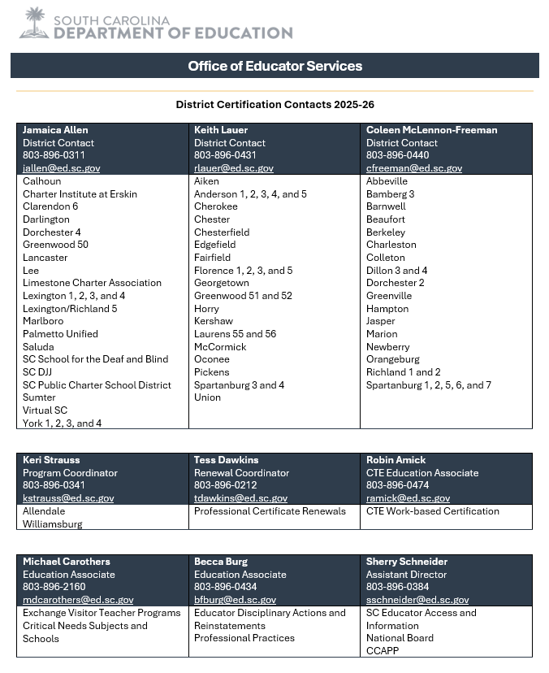
Educator Services Contact List

Slide 21
Office Hours Dates for 2025-26
Wednesday, August 13, 2025
Wednesday, September 10, 2025
Wednesday, October 8, 2025
Wednesday, November 12, 2025
Wednesday, January 14, 2026
Wednesday, February 11, 2026
Wednesday, March 11, 2026
Wednesday, May 6, 2026

Slide 22
Questions and Discussion

Slide 23
Office of Educator Effectiveness & Leadership Development
Effectiveness Leads
Leadership Development Leads
  Dr. Gerard Edwards, Veteran Principals & District Leaders, gedwards@ed.sc.gov
  Keasha Grant, Certified Support & Emerging Leaders, ksgrant@ed.sc.gov
  Crystal Halma, Collective Leadership, chalma@ed.sc.gov
  Dr. Frank Robinson, New Principals & Emerging Leaders, frobinson@ed.sc.gov
Office Support
  Kimberly Mack, Director, kemack@ed.sc.gov
  Marilyn Suber, Administrative Assistant, masuber@ed.sc.gov
Kate Berresford, EPPs, skberresford@ed.sc.gov
Ashley Cohoon, Communications, ascohoon@ed.sc.gov
Dr. Roshonda Frazier, SLO and Teacher Leadership, rfrazier@ed.sc.gov
Jenny Henke, Induction & Mentoring, vhenke@ed.sc.gov
Dr. Kimberly Howard, PADEPP, khoward@ed.sc.gov
Torian Nunn, Data & Reporting, tmnunn@ed.sc.gov
  Visit our website: https://ed.sc.gov

Slide 24
SCDE SEAL LOGO

