Slide 1
Educator Effectiveness
Virtual Office Hours
August 2023
Welcome back!
What are you celebrating this week?
2. What are you focusing on with teachers as the year begins?
Notes:
Lilla: Welcome to our educator effectiveness virtual office hours. We’re so glad you could make it. Please type in the chat box your name and district. We have two opening questions posted that we’d love for you to answer in the chat. We’ll get started right at 2 PM. ​
​
@ 2 PM: Welcome again everyone! (Introduce self and team) If you haven’t done so, please type in the chat box your name and district. First, to orient you to the Microsoft Teams platform, the control icons will be on the upper right section of your screen for most users. If you haven’t yet, please click the mic icon to mute yourself. You will click the same mic icon to unmute yourself later when we are ready for conversation. We encourage you to utilize the chat throughout this session for any questions you may have during the presentation. Our team will be monitoring the chat and responding accordingly. We will also hold a time at the end for discussion.​ ​
The purpose of Office Hours is to hold time to ensure that we share timely reminders with districts, but even more importantly to create a space where you can share feedback, questions, ideas and best practices with your peers. If you are new, there is no question too small; if you are an effectiveness veteran, don’t be shy about letting us know what you need. Before we get started, let’s consider our opening question (summarize responses or ask 1-2 districts to elaborate….)

Slide 2
Agenda
Effectiveness and Training Resources
2. ADEPT Reminders and Calendar
3. FAQs: How do I load a correction for an Annual Summative evaluation?
4. Professional Learning Library Resources
5. Questions & Discussion
Notes:
Lilla: We are so glad to have you here with us today. Before we get to questions and open discussion, we have a few things to share with you (state them). As we go, please feel free to add questions in the chat. We will respond to all that we can as we go and we address any lingering questions and open up the room for discussion at the end.

Slide 3
SCDE Office of Educator Effectiveness and Leadership Development
SCDE
Office of Educator Effectiveness & Leadership Development
Professional learning
& coaching
  educator effectiveness,
  new teacher & principal induction,
  instructional leadership
WHAT WE DO
  Personalized Learning
  Collective Leadership
  Equitable access
HOW WE DO IT
OUR FOCUS
  Culture & Environment
  Instruction
Growing educators to lead schools where ALL students have equitable access to effective instruction.
  More effective teachers & leaders stay
  More students & educators grow
DESIRED RESULTS
Notes:
Lilla: By way of introduction, our office’s mission is to grow educators to….
Our focus is on two things we know characterize great schools – leaders and teachers intentionally creating great cultures, those inclusive learning environments and leading systems to improve teaching and learning.
.

Slide 4
Effectiveness and Training Resources
Notes:
We realize there's been some turnover in ADEPT leads this year, so we want to start with a reminder about where to find our top resources.

Slide 5
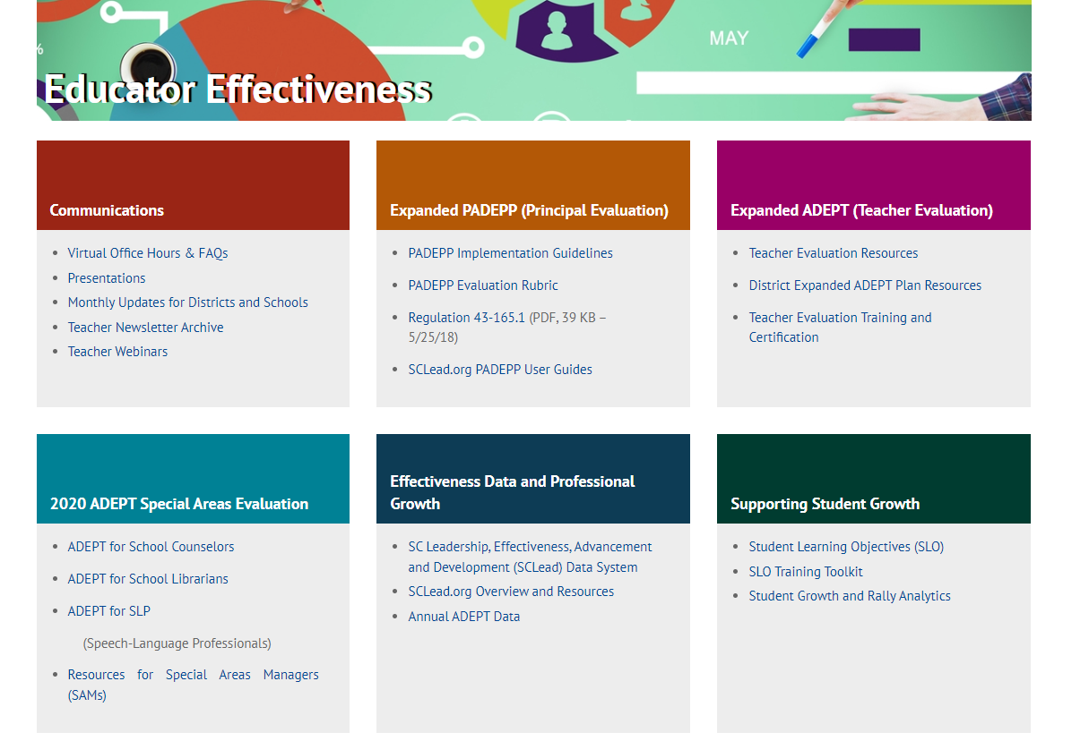
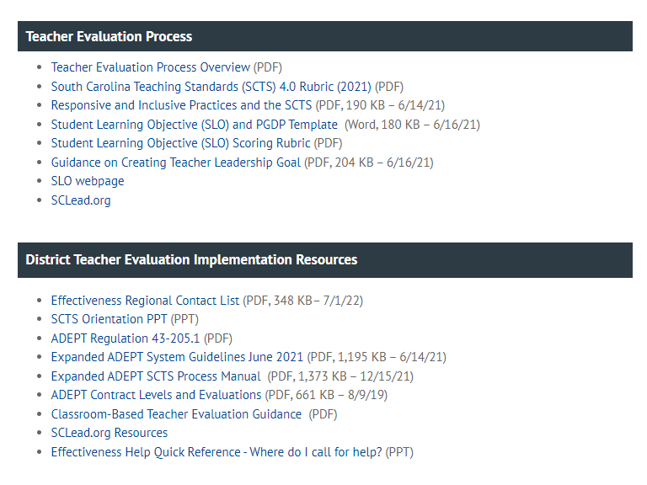
Teacher Evaluation and Support Guidance
South Carolina Department of Education
Notes:
As a district level leader, there are many resources offered to you on the website. When you visit ed.sc.gov and click on "teachers," it will take you to the Office of Educator Effectiveness site. You can see the many resources you can access. If you notice the purple box, it highlights resources related to ADEPT. This will take you to where you can find District Teacher Evaluation Implementation resources including ADEPT regulations, the process manual, and guidance for Contract levels an classroom based teacher evaluation.

Slide 6
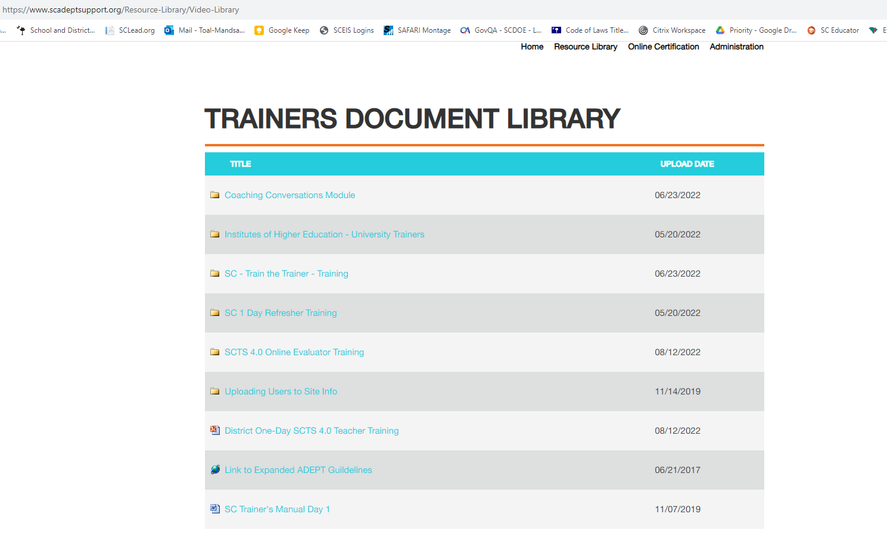
SCTS Training Resources
www.scadeptsupport.org
Notes:
To access training documents from NIET, you can visit SCadeptsupport.org and click on the resource library at the top. You can see the variety of resources you can click on and view concerning evaluator training and train the trainer training.

Slide 7
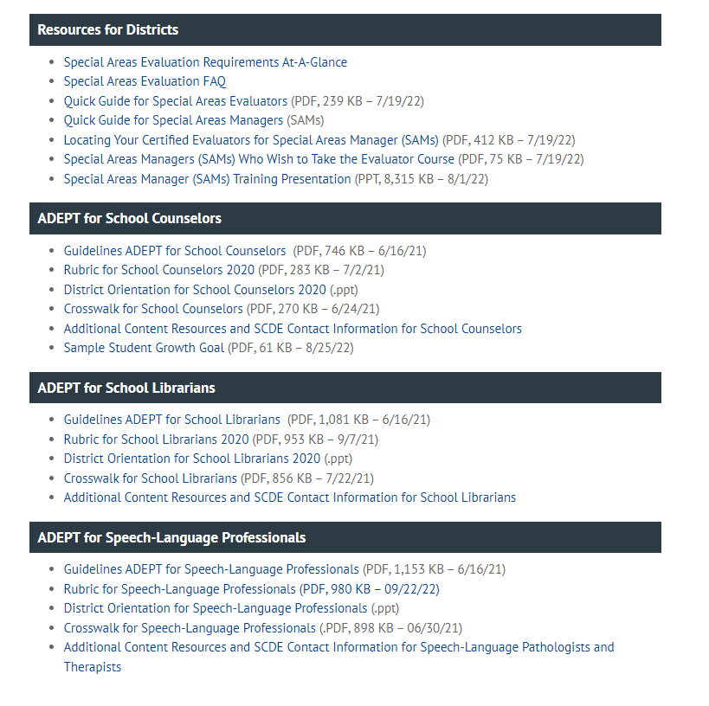
Special Areas Evaluation and Support Guidance
South Carolina Department of Education

Slide 8
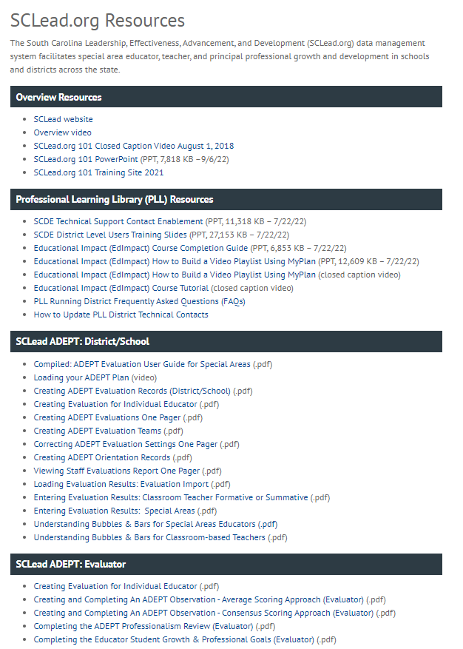
SCLead.org
Resources https://ed.sc.gov/educators/ educator-effectiveness/
Notes:
We have many districts that maximize the use of SCLead.org to track the progress of evaluations. Our Effectiveness Team has uploaded resources that can help you with questions that may arise.
Many of you typically ask why the bubbles under the Evaluation Tab are not filled in or why the educator’s Status Page bars are not at 100%.
There are 2 resources in the SCLead.org ADEPT: District/School Section to help you with these questions.
We have the Understanding Bubbles & Bars for Special Areas Educators and Understanding Bubbles and Bars for Classroom-based Teachers.
Our Effectiveness Team co-created these resources along with the others you see with our partners at Randa/SCLead.org. If you have questions outside of the guide, please feel free to email support@sclead.org.

Slide 9
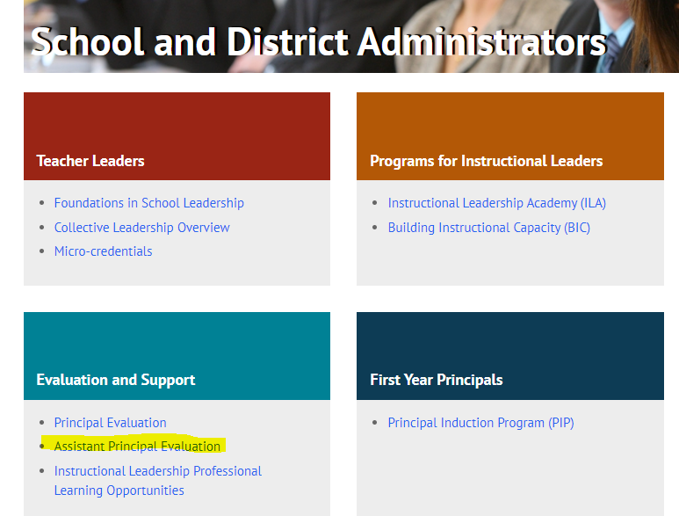

Assistant Principal Evaluation
Notes:
https://ed.sc.gov/educators/school-and-district-administrators/principal-evaluation/optional-assistant-principal-evaluation/
-This tool is close to my heart, we know how essential assistant principals are to instructional leadership, creating an inclusive enviornment, communicating behavior expectations, and managing a safe, inviting school building. They do not have a required evaluation tool, but we've heard from induction principals and APs that one is needed.

Slide 10
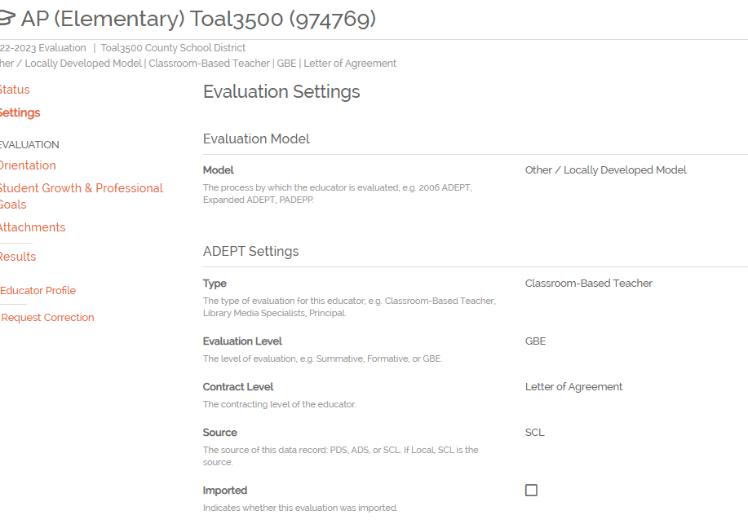




Using SCLead to Enter AP Evaluations
Evaluation Settings: Locally Developed Model, Classroom-based Teacher, GBE, LOA
Notes:
Lilla:
-Most APs who help out with the evaluation process are staffed as "School Staff" which is a non-evaluated role, but if you want to use SCLead to track AP evaluations there is a work around.
-When you add an evaluation for an AP, go to their profile and click "add evaluation". Once added you can go into evaluation settings and change them to Other/locally developed model, classroom-based teacher (because this will keep them out of the PADEPP statistics and doughnuts), and LOA)
-If you are interested, please reach out to Tom Smith who will put his email in the chat or me and we are happy to help you think through this process or even come present to your APs or principals.
Pass to Jenny

Slide 11
ADEPT Reminders and Calendar
Notes:
Jenny

Slide 12
The When:
ADEPT Calendar of Events and
Due Dates
Date | Key Milestones and Progress Monitoring
April through June | Check to ensure enough evaluators are SCTS certified. Schedule additional SCTS evaluator and Mentor trainings at the district level to ensure availability of evaluators for next school year. Review implementation feedback and complete ADEPT Plan for next year.
July through September | Conduct district evaluator training and orientation and review how SCLead.org features will be used by the district. Conduct differentiated evaluation orientations for educators by contract level, including SCLead.org Orientation signature, review of evaluation process and team, and SCLead.org requirements​. Create evaluations in SCLead.org and confirm initial settings data (e.g., current year’s contract level and evaluation type). ​ Confirm evaluation teams are set by district or school-level personnel.​ Monitor principal/teacher signatures for SLO initial conference​. Confirm all teams have scheduled announced preliminary evaluation cycle observations.
Mid-October through January | Confirm that Preliminary evaluation cycle pre-conferences, observations, and post-conferences occur. The minimum number of required observations is defined by contract level. Conduct district evaluator trainings as needed. Conduct evaluation orientation and training on SCLead.org functionality and requirements for new hires, as needed.
February through April | Confirm initial data entry of contract levels for current academic year in SCLead.org (February 1). Confirm all data for fully certified Induction 1 teachers (February 1, Induction count for ADEPT funding) . Confirm that final evaluation cycle pre-conference(s) and observation(s) occur. Evaluators submit evaluation results in SCLead.org Issue contract notification (before May 1).
May through June | Enter or confirm current year’s evaluation results and next year’s contract and evaluation type. Confirm educators who have had two unsuccessful Annual Summative evaluations for ADEPT sanction letters. Last day to submit End-of-Year evaluation data in SCLead.org (June 20)
Notes:
Jenny: As the year get started, we know many of you may be in different places as far as with the staggered start of the school year. This calendar does give you an idea of the key milestones and monitoring steps you will take as you guide the ADEPT process this year. July through September is highlighted since this is what should be happening during this time. (READ BULLETS)
Be sure to keep this calendar handy as you progress through the school year.
I will pass the mic back to Lilla...

Slide 13
Cleaning up Staff Lists
Educators/administrators no longer with your district
Newly hired educators/administrators
Educators/administrators who moved positions or schools in your district
Notes:
Lilla
The benefits of doing a clean-up are:
You avoid accidentally creating evaluation records for educators no longer at your school or district.
Your educators/administrators will show at the correct location.
You can ensure that a former SCLead.org ADEPT Administrator no longer has access to evaluation records.
You can grant ADEPT Administrator Rights to newly hired administrators so they can start utilizing SCLead.org.

Slide 14
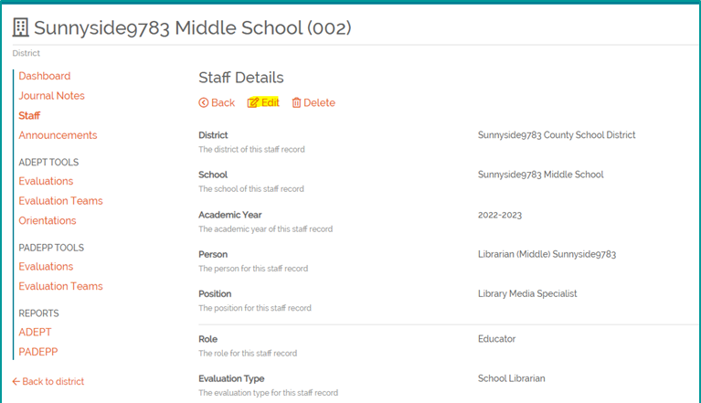
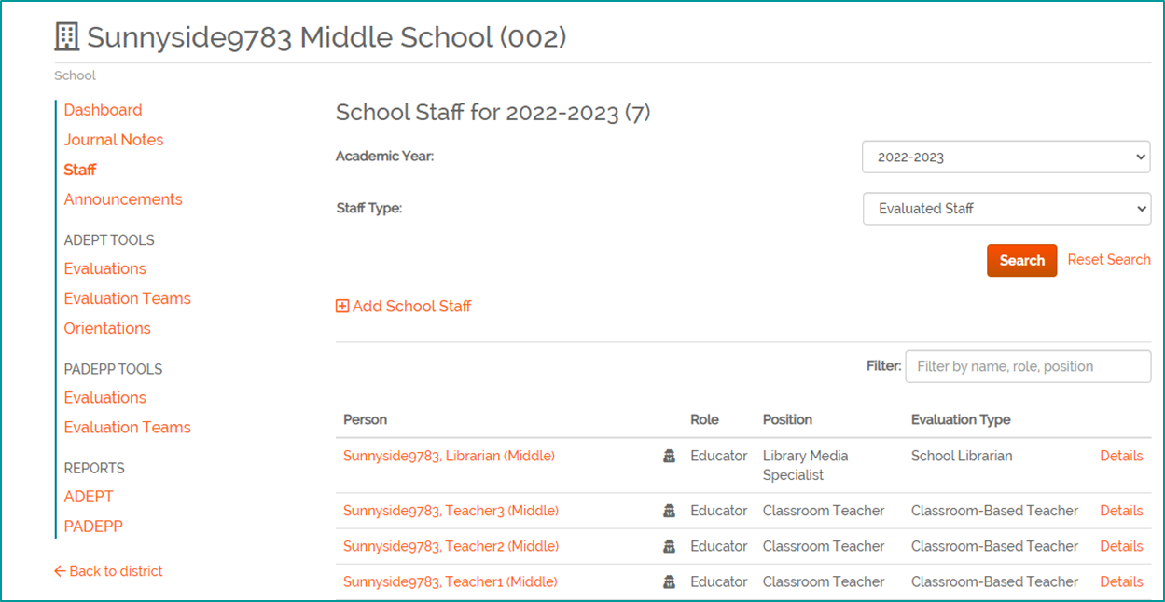
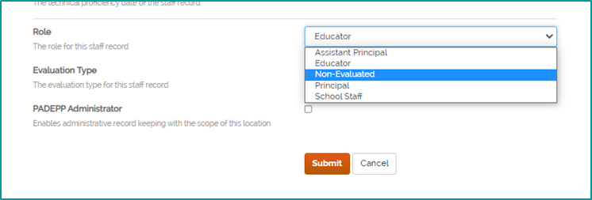
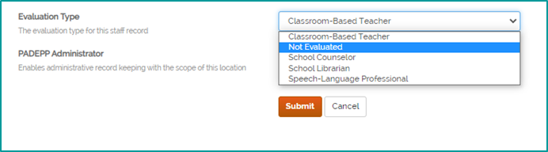
Removing Staff
Notes:
Lilla: To go about "cleaning-up" your staff lists, you can manually add and remove educators/administrators.
Let’s get familiar with the staff lists in SCLead.org. At the district or school level, you will see filters for the Academic Year, Evaluated Staff and Non-evaluated Staff as shown on the left. You will see a list of educators pulled from SCEducator and their corresponding roles and positions as well as evaluation types. On the right-most column you will see details.
To remove a staff member who no longer has a teaching position, no longer at your district/school and to remove ADEPT Administrator Rights:
Go to the district or school staff list, locate the educator, click "details" then click edit on the new page that appears, that’s shown on the upper right screenshot, Edit the Role as Non-Evaluated and Evaluation Type as Not Evaluated and click Submit.
Note that Non Evaluated automatically removes the Administrator Rights as shown on the lower right screenshot.

Slide 15
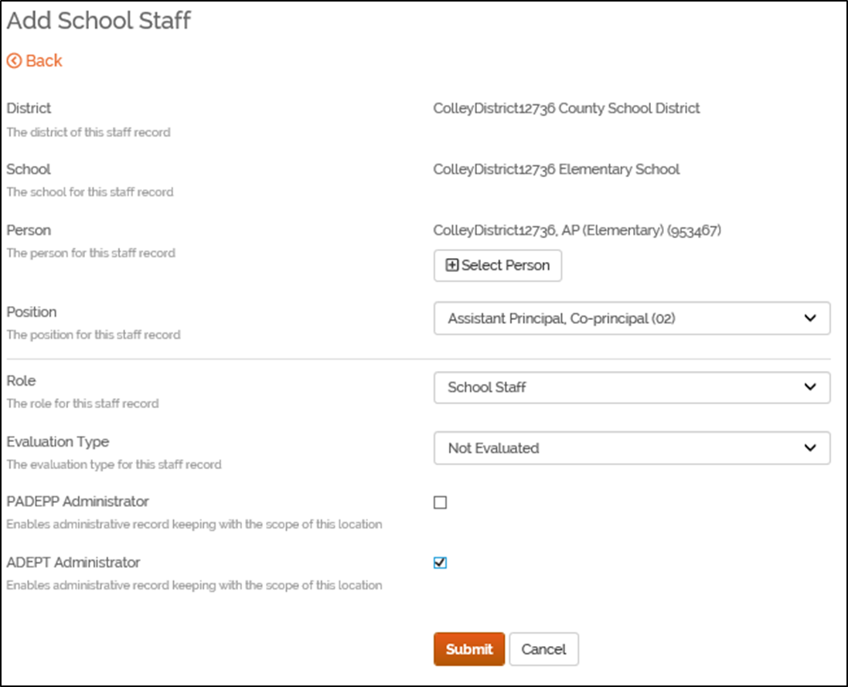
Adding New Staff
Steps:
1.Go to school staff list
2.Click “Add School Staff"
3.Select the person with correct CID
4.Select correct position code
5.Enter appropriate role and evaluation type
6.Click “Submit"
Notes:
Lilla:
Tip: When adding an Assistant Principal that you want to use as ADEPT Administrator the role should be School Staff.
You can only add ADEPT administrator rights if the role you selected is either “Principal” or “School Staff”, then you can check the ADEPT administrator box.

Slide 16
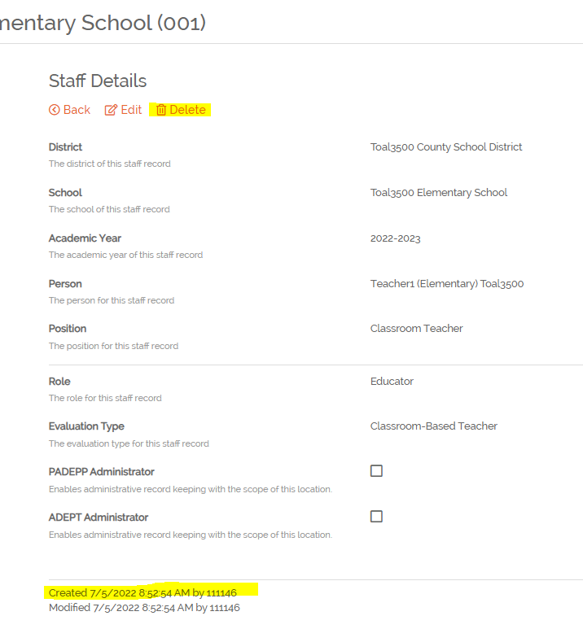
Dealing with Duplicates
Delete Option will only show if the record was manually added to SCLead.org
Notes:
Lilla: If a staff assignment has been manually added to SCLead.org, there will be a delete option when you click details for the staff assignment. If the delete option appears, it would indicate the assignment was manually added and can be deleted if desired. You can also check at the bottom where it says Created by. If it was created by number 0, then it was created by SCEducator and can’t be deleted.
Other Tips:
If you created an evaluation record and entered evaluation data under the educator’s profile without a CID, enter the same evaluation data in the evaluation record created under the educator with CID.
Remove any evaluation record from the educator Profile without CID. To remove, locate the evaluation record, go to Settings, scroll down and click “Remove” Pass to Beverly

Slide 17
Reciprocity and Contract Levels
SCDE may issue one of two certificates to out-of-state educators: Initial or Professional
Initial certificates are issued when the educator presents less than twenty-seven months of qualifying experience and follow the same process as other Initial certificates.
Professional certificates are issued when the educator presents at least twenty-seven months of qualifying experience. This Professional certificate affects contract and evaluation levels differently. An out-of-state educator on a reciprocal Professional certificate must pass a summative ADEPT evaluation prior to being offered a Continuing contract.
Notes:
Beverly: An out-of-state educator eligible for a South Carolina certificate based on reciprocity will be issued an educator certificate either at the Initial or Professional level.
The SCDE will issue an Initial certificate to an educator who presents less than twenty-seven months of qualifying educator experience in the last seven years on the out-of-state credential. An Initial certificate is typically issued to an early career educator or to an educator without recent work experience in a regionally accredited PK-12 education setting.
The South Carolina Initial certificate is valid for up to three school years, can only be extended at the request of an employing school district if needed. To advance from the Initial to a Professional certificate, an educator must complete South Carolina’s summative ADEPT evaluation.
During the validity period of the Initial certificate, the educator must also document successful completion of a pedagogy assessment.
Professional Certificate
The SCDE will issue a Professional certificate to an educator who presents at least twenty-seven months of qualifying educator experience in the last seven years on the out-of-state credential.
While employed in a public school setting, an educator who is issued a Professional certificate by reciprocity should be placed on an Annual 1 Summative contract and must complete a full summative ADEPT evaluation in order to advance to a continuing contract.
There is no glaring notification in SCLead or SCEducator to make you aware of the pathway to Professional, so it is imperative that you check the history of any new hire's certificate and ADEPT history before setting contract and evaluation level. We should never assume that Professional automatically equals Continuing for new hires.

Slide 18
Professional Learning Library
Notes:
Jenny: I would like to take a few moments to share information about the Professional Learning Library and it's many uses.

Slide 19
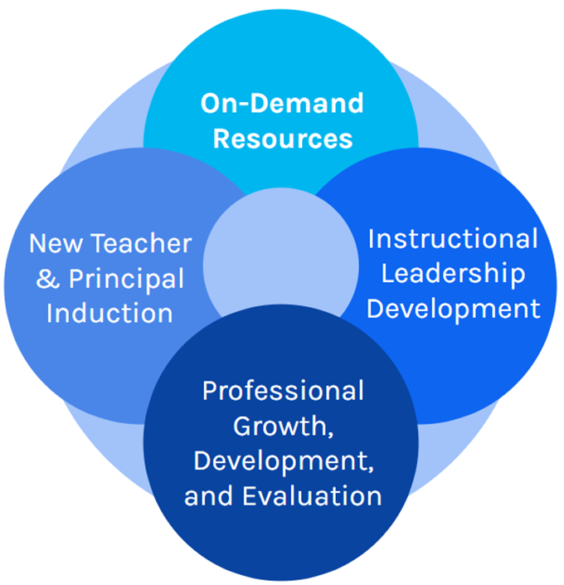

Why the Professional Learning Library?
Notes:
Jenny: The work of the Office of Educator Effectiveness and Leadership Development includes creating systems for new teacher and principal induction, supporting professional growth, development, and evaluation in all districts, and offering professional learning opportunities focused on high quality instruction and leadership development. The professional learning library provides on-demand resources that you can access at any time.

Slide 20
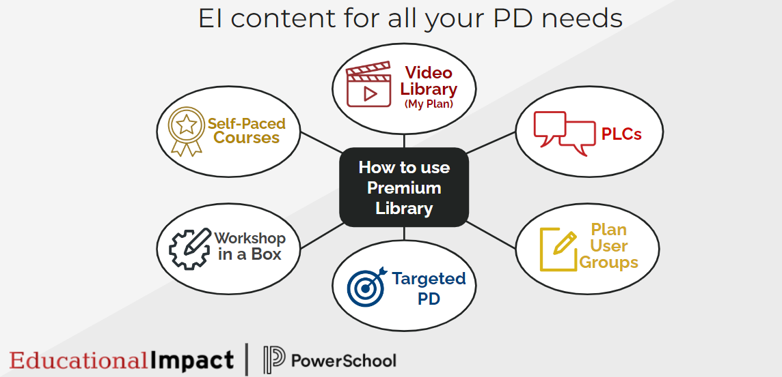
Endless Possibilities
Notes:
Jenny: As you can see there are endless possibilities for using the PLL.
The Video Library where Participants can create their own video playlist in My Plan.
School-based Professional Learning Communities can decide on a topic, choose a course, and work through a unit together and discuss along the way.
Targeted Professional Development where Schools can assign groups of learners to specific courses or suggest a learning path.
Workshop in a Box where Schools can select a course and work through a unit together during a Professional Development day.
And finally Self-Paced Courses are always an option for anyone on areas of growth or interest.

Slide 21

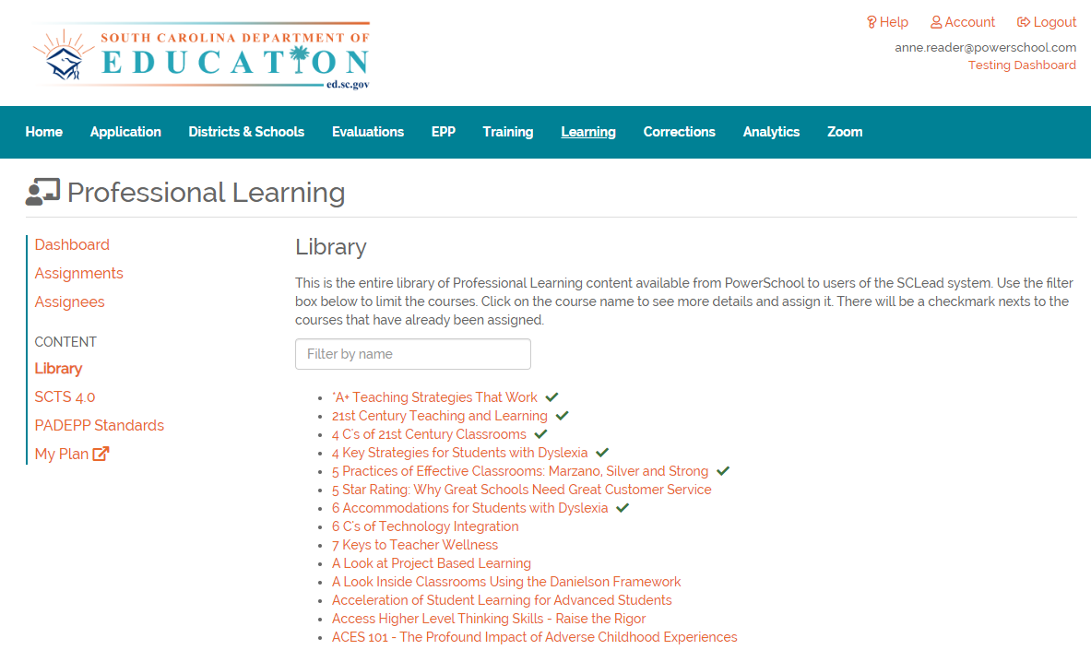
Accessing the PLL
SCLead.org
Click on the Learning tab at the top
Select Library, SCTS 4.0 or PADEPP Standards on the left-side menu
The PLL courses are listed alphabetically, or by standard
Click the Course Title to view
Notes:
Jenny:
-this screen shot shows you where you can locate the professional learning library
-….READ SLIDE....
-The PLL includes custom designed courses for SCTS and PADEPP along with a wealth of other content including instructional strategies, literacy, content specific work, student engagement

Slide 22
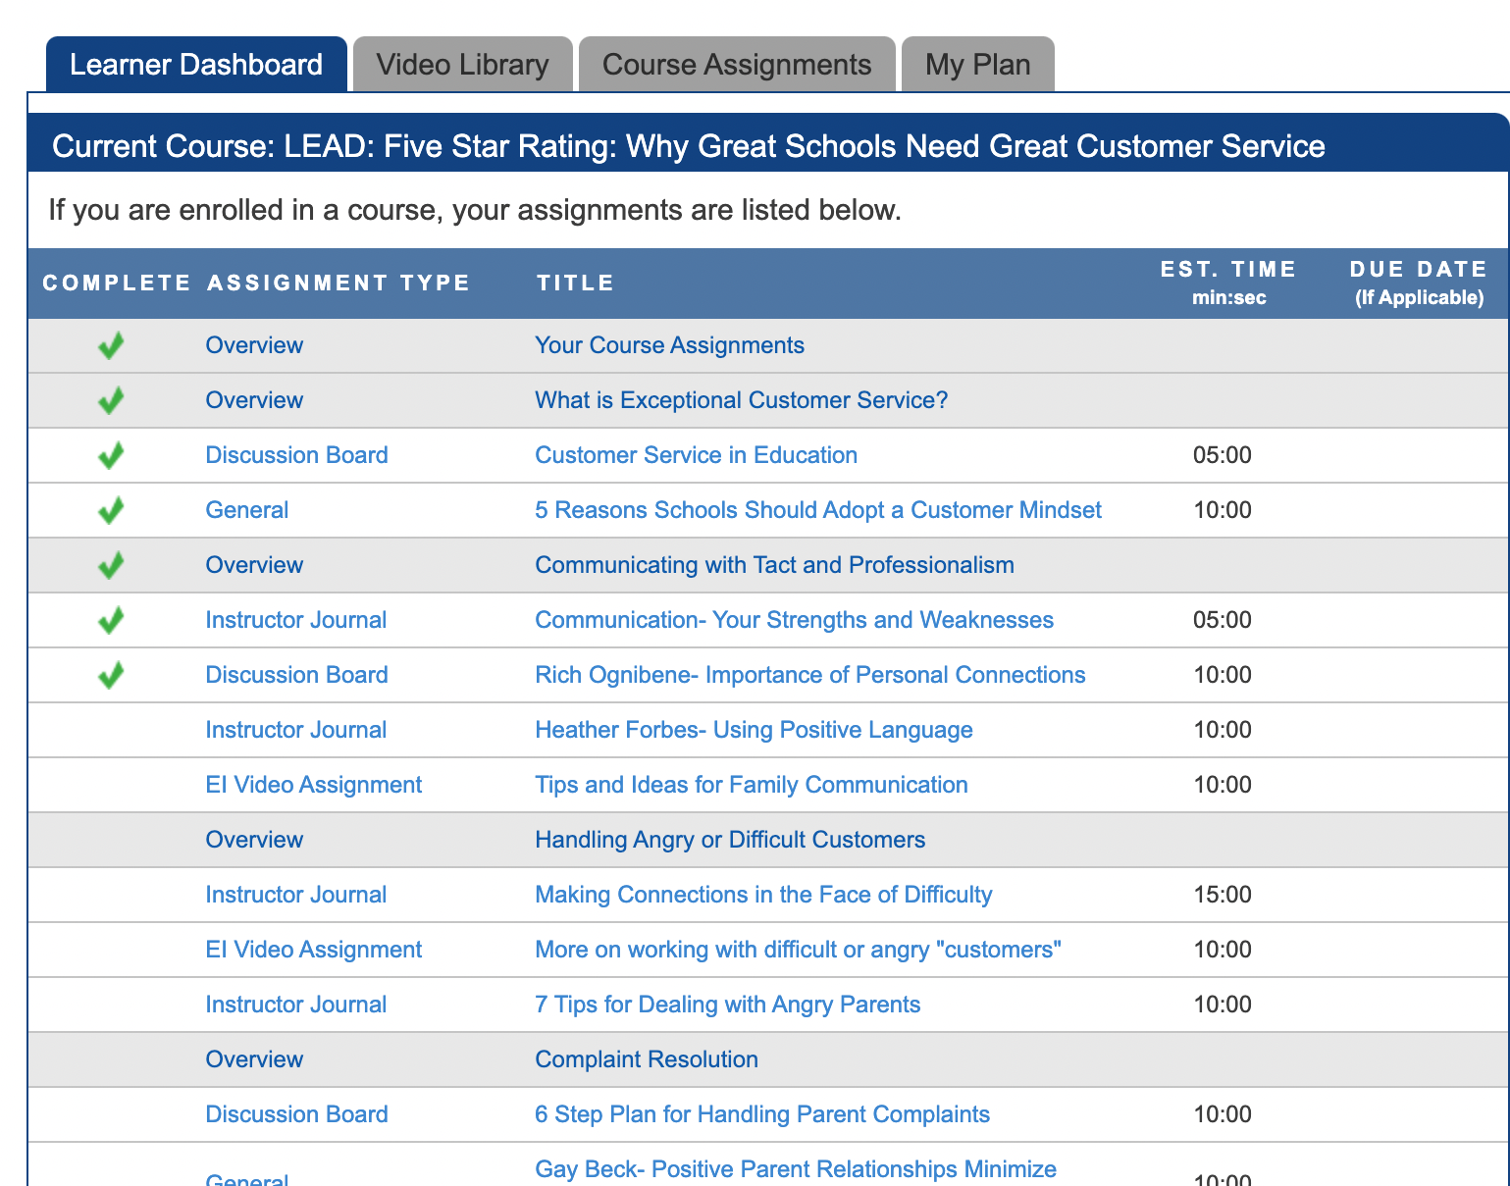
Learner Dashboard
Notes:
Jenny: Once you select a course and register for it, you will see your Learner Dashboard that provides the components of the course. As you complete each course activity in order, you will earn a green check once the task is completed.

Slide 23
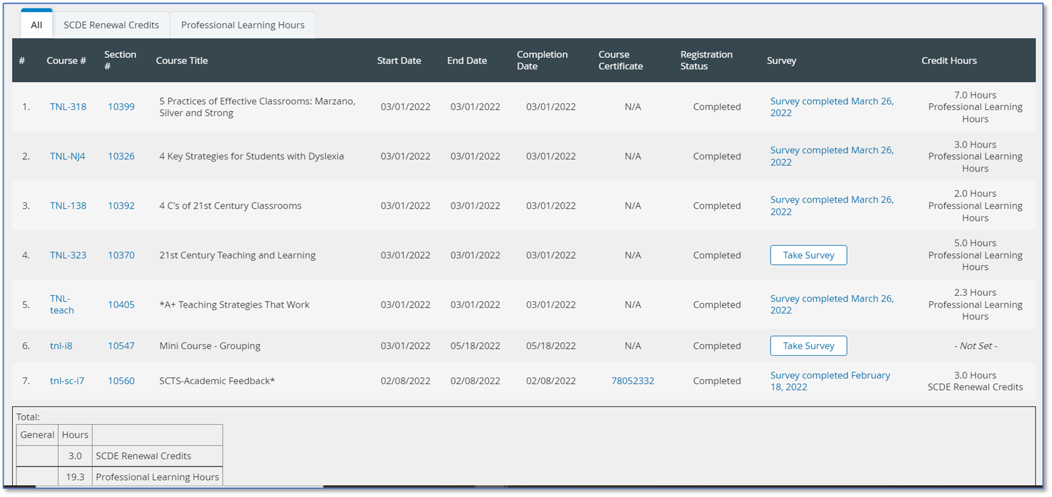
Transcript
Notes:
Jenny: You also will have access to your transcript that provides a list of all of your completed courses, including topics, dates, a tally of credits earned by type, a copy of course certificates for those courses earning SCDE renewal credits, and course surveys.

Slide 24
Renewal Credit
SCDE Renewal Matrix, Option 6 (Professional Training)
Type | Renewal Credits | Proof Required
Professional Training (Option 6) | 1 hour of direct participation = 1 renewal credit | Training objectives and/or outline A certificate or other official documentation
Notes:
Jenny: As I mentioned before, some courses aligned to the teacher evaluation rubric and the principal evaluation rubric have been vetted by our office to offer certificate renewal credit by the SCDE. Districts have the option to approve other courses or mini-courses for credit according to the SCDE Renewal Credit Matrix.

Slide 25
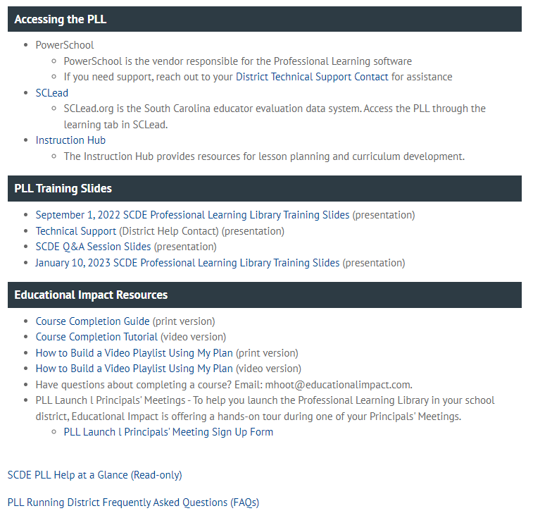
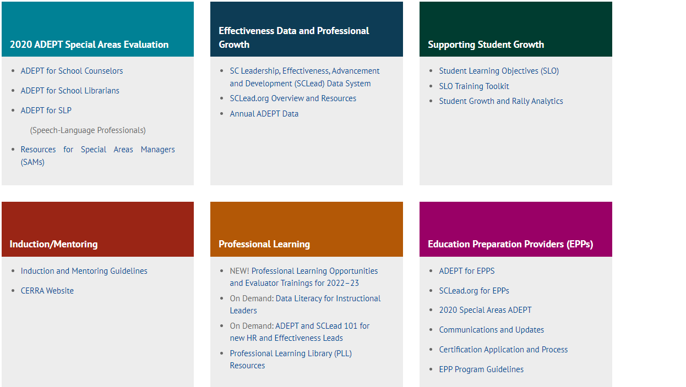
PLL Resources
PLL Workshop Reminder:
  Monday, Sept. 11, 2023; Location: TBD
Notes:
Jenny: To access additional PLL resources, click on the link to the Professional Learning Library under the Professional Learning Block
You will find a list of easy to access resources to meet any needs you may have.
I will turn it over to Roshonda for some frequently asked questions.

Slide 26
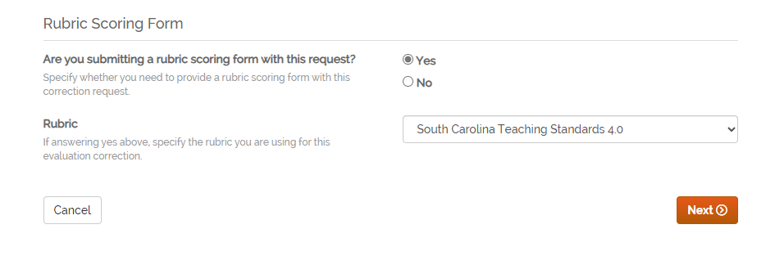
SCLead FAQs
How do you load a correction for an Annual Summative Evaluation?
Notes:
Roshonda: Gentle Reminder: When entering in a correction for an Annual Summative Evaluation do not forget to submit a rubric scoring form. If you've received a rejected correction this could be the case. We just need you to resubmit it with a scoring form.

Slide 27
Questions and Discussion
Office Hours Dates for 2023-24
8/16/2023
Special Areas Office Hours
9/12/2023 (School Counselor), 9/13/2023 (School Librarian), 9/14/2023 (SLP)
10/4/2023
11/1/2023
12/6/2023
Special Areas Office Hours
1/16/2024 (School Counselor), 1/17/2024 (School Librarian), 1/18/2024 (SLP)
2/7/2024
3/6/2024
4/3/2024
5/1/2024
Notes:
Roshonda

Slide 28
Office of Educator Effectiveness
& Leadership Development
Educator Effectiveness Leads
Beverly Flythe, Educator Preparation Programs, bflythe@ed.sc.gov
Jenny Henke, Data & Reporting, vhenke@ed.sc.gov
Kimberly Howard, Mentoring & Induction, khoward@ed.sc.gov
Roshonda Frazier, SLO and Teacher Leadership, rfrazier@ed.sc.gov
Vicki Traufler, PADEPP, vtraufler@ed.sc.gov
  Visit our website: https://ed.sc.gov
  Who’s my ADEPT Contact?: Click here
Leadership Development Leads
  Gerard Edwards, Veteran Principals & District Leaders, gedwards@ed.sc.gov
  Crystal Halma, Collective Leadership, chalma@ed.sc.gov
  Frank Robinson, New Principals & Emerging Leaders, frobinson@ed.sc.gov
  Tom Smith, Instructional Leadership & Assistant Principals, tsmith@ed.sc.gov
  Keasha Grant, Certified Support & Emerging Leaders, ksgrant@ed.sc.gov
Office Support
  Lilla Toal Mandsager, Director, lmandsager@ed.sc.gov
  Marilyn Suber, Administrative Assistant, masuber@ed.sc.gov
Notes:
Please feel free to reach out to us if you have questions or feedback for us. Our email addresses are shown on the slide.

