Slide 1
Educator Effectiveness
Virtual Office Hours
April 10, 2024
Welcome!
What's something you are looking forward to?
What questions or challenges are you facing?
Notes:
Welcome to our Educator Effectiveness virtual office hours. We’re so glad you could make it. Please type in the chat box your name and district. We have our opening questions posted that we’d love for you to answer in the chat. We’ll get started right at 2 PM. ​
RECORD
@ 2 PM: Welcome again everyone. If you haven’t done so, please type in the chat box your name and district. Our team will be monitoring the chat and responding accordingly. We will also hold a time at the end for discussion.
Welcome to OEELD April 2024 virtual office hours. We’re so glad you could be here with us. I am Ashley Cohoon and I am joined today by our Effectiveness Director, Lilla Toal Mandsager and Team Members: Dr. Vicki Traufler, Dr. Kim Howard, Dr. Roshonda Frazier, Beverly Flythe, and Jenny Henke.
​ ​
The purpose of Office Hours is to hold time to ensure that we share timely reminders with districts, but even more importantly, to create a space where you can share feedback, questions, ideas and best practices with your peers. Before we get started, let’s consider our opening questions (summarize responses or ask 1-2 districts to elaborate….)

Slide 2
Agenda
Welcome
Professional Learning Needs Survey Results
ADEPT Plan Reminders
SLO Updates
ADEPT Implementation/SCLead.org
Professional Learning & Support
Questions & Discussion

Slide 3
Professional Learning Needs Survey
Notes:
Here are some great questions from the chat…
Please feel free to hop on the mic or drop your questions in the chat.

Slide 4
Professional Learning Needs Survey Results
39% of SC School Districts participated
Findings
Opportunities for training with considerations for the time of the year(mostly Summer)
Most requested training? Inter-rater Reliability Training for Coaches & Evaluators
Round tables to discuss topics with similar districts
Next Steps
Professional Learning Opportunities for 2024-25
More face-to-face training in the Summer
On-demand resources
Notes:
A big thank you to our districts for completing the Professional Learning Needs Survey! We were able to consolidate the data to find trends so that we can better meet your needs.
Findings-
Opportunities for training with considerations for the time of the year (mostly Summer)
Most requested training? Inter-rater Reliability Training for Coaches & Evaluators
Round tables to discuss topics with similar districts
Next Steps
Professional Learning Opportunities for 2024-25
More face-to-face training in the Summer
On-demand resources

Slide 5
ADEPT Plan Reminders
Notes:
Kim

Slide 6
ADEPT Plan
The ADEPT Plan for the 2024-25 school year will be available at the end of April in SCLead.
Completed ADEPT plans are due June 1, 2024, in SCLead.org.
Complete all parts of the plan to avoid multiple resubmissions.
Your district's ADEPT contact will provide feedback/approval.
ADEPT Plan template and the Addendum Support Document can be found at:
Expanded ADEPT Plan Resources - South Carolina Department of Education (sc.gov)
Notes:
READ SLIDE
Drop Link to the ADEPT plan template and Addendum Support Document in the chat

Slide 7
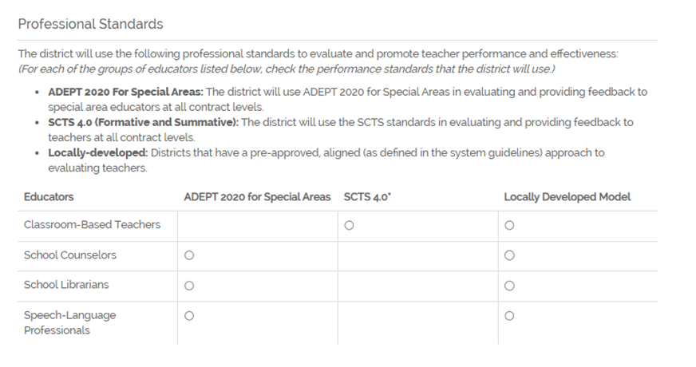
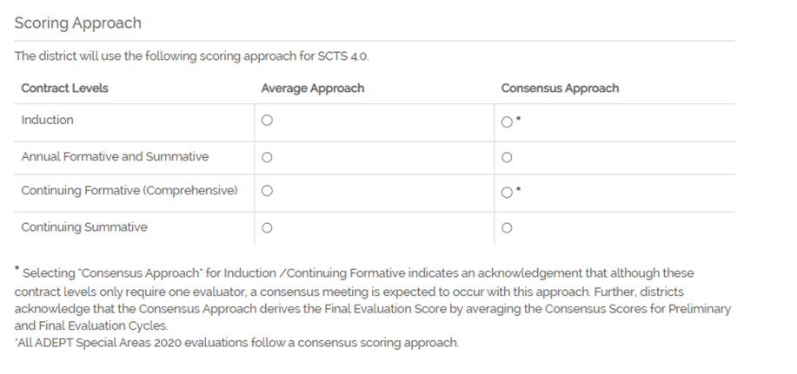
Evaluation Instrument
Only select Locally-Developed Model if approved by OEELD
If Consensus scoring approach is selected for Induction and Continuing Formative contract levels, evaluators are still required to complete consensus meetings even with one observation. You create a consensus meeting input the data from the observation.
Once evaluations are created, this page CANNOT be changed.
Notes:
Here are a few reminders about the ADEPT plan and how to select the evaluation instrument for your district.
READ SLIDE

Slide 8
Special Area References
Section IV: SLO, Goals-Based Evaluation
All school counselors undergoing Summative, Formative, and Goals-Based Evaluations (GBE) must complete at least one Student Growth Goal (SGG). The SGG is the goals-based evaluation tool for Continuing GBE and Annual GBE contract counselors.
  All school librarians undergoing Summative, Formative, and Goals-Based Evaluations (GBE) must complete at least one Professional Growth and Development Goal. This goal is embedded in SCLead.org.
  Section VII: Continuous Improvement
  Briefly describe how your district gathers data and monitors the fidelity of implementation of Expanded ADEPT.
Notes:
There is a brief Special Areas reference on the SLO, GBE, and Diagnostic Assistance about student growth goals for school counselors and PGDPs embedded in the school librarian plan.
READ SLIDE

Slide 9

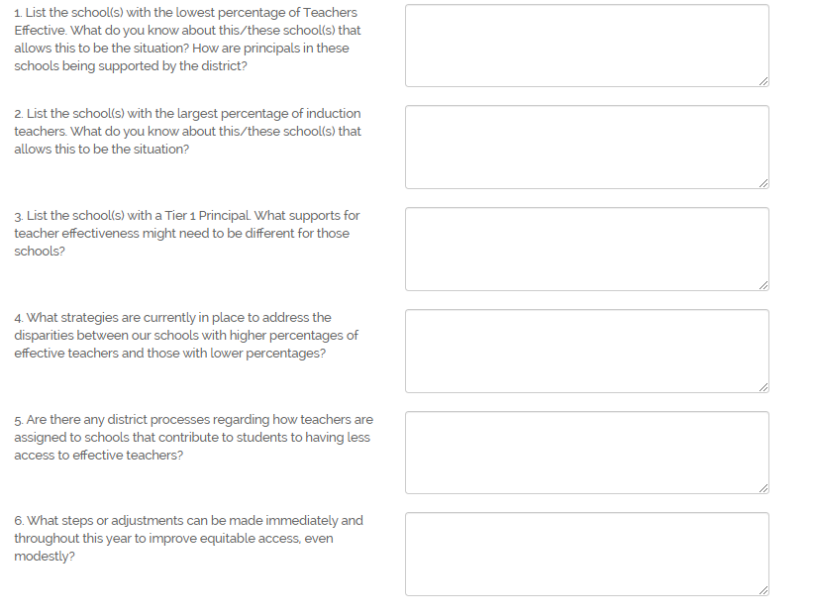
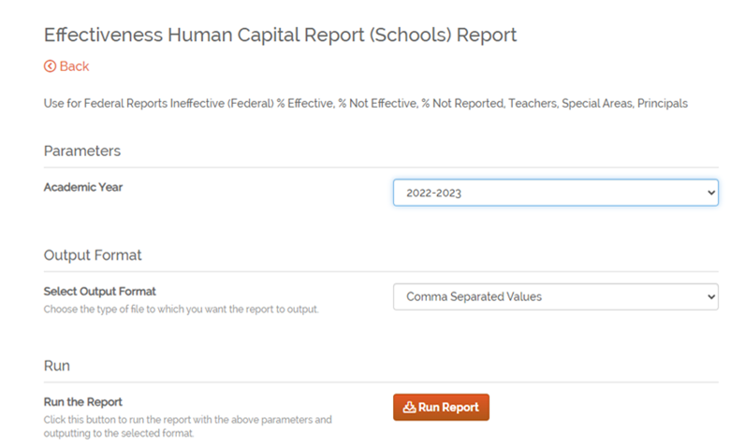
Addendum
Refer to the 2022-23 Effectiveness Human Capital (Schools) ADEPT Report in SCLead to respond to the questions.
Notes:
One of the required sections of the ADEPT plan is the Addendum. Please refer to the Effectiveness Human Capital (Schools) ADEPT Report in SCLead to respond to the questions. Select the 2022-23 academic year and click to run the report. Use the information on the spreadsheet for your responses. Note that the first 3 questions require a list of schools in addition to information concerning specifics of those schools.
I will now turn the mic over to Roshonda.

Slide 10
Student Learning Objectives Updates

Slide 11
SLO Updates
As a reminder, please ensure that all SLO observations and summative conferences have occurred before the date set in your ADEPT plan.
If an educator does not meet the SLO Business Rules for attendance, and is Incomplete on the SLO, use the “Skip SLO” feature and make a note in SCLead.org. According to our SLO Business Rules, districts also have the autonomy to allow the educator to have a shortened SLO interval if the educator is present for less than 85% of the interval. We do not recommend giving an SLO rating of “Needs Improvement” if the SLO was impacted by a teacher’s attendance such as leave.
Also, for classroom-based teachers, the SLO score or “skip SLO” must be present for auto completion to fill in Overall Status and recommendations for the following year for Continuing GBE educators.

Slide 12
ADEPT Implementation/SCLead.org

Slide 13

ADEPT/SCLead Reminders
Final Evaluation Cycles should be completed by April 30, 2024.
Completed evaluations are due in SCLead on or before June 20, 2024.

Slide 14




Reminders about "Bubbles" when reviewing the evaluations tab in SCLead.org
Skipped SLO shows filled in bubble
Induction Walkthrough does NOT fill observation bubble
Continuing Formative filled-in bubble with preliminary observation rated Proficient or Higher
Check why there are no filled bubbles
Notes:
One helpful place to go to get a snapshot of evaluations in your district is the Evaluations tab. When reviewing the Evaluations tab, you may want to first click on the orange number at the top to be able to view 20, 50, or 100 evaluations on the page. The “bubbles” listed next to each evaluation can help you see progress at a glance. First, note that skipping the SLO will fill the bubbles as shown in the first screen shot. The educator’s Student Growth Status bar inside the evaluation will also show 100%. Don’t be alarmed if you see No in the SLO report, as long as you know this educator skipped the SLO.
For districts using the ADEPT flexibility for doing walkthroughs in preliminary cycle, note that the walkthrough will not fill the Observation bubble. The educator’s Observation status bar inside their evaluation for the preliminary cycle will fill at 100%.
Next, note that with Continuing Formative evaluations, for educators with a Preliminary Observation entered that rated proficient or higher for each indicator, the observation bubble gets filled. Within the educator’s evaluation the Final Cycle Observation Status bar will show 100% even without entering a Spring observation.
Lastly, when you find educators with no bubbles filled at all, dig deeper.
Are they are truly being evaluated? If so, they need to sign orientation and have evaluation progress entered.
Could this be an accidentally created evaluation record for an educator that is not in your district? In such case, make sure to remove the evaluation record and locate the educator in your school staff list, edit staff details to “No Role” and “Not Evaluated”

Slide 15
Auto-Completion Feature for GBE Evaluations
What does this feature do?
    Completes all eligible open evaluations for the current academic year for Classroom-Based Teachers, School Counselors, Librarians, and Speech Language Professionals who are on a GBE evaluation with a continuing contract.
When will auto-completion start?
    Auto-completion will begin on Friday, May 17th and continue every Friday thereafter until June 20th.
Why is this feature important?
    This feature allows ADEPT Coordinators to focus on educators who are Not Met and may not be rehired the next school year
What about educators without SLO scores?
    Classroom-based teacher evaluations missing a Student Learning Objective Rating/Score will not be updated or closed during the Auto-completion feature.
Notes:
READ SLIDE

Slide 16
Professional Learning & Support

Slide 17
Professional Learning Library Credits
Renewal Hours vs. PD Hours
Courses aligned with SCTS and PADEPP indicators provide recertification renewal hours. The certificate generated for these courses will show the number of hours earned for renewal credits. PLL mini-courses aligned to SCTS indicators and other, non-SCTS courses will reflect the number of PD hours earned.
Districts are encouraged to use the SCDE Renewal Credit Matrix to provide renewal credit for any PLL courses aligned with educators’ professional growth and development plan. Reach out to your district's renewal coordinator for more information.
Professional Learning Library (PLL) Usage Questionnaire
Notes:
We wanted to take a moment and highlight how the credits work when an educator completes a course in the Professional Learning Library.
READ SLIDE
To better serve you and the educators in your communities, we would appreciate your responses to a brief questionnaire about the PLL and how we can better connect its content with your district's needs and goals. We will drop a link in the chat for you to copy and paste into your browser. https://docs.google.com/forms/d/e/1FAIpQLSfIV36YOl6H5DvXXC07vf2qYz1SzI6fXveBAYSNlePJftAbOA/viewform?usp=sf_link
This questionnaire will also be posted on the SCLead Announcements page for educators to provide their feedback.

Slide 18
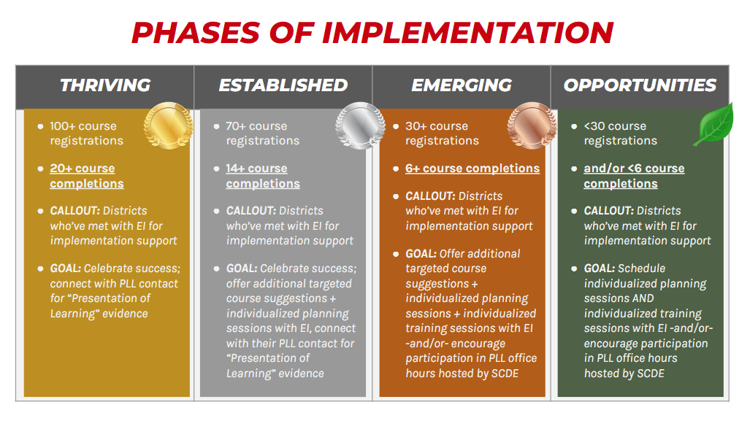
PLL Phases of Implementation
Notes:
Educational Impact has provided us with current data on district use of the PLL. They have categorized each school district into one of four current phases of implementation – thriving, established, emerging, and opportunities. Thriving districts include those with the top 25% of course enrollment, 20 or more course completions, and scheduled consultations with Educational Impact on how to increase usage to the next level. You can see the criteria for the phases of established, emerging, and opportunities.

Slide 19

"Thriving" School Districts
Sumter School District
Dorchester School District Two
Rock Hill School District (York 3)
Clover School District (York 2)
Richland School District Two
Charter Institute at Erskine
Charleston County School District
Cherokee County School District
Berkeley County School District
Lancaster County School District
Beaufort County School District
Barnwell School District 45
Fort Mill School District (York 4)
Spartanburg School District Five
Kershaw County School District
Horry County School District
Notes:
There are currently 16 districts who are designated as thriving, and we wanted to give them a shout out. Congratulations to Sumter, Dorchester, Rock Hill, Clover, Richland 2, Charter Institute at Erskine, Charleston, Cherokee, Berkeley, Lancaster, Beaufort, Barnwell, Fort Mill, Spartanburg 5, Kershaw, and Horry. Great job, guys!

Slide 20
PLL Course Highlights
Top 5 Registered Courses
Top 5 Completed Courses
My Plan – Build Your Own Playlist (SC)
A+ Teaching Strategies That Work
SCTS – Standards and Objectives
7 Keys to Teacher Wellness
Mini Course – Engaging Students and Managing Student Behavior 1
A+ Teaching Strategies That Work
7 Keys to Teacher Wellness
SCTS - Engaging Students and Managing Student Behavior
21st Century Teaching and Learning
Mini Course – Engaging Students and Managing Student Behavior 1
Notes:
We wanted to highlight the top 5 registered and completed courses in the PLL. Educators are taking advantage of courses that will directly impact their teaching and learning in their classrooms while also earning renewal credits.

Slide 21
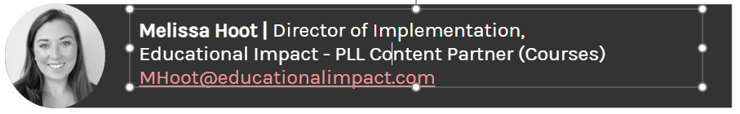
District Highlights
Rock Hill School District (York 3) worked with Educational Impact to develop a tailored blended PD package on how to turn PLL courses into a "Workshop in a Box" using synchronous PD, choice boards, 30-minute push-in sessions, and full PD sessions.
Richland 2 consulted with Educational Impact to design a PD learning path specifically for their mentor teachers
To request an implementation meeting for your district, visit Melissa's personal booking link: https://calendly.com/ei-mhoot
Notes:
We wanted to acknowledge a couple of our districts who have collaborated with Melissa Hoot at Educational Impact to develop specific professional development to meet the needs of the educators in their districts.
READ SLIDE
I'll now pass the mic to Kim.

Slide 22
FAQ – Mentoring Requirements
I received a notification from SCLead listing mentors in the district who have not met mentoring requirements. What are my next steps?
Mentors are required to have 18 hours of mentor-specific professional learning every 5 years. Districts are responsible for ensuring that this requirement is met; the feature in SCLead allows districts to document those hours. The message was sent to identify those at the end of a 5-year cycle. The task on your end is to ensure that those listed have met the 18-hour requirement so that they can continue to serve as mentors.
Notes:
Kim
Only mentors who have obtained the required PD should serve in the mentoring role.
It is not a requirement to house this data in SCLead.

Slide 23
OEELD Reminders and Memos
Principal Induction Registration for 2024-25
School Support Staff leadership development registration
Guidance on ESSER Positions
  Legal considerations
  Evaluating impact of positions
  Exploring options, including transitions back to classroom positions
Notes:
Only mentors who have obtained the required PD should serve in the mentoring role.
It is not a requirement to house this data in SCLead.

Slide 24
Questions?
Notes:
Here are some great questions from the chat…
Please feel free to hop on the mic or drop your questions in the chat.

Slide 25
Office of Educator Effectiveness & Leadership Development
Educator Effectiveness Leads
Ashley Cohoon, Communications, ascohoon@ed.sc.gov
Beverly Flythe, Ed. Prep. Programs & Special Areas, bflythe@ed.sc.gov
Dr. Roshonda Frazier, SLOs, rfrazier@ed.sc.gov
Jenny Henke, Data & Reporting, vhenke@ed.sc.gov
Dr. Kimberly Howard, Mentoring & Induction, khoward@ed.sc.gov
Dr. Vicki Traufler, PADEPP, vtraufler@ed.sc.gov
Visit our website: https://ed.sc.gov
Who’s my ADEPT Contact?: Click here
Leadership Development Leads
  Dr. Gerard Edwards, Experienced Leaders, gedwards@ed.sc.gov
  Crystal Halma, Collective Leadership, chalma@ed.sc.gov
  Dr. Frank Robinson, New Principals & Emerging Leaders, frobinson@ed.sc.gov
  Tom Smith, Instructional Leadership & Assistant Principals, tsmith@ed.sc.gov
  Keasha Grant, Certified Support & Emerging Leaders, ksgrant@ed.sc.gov
Office Support
  Lilla Toal Mandsager, Director, lmandsager@ed.sc.gov
  Marilyn Suber, Administrative Assistant, masuber@ed.sc.gov
Notes:
Please feel free to reach out to us if you have questions or feedback for us. Our email addresses are shown on the slide.

