Slide 1
ADEPT 101
SC Department of Education, Office of Educator Effectiveness & Leadership Development
August 2018

Slide 2
Guiding Questions
Agenda
Foundations – Why, What, When of ADEPT
How – Setting Up SCLead.org
  SCLead.org Menus
  Adding Staff
  ADEPT Tools
Deep Dive – Contract Levels
How – Using SCLead
  Evaluations Menu
  Data Corrections
  Reporting Results
  Schedule a Training
Certification and Evaluation (Office of Educator Services)
Resources & Q & A
How can I support student and teacher growth through implementation of Expanded ADEPT evaluations?
What are my roles and responsibilities?
What are key areas of implementation I should keep my eyes on?
Notes:
We hope by the end of the day you can answer the questions on the left. (Read them)
Our agenda today will be divided up into 5 parts. (read them)

Slide 3
Foundations of ADEPT
The why, the what, and the when
Notes:
(Lilla) Foundations – The Why and What of ADEPT (and the documents you have to help you remember), calendar (use roles and responsibilities – ADEPT Administrators and HR functions)

Slide 4
WHY: Retaining Effective Educators
“…shortages of teachers of color are generally caused less by recruitment shortfalls than by retention problems”
(Ingersoll & May cited in Carver-Thomas , 2017).
“…teacher turnover has a significant and negative effect on student achievement in both math and ELA…. turnover is particularly harmful to the achievement of students in schools with large populations of low-performing and black students.”(Ronfeldt, Loeb, & Wycoff, 2012).
Notes:
Ingersoll and May find, “…shortages of teachers of color are generally caused less by recruitment shortfalls than by retention problems (cited in Carver-Thomas (2017)).
Results demonstrate that teacher turnover has a significant and negative effect 22 on student achievement in both math and ELA. Moreover, teacher turnover is particularly harmful to the achievement of students in schools with large populations of low-performing and black students. (Ronfeldt, Loeb, Wycoff)

Slide 5
What do highly effective teachers want?
Feedback, Recognition, and Opportunities to Lead
“Positive, effective communication between teachers and administration is lacking. Performance feedback is missing. For example, my principal never once visited my classroom during the entire school year to see how effective I really am with my students.”
(The New Teacher Project, 2012).
Notes:
New teachers want feedback, recognition, and opportunities to lead. If you read this quotation, you can see that our most effective teachers crave feedback.

Slide 6
Effectiveness System Feedback
  Effectiveness Experts
    District and IHE ADEPT Plans 2017
    Effectiveness Office Hours
    Effectiveness Advisory Teams (District, Higher Ed., Principals, Teachers)
  Trainings and Roundtables
    SC Teaching Standards, PADEPP, and Leadership Continuum trainings
    Personnel, Instructional Leaders, HR, SCEDA Roundtables, SCATE Conference
    Induction and Mentoring Coordinators
  Independent Reviews
    University of South Carolina Research, Evaluation, & Measurement Center
    Southern Regional Education Board Focus Groups
    American Institutes for Research Statewide Surveys (2016 and 2018)
Notes:
Sought extensive feedback.
Most consistent theme was that teachers wanted more and more meaningful feedback on their practice.
This year, we really dug in to ask about induction requirements and if they needed to change. Consensus was system is well set-up to support induction teachers’ needs, but the SCDE should emphasize current flexibility districts have to make the process easy for new teachers.
Feedback from stakeholders in this first year of partial implementation is that they love the intention, giving that feedback to teachers is more rigorous, but ultimately worth it
Meaningful, thoughtful, aligned were in the forefront of our minds and the minds of our advisors. We will continue to gather feedback.

Slide 7
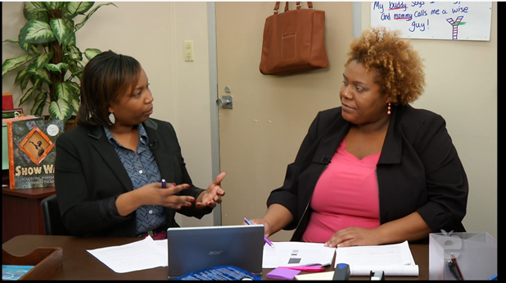
The What: SC Teaching Standards Process
Pre-observation Conference
Observation
Reflection
Post-observation Conference
Notes:
As much as the common language provided by the rubric will be powerful, the process will also feel very different from the end of the semester meeting with SAFE-T
Observation process (pre/post conference, self-reflection)
This is a shift for many evaluators and teachers. Engaging in dialogue is meant to create a culture of reflection, all teachers will zoom in on one areas of reinforcement and refinement versus focusing on the entire rubric.

Slide 8

The What: Student Learning Objectives
Notes:
The other big shift, to using artifacts as evidence of student experience vs. teacher planning
The SLO reflects the teaching process
It puts the emphasis on individual kids
Focuses on Growth v. proficiency
It encourages ongoing review of student data and responsive instructional practices
Honors teachers professionalism and expertise and responding to needs of specific students.
We don’t want to create extra paper work in the form of extensive planning documents; teachers are already monitoring data and reflecting on process as a part of everything else you do.

Slide 9
The What: Expanded ADEPT Process
Contract Level | Observations | Student Growth
Induction (Formative) | >1 – Full Classroom Observation per semester, with conferences* | Complete 1 SLO, may cover 2nd semester only
Annual and Continuing (Summative) | >2 – Full Classroom Observations per semester, with conferences* | Complete 1 SLO
Continuing (Formative) Comprehensive 5th year recertification | >1 – Full Classroom Observation per semester, with conferences* | Complete 1 SLO
Continuing and Annual (GBE) | Informal | Complete 1 SLO
Notes:
Differentiated: Induction/Annual/Continuing Contract, Our office sets the floor, your district may choose to do more
Observers
Induction: Principal or SCTS certified administrative designee, teacher also has a mentor
Annual: Principal or trained administrative designee AND person with knowledge of teachers content area
Highly Consequential: Three person team
Continuing Contract Comprehensive: Principal or SCTS certified administrative designee

Slide 10
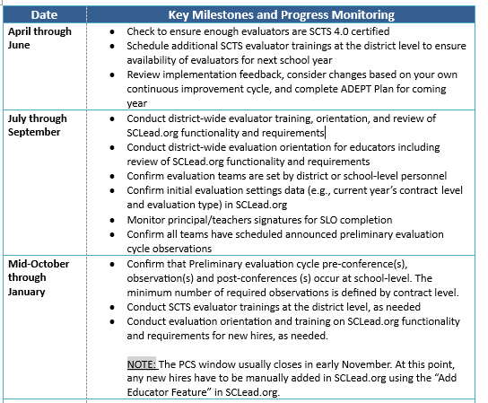
The When: ADEPT Calendar of Events
Notes:
Take time to look through handout.

Slide 11
The Who: Roles and Responsibilities
District Human Resource and Educator Support Staff
  HR Director, ADEPT Administrator, PADEPP Administrator, Trainers, Evaluators, Mentors
SCLead.org Permissions
  Superintendent
  District ADEPT and PADEPP Administrators
  Principals
  Evaluators
  Teacher Mentors
  Educators
Notes:
As district HR you have many roles, the evaluation specific ones are – issuing contract levels that match the guidance, on time, orienting educators to their evaluation process, supporting mentoring and induction, reporting evaluation data, correcting evaluation data, overseeing compliant reporting and implementation.
Refer to SCLead Roles handout

Slide 12

Parking Lot Pause

Slide 13
2. How: Setting up SCLead.org
South Carolina Leadership, Effectiveness, Advancement & Development

Slide 14
Required Reporting
for Classroom-based Teacher Evaluation
Overall effectiveness ratings (Met/Not Met) for Induction, Annual and Continuing contract educators)
Next year contract level and hiring status (district-level decision)
Observation results at the indicator level for Induction, Annual Summative and Formative, Continuing Summative and Formative)
Student learning objective scores
Notes:
As a service you can do the entire process here but you are not required to do so.
Required State-level reporting for classroom-based teachers
overall effectiveness ratings (Met/Not Met),
next year contract level and hiring status
observation results at the indicator level (Summative and Formative), if applicable, and
student learning objective scores (All, Summative, Formative, and GBE)
Required state-level reporting for PADEPP (2018-19)
Conferences and signatures (orientation, Mid-year, end-of-year)
Principal’s professional development plan
Principal’s self-assessment
Principal’s summative evaluation form (comments needed for all standards for induction principals, comments needed for all unsatisfactory and needs improvement for all other evaluations)

Slide 15
District Decisions
Teacher Evaluation Set Up (All in ADEPT Plan due June 1)
  Scoring Approach: By contract level, consensus or average
  SLO Scoring rubric, district choice measures
  Evaluator training and certification
  Evaluation team composition (teacher leaders, administrators, district staff)
  Mentoring and Induction Support
  Communication (orientation, evaluation timelines, and ongoing feedback)
SCLead.org Set up
  What features will you use at the district level (observation process, self-reflections, SLO process, etc.)
  How do you want to train? (consider roles, evaluation timeline, gathering
  feedback)
Notes:
Teacher Evaluation Set Up
There are some structural choices to be made with teacher evaluation and some logistical ones. You’ve already made most of the structural ones in your ADEPT plans.
2. SCLead Set up, you should be thinking today about which features you will use at the district level and how you want to train.
First, there are three main options for how you might use SCLead. At one end of the spectrum, using all of the SCLead functionality as designed to support the process including observations, conferences, the SLO, and professionalism. At the other end of the spectrum we have a few districts who have worked with other technology vendors to build systems to manage the evaluation process that they are very committed to. These districts might only report the required elements for all teachers. In the middle, there may be some districts who decide to manage a piece of the process offline, for example, they may have teachers store SLOs on google drive but manage the observation and conferencing process, as well as the final evaluation reporting through SCLead.

Slide 16
SCLead.org - Data Entry Reminders
District coordinators may enter teacher data into SCLead.org for the current school year only,
Districts may view SCLead.org reports from previous school years
Only teachers and other educators who fall under the ADEPT system are included in SCLead.org.
Only teachers and other educators who have valid SC teaching certificates are included in SCLead.org.

Slide 17
Imported from PCS SCLead.org | Imported from CPS SCLead.org
Teacher’s NAME | Teacher’s Education
Teacher Employment/Location | Teacher’s Training
Teacher’s Position Code | Teacher’s Experience
Teacher’s School Assignment | Teacher Certification AREA(s) and Teaching Certificate Number (CID)
Changes to information above MUST be made in PCS | Teacher’s Social Security Number
Imported from NIET SCLead.org | Imported from CERRA SCLead.org
SCTS 4.0 Evaluator Credential | Mentor Credential

Slide 18
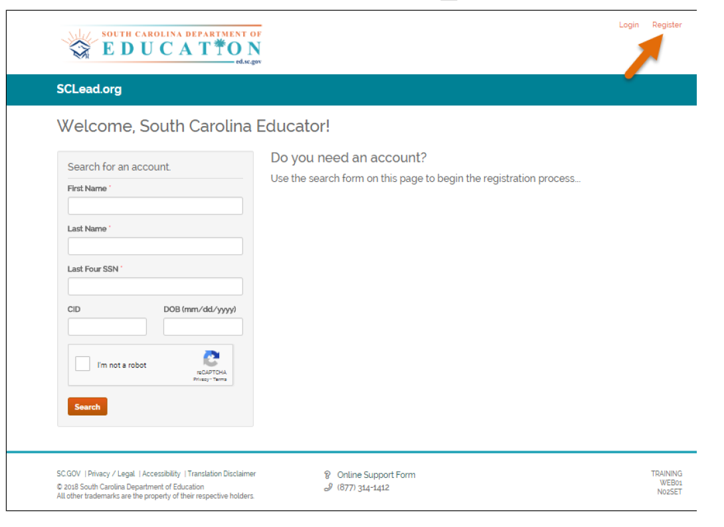
Requesting Access

Slide 19
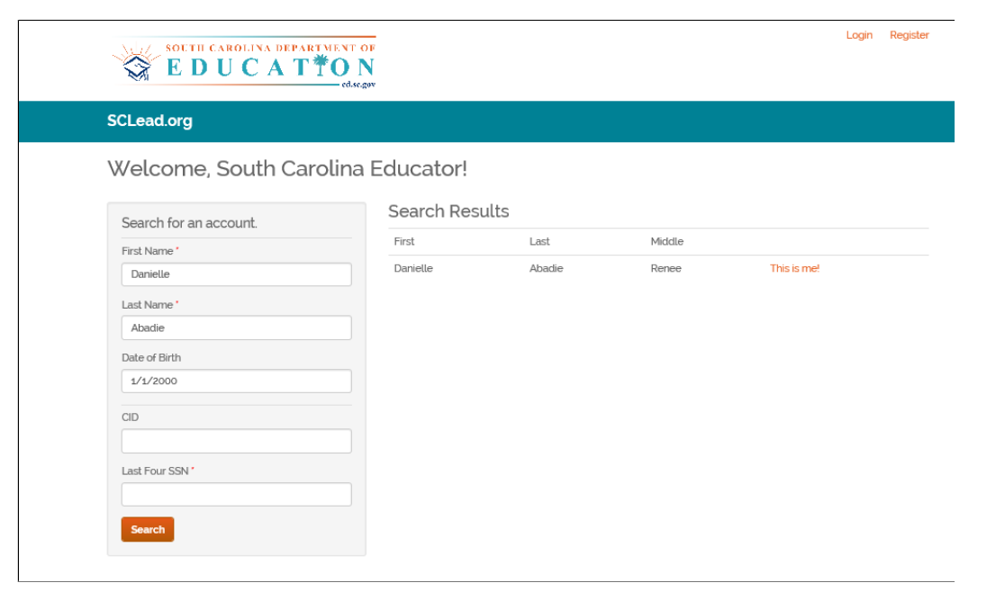
Requesting Access

Slide 20
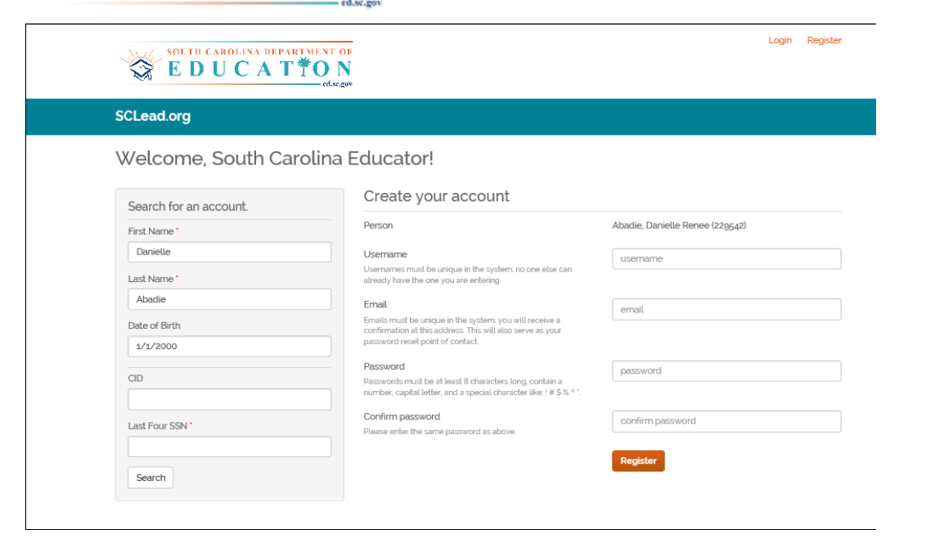
Requesting Access

Slide 21
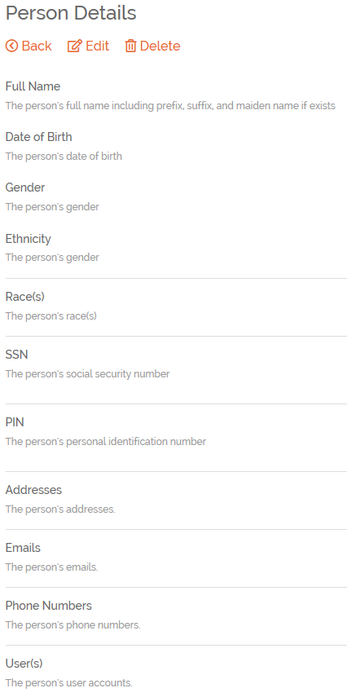
Teacher Information

Slide 22
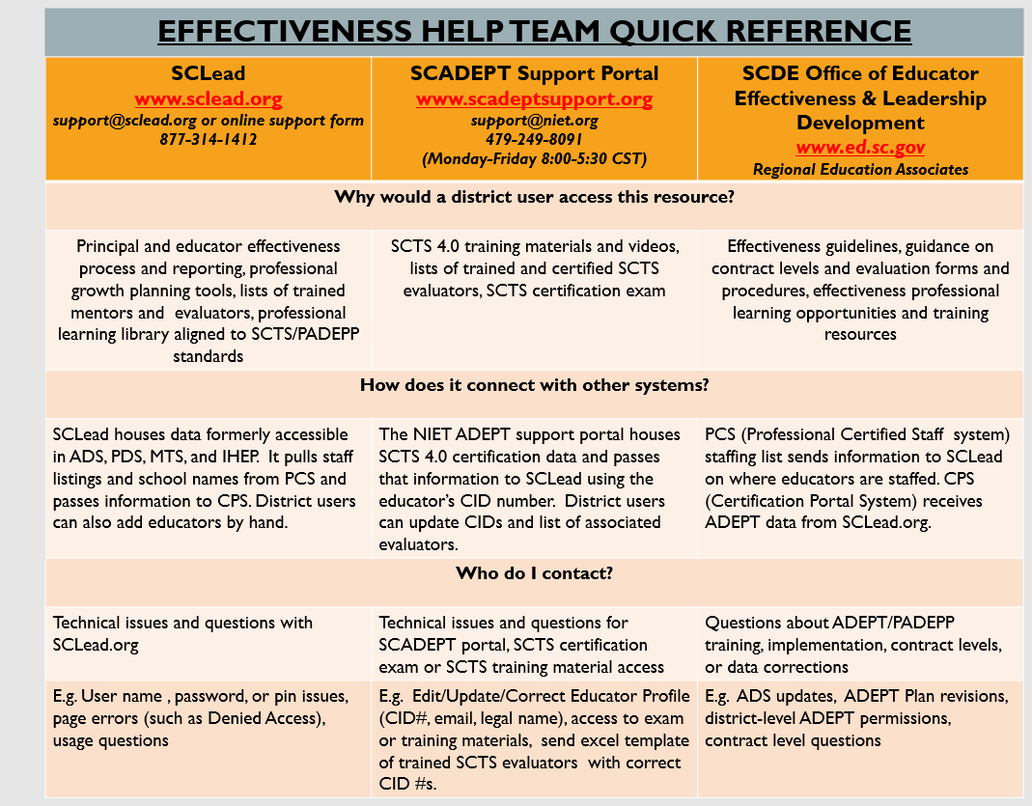
Help Needed?
- Support Portal will respond via email in most cases

Slide 23


Educator Credentials
Teacher Evaluator (SAFE-T)
Teacher Evaluator (SCTS 4.0)
Teacher Evaluator Trainer (SCTS 4.0)
Mentor (SCTS 4.0)
Mentor Trainer (SCTS 4.0)
Notes:
Credentials Slide 1 of 6: Educators need to have appropriate training to earn credentials. Focus on this training is the SCTS 4.0 Evaluator and SCTS 4.0 Evaluator Trainer Credential from NIET SC ADEPT Portal and Mentor Credentials from CERRA. You can pull your Staff Credential Report in SCLead to check who has different types of credentials in your district.

Slide 24
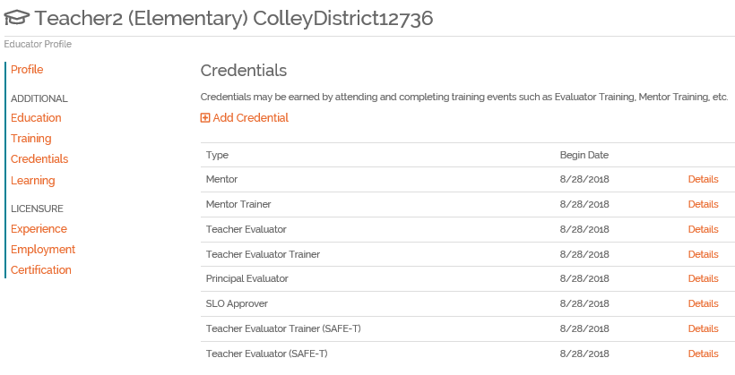
Screenshot of Credentials
Notes:
Credentials Slide 2 of 6: SLO Approval is determined by the District not the State. Please advise your Regional Support Ed Associate if you need to add this credential. For Principal Evaluator Credentials, please reach Dr. Vicki Traufler, OEELD PADEPP Coordinator.

Slide 25
SCLead.org Missing
SCTS 4.0 Evaluator Credential
EID-CID mix-up
Legal Name doesn’t match
Name is misspelled
First Name and Last Name switched
Notes:
Credentials Slide 3 of 6: These are the main reasons for SCTS 4.0 Missing Evaluator Credentials. Before any Regional Ed Associate can add credential, we first verify in NIET SC ADPE Portal if the educator has earned credential. Upon verification, we manually add the credential. If during the verification process we notice any of the above, we advise you to reach support@NIET.org with the CID Correction Spreadsheet that we sent out with the August 15, 2018 Effectiveness Communications. If you have administrator rights in NIET SC ADEPT Portal, you can make the corrections yourself. However, you must contact support@NIET.org if you need to correct emails, delete staff members or merge duplicate records (maiden name has a record and married name has another record but is the same educator or nickname has record and legal name has record for same educator).

Slide 26
SCLead.org SCTS 4.0 Evaluator
“Fake Credential” Issue
EID-CID mix-up
Notes:
Credentials Slide 4 of 6: Please make the correction in NIET SC ADEPT Portal first before requesting your OEELD Regional Ed Associate to delete credentials. Any deleted credential in SCLead will reappear the next day if the CID source, NIET SC ADEPT Portal, is not corrected. Note that we cannot delete credentials that were earned by educators. Some credentials may have been earned when they were not in your district. If you wish not to use an evaluator, just don’t choose them from the populated list.

Slide 27
SCLead.org Mentor Missing Credential & “Fake Credential” Issue
EID-CID mix-up
Legal Name doesn’t match
Name is misspelled
First Name and Last Name switched
Notes:
Credentials Slide 5 of 6: Dr. Kim Howard has provided SCLead.org a list of corrections as you send her the Mentor spreadsheet correction.

Slide 28
CID vs. EID
CID is the Certificate ID
This is the 6-digit License number on the SC Teaching Certificate
EID is a number assigned to educators under the ADS System.
In SCLead.org you will see this referred to as ID. In SCLead.org, the CID is clearly labeled CID.
Notes:
In NIET SC ADEPT Portal the label is EID but it is supposed to be CID. The programmers are in the process of updating this label to prevent confusion.

Slide 29
Parking Lot Pause

Slide 30
SCLead.org Menus
Districts & Schools
Evaluations
Reports
Learning

Slide 31
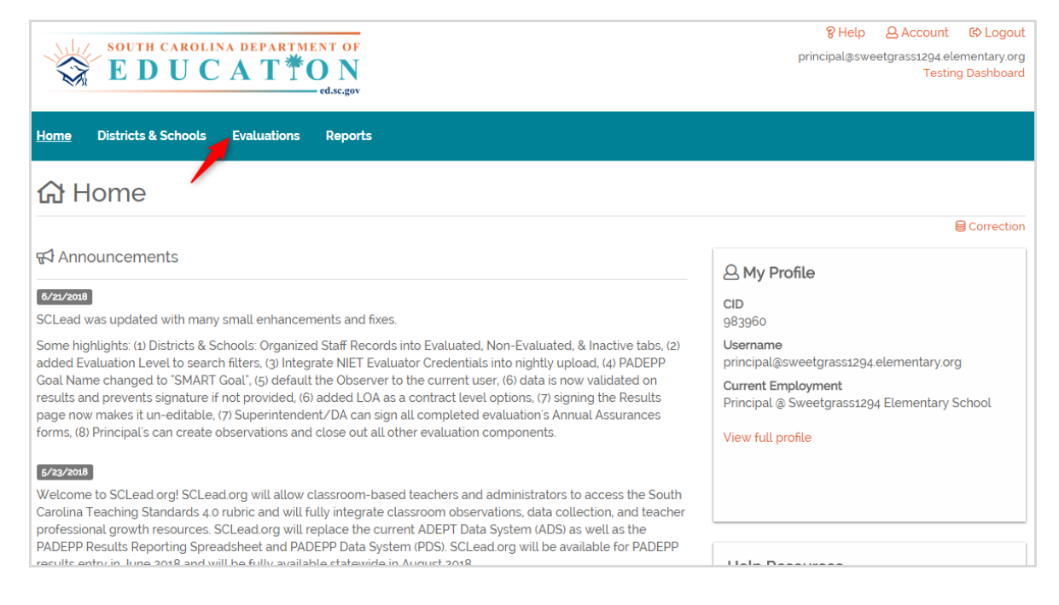

Slide 32
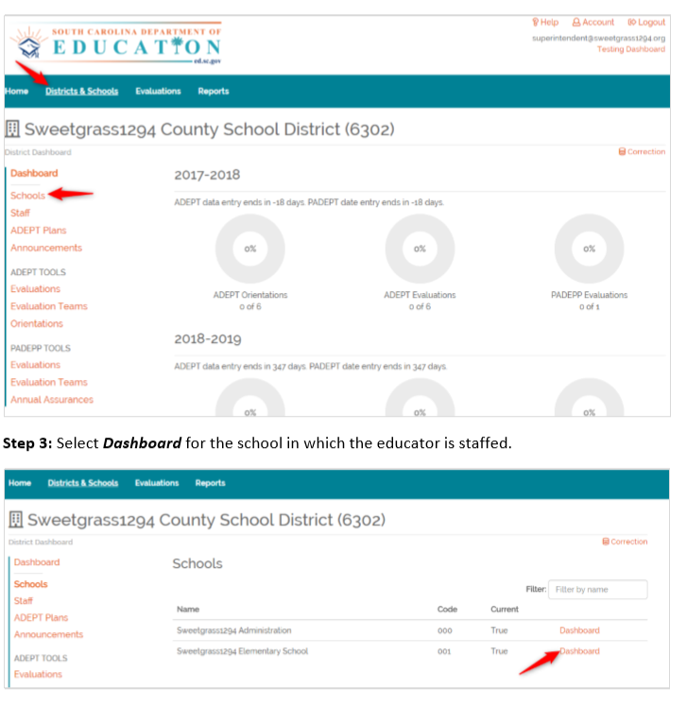
District Dashboard
~
School Dashboard

Slide 33
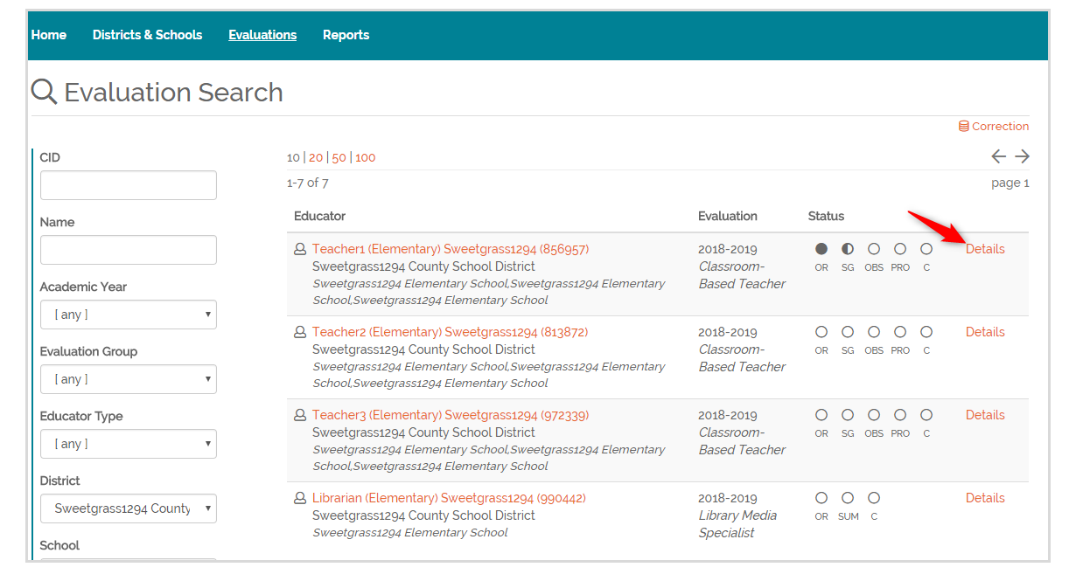

Slide 34
Adding District and sShool Staff

Slide 35
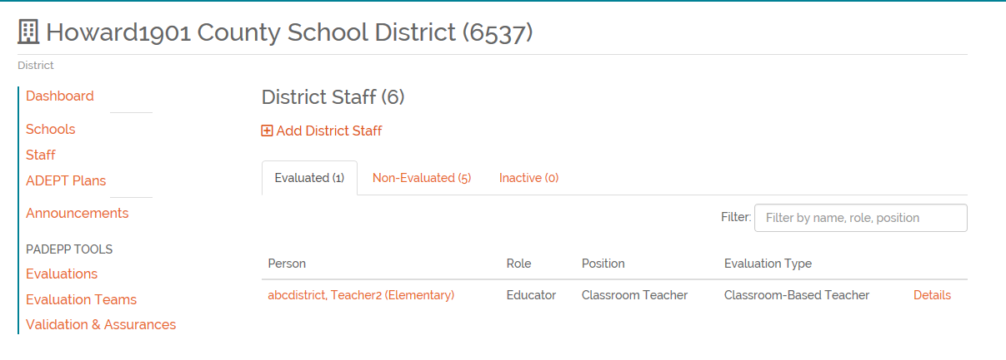
Adding District Staff

Slide 36
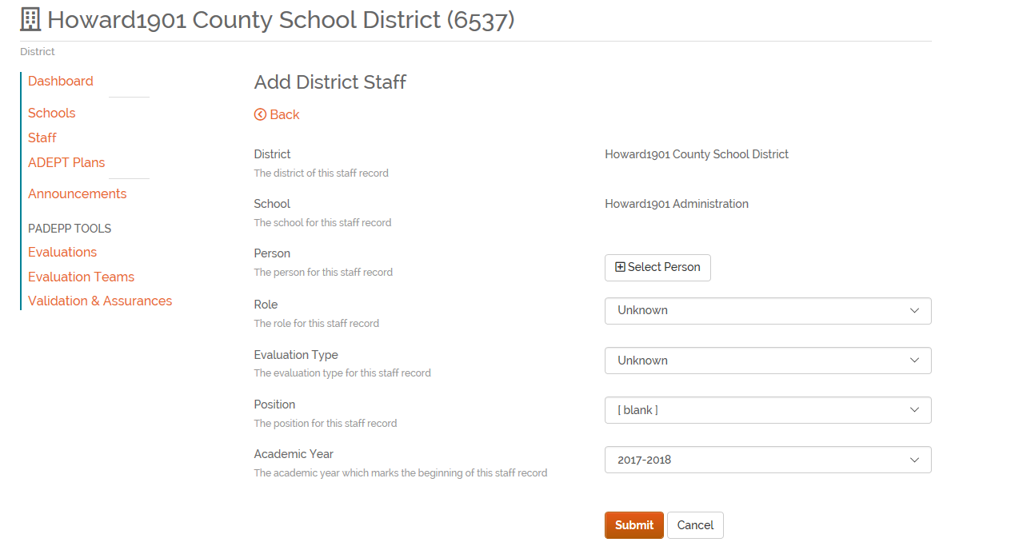
Adding District Staff
Staff must first be a “Person” in SCLead.org

Slide 37
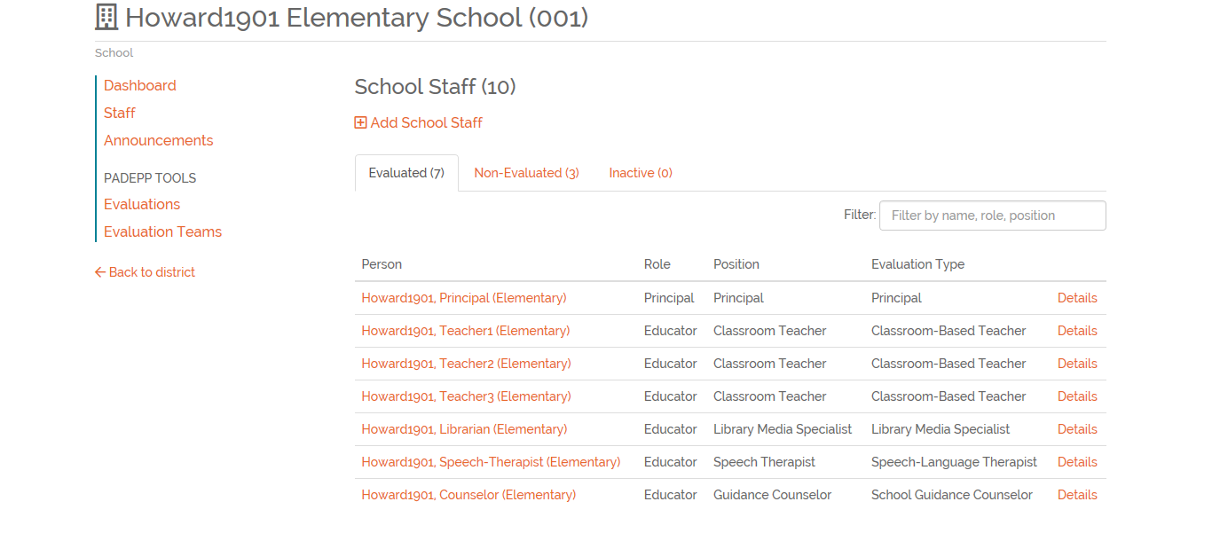
Adding School Staff

Slide 38
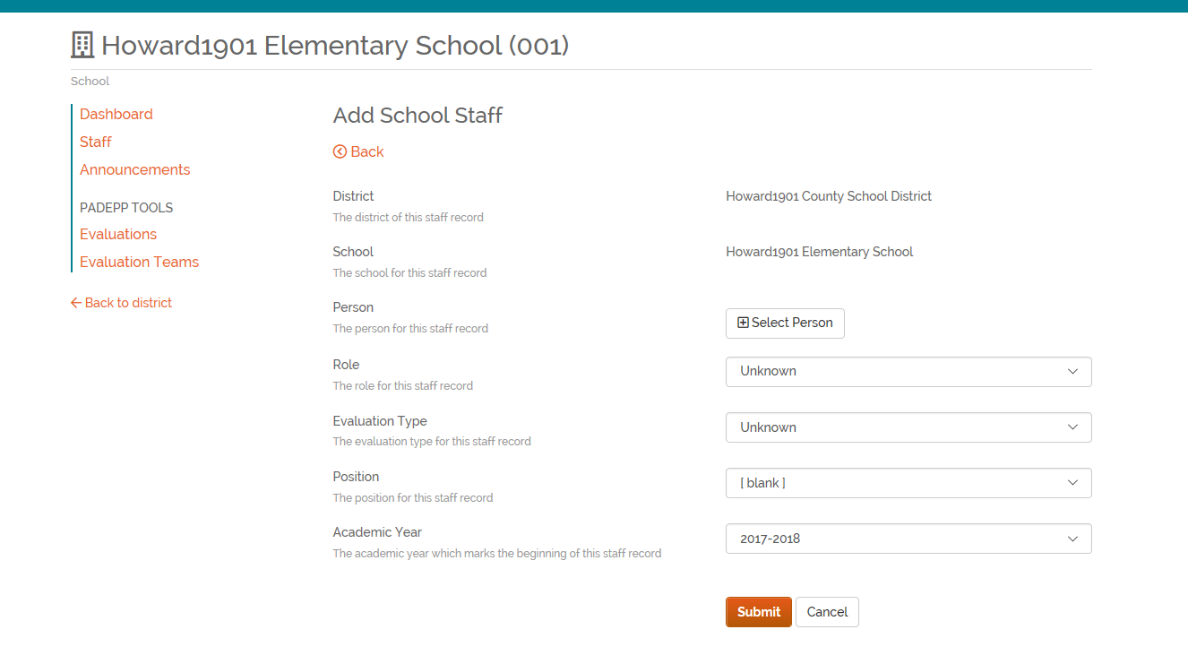
Adding School Staff
Staff must first be a “Person” in SCLead.org

Slide 39
ADEPT Tools
Getting Started in SCLead.org
Why is it important to get staff verified before beginning district set-up using ADEPT Tools?

Slide 40
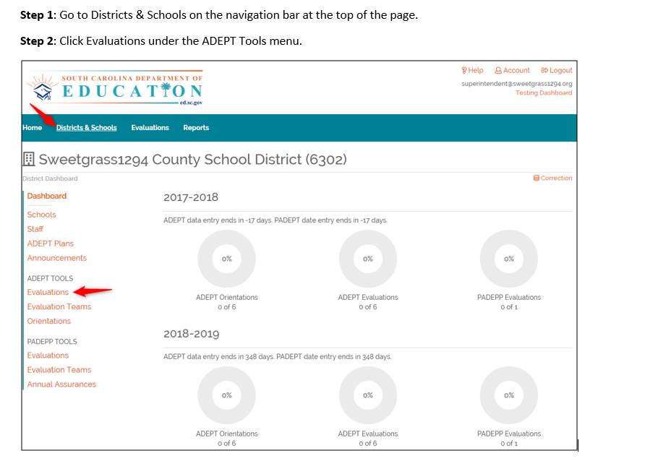
SYSTEM OPTION:
USE BULK TOOLS
STEP 1:
Create Evaluation Record
Notes:
When you login, you land on your dashboard. For the principal, it will be the school dashboard. For the district administrator, it will be the district dashboard. Regardless of your position, the screen looks the same. You have a menu of options on the right, status circles in the middle and links across the top blue bar.
So here is an SCLead.org tip. The order of options at the top and options on the left-hand side are listed sequentially. So work your way down the menu of options and it should decrease an error messages from the system.
Most district have already accomplished the 1st 4 options in the left menu. If you have not, please contact your ADEPT liaison at the Dept.
Let’s jump down to ADEPT Tools also referred to as BULK TOOLS – these are optional but highly recommended because you can handle multiple educators at one time.
So First – you have to create an evaluation record for EVERY CLASSROOM BASED TEACHER AND SPECIAL AREA EDUCATOR IN THE DISTRICT WHO IS EVALUATED UNDER ADEPT. This step will create a current year evaluation record for each educator AND they have to a current year evaluation record to be evaluated. If they don’t have a record created, you can’t assign teams or create orientation records.
So first Go to Districts & Schools on the navigation bar at the top of the page.
Then Click Evaluations under the ADEPT Tools menu.

Slide 41
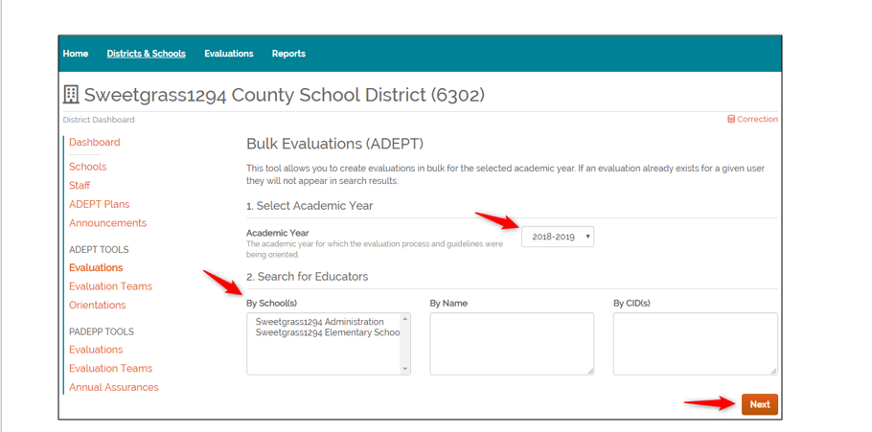
Notes:
When you click on evaluations – the bulk evaluation tool will appear.
Select the academic year and educators you intend to work with. You can search by school, name or CID.
If you don’t select any search criteria or filter in #2 – all educators will appear.
For the sake of efficiency, this step can be completed by district staff if school rosters have been reviewed.

Slide 42
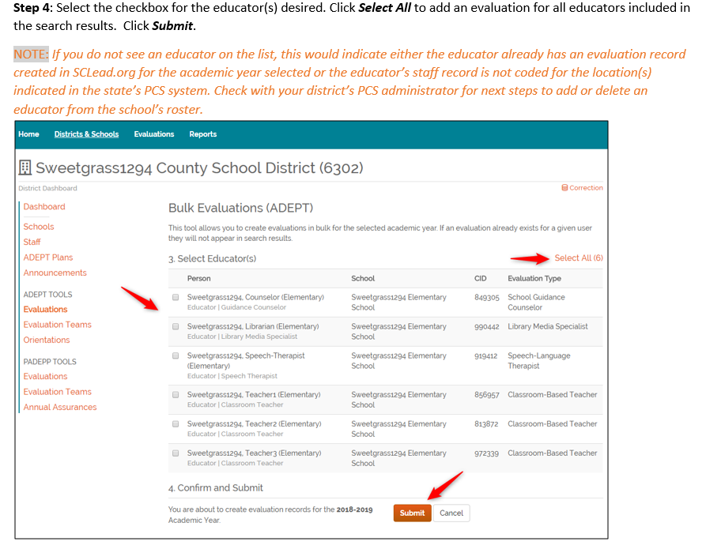
Notes:
Next you will select all the educators you want to create an evaluation record for and click submit. You can select educators one at a time or you can select all.

Slide 43
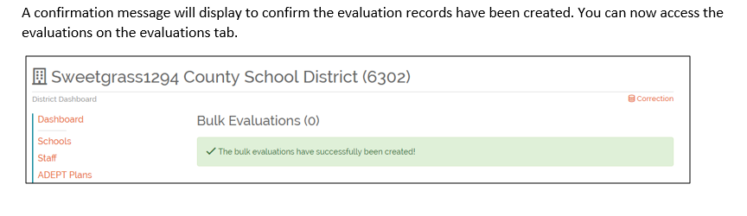
Part 1 - DONE
Notes:
Part 1 is done – you have just created an 2018-19 record for all educators.

Slide 44
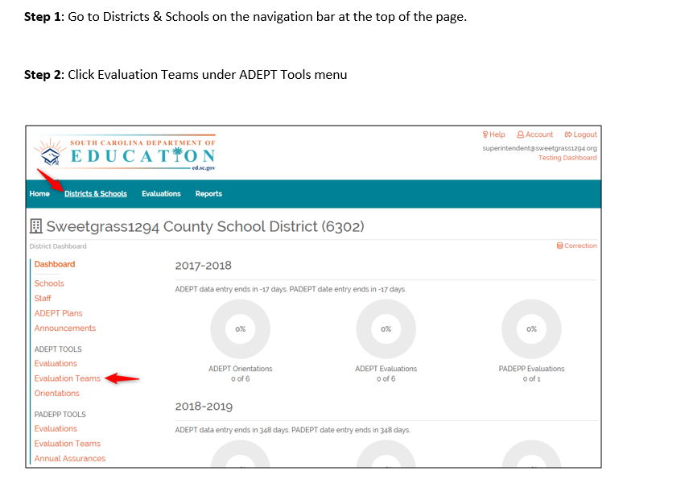
STEP 2:
Create Evaluation Teams
Notes:
The second task is to create evaluation teams. This can be accomplished by school or district administrators.
First Go to Districts & Schools on the navigation bar at the top of the page.
Then: Click Evaluation Teams under ADEPT Tools menu

Slide 45
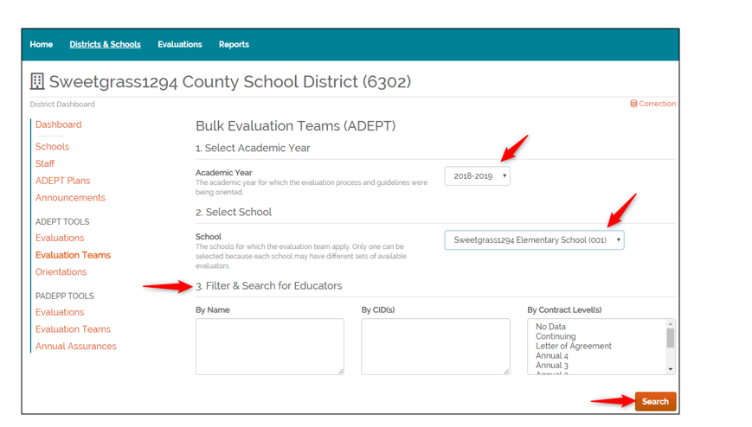
Notes:
Just like you did for evaluation records, select the year and filter criteria.
Press search

Slide 46
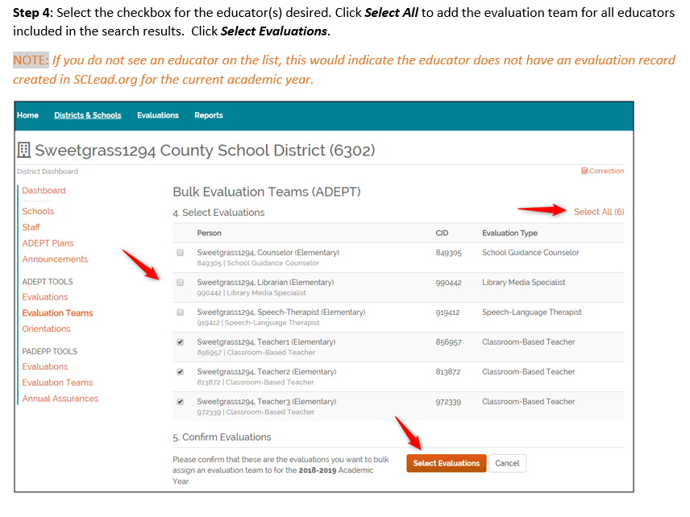
Notes:
Then select the educators from the available list you want to create evaluation teams for
Remember the persons you pick here will be evaluated by the same evaluator or evaluation team.
If the principal will be the ONLY person serving on the team, you do not have select them here. A principal can automatically create an evaluation or serve on a team.
If you intend to assign a mentor – all selected on this page will be assigned the same mentor – so keep that in mind.
Once you’ve made your selections - click select evaluations.

Slide 47
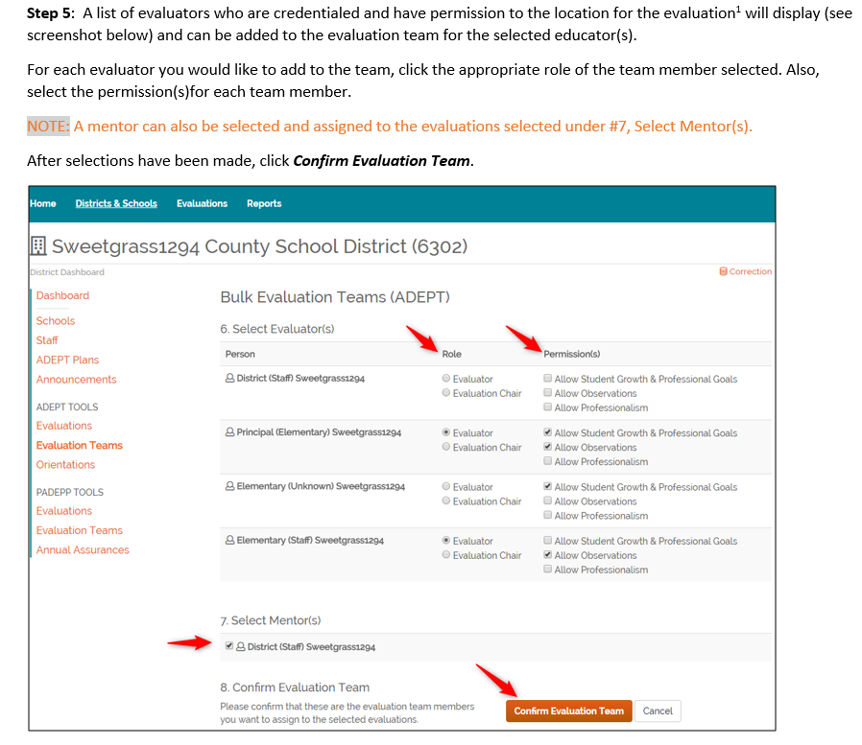
Notes:
Next determine who the evaluator or evaluators will be for the educators selected.
Here is where you assign a mentor. Remember if you selected more than one person to work with - they will all be assigned the same mentor.
Click Confirm evaluation team

Slide 48
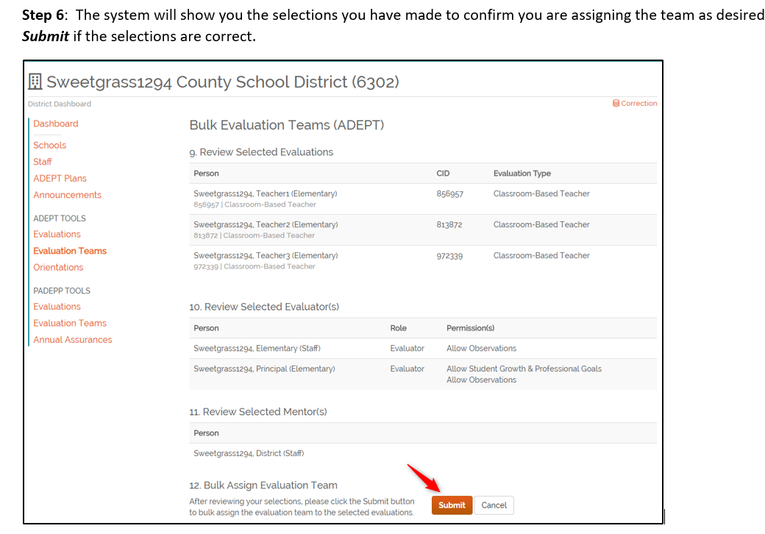
Notes:
The system will give you a confirmation screen – so you can review your work.
After confirming everything is correct – Click submit.

Slide 49
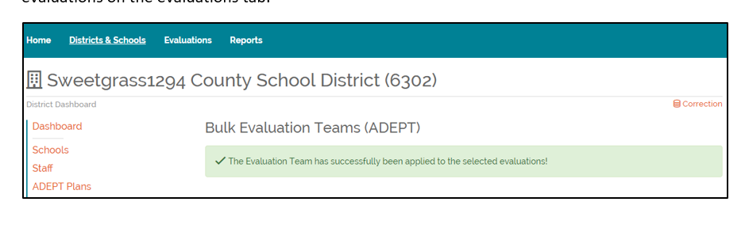
Part 2 - DONE
Notes:
Part 2 is done – you have just created evaluation teams for your educators.

Slide 50
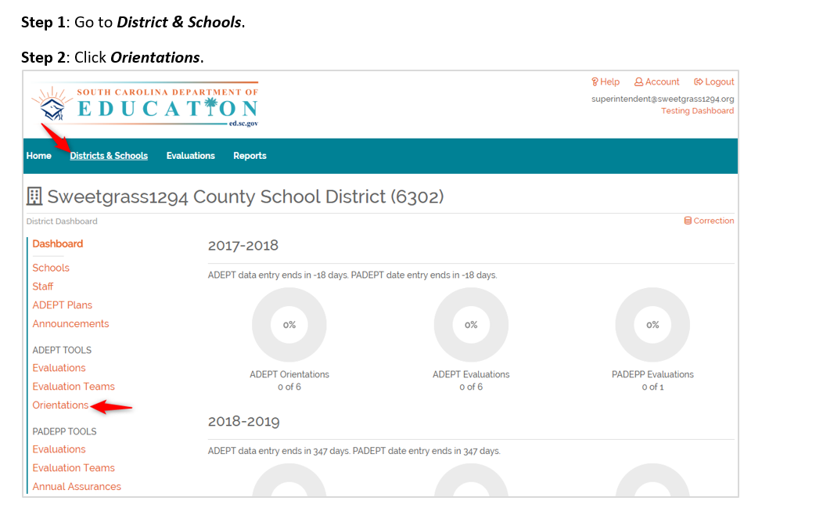
STEP 3:
Create Orientation Record
Notes:
The third task is to create orientation records. This can be accomplished by school or district administrators.
First Go to Districts & Schools on the navigation bar at the top of the page.
Then: Click Orientations under ADEPT Tools menu

Slide 51
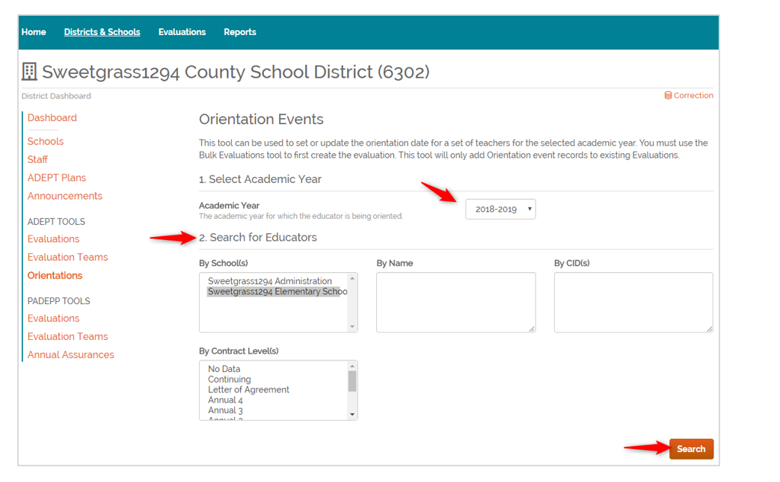
Notes:
You will follow the same steps as before
Select academic year
Enter your search criteria – click Search

Slide 52
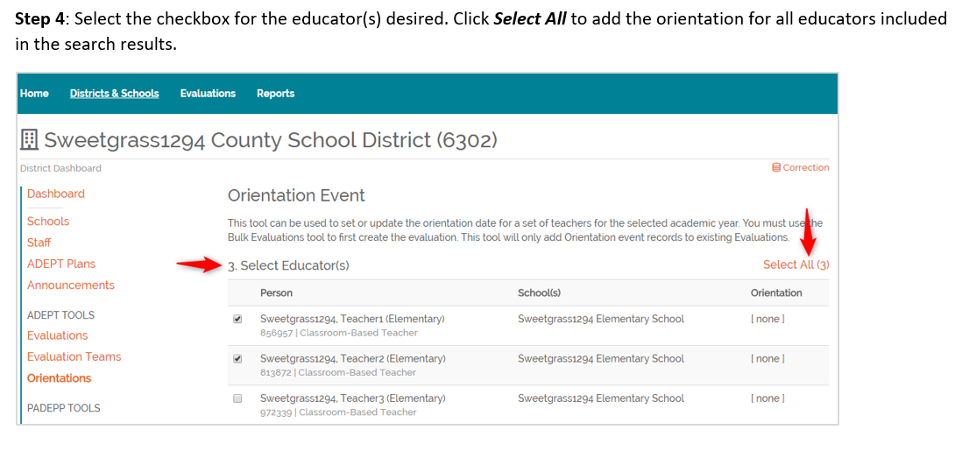
Notes:
And select those you want to attend the Orientation.

Slide 53
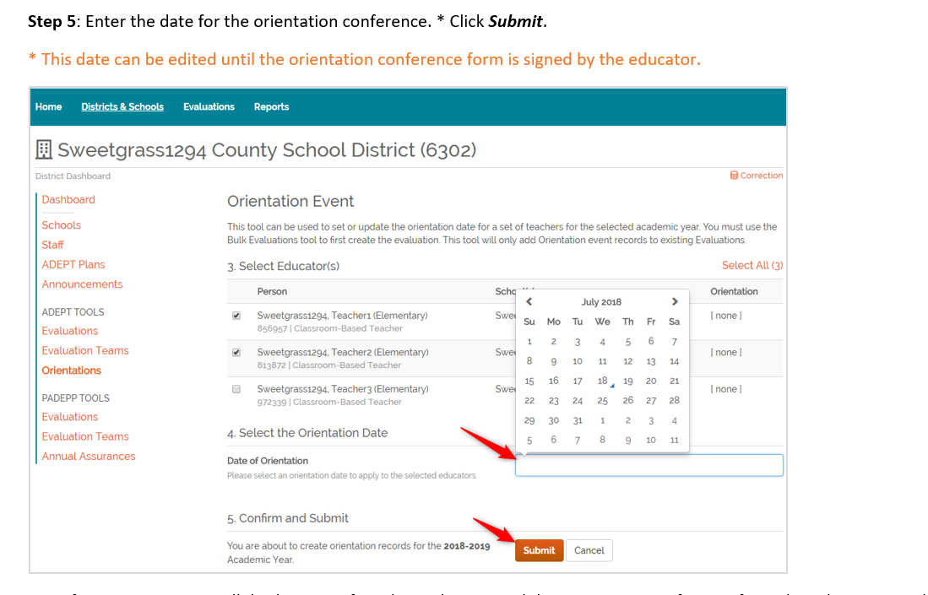
Notes:
You will have to select an orientation date – please ensure that it is accurate then click submit.

Slide 54
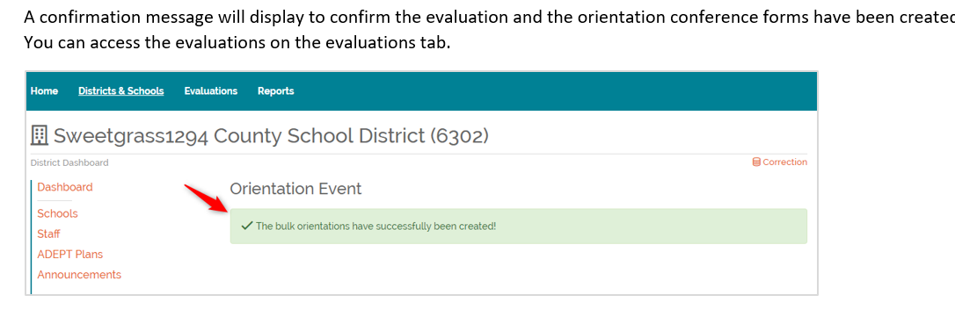
Part 3 - DONE
Notes:
Part 3 is done – you have just created orientation records for your educators.

Slide 55
Parking Lot Pause

Slide 56
Deep Dive: Educator Contract Levels and Evaluation Types

Slide 57
Induction
  Formative
  Differentiated Support
    Induction 1 (certified mentor required)
    Induction 2 (mentor suggested)
    Induction 3 (mentor suggested)
    *If a district will have Induction 2 and 3 teachers this must be indicated in the district’s ADEPT plan, which must include a description of how these educators will be supported.

Slide 58
Annual
Maximum of 4 years
Types of ADEPT Processes
  Formal evaluation (summative)
  Diagnostic Assistance (formative)
  Goals-Based Evaluation (GBE)
  *An annual contract teacher who has unsuccessfully completed the formal evaluation process for a second time, may not teach in a SC public school district for a period of at least two years and must complete a state-approved remediation plan in the area(s) of identified challenge.
  *After a minimum two-year period and successful completion of the state-approved remediation plan, the teacher is eligible for employment, at the annual contract level, for one additional year in order to attempt successful completion of the formal evaluation.
Notes:
Exceptions to 4 year maximum: If a year is “Incomplete” it can be repeated the following year; Teachers returning on an international contract
Diagnostic Assistance – a teacher who demonstrates potential, but is not quite ready for the formal evaluation process (unsuccessful induction year) OR after the first unsuccessful formal evaluation at the annual contract level; Can only be issued once
GBE – SLO or GBE if class size not 6 or more

Slide 59
Continuing
Educator must have satisfied all requirements for a professional teaching certificate
Types of ADEPT Processes
  GBE (or SLO)
  Summative (must be notified in writing by contract date)
  Formative (5th year Comprehensive Evaluation)
Notes:
Requirements include successfully completing the summative evaluation and passing the Praxis.
Summative –
The written notification must include:
- the reason(s) for recommending formal evaluation,
- the evaluation process, and
- the evaluation timelines

Slide 60
Letter of Agreement
Teachers who are eligible for a teaching contract but are hired on a date that would result in an employment period of less than 152 days may receive a LOA.
  No standard evaluation process is required
  ADEPT does not apply, but district must assist and “evaluate”, as appropriate
  Provisions of Employment and Dismissal Act do not apply

Slide 61
Educator Contract Levels and Evaluation Types
Check for Understanding

Slide 62
What Contract?
Your district is interested in hiring a teacher that just completed his first year of teaching in Arizona.
What contract do you offer?

Slide 63
What Contract?
Your district is in the process of hiring a teacher with a professional certificate from out of state. She has been teaching for 11 years.
What contract do you offer?
Notes:
Under what circumstances could this teacher be offered a Continuing contract?

Slide 64
What Contract?
Your district is in the process of rehiring a teacher on an international teaching certificate. She’s been with the district previously and returned to Spain after completing an Annual 4 contract. She is now back in the United States on a new visa for a period of five years.
What contract do you offer?

Slide 65
What Evaluation Level?
You have a reading coach who has been with the district for several years. Next year will be her tenth year at the Continuing level, which means she’s up for certificate renewal. She doesn’t have her own classroom, but instead supports teachers in supporting students.
What type of evaluation should this educator receive?

Slide 66
What Contract?
Your district is hiring a school counselor that will join the district in early October. He has already completed two years as a school counselor in Georgia.
What contract do you offer?

Slide 67
What Contract and Evaluation Level?
Your district is hiring a teacher that successfully completed an Annual 1 contract in a previous district. The district suggested the teacher receive a Continuing GBE contract next year, but your district has not been able to assess the teacher’s performance.
What contract and evaluation level do you offer?

Slide 68
Parking Lot Pause

Slide 69
Office of Educator Services

Slide 70
How: SCLead.org Evaluations Menu
From Settings to Student Growth and Professional Goals

Slide 71
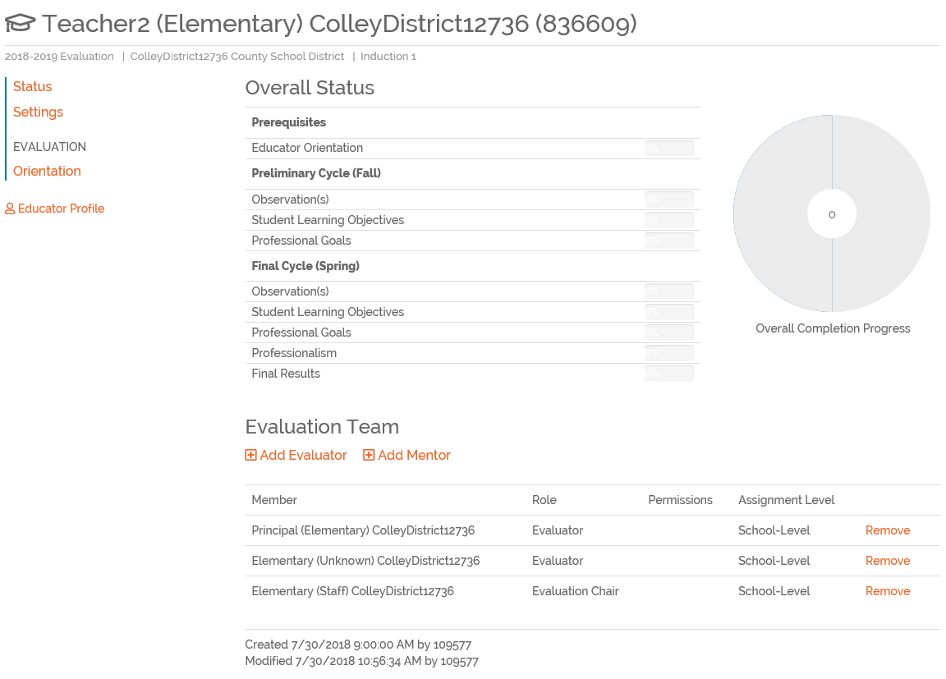
SCLead.org Educator
Evaluation Status Screenshot
Notes:
Status Slide 1 of 1: Educators can track where they are in the evaluation process. The doughnut on their status page will fill-in accordingly as they complete each step of the evaluation.

Slide 72
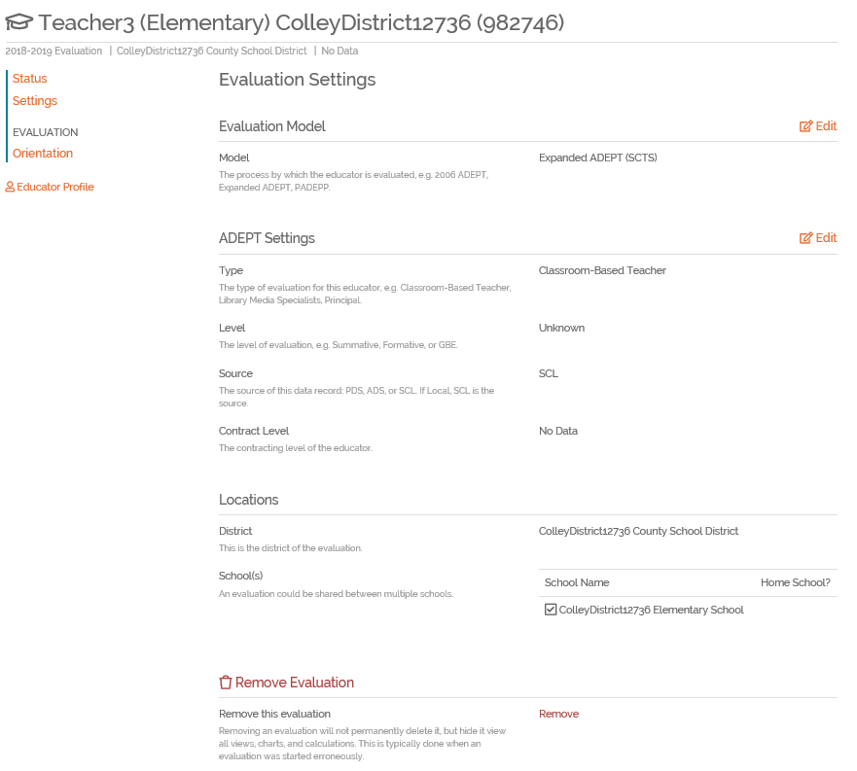
SCLead.org Educator
Evaluation Settings Screenshot
Notes:
Settings Slide 1 of 3: The Evaluation Settings is where District Coordinators and Principals can change the Evaluation Model and ADEPT Settings.

Slide 73
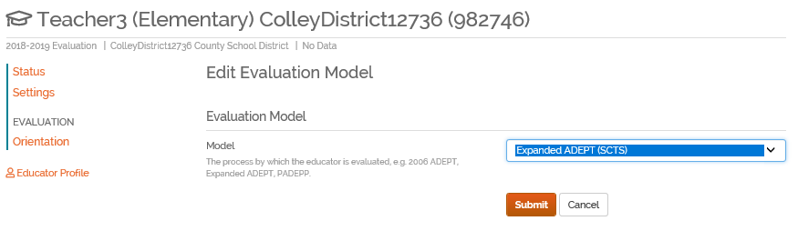
SCLead.org Educator
Edit Evaluation Settings Screenshot
Notes:
Settings Slide 2 of 3: The Evaluation Model dropdown choices include 2006 ADEPT for Media Specialists, Guidance Counselors and Speech Therapists, Expanded ADEPT (SAFE-T) for those granted waiver for the approved Addendum/Exceptions submitted with Expanded ADEPT Plan; Expanded SCTS wherein majority of those being evaluated should fall; Other Locally Developed Model as approved by Districts submitted ADEPT Plan; and PADEPP, which we will not discuss. If you created bulk evaluations, make sure to pull your evaluations report to verify that you assigned the correct evaluation model. It is very important for you to choose the correct evaluation model, so SCLead knows the correct documents to populate.

Slide 74
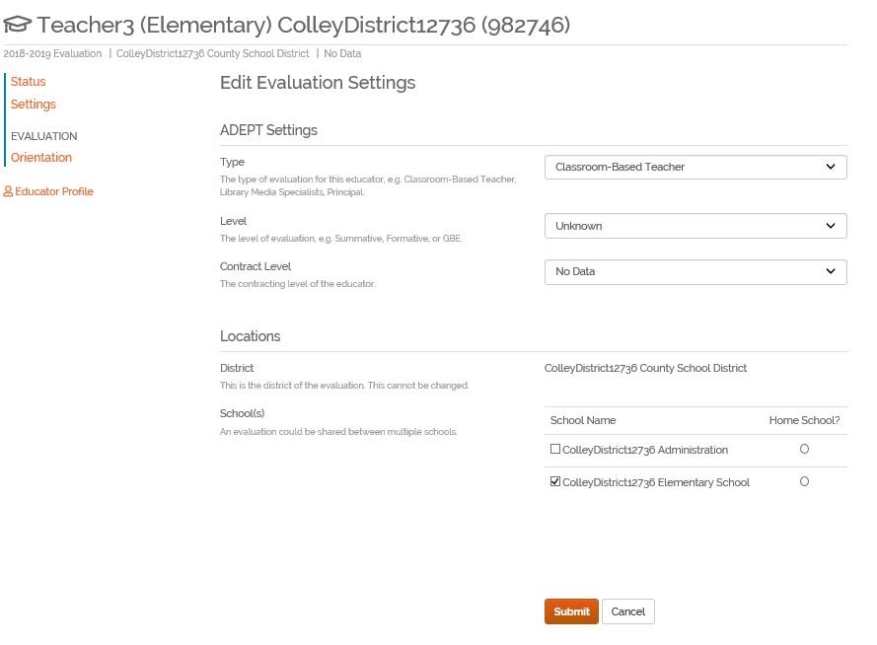
SCLead.org Educator
Edit ADEPT Settings Screenshot
Notes:
Settings Slide 3 of 3: Under ADEPT Settings, you can edit the type of Evaluation for the appropriate educator, e.g. Classroom-based teacher, Guidance Counselor, Speech Therapists, Library Media Specialist, Principal; Level options are GBE, Formative, Summative and Unknown. Contract Level options Use your Contract Level Flowchart to guide you in assigning contract levels. SCLead should have populated based on the last ADS status. Make the necessary changes here if needed.

Slide 75
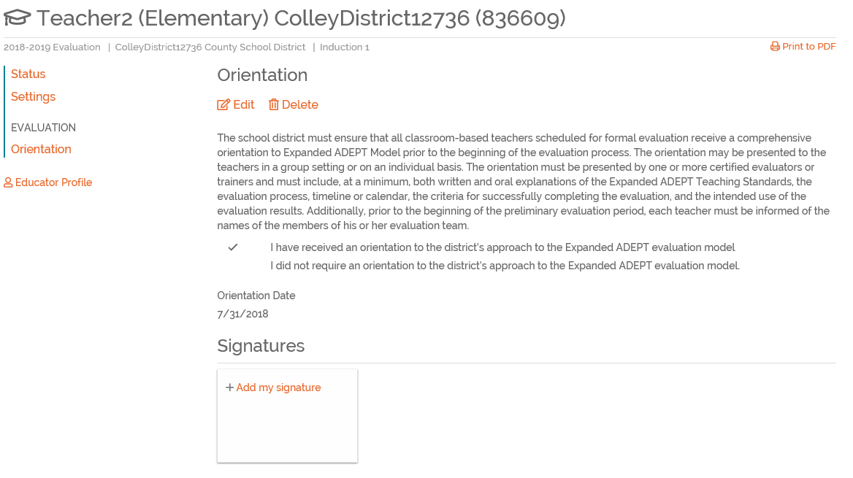
SCLead.org Educator
Evaluation Orientation Screenshot
Notes:
Orientation Slide 1 of 3: It is very important for districts to set-up orientation, so that evaluations can be created and evaluation teams can be set-up. When an orientation event has been created for a school or schools in the district, remind teachers to attach signature to their orientation. This will trigger SCLead to populate the forms for the evaluation.

Slide 76
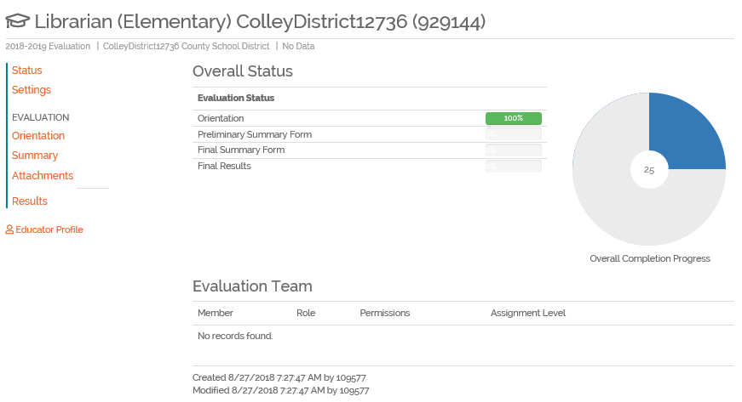
Librarian, Speech Therapist or Guidance Counselor Orientation Complete Screenshot
Notes:
Slide 2 of 3: The evaluation forms that will populate for these individuals are Summary, Attachments and Results.

Slide 77
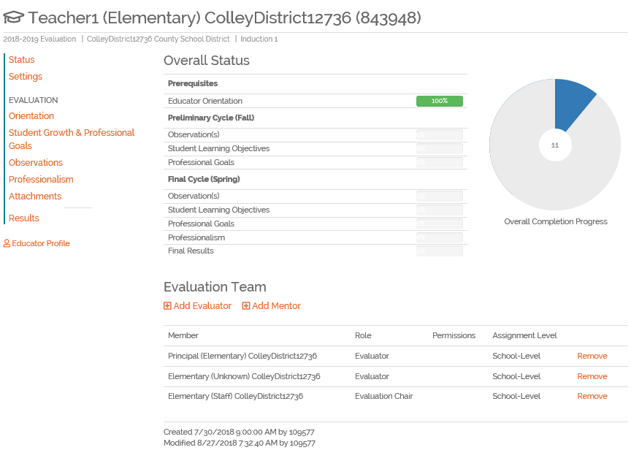
Classroom-Based Teachers Orientation Completed Screenshot
Notes:
Slide 3 of 3: Student Growth & Professional Goals, Observations, Professionalism, Attachments and Results will populate for classroom-based teachers under Expanded ADEPT (SCTS) Evaluation Model.

Slide 78
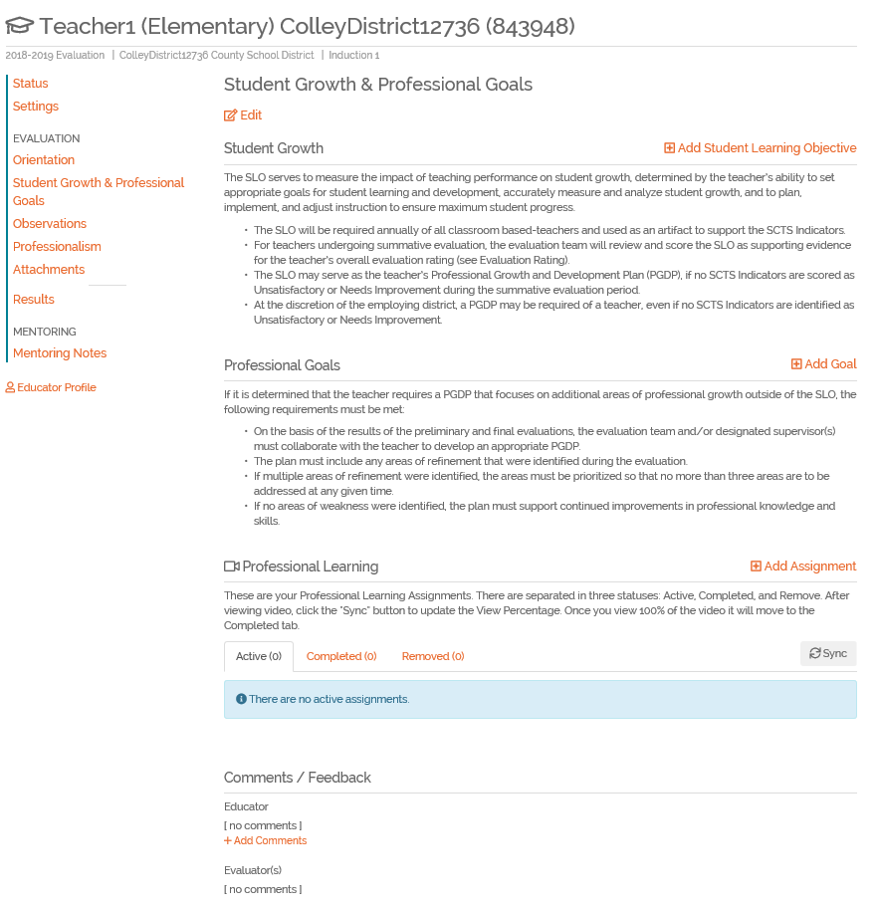
SCLead.org Student Growth & Professional Goals Screenshot
Notes:
Student Growth Slide 1 of 5: Educators will enter their SLOs here

Slide 79
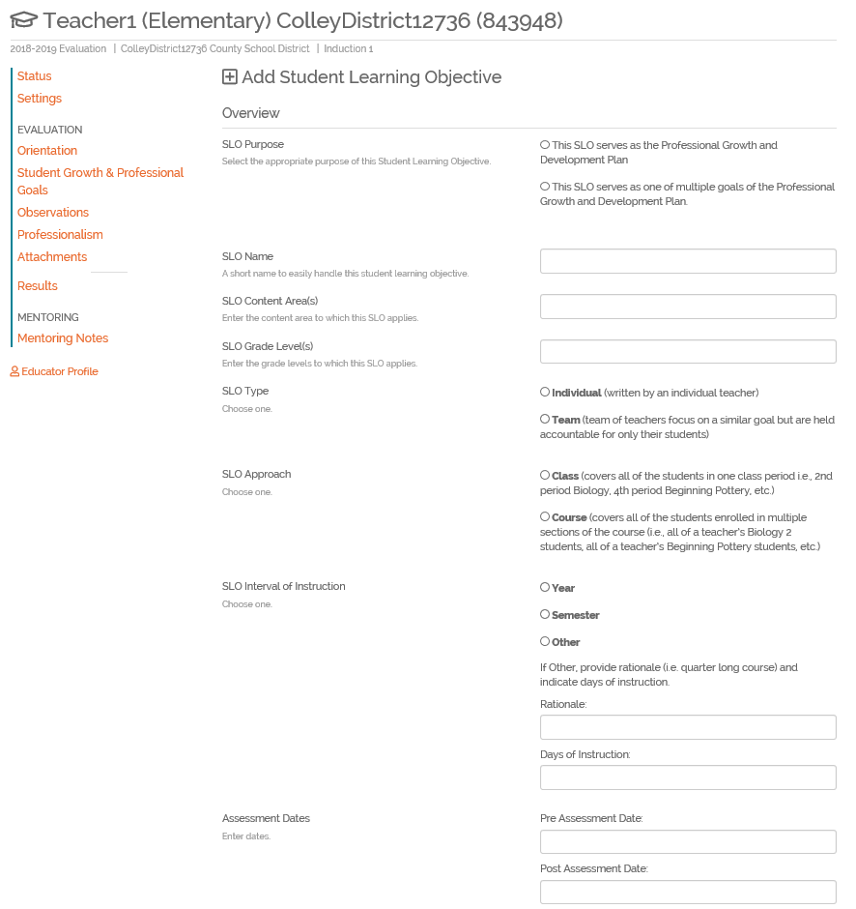
SCLead.org Add Student Learning Objective Screenshot
Notes:
Student Growth Slide 2 of 5: Educators must Click Add Student Learning Objective and then enter the required fields. The fields correspond to the written SLO template. Submit is the same thing as save. The SLO can be edited by the teacher until the teacher and evaluator have signed and at that point the evaluator can edit as needed.

Slide 80
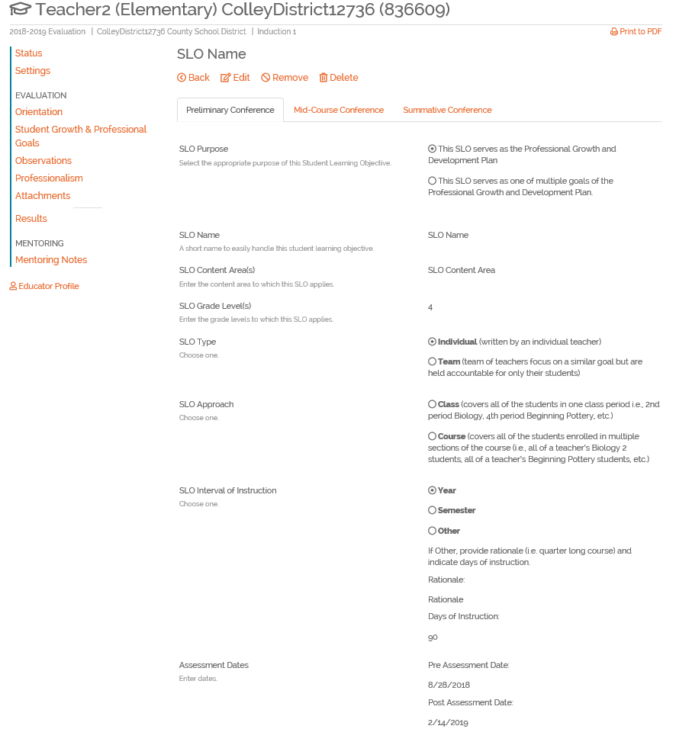
SCLead.org SLO Screenshot
Notes:
Student Growth Slide 3 of 5: Once educators enter their SLOs, the appropriate Tabs will appear

Slide 81
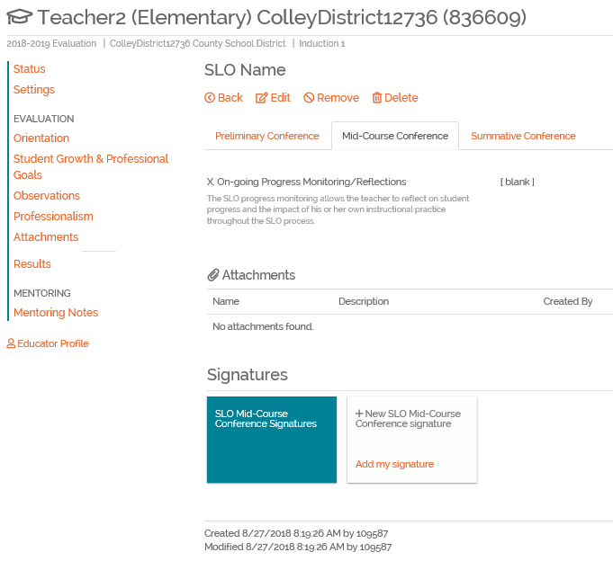
SCLead.org SLO Screenshot
Notes:
Student Growth Slide 4 of 5: Mid-Course and Summative Conference must be held and signed by evaluator and educator. The educator’s doughnut will fill accordingly, to indicate where the educator is in the evaluation process. Remember that SLOs are important as they are the evaluation score modifier as per Expanded ADEPT Support and Evaluation System Guidelines. It states that “at the conclusion of the formative or summative evaluation period, the teacher’s SLO score is used as a modifier for the teacher’s overall evaluation rating. An SLO score of 4 will increase the teacher’s overall evaluation rating by .25; Conversely, an SLO score of 1 will change the teacher’s overall evaluation rating by -.25. SLO scores of 2 or 3 are to have no bearing on the teacher’s overall evaluation rating.”

Slide 82
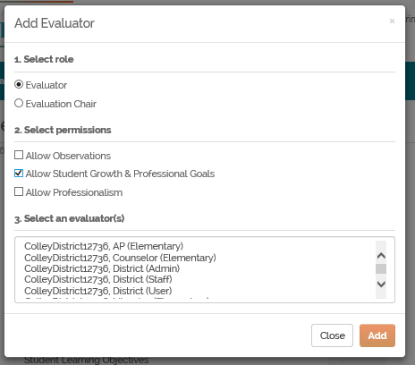
ScLead.org Add SLO Approver Screenshot
Notes:
Student Growth Slide 5 of 5: In cases where you later decide to add an SLO Approver, you can edit the Evaluation Team to add it by selecting Evaluator Role and Allow Student Growth & Professional Goals permission.

Slide 83
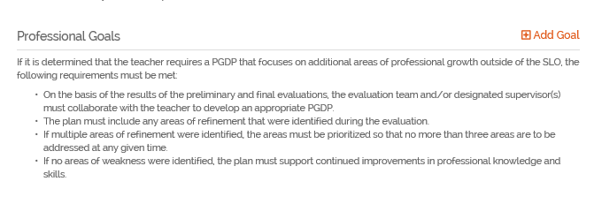
SCLead.org PGDP Screenshot
Notes:
Professional Goals Slide 1 of 4

Slide 84
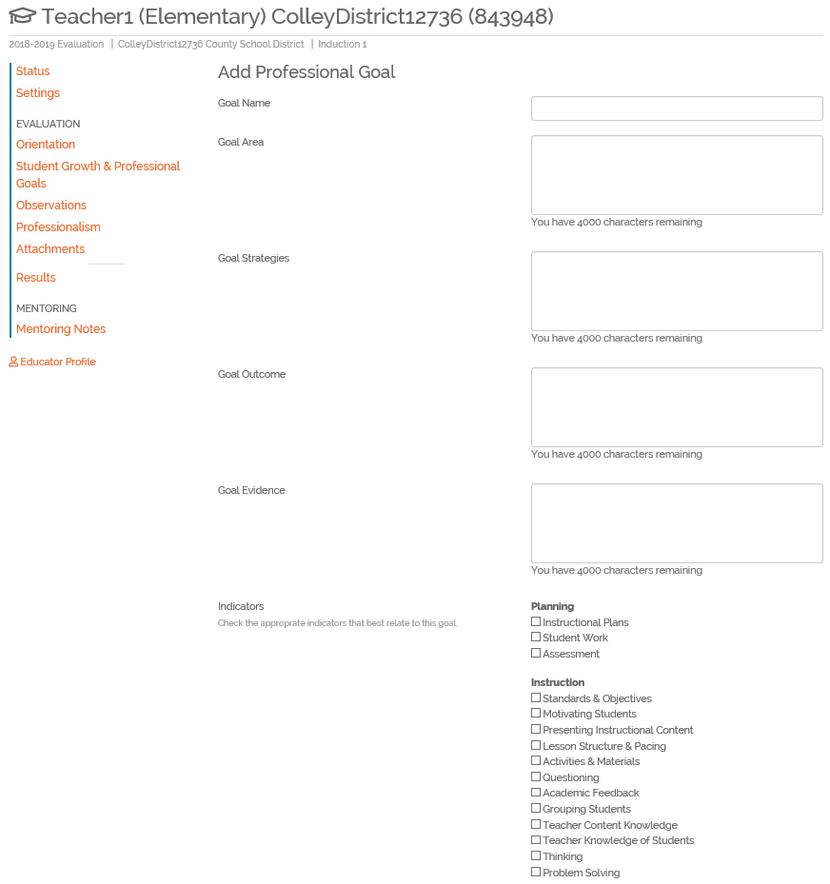
Notes:
Professional Goals Slide 2 of 4: Environment and Professionalism Domains and Indicators are also options

Slide 85
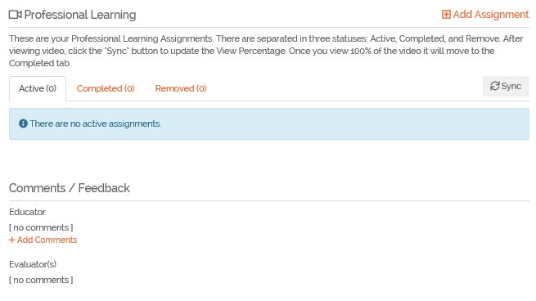
Notes:
Professional Goals Slide 3 of 4: Educators can seek their own Professional Growth and add their own assignments.

Slide 86
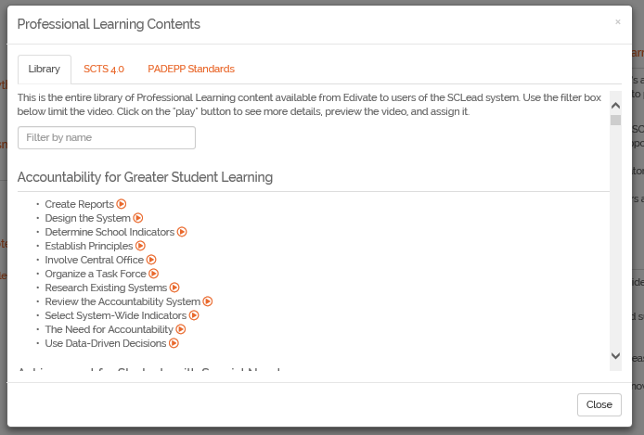
Notes:
Professional Goals Slide 4 of 4: Professional Growth The resources under Library are Alphabetically ordered by General Topics: Accountability, Achievement, Action Research. The resources under SCTS 4.0 are organized under the SCTS 4.0 Domains and Indicators. PADEPP Standards have resources organized by standard.

Slide 87
Evaluations Menu
From Observations to Professionalism Self- Review

Slide 90
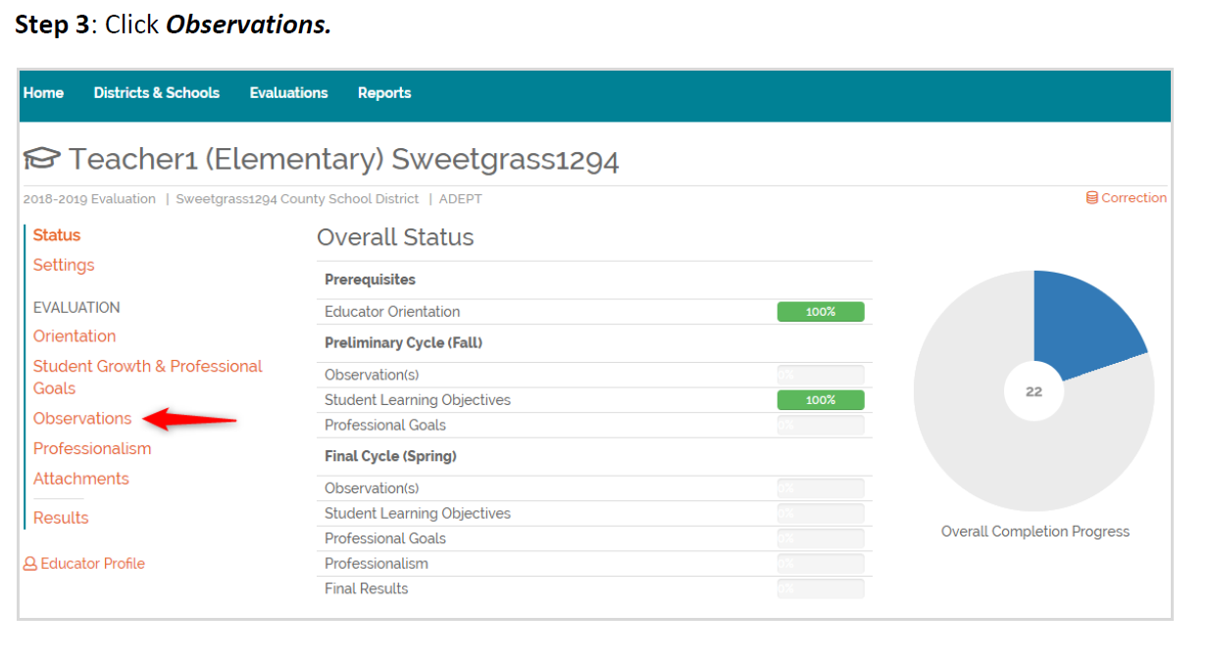

Slide 91
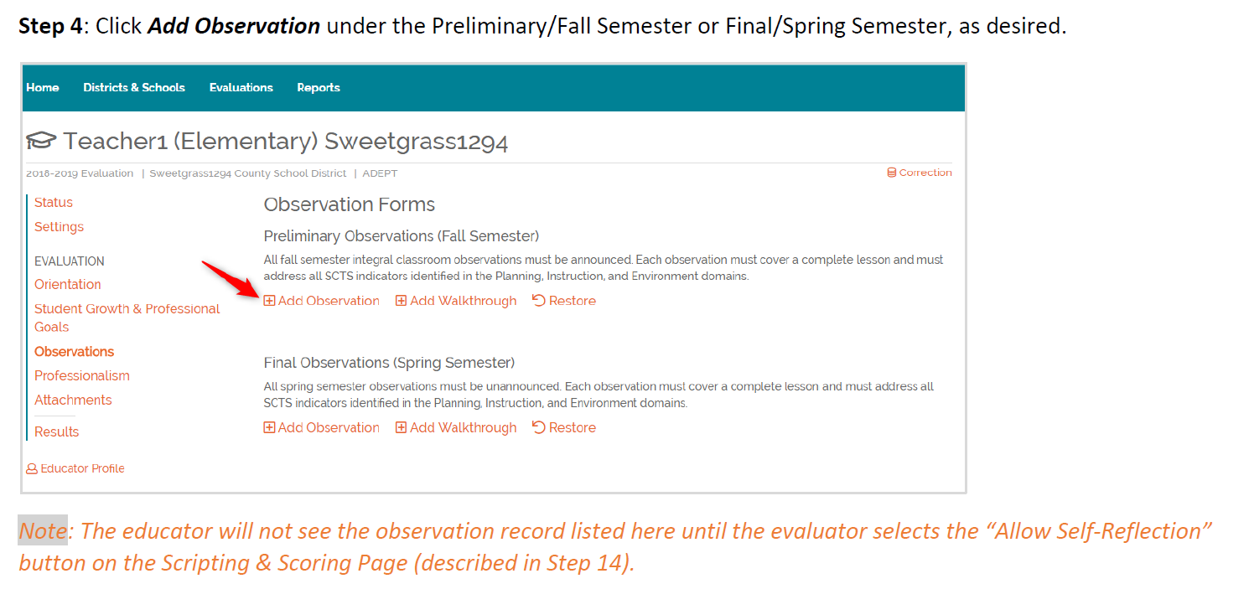

Slide 92
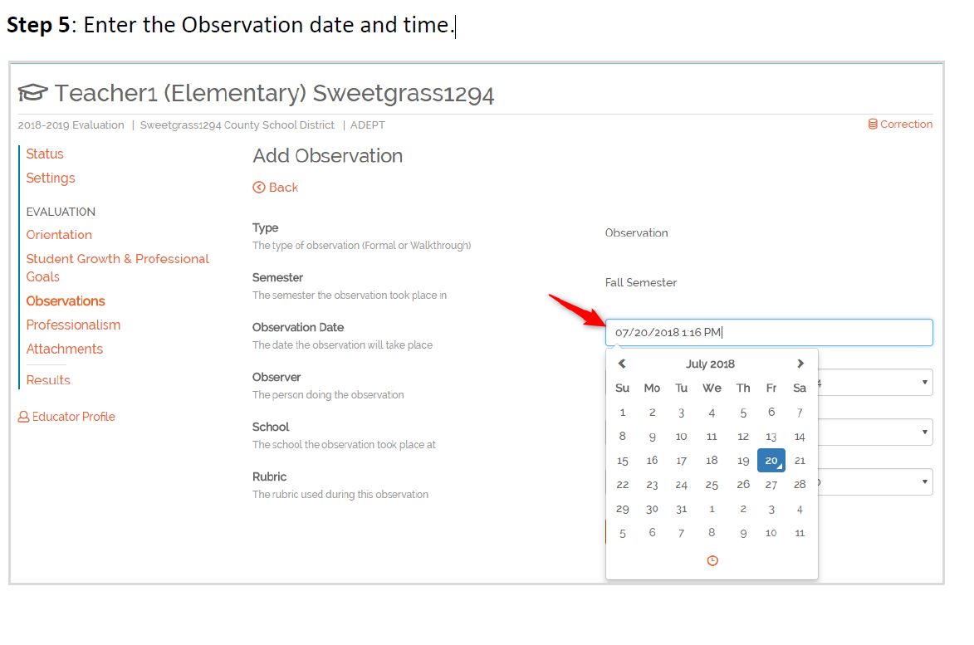

Slide 93
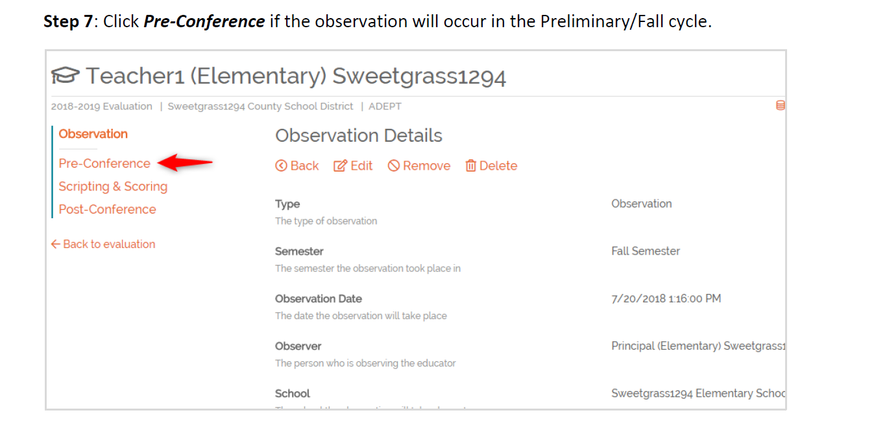

Slide 94


Slide 95


Slide 96


Slide 97


Slide 98


Slide 99


Slide 100


Slide 101

Professionalism Self-Review

Slide 102

Assigned Team Member or Principal Completes

Slide 103




Slide 104
Parking Lot Pause

Slide 105
SCLead.org
Data Corrections

Slide 106

Educator Updates

Slide 107
Educator Corrections
District ADEPT Coordinators/Superintendents
Assigned to regional support associate
Shows progression of submitted items
District houses evidence to support submissions
District must verify that CID and Educator Name match
Printable form

Slide 108
ADEPT Results

Slide 109

Results
This information is required for your ADEPT report as your ADEPT record and for certification.
Here is where you will input the SLO rating and any Final 4.0 Evaluation data as applicable for every certified educator in your district.
Notes:
The State Board of Education may withhold ADEPT funds from school districts who fail to submit required information.
Teacher contract levels and evaluation processes are tied to ADEPT results.
ADEPT results for induction and annual contract teachers are required in order for the teachers to advance to professional teaching certificates.
ADEPT results for teachers who are being formally evaluated for the second time at the annual contract level are required in order to inform the state about the need for sanctions.
Institutions of Higher Education (IHEs) use data for improvement and accreditation documentation.
ADEPT flow-through funding for school districts is calculated on the basis of the number of certified Induction 1 teachers reported on ADS. (i.e. February Induction Count)

Slide 110
Scheduling a Training

Slide 111

Scheduling a District Training

Slide 112


Slide 113
Training Reminders
“Training” can be used to schedule a training or register for a training
Add attendees after the training has occurred
  Select passed/completed
  Award credential

Slide 114
Resources

Slide 115

ADEPT Tips and Key Resources
ADEPT is a growth model – constructive feedback is essential
SLOs + SCTS = Data-informed reflection on teacher effectiveness
Communication with and feedback from teachers about the process is essential
ADEPT resources https://ed.sc.gov/educators/educator-effectiveness/

Slide 116

Important information and updates are communicated through the OEELD monthly communication and office hours webinars.

Slide 117
Questions?

Slide 118
Office of Educator Effectiveness & Leadership Development
Educator Effectiveness Liaisons
Faye Colley, Professional Learning and Communications, fcolley@ed.sc.gov
Beverly Flythe, EPPs, bflythe@
Dr. Julie Hartwell, Data and Reporting, jhartwell@ed.sc.gov
Dr. Kimberly Howard, Mentoring and Induction, khoward@ed.sc.gov
Dr. Vicki Traufler, PADEPP, vtraufler@ed.sc.gov
Leadership Program Managers
Walter Clark, Experienced Leaders, wclark@ed.sc.gov
Olivia Ortmann, Collective Leadership, oortmann@ed.sc.gov
Dr. Frank Robinson, Principal Induction, Emerging Leaders frobinson@ed.sc.gov
Tom Smith, Assistant Principals and Instructional Leaders, tsmith@ed.sc.gov
Regina Thurmond, Emerging Leaders, Special Areas, rthurmond@ed.sc.gov
Office Support
Lilla Toal-Mandsager, Director, lmandsager@ed.sc.gov,
Marilyn Suber, Administrative Assistant, masuber@ed.sc.gov
Online https://ed.sc.gov/educators
Leadership: /school-and-district-administrators/
Effectiveness: /educator-effectiveness/

Slide 119
References
Carver-Thomas, D. and Darling-Hammond, L. (2017) Why Black Women Teachers Leave and What Can Be Done About It. Black Female Teachers: Diversifying the United States’ Teacher Workforce Advances in Race and Ethnicity in Education, Volume 6. Emerald Publishing Limited. Retrieved from https://learningpolicyinstitute.org/sites/default/files/product-files/Why_Black_Women_Teachers_Leave_CHAPTER.pdf.
Center for Educator Recruitment, Retention, and Advancement. (2018). South Carolina Annual Educator Supply and Demand Report. Retrieved from https://www.cerra.org/uploads/1/7/6/8/17684955/2017-18_supply_demand_report.pdf
Gallup. (2017). Leadership Perspectives on Public Education: The Gallup 2017 Survey of K-12 School District Superintendents. Retrieved from https://news.gallup.com/reports/217103/gallup-k-12-superintendent-report-201708.aspx
Ronfeldt, M., Loeb, S., & Wyckoff, J. (2012). How Teacher Turnover Harms Student Achievement. National Center for Analysis of Longitudinal Data in Education Research. Retrieved from https://caldercenter.org/sites/default/files/Ronfeldt-et-al.pdf
The New Teacher Project. (2012) The Irreplacables: Understanding the Real Retention Crisis in America’s Urban Schools. New York, NY: TNTP.https://tntp.org/assets/documents/TNTP_Irreplaceables_2012.pdf

Slide 120
Thank You
Include Contact Information Here

