Slide 1
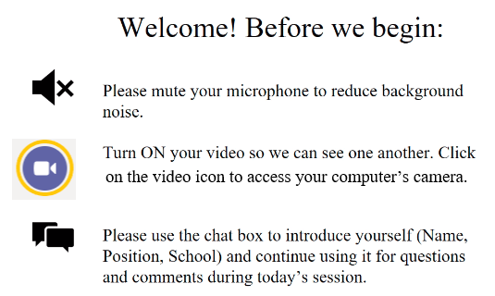
ADEPT 101
Notes:
Lilla: First of all welcome and hello. We’re thankful you’ve made time today to learn with us. This section focuses on the 4 W’s, the Why and What of ADEPT (and the documents you have to help you remember those Whats), the roles and responsibilities or the Who and finally the When and a general calendar. The rest of training really dives into the Hows of SCLead and assigning educator contract levels.

Slide 2
ADEPT 101
SC Department of Education,
Office of Educator Effectiveness & Leadership Development
August 2020

Slide 3
ADEPT 101 Agenda
Foundations of ADEPT
Reminders-Tips-Targets
  SCLead.org Overview
  Start of School Year (Bulk Tools, Evaluation records, Teams, Credentials)
  Managing the Evaluation Process (Tracking, Evaluation Cycles)
  Ending the School Year ( Auto Complete, Closing, Ending)
Deep Dive: Contract Levels
SCLead Administrative Functions & FAQs
Certification Highlights, Office of Educator Services
Q&A
  Work session (Optional): (A) Rosters/Teams/NIET; (B) Import/Contracts; (C) Reports; (D) Corrections/Training; (E) Administrative Questions
Notes:
We hope by the end of the day you can answer the questions on the left. (Read them)
Our agenda today will be divided up into 5 parts. (read them)

Slide 4
SCLead.org 101 Training Norms
Don’t multi-task.
While in the Training Room, please stay engaged.
Be prompt.
Please return to the Training Room on time for the afternoon work sessions and enter your name in the chat.
Please work along with the training team and enter questions or requested responses in the chat box.
We’re in this together.
Have your camera on when in the Training Room and unmute your mic to speak.
Notes:
Read the norms.

Slide 5
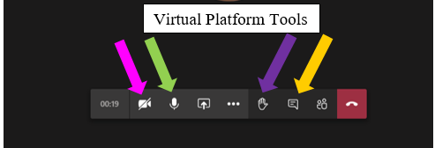
Using the Virtual Platform
Notes:
As a quick intro to the TEAMS tools, point out the camera (pink), microphone (green), raised hand (purple) and chat (gold) option on the TEAMS page.

Slide 6
Foundations of ADEPT
The Why, the What, the Who, and the When
Notes:
Lilla: First of all welcome and hello. We’re thankful you’ve made time today to learn with us. This section focuses on the 4 W’s, the Why and What of ADEPT (and the documents you have to help you remember those Whats), the roles and responsibilities or the Who and finally the When and a general calendar. The rest of training really dives into the Hows of SCLead and assigning educator contract levels.

Slide 7
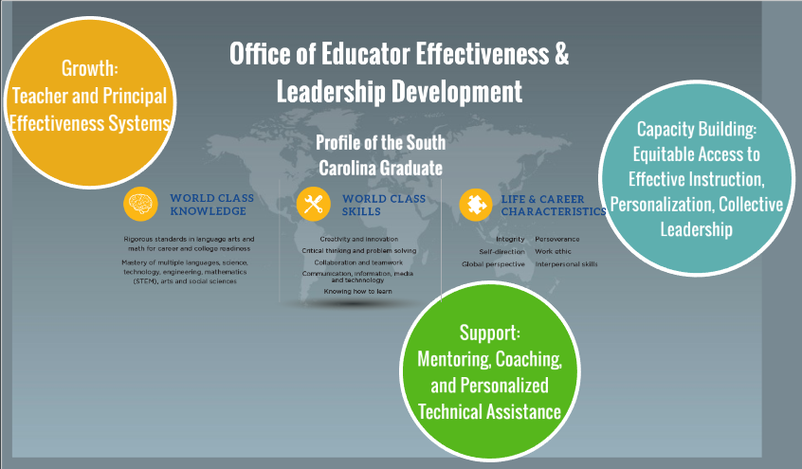

Effectiveness and Leadership Development Framework
Follow the work:
#SCTSRubric
#CollectiveLeadership
@PIPLeaders
ed.sc.gov/educators/
  effectiveness
  school-and-district-administrators
Notes:
By way of introduction, the Office of Educator Effectiveness has three functions.
The first is Effectiveness Systems Design—The teacher and principal effectiveness models and data systems provide ways for districts and preparation providers to measure growth, create professional learning, and monitor continuous improvement. These systems are focused on growing educators and leaders so that every student can have access to effective teachers.
The second is Direct Support—early career educators and new principals need structured induction programs and mentoring, so our office works with CERRA to provide that for teachers and certified educators. Our office also facilitates the principal induction program. Additionally, we offer training, monthly office hours, and a tiered system of district support for the implementation of the teacher and principal effectiveness systems. Your ADEPT contact is a part of that support.
Our third function is Capacity Building—Our instructional leadership development cohorts serve the continuum of educators from teacher leaders to district leaders. We aim to build leaders’ capacity to improve instruction in their schools and districts. Our cohorts focus on and model equitable access to effective instruction, personalization, and collective leadership.
We invite you to check out our work on social media using #SCTSRubric, #Collectiveleadership, @PIPLeaders or on our website at ed.sc.gov/Educators and then clicking on either effectiveness or school and district leaders.

Slide 8
The Why? Retaining Effective Educators
“…shortages of teachers of color are generally caused less by recruitment shortfalls than by retention problems”
(Ingersoll & May cited in Carver-Thomas , 2017).
“…teacher turnover has a significant and negative effect on student achievement in both math and ELA…. turnover is particularly harmful to the achievement of students in schools with large populations of low-performing and black students.”(Ronfeldt, Loeb, & Wycoff, 2012).
Notes:
(Lilla) Zooming in specifically on the teacher and educator effectiveness system, I’ll start with the why. Our office focuses on making sure every student in SC has equitable access to great teachers and leaders. The research tells us that retention relies on our leadership,
Ingersoll and May find, “…shortages of teachers of color are generally caused less by recruitment shortfalls than by retention problems (cited in Carver-Thomas (2017)).
Furthermore, in another study, Ronfeldt, Loeb, and Wycoff find,
Results demonstrate that teacher turnover has a significant and negative effect on student achievement in both math and ELA. Moreover, teacher turnover is particularly harmful to the achievement of students in schools with large populations of low-performing and black students. (Ronfeldt, Loeb, Wycoff)
If we believe in equitable access to effective teachers, we need to address issues of leadership and turnover.

Slide 9
What do highly effective teachers want?
Feedback, Recognition, and Opportunities to Lead
“Positive, effective communication between teachers and administration is lacking. Performance feedback is missing. For example, my principal never once visited my classroom during the entire school year to see how effective I really am with my students.”
(The New Teacher Project, 2012).
Notes:
Fortunately, the ADEPT effectiveness system focuses on feedback and recognition. The New teacher project finds that highly effective early career teachers want feedback, recognition, and opportunities to lead. If you read this quotation, you can see that effective teachers crave the feedback the ADEPT process provides. It is part of our role as system leaders to make sure that even as we steer the what and how of evaluations, we keep evaluators focused on their incredible power to grow and retain teachers through the relationships they build and the feedback they provide.

Slide 10
The What? ADEPT System Documents
ADEPT Statute: 59-26-30 and 59-26-40
ADEPT Regulation: 43-205.1
ADEPT Guidelines, Process Manual, and Forms
Notes:
The authority for the ADEPT teacher evaluation system flows from the SC Code Statutes 59-26-30 and 59-26-40. The ADEPT Regulation delineates the specifics for each contract level and the rules for special cases like educators with experience from out-of-state. It also gives the SC State Board of Education the power to approve guidelines. The ADEPT teacher evaluation guidelines (2018) specify the requirements for teacher evaluation processes.

Slide 11
The What? 2020–21 ADEPT Flexibility
All Observations:
Observations may take place in virtual or face-to-face settings
Conferencing may take place virtually or in person
For observations in a virtual setting: teacher should make student work and other asynchronous supports available to the observer
Video observations may be used for evaluation if video can capture both teacher and student voices
Timelines for days between steps in the observation cycle (pre-conference, observation, and post-conference) are best practices, but districts have flexibility to extend as needed given the many different scheduling concerns for school reopening.
Resources
The full flexibility memo is available on the SCDE’s website.
The NIET Virtual Companion describes the SC Teaching Standards in a virtual setting.
SCDE is partnering with NIET to offer teacher and administrator training in virtual instruction.
Notes:
LILLA: During the COVID-19 pandemic, teachers, school leaders, and districts have needed to shift to new practices that prioritize school safety, student and staff social emotional health, and different modes of teaching and learning. Recognizing that these adjustments take time and feedback, the Office of Educator Effectiveness and Leadership Development (OEELD) has outlined optional flexibilities for districts this fall.

Slide 12
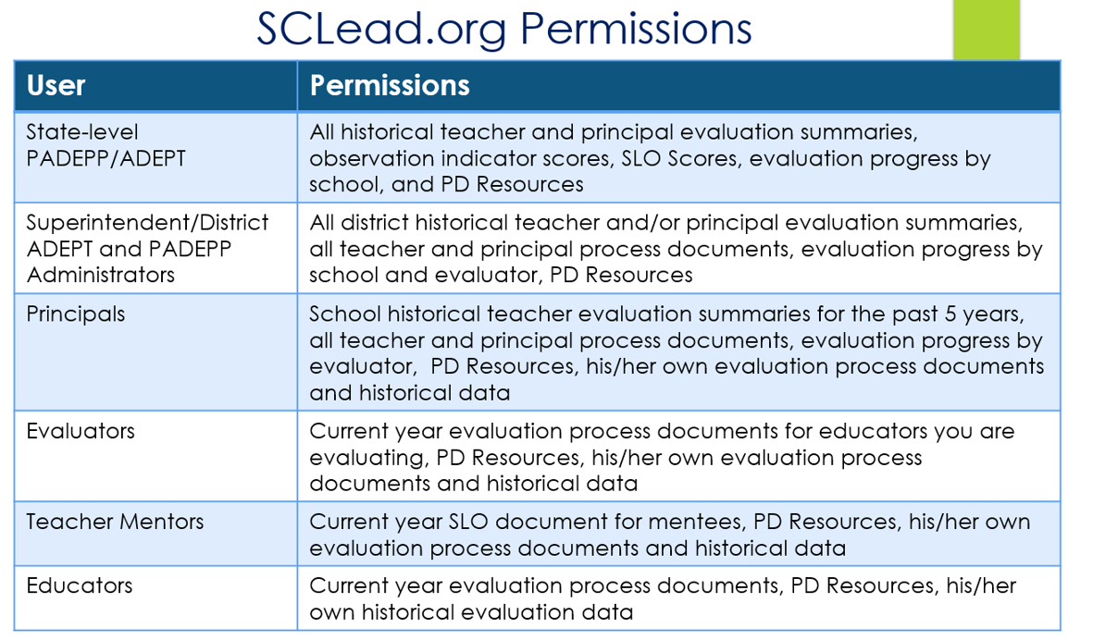
The Who: Your Team and SCLead Permissions
Notes:
LILLA: Now let’s take a moment and discuss The Who – Who is involved in the ADEPT evaluation process? As we go through the specific steps in ADEPT evaluations and SCLead today, keep in mind that teacher evaluations are a team effort. Depending on the structure of your district-level team, some of these roles may be played by the same person. SCLead does show different options depending on the permissions listed here.

Slide 13
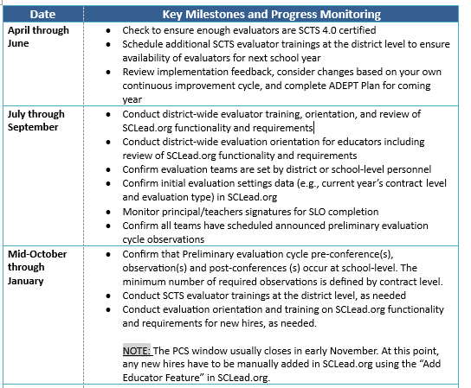
The When: ADEPT Calendar of Events and Due Dates
Notes:
LILLA: Take time to look through the calendar handout that Julie sent. Although we know that timelines this year will need to be more flexible than ever, this calendar does give you an idea of the key milestones and monitoring steps you will take as you guide the ADEPT process this year. Before we move on, are there any questions about anything on this document?

Slide 14
Special Areas Evaluation Revision Timeline
Stakeholder Feedback & Needs Assessment
Job-specific stakeholders
Advisory group
Draft and Revise Guidelines
Advisory Group
State Board
Roll Out & Training
HR leaders
Implementation
HR leaders
Job-specific stakeholders
Feedback 2. Drafting 3. State Board Information Spring 2020
Approval: March 2021 Summer-Winter 2019 State Board Approval Spring 2021
Winter-Fall 2019
1
2
3
4
5
4. Training 5. Implementation
Summer 2020 Pilot 2020-21
Summer 2021 Full 2021-22
Notes:
LILLA: Finally, Our office started in Winter of 2018-19 with gathering survey feedback from counselors, librarians, speech language professionals, evaluators, principals, and districts. From there we reached out specifically to advocacy groups, HR leaders and a series of advisory groups. This past winter we drafted those guidelines and sought additional feedback. We presented to the State Board of Education this spring and will open up the option for districts to pilot the instrument in 2020-21. Districts indicated their intent to pilot in their annual ADEPT plans due July 1.Make sure that even if you aren’t piloting, you have contacted Beverly Flythe with who the ADEPT for Special Areas manager will be. Full implementation of the evaluation instrument will happen statewide in 2021-22.

Slide 15

Question Slide Holder 1
Questions?

Slide 16
SCLead.org Walkthrough
Overview
Evaluation Records/Teams/Orientations
Evaluation Workflow
End of the Year Reminders

Slide 17
SCLead.org Walkthrough
Overview

Slide 18
SCLead.org Data Sources
From PCS To SCLead.org | From CPS To SCLead.org
Teacher’s NAME | Teacher’s Education
Teacher Employment/Location | Teacher’s Training
Teacher’s Position Code | Teacher’s Experience
Teacher’s School Assignment | Teacher Certification AREA(s) and Teaching Certificate Number (CID)
Changes above MUST be made in PCS | Teacher’s Social Security Number (record matching)
From NIET To SCLead.org | Mentor Trainers to SCLead.org
SCTS 4.0 Evaluator Credential | Mentor Credential
Notes:
So the last slide refers to the data districts enter in SCLead.org. So what data is already in the system?
This graphic displays data sources automatically imported in SCLead.org. SCLead.org gets automatic updates from PCS which loads staffing assignments, CPS which loads experience and certification areas, and NIET which sends SCTS evaluator credentials. After you conduct a local mentor training, the district is responsible for updating the list with new mentors in SCLead.org and sending a copy of that list to CERRA. You’ll hear a little more late on updating mentor credentials. This slide should be saved somewhere as a reference because it also tells you who to call if you have a question.

Slide 19
ADEPT Required Reporting in SCLead.org
Induction, Annual (Summative and Diagnostic),
Continuing Comprehensive (Formative) and Continuing Summative
  Indicator/Consensus scores; SLO Overall Score; Next Year's Recommendations
Continuing GBE
SLO Overall Score; Overall Met/Not Met; Next Year's Recommendations
LOA
  Required reporting for alternative route candidates (PACE, TFA, ABCTE)
  Recommended for employed less than 152 days: SLO Overall Score, Overall Met/Not Met; Next Year's Recommendations
Notes:
So what data are you required to report?
For educators on an Induction (Formative) contract, you are required to report 23 Indicator Scores and Consensus Post-conference form, if using the Consensus scoring model; the SLO Overall Score; and Next Year's contract Recommendation.
For educators on an Annual Summative or Annual Diagnostic contract, you are required to report 23 Indicator Scores and Consensus Post-conference form, if using the Consensus scoring model; SLO Overall Score; and Next Year's contract Recommendation.
For educators on a Continuing Comprehensive (Formative) or Continuing Summative contract, you are required to report 23 Indicator Scores and Consensus Post-conference form, if using the Consensus scoring model; SLO Overall Score; and Next Year's contract Recommendation.
For educators on an Continuing GBE contracts, you are required to report Met/Not Met; SLO Overall Score; and Next Year's contract Recommendation.
Districts are only required to report data for alternative route teacher (PACE, Teach for America, ABCTE) placed on an LOA. These teachers would be on an LOA if they are in the Winter cohort and won’t be certified until the middle of the year. For these teachers you are required to report Met/Not Met; SLO Overall Score; and Next Year's contract Recommendation. For teachers placed on an LOA because they are employed less than 152 days, the district makes the decision to report data on these educators. We recommend it, but it is not required.

Slide 20
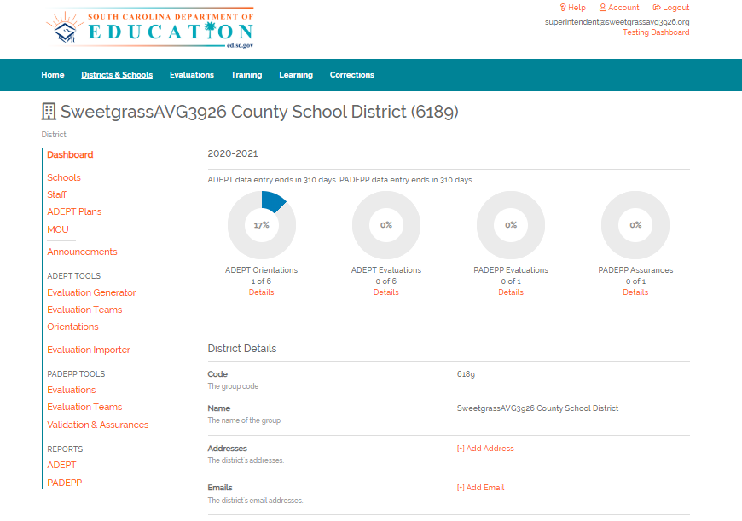
Orientation to SCLead.org

Slide 21
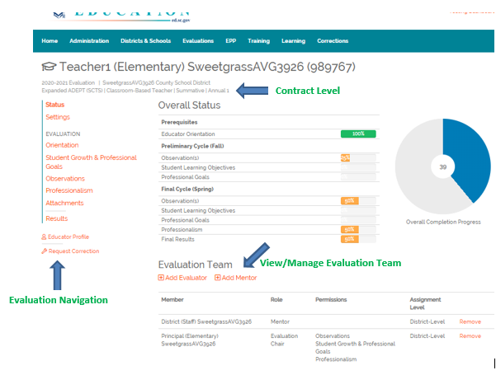
Orientation to Overall Status Page
Notes:
So now that we have a sense of where data comes from and what is required in the system, let’s get acclimated to the Overall Status page. This page only references the current evaluation and provides the educator’s name, CID, and the contract level assigned. The left-hand menu in orange provides access to the settings page and the list of required forms under the Evaluation Navigation section. The Educator Profile page link at the bottom, gives you additional detail on the educator’s certification area, experience and evaluation history. In the center is an at-a-glance of the forms included under the Evaluation Navigation in orange. The bars will advance to 100% based on the completion of required forms and suggested signatures. So if you see a bar at 33%, you’re likely missing forms and signatures. If you see a bar at 90%, you’re likely missing a signature or two. The big donut will populate as the bars advance and your display your overall progress in completing everything required. At the bottom of the page, you will be able to view and manage the evaluation team. Remember, that if the district set the team, only the district or Superintendent can change the team. If school set the team, the school or district or superintendent can change the team.

Slide 22
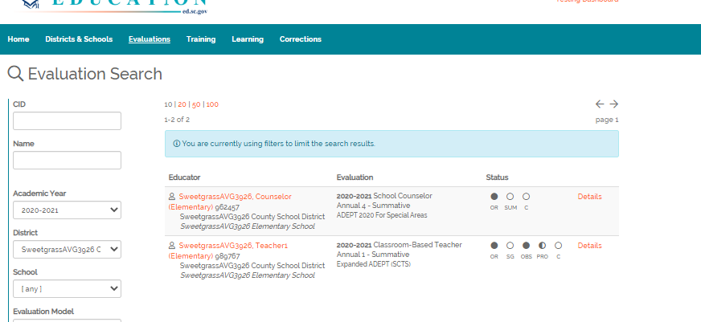
Keep your eye on ….
School Dashboards (completion progress)
Progress of Summative Evaluations (completion progress)
  Status Bubbles (Evaluations page); Status Bars (Overall Status page)
Blank Bubbles

Slide 23
Question 1:
Principals and school-level ADEPT administrators have access to how many years of historical evaluation data for educators assigned to their school.
Only the current year’s evaluation data
The current year plus last year’s evaluation data
The last five years’ of evaluation data
All evaluation data, regardless of where they were employed
Answer: C

Slide 24
Question 2:
Select the option below that includes the
evaluation data required to be reported to SCDE at the end of the year.
SLO score and Overall effectiveness rating
SLO score, Overall effectiveness, Next year contract level, and next year hiring status
SLO score, Overall effectiveness, Next year contract level, next year hiring status, indicator level scores
Indicator level scores only
Answer: C

Slide 25
SCLead.org Walkthrough
Beginning of the Year:
Evaluation Records/Teams/ Orientations
Notes:
Faye: Thanks so much Dr. Hartwell!
In this section we will go over some tips, prerequisites and overviews of steps around how to set-up Evaluation Records, Evaluation Teams & Orientations. We won’t go into all the detailed steps but please join me in the afternoon session in the Congaree Room if that’s something you need assistance with.

Slide 26
Pre-requisite for Setting-up Evaluation
Clean-up Staff List
Create Evaluations
Create Evaluation Teams
Create Orientations
Do you have…
Educator(s) no longer with your district
Administrator(s) no longer with your district
Newly hired educator(s)
Newly hired administrator(s)
Educator(s) or administrator(s) who moved positions or schools in your district
f) All of the above.
Pick One or more letters as they apply to your district.
Notes:
Faye: The first "Pro-Tip" I highly suggest before diving into the actual creation of your evaluations is to do a "Clean-up" of your staff lists.
First, please respond in the chat which letter or letters apply to your district.
Do you have…
Educator(s) no longer with your district
Administrator(s) no longer with your district
Newly hired educator(s)
Newly hired administrator(s)
Educator(s) or administrator(s) who moved positions or schools in your district
d) All of the above.
Pick One or more letters as they apply to your district.
Thank you for your responses!
Each of these responses are reasons why you need to clean-up staff lists in SCLead.org. PCS may not be live yet and thus may have not updated your staff lists in SCLead.org.
The benefits of doing a clean-up are:
You avoid accidentally creating evaluation records for educators no longer at your school or district.
Your educators/administrators will show at the correct location.
You can ensure that a former SCLead.org ADEPT Administrator no longer has access to evaluation records.
You can grant ADEPT Administrator Rights to newly hired administrators so they can start utilizing SCLead.org.

Slide 27
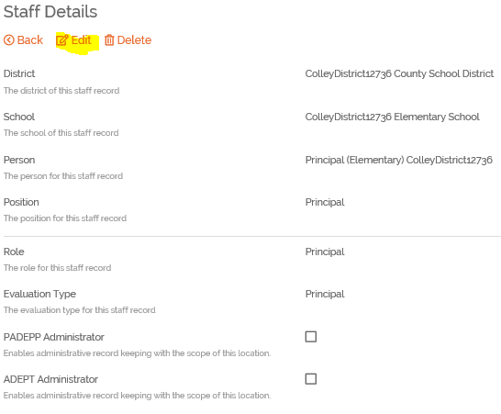
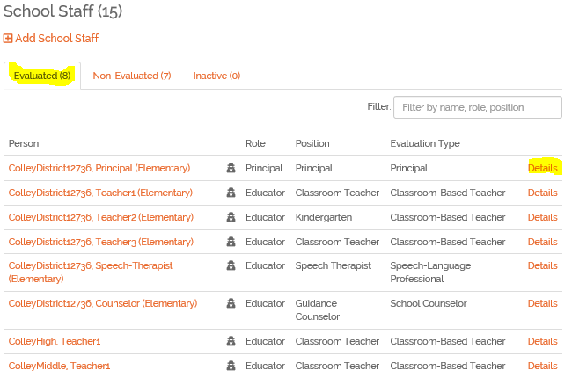
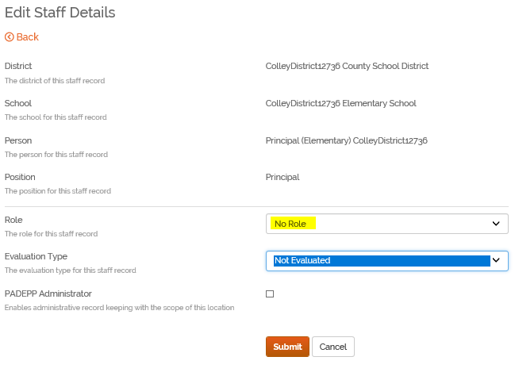
SCLead.org Staff Lists, Staff Details & Removing ADEPT Administrator Rights
Notes:
Faye: To go about "cleaning-up" your staff lists, you can manually add and remove educators/administrators.
Let’s get familiar with the staff lists in SCLead.org. At the district or school level, you will see an Evaluated Tab and Non-evaluated tab as shown on the left. You will see a list of educators pulled from PCS and their corresponding roles and positions as well as evaluation types. On the right-most column you will see details.
To remove a staff member who no longer has a teaching position, no longer at your district/school and to remove ADEPT Administrator Rights:
Go to the district or school staff list, locate the educator, click "details" then click edit on the new page that appears, that’s shown on the upper right screenshot, Edit the Role as No Role and Evaluation Type as not-evaluated.
Note that No Role automatically removes the Administrator Rights as shown on the lower right screenshot.

Slide 28
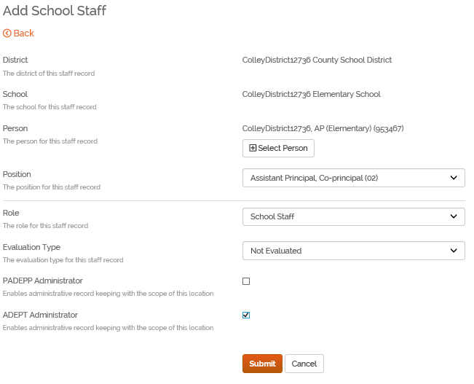
Clean-up Staff List
Adding New Staff and
Add ADEPT Administrator Rights
Steps:
Go to school staff list
Click “Add School Staff"
Select the person with correct CID
Select correct position code
Enter appropriate role and evaluation type
Click “Submit"
Notes:
Faye: Now, you see the steps for Adding staff. We have a video resource for you to use so I will not go over these steps with screenshots.
I want to share this tip instead:
When adding an Assistant Principal that you want to use as ADEPT Administrator the role should be School Staff.
You can only add ADEPT administrator rights if the role you selected is either “Principal” or “School Staff”, then you can check the ADEPT administrator box.

Slide 29
Creating Evaluations in SCLead.org
Raise your hand if you are aware of these resources
Yearly Evaluation Results Detail (District, ADEPT) Report
SCDE Contract and Evaluations Flow-chart
District ADEPT Staff Certification Renewal Report
Clean-up Staff List
Create Evaluations
Create Evaluation Teams
Create Orientations
Notes:
Faye: Here’s another tip, after "cleaning-up" the staff lists, review evaluated staff lists and make sure only those who need evaluations are listed there.
Now, before we talk about how to Create Evaluations, please Raise your hand if you are aware of these resources
Yearly Evaluation Results Detail (District, ADEPT) Report
SCDE Contract and Evaluations Flow-chart
District ADEPT Staff Certification Renewal Report
Thanks for your responses! You may put your hand down now.
We want you to be aware of these resources since we highly suggest using these as safeguard to set-up evaluations correctly.
Here are benefits of looking into these:
The 2019-20 Yearly Evaluation Results Detail (District, ADEPT) Report shows 2019-20 Recommendations for Next Year and will make you aware of the reported contracts for 2019-20.
Reviewing the SCDE Contract and Evaluations Flow-chart will ensure that you are making legal choices for your educators on the progression of their contract levels and evaluations.
Reviewing the District ADEPT Staff Certification Renewal Report will tell you classroom-based teachers who are on their recertification year and who need to be on Continuing Formative Evaluation.

Slide 30
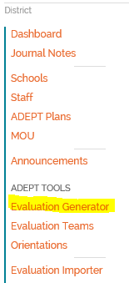
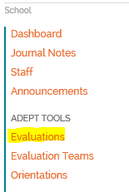
Create Evaluations in Bulk
Steps:
Go to Evaluation Generator
Double-check AY 2020-2021
Click School(s) creating evaluations for/Highlight if multiple schools
Click "Next"
Select Educators
Click "Submit"
Notes:
Faye: After you’ve done our suggested clean-up tips and review of resources, use the Bulk Tools for Creating Evaluations. Based on your evaluated staff-list, the Bulk Tool will generate the list of educators that have the role educator and SCLead.org expects them to have evaluation records created.
The steps for creating evaluations are on the slide. We have a video resource for you to use so I will not go over each step with screenshots but instead go over a few tips.
Creating Evaluations in Bulk can be done at the District Level or School Level. You can find the tool under your district/school dashboard’s left vertical menu. If you are instructing your schools to create evaluations, note that the district level evaluation tool is labeled “Evaluation Generator” while school level evaluation bulk tool is labeled “Evaluations” as shown on the screen. Please communicate to your school administrators the right bulk tool to use.
Make sure to scan the list of educators the bulk tool populates, rather than simply selecting all educators, to avoid creating evaluation records in error and having to delete them later.
When using this tool, if educators are not required ADEPT Evaluations and should not appear on the bulk list, then do not select them to have an evaluation created. Proceed with the rest of the steps for creating evaluations.
To remove educators from bulk list, go to evaluated staff list, then change their roles to either school staff or no role and evaluation type “Not Evaluated” as appropriate.

Slide 31
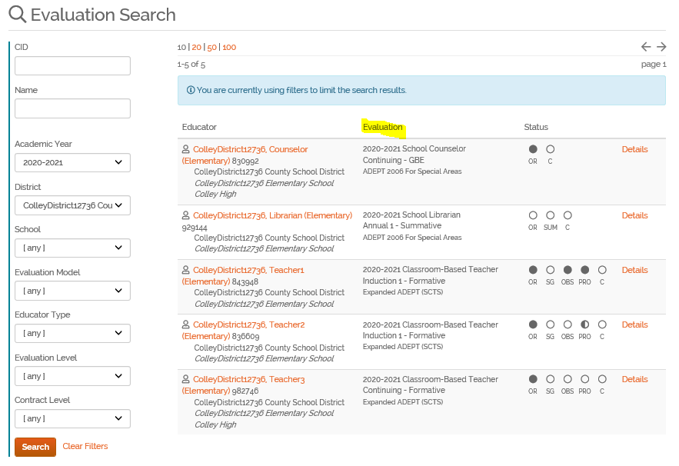
Reviewing Evaluation Records
Using Evaluations Search Tab
Steps:
Go to Evaluations Tab
Filter AY 2020-2021
Click School(s) creating evaluations for/Highlight if multiple schools
Click "Next"
Select Educators
Click "Submit"
Notes:
Faye: Here’s another tip, after creating evaluation records, it is good to look at the Evaluations Tab to check if you created evaluations correctly.
Make sure that the "Evaluation" Column has three rows
First Row - Academic Year and Evaluation Type
Second Row - Evaluation Contract Level and Evaluation Level
Third Row - Evaluation Model
While on this page, you may want to check the "Educator Column" and make sure there is a
Homeschool assigned to the educator
The district name and school should appear below the educator's name
If you are interested to know other ways to check your evaluation records are correctly set-up, please join my afternoon session.

Slide 32
Pre-requisites for Creating
Evaluation Teams in SCLead.org
At this point in the year, which of these have you already completed for your district?
a) Review of Staff Credentials Report
b) Ensuring all your certified Mentors and
Evaluators are listed in the Staff Credentials
Report
c) Reviewing the ADEPT Guidelines for number
of required evaluators and/or mentors by
contract level and evaluation
d) Creating a list of evaluation team assignments
Clean-up Staff List
Create Evaluations
Create Evaluation Teams
Create Orientations
Notes:
Faye: Now let’s look at pre-requisites to ensure you are able to create your evaluation teams easily. In the chat, select which letter or letters are things you have already done?
a) Review of Staff Credentials Report
b) Ensuring all your certified Mentors and
Evaluators are listed in the Staff Credentials
Report
c) Reviewing the ADEPT Guidelines for number
of required evaluators and/or mentors by
contract level and evaluation
d) Creating a list of evaluation team assignments
Thank you for your responses! If you have done any of these, you are on the right track to creating evaluation teams in SCLead.org much easier. If you haven’t done so, please consider working on them.
Some quick tips when reviewing the ADEPT Staff Credentials Report, Teacher Evaluator refers to those evaluators with certified SCTS 4.0 Evaluator Credentials. Don’t be alarmed if an evaluator/mentor appears multiple times on the report. They will appear for every credential they have and for every location they are at.
If you already reviewed your Staff Credentials report and are missing evaluators or mentors on your list, please join me in the afternoon session to assist you in adding them in SCLead.org

Slide 33
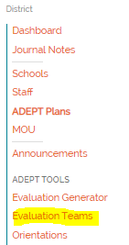
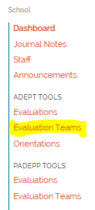
Create
Evaluation Teams in Bulk
Steps:
Go to Evaluation Teams
Double-check AY 2020-2021
Click School(s) creating evaluation teams for
Select the contract levels
Click "Next"
Select Educators
Click "Select Evaluations"
Select Evaluators/Mentors
Confirm Evaluation Team
Notes:
Faye: After doing our suggested pre-requisites, use the Bulk Tool to create Evaluation Teams in SCLead.org. The steps for using this tool are on the slide. We have a video resource for you to use so I will not go over each step with screenshots.
However, here are a few things to note:
Creating Evaluation Teams in Bulk can also be done at the District Level or School Level. You can find the tool under your district/school dashboard’s left vertical menu. The left vertical menu is generally sequenced chronologically from top to bottom on which steps to take. Note that you cannot create Evaluation Teams if you haven’t created evaluations first.
Also note that it is OK not to assign all members of the team at once when creating the Evaluation Team, however, you must remember to add the missing evaluation team members individually later on.
Lastly, please note that an Evaluation Team Member added by the district level ADEPT Administrator in SCLead.org cannot be removed by a school level District ADEPT Administrator in SCLead.org. Districts must consider such rule when deciding to enter the evaluation teams at district level or deciding to allow school level ADEPT Administrators to create evaluation teams.

Slide 34
Setting-up Orientations in SCLead.org
Do you have the following?
District ADEPT Plan Evaluation Timeline
The actual dates the orientations take place for different schools/contract levels
Clean-up Staff List
Create Evaluations
Create Evaluation Teams
Create Orientations
Notes:
Faye: In the chat box, respond Yes or No if you have the following:
District ADEPT Plan Evaluation Timeline
The actual dates the orientations take place for different schools/contract levels
Thanks for your responses!
It is beneficial to have these information before creating orientations.
If you haven’t submitted your ADEPT Plan, please do so, so that it can go through the approval process and you can share your timeline with your educators.
As a reminder, for transparency, please enter in SCLead.org the actual dates orientations were held.

Slide 35
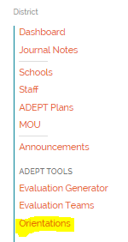
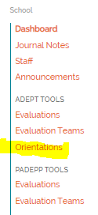
Create Orientations in Bulk
Steps:
Go to Orientations
Double-check AY 2020-2021
Click School(s) creating orientations for
Select the contract levels
Click "Search"
Select Educators
Select (enter) the Orientation Date
Click "Submit"
Notes:
Faye: To easily create Orientations use the Bulk Tool. The steps for using this tool are on the slide. We have a video resource for you to use so I will not go over each step with screenshots. However, here are some things to remember:
Remember that you can use the Orientations Bulk Tool before the Evaluation Teams Bulk Tool, as long as you have created Evaluation Records.
Remember that orientations are required and are differentiated based on contract and evaluation levels. If someone missed a scheduled orientation or the date you planned to hold it changed, the orientation date can be edited as long as the educator has not signed it. If dates need to be changed after an educator has signed, the educator needs to remove his/her signature then sign again after date has been changed.
Remember that educators cannot sign an orientation in the system if they have not been created. Please create the orientations before instructing them to sign. It will prevent teachers from being frustrated with the use of SCLead.org.
Lastly, remember that all the bulk tools were created to help you easily start the documentation of ADEPT Evaluations in SCLead.org. In fact, these bulk tools were highly requested by districts. We hope that you will be able to utilize them.

Slide 36
SCLead.org Scenarios
Which of these are your concerns?
I already created evaluation teams, but several evaluators are no longer in our district.
b) I already created evaluation teams, but my evaluators have the wrong role or permissions.
c) I already created evaluation records, but my district has decided not to participate in the Special Areas pilot.
d) I have several administrators, evaluators and educators that don’t know how to use SCLead.org.
Notes:
Faye: We’ve wrapped-up pre-requisites, tips, notes and reminders around using Bulk Tools. Now let’s see which other topics we should cover.
In the chat box, type in the letter or letters that apply to you.
a)I already created evaluation teams, but several evaluators are no longer in our district.
b) I already created evaluation teams, but my evaluators have the wrong role or permissions.
c) I already created evaluation records, but my district has decided not to participate in the Special Areas pilot.
d) I have several administrators, evaluators and educators that don’t know how to use SCLead.org.
Thank you for your responses!
I will address topics that you indicated are your concerns and skip ones that are not helpful to you at this time.

Slide 37
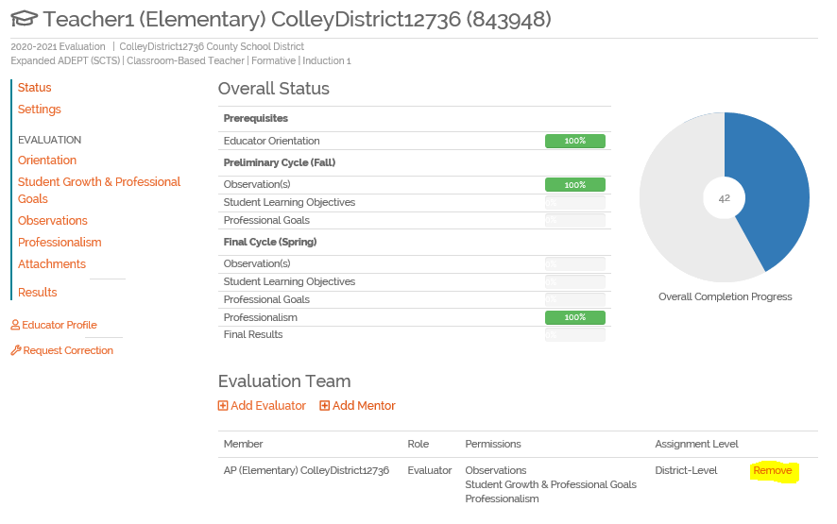
Removing Evaluation Team Members
I already created evaluation teams, but several evaluators are no longer in our district.
Steps:
Use Evaluations Search to locate the educator’s evaluation record whose evaluation team member has to be removed
Click “Details” to take you to the evaluation record
On the Overall Status Page, locate the team member you need to remove and click “Remove”
Notes:
Faye: Here are quick steps to remove evaluation team members you added incorrectly to a team or if sometime within the academic year they are no longer part of the evaluation team.
Note that removing a team member will not result in data they entered to be lost.

Slide 38
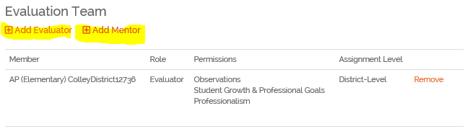
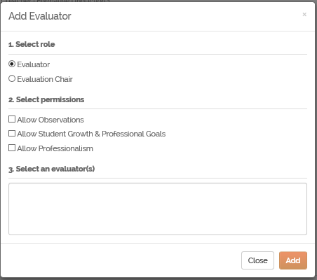
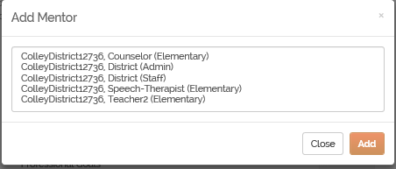
Changing Evaluation Team Member
Permissions or Roles
Steps:
Inside the educator’s Evaluation Status Page, do the Steps for Removing Evaluation Team
Click “Add Evaluator” or “Add Mentor”
When adding an evaluator, select the permissions to grant then select the evaluator from the list that populates, click “Add”
When adding a mentor, select from the list that is generated then click “Add”
Notes:
Faye: Here are quick steps if you need to add or remove permissions. In essence, you remove the evaluation team member first, add the evaluation team member again and then add the correct permissions.
It’s good to note that if you don’t add a Principal to an Evaluation Team, SCLead.org will automatically grant the Principal all three permissions to be able to enter Observations if Principal has evaluator credentials, to approve SLO/GBE and to enter Professionalism scores. If the Principal is added to the team, SCLead.org will limit the permission to what you indicate.

Slide 39
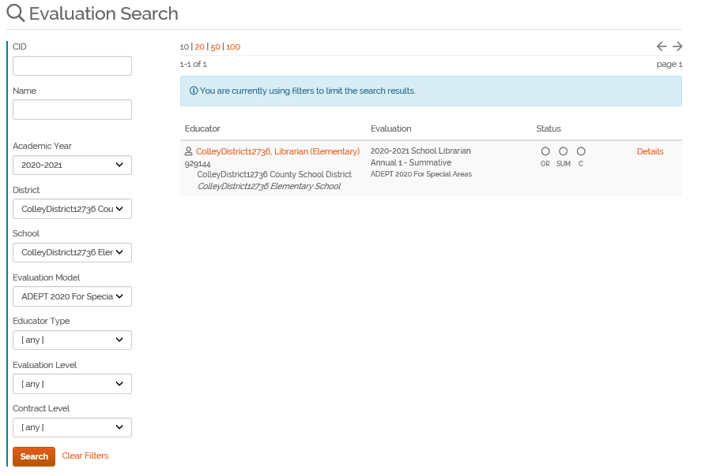
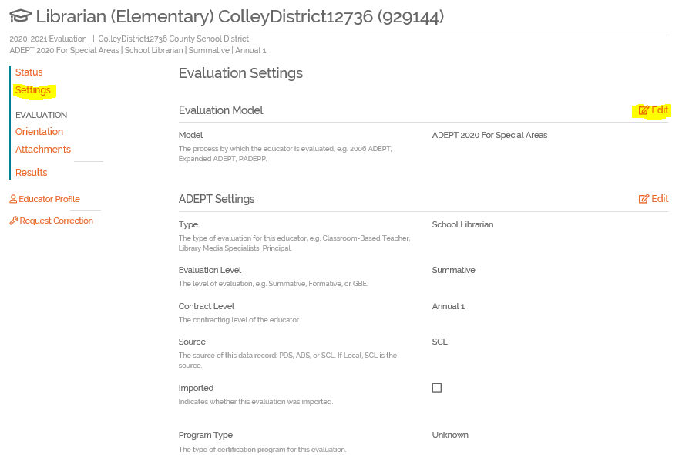
Changing Special Areas Evaluation Settings
Any SCLead.org Administrator at district level or school level can either:
a) Edit the evaluation record settings
b) Remove the evaluation records and create a new one

Slide 40
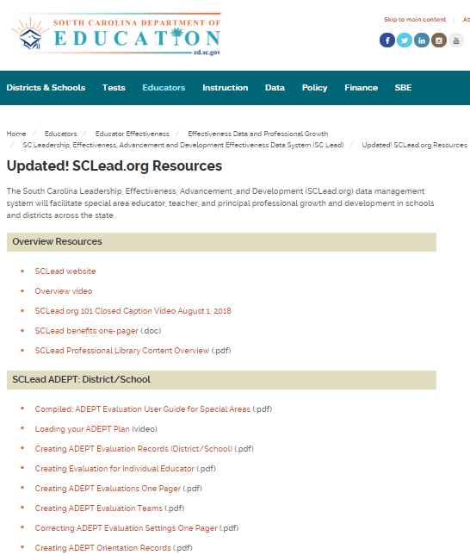
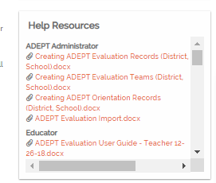
SCLead.org Resources
SCLead.org User Guides on our website and Help Resources inside SCLead.org Home Page
SCLead.org Registration Video
SCLead.org 101 Training Bulk Tools Video
SCLead.org 101 Training Add Staff Video
SCLead.org 101 Training Classroom-based Teacher Evaluator Overview Video
Notes:
Faye: I am wrapping-up this section by sharing resources that would be beneficial in the beginning of the year. This will be emailed by Dr. Hartwell. Please share these with your administrators, evaluators and educators so that they can navigate inside SCLead.org.

Slide 41
Questions?
Questions?

Slide 42
SCLead.org Walkthrough
Evaluation Workflow

Slide 43
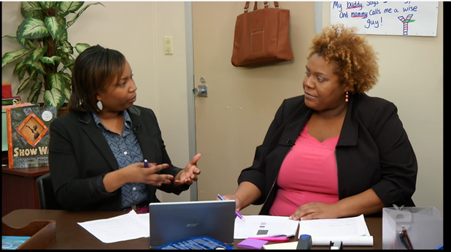
The What: SC Teaching Standards Process
Pre-observation Conference
Observation
Reflection
Post-observation Conference
Notes:
As many of you already are familiar with, here is a reminder of the SC Teaching Standards Process. This flow is typical in the preliminary cycle. We will discuss on later slides how the final cycle will not require the preconference with the teacher. We will also discuss how the flexibility guidelines factor in to the SC Teaching Standards Process.

Slide 44
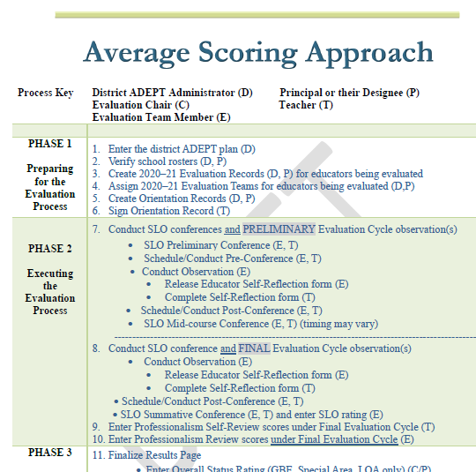
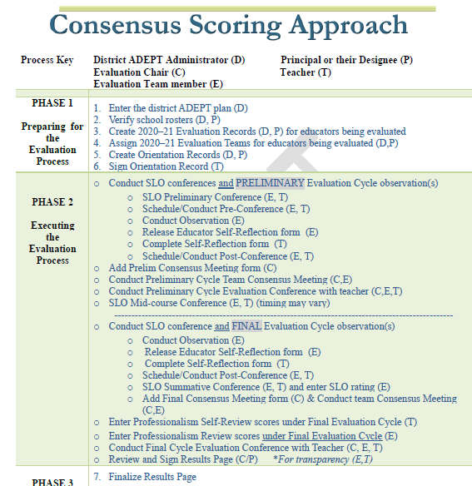
Steps in the Observation Process
Notes:
On the screen you can see the 2 phases for a consensus district and an average district. The process key at the top of each box, identifies who plays what role in the evaluation process. Through these lens, you can clearly see who does what during each phase and can monitor the process to ensure that each phase is handled with fidelity. Take a moment to look at each approach. Put any questions or comments in the chat.

Slide 45
Required Observations
Induction
≥1 – Full Classroom Observation per semester with conferences.
Annual and Continuing Summative
≥2 – Full Classroom Observations per semester, conducted separately by at least two observers (4 observations total)
Annual Diagnostic (Formative)
≥2 – Full Classroom Observations per semester, conducted separately by at least two observers (4 observations total)
Continuing Comprehensive (Continuing Formative, 5th year recertification)
>1 – Full Comprehensive Classroom Observation per semester with conferences.
Continuing GBE (Continuing GBE Years 1-4)
PDGP (SLO + Professional Goal if required)
Preliminary/Fall Cycle -(Announced observations) Final/Spring Cycle - (Unannounced observations)
Notes:
These are our state requirements before our COVID-19 Educator Evaluation Flexibility 2020–21 guidelines were established. The COVID-19 Educator Evaluation Flexibility 2020–21 guidelines give districts the flexibility during the pandemic to meet the needs of their district. The SCDE sets the floor but districts do have the right to go above and beyond and can take educators through our normal evaluation process.
SCLead will be modified to meet the flexibility guidelines and we will discuss them on the next two slides.

Slide 46
COVID-19 Educator Evaluation Flexibility 2020–21
Required Observations
Induction
≥1 – Walkthrough OR Full Classroom Observation (PRELIMINARY CYCLE), ≥1 – Full Classroom Observation (FINAL CYCLE)
Annual and Continuing Summative
≥2 – Full Classroom Observations (PRELIMINARY CYCLE), ≥1- Full Classroom Observation
(FINAL CYCLE) (Min of 3 observations total by 2 observers)
Annual Diagnostic (Formative
≥2 – Full Classroom Observations (PRELIMINARY CYLCE), ≥1- Full Classroom Observation
(FINAL CYCLE) (Min of 3 observations total by 2 observers)
Continuing Comprehensive (Continuing Formative, 5th year recertification)
≥1 – Full Comprehensive Classroom Observation per semester*
(*Districts have the flexibility to waive the final evaluation cycle observation for all teachers regardless of performance in the preliminary cycle.)
Preliminary/Fall Cycle -(Announced observations) Final/Spring Cycle - (Recommend Unannounced observations)
Notes:
Here are the COVID-19 Flexibility Guidelines.

Slide 47
SLOs & GBEs
SLOs & GBEs
COVID-19 Educator Evaluation Flexibility 2020–21
The goal of this Student Learning Objective (SLO) flexibility is to refocus the SLO on its original purpose, to facilitate job-embedded reflection on how students are growing and how teaching practice is connected to that growth.
The SLO functions as the individual professional growth plan for all classroom-based teachers. For 2020–21, all classroom-based teachers are required to complete the simplified SLO that focuses on a teacher-created goal, 1-2 high priority standards, and 1 instructional strategy related to the SCTS 4.0 indicators.
Beginning-of-year and end-of-year conferences with the SLO approver are still required, but the mid-course conference may be folded into existing data team, professional learning community, department, grade-level, or other collaborative meetings.
The SLO rubric has been updated to align with the simplified SLO.
Simplified SLO resources are posted on our SLO Webpage for support (SLO template, Rubric, Quality Review Tool, SLO examples, SLO PPT)
Link to SLO Crosswalk

Slide 48
Track Evaluation Progress
Orientation
Student Growth and Professional Goals (SLOs)
Observations
Notes:
Rodney: You can manage evaluations in SCLead.org by tracking progress on educators' orientation, observations, student growth (SLO) and professional goals.

Slide 49
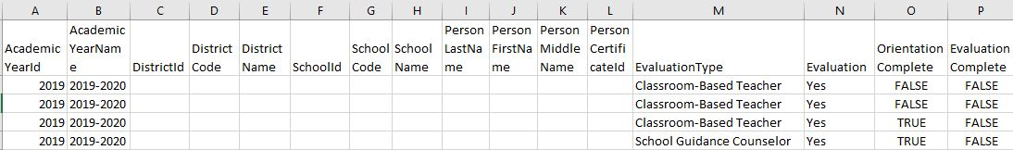
Track Orientation
Staff Evaluation Status (ADEPT) Report
Refer to Column O, "Orientation Complete" if it is false the educator has not signed the orientation, if it is true, they have signed the orientation.
For those that are false, you may want to check that you created orientations for them.
Remember we don't have report that pulls specific orientation dates entered, but again an educator can't sign an orientation if it was not created.
Notes:
Rodney: Use the Staff Evaluation Status (ADEPT) Report to track orientations.
Refer to Column O, "Orientation Complete" if it is false the educator has not signed the orientation, if it is true, they have signed the orientation. For those that are false, you may want to check that you created orientations for them. Remember we don't have report that pulls specific orientation dates entered, but again an educator can't sign an orientation if it was not created.

Slide 50
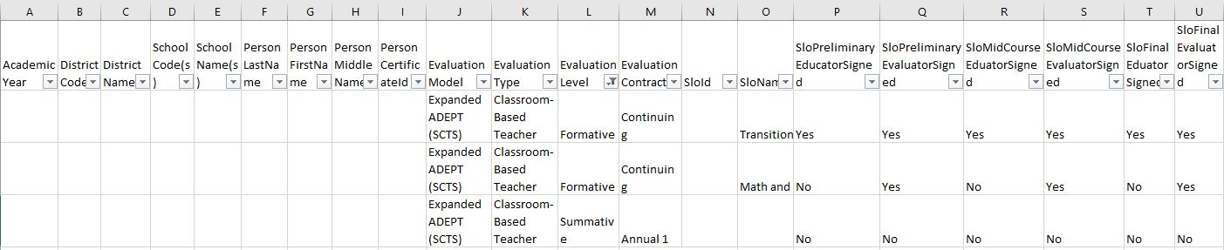
Track SLOs
Evaluation SLOs (ADEPT) Report
Refer to Columns N & O, SLO ID and SLO Nam to note if an SLO was entered in SCLead.org
Refer to Columns P to U, to check if the conferences have taken place as affirmed by both the educator and evaluator with their signatures
To use this report easily, filter Column J "Evaluation Model" to show only Expanded ADEPT (SCTS)
Notes:
Rodney: Use the Evaluation SLOs (ADEPT) Report to track progress on SLOs
Refer to Columns N & O, SLO ID and SLO Nam to note if an SLO was entered in SCLead.org
Refer to Columns P to U, to check if the conferences have taken place as affirmed by both the educator and evaluator with their signatures
To use this report easily, filter Column J "Evaluation Model" to show only Expanded ADEPT (SCTS)
Note that you can only utilize this report to track SLOs if you asked your educators to either enter their SLO completely in the SCLead.org digital SLO form or if you instructed your educaotrs to at least activate the SLO form by entering the purpose and type of the SLO in the SCLead.org digital SLO form.
This report is available at the district and school level.
We still give districts the flexibility to either store SLOs in SCLead.org or not.

Slide 51
Track Observations
Staff Evaluation Observations (ADEPT)
Refer to Columns N-AA for details of the observation
Columns Z and AA are automatically defaulted to No when the observation entered in SCLead.org is not signed by either observer or educator.
When pulling this report, it will pull non-evaluated staff.
Make sure to filter Column P "Evaluation Model" only to show Expanded ADEPT SCTS
Filter Column R "Evaluation Level" and uncheck the GBE, only show/check Summative and Formative
Notes:
Rodney: Use the Staff Evaluation Observations (ADEPT) Report to track Observations. This report is available both at the district and school levels.
Refer to Columns N-AA for details of the observation
Columns Z and AA are automatically defaulted to No when the observation entered in SCLead.org is not signed by either observer or educator.
When pulling this report, it will pull non-evaluated staff.
Make sure to filter Column P "Evaluation Model" only to show Expanded ADEPT SCTS
Filter Column R "Evaluation Level" and uncheck the GBE, only show/check Summative and Formative

Slide 52
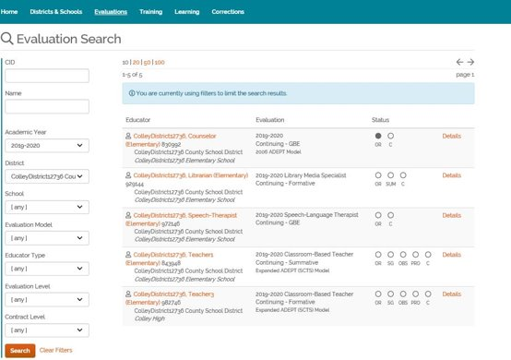
Understanding the "Bubbles" using the Evaluations Tab
Notes:
You will notice the first bubble on the left labeled O for Orientation is darkened if the orientation was signed.
The bubble will remain unfilled if the educator has not signed his/her orientation in SCLead.org.
If the SG bubble is half-filled, something has been entered, and signed by the educator and the evaluator.
The SG bubble will completely fill if all the SLO conferences have been signed by both educator and evaluator or if the Professional Goal Preliminary and Final Review have been signed by both educator and evaluator.
The SG bubble will remain unfilled if the educator and evaluator have not entered anything under this section.
You will notice for those that require observations for their evaluations, the third bubble from the left is labeled OBS for Observation. If it is partially filled/darkened some observations have been entered and completed
If all required observations have been entered and completed for both Preliminary and Final Evaluation cycles, including consensus meetings for those ding consensus, the bubble will be fully filled/darkened.

Slide 53
Manage Evaluations in a Nutshell
Notes for Full Evaluation Cycle
SCDE sets the floor for number of evaluators and observation requirements, districts can go above and beyond
Support teacher growth by utilizing Professional Learning
Utilize reports
Utilize the Evaluation Tab
Setting –up your evaluations in SCLead.org produces the Induction Count for your district
Refer to the SCLead.org Workflow for either Average or Consensus Approach
Notes:
Rodney: Here is managing evaluations in a Nutshell..read slides

Slide 54
Questions? 2
Questions?

Slide 55
Stretch Break: 5 minutes

Slide 56
SCLead.org Walkthrough
End of the Year Reminders

Slide 57

How Does the Year End in SCLead?
Notes:
We know it may seem far away, but it is important to have a working knowledge of how you will handle the year ending processes now.

Slide 58
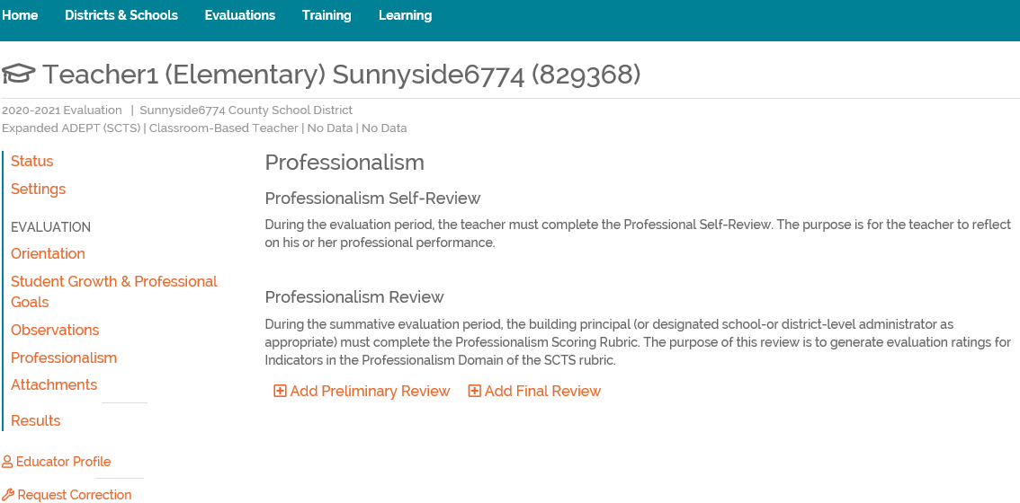
Professionalism Domain in SCLead
Notes:
Of the four SCTS 4.0 Rubric domains, the scoring for the professionalism domain is formatted as a checklist and should be completed by the principal. It is important to know that only the Final Review from the Professionalism Review will be calculated with the educator’s overall composite rating/scores. Most importantly, please ensure your principals do not forget to complete this section of the evaluation as some evaluators do.

Slide 59
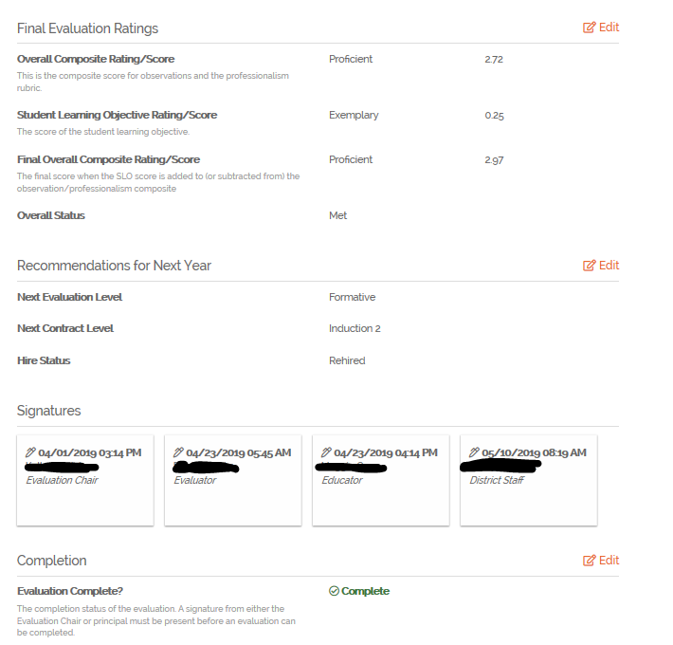
Overall Status, SLO, Recommendations, and Signatures in SCLead
Notes:
All of these actions can be found on the educator’s results page in SCLead. The Overall Status of Met or Not Met comes from the Final Overall Composite Rating/Score using a formula in SCLead. The Overall Composite Rating/Score comes from scoring the (four) 4.0 rubric domains, and using the SLO as a modifier. An SLO score of 4 will increase the score by .25 and an SLO score of 1 will decrease the score by .25. A score of 2 or 3 on the SLO will not affect the Final Overall Composite Rating/Score. The SLO rating of Unsatisfactory, Needs Improvement, Proficient, or Exemplary will have to be selected on the results page instead of the number ratings since some districts are using a different rubric than the state's.
*For recommendations, please select the appropriate evaluation level, contract, and hire status for the upcoming school year. This selection has a dropdown box feature in SCLead.
*Signatures in SCLead need to be present from the principal or evaluator chair before an evaluation can be completed by the district ADEPT administrator.

Slide 60
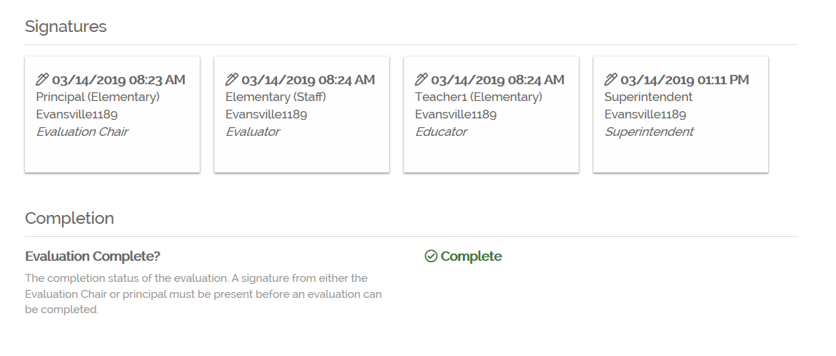
Completing Evaluation Records in SCLead
Notes:
Again, in order for an evaluation to be completed in SCLead the evaluation chair or the principal must add a signature. The ADEPT coordinator needs to check that Recommendations for next year are correct on this page. Once all evaluation data has been properly recorded and all signatures have been applied, and the recommendations for next year are correct, the district staff can complete the evaluation by selecting the “evaluation complete” tab and clicking submit.

Slide 61
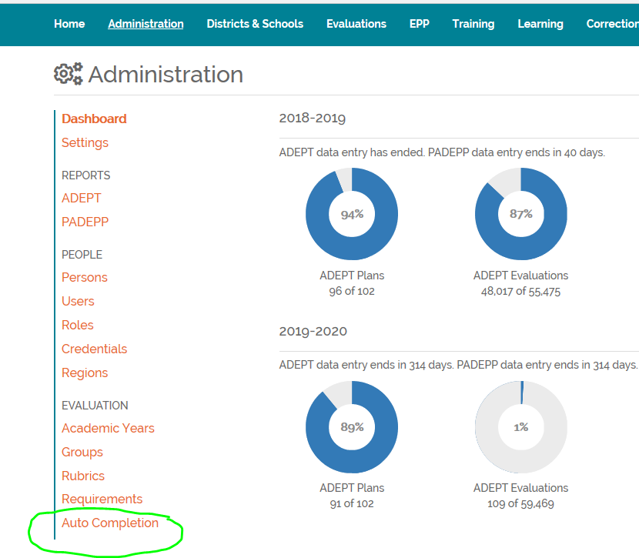
Auto Completion in SCLead.org
Notes:
The Auto Completion process will complete all eligible open evaluations for the current academic year for Classroom-Based Teachers, School Counselors, Librarians, and Speech Language Professionals who are on a GBE evaluation with a Continuing contract. The Overall Statuses and/or Recommendations for the evaluations will be added if they have not already been set, the Overall Statuses will be set to Met and the Recommendations for next year will be set to Rehired with a GBE evaluation level and a Continuing contract level. Classroom-Based Teacher evaluations missing an SLO score will not be updated or closed. The Auto Completion feature is activated by our office and begins on or around May 1, and and will run periodically or weekly until the reporting deadline on June 20, 2021. This feature is strictly for Continuing GBE educators who have SLO scores in SCLead.

Slide 62
Handling Special Cases:
Closing an evaluation record
Notes:
(

Slide 63
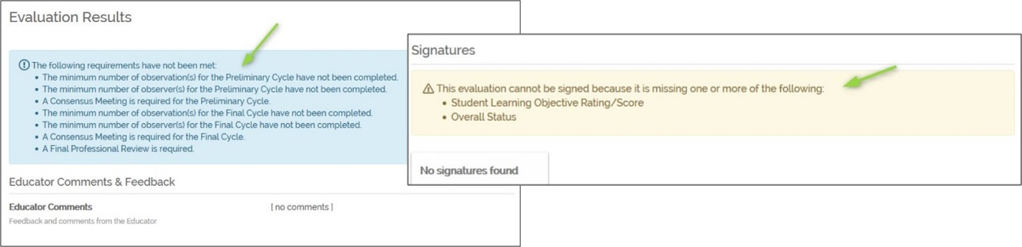
How to Handle Special Cases: Process Errors
Potential reasons you might not be able to “complete” an evaluation in SCLead
  Team did not have minimum number of required observers
  Observer(s) did not complete minimum number of observations
  Consensus meeting(s) did not occur
  A mentor was required, but not assigned
Notes:
Part of completing an evaluation record at the end of the year is knowing how to handle special cases. One case you may encounter is an incomplete record. Records are incomplete if the SCTS process has not been followed or data is missing. The first clue that an evaluation is incomplete is a message which may appear in blue or yellow. The blue messages indicate process missing items and the yellow items needed to complete the results page. An evaluation should be noted as Incomplete if the team did not have the minimum number of required observers, observer(s) did not complete the minimum number of observations, if consensus meeting(s) did not occur, or if a mentor was required but not assigned.

Slide 64
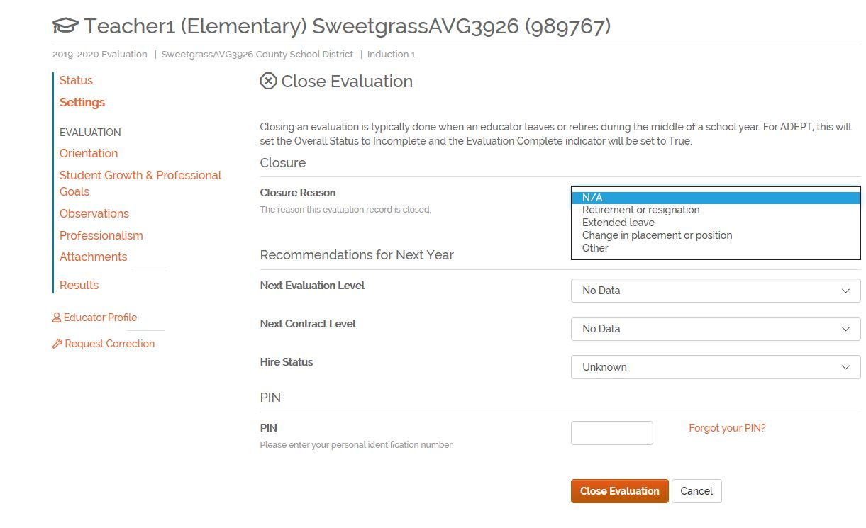
Incomplete Evaluation Record
Evaluations that are “Incomplete” must be closed
Select 2020-21 evaluation record
Click on Evaluation Settings
Select Close Evaluation
Complete all fields
Notes:
So if you have a record that is Incomplete, the ADEPT lead needs to close the evaluation. The evaluation can be closed due to retirement, resignation, extended leave, change in placement/positions or other. To handle an incomplete evaluation, select the 2020-21 evaluation record, click on evaluation settings, select close evaluation, and complete all fields. You will still need to select recommendations for next year even though the record is incomplete and enter your pin to finalize the change. When you look on the results page, Incomplete will be listed as the Overall Status and the record will be unavailable for editing.

Slide 65
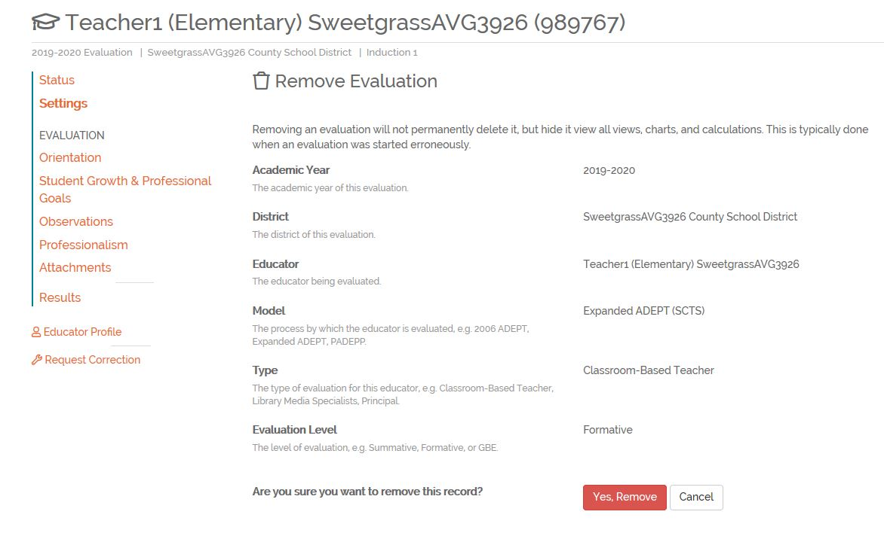
How to Handle Special Cases-Created in Error
Select 2020-21 evaluation record
Click on Evaluation Settings
Select Remove Evaluation
Confirm
Notes:
Another special case you may encounter is handling an evaluation that was created in error. While we suggest that you carefully create evaluations in SCLead.org, you may have several created for educators that are hired but don’t show up or circumstances change before you can being the evaluation process. In this case, you have two options. If they have spent any time in the district at all, it may be cleaner to close the evaluation so that you will have a record of that person being in the district even if only for a short time. If the person never shows up, removing the evaluation may be the best option. To remove an evaluation, select 2020-21 evaluation record, click on evaluation settings, select Remove Evaluation and confirm. The record will no longer be visible under the evaluations tab, but could be recovered by RANDA if needed.

Slide 66
Questions? 3
Questions?

Slide 67
Deep Dive: Contract Levels and Evaluation Types
Notes:
As district ADEPT leads, you have many roles, the evaluation specific ones are – issuing contract levels that match the guidance, on time, orienting educators to their evaluation process, supporting mentoring and induction, reporting evaluation data, correcting evaluation data, overseeing compliant reporting and implementation.
At this time of year, it is typical that we receive questions about the contract types and evaluations that should be offered to educators. Let's take a look at the options.

Slide 68
The What: Expanded ADEPT Process
Contract Level | Observations | Student Growth
Induction (Formative) | >1 – Full Classroom Observation per semester, with conferences | Complete 1 SLO
Annual and Continuing (Summative) | >2 – Full Classroom Observations per semester, with conferences | Complete 1 SLO
Continuing (Formative) Comprehensive 5th year recertification | >1 – Full Classroom Observation per semester, with conferences | Complete 1 SLO
Continuing and Annual (GBE) | Informal | Complete 1 SLO
Notes:
Differentiated: Induction/Annual/Continuing Contract, Our office sets the floor, your district may choose to do more
Observers
Induction: Principal or SCTS certified administrative designee, teacher also has a mentor
Annual: Principal or trained administrative designee AND person with knowledge of teachers content area
Highly Consequential: Three person team
Continuing Contract Comprehensive: Principal or SCTS certified administrative designee

Slide 69
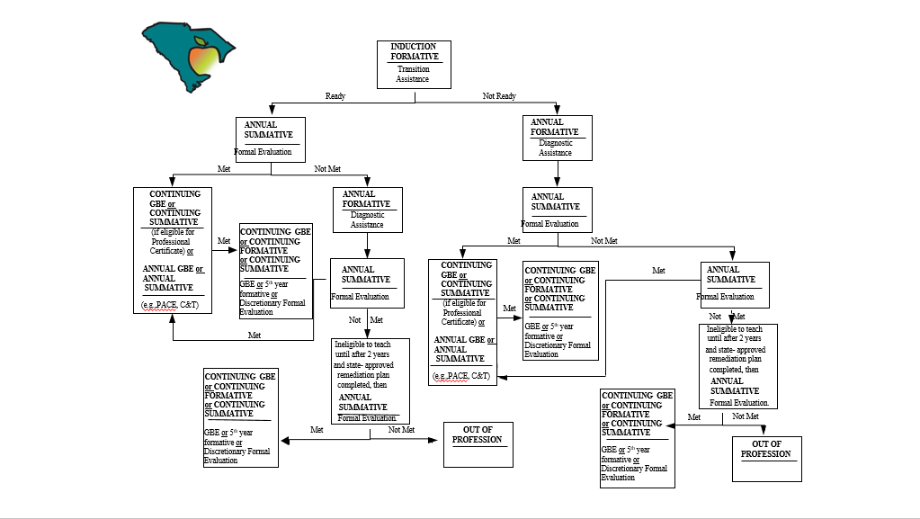
The Who: Teacher Contract Levels
Notes:
The diagram displayed provides a graphic representation of the contract level guidance you received via email. Here, you can see the contract options for educators after they complete each contract year.

Slide 70
Induction
  Formative
  Differentiated Support
    Induction 1 (certified mentor required)
    Induction 2 (mentor suggested)
    Induction 3 (mentor suggested)
    *If a district will have Induction 2 and 3 teachers this must be indicated in the district’s ADEPT plan, which must include a description of how these educators will be supported.
Notes:
The first contract level offered to beginning educators is Induction. Educators on an induction contract are on a initial certificate and should be preparing to advance their certificate. This evaluation is formative. With Induction there is not a GBE or Summative evaluation. There is differentiated support at the induction level.

Slide 71
Induction Count
Induction Count is due February 1, 2021.
•ADEPT funding will be issued to districts based on the number of Induction 1 teachers reported.
•Evaluation records will be reviewed prior to February 1 to determine induction count.
•We will reach out to you via email to verify the accuracy of the numbers reported prior to the deadline.
Notes:
Each year, districts receive ADEPT funding based on the number of Induction 1 teachers being served. Induction count will be determined using information reported in SCLead. All induction 1 contract/evaluation levels should be reported either directly in SCLead or uploaded using the Evaluation Importer. This information must be input prior to February 1st.

Slide 72
Annual
Maximum of 4 years
Types of ADEPT Processes
  Formal evaluation (summative)
  Diagnostic Assistance (formative)
  Goals-Based Evaluation (GBE)
  *An annual contract teacher who has unsuccessfully completed the formal evaluation process for a second time, may not teach in a SC public school district for a period of at least two years and must complete a state-approved remediation plan in the area(s) of identified challenge.
  *After a minimum two-year period and successful completion of the state-approved remediation plan, the teacher is eligible for employment, at the annual contract level, for one additional year in order to attempt successful completion of the formal evaluation.
Notes:
After educators complete an induction year, they are eligible for an Annual contract. The Annual contract level is usually where the evaluation process identifies whether an educator is ready to advance to a professional certificate.
There are 3 processes at this level:
Formal evaluation (summative)
Diagnostic Assistance (formative)
Goals-Based Evaluation (GBE)
An educator can be on an Annual contract for a maximum of 4 years.
Exceptions to 4 year maximum:
If a year is “Incomplete” it can be repeated the following year
Teachers returning on an international contract can have 4 more years at the annual level after completing induction again
Diagnostic Assistance – a teacher who demonstrates potential, but is not quite ready for the formal evaluation process (unsuccessful induction year) OR after the first unsuccessful formal evaluation at the annual contract level; Can only be issued once
GBE – For this level educators will complete a SLO or GBE evaluation if class size is 6 or more

Slide 73
Continuing
Educator must have satisfied all requirements for a professional teaching certificate
Types of ADEPT Processes
  GBE (or SLO)
  Summative (must be notified in writing by contract date)
  Formative (5th year Comprehensive Evaluation)
Notes:
Once an educator successfully completes a summative evaluation at the Annual level and satisfies all requirements for a professional certificate (passing the praxis), he/she is eligible for a Continuing contract.
•Summative –
The written notification must include:
- the reason(s) for recommending formal evaluation,
- the evaluation process, and
- the evaluation timelines
Formative required every 5 years at the continuing level (certificate renewal year).

Slide 74
Letter of Agreement
Teachers who are eligible for a teaching contract but are hired on a date that would result in an employment period of less than 152 days may receive a LOA.
  No standard evaluation process is required
  ADEPT does not apply, but district must assist and “evaluate”, as appropriate
  Provisions of Employment and Dismissal Act do not apply
Notes:
Educators who are not eligible for a contract because they are hired for a period of less than 152 days may be hired on a LOA.
As a district coordinator, you need to ensure that your district has a clear process of what to do with these educators. Because LOA does not fall under ADEPT, reporting of these evaluations is not required; however, alternate certification educators such as those in the PACE program on a LOA will need data reported in SCLead for certification program requirement purposes.

Slide 75
Educator Contract Levels and Evaluation Types
Check for Understanding
Notes:
For this next section we will look at different contract and evaluation scenarios and answer related questions. You will have the opportunity to report out to the whole group your responses to these questions. The answers for these scenarios are found in our state ADEPT regulations # 43-205.1.

Slide 76
What Contract?
Your district is in the process of hiring a teacher with a National Board for Professional Teaching Standards certificate from out of state. She has been teaching for 11 years.
What contract do you offer?
Notes:
Here is what the state says:
State regulations state that teachers who are employed from out of state or from nonpublic schools who are National Board certified are eligible for continuing contract status.

Slide 77
What Contract? Question 1
Your district is in the process of rehiring a teacher on an international teaching certificate. She’s been with the district previously and returned to Spain after completing an Annual 4 contract. She is now back in the United States on a new visa for a period of five years.
What contract do you offer?
Notes:
Educators on an international certificate can only be on an annual contract for a maximum of four years and cannot advance to a professional certificate. Since this educator is returning on a new international certificate after completing the prior 4 years at the annual level, she can start over again at the induction level and will eligible for 4 more years at the induction or annual level with a new contract.

Slide 78
What Evaluation Level?
You have a reading coach who has been with the district for several years. Next year will be his tenth year at the Continuing level, which means he’s up for certificate renewal. He doesn’t have his own classroom, but instead supports teachers in supporting students.
What type of evaluation should this educator receive?
Notes:
Here is what the state says:
This educator is considered a non-classroom based teacher and will only need a GBE evaluation for recertification.

Slide 79
What Contract? Question 2
Your district is hiring a school counselor that will join the district in early October. He has already completed two years as a school counselor in Georgia.
What contract do you offer?
Notes:
Here is what the state says:
This educator is working less than 152 days so he is eligible for a LOA.

Slide 80
What Contract and Evaluation Level?
Your district is hiring a teacher that successfully completed an Annual 1 Summative evaluation in a previous district. The district suggested the teacher receive a Continuing GBE contract next year, but your district has not been able to assess the teacher’s performance.
What contract and evaluation level do you offer?
Notes:
Here is what the state says:
This next contract and evaluation level is up to the accepting/new district. Districts do not have to accept what the former district is suggesting for next contract and evaluation level. There are a few options for the new district with the contract and evaluation level for the educator. The hiring district can offer another Annual contract (summative or GBE) or move the educator to a Continuing contract with a formative, summative, or GBE evaluation.

Slide 81
Questions? 4
Questions?

Slide 82
Administrative Functions: Import, Training, Credentials, Corrections
Notes:
Now let's take a look at some administrative features that are available to you in sclead.org. Specifically, we'll briefly discuss the Import, Training, Credentials, and Corrections features.

Slide 83
Import Records Setup & Reporting
Districts using the import feature in SCLead agree to manage evaluations (fidelity, transparency, scores) outside of this system.
Import Timing
  Option A - import all contract/evaluation levels at the beginning of the school year (first two columns of spreadsheet) and import evaluation completion data/recommendations by June 20 (remainder of spreadsheet)
  Option B – import Induction 1 contract/evaluation levels by January and import all remaining data by June 20 (contract/evaluation levels and completion data/recommendations for all educators)
Notes:
If your district chooses to use sclead.org to manage the evaluation process, all parts of the evaluation process can be reported directly in the system. If your district chooses to use an alternative management system, data will have to be uploaded into SCLead using the Evaluation Importer feature. For districts using the import option, there are two options for ensuring that all data is reported in a timely manner (read options A and B).

Slide 84
Import Reminders
SCLead will not allow past year data to be imported.
Districts using locally-developed evaluation models must take an additional step after import to edit the Overall evaluation status (Met/Not Met) if it is not correctly displayed in SCLead.org. (Evaluation Override feature).
Spreadsheet cannot be altered.
All columns should be completed.
If not providing information for a specific educator, the entire row for the educator should be deleted.
Notes:
Other important reminders about the import feature are as follows: (read slide)

Slide 85
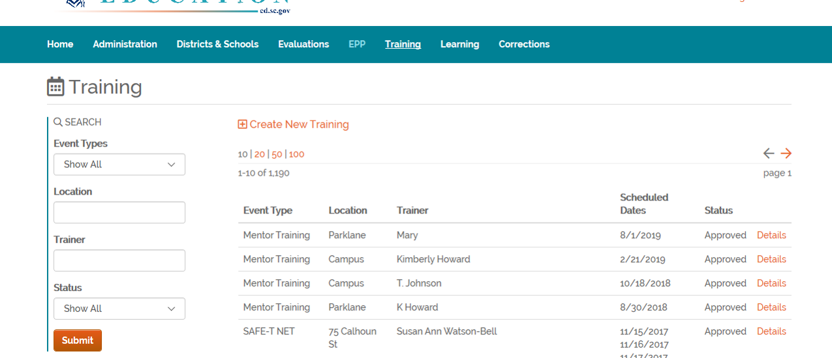
Training
Reasons to use this feature:
1) Help another district
2) Get Mentor Credentials added in SCLead.org
Notes:
We encourage districts to use the Training feature in SCLEad.org.
This resource allows districts to find available trainings
This is also very helpful in making sure your newly-trained mentors get their mentor credential as soon as they complete their training with your district's certified Mentor Trainer.
The mentor credential is the only credential the district can add in SCLead.

Slide 86
Mentor Training
Anyone planning to attend the SC Mentor Training offered by CERRA must receive a registration code from the district's Induction & Mentoring coordinator.
To register for training, potential participants must visit
CERRA Website
Notes:
If a district trainer is not available to provide training, educators looking to become trained mentors should seek training through CERRA (READ SLIDE).
If your district has a new induction & mentoring coordinator – please let your ADEPT contact know.

Slide 87
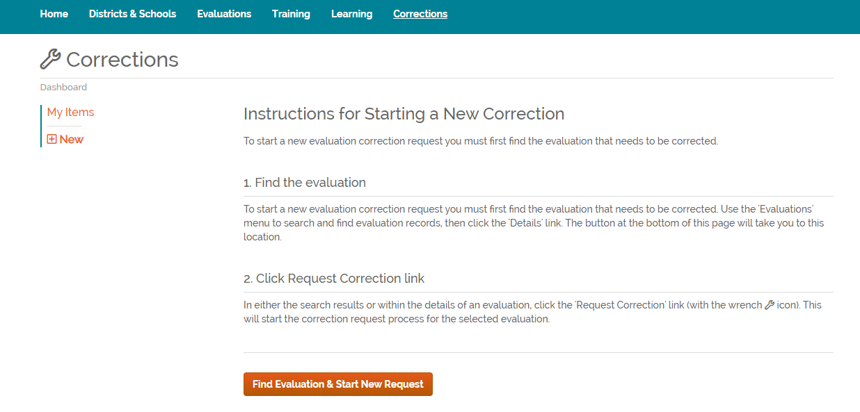
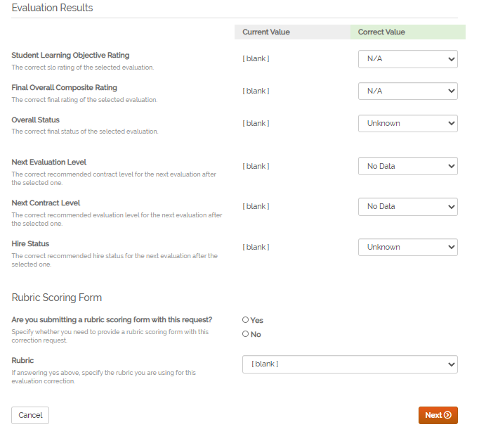
Evaluation Corrections
Notes:
Another available feature is the Corrections function, which allows you to submit a request for an update to an educator's record.
Why enter a Correction Request?
You keyed the wrong settings, results and/or recommendations for next year
An educator is missing settings or recommendations for next year. Shows as "No Data"
If you would like more detailed information about this feature or any of the features I just mentioned, please join us for our afternoon session.

Slide 88
Questions? 5
Questions?

Slide 89
Office of Educator Services: Updates

Slide 90
Office of Educator Services
Mary Hipp | Director
  mhipp@ed.sc.gov | 803-896-0352
Kathy McCoy | Administrative Assistant
  kmccoy@ed.sc.gov | 803-896-0401

Slide 91
Educator Services
Alternative Certification
Alicia Gaither| Team Lead
agaither@ed.sc.gov | 803-896-0384
Angela Faile| PACE Program Coordinator
afaile@ed.sc.gov | 803-896-0384
Kimberly Kelso| Program Coordinator
(all other alternative route programs)
kkelso@ed.sc.gov | 803-896-0384

Slide 92
Educator Services
Alternative Certification
Slide 2
District Contacts
Paula Hayden
Brandon Hoover
Ryan Tavenner
DC Hutchins

Slide 93
Alternative Route Certificates and ADEPT
Slide 2
S.C. Code Ann. § 59-25-30 (Supp. 2018) allows for a maximum of four Alternative Route certificates
  Exception: American Board Statute allows for only three certificates for those participants.

Slide 94
Alternative Route Certificates and ADEPT
Slide 3
Always consider a participant’s number of Alt Route certificates
Ex: a PACE participant must be placed on Annual Summative no later than the third certificate year.
A teacher with Annual 1 Summative = Not Met should move directly to Annual 2 Summative.

Slide 95
Alternative Route Certificates and ADEPT
Consistent with the SBE Regulation 43-205.1 (ADEPT), Alt Route participants must not receive a continuing contract until they have completed all requirements for a Professional certificate.

Slide 96
Alternative Certification Procedures
Must have new Confirmation of Employment (COE) for each participant, each year.
COE must be submitted using the electronic COE link in CPS.
The first Alt Route certificate is issued after receipt of the COE and verification of all required pre-service training for the pathway (e.g., PACE, TFA, etc.).

Slide 97
Alternative Certification Procedures
Slide 2
2020-21 certificates are currently being issued for first year educators who just completed PACE I training in July.
District HR and ADEPT contacts will be copied on annual certification status letters.

Slide 98
Alternative Certification
COVID-19 Flexibility
Temporary Certificate
  Applicants who have completed all admission requirements except required subject area exam
  Applicants with three or more unsuccessful attempts on the required subject area exam are not eligible
  Valid 2020-21 school year only
  Must submit passing score by June 30, 2021

Slide 99
Alternative Certification
COVID-19 Flexibility
Slide 2
Final Year Extension
  Educators who have held the maximum number of conditional certificates per state statute
  Valid 2020-21 school year only
  Must complete remaining requirements by June 30, 2021

Slide 100
Alternative Certification
Important Dates
October 16, 2020
  Confirmation of Employment forms must be submitted by districts for educators attending winter PACE I training.
Winter PACE I training dates:
  November 21, 22; December 5, 6, 12, 13, 27-30
February 1, 2021
  Certificates issued for all educators who successfully complete the winter PACE I training

Slide 101
Questions? 6
Questions?

Slide 102
Educator Services
Sherry Schneider | Team Leader sschneider@ed.sc.gov | 803-896-0384
  Certification
    CPS
  Professional Practices
  CTE
  Recruitment and Retention

Slide 103
Educator Services
Slide 2
Professional Practices
Katie Crews| Education Associate
  Educator Ethics and Professional Practices
  Background clearance for all applicants
  NASDTEC reporting of disciplinary actions

Slide 104
Educator Services
Slide 3
District Contacts
Becca Burg
Elizabeth Cantey
Coleen McLennon-Freeman
Keri Strauss
Sean Osborne | Renewal Coordinator
  (all districts)

Slide 105
Educator Services
Slide 5
Educator Recruitment and Recognition
Carla Edwards| Education Associate
  Cultural exchange programs (international teachers)
  SCDE liaison to J1 sponsors
  Teacher of the Year

Slide 106
International Educators
Distinction between international teachers and International certificate holders.
All International Certificate holders are international teachers—Exchange Visitor teachers on a J-1 visa status.
Not all international teachers hold an International certificate. They can be issued an Initial, Professional, or even an Alternative Route certificate if they hold an H-1B or “green card” or have become US citizens.

Slide 107
International Educators
Slide 2
First year Exchange Visitor Teachers (J-1) are issued an International certificate and must receive a mentor. They follow the same ADEPT sequence as all other teachers, beginning with the district’s formative induction program.
They are eligible for induction or annual contracts during the duration of their visiting program. (If employed for fewer than 152 days, the teacher may be employed on a letter of agreement.)
Teachers on an International certificate cannot advance to a Professional teaching certificate and are NOT eligible for a continuing contract.

Slide 108
International Educators
Slide 3
International teachers authorized to remain in SC after completing their visiting program must apply for an Initial certificate and repeat the ADEPT processes beginning with an induction level contract.
ADEPT results received while teaching under an International certificate cannot be applied toward certificate advancement.
Teachers must successfully complete the same ADEPT processes under a valid Initial teaching certificate to be eligible to advance to a Professional certificate.

Slide 109
Career and Technology Education (CTE) Work-based Certification
Steve Senf
  Career and work-based certification
  ssenf@ed.sc.gov
  803-896-0346

Slide 110
Work-Based, CTE certificates
NEW: All work-based, CTE teachers with an Induction or Pre-Professional certificate requires an annual COE submitted through CPS until they have a Professional certificate.
ADEPT: Previously, an ADEPT Extension Request was required if an educator did not complete the summative evaluation process by the end of the second year. The annual COE in CPS will now cover that request.
.

Slide 111
Work-Based, CTE certificates
Slide 2
Renewal: CTE certificates cannot be renewed until the educator meets annual progress requirements (other than ADEPT) and the district submits the COE. Example: DIRECT, Trade Exams, Coursework
Current COVID Flexibility and Grace: Any
CTE certificate in good standing can be renewed for 2020-21 if the district submits the COE in CPS and if a requirement was not met due to a COVID-19 related delay. This does not include the SCDE trade exams since the testing occurred prior to emergency closures.

Slide 112
District Requests
Provisional Certificate Requests
Initial Extension Requests
Certification Permit Requests
Renewal following one-year extension
Renewal for National Board teachers not re-certifying through NBPTS

Slide 113
District Requests
Slide 2
Certification Portal System (CPS) access
  District users must have SCDE user account and be given access to the application by the Office of Educator Services.
  Must receive training from the Office of Educator Services for level 3 (renewal) users.

Slide 114
Educator Requests
Educators must submit a Request for Change/Action form for the following
  Add-ons and endorsements
  Class changes
  Extensions of Professional certificates ≤ 5 years
  Course and program approvals

Slide 115
Automatic Updates
Professional certificate renewals
Initial to Professional
Annual district teaching experience
2020 -21 Grace Year for Professional and Initial certificates
These updates are processed each summer. A request from the district or educator is not needed.

Slide 116
Certification Permits
Classroom Teaching Fields
  12 semester hours towards the area
  3 semester hours or the exam to renew
Service and Leadership Fields
  12 semester hours and enrolled in an approved program
  6 semester hours to renew*
*COVID provisions apply

Slide 117
Renewals for Permits
Due to closures of Praxis testing centers and changes in college and university schedules, renewal requirements will be waived for educators issued a certification permit for 2019-20.
Districts must request the permit for 2020-21, but educators do not need to submit coursework or Praxis scores for the renewal.

Slide 118
Grace Period - Professional Certificate
On July 1, 2020, the SCDE added a one-year grace period to Professional and Limited Professional certificates for which renewal requirements had not been met or had not been processed by the June 30 expiration date.
This included certificates with an extension for the 2019-20 school year.
The new validity period with the grace year added is July 1, 2020, to June 30, 2021.

Slide 119
Grace Period - Professional Certificate
Slide 2
If an educator has received the grace year but submits all renewal requirements before November 1, 2020, the SCDE will remove the one-year grace period and renew the certificate for the standard five-year validity period
(or four years if the educator held an extension for 2019-20).
For remaining certificates with the one-year grace period, educators must complete necessary requirements to renew the certificate expiring June 30, 2021

Slide 120
Grace Period – Initial Certificates
On July 20, 2020—after the verification of 2019-20 ADEPT results—the SCDE advanced eligible Initial certificates to the Professional level.
The SCDE added a one-year grace period to remaining Initial certificates that expired on June 30, 2020.
Educators will have the one-year grace period to complete remaining requirements, which might include a qualifying score on a pedagogy assessment or successful completion of ADEPT summative evaluation requirements.

Slide 121
New Certification System
The Office of Educator Services will be implementing a new certification system.
Training will be coming soon.
No Go Live date yet

Slide 122
Questions?7
Questions?

Slide 123

Office of Educator Effectiveness and Leadership Development
ADEPT, IHE and PADEPP Liaisons
  Dr. Julie Anna Hartwell, jhartwell@ed.sc.gov
  Faye Colley, fcolley@ed.sc.gov
  Dr. Kimberly Howard, khoward@ed.sc.gov
  Rodney Evans, revans@ed.sc.gov
  Beverly Flythe, bflythe@ed.sc.gov
  Dr. Vicki Traufler, vtraufler@ed.sc.gov
Director
  Lilla Toal-Mandsager, Director, lmandsager@ed.sc.gov

Slide 124
Survey
Please complete the survey.
We want your feedback.

Slide 125
  Afternoon Work Session:
  Congaree Room: Bulk Tools, Roster Questions, Teams, NIET portal
  Presenter, Faye Colley
  Wateree Room: Import and Contracts
  Presenters, Rodney Evans and Dr. Kim Howard
  Hartwell Room: Reports
  Presenter, Dr. Julie Hartwell
  Marion Room: Corrections and Training
  Presenter, Beverly Flythe
  Murray Room: Administrative Questions
  Presenter, Lilla Toal Mandsager

