Slide 1

The Evaluator's Role in the SLO Process
Presented in cooperation with the SCDE Offices of Teacher Evaluation, Office of School Leadership and TAP

Slide 2

Connector
How does supporting the SLO process with teachers benefit a principal?
Take one minute to process independently
Turn and talk to your neighbor to discuss your thoughts
Be prepared to share out with the group

Slide 3
Welcome
and
Introductions

Slide 4
Group Norms
Be present (physically and mentally)
Please use electronic devices responsibly
Ask questions when in doubt
Honor the time schedule
Participate actively

Slide 5
Key Topics
Welcome and Introductions
SLOs and Teacher Evaluation
Supporting teachers in developing and monitoring SLOs
Engaging in Coaching Conversations
Evaluating and scoring SLOs
Next Steps: Districts, Evaluators, Teachers

Slide 6
Overarching Objectives
Develop an understanding of SLOs and their role in the Expanded ADEPT Support and Evaluation System
Become proficient in evaluating SLO components to ensure successful implementation
Identify methods to support teachers in the development and monitoring of SLOs
Identify resources to facilitate the evaluation of SLOs at the school level

Slide 7

SLOs and Teacher Evaluation

Slide 8
Expanded ADEPT
ADEPT (2006) | Expanded ADEPT (2015)
Professional Practice-100% Observation and Artifacts | Professional Practice Student Growth Measure District Choice (optional)
Districts have flexibility to determine composition; however, to satisfy ESEA requirements:
Multiple Measures- no one factor be more than 80%
Student Growth Measures- significant portion- at least 20%

Slide 9
SLOs and Teacher Evaluation
Student growth must be a significant portion of an educator’s evaluation
SLOs are a vehicle for collecting evidence of student growth
Designed for use by teachers in grades and subjects that do not have a state-mandated, ESEA required assessment.
SLOs can be combined with a teacher’s VAM score to yield a student growth score

Slide 10
SLO Implementation Training
District SLO readiness
Teacher Training Resources
SLO TOOLKIT
Evaluator Training
Summer and Fall 2015
Spring 2015
Fall 2014

Slide 11
SLO Resources
SLO Toolkit- http://ed.sc.gov/slo
District Decision Checklist
SLO Guidebook
Notes:
These resources are in Word form so they can be manipulated.

Slide 12

Tic-Tac-Toe GOGO Activity
Directions:
Find the SLO Tic-Tac-Toe sheet in your participant packet.
2. Select a row, column, or
diagonal of questions/tasks to
answer/respond.
3. Use the SLO Guidebook to locate the
responses to the tasks in the boxes.
When you’ve completed your three, get up and visit with others to share and find answers to all the questions on the grid.

Slide 13
The SLO Process and Product

Slide 14
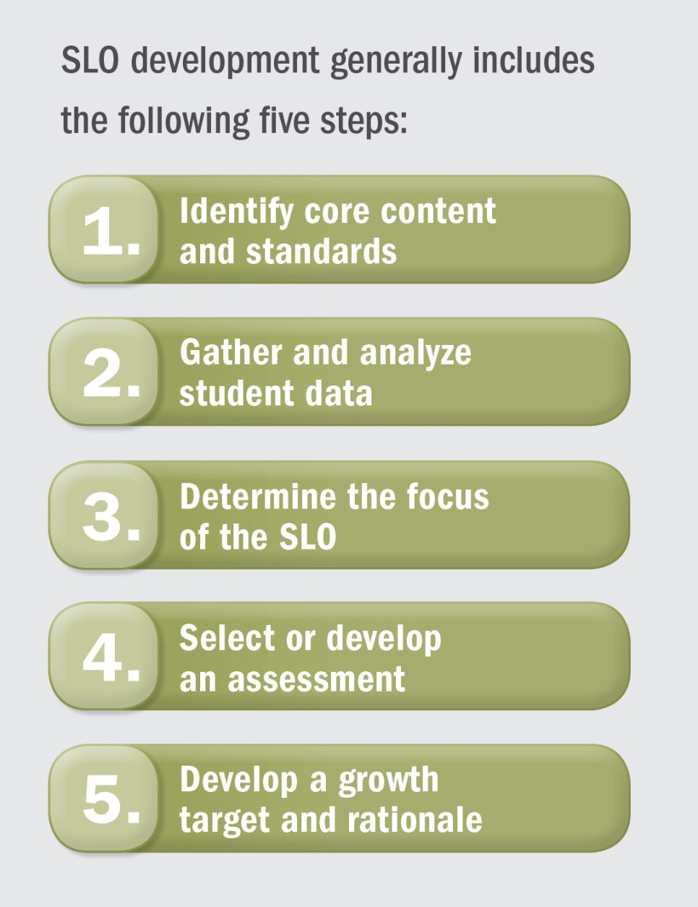
The SLO Process
SLO Development
Mid-Course Conference
Final Review and Score
Preliminary Conference- SLO Approval
Summative Conference and Reflection

Slide 15
Product
The Anatomy of a SLO
Objective- The goal statement. Identifies content; focused enough that it is measurable.
Rationale- Explains how growth targets and student population were determined.
Student Population- Specific population targeted by the SLO; includes information about student learning.
Content/Standards/Interval of Instruction- Specifies time period of instruction, and demonstrates content standard alignment.
Assessment- Describes which assessment(s) and grading procedures will be used and why they are appropriate.
Progress Monitoring- Describes type and frequency of interim assessments to measure student progress.
Baseline and Trend Data- Describes students’ baseline knowledge for learning and patterns in data.
Instructional Strategies- Describes research-based instructional strategies that will be used during interval.
Growth Targets- Describes teacher’s expectations for student growth at end of interval; tiered for all students.
Teacher Professional Growth and Development (and Action Research): SC specific component.

Slide 16
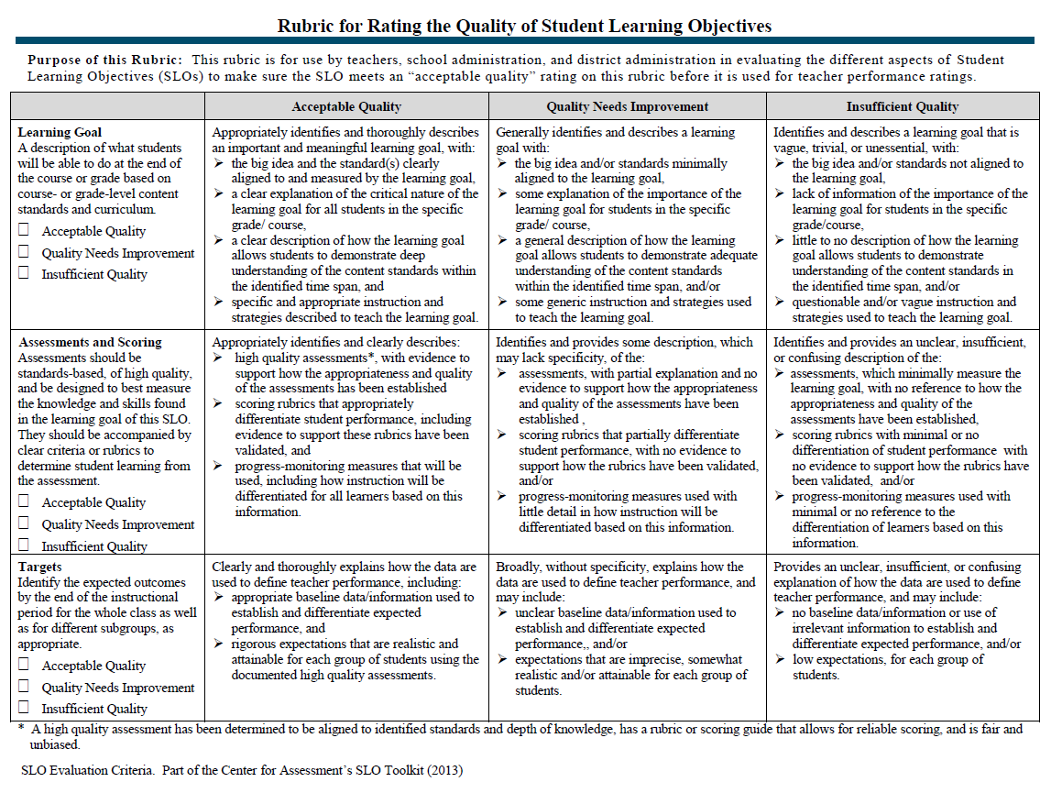
The Quality Review Tool

Slide 17
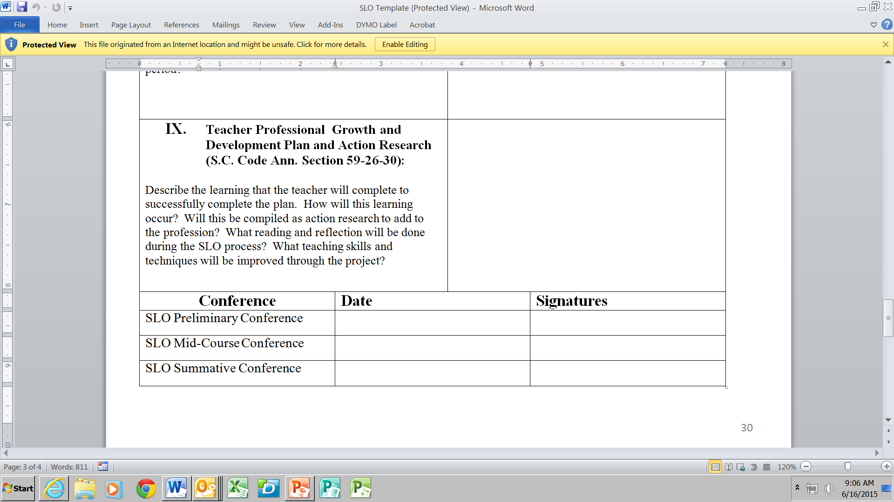

Slide 18
Summative Scoring Table
Exemplary In addition to meeting the standard… | Proficient | Needs Improvement | Unsatisfactory
The teacher attains a high level of student achievement with all populations of learners. | The work of the teacher results in acceptable, measurable progress based on established standards for a significant number of students. | The work of the teacher results in student growth but does not meet the established standard and/or is not achieved with all populations taught by the teacher. | The work of the teacher does not achieve acceptable student growth.
Almost all students meet their targeted growth, and many exceed their targets | A significant number of students meet or exceed their targets. | A less than significant number of students meet or exceed their targets. | Fewer than of students meet or exceed their targets.
Beginning of the Year Targets:
Performance Level: | Performance Level: | Performance Level: | Performance Level:
of Meet/Exceed of Exceed | of Meet/Exceed | of Meet/Exceed | < of Meet/Exceed
End of Year Performance:
of Meet/Exceed of Exceed | of Meet/Exceed | of Meet/Exceed | < of Meet/Exceed

Slide 19
Evaluating and Scoring
Occurs at the end of the interval of instruction
Should be the result of a collaborative effort by the evaluator and the teacher
SLO scoring is based on the district-created SLO scoring rubric
15-16 Presume “proficiency” (p. 25, SLO Guidebook)

Slide 20
3-2-1 Reflection
On an index card, respond to the following:
3- things that made you think “WOW” (new learning) 2- questions you have about the SLO process or product – What about? 1- connection you made to your local district

Slide 21
Interpreting Cognitive Demands of the State Standards
Developed by Christina Schneider, Ph.D
Center for Assessment
cschneider@nciea.org

Slide 22
Learning Goals
Accurately analyze standards and tasks for Webb’s Depth of Knowledge levels.
Match tasks to standards and SLO Objective statements for alignment.

Slide 23
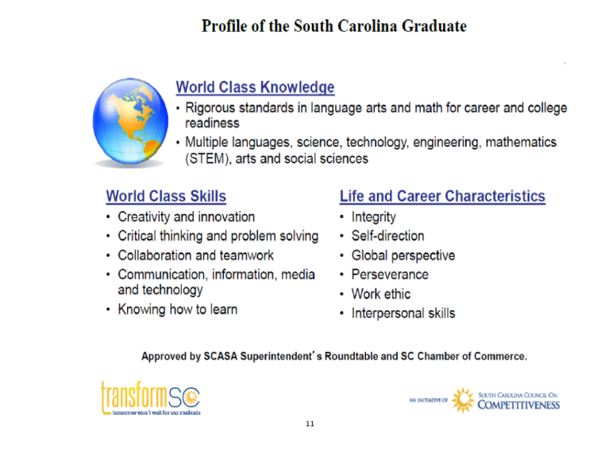

Why is DOK important?
DOK 4
DOK 3
DOK 2
DOK 1
Notes:
.

Slide 24
Understanding Cognitive Demand
Allows teachers to better target what the state wants students to do with the content.
Allows teachers to align expectations and evaluate their instructional strategies and materials to determine if their schema of instruction are meeting or exceeding the cognitive demand stipulated in the standard.
Guides teachers in supporting students problem solving with the content in the student’s long-term memory.
Goal is not memorization or rote procedures but using the content in real world, problem solving contexts.
South Carolina uses Webb’s Depth of Knowledge (DOK) framework to align curriculum, instruction, and assessment.

Slide 25
Alignment
Is the knowledge elicited from students on the assessment as complex in the content area as what students are expected to know and be able to do as stated in the standards (Webb, 2005)?
In other words, do the knowledge and skill requirements of an item/task match the knowledge and skill demands stated in the standards?

Slide 26
DOK Levels
DOK-1 – Recall & Reproduction - Recall of a fact, term, principle, concept, or perform a routine procedure, such as performing a simple algorithm or applying a formula. A well defined one-step problem (e.g., a one-step word problem requiring multiplication in a multiplication unit)
DOK-2 - Basic Application of Skills/Concepts – Some decision and application of information, conceptual knowledge, procedures, two or more steps with decision points along the way, routine problems, organize/display data, interpret/use simple graphs
DOK-3 - Strategic Thinking - reasoning, planning, using evidence to make decisions, determining sequencing of steps to approach problem; requires decision making and justification; abstract, complex, or non-routine; often more than one possible answer or approach, synthesize information within one source or text
DOK-4 - Extended Thinking - An investigation or application to real world; requires time to research, problem solve, and process multiple conditions of the problem or task; non-routine manipulations, synthesize and make connections across disciplines/content areas/multiple sources

Slide 27
One way to envision how Bloom’s relates to DOK
Depth + thinking | Level 1 Recall & Reproduction | Level 2 Skills & Concepts | Level 3 Strategic Thinking/ Reasoning | Level 4 Extended Thinking
Remember | - Recall, locate basic facts, details, events
Understand | - Select appropriate words to use when intended meaning is clearly evident | - Specify, explain relationships - summarize – identify main ideas | - Explain, generalize, or connect ideas using supporting evidence (quote, example…) | - Explain how concepts or ideas specifically relate to other content domains or concepts
Apply | - Use language structure (pre/suffix) or word relationships (synonym/antonym) to determine meaning | – Use context to identify meaning of word - Interpret information using text features or graphs | - Use concepts to solve non-routine problems | - Devise an approach among many alternatives to research a novel problem
Analyze | - Identify whether information is contained in a graph, table, etc. | – Compare literary elements, terms, facts, events – analyze format, organization, & text structures | - Analyze or interpret author’s craft (literary devices, viewpoint, or potential bias) to critique a text with justification of reasoning | – Analyze multiple sources - Analyze complex/abstract themes
Evaluate |  |  | – Cite evidence and develop a logical argument for conjectures | - Evaluate relevancy, accuracy, & completeness of information
Create | - Brainstorm ideas about a topic | - Generate conjectures based on observations or prior knowledge | - Synthesize information within one source or text | - Synthesize information across multiple sources or texts

Slide 28
What do you notice?
Describe the information contained in the table.
Describe how two story characters are alike and different.
Describe the data or text evidence that supports your solution, reasoning, or conclusion.
Describe varying perspectives on global climate change using supporting scientific evidence, and identify the most significant effects it night have on the planet in 100 years.
Remember that DEPTH is about complexity- not difficulty.

Slide 29
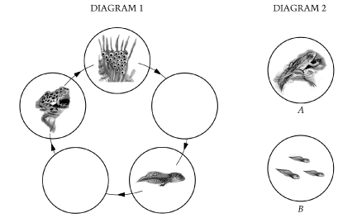
DOK 1
2-2.5 Illustrate the various life cycles of animals (including birth and the stages of development).

Slide 30
DOK 2
2-2.5 Illustrate the various life cycles of animals (including birth and the stages of development).
Draw the life cycle of a frog and the lifecycle of a lizard. What is the same, and what is different?
While verbs may appear to point to a DOK level, it is what comes after the verb that is the best indicator of the rigor/DOK level.

Slide 31
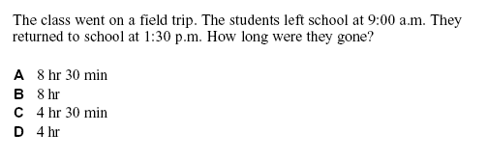
DOK Level?
The students must recognize the difference between a.m. and p.m. and make some decisions about how to make this into a subtraction problem, then do the subtraction.
DOK 2
Webb, N. (2005). Web Alignment Tool Training Manual (pages 45-84) wat.wceruw.org/Training%20Manual%202.1%20Draft%20091205.doc

Slide 32
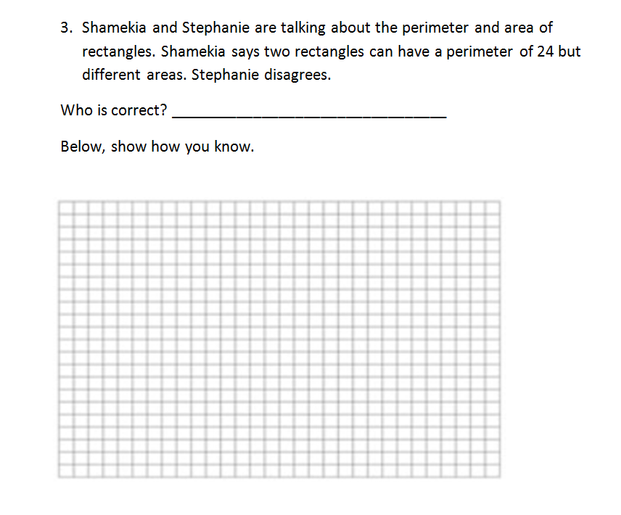
DOK Level?
Requires decision making and justification; abstract, complex, or non-routine; often more than one possible answer or approach
DOK 3

Slide 33
DOK Level-?– Grandma’s Tea
My grandmother lives in England. Whenever she buys a box of tea, the box has a small glass animal in it called a Wade. When Grandma gets two animals that are alike, she sends one of them to me. I want to keep collecting Wades until I have a whole set like Grandma. I wish Mother could buy tea like Grandma’s so we could get boxes with Wades in them. It is fun to have a collection.
Why does the child want Mother to buy tea like Grandma’s?
Do you think Mother will buy the child tea? Why?

Slide 34
DOK Level – Grandma’s Tea
My grandmother lives in England. Whenever she buys a box of tea, the box has a small glass animal in it called a Wade. When Grandmas gets two animals that are alike, she sends one of them to me. I want to keep collecting Wades until I have a whole set like Grandma. I wish Mother could buy tea like Grandma’s so we could get boxes with Wades in them. It is fun to have a collection.
Why does the child want Mother to buy tea like Grandma’s? Locate Explicit Detail – DOK 1
Do you think Mother will buy the child tea? Why? Connect evidence to draw conclusion and explain – DOK 3

Slide 35
DOK Level-?
Find an editorial from a newspaper or a blog on the internet in which the author makes a claim or takes a position.
Analyze the author’s argument structure, and write a paper critiquing the author’s use of evidence and argument structure to support his or her claim. Your grade will be based on your use of rich examples cited from the text and connecting those examples to the characteristics of argumentative writing that we have studied.
Evaluate evidence quality and completeness of information, connecting to real world, requires more than 1 class – DOK 4

Slide 36
Highest DOK level Supporting SLO
What could students do to move to a
DOK 4?
Notes:
Segue from just identify DOK into how can we raise the DOK level of assessments to support the level of cognitive demand expected by the SLO

Slide 37
Alignment and SLOs
  My Grade 3 students will conceptualize and fluently solve multi-step word and applied problems that include multiplication and division within 100. DOK?
  Multistep word problems denotes DOK level 2 because Webb (2005) describes DOK 2 as “Some decision and application of…procedures, two or more steps with decision points along the way.”
  Conceptualize and fluently solve can denote DOK 2 or DOK 3, depending on the reasoning involved.
  As an evaluator I must check that the tasks supporting SLO Objective Statement matches and sometimes exceeds the underlying standards.
  As an evaluator I must check that the rubric and tasks match AND sometimes exceed the underlying standards.

Slide 38
Social Studies Indicator
7-3.1 Summarize the achievements and contributions of the scientific revolution, including its roots, the development of the scientific method, and the interaction between scientific thought and traditional religious beliefs.

Slide 39
Does this match the intent of the standard?
Summarize information that you know about the scientific revolution by completing the chart. You may use your notes to help you complete the chart.
Scientist | Country | Contribution | Effect
Does summarize mean the same thing in the indicator and the task stem?
How does the use of notes influence the cognitive demand of the task?

Slide 40
Depths of Knowledge
Standards Review
Activity
Notes:
Trainer will utilize the Standard/indicator strips in the envelopes to practice identifying DOK levels.

Slide 41
Higher DOK is key!
Boaler, professor of mathematics education at Stanford University, wrote that "we continue to value the faster memorizers over those who think slowly, deeply, and creatively," and that this has "produced a generation of students who are procedurally competent but cannot think their way out of a box.“
http://hechingerreport.org/memorizers-are-the-lowest-achievers-and-other-common-core-math-surprises/
http://blogs.edweek.org/edweek/curriculum/2015/05/professor_stop_math_memorization.html?qs=memorization

Slide 43

Please be ready to begin the next session in 15 minutes.
Thank you!

Slide 44
Learning Goal Alignment

Slide 45
Learner Outcomes
identify whether the description of what the students learn is based on course or grade level content standards
determine whether the standards are measured by the learning goal/objective
determine whether the instructional strategies are appropriate for the learning goal

Slide 46

“One day Alice came to a fork in the road and saw a
Cheshire cat in a tree.
‘Which road do I take?’ she asked.
‘Where do you want
to go?’
was his response.
‘I don’t know,’ Alice answered.
‘Then,’ said the cat, ‘it doesn’t matter.”
-Lewis Carroll, Alice in Wonderland

Slide 47
What is content alignment?
Alignment is the connection between learning objectives, learning activities and assessment. An aligned SLO has learning objectives, activities and assessments matched so students learn what is intended and assessments accurately measure what students learn.

Slide 48
Why is Alignment Important?
When teachers ensure learning goals, content, instructional strategies and assessments are aligned, it is easier for students to reach their targets.
Alignment will keep you moving in the right direction.

Slide 49

When there is no alignment
Student may complete assignments/activities that don’t move them in the right direction (toward the goal).
the course may be unconnected and unproductive
Teachers may not accurately measure the impact of their instruction on student growth.

Slide 50
It’s All Connected
Rationale
Standards/
Content
Instructional Strategies
Assessment
Objective Statement

Slide 51
Learning Goal
A description of what students will be able to do at the end of the course or grade based on course- or grade-level content standards and curriculum.
Three Levels
Acceptable Quality
Quality Needs Improvement
Insufficient Quality
Generally identifies and describes a learning goal
Identifies and describes a learning goal that is vague, trivial, or unessential
Appropriately identifies and thoroughly describes an important and meaningful learning goal

Slide 52

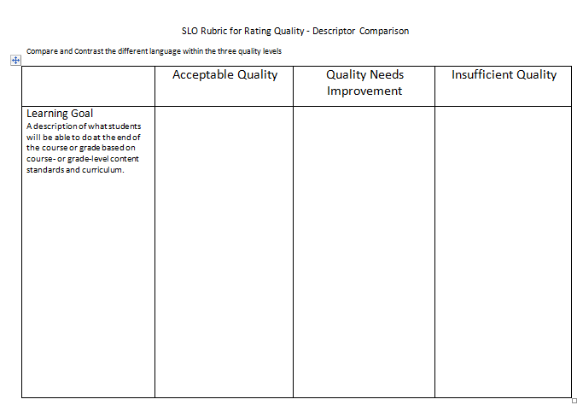
Record
Share
Create
Find this handout
Activity
Resources
  SLO Quality Review Tool
  Descriptor Comparison
Read the 3 Quality Levels
Record the different language/tasks between the three levels on the Descriptor Comparison Handout
Share what you’ve found with an elbow partner.
Prepare to share whole group

Slide 53
Acceptable Quality
Appropriately identifies and thoroughly describes an important and meaningful learning goal, with:
the big idea and the standard(s) clearly aligned to and measured by the learning goal,
a clear explanation of the critical nature of the learning goal for all students in the specific grade/ course,
a clear description of how the learning goal allows students to demonstrate deep understanding of the content standards within the identified time span, and
specific and appropriate instruction and strategies described to teach the learning goal.

Slide 54
Quality Needs Improvement
Generally identifies and describes a learning goal with:
the big idea and/or standards minimally aligned to the learning goal,
some explanation of the importance of the learning goal for students in the specific grade/ course,
a general description of how the learning goal allows students to demonstrate adequate understanding of the content standards within the identified time span, and/or
some generic instruction and strategies used to teach the learning goal.

Slide 55
Insufficient Quality
Identifies and describes a learning goal that is vague, trivial, or unessential, with:
the big idea and/or standards not aligned to the learning goal,
lack of information of the importance of the learning goal for students in the specific grade/course,
little to no description of how the learning goal allows students to demonstrate understanding of the content standards in the identified time span, and/or
questionable and/or vague instruction and strategies used to teach the learning goal.

Slide 56
Evidence of Alignment
Compare the evidence of alignment in the components of the Visual Arts SLOs
Rationale
Standards/
Content
Instructional Strategies
Assessment
Objective Statement

Slide 57
Evidence of Alignment Activity
 | SLO 1 | SLO 2
Objective Statement
Rationale
Standards/ Content
Instructional Strategies
Assessment
With your group, find evidence of each of the SLO components and record on chart paper. Circle or underline evidence of alignment for each SLO. What do you notice? Discuss with your group.

Slide 58

The components must be aligned
The Big

Slide 59
“One day Alice came to a fork in the road and saw a
Cheshire cat in a tree.
‘Which road do I take?’ she asked.
‘Where do you want
to go?’
was his response.
‘I don’t know,’ Alice answered.
‘Then,’ said the cat, ‘it doesn’t matter.”
-Lewis Carroll, Alice in Wonderland

Slide 60

Please be ready to begin the next session at time reported by your trainer.
Thank you!

Slide 61
Assessment & Scoring

Slide 62

Assessment Literacy
Line up along the wall according to your level of assessment expertise. “Ace” being expert, “Two” being beginner.
Take 2 Minutes to explain to a neighbor why you selected your location. Be ready to report:
  What are the characteristics of a high quality assessment?
  What do you hope to learn about assessments and the SLO process?

Slide 63
Objectives
The learner should be able to:
Identify components of high quality assessments
  Determine whether the assessment is aligned to content standards
  Determine whether scoring differentiates students performance adequately
Provide feedback to teachers on how to improve the quality of the assessment

Slide 64
Components of High-Quality Assessments
Balanced System of Assessments
Alignment & Validity
Authenticity
Variation
State Standardized Assessments
Common Assessments
Teacher-Created Assessments
District Standardized Assessments

Slide 65
Balanced System of Assessments
  A balanced assessment system includes:
  Multiple kinds of assessments
    Variety in assessment format
      Selected-response format
        Multiple-Choice
        True/False
        Matching
      Constructed-response format
        Fill-in-the-blank
        Short answer
        Performance assessments
          Oral performance
          Creation of a product
          Demonstration of a process

Slide 66
Balanced System of Assessments
  A balanced assessment system includes:
  Multiple kinds of assessments
    Variety in assessment format
    Ongoing forms of assessments
Baseline/Diagnostic Assessment
Formative Assessment/Progress Monitoring
Summative Assessment

Slide 67
Video: My Favorite No https://www.teachingchannel.org/videos/class-warm-up-routine
Discussion Questions:
  How did Mrs. Alcala use formative assessment to inform her instruction?
  How can this ongoing type of assessment be part of measuring achievement of the SLO?

Slide 68
Balanced System of Assessments
  A balanced assessment system includes:
  Multiple kinds of assessments
    Variety in assessment format
    Ongoing forms of assessments
  Progression in terms of difficulty of assessments and cognitive rigor

Slide 69
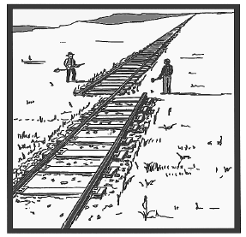
What is Validity?
2 definitions:
Are we measuring what we intended to measure? Alignment

Slide 70
Ensuring Validity through Alignment
Ask your Teachers:
Does the test measure the content and the DOK of the standard used in the SLO?
  Selected Assessments
    What was your thought process behind selecting this assessment?
    How do you know it measures the content of your SLO?
    How do you know it measures the cognitive rigor/DOK of your SLO?
  Teacher-Created Assessments
    How did you decide what type of assessment was most appropriate to use and why?
    (Performance Assessments) How did you determine the scoring criteria for your rubric that accompanies your performance assessment?
    (Multiple-Choice Assessments) Are at least 50% of the multiple choice items at or above the desired DOK level of your SLO?

Slide 71
Alignment Evaluation Tool
What standards are measuring? | What is the goal you want students to achieve? | What constitutes successful learning? | What evidence can be collected to help you know if students reached the goal?

Slide 72
Ensuring Validity
Ask your Teachers:
Does the test measure the content and the DOK of the standard used in the SLO?
Are the items in a multiple choice assessment:
Clearly written, clearly formatted, and concise?
Free from “tricky” language?
Formatted in a way that is most clear to students?

Slide 73
How can this be improved?
The new basketball arena holds 20,000 people. If 4,000 people can be seated in the bleachers, ______ seats are available in the rest of the stadium.
A. 29,000
B. 1,000
C. 16,000
D. 13,000

Slide 74
Improved Item
1. An arena holds 20,000 people. If 4,000 people are already seated, how many seats are empty?
a. 5,000
b. 16,000
c. 24,000
d. 80,000

Slide 75
Ensuring Validity
Ask your Teachers:
Does the test measure the content and the DOK of the standard used in the SLO?
Are the items in a multiple choice assessment clearly written, formatted, and concise?
Is the reading level appropriate?
Are directions for performance assessments clear?

Slide 76
What is Validity?
2 definitions:
Are we measuring what we intended to measure? Alignment
Extent to which inferences based on an assessment are useful and appropriate.

Slide 77
Appropriate and Useful Inferences about Student Learning and Teacher Effectiveness
In coaching your teachers toward SLO approval:
Explain how the assessment helped you identify what students can do and what is just beyond their current capability?
How does the assessment being used to guide your instruction?
Based on what you learned from the assessments, what additional professional development do you need?

Slide 78
What is Authenticity?
Extent to which the assessment requires students to demonstrate their learning in ways that they would be applied in the real world. An authentic assessment engages learners.

Slide 79
Authenticity
Ask your Teachers:
How does this assessment cover knowledge and skills that will be valuable to the student in later grades and/or later in life?
Were your students motivated to do their best on this assessment? How do you know?
What new learning experience(s) does the assessment provide for students?
In what ways does the assessment prompt your students to reflect on their own learning?

Slide 80
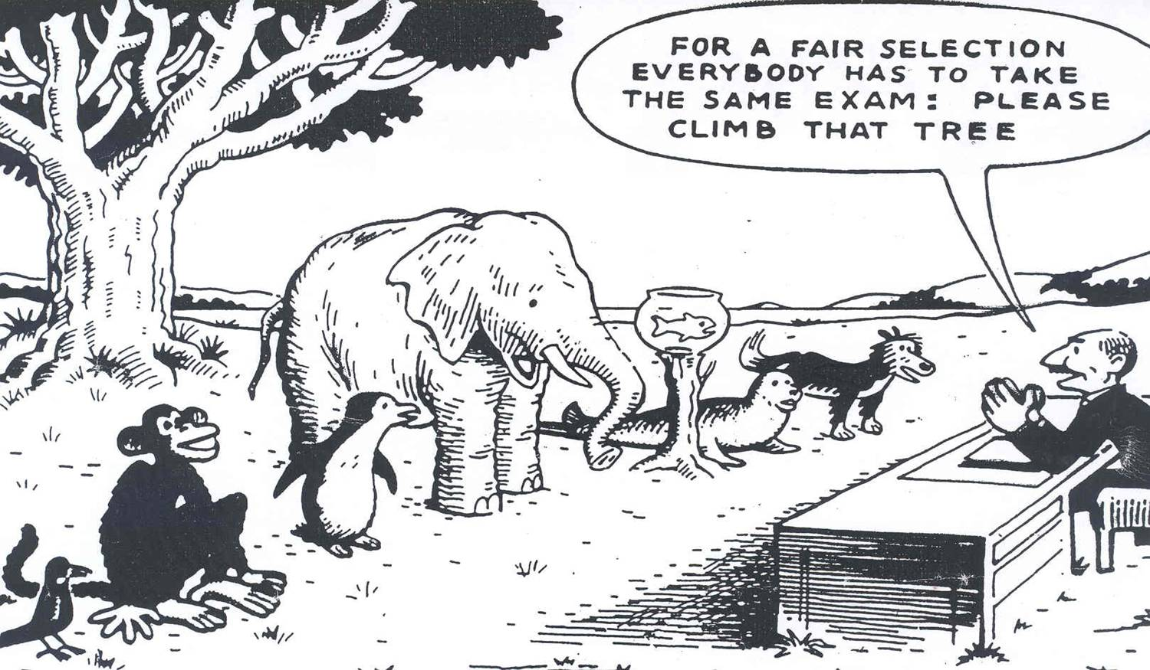
Variation
This assessment is going to lead to very little variation in being able to complete the task. Part of variation is including multiple access points for students to demonstrate their learning.

Slide 81
Little Range
Wide Range
Student | Score
Adam | 60
Barbara | 60
Cathryn | 100
Dillan | 60
Eve | 100
Fred | 60
Gary | 100
Student | Score
Adam | 65
Barbara | 75
Cathryn | 95
Dillan | 45
Eve | 100
Fred | 85
Gary | 80

Slide 82
Variation
Ask your Teachers:
Does the assessment measure a range of DOK levels?
Does the score allow you to gauge the full range of student performance?
Do student baseline data suggest that all students will be able to demonstrate growth on this assessment?

Slide 83
Case Study
You and Mr. Wright, the 3rd grade teacher, are meeting to review the assessments he has used to measure his SLO on reading comprehension. When you meet, he presents you with two assessments. One is the assessment he created and administered at the beginning of the semester. This assessment included a brief paragraph about animals at the zoo. After reading the passage, students responded to 10 multiple-choice items about it. The other assessment he has selected is the spring MAP assessment. As you look at the scores on the assessment that he administered at the beginning of the semester, you see that almost all students got all of the items right. However, the scores on the MAP assessment show a wider range of student performance.
Discussion Questions:
  What has Mr. Wright done well?
  What advice would you offer Mr. Wright to help him improve his assessment system?
  What other ways could Mr. Wright assess students’ reading comprehension?
Notes:
Be sure to link the discussion questions to Validate-Clarify & Stretch.

Slide 84
What did you learn in this session that was most helpful to you?
What questions do you still have?

Slide 85
Sources
Schneider, M. & Thompson, J. A framework for evaluating the quality of performance tasks and their associated scoring guides within a student learning objective context.
Teacher-Made Assessments: Multiple Choice and Other Selected-Response Items, 2010, The McGraw-Hill Companies, Inc.
Image retrieved from https://gjismyp.files.wordpress.com/2011/10/fair-assessment.jpg

Slide 86
Please be ready to begin the next session in 15 minutes.
Thank you!

Slide 87
Growth targets

Slide 88
Baseline and Trend Data Activity
Take out the Baseline and Trend Data Activity packet.
This activity will be facilitated.

Slide 89
The Data Analysis Process
Identify and gather baseline data:
  Is there a pre-assessment that is aligned to the post-assessment?
  If not, are there expectations or guidelines for how teachers can use trend data to set growth targets?
Activity: In your group, locate the baseline data in the packet.
  Are there clear groups of students? If so, what are they?
  Where is this kind of data stored in your district? How do you expect teachers to access this data?
  Discuss: is baseline data alone sufficient for setting growth targets? Why or why not?

Slide 90
The Data Analysis Process
Trend data and other student data helps educators determine how much growth each student is likely to make
Identify and gather trend data:
  Test scores from prior years (any available)
  Current and past grades
  Formative assessment data from this year and previous years, including running records
  Reading and math conferences
  Data to inform the student population section, such as attendance records or 504 plans
  Results from diagnostic assessments

Slide 91
The Data Analysis Process
Activity: Analyze the data and look for trends
  Are there clear groups of students? If so, are they the same groups represented in the baseline data? Are there some students whose performance has changed or been inconsistent in the last year or two?
  How are students performing overall? Are most students consistently demonstrating proficiency?
  What kind of growth have students been making? Have students been consistently meeting or missing expectations?
  What process did you use to analyze the data? What kind of skills do you think are necessary to do this kind of analysis?
  How can your district or IHE support teachers in engaging in this type of data analysis?

Slide 92

Activity Part III: Setting Growth Targets
Baseline Performance Level | Growth Target
Below Proficiency
At Proficiency
Above Proficiency
+ 15 points or more
+ 7 points or more
+ 2 points or more
Demonstrates ability to transfer skills to authentic situations

Slide 93
The Data Analysis Process
Districts can set rules or give guidance on what kind of baseline or trend data teachers should include in their SLO
Meaningful Baseline and Trend Data should:
  Describe students in terms of groups
  Describe student performance over time
  Inform growth targets
  Inform instructional strategies

Slide 94
The Quality Review Tool

Slide 95
Reminders for Tomorrow
Training begins promptly at 8:30 am.
Please provide Day One feedback on the Parking Lot:
☺ Something that worked well for you
☹ Challenges, concerns and questions you have

Slide 96


