Slide 1

Growing Teachers to Grow Students
February 2018
Office of Educator Effectiveness and Leadership Development

Slide 2
Welcome!
As you are waiting for us to get started, please mute your microphone. Then type your answers to these questions into the chat box.
What have you heard about the new SC Teaching Standards and teacher evaluation process?
What are you excited about?
What questions do you have for us?

Slide 3
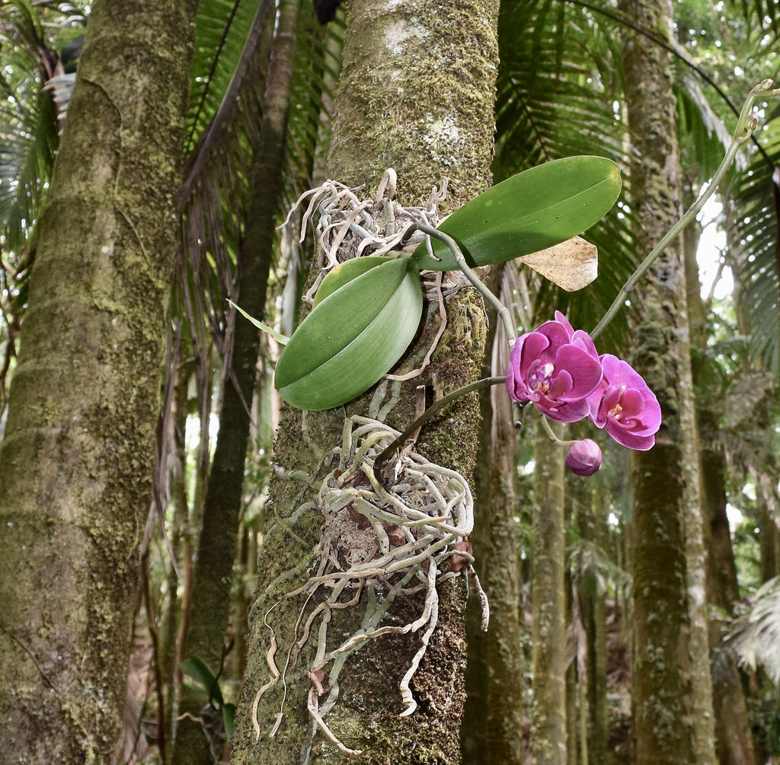
OEELD Vision
Growing educators to grow students. . .
South Carolina Schools will be filled with highly effective educators engaged in learning, leading, and maximizing student growth and readiness for college, career, and life.
Photo Credit: Flickr, Tatiana 12

Slide 4
Agenda
What is Expanded ADEPT? Why change?
What will changes look like?
  SC Teaching Standards
  Student Learning Objectives (SLOs)
Implementation: How will this work?
How can I help?
  Next steps
  Feedback and closing

Slide 5
What is Expanded ADEPT?

Slide 6

Profile of the SC Graduate

Slide 7

Feedback from teachers
Growth

Slide 8
What will the new Expanded ADEPT look like?

Slide 9
Expanded ADEPT
Now
SAFE-T
ADEPT Performance Standards (APS)
New System
Expanded ADEPT process
SC Teaching Standards (SCTS)
SLOS
SLOs

Slide 10
Expanded ADEPT Implementation Timeline
Contract Level | Observations | Student Growth
Induction | >1 – Full Classroom Observation per semester, with conferences | Complete 1 SLO, often just covers 2nd semester
Annual | >2 – Full Classroom Observations per semester, with conferences | Complete 1 SLO
Continuing Contract – Comprehensive 5th year recertification | >1 – Full Comprehensive Classroom Observation per semester, with conferences | Complete 1 SLO
Continuing Contract – GBE | Informal | Complete 1 SLO

Slide 11
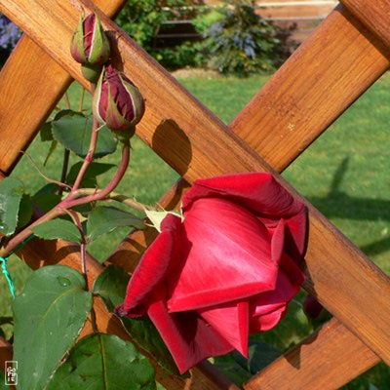
Alignment to ADEPT Performance Standards
ADEPT 4.A Establishes, communicates, and maintains high expectations for student achievement
  SCTS: Expectations (Environment)
  SCTS: Standards & Objectives (Instruction)
ADEPT 4.B Establishes communicates and maintains high expectations for student participation
  SCTS: Expectations (Environment)
  SCTS: Motivating Students (Instruction)
ADEPT 4.C Helps students assume responsibility for their own participation and learning
  SCTS: Motivating Students (Instruction)

Slide 12
Expanded ADEPT
  South Carolina Teaching Standards 4.0 rubric selected to replace SAFE-T as a part of Expanded ADEPT
  Initiative led by SCDE and educators from across the state
  Supports educators with feedback related to professional practice, not simply based on student test scores
  New rubric is aligned to the Profile of the South Carolina Graduate
Instruction
Environment
Student Growth
Planning
Professionalism

Slide 13
South Carolina Teaching Standards
Planning
Environment
Instruction
Professionalism
Instructional Plans
Student Work
Assessment
Managing Student Behavior
Expectations
Environment
Respectful Culture
Standards & Objectives
Motivating Students
Presenting Instructional Content
Lesson Structure & Pacing
Activities & Materials
Questioning
Academic Feedback
Grouping Students
Teacher Content Knowledge
Teacher Knowledge of Students
Thinking
Problem Solving
Growing and Developing Professionally
Reflecting on Teaching
Community Involvement
School Responsibilities

Slide 14
Parts of the Rubric
Domains
Indicators
*Descriptors
*Performance Levels
Instruction
 | Exemplary (4) | Proficient (3) | Needs Improvement(2) | Unsatisfactory (1)
Standards and Objectives | All learning objectives and state content standards are explicitly communicated. Sub-objectives are aligned and logically sequenced to the lesson’s major objective. Learning objectives are: (a) consistently connected to what students have previously learned, (b) know from life experiences, and (c) integrated with other disciplines. | Most learning objectives and state content standards are communicated. Sub-objectives are mostly aligned to the lesson’s major objective. Learning objectives are connected to what students have previously learned. | Some learning objectives and state content standards are communicated. Sub-objectives are sometimes aligned to the lesson’s major objective. Learning objectives are not clearly connected to what students have previously learned. | Learning objectives and state content standards are not communicated. Sub-objectives are rarely aligned to the lesson’s major objective. Learning objectives are rarely connected to what students have previously learned. Expectations for student performance are vague. State standards are not appropriately displayed. There is evidence that few students demonstrate mastery of the objective.
Notes:
These slides will highlight each element of the rubric (Domain, Indicator, Descriptors and Performance Levels) in slide show mode.
Click 1, Click 2: Domains are the big buckets
Click 3, Click 4: Indicators are the specific elements of practice
Click 5, Click 6: Descriptors describe what performance looks like at each level.
Click 7, Click 8: The four performance levels are the biggest difference from the APS standards

Slide 15
Instruction
Student Centered Teacher Centered
 | Exemplary | Proficient | Needs Improvement | Unsatisfactory
Description of Qualifying Measures | Consistent Evidence of Student Centered Learning/Student Ownership of Learning- Teacher Facilitates the Learning. | Some Evidence of Student Centered Learning/ Student Ownership of Learning – Teacher Facilitates the Learning | Moving Towards Student Centered Learning/Student Ownership of Learning- Consistent Reliance on Teacher Direction. | Heavy emphasis on Teacher Direction – Minimal Evidence of Student Ownership of Learning

Slide 16
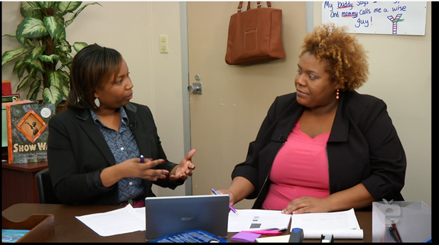
SC Teaching Standards Process
Pre-observation Conference
Observation
Reflection
Post-observation Conference

Slide 17
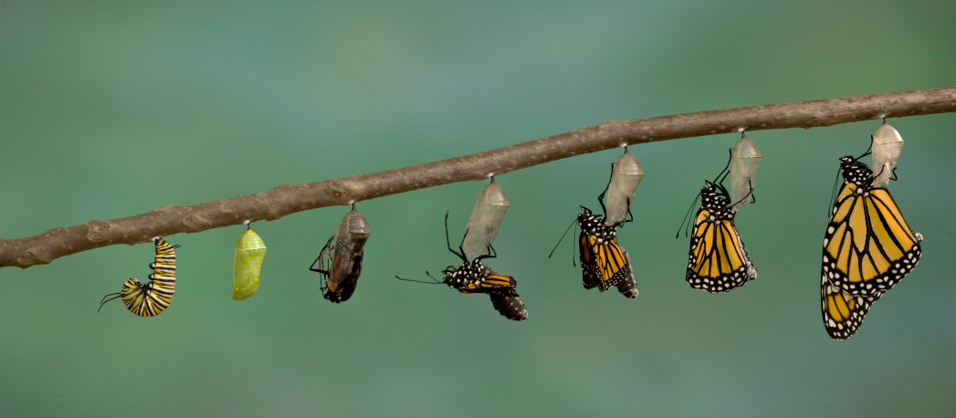
Student Learning Objectives

Slide 18
Implementation Timeline
How will this all work?

Slide 19
Expanded ADEPT Implementation Timeline
Recalibration
2016-2017
Readiness & Training
2017-2018
Implementation
2018-2019

Slide 20
SCLead.Org
South Carolina Leadership Effectiveness, Advancement, & Development (SCLead)
State wide launch in August 2018
On-demand access to evaluation data and professional development resources
District trainings this summer

Slide 21
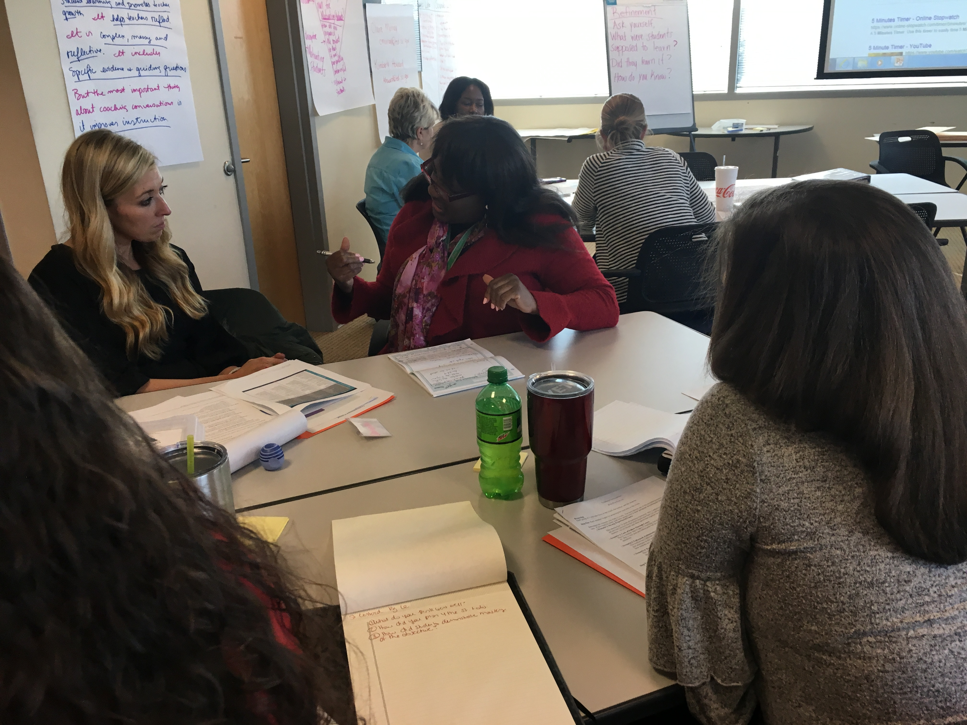
Building Relationships to Grow Teachers

Slide 22
What can I do now to support these changes?
  Reflect: What do the SCTS indicators look like and sound like in my classroom?
  Connect: How can I practice with my grade-level team? Student teacher? PLC? Student support team?
  Model: Do I have a growth mindset for my own practice?
  Lead: How can I support strong implementation at my school?

Slide 23
Stay Connected ed.sc.gov/educators/ educator-effectiveness

Slide 24
Feedback Survey
https://tinyurl.com/ExpandedADEPT
Notes:
Link to Feedback: https://tinyurl.com/ExpandedADEPT

Slide 25
Questions?

