Slide 1
My Plan
How to Build an Educational Impact Video Playlist
Last updated: 5-12-22

Slide 2

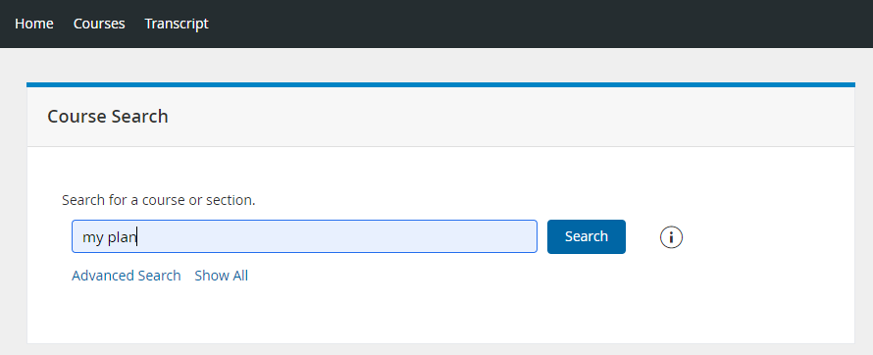
Search for My Plan
1
Click the Courses tab
Conduct a keyword search for My Plan
Click Search when ready
2
3

Slide 3
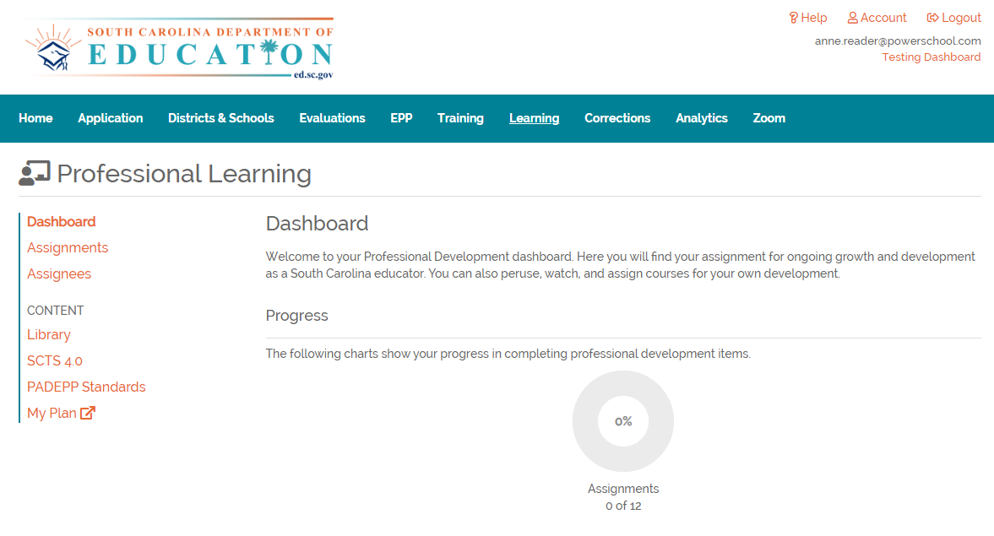
South Carolina Users ONLY
South Carolina Users ONLY:
  From within SC Lead, click the Learning tab
  Click My Plan to launch course information in Professional Learning

Slide 4
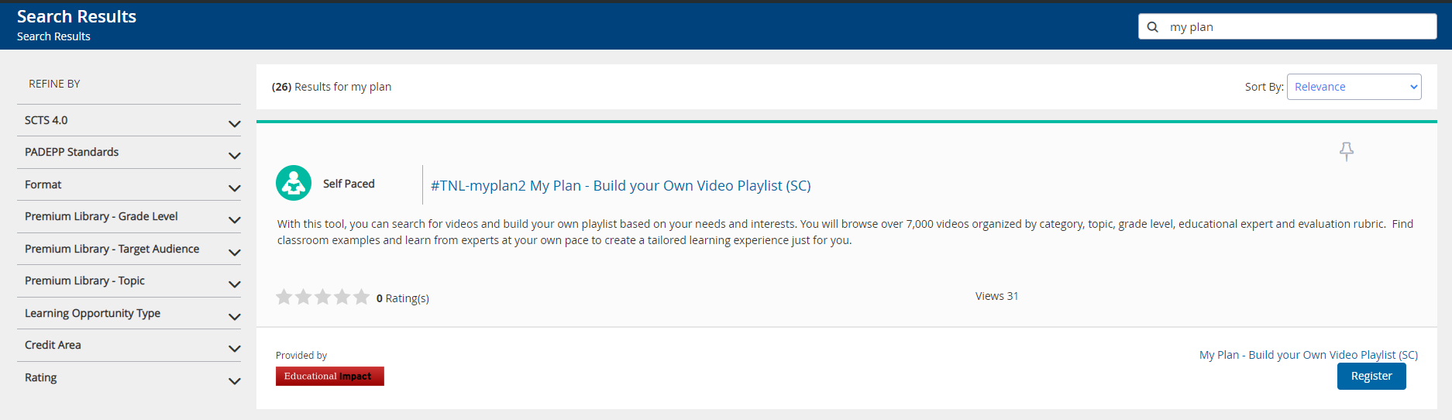
Register for My Plan
First-time users must Register for the My Plan course to access

Slide 5
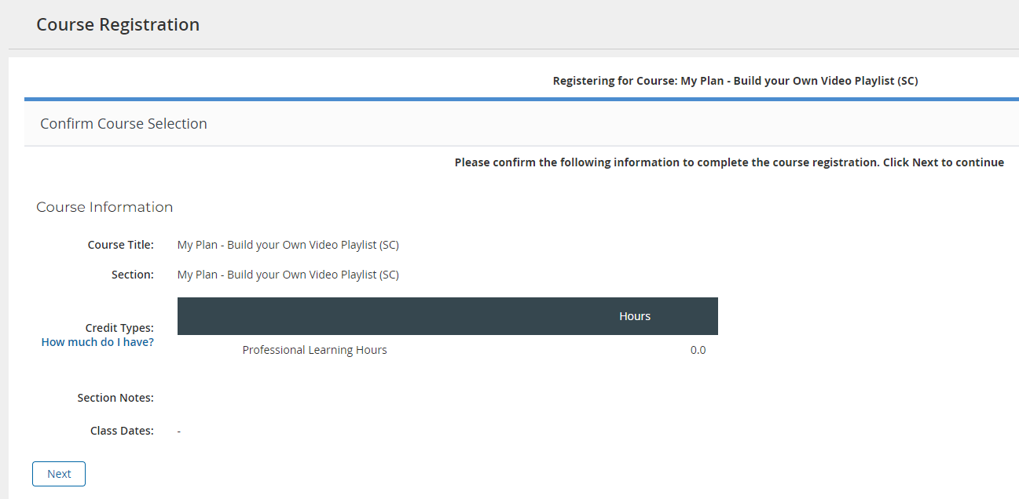
Confirm Registration
Click Next to confirm registration

Slide 6
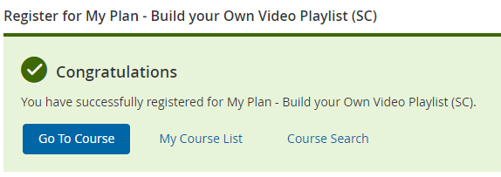
Launch Ed Impact
Click Go to Course to launch the Educational Impact My Plan

Slide 7
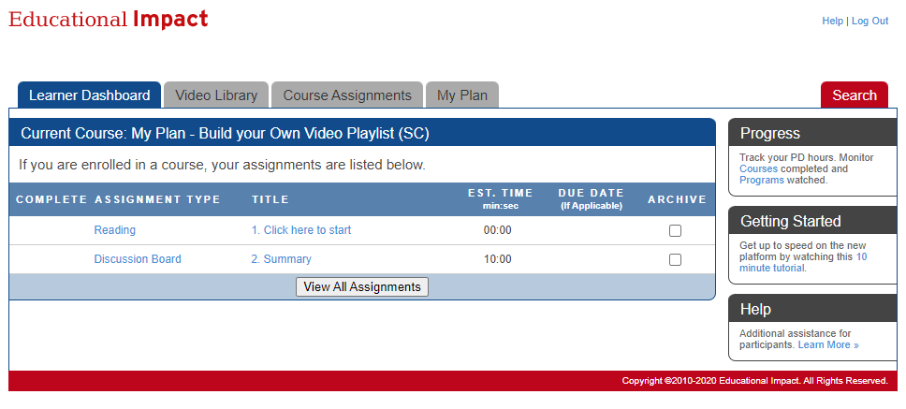
Open the Instructions
Click the title to open the My Plan instructions

Slide 8
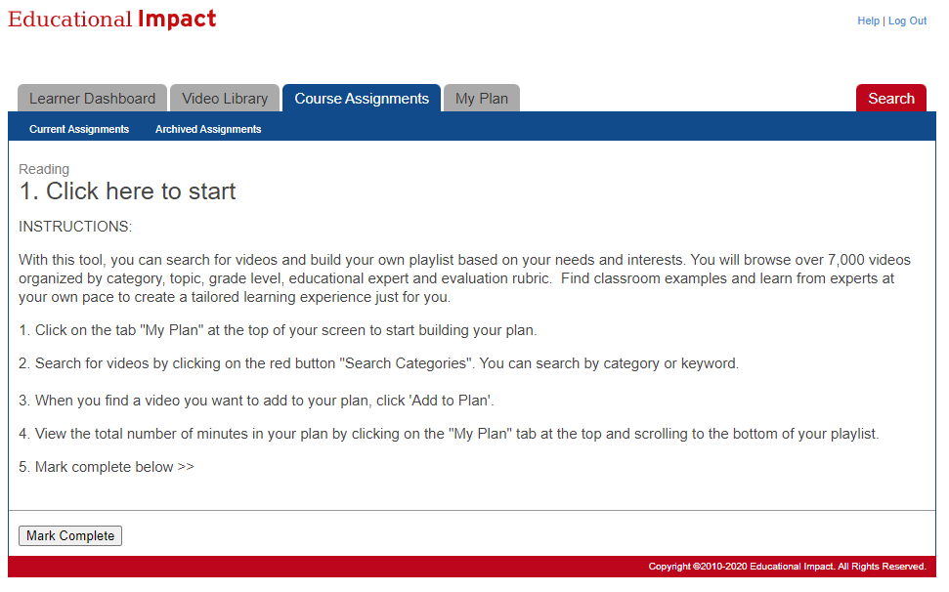
Review Instructions
Read the text provided
Click the My Plan tab when ready

Slide 9

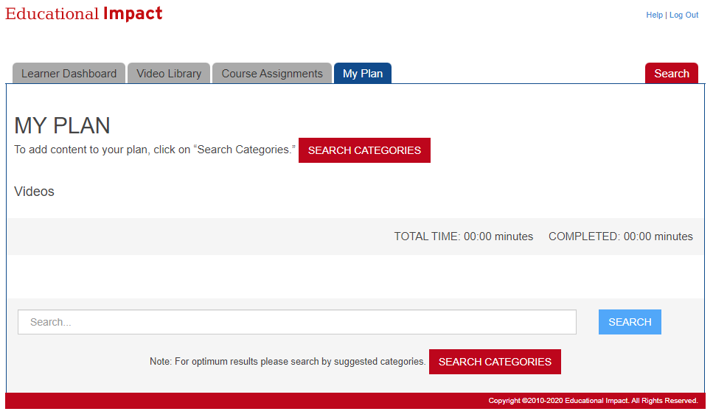
2 Ways to Search
Ed Impact
Click Search Categories to browse video content
Search for video content by keyword
1
2
1
2

Slide 10
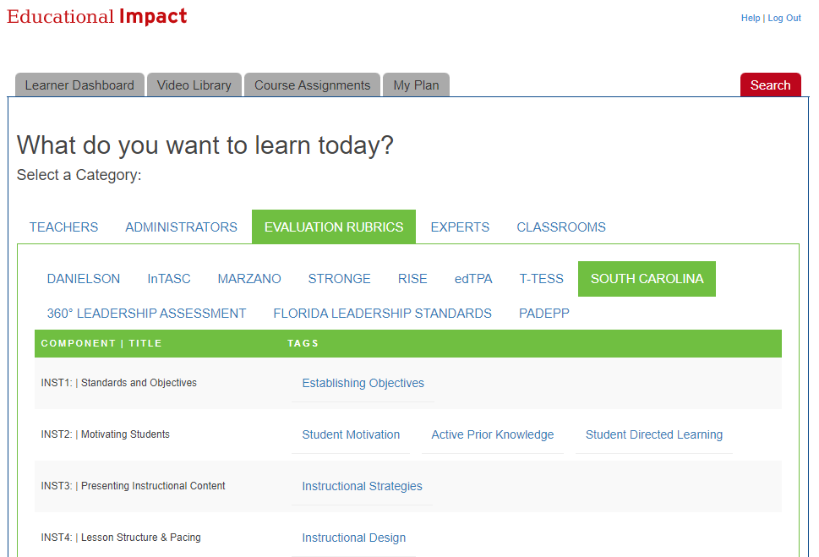
Category Search
Browse video content by keyword or rubric

Slide 11
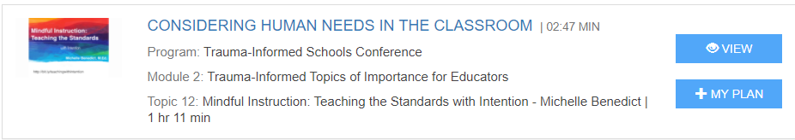
Add Content to My Plan
Click View to preview content
Click +My Plan to add content to your Playlist

Slide 12
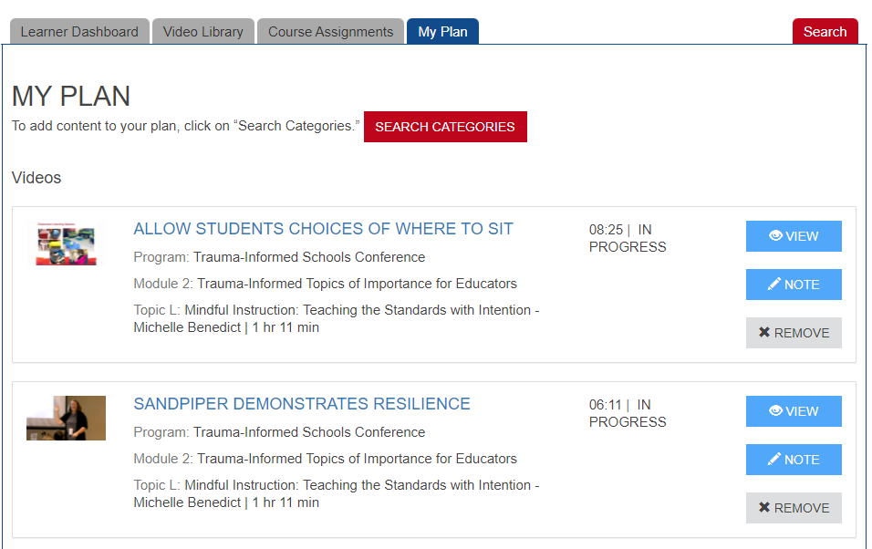
View My Plan
Click the My Plan tab to review content added to your Playlist
Use the buttons on the right to view, write notes or remove videos

