Slide 1
Professional Learning Library Training
SIS + Schoology LMS + Assessment + Analytics + Naviance CCLR
SCDE District-Level Users & District Technical Support
Last updated: 7-11-22

Slide 2


Zoom Communication Tools
Q&A will be our primary method of communication today.
We may use a poll in this webinar. Please participate if/when you see one appear on your screen.
The chat will be disabled during the webinar today. Please use the Q&A instead.
Notes:
Deanna

Slide 3
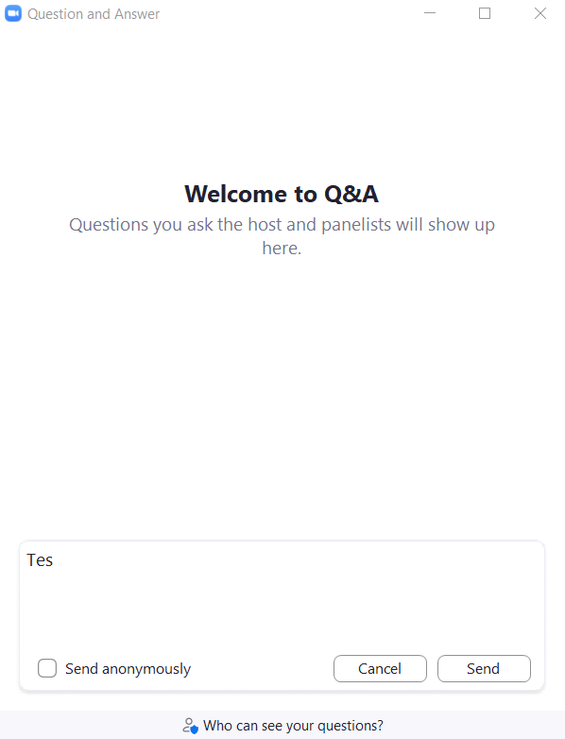
Anatomy of the Zoom Q&A
Check the box to send anonymously, if desired.
Type your question in the box. Click Send when ready.
How do I access the PLL?

Slide 4
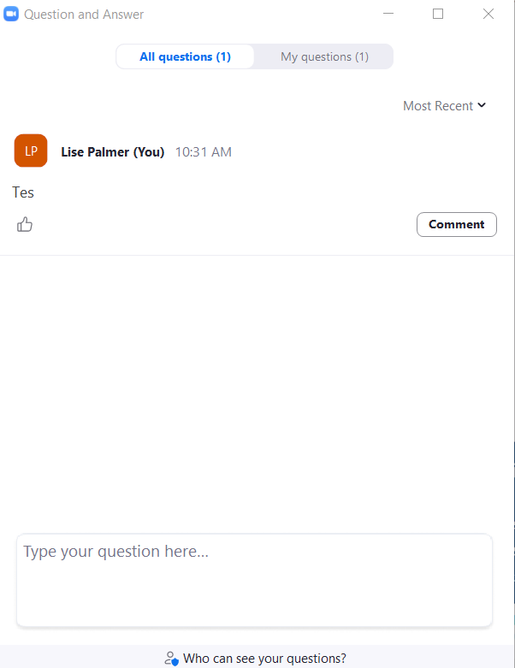
Review Submitted Questions
Click the tabs to move between Question types.
If you have the same question as another participant, upvote it!
How do I access the PLL?
Comment on others’ questions, if desired.
Notes:
Deanna

Slide 5
Agenda
Introductions
Office of Educator Effectiveness and Leadership Development
PLL Content Highlights
How it Works
Making Assignments in SCLead.org
Viewing Assignees
Robust Searching using PowerSchool Professional Learning
Check for Understanding / Questions
Additional Resources / FAQs

Slide 6
Introductions

Slide 7
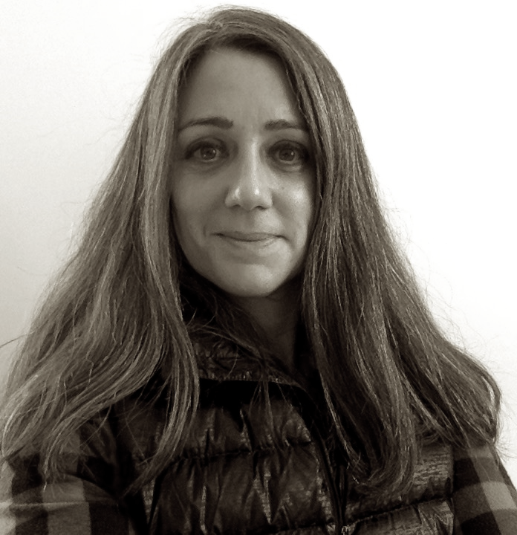
Anne Reader
The University of Michigan
  BA in German
  MA in Information Science
20 years teaching for the Ann Arbor Public Schools
  Librarian (all levels)
  Instructional Coach
  Instructional Technology Consultant
  Director of Instructional Technology
Anne Reader
Senior Strategic Solutions Consultant, PowerSchool

Slide 8
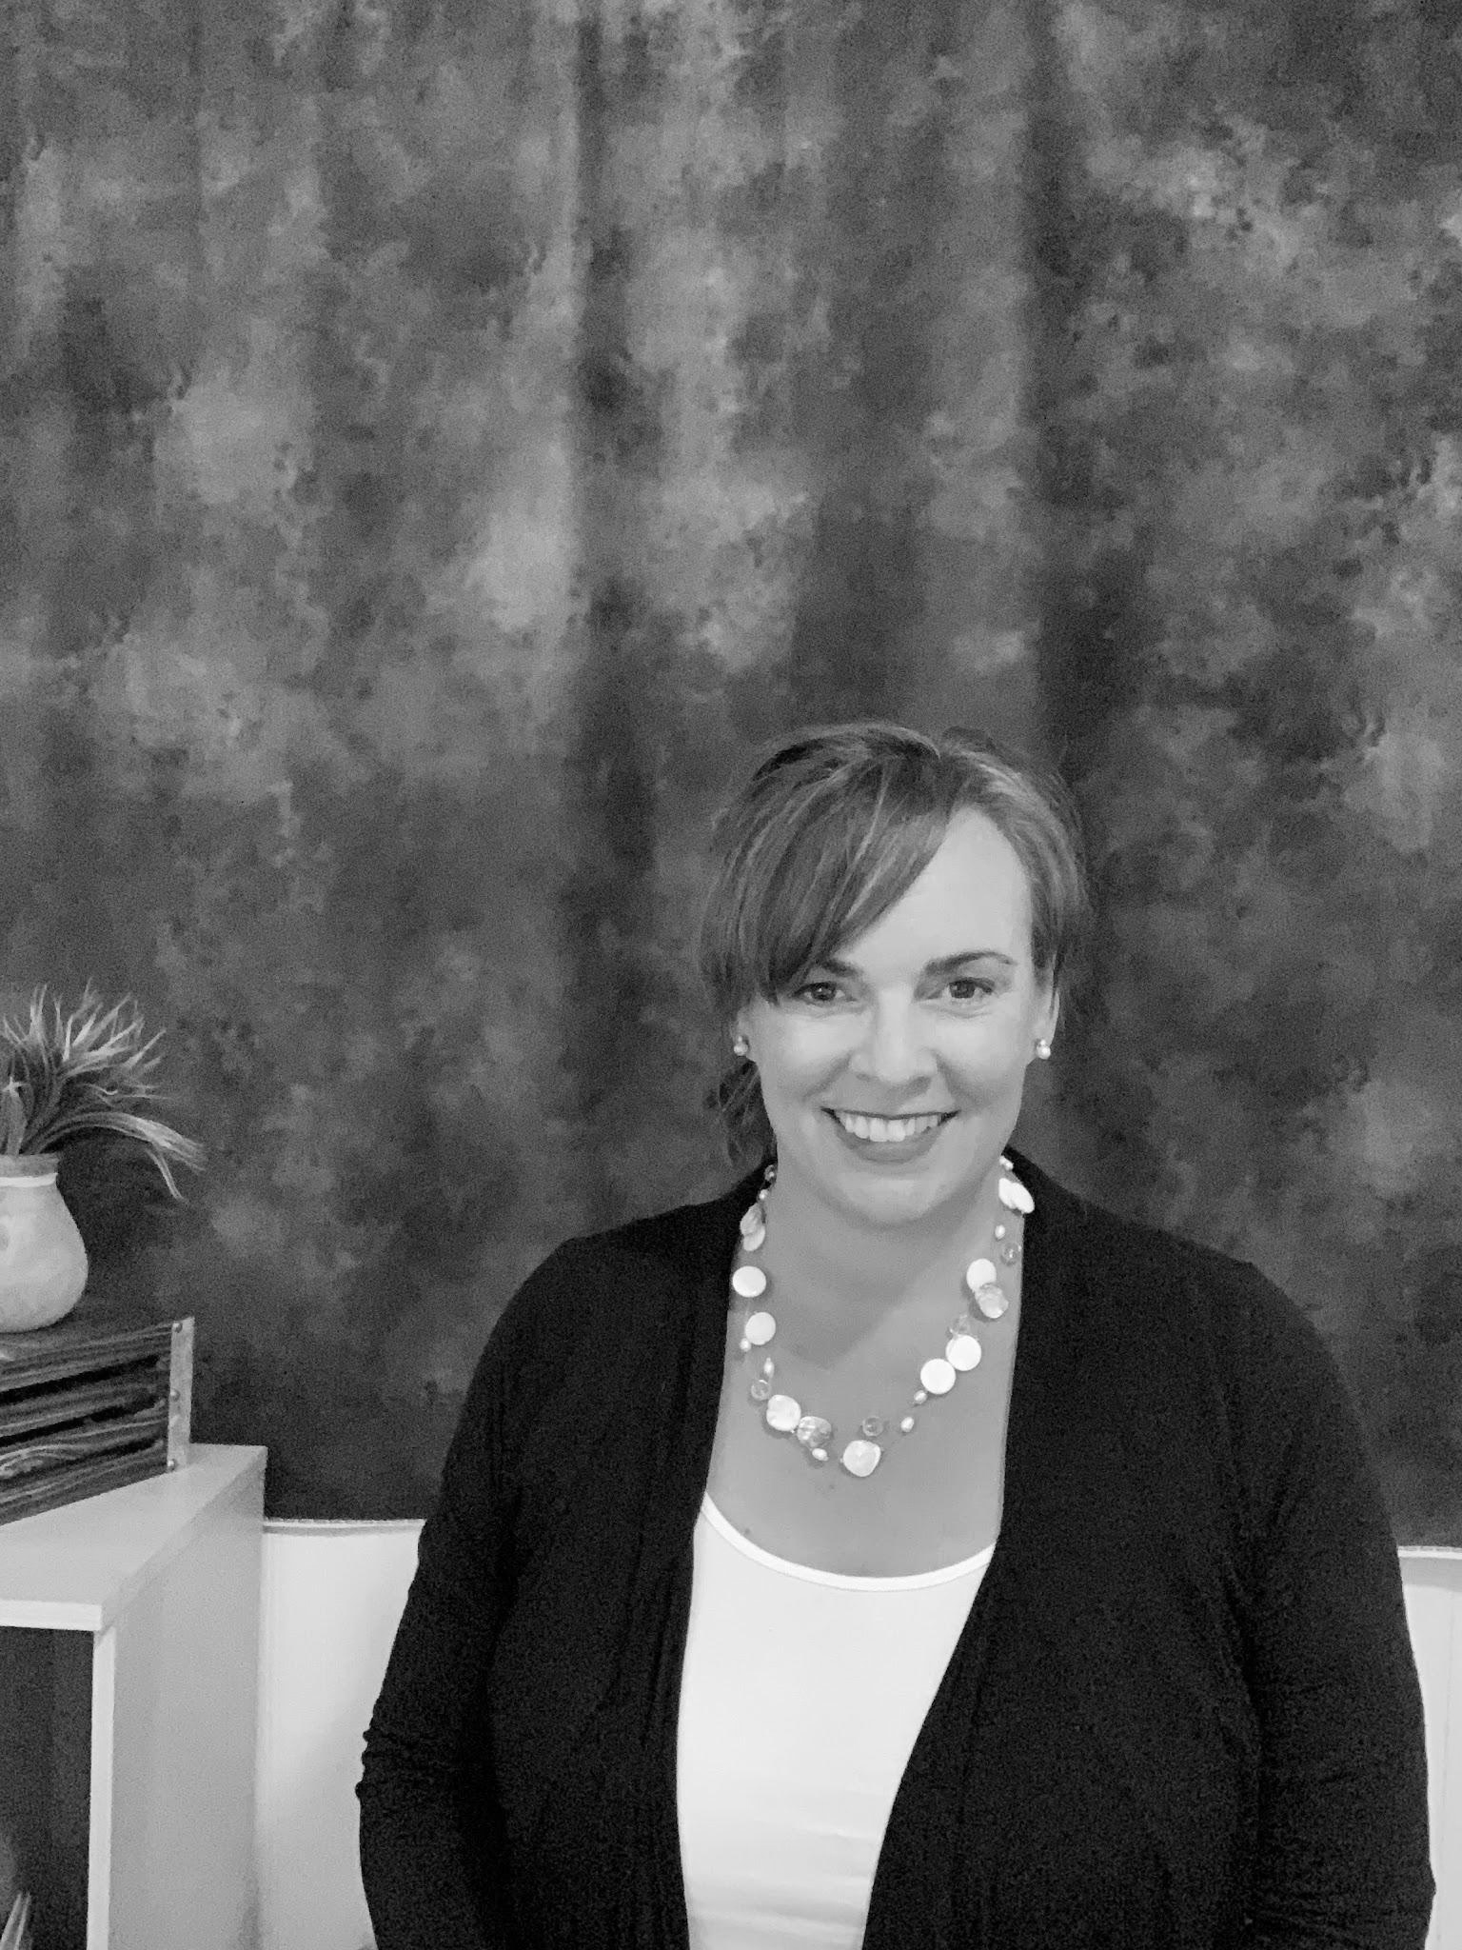
Deanna Maki
Special Education Teacher
  Education Consultant
  Reading/Math Intervention
  Simon Fraser University: Mental Health Study COVID-19
  WGU,UPX,NDC,UH: College of Education Curriculum Alignment
  Danielson Framework: eLearning Support Materials
  Educational Impact: Instructional Design
Author / Workshop Facilitator
  Classroom180: A Framework for Creating, Sustaining and Assessing the Trauma-Informed Classroom (Heather Forbes)
Deanna Maki
President, Educational Impact

Slide 9
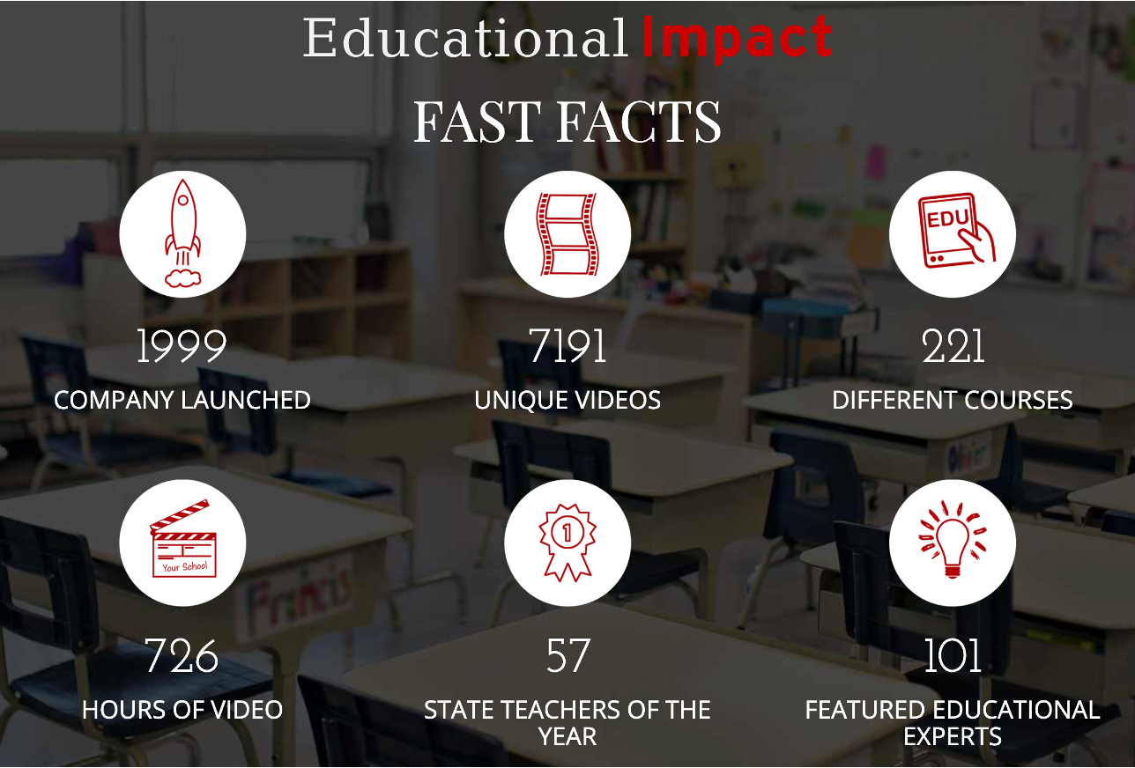
Content Provider
www.educationalimpact.com
Notes:
Deanna

Slide 10
Office of Educator Effectiveness and Leadership Development

Slide 11

Office of Educator Effectiveness and Leadership Development
On-Demand Resources
Instructional Leadership Development
New Teacher & Principal Induction
Professional Growth, Development, and Evaluation
Notes:
The Office of Educator Effectiveness and Leadership Development supports the growth of all educators so that they can be prepared to grow all of their students. This includes creating systems for new teacher and principal induction, supporting professional growth, development, and evaluation in all districts, and offering professional learning opportunities focused on high quality instruction and leadership development.
In our experience and in the research, excellent schools tend to share two characteristics: a clearly communicated vision for teaching and learning, and an inclusive environment.
Our best teachers gravitate toward schools where they can collaborate and grow. School leaders that can provide opportunities for teachers to have a say in how they grow and what they learn end up attracting the best.
The OEELD is committed to providing schools and districts high-quality content that they can use to help teachers continue to grow. The SCDE professional learning library is an important part of that support.

Slide 12
SCDE Professional Learning Library Timeline
May 2021 - September 2021
October 2021 - February 2022
March 2022 – June 2022
July 2022 - August 2022
2022 - 2023
Request for Proposal & Award Process
Design system & Review content
Pilot: Access to Professional Learning Content through PowerSchool.
Training begins.
Professional Learning Library Available in SCLead.
Training continues.
Professional Learning Library Available in Instruction Hub (October), SCLead, & through PowerSchool.
Notes:
In 2018, the SCDE made our commitment to personalized professional learning by adding the first version of the professional learning video library to compliment our roll out of SCLead and the SC Teaching Standards rubric. At the heart of this decision was wanting every district in the state to have high quality resources aligned to the SC teaching and principal standards.
The vision then and now is that educators know they want to keep improving, but often they need fresh ideas, examples, and models to help them make that improvement concrete.
When we gathered feedback from you and your principals about our professional learning library, it was clear you wanted more insight into what resources teachers were choosing and more meaningful access to teachers’ reflective responses.
We started the journey to seek a new professional learning library in May 2021 and were able to start offering access to the content library through PowerSchool in February By June, the resources you will see today will be available through PowerSchool and through the Learning tab in SCLead..
We are optimistic that this new partnership will meet our needs. What makes the new professional learning library unique is a partnership between Educational Impact, a company with deep expertise in designing self-paced courses, and PowerSchool, a company with a platform that makes it easy to administrer personalized professional learning, and the integration of those resources into our existing professional learning infrastructure, SCLead and the Instruction Hub.

Slide 13
PLL Content Highlights
Notes:
Deanna

Slide 14

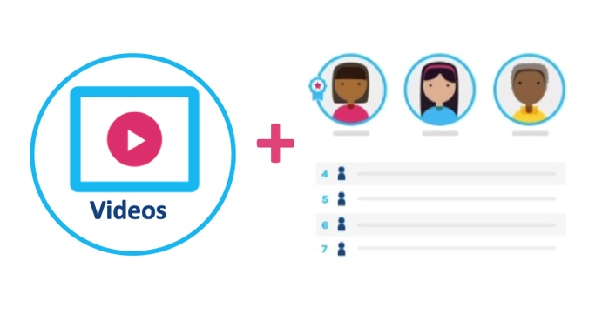
What is the PLL?
Professional Learning Library
  Videos
  Video response
  Reflective writing
  Articles and blogs
  3rd party links
  Discussion boards
  Self-assessment
  Multiple choice assessments
  Multimedia Learning Experience
Notes:
Deanna

Slide 15
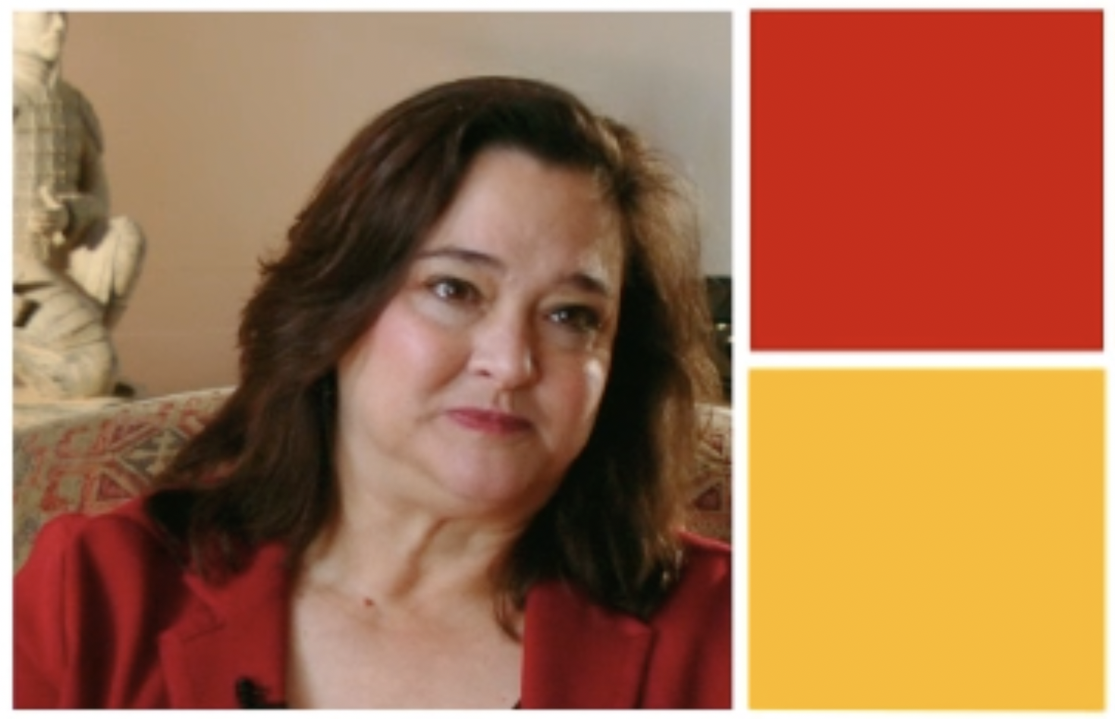
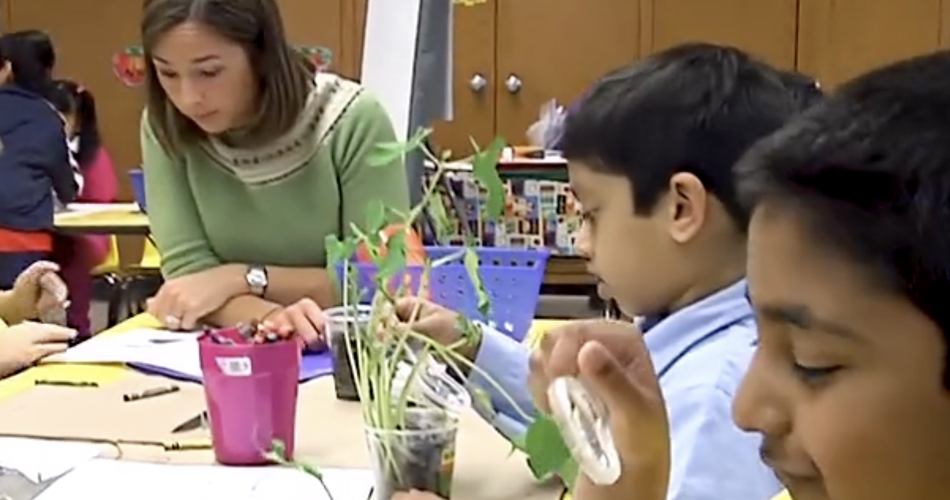
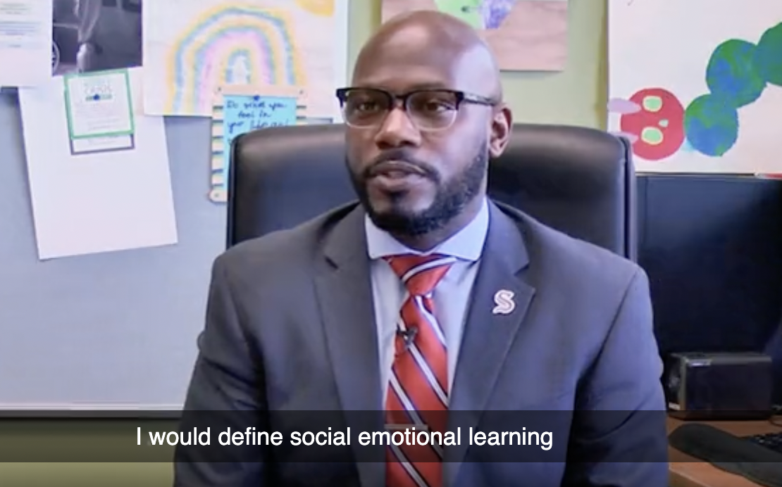
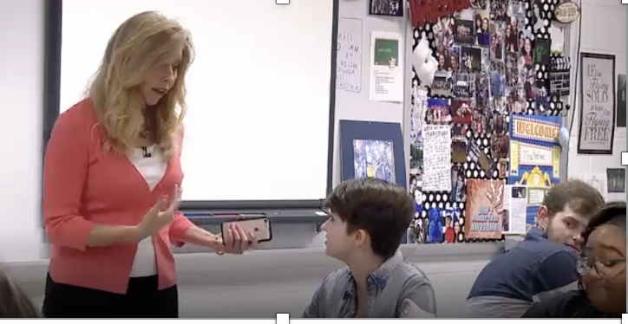
PLL Content Highlights
Analysis
Custom
Changemakers
Don’ts
Can turn cc off/on
Notes:
Deanna

Slide 16

PLL Favorites
ACES / Trauma
SEL
ESE / Diverse Learning Needs
Return to Learning
Technology
Literacy
(in development)
SCTS 4.0
Minis
PADEPP
My Plan
Notes:
Deanna

Slide 17
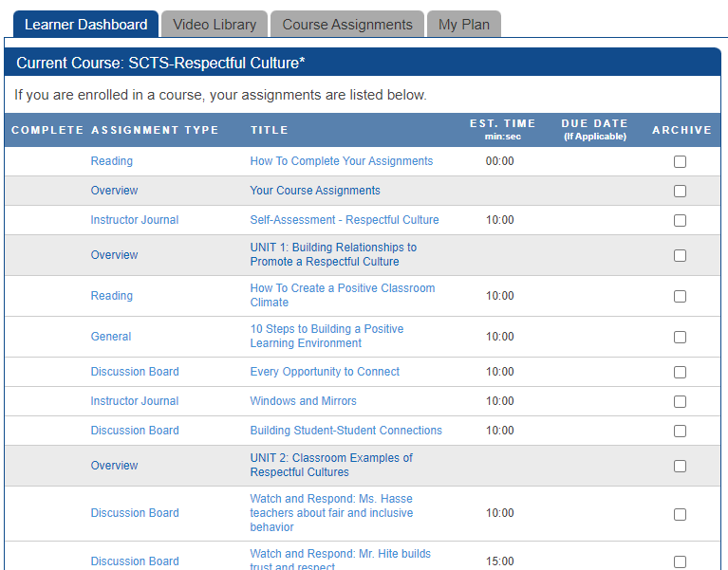
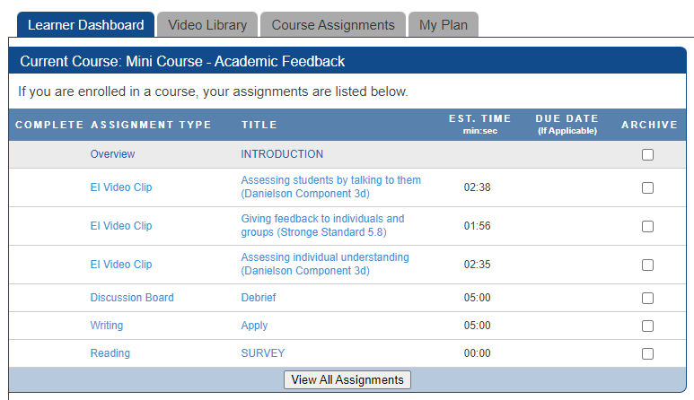
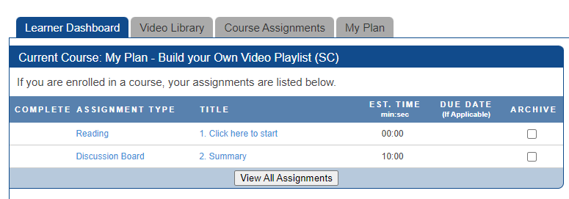
PLL Courses, Minis and Videos
Full Courses (2+ hours)
Videos
Articles
Discussion Boards and Reflections
3rd party links
Assessment
SCTS courses include rubric and indicators
Mini Courses (< 1 hour)
Curated Video list
1 Discussion Board
1 Reflection
My Plan
Build your own video playlist
Search for videos by topic, SCTS standard or PADEPP standard
Notes:
Deanna

Slide 18
How it Works
Notes:
Deanna

Slide 19






The Integration
SCLead.org
Ed Impact PLL
Professional Learning
SC Instruction Hub

Slide 20
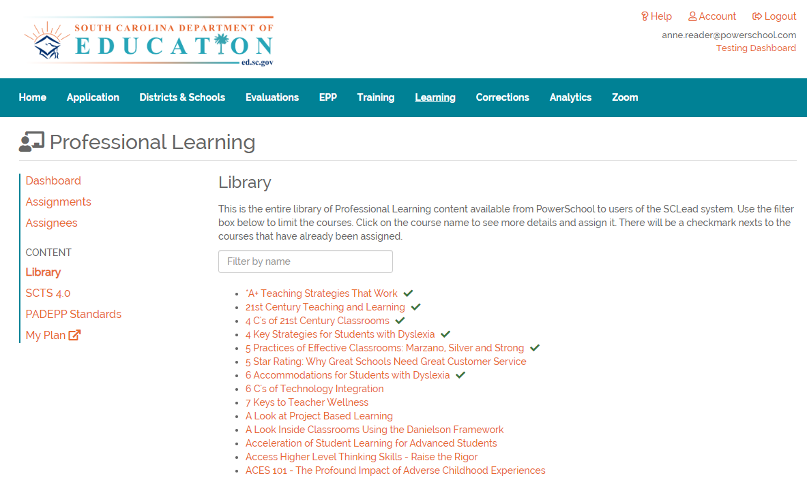
1) Start in SC Lead
SCLead.org
Click Library, SCTS 4.0 or PADEPP Standards
The PLL courses are listed alphabetically, or by standard
Click the Course Title to view
Courses may be assigned or open to self-registration
Notes:
Deanna

Slide 21
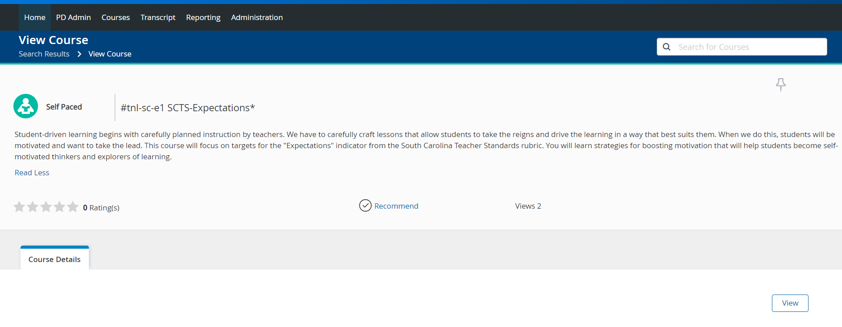
2) Register in Professional Learning
Read course description
Click View to launch the Ed Impact PLL course content in a new tab or browser window
Notes:
Deanna

Slide 22
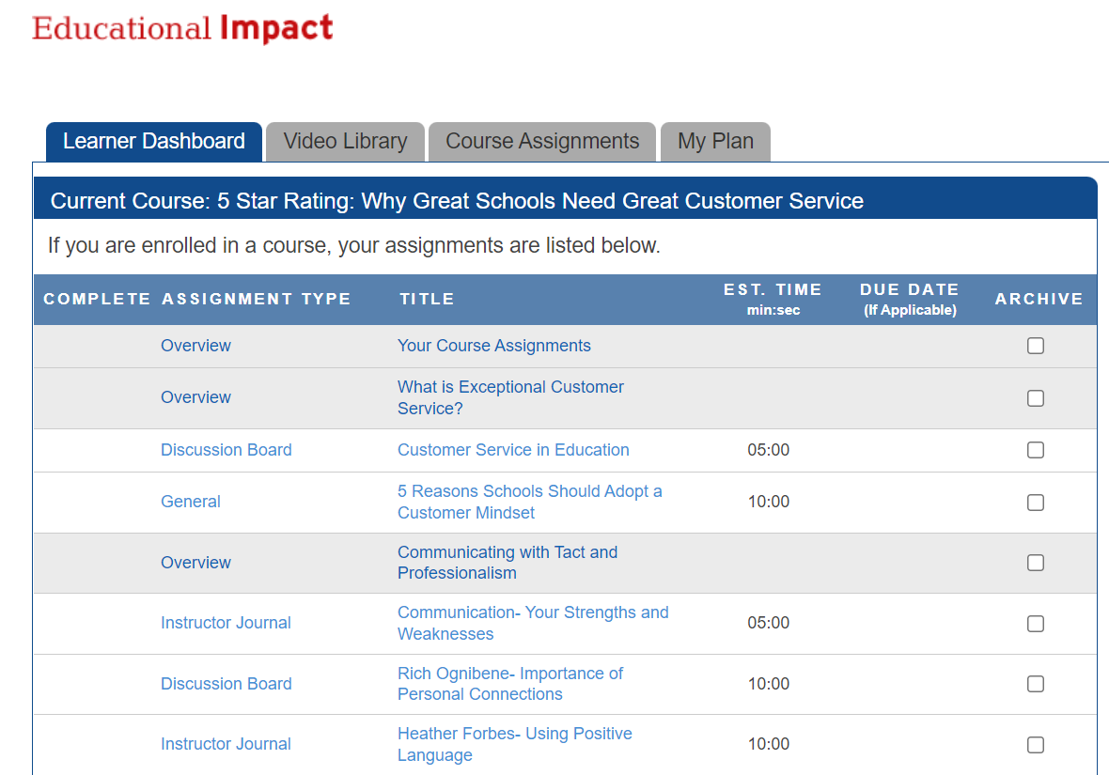
3) Access Content in Ed Impact
You will be taken to Educational Impact’s Learner Dashboard where you will see your course title and list of assignments
Move through each content item at your own pace
Complete in one sitting or resume later
Use the Course Assignments tab to navigate back to your list of assignments at any point
Notes:
Deanna

Slide 23
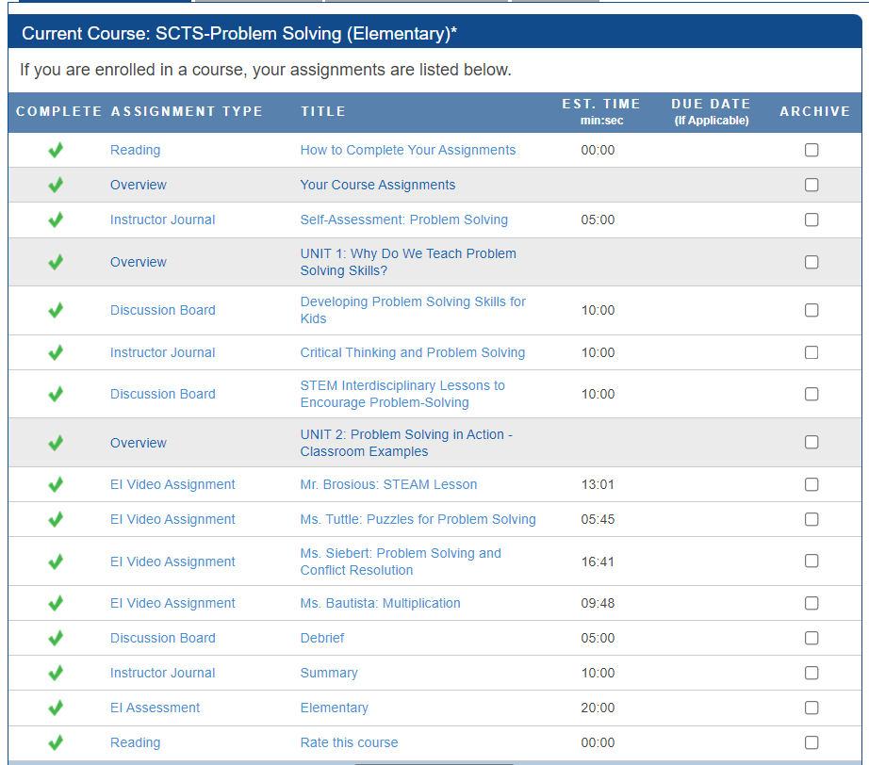
4) Complete Course Assignments in Ed Impact
Work through all the content within Educational Impact
Once finished, the course completion information will travel back to Professional Learning and appear on the user transcript
Course completions will also travel back to SCLead.org
Notes:
Deanna

Slide 24
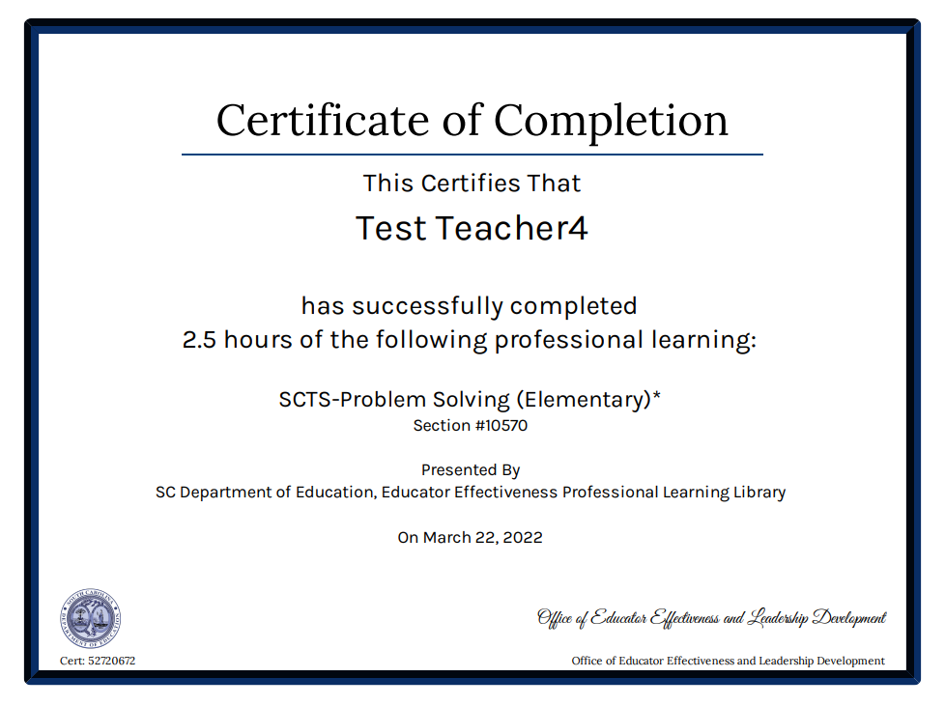
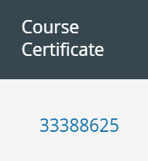
5) Earn a Certificate in Professional Learning
Professional Learning autogenerates a course certificate for those courses earning SCDE Renewal Credits:
  SCTS Courses
  PADEPP Courses
Certificates are linked within the user transcript
Notes:
Deanna

Slide 25
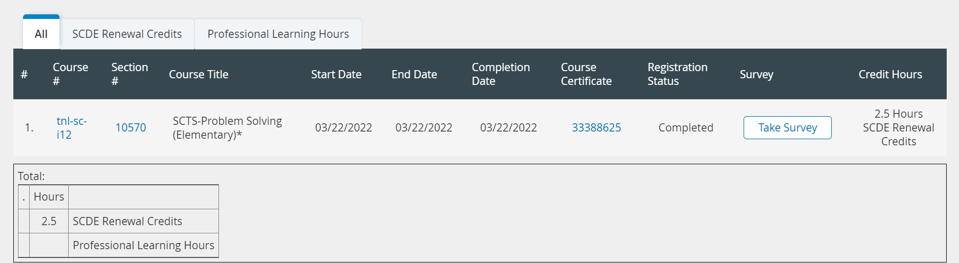
6) Keep Track of Credits in Professional Learning
Professional Learning
Click the Transcript tab to view all course completions
Courses earn SCDE Renewal Credits or Professional Learning Hours
Notes:
SCDE will award renewal credit for the courses directly related to the SCTS and PADEPP rubrics. SCDE encourages your district to grant renewal credit for other courses, but you have authority to make those decisions as a district.

Slide 26

SCLead.org
SCLead.org
SC Instruction Hub
Educational Impact
Professional Learning

Slide 27
SCLead.org Access
Users with accounts in SCLead.org will access the PLL seamlessly through the Learning tab
SCLead.org
Ed Impact PLL
Professional Learning

Slide 28
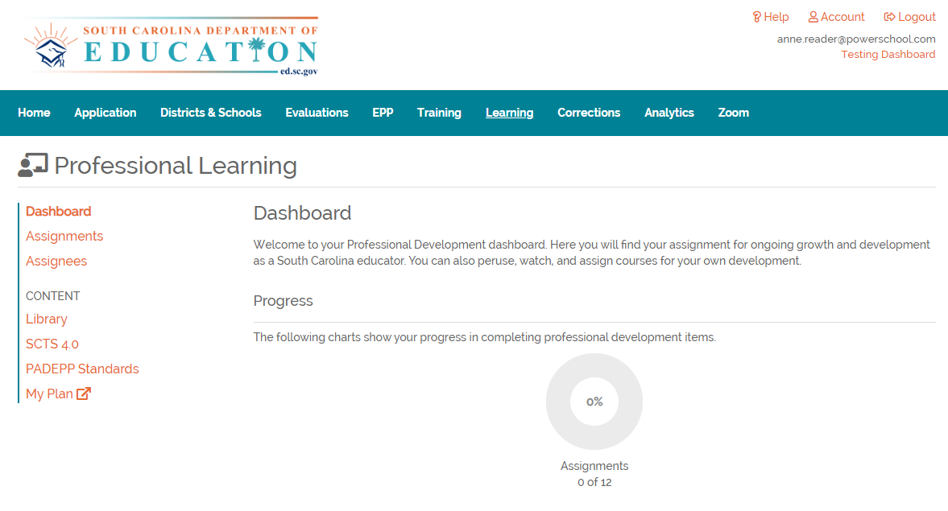
SCLead.org Dashboard
SCLead.org
Login to SCLead.org
Click the Learning tab
View assignment progress on the Dashboard

Slide 29
Accessing the PLL
SCLead.org
Click Library, SCTS 4.0 or PADEPP Standards
The PLL courses are listed alphabetically, or by standard
Click the Course Title to view

Slide 30
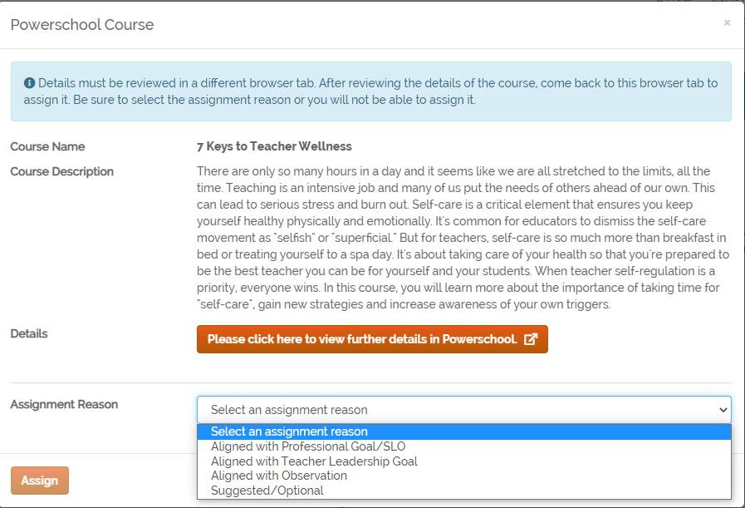
Assign Courses
SCLead.org
Choose an Assignment Reason from the drop-down
Click Assign

Slide 31
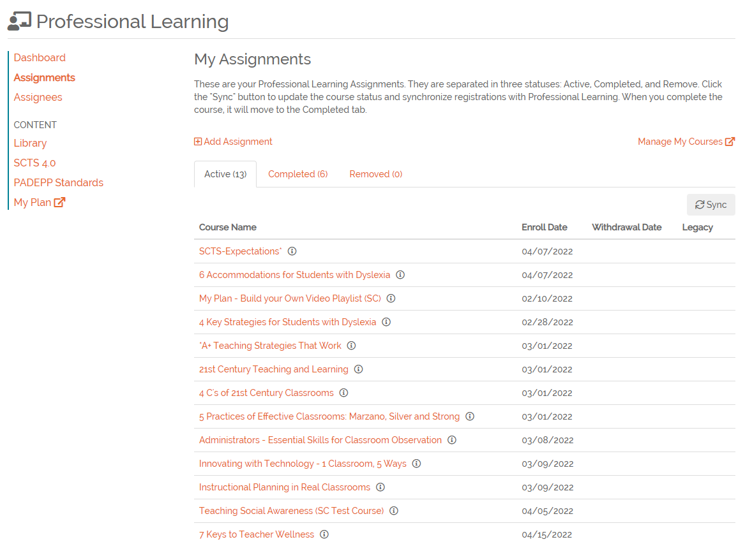
SCLead.org Assignments
SCLead.org
Click Assignments to view current courses
Click the Active, Completed or Removed tabs
Click Sync to connect to PowerSchool completion data
Hover over the “i” to view the Assignment Reason code
Click the Course Title to launch Professional Learning

Slide 32
Professional Learning Course Details
Click View to launch the Ed Impact PLL course content in a new tab or browser window

Slide 33
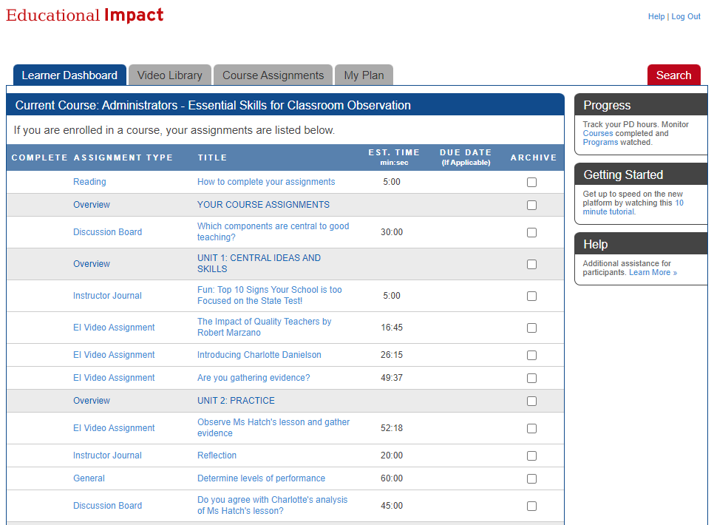
Course Details
Ed Impact PLL
Work through course content at your own pace

Slide 34
Viewing Assignees
SCLead.org
SC Instruction Hub
Educational Impact
Professional Learning

Slide 35
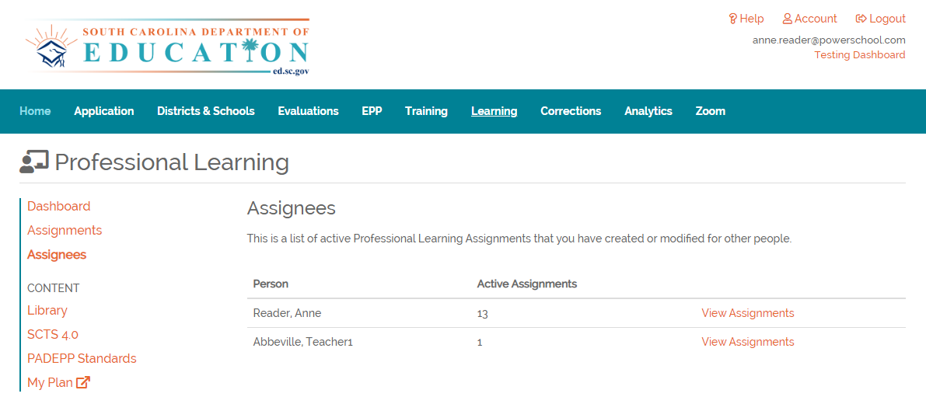
View Assignees
SCLead.org
Click Assignees
Click View Assignments to see what courses the user has in progress

Slide 36
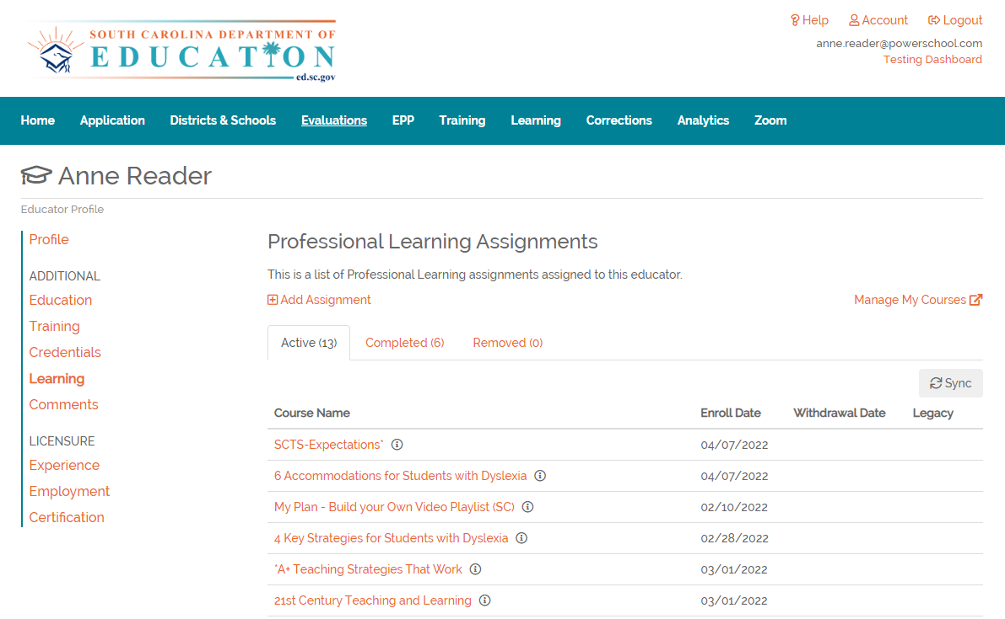
Assignee’s Course Progress
SCLead.org
Move through the Active, Completed and Removed tabs to view the Assignee’s course progress

Slide 37
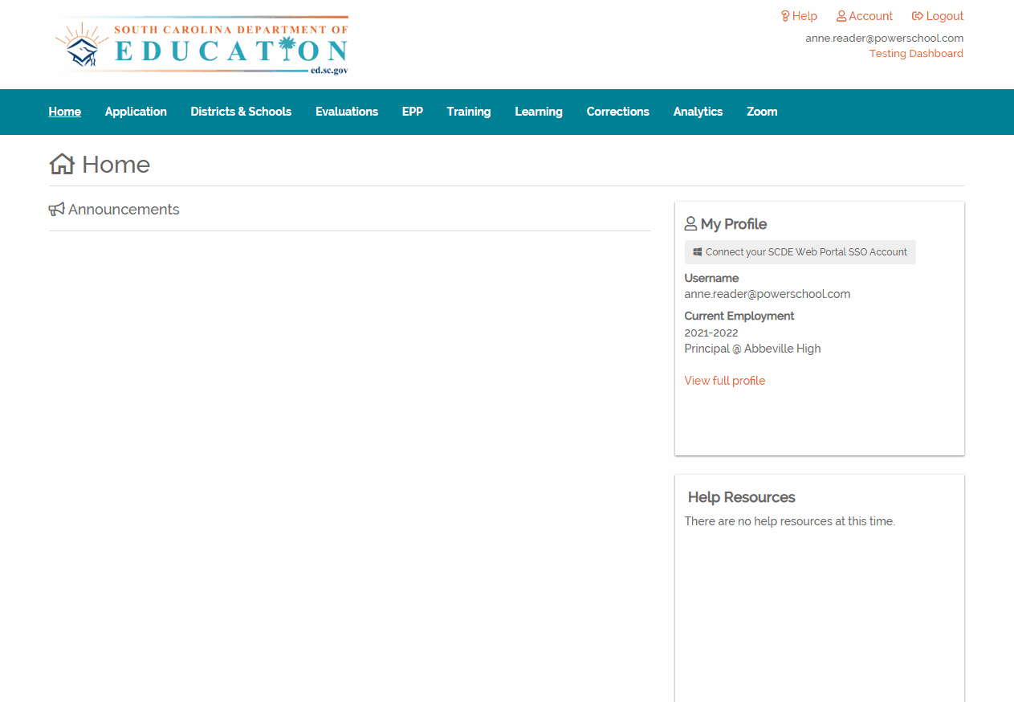
Post-Observation Assignment
SCLead.org
Assign PLL content through the Post-Conference form

Slide 38
Robust Searching using PowerSchool Professional Learning
Notes:
Deanna

Slide 39
Additional Features
Professional Learning
Search courses by keyword, advanced, catalog browse, tag or rating
Pin courses to Favorites List
Resume courses
Withdraw from courses
Complete course surveys
Rate courses
View transcript
View certificates
Notes:
Deanna

Slide 40
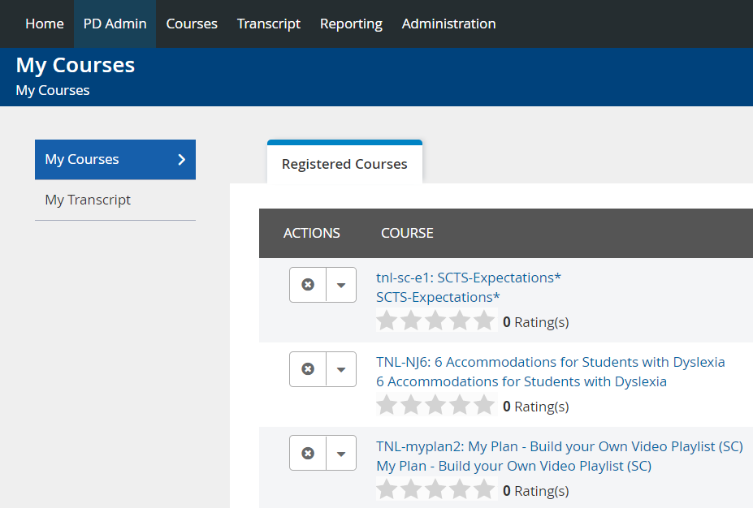
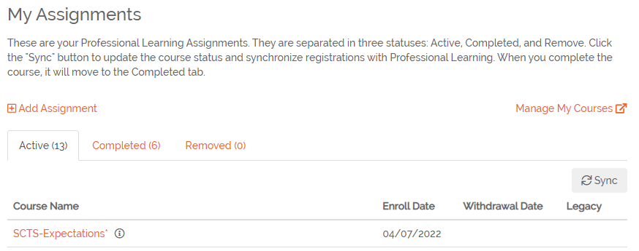
Search for Courses Using Filters
Professional Learning
In SCLead.org click Manage My Courses to open Professional Learning
In Professional Learning, click the Courses tab
1
2
2
1
Notes:
Deanna turn over to Anne for live demo after this

Slide 41
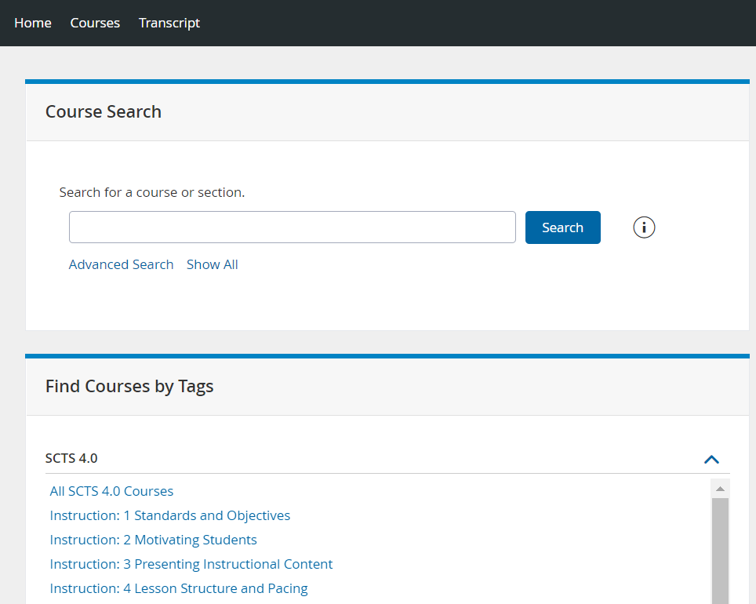
Course Search
Professional Learning
Keyword Search
Advanced Search
Show All to browse the catalog
Filter by Course Tag
1
2
1
3
2
3
4
4
Notes:
Anne – live demo

Slide 42
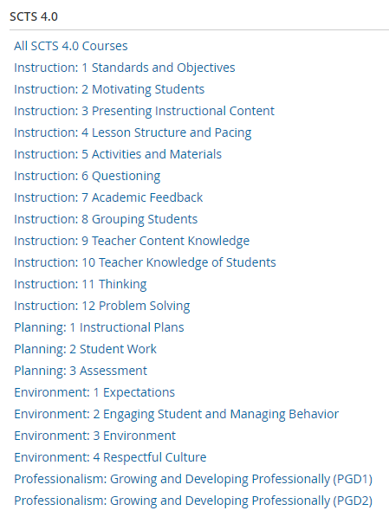
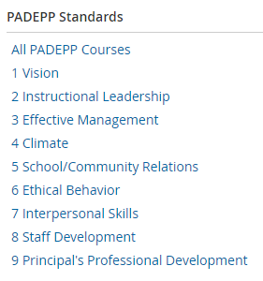
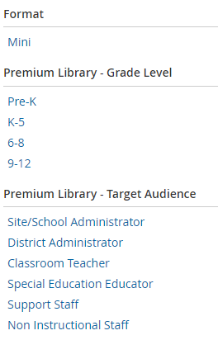
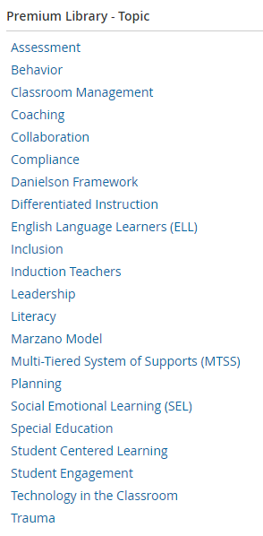
Robust Catalog Filtering by Tag
Professional Learning
Notes:
Anne

Slide 43
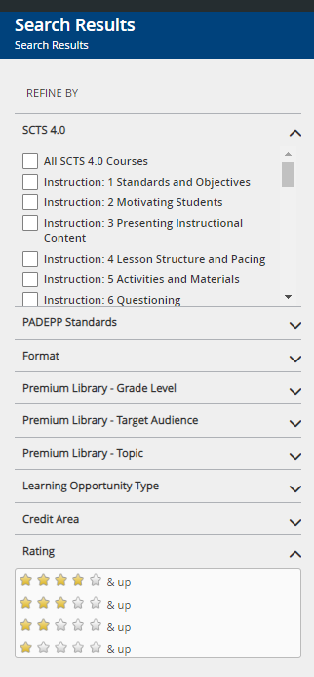
Filter Catalog Search Results
Professional Learning
Click the arrow to open filters
Select a tag or set of tags to filter the catalog
Filter course catalog by Rating
Notes:
Anne

Slide 44
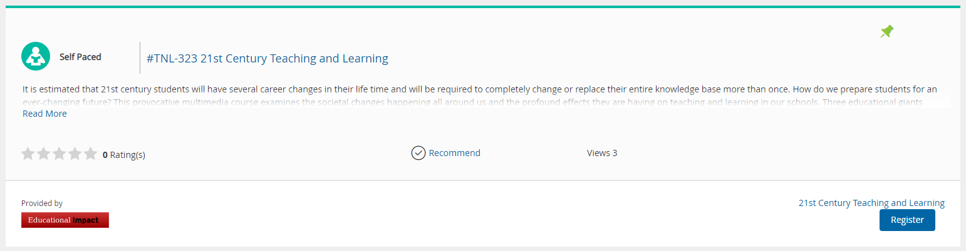
How to Save Favorites
Professional Learning
From the Course Catalog, pin courses to a Favorites List to view later
Notes:
Anne

Slide 45
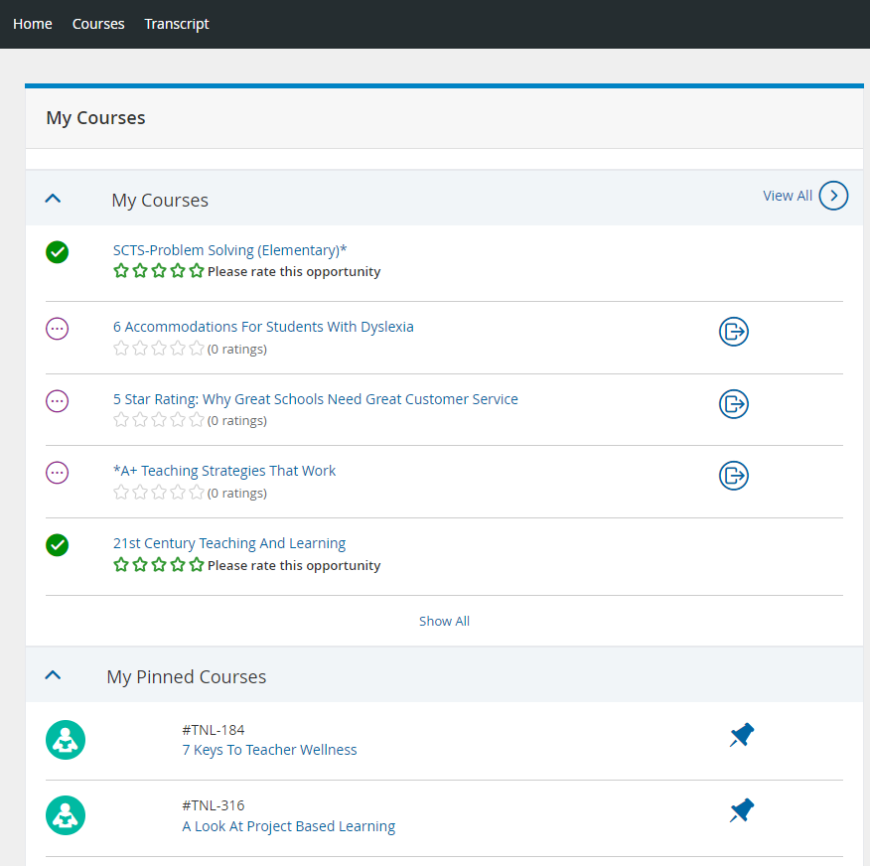
Resume a Course
Professional Learning
Click the Courses tab
Scroll to the My Courses channel
Click the Course Title to resume course
  Ed Impact PLL content will open in new tab or browser window
Notes:
Anne

Slide 46
Withdraw From a Course
Professional Learning
Click the Courses tab
Scroll to the My Courses channel
Click the Withdraw button
Confirm withdrawal
Notes:
Anne

Slide 47
Rate a Course
Professional Learning
Click the Courses tab
Scroll to the My Courses channel
Click the Star Rating to rate
Notes:
Anne

Slide 48
How to View Favorites
Professional Learning
Click the Courses tab
Scroll to the My Courses channel
Expand My Pinned Courses
Click the Pin to remove from Favorites
Notes:
Anne

Slide 49
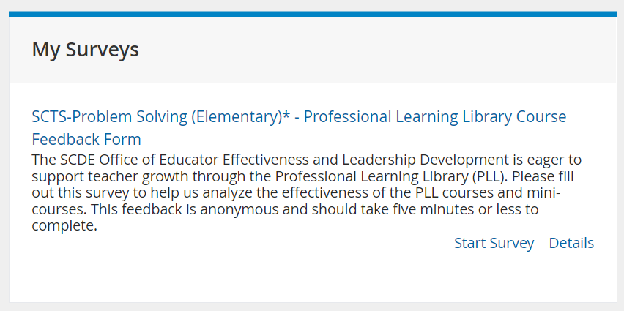
Course Surveys
Professional Learning
Each course has a survey available upon completion
Click the Courses tab
Scroll to the My Surveys Channel
Click Start Survey
Notes:
Anne

Slide 50
Summary
Targeted PD: Connect teachers to their Areas of Reinforcement and Refinement
Content is responsive and based on current initiatives
More rigor and relevance
Courses earn SCDE Renewal Credit or Professional Learning Hours
  PL Hours are used at the district’s discretion
Robust reports
Course ratings and surveys
Access to top speakers, experts and master teachers
Provide educators with voice and choice
Questions?
Notes:
Deanna

Slide 51
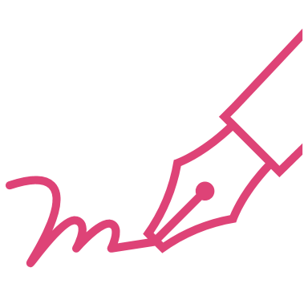
Coming October 2022
PowerSchool is working with the SC Instruction Hub to allow users to login to access the PLL seamlessly
Ed Impact PLL
Professional Learning
SC Instruction Hub
PowerSchool is working to improve the current integration to allow Evaluators to view Assignee written reflections

Slide 52
Additional Learning Opportunities
District-Level Q&A Session
  August 8, 1:00-1:45pm EST
      Register Now!
Mixed Audience Q&A Session
  November 7, 3:30-4:15pm EST
      Register Now!
Educator Training
  September 1, 3:30-5:00pm EST
  October 13, 3:30-5:00pm EST
      Register Now!
Educator Q&A Session
  September 29, 3:00-3:45pm EST
      Register Now!

Slide 53
Questions?

Slide 54
Thank you for attending, District Level Users!
In 5 minutes, we will resume training, focusing on District Technical Support Enablement

Slide 55
Additional Resources / FAQs

Slide 56
I finished the course assignments, but I don’t see the credit on my transcript.
The learner has not checked something off as complete.
The learner has archived an assignment. Click on the Assignments tab and then click on the “Archived” assignments to see if there are any assignments in there. If so, unarchive them.
The learner has not mastered the assessment – it will be marked complete automatically when 80% mastery is achieved
The learner has not watched an “EI Video Clip” all the way to the end. It will be marked complete automatically when the clip is watched in one sitting.
If none of these steps resolve the problem, please reach out to your district technical contact for support.

Slide 57
How do I mark the EI Assessment complete?
You cannot manually mark the Assessment complete.
Instead, the system marks the Assessment complete automatically when the user reaches at least 80% correct.

Slide 58
How do I mark the EI Video Clip complete?
You cannot manually mark the EI Video Clips complete.
Instead, the system marks the Video Clips complete automatically when the user watches the entire clip from start to finish.
These are different from “EI Video Assignments” which are used to assign multiple clips and can be marked complete by the learner.

Slide 59
I encountered a dead link inside one of the assignments. What do I do?
On occasion, links to articles/videos from 3rd party websites are moved or updated.
Ed Impact does not control those links as they are to websites like Edutopia, TED Talks, Understood, etc.
Ed Impact’s instructional design team will respond immediately to dead links and update the assignment quickly.
Please email support@educationalimpact.com if you encounter dead links.

Slide 60
Building Your Own Video Playlist
SCLead.org
SC Instruction Hub
Ed Impact PLL
Professional Learning

Slide 61
Build a Video Playlist
SC Lead
My Plan allows teachers to take charge of their own Professional Development
Click My Plan to launch course information in Professional Learning

Slide 62
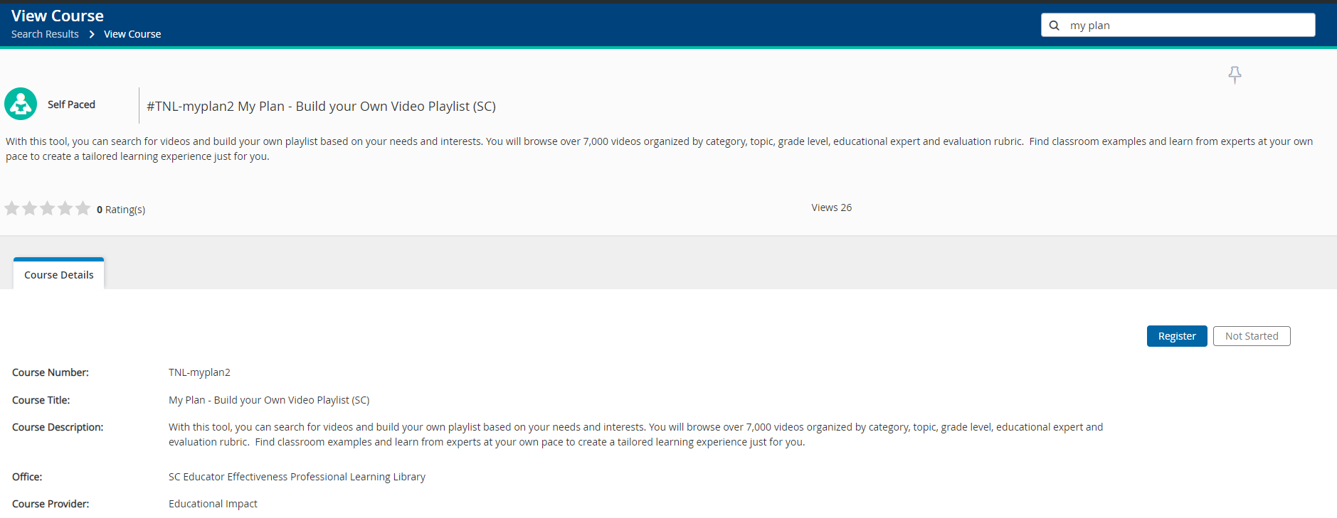
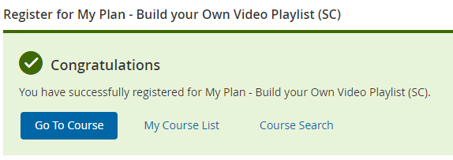
Register for My Plan
Professional Learning
First-time users will need to Register for the course to access
Click Go to Course to launch the Educational Impact My Plan

Slide 63
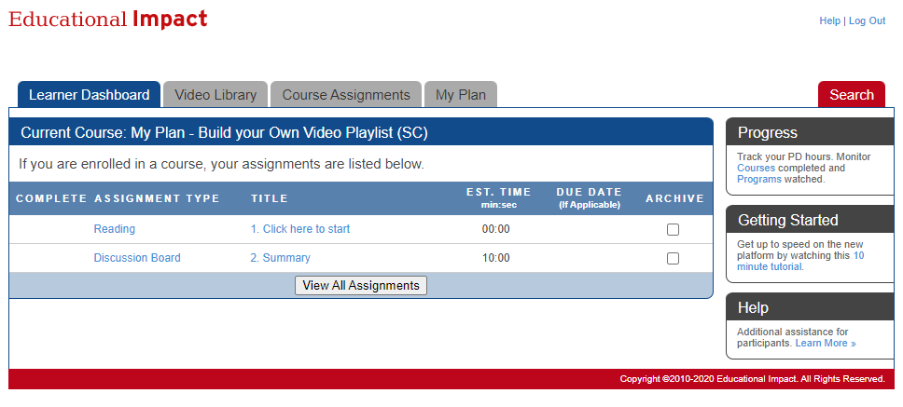
Ed Impact My Plan
Ed Impact
Begin the course by reading the “Click Here to Start” information

Slide 64
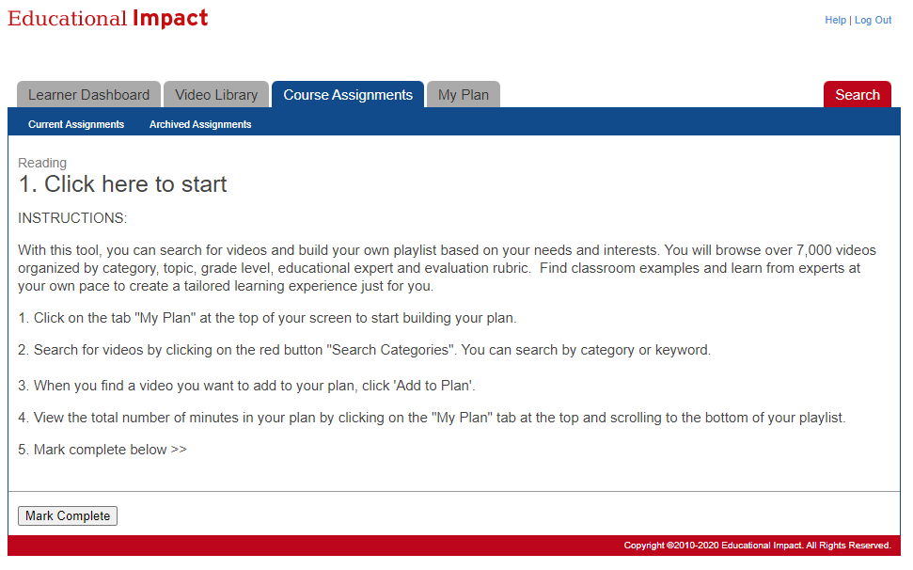
My Plan Tab
Ed Impact
When ready, navigate to the My Plan tab and begin selecting videos of interest

Slide 65
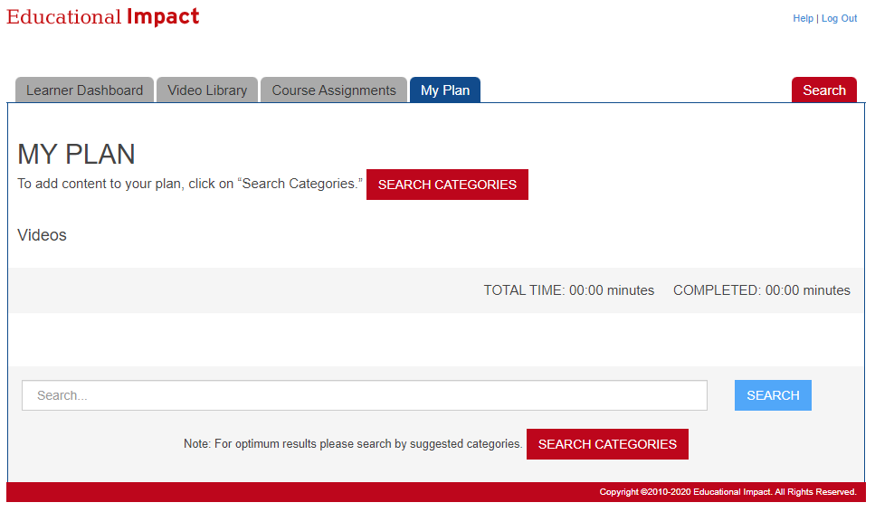
Search Categories
Ed Impact
Click Search Categories to browse video content
Search for video content by keyword

Slide 66
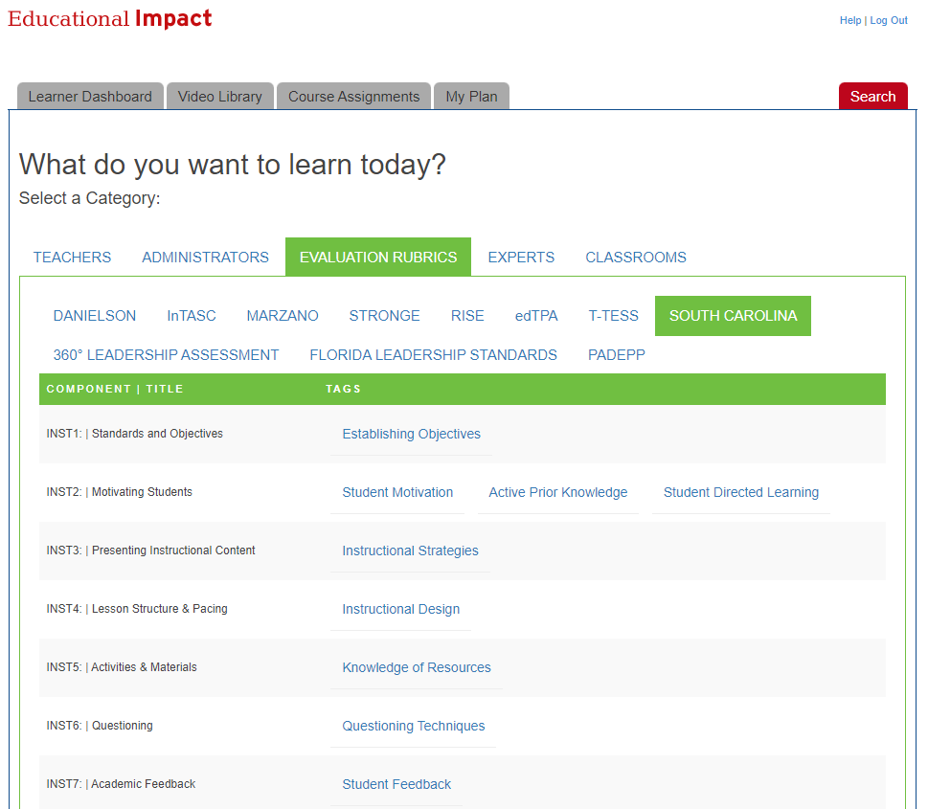
Browse by Category
Ed Impact
What do you want to learn today?

Slide 67
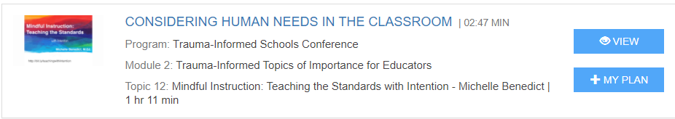
Add Content to My Plan
Ed Impact
Click View to preview content
Click +My Plan to add content to your Playlist

Slide 68
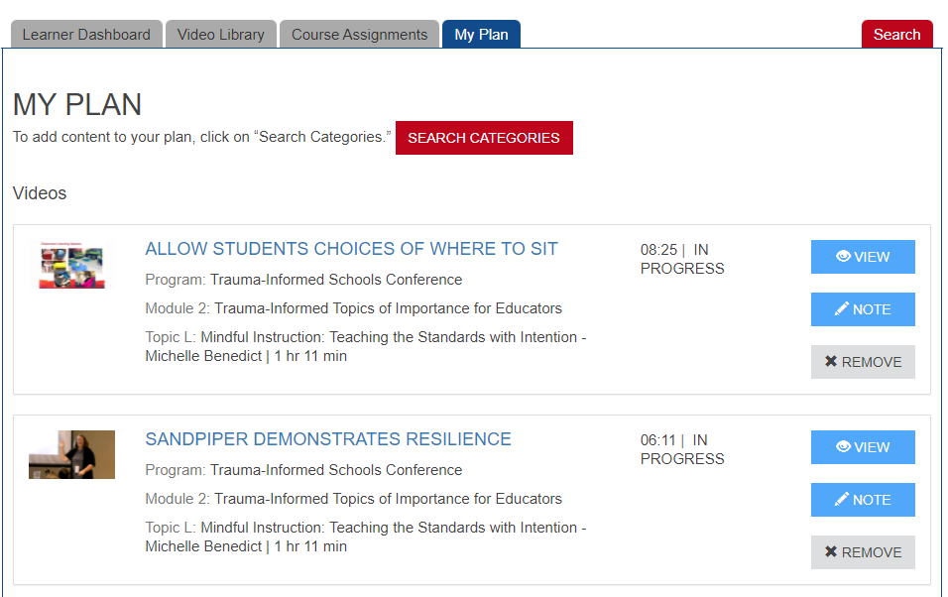
Review My Plan
Ed Impact
Click the My Plan tab to review content added to your Playlist
Use the buttons on the right to view, write notes or remove videos

