Slide 1

Professional Learning Library
SIS + Schoology LMS + Assessment + Analytics + Naviance CCLR
How to Complete Courses from Educational Impact
Last updated: 5-12-22

Slide 2
Table of Contents
Accessing the Professional Learning Library (PLL)
Navigating Educational Impact (EI)
Completing a Reading Assignment
Completing the Overview Assignment
Completing a Discussion Board
Completing an Instructor Journal
Completing an EI Video Clip
Completing an EI Video Assignment
Completing a General/Writing Assignment
Completing an Assessment
FAQs / Troubleshooting

Slide 3
Accessing the PLL

Slide 4
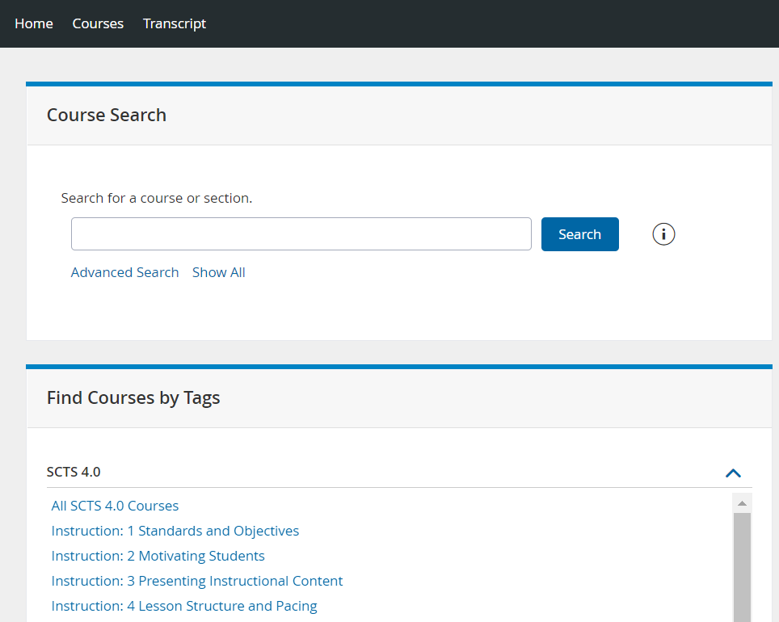
Search for Courses
Keyword Search
Advanced Search
Show All to browse the catalog
Filter by Course Tag
1
2
1
3
2
3
4
4

Slide 5
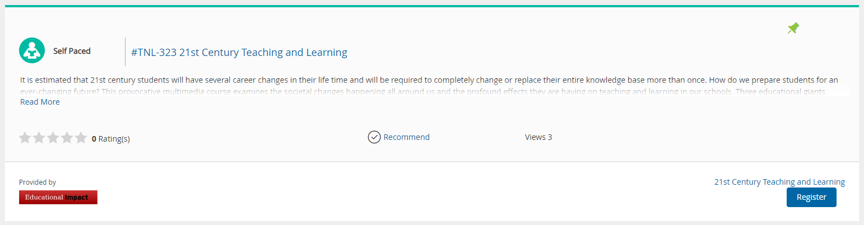
Register
From the Course Catalog, click the Register button

Slide 6
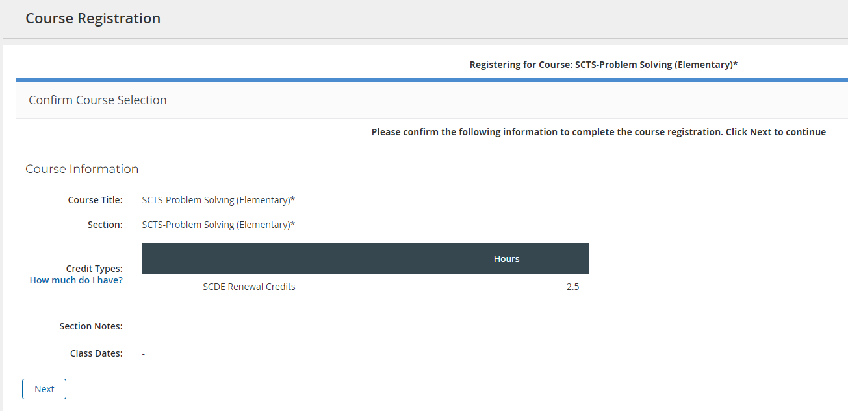
Confirm Registration
Click Next to confirm Registration

Slide 7
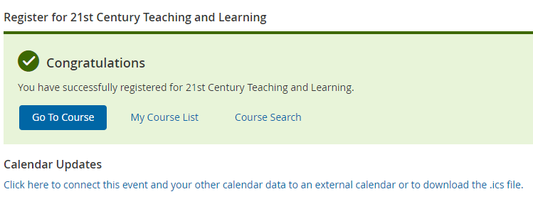
Launch
Once registered, click Go to Course
This will launch the Educational Impact content in a new tab or browser window

Slide 8
Navigating EdImpact

Slide 9
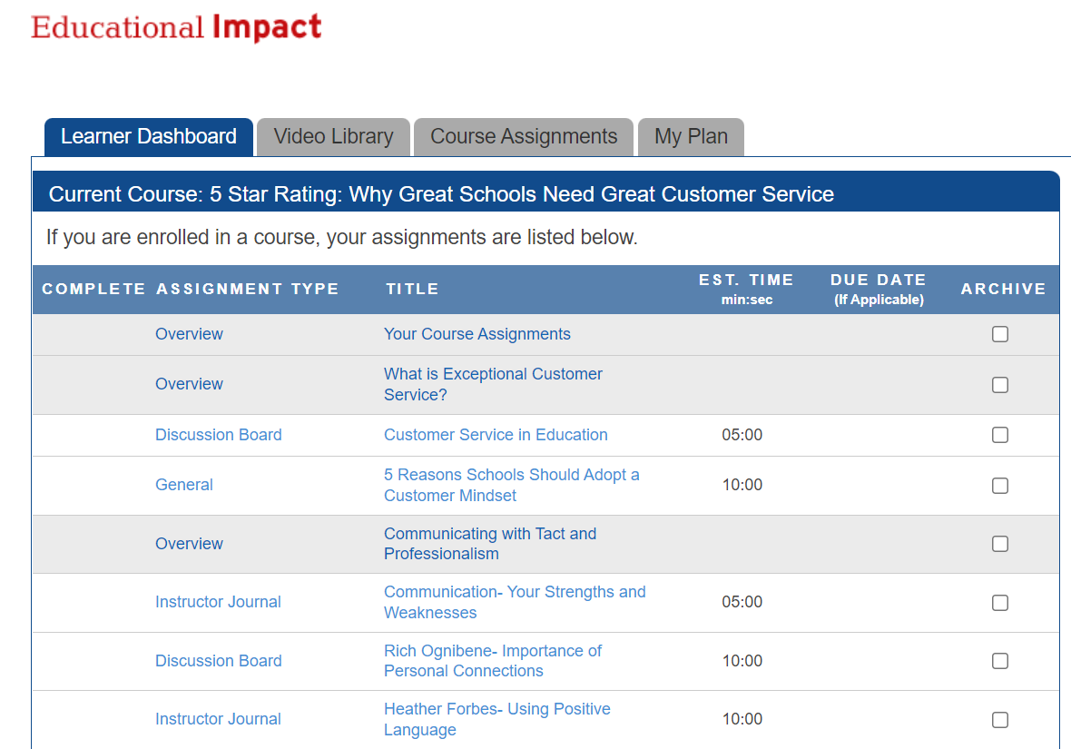
View Learner Dashboard
You will be taken to Educational Impact’s Learner Dashboard where you will see your course title and list of assignments
Move through each content item at your own pace
Complete in one sitting or resume later
Use the Course Assignments tab to navigate back to your list of assignments at any point

Slide 10
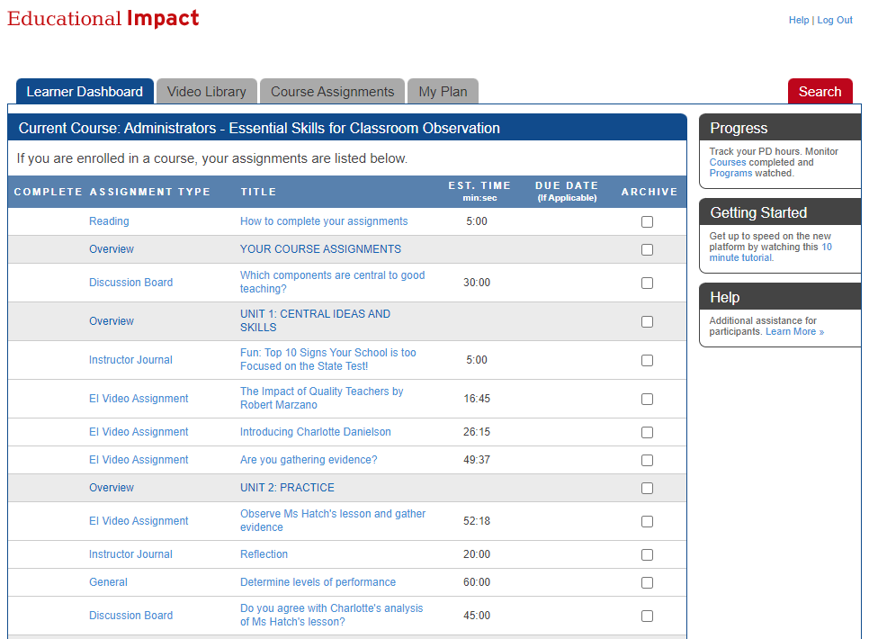
Different Types of Assignments
Videos
Articles
Watch, Read and Respond: Some assignments require a written response
  Discussion Boards
  Instructor Journals
  General
  Writing
Multiple Choice Assessments

Slide 11
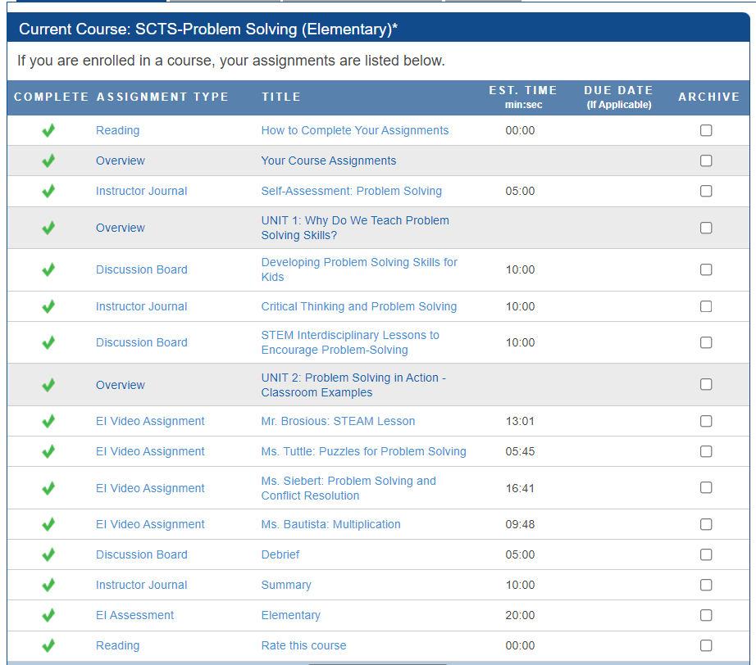
Marking Complete
Work through all the content within Educational Impact
Every assignment must have a green checkmark beside it
Once finished, the course completion information will travel back to Professional Learning and appear on the user transcript

Slide 12
Archiving
Please ignore the Archive column
Do not ARCHIVE assignments as this removes the assignment from your list and impedes course completion
If you have archived an assignment by mistake, you can unarchive it

Slide 13
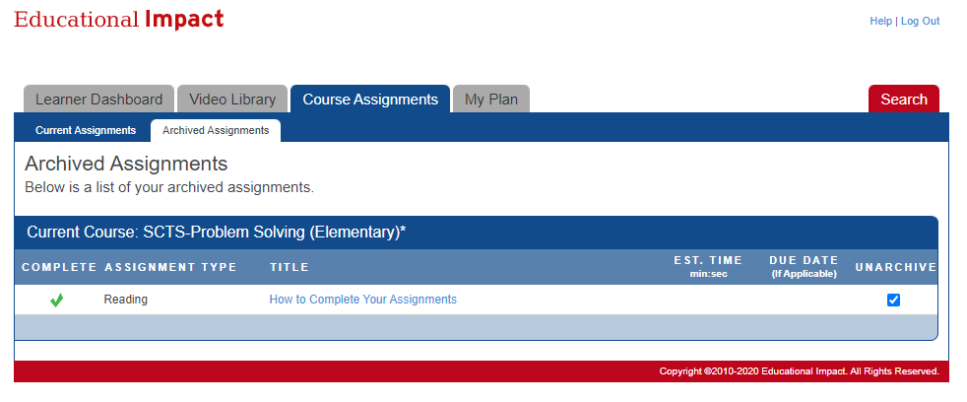
Unarchiving Assignments
Click on the Course Assignments tab
Click on Archived Assignments
Check the box next to each assignment to unarchive
Unarchived assignments will return to the list of current assignments

Slide 14
Completing a Reading Assignment

Slide 15
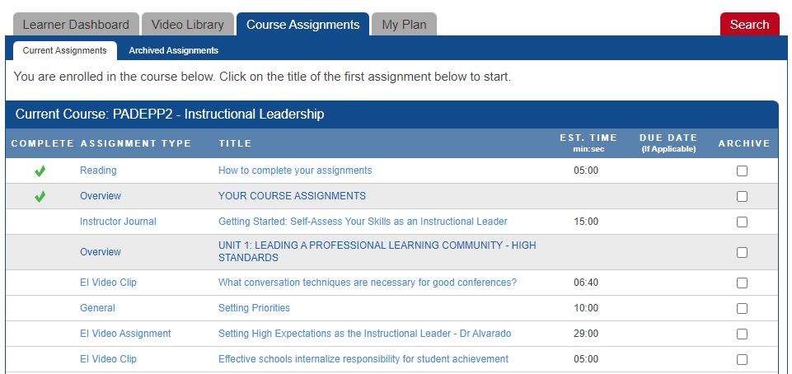
Open the Reading Assignment
Click the title to open the Reading Assignment

Slide 16
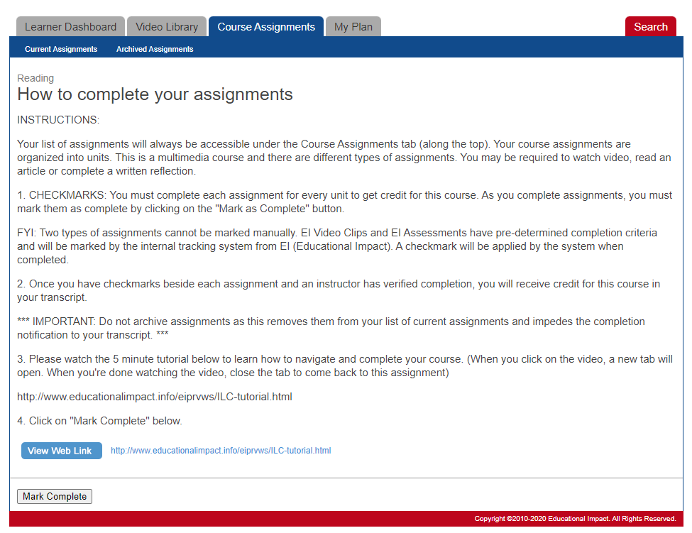
Review Reading Materials
Read the text provided
If there is an article or file to view, click on it to open in a new tab
Read the material
Close the tab to return to the assignment
Click Mark Complete when done

Slide 17
Confirm Reading Completion
Confirm completion by looking for the green checkmark

Slide 18
Completing the Overview Assignment

Slide 19
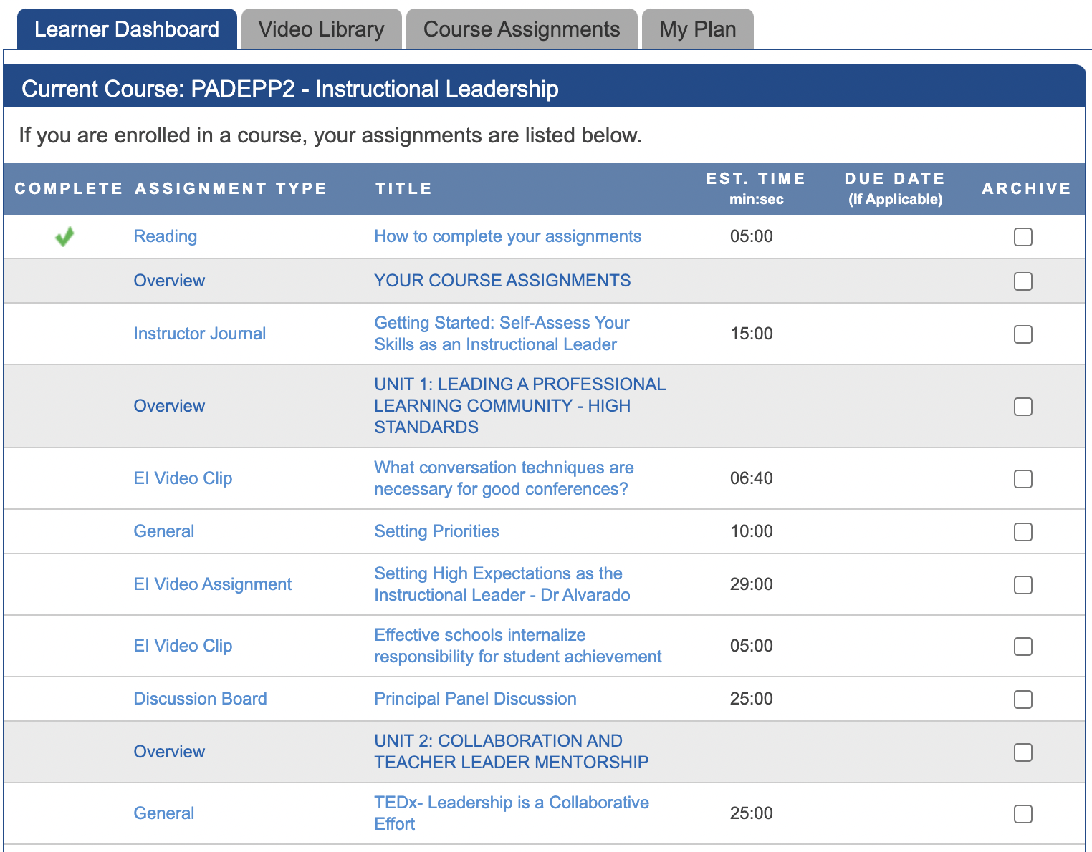
Open Overview
Click the title to open the Overview assignment

Slide 20
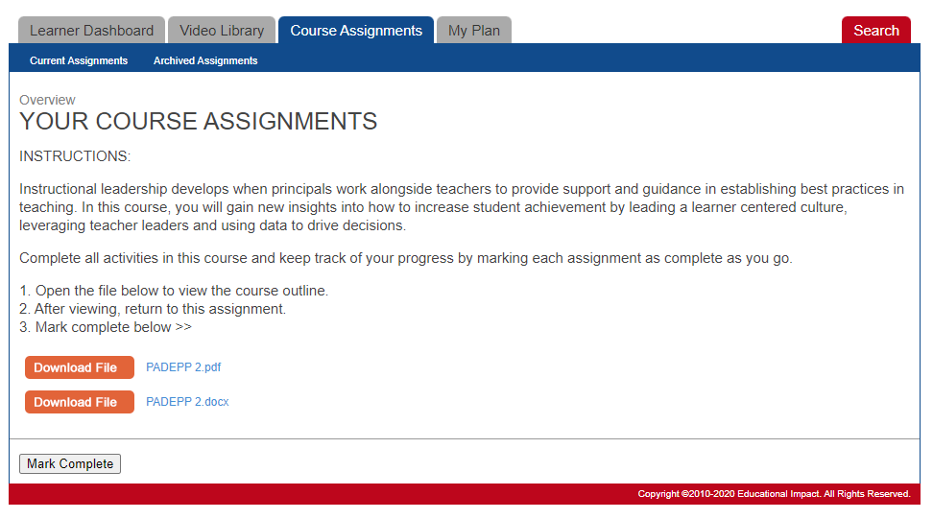
Read Overview Materials
Read the text provided
If there is an article or file to view, click on it to open in a new tab
Read the material
Close the tab to return to the assignment
Click Mark Complete when ready

Slide 21

Confirm Overview Completion
Confirm completion by looking for the green checkmark

Slide 22
Completing a Discussion Board

Slide 23
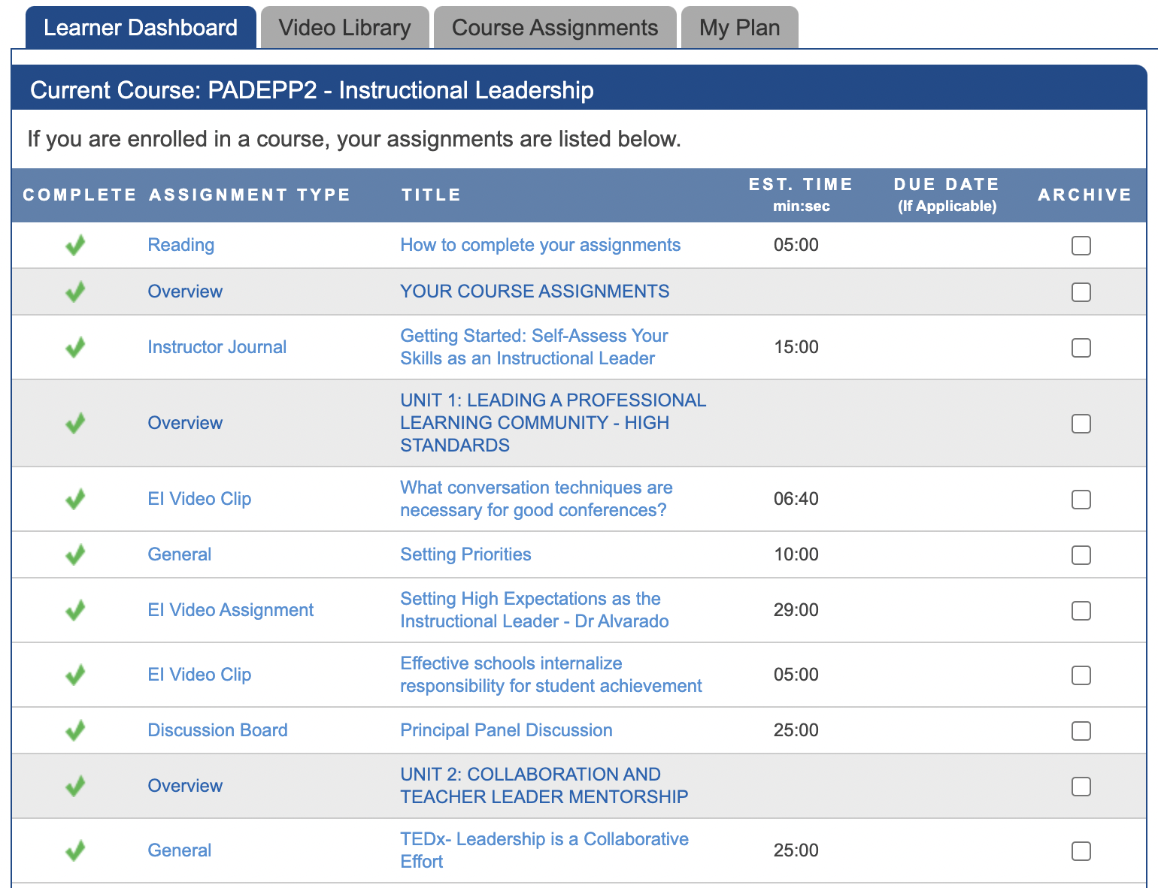
Open the Discussion Board
Click the title to open the Discussion Board

Slide 24
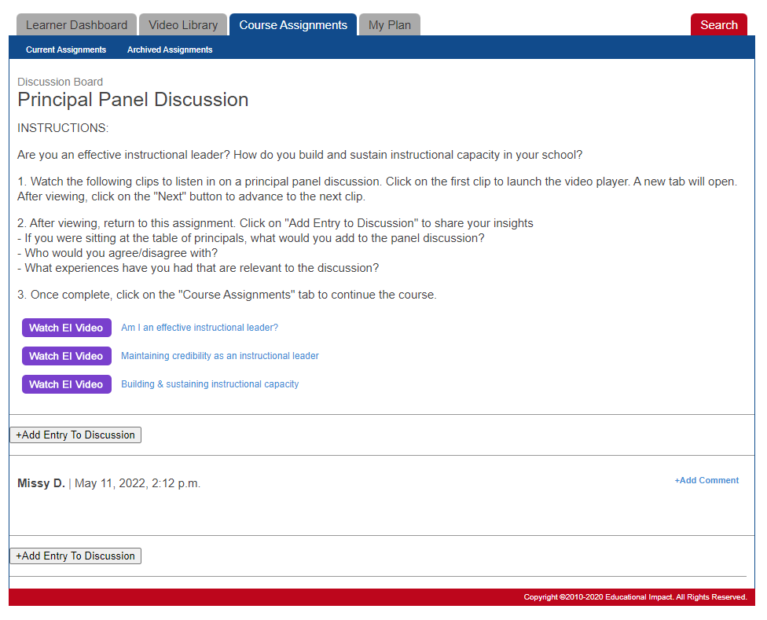
Review Discussion Board Materials
Read the instructions
Review attached files and/or videos
Click +Add Entry to Discussion when ready to contribute

Slide 25
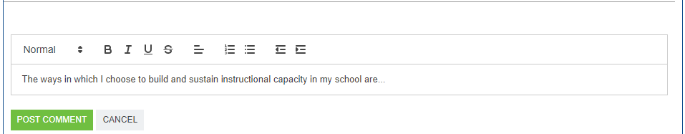
Post a Comment
Type your response
  Note: All learners in the course will be able to view your comments
Click Post Comment when ready
View Discussion Board comments from classmates, if available

Slide 26
Confirm Discussion Board Completion
Once a post has been entered, the system automatically marks the user complete

Slide 27
Completing an Instructor Journal

Slide 28
Open the Instructor Journal
Click the title to open the Instructor Journal

Slide 29
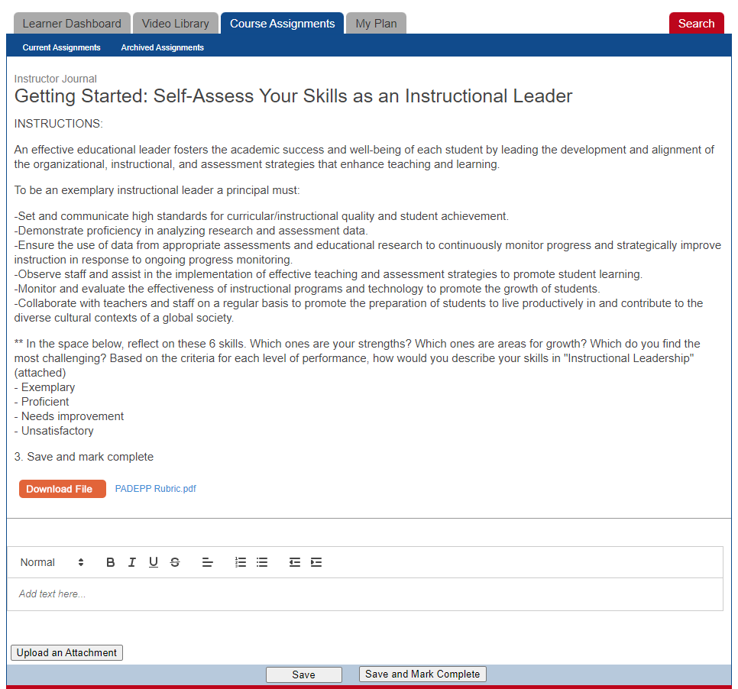
Review Instructor Journal Materials
Read the text provided
If there is an article or file to view, click on it to open in a new tab
Read the material
Close the tab to return to the assignment

Slide 30
Complete Instructor Journal
Type your response
Click Save and Mark Complete when ready

Slide 31
Confirm Instructor Journal Completion
Confirm completion by looking for the green checkmark

Slide 32
Completing an EI Video Clip

Slide 33
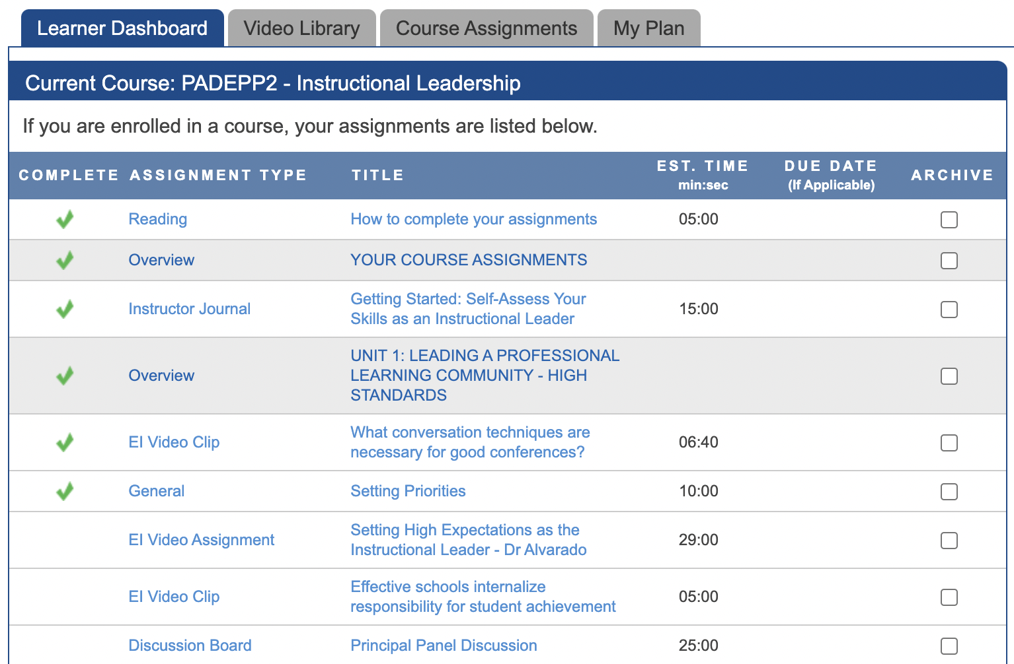
Open the EI Video Clip
Click the title to open the EI Video Clip

Slide 34
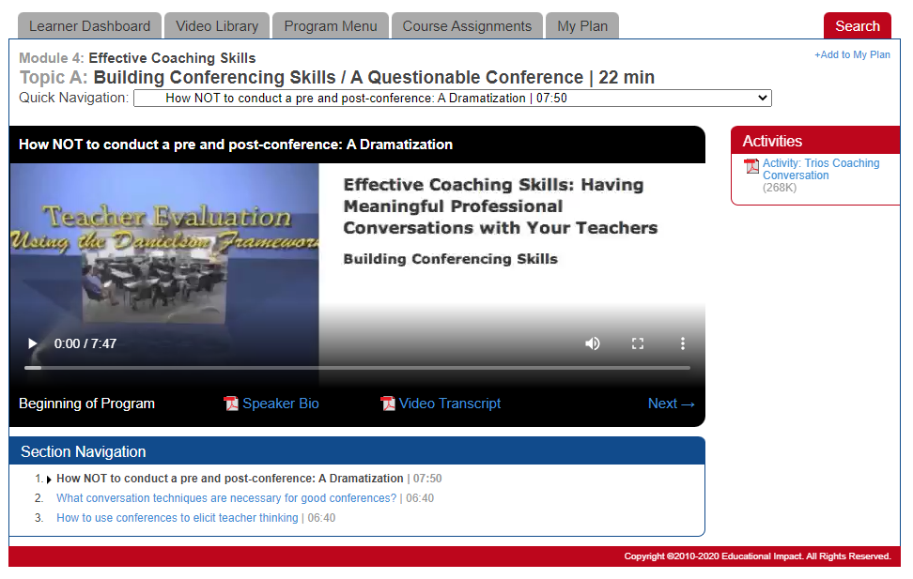
Watch the EI Video Clip
2
Click Play
Watch the entire clip from start to finish
  Note: If you do watch until the very end, you will not earn completion credit
Click the Course Assignments tab to return to your course
1

Slide 35
Confirm EI Video Clip Completion
Confirm completion by looking for the green checkmark

Slide 36
Completing an EI Video Assignment

Slide 37
Open the EI Video Assignment
Click the title to open the EI Video Assignment

Slide 38
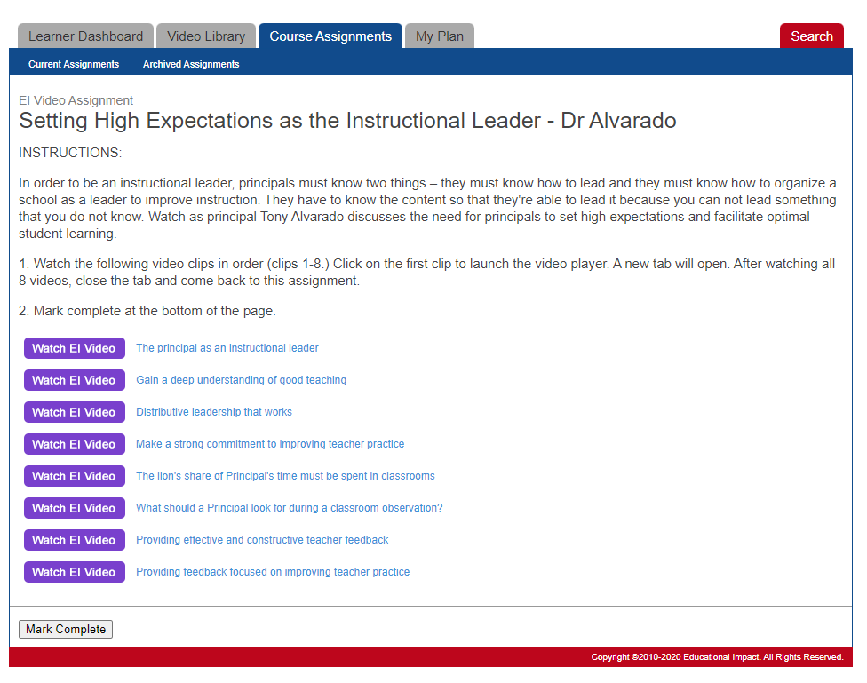
Review the EI Video Assignment
Read the text provided
Review the list of videos
Click the title to open the video player

Slide 39
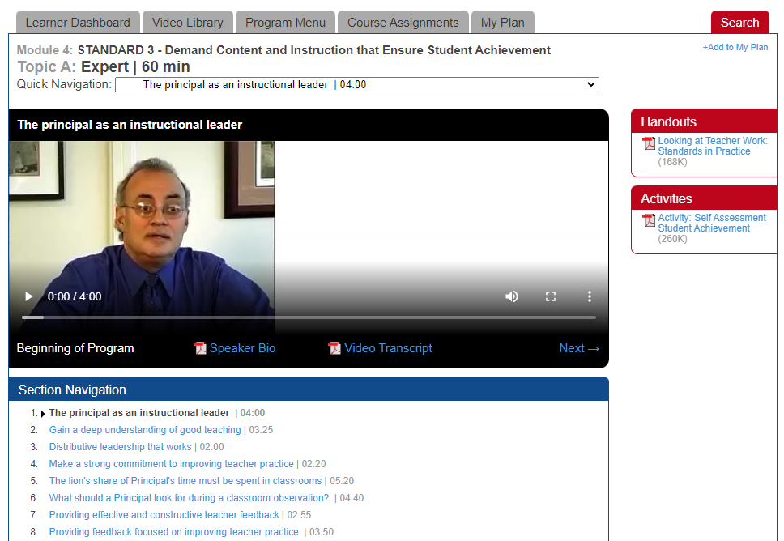
Watch the EI Videos
2
Watch the video
If you have been assigned a sequence of videos, click Next to move through the playlist
When ready, click the Course Assignments tab to return to the assignments list
1

Slide 40
Reopen the EI Video Assignment
Click the title to open the EI Video Assignment again

Slide 41
Complete the EI Video Assignment
Click Mark Complete when you have viewed all videos in the series

Slide 42
Confirm Video Assignment Completion
Confirm completion by looking for the green checkmark

Slide 43
Completing a General/Writing Assignment

Slide 44
Open General/Writing Assignment
Click the title to open the General assignment

Slide 45
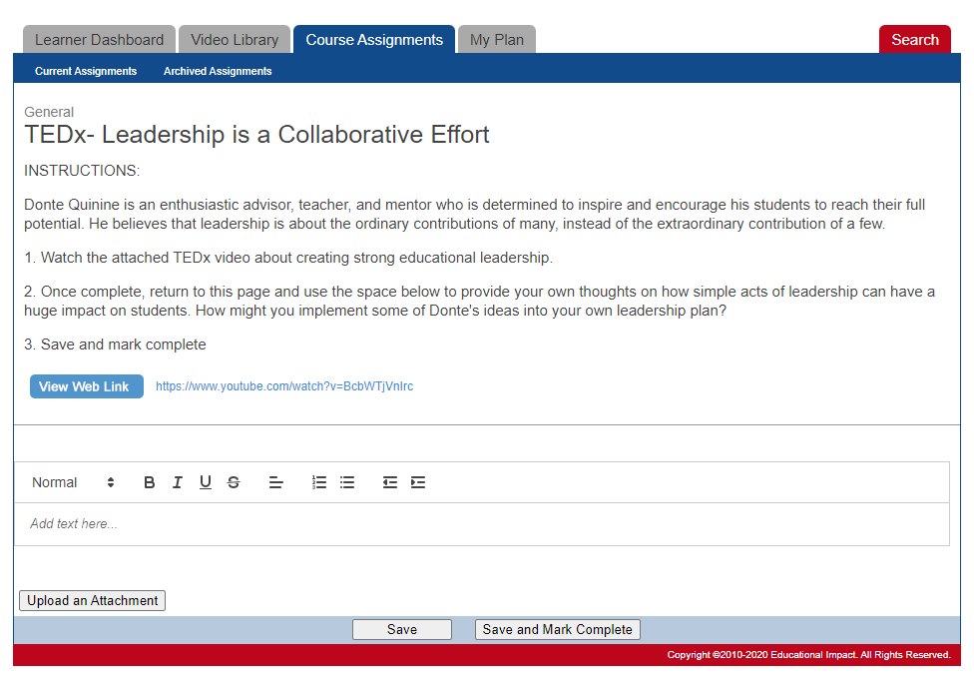
Review General/Writing Assignment Materials
Read the text provided
If there is an article or file to view, click on it to open in a new tab
Read the material
Close the tab to return to the assignment

Slide 46
Complete General/Writing Assignment
Type your response
Click Save and Mark Complete when ready

Slide 47
Confirm General/Writing Assignment Completion
Confirm completion by looking for the green checkmark

Slide 48
Completing an Assessment

Slide 49
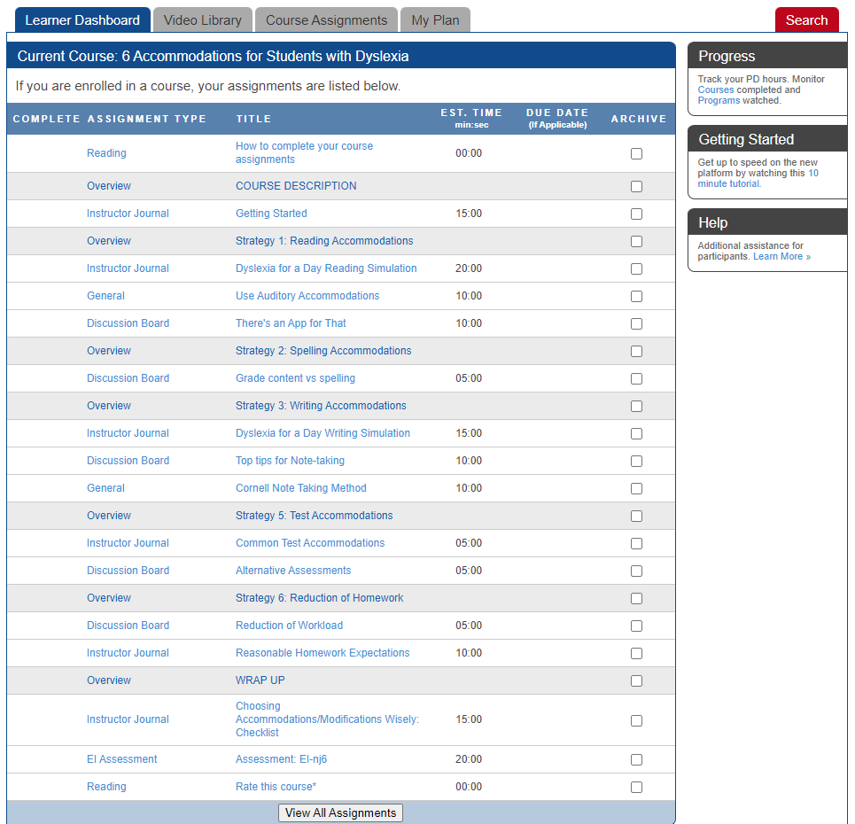
Open Assessment
Click the title to open the Assessment

Slide 50
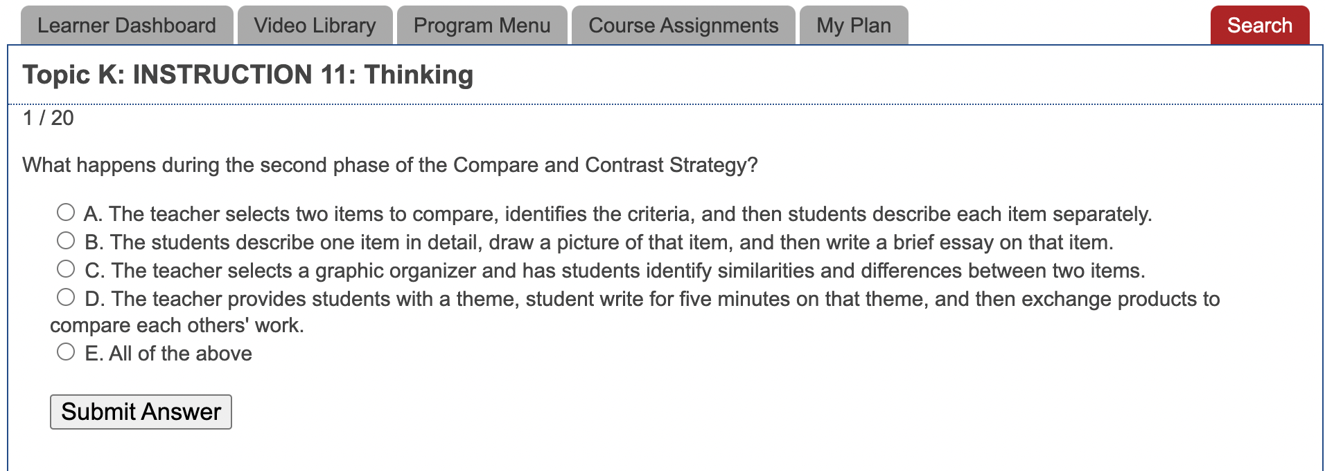
Taking an Assessment
There may be 10-20 questions in your assessment
Answer each question

Slide 51
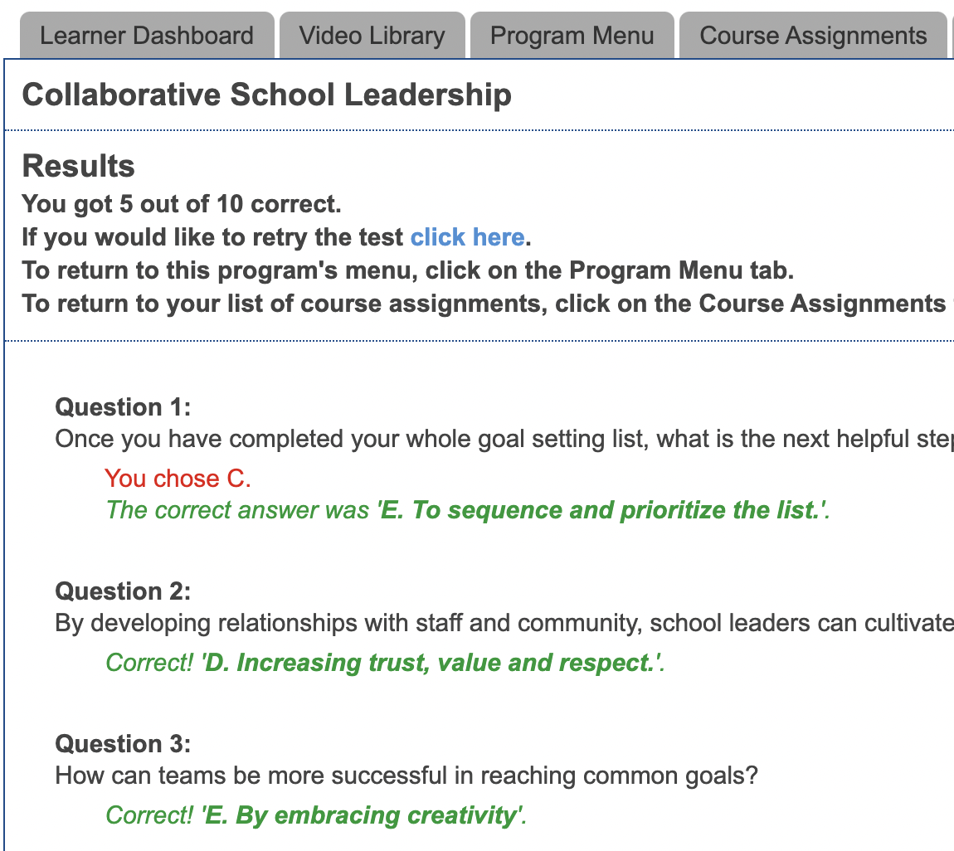
Finishing an Assessment
When you finish, you will see feedback about how many answers were correct / incorrect
When you achieve 80% correct, the system will automatically mark the assessment complete
  Note: You cannot mark this as complete until you master the assessment.
  Note: You may complete the assessment more than once.

Slide 52
Confirm Assessment Completion
Confirm completion by looking for the green checkmark

Slide 53
FAQs / Troubleshooting

Slide 54
I finished the course assignments, but I don’t see the credit on my transcript.
The learner has not checked something off as complete.
The learner has archived an assignment. Click on the Assignments tab and then click on the “Archived” assignments to see if there are any assignments in there. If so, unarchive them.
The learner has not mastered the assessment – it will be marked complete automatically when 80% mastery is achieved
The learner has not watched an “EI Video Clip” all the way to the end. It will be marked complete automatically when the clip is watched in one sitting.
If none of these steps resolve the problem, please reach out to your district technical contact for support.

Slide 55
How do I mark the EI Assessment complete?
You cannot manually mark the Assessment complete.
Instead, the system marks the Assessment complete automatically when the user reaches at least 80% correct.

Slide 56
How do I mark the EI Video Clip complete?
You cannot manually mark the EI Video Clips complete.
Instead, the system marks the Video Clips complete automatically when the user watches the entire clip from start to finish.
These are different from “EI Video Assignments” which are used to assign multiple clips and can be marked complete by the learner.

Slide 57
I encountered a dead link inside one of the assignments. What do I do?
On occasion, links to articles/videos from 3rd party websites are moved or updated.
Ed Impact does not control those links as they are to websites like Edutopia, TED Talks, Understood, etc.
Ed Impact’s instructional design team will respond immediately to dead links and update the assignment quickly.
Please email support@educationalimpact.com if you encounter dead links.

