Slide 1

Assisting, Developing, and Evaluating Professional Teaching (ADEPT) Results and Presentation of District Plans 2020–21
State Board of Education | Educator Professions Committee
October 2021
Lilla Toal Mandsager
Office of Educator Effectiveness & Leadership Development
Notes:
03. Assisting, Developing, and Evaluating Professional Teaching (ADEPT) Results for 2020–21 and District ADEPT Plans—Lilla Toal Mandsager, Director, Office of Educator Effectiveness and Leadership Development, Division of College and Career Readiness
I’m Lilla Toal Mandsager, the director in the Office of Educator Effectiveness and Leadership Development
Many thanks to Dr. Julie Hartwell who was invaluable in helping to compile this data, to the districts that reported it, and to our effectiveness associates who assisted and gave feedback to districts along the way.

Slide 2

Overall ADEPT Results 2020–21
Adept Result | Number of Educators
Met | 53,712 (96%)
Not Met | 331 (<1%)
Incomplete | 1,087 (2%)
Not Reported | 537 (1%)
Total Number of Evaluations | 55,667
Notes:
Similar to 19-20
Incomplete down from 1,635 to 1087
Not reported also down again, despite pressures of the pandemic.

Slide 3
ADEPT Results Comparison
Notes:
Overall ratings for ADEPT are very consistent with previous year
Not reported—created, in error, incomplete, or for SLO’s, doesn’t meet the business rules.
Student learning objectives are where we saw a change, with more SLO’s completed. Fewer SLOs “not reported” this year than in 18-19 pre-pandemic.
Anecdotally, honest conversations about progress when evaluators made time to have them. Certainly anxiety from teachers at the beginning of the year about which students who were absent.
Source: ADEPT Report (totals) | SCLead, Yearly evaluation results detail report

Slide 4
Teacher and Special Area Details
South Carolina Teaching Standards 4.0
Overall Educator Performance Levels
Strengths
Respectful Culture
Environment
Content Knowledge
Areas of Growth
Thinking
Assessment
Questioning
Grouping
Notes:
Review strengths and areas of growth – very similar to previous year
These are the relatively highest scoring and lowest scoring indicators, Questioning and Lesson Structure and Pacing are the most frequent indicators that observers ask teachers to work on.
Sources: Title II report, SC Lead Indicator report
Performance levels Include 4463 special areas educators

Slide 5
Principal Effectiveness Details
Principal Standards
Overall Levels of Performance
Strengths
Standard 5: School/ Community Relations
Areas of Growth
Standard 2: Instructional Leadership
Standard 3: Effective Management
Standard 4: Climate
Standard 6: Ethical Behavior
Standard 1: Vision
Standard 8: Staff Development
Notes:
New on the strengths, Vision and Staff Development
Areas of growth very consistent.
With principal performance levels, we see a We see a higher percentage of principals with an overall exemplary rating than teachers, and part of this is that the rubric is designed with exemplary as the expectation.
Having the forms online has made a difference in what we hear about fidelity of meeting with principals about goals and incorporating meaningful reflection on growth.
Source: PADEPP Overall Evaluation Ratings report and PADEPP Ratings by Standard

Slide 6
ADEPT Plans & Implementation
 | State Model for Classroom Teachers | Locally-Developed Model for Classroom Teachers | Consensus Scoring Approach | Average Scoring Approach | Mix of Consensus and Average Scoring Approaches
Number of Districts | 81 (98%) | 2 (2%) Greenville, Florence 1 | 21 (25%) | 34 (41%) | 28 (34%)
State Student Learning Objective (SLO) Rubric | Local SLO Rubric | Induction 1 and 2 | Induction 1, 2, and 3 | SCLead for Reporting Only | SCLead for Progress Monitoring and Reporting
65 (78%) | 18 (22%) | 30 (36%) | 24 (29%) | 10 (12%) | 73 (88%)
Notes:
Note, mix of consensus and average cutoff on handout.

Slide 7
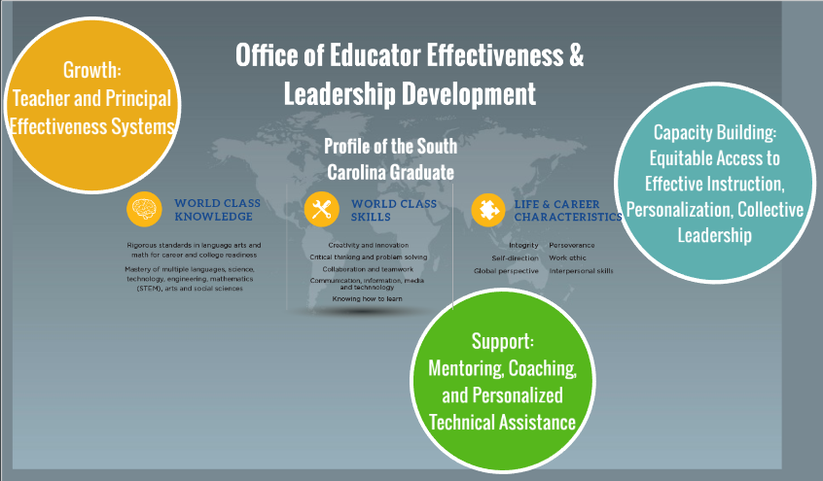

Questions
Follow the work:
#SCTSRubric
#CollectiveLeadership
@PIPLeaders
ed.sc.gov/educators/
  effectiveness
  school-and-district-administrators
Notes:
Equitable Access to Effective Instruction and the instructional leadership needed is at the heart of our work.

Slide 8
Emergency Educator Evaluation Flexibility 2021–22
State Board of Education | Educator Professions Committee
October 2021
Lilla Toal Mandsager
Office of Educator Effectiveness & Leadership Development
Notes:
04. Emergency Educator Evaluation Flexibility 2021–22—Lilla Toal Mandsager, Director, Office of Educator Effectiveness and Leadership Development, Division of College and Career Readiness

Slide 9
Educator Evaluation Flexibility 2021-22​
Teachers on Annual Summative, Annual Formative, and Continuing Summative Evaluations​
At least one required observation in the preliminary evaluation cycle.​
All required observations in the final evaluation cycle.
Teachers on Continuing Formative Evaluations​
Final cycle observation may be waived​
PADEPP Principal Evaluations​
Deadline for Orientation Conference extended to October 15, 2021.​
Notes:
04. Emergency Educator Evaluation Flexibility 2021–22—Lilla Toal Mandsager, Director, Office of Educator Effectiveness and Leadership Development, Division of College and Career Readiness

