Slide 1


Educator Effectiveness
Virtual Office Hours
February 11, 2026
Welcome!
If your leadership style were a movie title, what would it be?
Notes:
Roshonda - Welcome to our educator effectiveness virtual office hours. We’re so glad you could make it. Please type in the chat box your name and district. We have an open-response posted that we’d love for you to answer in the chat. We’ll get started right at 2 PM. ​
​
@ 2 PM: Welcome again everyone! (Introduce self and team) If you haven’t done so, please type in the chat box your name and district. First, to orient you to the Microsoft Teams platform, the control icons will be on the upper right section of your screen for most users. If you haven’t yet, please click the mic icon to mute yourself. You will click the same mic icon to unmute yourself later when we are ready for conversation. We encourage you to utilize the chat throughout this session for any questions you may have during the presentation. Our team will be monitoring the chat and responding accordingly. We will also hold a time at the end for discussion.​ ​
The purpose of Office Hours is to hold time to ensure that we share timely reminders with districts, but even more importantly to create a space where you can share feedback, questions, ideas and best practices with your peers. If you are new, there is no question too small; if you are an effectiveness veteran, don’t be shy about letting us know what you need. Before we get started, let’s see what exciting events have happened recently in our chat. (summarize responses or ask 1-2 districts to elaborate….)

Slide 2
Agenda
ADEPT Reminders
ATSI Highlight with Joey Greene
USHCA Sessions
Induction Count Funding FAQs
Mentor and Induction Support Sessions
Temporary Changes for Special Areas Managers (SAMs)
Questions
Notes:
We are so glad to have you here with us today. Before we get to questions and open discussion, we have a few things to share with you (state them). As we go, please feel free to add questions in the chat. We will respond to all that we can as we go and will address any lingering questions and open up the room for discussion at the end.

Slide 3
ADEPT Reminders

Slide 4
ADEPT Reminders/Information
April 30 – Final evaluation conference meetings completed
June 1 – ADEPT Plans Due
June 20 – All evaluations completed in SCLead

Slide 5
ADEPT Reminders Continued
Highly Consequential Evaluations: Be sure there are at least 3 persons on the evaluation team.
Special Areas: Be sure correct model has been used and all required components and signatures are present.
Begin Final evaluation cycle observation(s), ensure that post-conferences and SLO and Special Areas plan conferences occur.
Use the Evaluation Status Report (ADEPT, District) in SCLead to assist in monitoring the components of your educators' evaluations.

Slide 6
ATSI Identification with
Joey Greene

Slide 7
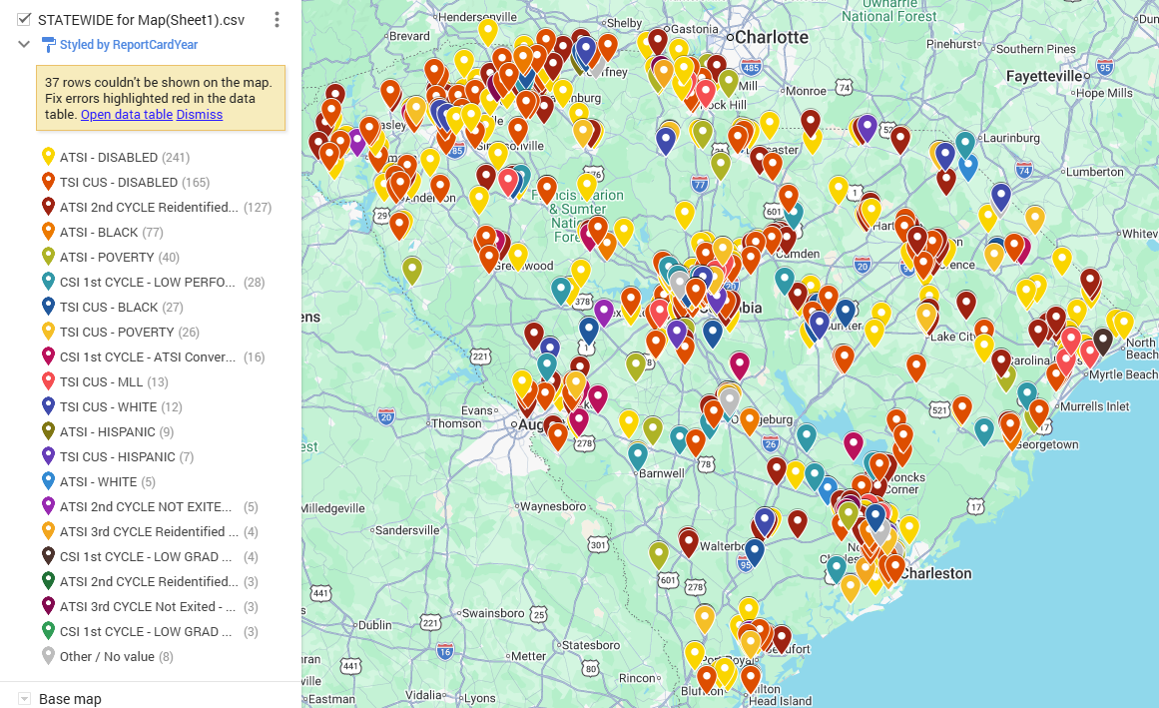
Our Current Reality

Slide 8
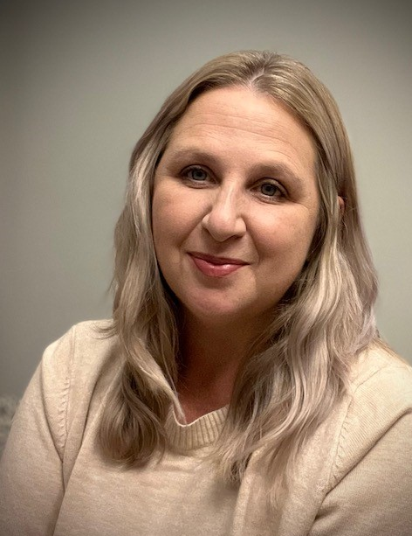

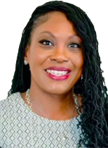
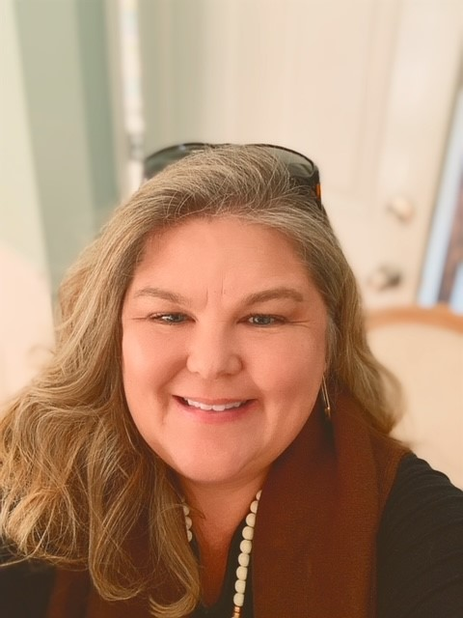
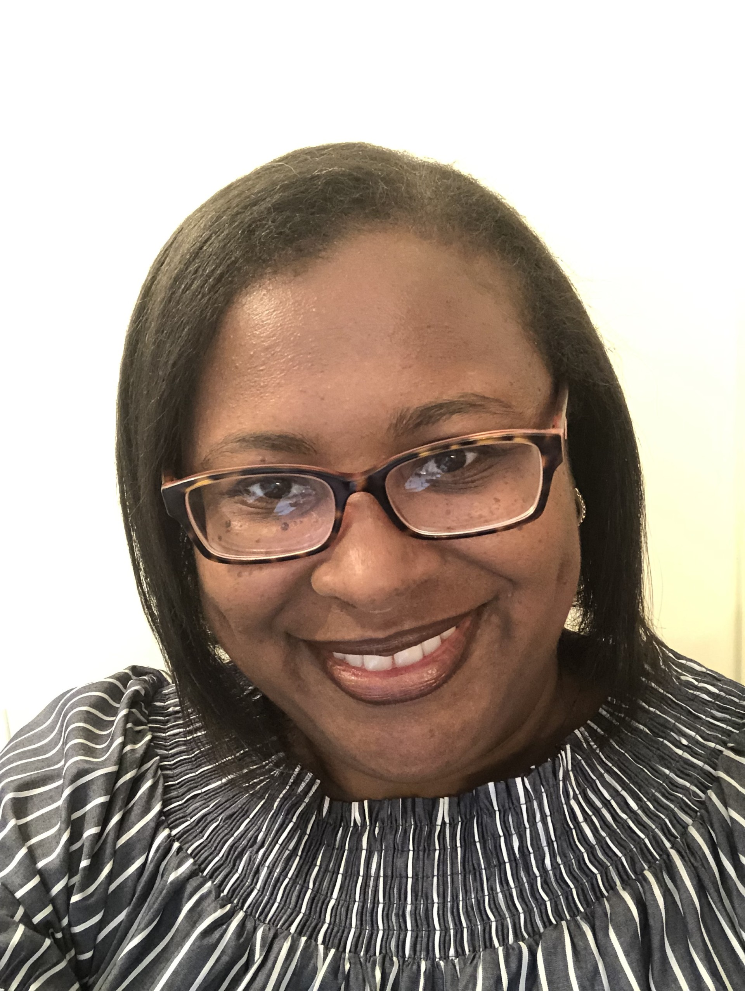
Meet Your OLE Subgroup Support Team
Joey Greene
Subgroup Support
Team Lead
Jgreene@ed.sc.gov
843-908-4822
Andrea Niesse
Subgroup Support Coach
Aniesse@ed.sc.gov
Deirdre Howard
Subgroup Support
Coach
Dfhicks@ed.sc.gov
Marcella Delee
Subgroup Support
Coach
Mtgloverdelee@ed.sc.gov
Dr. LeConte Middleton
Subgroup Support Coach
Lmiddleton@ed.sc.gov
Notes:
andrea

Slide 9
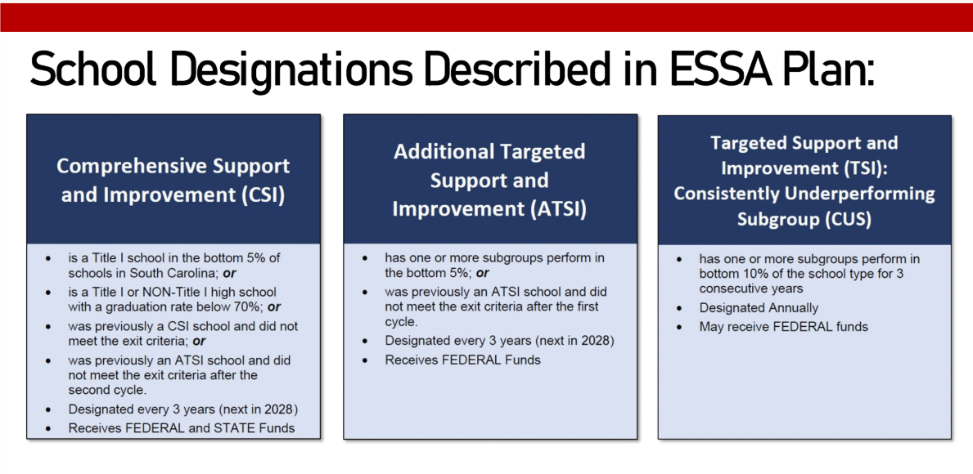
ATSI Information

Slide 10
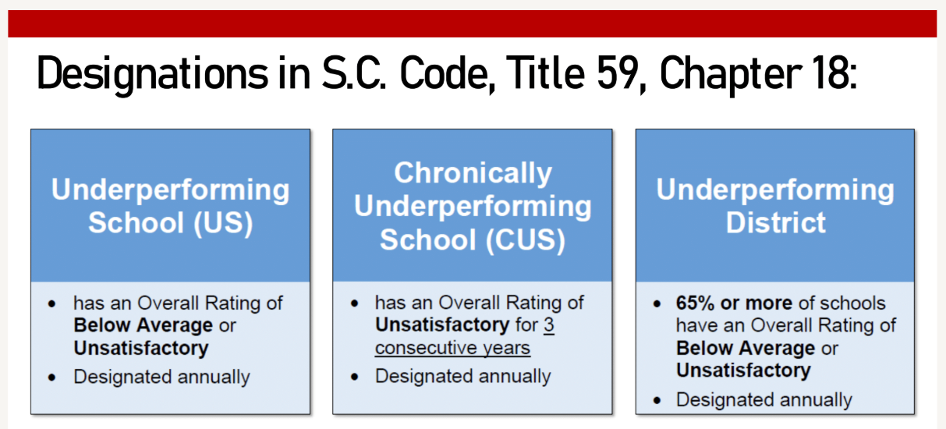
ATSI Information Continued

Slide 11
Identifications
School
ATSI Disabled
ATSI ML
TSI Poverty
TSI Race_White
TSI Race_Black
Below Average
You may have multiple identifications!
Multiple Federal AND State...

Slide 12
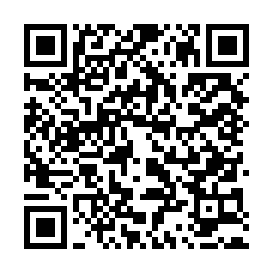
Upcoming Professional Development: Subgroup Support
Date | Location | Topic
February 19 FULL | Phillips Market Center | Effective Scheduling for SWD, CIP Support, Grouping for Interventions
February 24 FULL | Berkeley, Men Riv Education Park
March 10 | Lake City, The Continuum | Leadership Development- Accountability Structures and Protocols *Registration opens soon!*
March 12 | Phillips Market Center
March 17 | Aiken, Six Points Learning Center
March 24 | Beaufort
REGISTER HERE​​
Notes:
REGISTER HERE

Slide 13
USHCA
(Urban School Human Capital Academy)

Slide 14
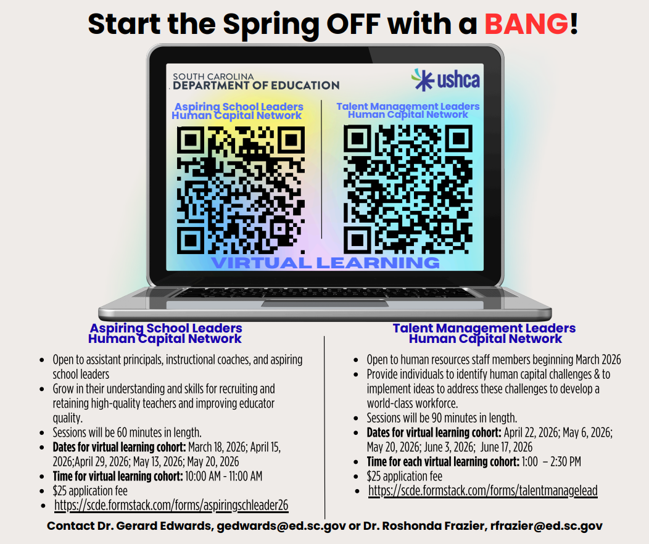
USHCA Cohorts
Notes:
USHCA Aspiring School Leaders Human Capital Network - Intellistack
USHCA Talent Management Leaders Human Capital Network - Intellistack

Slide 15
Induction Count Funding FAQs
Notes:
We would like to go over some frequently asked questions we've received over the last couple weeks.

Slide 16
FAQ 1 – Use of Funds
How can these funds be used?
  Allowed expenditures include costs that are directly associated with ADEPT-related planning, training, implementation, and program evaluation.
    Refer to pages 29-30 of the 2025 - 2026 Funding Manual (REVENUE 3502 ADEPT, SUBFUND 302 EIA)
Notes:
Drop in chat: 2025 - 2026 Funding Manual

Slide 17
FAQ 2 – Unused Funds
Can funds be carried over to another school year?
  Unexpended ADEPT funds may be carried forward to the next fiscal year and expended for the same purposes as initially allowed.

Slide 18
FAQ 3 – Funding Amount
When will our district receive these funds, and how much will we receive?
  Funds are typically disbursed to districts in March. The funding amount for each district varies, based on the total available funds divided by the number of certified first-year induction contract teachers. Once funds are released, districts can use the public link to see their specific ADEPT funding amount: Monthly Payments to Districts - South Carolina Department of Education
Notes:
Drop in chat-
Monthly Payments to Districts - South Carolina Department of Education
Revenue 3502 ADEPT, Subfund 302 EIA

Slide 19
FAQ 4 – Certification Deadline
Since the deadline to add contract data in SCLead for the Induction Count is February 1st, does this mean if an educator becomes certified after that date that Induction 1 would have to be repeated the next year?
  No. The February 1st deadline is specific to the induction count.
  For specific questions about Induction Funds, feel free to email Jenny at vhenke@ed.sc.gov

Slide 20
Mentor & Induction
Training & Virtual Support Sessions

Slide 21
Upcoming In-person Mentor Training Dates
February 24–25, 2026
  Location: Easley Campus of Tri-County Technical College, Easley, SC
  Registration: REGISTRATION LINK (Password: cerra4244)
April 21–22, 2026
  Location: Charleston Southern University, Charleston, SC
  Registration: REGISTRATION LINK (Password: cerra2589)
May 12–13, 2026
  Location: SCEA Building, Columbia, SC
  Registration: REGISTRATION LINK (Password: cerra9090)
**These two-day sessions will be held from 9:00 a.m. to 4:00 p.m.
Notes:
Upcoming in-person Mentor Training Dates
Drop in chat:
February 24–25, 2026
Location: Easley Campus of Tri-County Technical College, Easley, SC
Registration: REGISTRATION LINK (Password: cerra4244)
April 21–22, 2026
Location: Charleston Southern University, Charleston, SC
Registration: REGISTRATION LINK (Password: cerra2589)
May 12–13, 2026
Location: SCEA Building, Columbia, SC
Registration: REGISTRATION LINK (Password: cerra9090)

Slide 22
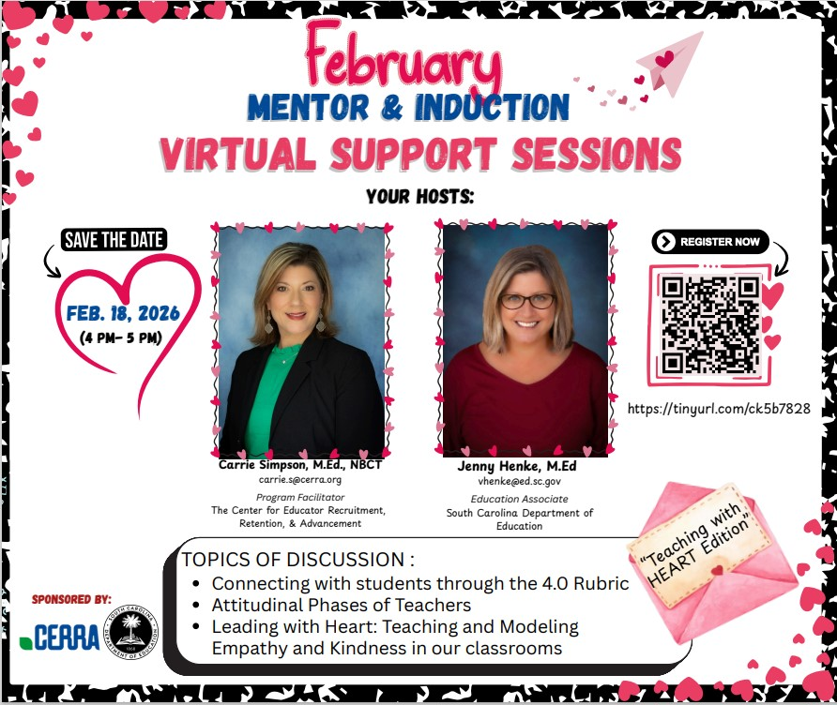
February Mentor & Induction Virtual Support Session
Upcoming M&I Virtual Support Sessions
(4:00 – 5:00 PM):
February 18
March 18
April 29
May 20
Notes:
Our next Mentor and Induction Virtual Support Session will be held on Wednesday, February 18 from 4:00-5:00 pm. You can register by scanning the qr code or pasting the tiny url in your browser. Please pass this along to your Induction 1 educators, mentors, or whoever else would benefit from this resource.
Please mark your calendars for the remaining session dates for the 2025-26 school year.
We've averaged 45 or so participants for each session and look forward to supporting our Induction educators and their mentors through the final evaluation cycle. Thank you for sharing this resource in your districts!

Slide 23
Temporary Changes for Special Areas Managers (SAMs)

Slide 24
As of March 1st...
SAMs should send their Special Areas Evaluator credential spreadsheet to Dr. Frazier for her to add to SCLead
Dr. Frazier will also be the OLE's point of contact for Moodle troubleshooting
  rfrazier@ed.sc.gov

Slide 25
Questions

Slide 26
Question Submitted:
How does a 'Not Met' ADEPT Evaluation result on a Continuing formative / Recertification year impact a teacher's renewal?
  An educator who is on their recertification year, can still recertify their teaching certificate as long as they have completed the 120 renewal credits requirement. Scoring "Not Met" does not mean that they cannot recertify their teaching certificate.
  The district will decide what is best for the next contract level: Continuing Formative, Summative, or GBE.
  Continuing-contract teachers who are being recommended for formal evaluation the following school year must be notified in writing when a contract is offered.

Slide 27
Office of Leadership Effectiveness
Effectiveness Leads
Leadership Development Leads
Kate Berresford, EPPs, skberresford@ed.sc.gov
Ashley Cohoon, Communications, ascohoon@ed.sc.gov
Dr. Roshonda Frazier, SLO and Teacher Leadership, rfrazier@ed.sc.gov
Jenny Henke, Induction and Mentoring, vhenke@ed.sc.gov
Dr. Kimberly Howard, PADEPP, khoward@ed.sc.gov
Kimberly Mack, Director, kemack@ed.sc.gov
Lilla Toal Mandsager, Executive Director, lmandsager@ed.sc.gov
Marilyn Suber, Administrative Assistant, masuber@ed.sc.gov
  Dr. Gerard Edwards, Veteran Principals & District Leaders, gedwards@ed.sc.gov
  Keasha Grant, Certified Support & Emerging Leaders, ksgrant@ed.sc.gov
  Crystal Halma, Collective Leadership, chalma@ed.sc.gov
  Dr. Frank Robinson, New Principals & Emerging Leaders, frobinson@ed.sc.gov
  Dr. Adrienne Davenport, Instructional Leadership & Assistant Principals, tsmith@ed.sc.gov
  Visit our website: https://ed.sc.gov
Office Support
Notes:
We thank you for your time today. We will stay for a few extra minutes if anyone has any additional questions.
Feel free to reach out to us if you have questions or feedback for us. Our email addresses are shown on the slide.
Have a great rest of your day!

Slide 28
SCDE SEAL LOGO

