Slide 1
Welcome!
Virtual Office Hours on
ADEPT 2020 for Special Areas
in, you will nee
Office of Educator Effectiveness &
Leadership Development
2020 Guidelines for all 3 Areas
Rubrics for all 3 Areas
Notes:
Welcome to the first installment of our Deep Dive into managing Special Areas evaluations in SCLead. Today our focus will be on managing evaluations for Speech Language Professionals. We use the term Speech Language Professional to encompass both the Speech Pathologists and the grandfathers Speech Therapists, for the purpose of brevity I will use the acronym SLP during the presentation. As a matter of housekeeping before we get started, please mute your mics until you are ready to speak. Feel free to type any questions in the chat, or hop on the mic during our periodic breaks for questions.

Slide 2

Objectives
Participants will:
Walk through all components of the evaluation instrument to support speech professional growth and improved impacts on students
Understand that the Special Areas ADEPT process is based on best practices and an ongoing system of feedback and support.
Notes:
Our primary goal for today is to provide you with the information you will need to create and manage evaluations for SLPs in your district. As a side note, if you have not completed the on-demand evaluator training in Moodle, and/or if your Special Areas Manager has not submitted your information to Dr. Kimberly Howard for credentialing in SCLead, you cannot be added to an evaluation and will be unable to see the content we will be sharing today, unless you are the SLP being evaluated.
READ SLIDE

Slide 3
Agenda
Introduction
Overview of Special Areas Evaluation for SLPs
  Contract Levels
Understanding the Rubric
  Components & Sources of Evidence
Deep Dive: Evaluation Process & Evidence Collection
  Orientation
Notes:
As you can see from our agenda, we will cover a great deal of information in the next hour. These sessions are recorded and will be posted to the Educator Effectiveness webpage once they have been through our accessibility process. Since our main target audience for today is evaluators, we will not spend a lot of time on contract levels or setting up the evaluations, since that is covered in other trainings for the ADEPT Coordinators and Special Areas Managers. However, it is beneficial as an evaluator and an educator to be somewhat familiar with how the evaluation requirements vary based on contract level.

Slide 4
Speech-Language Professional FAQ ​
Which Speech-Language Professionals (SLPs) require ADEPT evaluations? ​
​
SLPs Employed Directly By a School District ​
SLPs will participate in the district’s ADEPT evaluation process using the appropriate contract level. ​
SLPs should be evaluated every year. ​
SLPs on an Internship certificate must participate in the district’s induction program and be assigned a mentor. ​
SLPs on a Professional certificate must successfully complete the ADEPT summative evaluation process at the annual contract level in order to be eligible for a continuing contract. ​
SLPs on a Continuing contract, the evaluation may be summative, formative, or goals-based, at the discretion of the local school district. Continuing Formative evaluation is not required for SLPs maintaining their ASHA Certificate of Clinical Competence, instead those SLPs should complete a GBE.​
Contracted SLPs ​
SLPs employed trough a third-party vendor will be evaluated using the employer’s protocols. An employer may choose to use the state’s ADEPT evaluation model for SLPs in conjunction with a school district but is not required to do so.​​
Notes:
Read slide.

Slide 5
Understanding the Rubric
Components
Sources of Evidence

Slide 6
South Carolina Speech-Language Rubric
Planning
Instruction
Collaboration
Professionalism
Demonstrating Knowledge & Skills
Planning Program & Services
Developing the IEP
Conducting IEP Meetings
Assessing Student Needs
Creating a Positive Learning Environment
Scheduling Flexible & Responsive Services
Delivering Instruction
Communicating Responsively
Using Feedback
Demonstrating Compliance
Demonstrating Confidentiality
Demonstrating Ethical Communication
Growing & Developing Professionally
School Responsibilities
Leadership
Collaborating with Professionals
Collaborating with Families
Notes:
The rubric for Speech-Language Professionals has 4 Domains, with 18 Indicators. There are 4 Performance Levels for the descriptions of practice for Planning, Instruction, and Collaboration. Professionalism is slightly different, using a combination of the reflections from the speech-language professional and administrative evaluator.

Slide 7
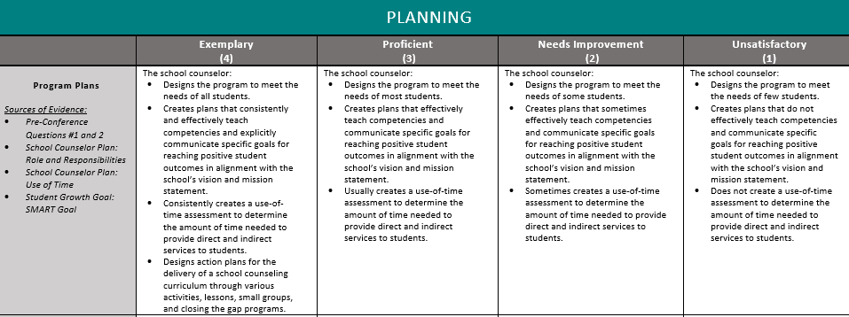
Parts of the Rubric
Sources of Evidence
Performance Levels
Descriptors
Indicators
Domains
Notes:
This slide is taken from the Speech-Language Professional Rubric to highlight each element of the rubric.
Domains are the big buckets
Indicators are the specific elements of practice
Descriptors describe what performance looks like at each level
The four performance levels are the biggest difference from the ADEPT 2006 model, giving the SLP more specific feedback.
The Sources of Evidence show the evaluator where to find evidence of the descriptors.

Slide 8
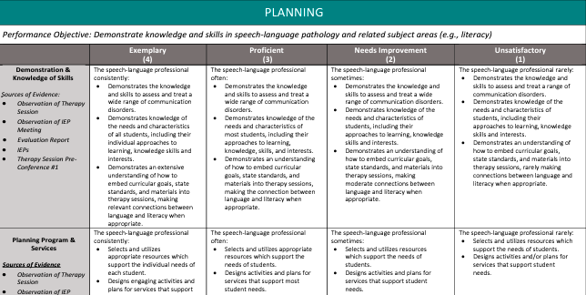
Growth Mindset
Planning
Student Centered Teacher Centered
Notes:
Each special area rubric has 4 levels – moving from Unsatisfactory to Exemplary – increasingly student centered as we move left.

Slide 9

Administrative Support
Administrative Support section for each Domain within the guidelines
Sources of Evidence for each Domain
Questions for Pre- and Post-Conferences Cross-Referenced for each Indicator
Training will include Roles and Responsibilities via video clips of SC practitioners
Notes:
We understand that it is imperative that the school level administrators and evaluators understand and acknowledge the unique roles and responsibilities of these three areas. We built in several ways to assist administrators throughout this process.
First, near the very beginning of the guidelines, we have devoted a section that lists ways for administrators to support the practitioner. These suggestions are listed by the Domains of the rubric so you can be successful in using the rubric. For example, for the Planning Domain in the Speech-Language Rubric, the Speech-Language Professional must have all resources necessary to be compliant with state and federal regulations for children with disabilities. Districts and schools must provide the Speech-Language Professional with adequate funding for purchasing current standardized speech and language materials and assessments as well as time to collect the wide range of data produced by these tools.
As you become familiar with your evaluation rubric, you will see in the first column under the Indicator "Sources of Evidence" are listed. The administrator and/or evaluator can readily see where they can find evidence to match every indicator on the rubric. For example, some of the sources of evidence may be correlated pre- or post-conference questions, observations, IEP documents.
We are providing the administrators and evaluators with required questions to ask during the pre- and post-observation conferences. These questions were developed by the Advisory Groups, and align to the Indicators on the Rubric. Of course, the administrator and evaluator may ask additional questions for clarification or additional information as needed.
Finally, as evaluators will see at the beginning of their online Evaluator Training, they are able to hear first-hand from speech-language professionals, school counselors, and school librarians through video clips as they share their various roles and responsibilities that administrators may not readily see during scheduled observations with students.
We feel that these new strategies will help bridge the gap of knowledge and understanding between the administrators and the practitioners.

Slide 10

Domain Weightings for SLPs
Planning 25%
Instruction 40%
Collaboration 10%
Professionalism 25%
Notes:
One of the tasks of each Advisory Group was to determine the weightings for each of the four Domains that will be calculated to reach an overall composite score. This slide shows the weightings for the speech-language professionals. The weighting of the Planning Domain is 25% of the composite score, the Instruction Domain is 40%, Collaboration Domain is 10%, and the Professionalism Domain is 25%.

Slide 11
Evaluation Process and Evidence Collection
Notes:
Now let’s take a look at an overview of the evaluation process and evidence collection.

Slide 12
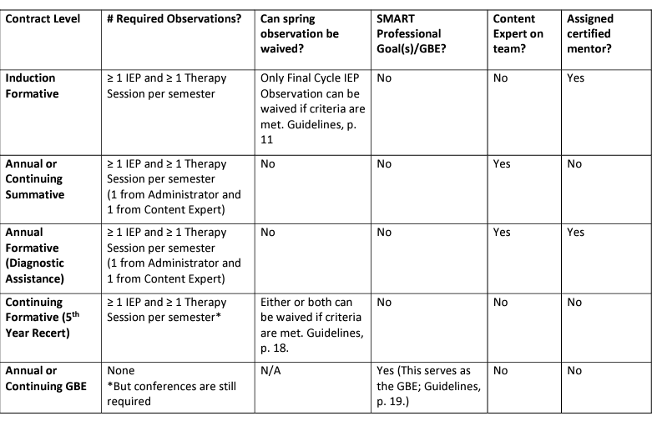
At a glance

Slide 13
Reminders for Evaluation Set-up
Every evaluation needs an evaluation chair. This is also required for Special Areas.
When adding team members, the evaluator needs to be given permissions to the evaluation.
If evaluation teams are created at the district level, the schools cannot change the teams. If the teams are created by the school, changes can be made by the district or the school.
The Orientation date must be entered by an ADEPT administrator or an evaluator before the teacher can sign the orientation.
Notes:
An evaluation chair is required for ADEPT 2020 for Special Areas. There is a form that can only be completed by the evaluation chair.
When using the bulk tool to set the evaluation team, please make sure to select permissions for each person you are adding to the team. If permissions are not selected, the person will be added but will not be able to access anything.
Besides login issues, Orientation generates the most support cases for SCLead. The Orientation date must be entered before and educator can sign the orientation. Please remind your administrators to enter the Orientation dates before they ask the educators to sign. If the date is not there, the educator will receive an access denied message.

Slide 14
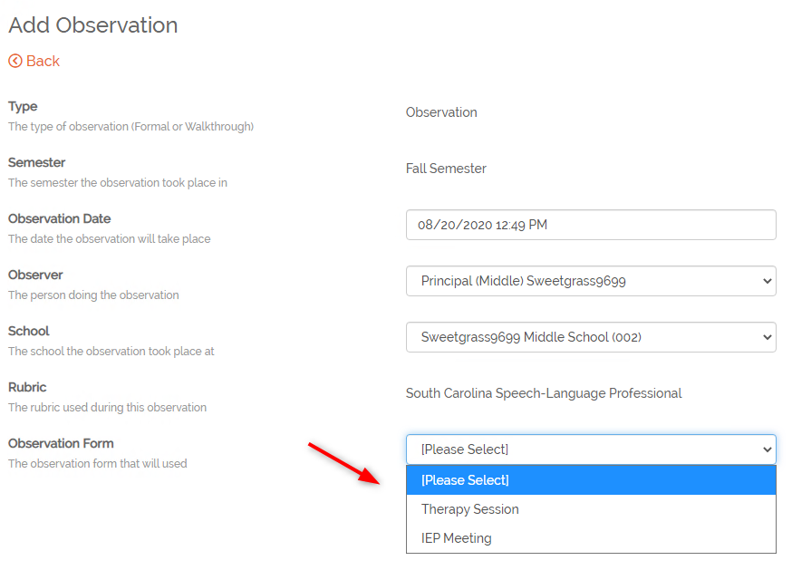
Speech-Language Professional
The evaluator will need to select the observation type when creating the observation.
  Therapy Session
  IEP Meeting
Notes:
SCLead is set up so the type of evaluation is tailored to the IEP Meeting or Therapy Session for the Speech-Language Professional.

Slide 15

Speech Language Professionals

Slide 16
Stay Connected
ADEPT 2020 for Special Areas
Or reach out to:
Beverly Hyatt Flythe, MSEd
803.896.0318
bflythe@ed.sc.gov
Or your district’s ADEPT contact in our office

