Slide 1
Welcome!
Special Areas Management Training for ADEPT 2020ain
in, you will nee
Office of Educator Effectiveness &
Leadership Development
2020 Guidelines for all 3 Areas
Rubrics for all 3 Areas
Notes:
Welcome to the management training for Special Areas. This training is designed to train district level administrators who will serve as district managers for evaluators of one or more of the three Special Areas. The three Special Areas are school counselors; school librarians, formerly referred to as library media-specialists; and speech-language professionals, which include speech-language therapists and pathologists. This training is required for each district’s Special Areas Manager and must be completed before access rights in Moodle are granted.
Let me introduce you to our trainers today.
You will have a very important role in providing meaningful training to your evaluators and mentors of the three special areas. We will guide you through the information you will need to be an effective trainer.
You will need copies of several documents on hand to have the full benefit of the training exercises. You may find that hard copies make it easier to follow than flipping to electronic copies. Specifically, you will need a copy of the 2020 ADEPT Support and Evaluation System Guidelines for Speech-Language Professionals, School Counselors, and School Librarians, and the three rubrics.

Slide 2

Objectives
Participants will:
Become familiar with the Special Areas training process
Be exposed to the evaluation instrument to support educator growth and improved instruction
Understand that the Special Areas ADEPT process is based on best practices and an ongoing system of feedback and support.
Participate in activities that can be used to enhance the Evaluator Training through face-to-face experiences
Understand the steps necessary to manage training and certification of special area evaluators and mentors
Understand the key features of the Moodle virtual learning platform being used to train evaluators and mentors
Notes:
Our primary goal is to provide you with the information you will need, along with the ADEPT guidelines document, to provide meaningful support and guidance to those who will be evaluating and mentoring special area practitioners. To do this, we will use the following objectives.
READ SLIDE
Explain Evaluator Training is an online, self-paced training
Suggest Face to Face experiences to establish interrater reliability and review steps and requirements yearly
SAM will manage the evaluators

Slide 3




Examine Your Emoji Emotion…
1 2 3 4
Notes:
Before we begin, we want to hear from you. Now that you have heard our objectives for this training, how are you feeling about becoming a manager for your district special areas evaluators? Let’s examine your emoji emotions.
1. Are you overwhelmed but know that you will get what training has to offer?
2. Are you a little uneasy, but ready to learn?
3. Are you curious and full of questions about how this is all going to work in your district?
4. Are you excited to learn, ready to go, and all ears?
Choose one of the emojis and type your number in the chat box now.
(Pause. Wait for responses. Comment on what you are seeing.)

Slide 4
Agenda
Introduction
Overview of Special Areas Evaluations
  Changes
  Collaborative Activity 1: Elements of Effective Practice
Understanding the Rubric
  Components & Sources of Evidence
  Collaborative Activity 2: Looks Like/Sounds Like
Evaluation Process & Evidence Collection
  Contract Levels
  Roles of Evaluators and Mentors
  Collaborative Activity 3: The Pre-Conference
Next Steps
  How to Set Up Accounts in Moodle
  How to Set Up Evaluators in Moodle
  How Certification Will Work
Notes:
As you can see from our agenda, we will cover a great deal of information so that you will be fully equipped to effectively manage the training of your special area evaluators and mentors. The introduction will include our norms for virtual training and your role as a manager. We will provide a brief overview of the special areas evaluations, why and how the evaluation process and instruments have changed since the last revision in 2003, and participate in a collaborative activity that focuses on elements of effective practice. Then, we will take a look at the special areas rubrics and how they will be used, followed by our second collaborative activity. Next, we will take a closer look at the evaluation process and evidence collection by contract levels and the roles of the evaluation team members, followed by our third collaborative activity. Finally, we will explain your next steps as you learn how to set up your account in Moodle, sign up your evaluators in Moodle, and manage certification.

Slide 5
Virtual Training Norms
Participate actively
While in the training room and working on your own please stay engaged and avoid multi-tasking.
Be prompt.
After working on your own, please return to the training room on time.
We’re in this together.
Have your camera on when in the training room and unmute your mic if you want to speak.
Reach out to the Special Areas Lead with any questions.
Beverly Hyatt Flythe bflythe@ed.sc.gov 803.896.0318
Notes:
We know that virtual training is very different from face-to-face training. We are learning this process together at the SCDE, and it takes teamwork to make this opportunity both meaningful and productive for our attendees.
While in this training, please ensure that your focus is on the training information and activities. Avoid engaging in other activities during this time.
Please do your best to be prompt. There will be times that you will have to leave the main room. When those times occur, please return to the room at the assigned time.
A part of being engaged in this training is being available physically and mentally. Please have your camera on throughout our time together and use the features available to share your voice whenever possible.

Slide 6
Training Requirements
To serve as a Special Areas Manager
Must be recommended by a school district administrator or faculty member in an Educator Preparation Program
Complete this training
To serve as a Special Areas Evaluator:
Must be recommended by a school district administrator or faculty member in an Educator Preparation Program.
Complete the online Evaluator Training
To serve as a Special Areas Mentor
Participate in the 2-day South Carolina mentor training
Within the first five years of becoming a mentor, complete the appropriate content-specific special area training
Notes:
To serve as a Special Areas Manager
Must be recommended by a school district administrator or faculty member in an Educator Preparation Program
Complete this training
To serve as a Special Areas Evaluator:
Must be recommended by a school district administrator or faculty member in an Educator Preparation Program.
Complete the online Evaluator Training
To serve as a Special Areas Mentor
Participate in the 2-day South Carolina mentor training through Cerra.org
Within the first five years of becoming a mentor, complete the appropriate content-specific special area training
New peer evaluators or mentors for special areas evaluations are not required to attend the SCTS 4.0 training.

Slide 7
As a Special Areas Manager (SAM)…
I am certified to manage the training of evaluators of speech-language professionals, school counselors, and school librarians.
I can deliver the required district orientation to speech-language professionals, school counselors, and school librarians.
I am responsible for maintaining records and sending the list of persons trained (Evaluator Training) to Dr. Kim Howard at khoward@ed.sc.gov
I am NOT certified to train other managers. Only SCDE trains Special Areas Managers.
I am NOT certified to evaluate speech-language professionals, school counselors, or school librarians unless I complete Evaluator Training for the appropriate area(s).
Notes:
This training will allow you to be the person to manage special areas evaluator training for your district. As the district's manager, you will ensure that each person who completes the training in your district receives the proper credential by committing to all of the following (read slide). This training will also certify you to provide the one-day orientation for speech-language professionals, school counselors, and school librarians.
This training will not certify you as a trainer of other trainers. Only the SCDE can train special area managers. In addition, this training will not certify you to evaluate the special areas. To serve as an evaluator, you will need to participate in the content-specific training for the area you intend to evaluate.

Slide 8
Overview of Special Areas Evaluations
Notes:
Now I will be giving you an overview of the special areas evaluation revisions. If you have questions during the presentation, you may type them into the chat box, and my co-trainers will be able to answer them there. We will also have time at the end of the presentation before lunch to answer any questions you may still have after hearing the information we will give you.
As a reminder, ADEPT, the system of assisting, developing, and evaluating professional teaching, is the overall umbrella for teacher education in the state of South Carolina.
ADEPT for 2006 was previously the portfolio-based process for school counselors, school librarians, and speech-language therapists and pathologists.
Since then, national standards for librarians, school counselors, and speech language professionals have changed, as has teacher evaluation in SC and across the country.
The Office of Educator Effectiveness and Leadership Development has heard from advocates for school counselors, school librarians, and speech-language therapists and pathologists that change is needed, but we also wanted to make sure SC districts, schools, and evaluators had lived through and learned from the beginning of implementation of the new teacher evaluation system before addressing changes to evaluations for support professionals.

Slide 9
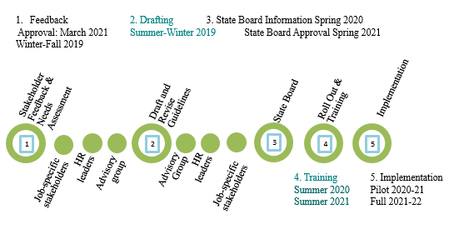
Special Areas Evaluation Revision Timeline
Notes:
Here you see the Special Areas Evaluation Revision Timeline that includes:
1. Feedback
2. Drafting and Revision
3. Approval
4. Training
5. Implementation
Specifically, during the winter of 2018-19, the Office of Educator Effectiveness and Leadership Development gathered survey feedback from school counselors, school librarians, speech-language professionals, evaluators, principals, and districts. From there, we reached out specifically to advocacy groups, HR leaders and a series of advisory groups in the summer and fall of 2019. During the winter of 2019-20, we began drafting those guidelines and continued to seek feedback from stakeholders. Training began during the summer of 2020. Each district had the opportunity to pilot the new guidelines and evaluation instrument in 2020-21. Full implementation took place in 2021-22 school year. Surveys went out in spring 2022 for feedback to drive revisions to training.

Slide 10
Advisory Groups
Practitioners, professors, HR leads, district leads, principals, evaluators & mentors
Diverse in geography, size, grade level, & schedule
Analyzed surveys, other state and national models, SCTS 4.0 and ADEPT 2006
Notes:
The Advisory Groups that met during the summer and fall of 2019 included experienced school counselors, speech-language therapists and pathologists, library media specialists, IHE representatives, district Human Resource directors and district leads, representatives from state organizations, principals, and school level trained evaluators and mentors.
Representatives chosen were from
•All regions of SC,
•All school sizes, including elementary/middle/high, and where
•Library schedules are fixed/flexible.
The groups looked at all survey results, other state and national models, an overview of the SC Teaching standards 4.0 to recommend revisions.

Slide 11
Major Changes
Changes Made
Feedback from Surveys & Advisory Groups
Using a Four-Level Rubric to Measure Growth
Equipping Administrative Evaluators with Knowledge of School Support Roles and Responsibilities
Alignment to National Standards/Organizations
Reduce Paperwork: Year-Long Guiding Document
Replace isolated interviews with conferencing and reflection
Shift to professional growth
Knowledge of unique role and responsibilities
Alignment to national standards
Eliminate unnecessary paperwork
Notes:
We received feedback from 300 school librarians, school counselors, speech-language therapists and pathologists, and administrators from winter 2018 to spring 2019.
The overwhelming feedback included:
It’s been a long time since the evaluations were updated, change is needed.
We need a shift from evaluation to professional growth and development (away from a checklist to meaningful feedback).
Administrative evaluators need to have knowledge and understanding of the roles and responsibilities.
Our evaluation should align to national standards/organizations and
We need to eliminate the long-range plan, unnecessary paperwork, and isolated interviews.
Advisory groups helped make proposals for each evaluation, including how to incorporate national standards in the evaluation instrument, weightings for the domains, what artifacts would be required, how evaluation teams and process would look for educators early in their career versus later, and what to keep, change, or eliminate from the current evaluation model.
Advisory Groups landed on 5 major changes that directly address the feedback we were given:
Using a 4-level rubric to measure growth
Equipping administrative evaluators with knowledge of the unique roles and responsibilities
Alignment to National Standards/Organizations
Reducing paperwork by replacing the Long Range Plan with a tailored year-long guiding document, and replacing isolated interviews with conferencing and reflection.

Slide 12
Alignment to National Standards/Organizations
Speech-Language Professionals | School Counselors | School Librarians
ASHA | ASCA SC Model | AASL
Notes:
As we have mentioned, one of the important changes our Advisory Groups felt was needed was the alignment to national standards or organizations. The revised evaluation system for speech-language professionals is aligned to the American Speech-Language-Hearing Association. The revised evaluation system for school counselors is aligned to the American School Counselor Association and to the South Carolina Model. The revised evaluation system for school librarians is aligned to the American Association of School Librarians. As you read the guidelines and evaluation instrument for each area, you will see direct alignment to the national expectations.

Slide 13
Year-Long Guiding Document
(instead of Long-Range Plan)
Speech-Language Professionals | School Counselors | School Librarians
Samples of Individual Student IEPs and Evaluations | School Counselor Plan Role & Responsibilities Use of Time Assessment Records Report Collaboration | School Librarian Plan Schedule Collection Analysis Budget Resource Alignment Goals Policies & Procedures Leadership within School & Community
Notes:
Instead of requiring the Long-Range Plan during the years of Formative and Summative evaluations, we wanted to tailor meaningful documents to assist each group in guiding them through a successful year.
This is to reduce planning documents that practitioners and evaluators said were unnecessary and just for show.
These documents are working documents that may be adjusted throughout the school year as needed and will be re-visited by the practitioner and evaluator multiple times per year.
For the school counselors and school librarians, this will happen during an approval conference, the Preliminary cycle Evaluation conference, and during the Final cycle Evaluation conference. For speech language professionals, sampling of IEPs and evaluations are a part of the observation process.

Slide 14
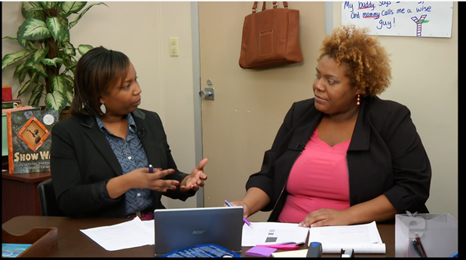
Reflections and Conferences
Pre-observation Conference
Observation
Reflection
Post-observation Conference
Reflections embedded in pre- and post-conference questions
Self-Reflections after each observation
Professional Self-Review
Notes:
The reflections and interviews for the special areas are no longer isolated. They are embedded in the pre- and post-conferences which provide focused, meaningful conversations between the evaluator and the practitioner. This engaging dialogue allows practitioners to reflect on their own professional practices. All educators target one area of reinforcement and one area of refinement following each observation. This process parallels the evaluation process for classroom-based teachers and principals.

Slide 15
Collaborative Activity 1
Elements of Effective Practice
If you walked into a small group being served by a school counselor, what would you see that indicates effectiveness? What about other direct or indirect services that the school counselor provides?
In your assigned room, you will work with your group to brainstorm a list of effective practices.
Notes:
Here's a sample activity from the evaluator training. Those training to evaluate school counselors will engage in an activity that will require them to identify elements of an effective counseling session.
Think about what should be happening in an effective small group counseling session. Evaluators will be observing and looking for evidence of effective practice.
If you walked into an effective small group counseling session, what would you see and hear? What would the school counselor be doing? What would the students be doing?
In just a moment, you will be pushed to your assigned breakout room. With your group, you will brainstorm a list of effective practices. Select a note-taker/spokesperson from the group jot down your ideas. He or she will be responsible for reporting out to the main group, sharing two ideas that have not already been shared. After 10 minutes, you will return to the main room and share your ideas.

Slide 16
Elements of Effective Practice
DIRECT AND INDIRECT STUDENT SERVICES
Effective communication amongst student(s) and counselor
Instruction aligned to the ASCA Mindsets & Behaviors for Student Success
Appraisal and advisement
Short-term counseling
Referrals to appropriate school and community resources
Consultation to support student achievement and success
Collaboration with families, teachers, administrators, other school staff and education stakeholders
Notes:
What did you think of?
Here are some examples of elements of effective practice for school counselors. Did you think of these? Did you think of others?

Slide 17
Understanding the Rubric
Components
Sources of Evidence
Notes:
We will now take a look at the evaluation instruments for Special Areas.
All three special area Advisory Groups decided that a rubric would be the most effective way to measure their professional practices.
A rubric is a much different tool than a check list of standards to mark met or not met, and the language within each descriptor implies growth.
First, let’s take a look at the components of the rubric.

Slide 18
South Carolina Speech-Language Rubric
Planning
Instruction
Collaboration
Professionalism
Demonstrating Knowledge & Skills
Planning Program & Services
Developing the IEP
Conducting IEP Meetings
Assessing Student Needs
Creating a Positive Learning Environment
Scheduling Flexible & Responsive Services
Delivering Instruction
Communicating Responsively
Using Feedback
Demonstrating Compliance
Demonstrating Confidentiality
Demonstrating Ethical Communication
Growing & Developing Professionally
School Responsibilities
Leadership
Collaborating with Professionals
Collaborating with Families
Notes:
The rubric for Speech-Language Professionals has 4 Domains, with 18 Indicators. There are 4 Performance Levels for the descriptions of practice for Planning, Instruction, and Collaboration. Professionalism is slightly different, using a combination of the reflections from the speech-language professional and administrative evaluator.

Slide 19
South Carolina School Counselor Rubric
Planning
Program Management
Direct & Indirect Services
Professionalism
Program Plans
Communication
Lesson Planning
Assessment
Progress Monitoring
Direct Services
Indirect Services
Ethics
Growing & Developing Professionally
Student Success
Leadership
Collaboration
Notes:
The rubric for the school counselor has 4 Domains, with 12 Indicators. There are 4 Performance Levels for the descriptions of practice for Planning, Program Management, and Direct and Indirect Services. Professionalism is slightly different, using a combination of the reflections from the school counselor and administrative evaluator.

Slide 20
South Carolina School Librarian Rubric
Instruction
Environment
Library Services & Management
Professionalism
Promoting Literacy
Promoting Inquiry
Motivating Learners
Librarian Knowledge of Learners
Learner Collaboration
Thinking
Problem Solving
Multiple Perspectives
Collaborative Conversations
Learning Environment
Learner Feedback
Learner Engagement
Seeking Information
Sharing & Crediting Sources
Resource Management
Library Administration
Collaboration
Ethical Use
Growing & Developing Professionally
Community Involvement
School Responsibilities
Notes:
The rubric for School Librarian has 4 Domains, with 21 Indicators. There are 4 Performance Levels for the descriptions of practice for Instruction, Environment, and Library Services and Management. Professionalism is slightly different, using a combination of the reflections from the school librarian and administrative evaluator.

Slide 21
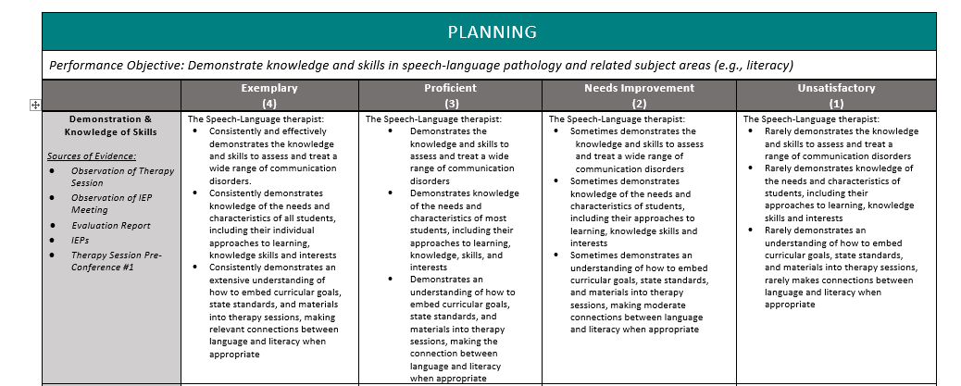
Parts of the Rubric
Domains
Indicators
Descriptors
Performance Levels
Sources of Evidence
Notes:
This slide is taken from the Speech-Language Professional Rubric to highlight each element of the rubric.
Domains are the big buckets
Indicators are the specific elements of practice
Descriptors describe what performance looks like at each level
The four performance levels are the biggest difference from the ADEPT 2006 model, giving the SLP more specific feedback.
The Sources of Evidence show the evaluator where to find evidence of the descriptors.

Slide 22
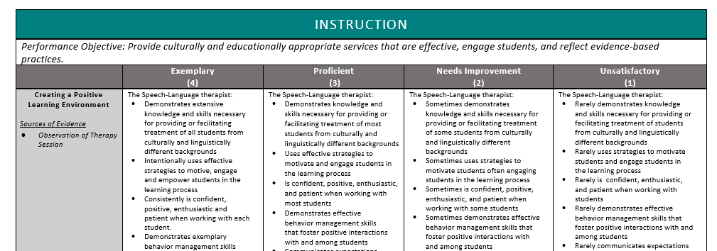
Growth Mindset
Instruction
Student Centered Teacher Centered
Notes:
Each special area rubric has 4 levels – moving from Unsatisfactory to Exemplary – increasingly student centered as we move left.

Slide 23

Administrative Support
Administrative Support section for each Domain within the guidelines
Sources of Evidence for each Domain
Questions for Pre- and Post-Conferences Cross-Referenced for each Indicator
Training will include Roles and Responsibilities via video clips of SC practitioners
Notes:
We understand that it is imperative that the school level administrators and evaluators understand and acknowledge the unique roles and responsibilities of these three areas. We built in several ways to assist administrators throughout this process.
First, near the very beginning of the guidelines, we have devoted a section that lists ways for administrators to support the practitioner. These suggestions are listed by the Domains of the rubric so you can be successful in using the rubric. For example, for the Planning Domain in the Speech-Language Rubric, the Speech-Language Professional must have all resources necessary to be compliant with state and federal regulations for children with disabilities. Districts and schools must provide the Speech-Language Professional with adequate funding for purchasing current standardized speech and language materials and assessments as well as time to collect the wide range of data produced by these tools.
As you become familiar with your evaluation rubric, you will see in the first column under the Indicator "Sources of Evidence" are listed. The administrator and/or evaluator can readily see where they can find evidence to match every indicator on the rubric. For example, some of the sources of evidence may be correlated pre- or post-conference questions, observations, IEP documents, the School Counselor Plan, or the School Librarian Plan.
We are providing the administrators and evaluators with required questions to ask during the pre- and post-observation conferences. These questions were developed by the Advisory Groups, and align to the Indicators on the Rubric. Of course, the administrator and evaluator may ask additional questions for clarification or additional information as needed.
Finally, as evaluators will see at the beginning of their online Evaluator Training, they are able to hear first-hand from speech-language professionals, school counselors, and school librarians through video clips as they share their various roles and responsibilities that administrators may not readily see during scheduled observations with students.
We feel that these new strategies will help bridge the gap of knowledge and understanding between the administrators and the practitioners.

Slide 24

Domain Weightings for SLPs
Planning 25%
Instruction 40%
Collaboration 10%
Professionalism 25%
Notes:
One of the tasks of each Advisory Group was to determine the weightings for each of the four Domains that will be calculated to reach an overall composite score. This slide shows the weightings for the speech-language professionals. The weighting of the Planning Domain is 25% of the composite score, the Instruction Domain is 40%, Collaboration Domain is 10%, and the Professionalism Domain is 25%.
The Office of Educator Effectiveness collected data from districts that elected to pilot ADEPT for each special area in 2020-21 to determine a recommendation to the SBE about how composite scores will be converted to overall evaluation ratings of Met and Not Met.

Slide 25

Domain Weightings for School Counselors
Planning 15%
Program Management 15%
Direct & Indirect Services 50%
Professionalism 20%
Notes:
This slide shows the weightings for the School Counselors. The weighting of the Planning Domain is 15% of the composite score, the Program Management Domain is 15%, Direct & Indirect Services Domain is 50%, and the Professionalism Domain is 20%.

Slide 26

Domain Weightings for School Librarians
Instruction 30%
Environment 20%
Library Services & Management 40%
Professionalism 10%
Notes:
This slide shows the weightings for the school librarians. The Instruction Domain is 30% of the composite score, the Environment Domain is 20%, the Library Services & Management Domain is 40%, and the Professionalism Domain is 10%.
The Office of Educator Effectiveness collected data from districts that elected to pilot ADEPT for school librarians in 2020-21 to determine a recommendation to the SBE about how composite scores will be converted to overall evaluation ratings of Met and Not Met.

Slide 27
Activity 2:
Looks Like/Sounds Like
Domain: Instruction
Indicator: Creating a Positive Learning Environment
Descriptor: The SLP uses effective strategies to motivate and engage students in the learning process.
What types of activities/strategies would the evaluator possibly see being used in a therapy session as evidence?
Jot down your ideas.
Notes:
Here, we have another sample activity from the evaluator training, this time from speech-language professionals training. For this activity, participants will identify what effectiveness looks like and sounds like.
Let's take one descriptor from the Instruction Domain. One of the descriptors that would demonstrate how a speech-language professional creates a Positive Learning Environment would be to use effective strategies to motivate and engage students in the learning process. What would the evaluator see and hear during a therapy session that would provide evidence of using effective strategies to motivate and engage students?
You will brainstorm a list of what this descriptor would look like and sound like in a session where effective therapy is taking place. After 7 minutes ask for responses from participants.

Slide 28
Looks Like/Sounds Like
Descriptor: The SLP uses effective strategies to motivate and engage students in the learning process.
Did you think of some of these strategies or activities?
Games
Picture Cards
Point Sheets
Manipulatives
Books
iPad Apps
BOOM interactive cards to use with iPads, Tablets, Laptops
Learning songs or videos
Crafts with different materials they can earn as they practice their sounds or language tasks
Notes:
Here are some examples of strategies that motivate and engage students. Did you think of more?

Slide 29
Evaluation Process and Evidence Collection
Notes:
Now let’s take a look at an overview of the evaluation process and evidence collection.

Slide 30
Contract Levels and Evaluation Types
Contract Level | Observations
Induction - Formative | >1 – Full Observation per semester, with conferences (Principal/Administrative Designee; Trained Mentor)
Annual - Formative (Diagnostic) | >2 – Full Observations per semester, with conferences (Principal/Administrative Designee, Content Expert & Trained Mentor)
Annual/Continuing - Summative | >2 – Full Observations per semester, with conferences (Principal/Administrative Designee & Content Expert; a third member is required for Highly Consequential Annual Summative evaluations)
Continuing - Formative | >1 – Full Observation per semester, with conferences (Principal/Administrative Designee, & if necessary, Content Expert)
Annual/Continuing - GBE | Informal
Notes:
We know that all practitioners do not need the same level and type of feedback, so the support they are given should be tailored to their needs. Evaluation level is assigned based on certification requirements and should be set by the ADEPT Coordinator or Human Resources department in your district.
You will notice that each evaluation team, regardless of contract level is required to have an Administrative evaluator or designee. For some contract levels, in addition to this, there is a requirement for a content expert that must be trained and certified in the content area. For school librarians, this content expert must be a school librarian. For school counselors, it must be a school counselor. For speech-language professional, it must be a speech-language professional or special education educator. Guidelines for each area provide more specific detail surrounding evaluation teams.
Note that observations for special areas do NOT require classroom instruction.

Slide 31
Reminders for Evaluation Set-up
Every evaluation needs an evaluation chair. This is also required for Special Areas.
When adding team members, the evaluator needs to be given permissions to the evaluation.
If evaluation teams are created at the district level, the schools cannot change the teams. If the teams are created by the school, changes can be made by the district or the school.
The Orientation date must be entered by an ADEPT administrator or an evaluator before the teacher can sign the orientation.
Notes:
An evaluation chair is required for ADEPT 2020 for Special Areas. There is a form that can only be completed by the evaluation chair.
When using the bulk tool to set the evaluation team, please make sure to select permissions for each person you are adding to the team. If permissions are not selected, the person will be added but will not be able to access anything.
Besides login issues, Orientation generates the most support cases for SCLead. The Orientation date must be entered before and educator can sign the orientation. Please remind your administrators to enter the Orientation dates before they ask the educators to sign. If the date is not there, the educator will receive an access denied message.

Slide 32
Speech Language Professionals

Slide 33
Overview for Speech-Language Professionals
Contract Level | Process
Formative and Summative | Records Review Preliminary Cycle: POP IEP Meeting Therapy Session Preliminary Evaluation Conference Final Cycle: OP IEP Meeting Therapy Session Final Evaluation Conference
Goals-Based Evaluation (GBE) | Professional Goal
Notes:
As we have already stated, the evaluation process and number of observations vary depending on the special area and the type of evaluation the practitioner is undergoing. Generally, all educators are evaluated every year. Specific details of each are thoroughly explored during Evaluator Training.
Generally speaking, the formative and summative evaluations of the speech-language professionals include a records review at the beginning of the year. The POP cycle during the preliminary evaluation cycle during the fall includes a pre-conference, observation, and post-conference. There are two types of observations for the speech-language professional – an observation of an IEP meeting and an observation of a therapy session. After the Preliminary Evaluation Conference mid-year, the final evaluation cycle includes the OP cycle, which is an observation and post-conference. The Final Evaluation Conference is held at the end of the school year.
During all other years, speech-language professionals participate in a Goals-Based Evaluation. During the GBE years, speech-language professionals will develop a Professional Goal that impacts student growth.

Slide 34
Speech-Language Professionals
Orientation
Goals (Professional – optional)
Observations
Evaluation Conferences
Worksheets
Evaluation Conference Scoring
Professionalism
Attachments
Results
Expectations in SCLead.org
Notes:
On this slide you will see the basic requirements for input into SCLead for a formative or summative evaluation. If a speech-language professional is on a GBE, professionalism would not be included, and professional goals would be added to the evaluation.

Slide 35
Speech-Language Professional FAQ ​
Which Speech-Language Professionals (SLPs) require ADEPT evaluations? ​
​
SLPs Employed Directly By a School District ​
SLPs will participate in the district’s ADEPT evaluation process using the appropriate contract level. ​
SLPs should be evaluated every year. ​
SLPs on an Internship certificate must participate in the district’s induction program and be assigned a mentor. ​
SLPs on a Professional certificate must successfully complete the ADEPT summative evaluation process at the annual contract level in order to be eligible for a continuing contract. ​
SLPs on a Continuing contract, the evaluation may be summative, formative, or goals-based, at the discretion of the local school district. Continuing Formative evaluation is not required for SLPs maintaining their ASHA Certificate of Clinical Competence, instead those SLPs should complete a GBE.​
Contracted SLPs ​
SLPs employed trough a third-party vendor will be evaluated using the employer’s protocols. An employer may choose to use the state’s ADEPT evaluation model for SLPs in conjunction with a school district but is not required to do so.​​
Notes:
Read slide.

Slide 36
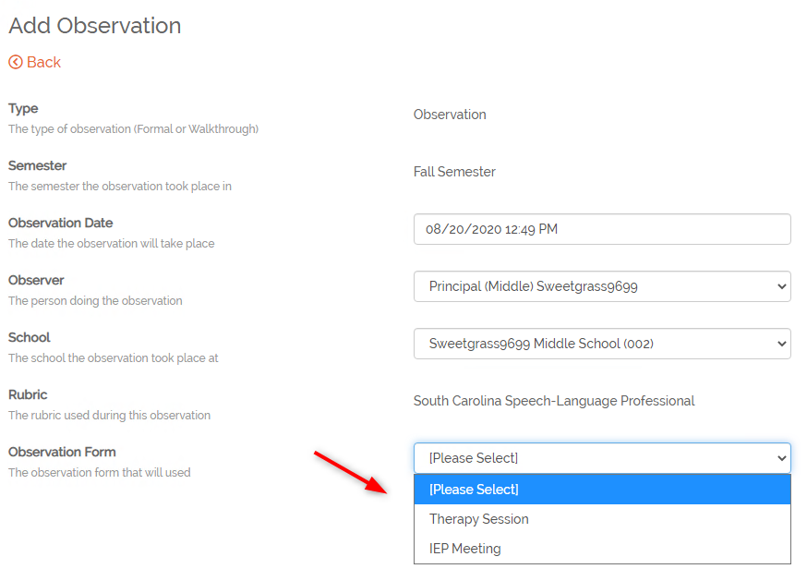
Speech-Language Professional
The evaluator will need to select the observation type when creating the observation.
  Therapy Session
  IEP Meeting
Notes:
SCLead is set up so the type of evaluation is tailored to the IEP Meeting or Therapy Session for the Speech-Language Professional.

Slide 37
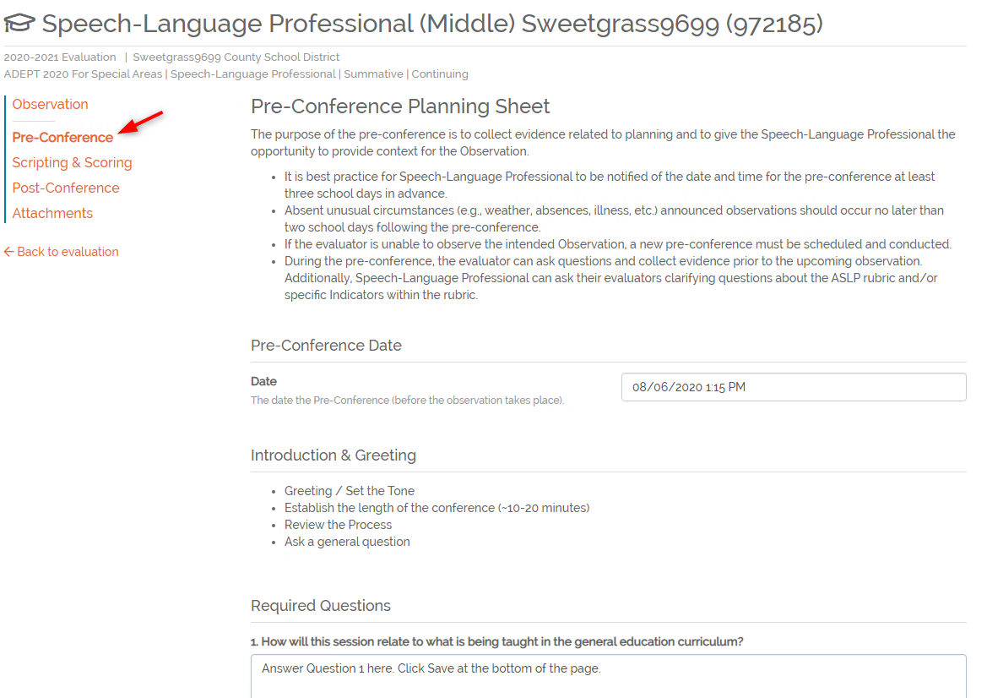
Pre-Conference Form
Each observation will have a pre-conference form to be completed by the evaluator.
Notes:
Each of the three areas will have its own pre-conference form. The questions will be answered by the evaluator.

Slide 38
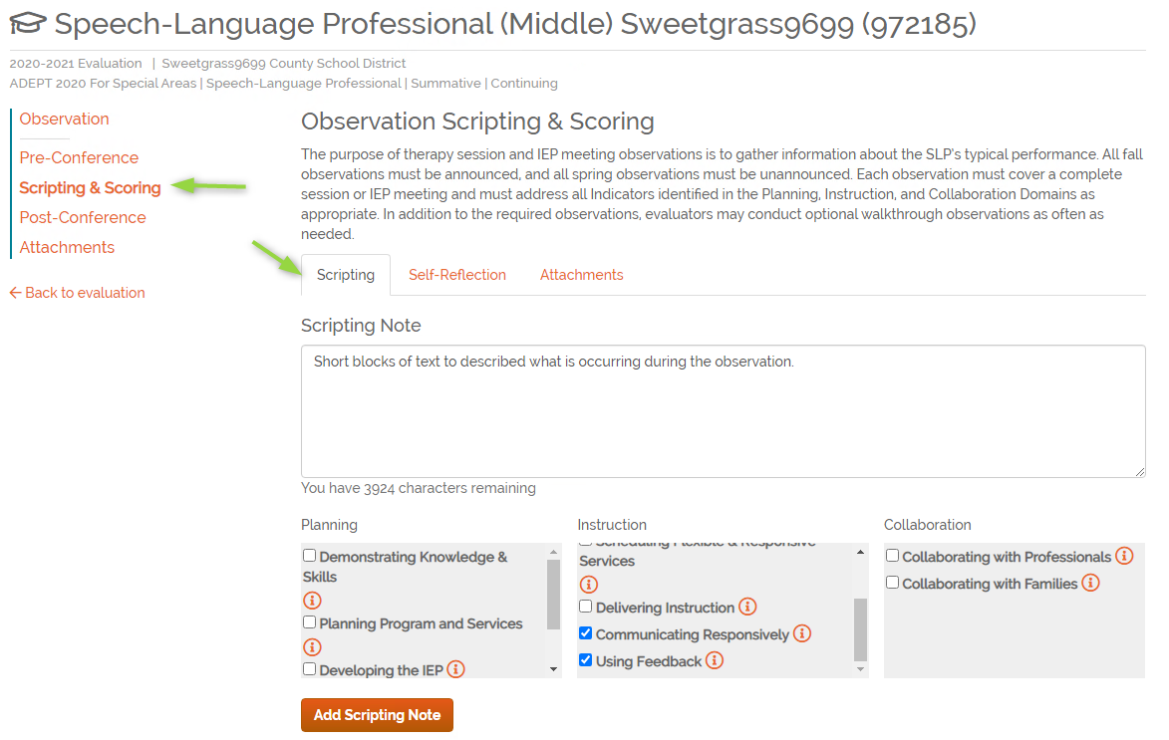
Observations: Scripting
Short blocks of evidence
Aligned to each indicator
Intended to facilitate scoring
Notes are not visible to anyone except the observer
Notes:
Scripting notes are an optional feature in SCLead. Scripting can be entered in SCLead and then each section of notes, or evidence, can be aligned to the rubric indicators. Each block of evidence can be aligned to as many indicators as applicable.
The idea is that each script block is a small description of what occurred during the observation. For example, you create one script block to describe what the educator just said to a group of students and how the students responded. Then you enter a new block to describe what happened next. Each of those small blocks of scripting can be aligned to each indictor to help inform scoring. The alignment can occur at any time, but it may be easiest to enter all scripting and then after the visit portion of the observation has concluded, go back and complete the alignment.
Some users may want to record all the notes in Word or even on paper and then later add them to SCLead and that is okay too. My only caution is that if you are copy/pasting from Word or similar program, copy into SCLead as plain text to avoid hidden characters. Please remember, the blocks are intended to be smaller sections of notes and there are character limits to each section. You could also just save the document and add it as an attachment. Attachments in this section are not viewable anyone else.
Scripting notes will only be visible to the observer. The educator, administrators or other observers will not be able to access the scripting notes at any time.

Slide 39
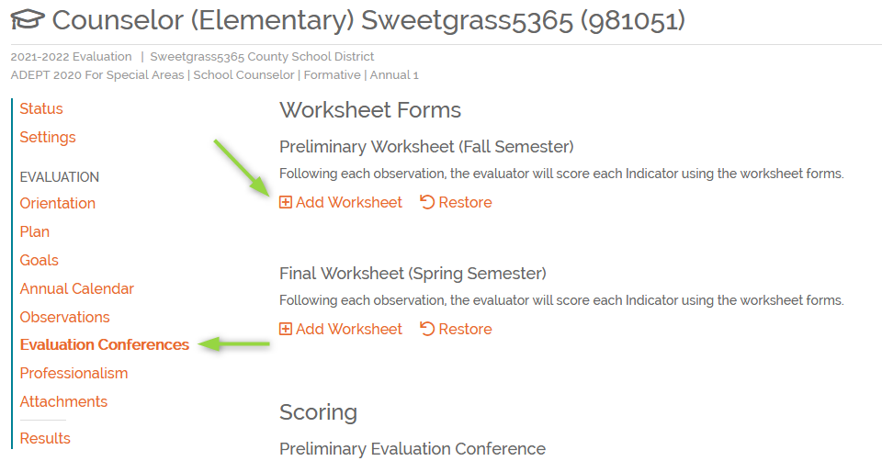
Worksheet
Each Evaluator will complete a Preliminary Worksheet.
If requirements are met, Spring worksheets may be skipped.
Educator will not see the worksheets.
Notes:
We understand for special areas, there are many sources of evidence to consider when scoring the rubric. Some indicators may not have any relation to an observation. With that, we have created worksheets as a space for evaluators to collect evidence, add notes and score the rubric.
The worksheets are not visible to the educator and are a tool solely for the evaluator.
Once the worksheets are complete, the scores will be displayed in the Preliminary and Final Conference forms. We’ll discuss the scoring section in just a moment.
To add a worksheet, click Evaluation Conferences in the left navigation menu. Then click Add Worksheet.
Each evaluator on the team will need to complete a worksheet for the preliminary and final cycles. The system will indicate if final cycles can be skipped based on scoring and contract levels.

Slide 40
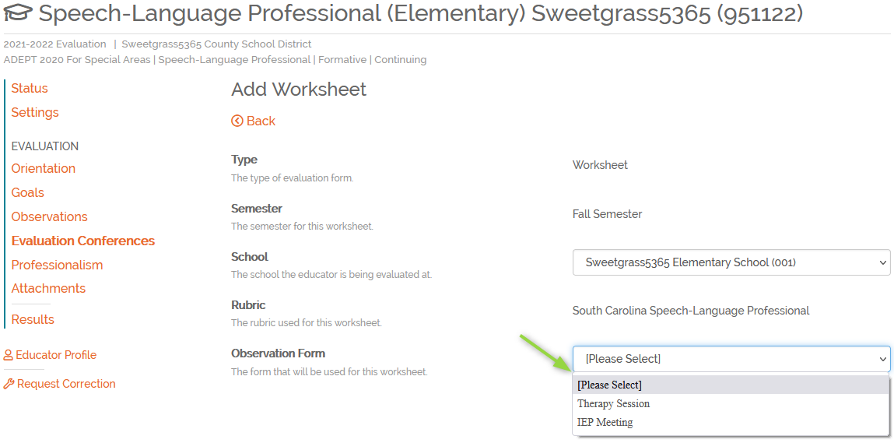
Worksheet, Lesson Type
Need select IEP Meeting or Therapy Session for Speech-Language Professionals
Notes:
Once you click add worksheet, you’ll go to the details page.
When creating worksheet for Speech-Language Professionals, the evaluator will select the type of observation he/she completed and are responsible for scoring.

Slide 41
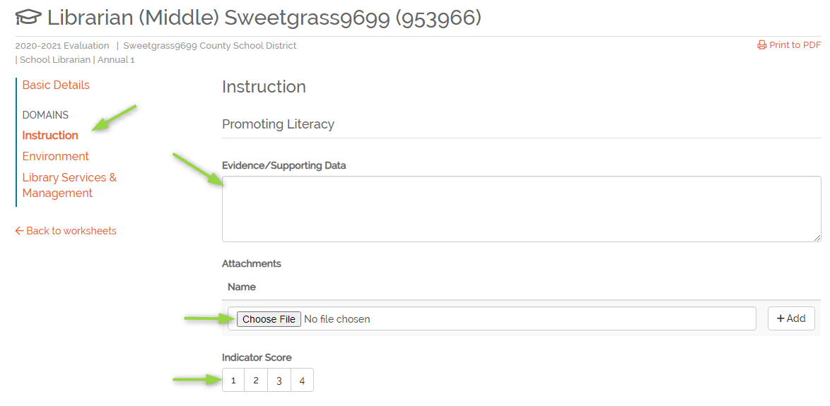
Worksheet, Domain
Select the Domain
For each indicator enter:
  Evidence
  Attachments
  Select a score
  Click save
Notes:
Next, select the domain you’d like to work with. Then enter supporting evidence in the form of notes and attachments. Each indicator will need a score selected. Before you leave the page, click Save at the bottom to save your work.
I know I’ve said this but as a reminder, the worksheet is not shared with the educator.
Once the evaluator has completed the worksheet and scored all indicators, the evaluator will add his/her signature to indicate the scores are complete.
Both evaluators on the team would need to complete a worksheet.

Slide 42
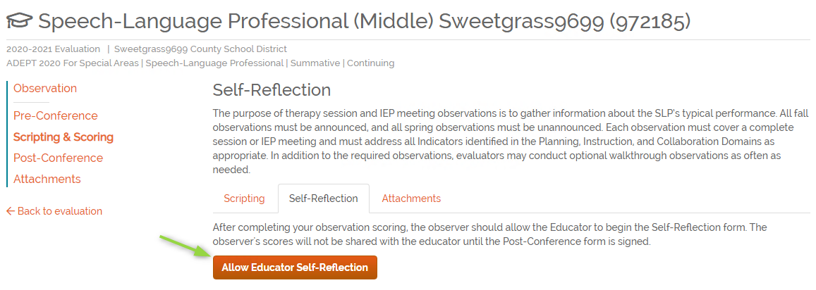
Observations: Self-Reflection
If the observation date has passed, self-reflection will be enabled.
If observation in the future, select when you are ready for the educator to see the observation in SCLead.org.
If not enabled, educator will not see the record of the observation.
If the observer has signed the post-conference, self-reflection can no longer be entered.
Notes:
We have added a feature that will automatically enable self-reflection if the date of the observation has passed. If the date has not passed, self-reflection will need to be enabled by the observer.
Once the observer clicks “allow educator self-reflection”, the educator can see the observation and enter self-scores provided the post conference form has not been signed.
If the observer disables self-reflection, the observation is no longer visible to the educator, even if the observer has signed the post-conference form. It’s important to remember “Allow Educator Self-Reflection” is required for an educator to see the observation. If you want to disable the self-reflection after the three-day window, you can; however, you must enable again before you sign the post conference form, thus allowing the educator to sign yet still controlling the window for self-reflection.

Slide 43
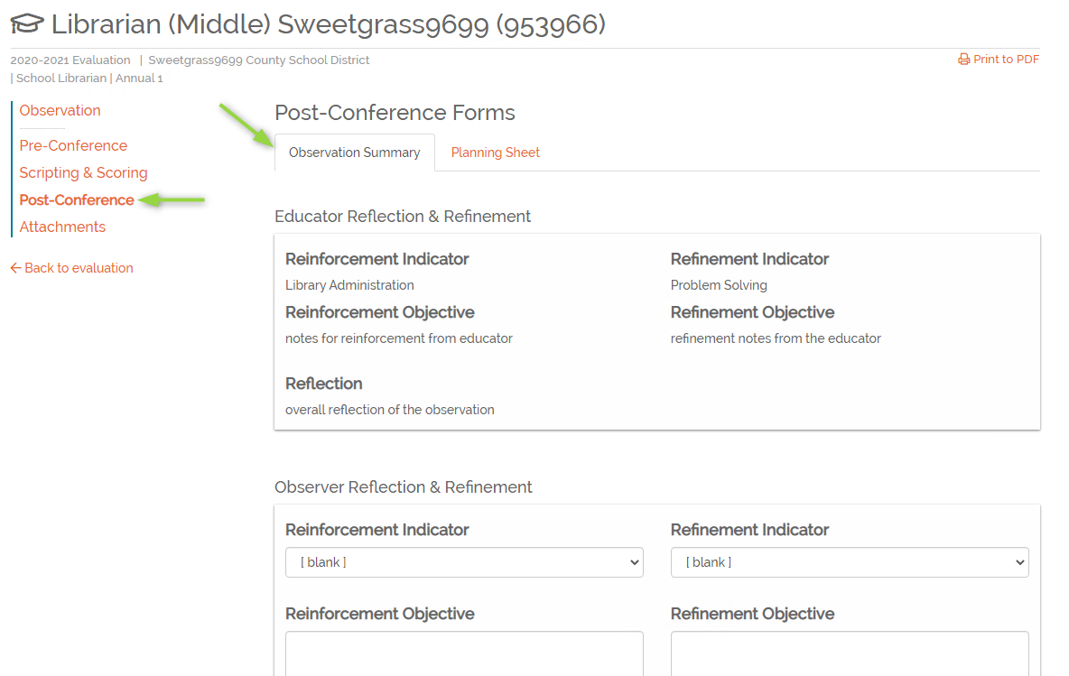
Observations: Post-Conference
The Post-Conference form for special areas will include
An observation summary tab
Only has Reflection and Refinement
Planning sheet
Notes:
The Post-conference form will have the Observation Summary and the planning sheet. Again, the scoring will not be included directly in the observation.
The Planning sheet will be completed by the evaluator.
The evaluator will also complete the Observation Summary. If the educator has completed the self-reflection and shared it with the evaluator, his/her reflection selections will be displayed. The evaluator will select a reinforcement and refinement and can enter reflections notes. The educator will not see the post-conference form until the evaluator has entered his/her signature.

Slide 44
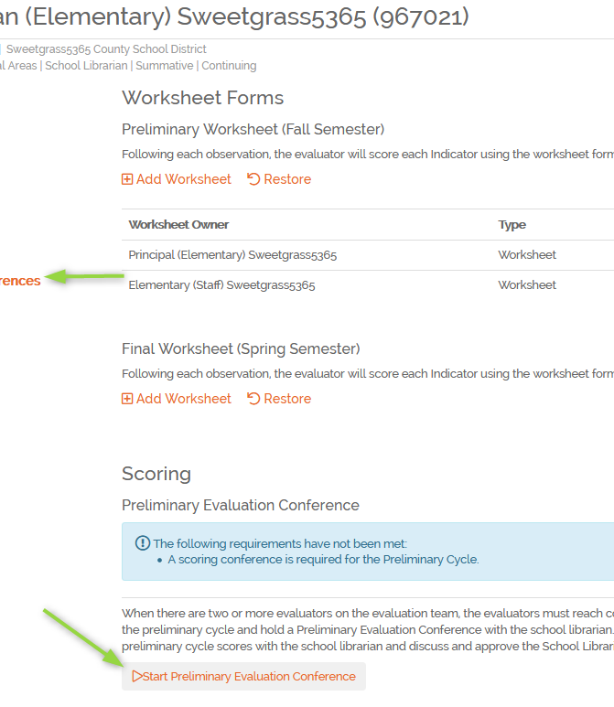
Scoring
The Evaluation chair will need to Start the conference forms
The consensus tab will not be shared with educators
Once scores have been selected and the conference occurs, the evaluation chair will sign, then evaluator and educator.
Notes:
The scoring section will have the Preliminary and Final Evaluation Conference forms. These are the forms where consensus scores will be selected, and the scores shared with the educator. The final evaluation conference form will carry forward to the results section unless the final cycle can be skipped in which case preliminary scores would be used. It could be a combination of preliminary and final scores for Speech-Language Professionals in a situation where the spring IEP meeting is eligible to be skipped.
The evaluation chair will need to start the evaluation conference forms. The evaluator only role cannot start the form.

Slide 45
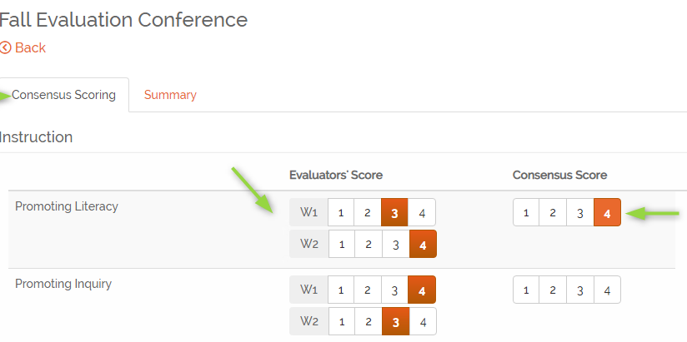
Consensus Scoring
Each evaluator’s score will be displayed.
The evaluation chair will select the consensus score.
Selected score will display on the Summary page.
Notes:
The evaluation conference form will open to the Consensus scoring page. Again, this page will not be shared with the educator.
The evaluation chair will select the consensus score for each indicator.

Slide 46
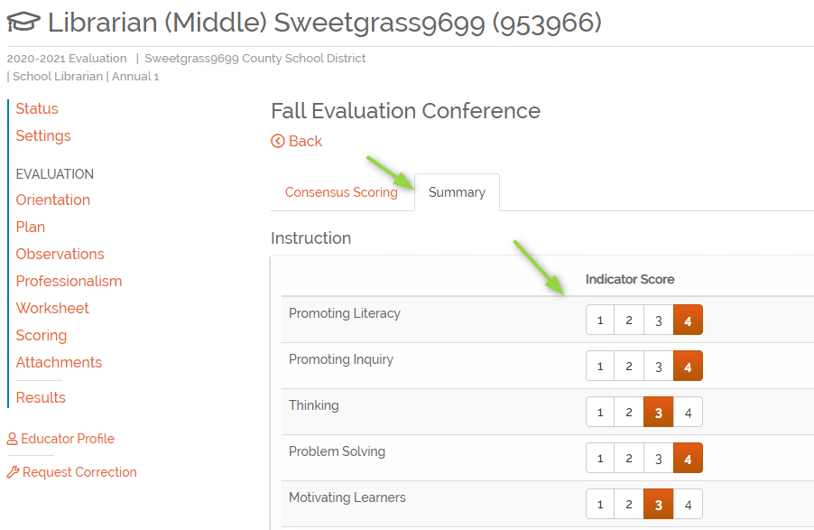
Scoring Signatures
Consensus scores will display
Evaluation Chair signs first, then evaluator
Educator will not see until both evaluators have signed.
Educator signs.
Notes:
The scores selected will display on the Summary tab. The evaluation chair and then evaluator will enter his/her signature. At that point, the conference form will be visible to the educator and the educator can enter his/her signature.
So the only action for the summary tab is to add signatures.

Slide 47
Overall Process
Review
Evaluators collect evidence such as
Plans submitted by educator
Annual Calendar
IEP reports
Observations
Evaluators complete a scoring worksheet
Evaluators have consensus meeting to determine final score.
Share evaluation feedback with educator.
Notes:
As an overview: The evaluators will collect evidence. This may be from an observation, the counselor submitting their annual calendars, reviewing communication regarding IEPs, etc. As the evaluator is reviewing evidence, he/she will complete the worksheet. Scoring does not really make sense in an observation since many of the indicators are not observable in a student setting, so the worksheet allows the evaluator to consider all evidence.
Once the evaluators have finalized individual scoring, they will meet to discuss scores and reach a consensus. Those consensus scores are shared with the educator in the Preliminary and Final Evaluation Conferences. The professionalism scores may be shared at this time as well, but those scores are recorded separately.

Slide 48
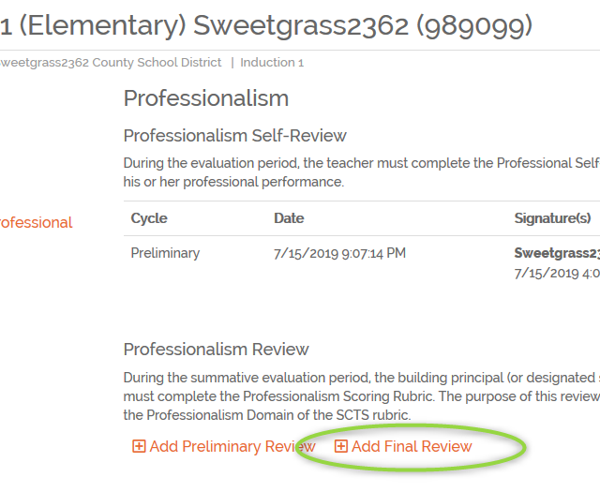
Professionalism Rubric
Evaluator must complete a Final Review.
Evaluator has the option to complete a Preliminary Review. – Preliminary reviews are not included in scoring.
Educator is required to complete a final self-review.
Notes:
As I just mentioned, special areas will also complete the professionalism rubric.
The Professionalism review is required unless on GBE/LoA. A preliminary review is optional, and the scores do not count. A final review must be completed and once signed by the evaluator; the scores will be included in results. The educator is not required to sign the professionalism review; however, the progress indicators will not show as complete unless the educator signs.
For special areas, educators ARE required to complete a final self-review. The preliminary self-review is optional.

Slide 49
Results
Results are calculated based on scored elements by the system.
Scores will be based on Spring scores unless the Spring cycle has been skipped based on eligibility.
The educator can sign but is not required to do so.
Once results are complete, the District ADEPT administrator will enter recommendations for the following year and must sign the results page.
Once district Administrator’s signature has been added, the evaluation can be marked as complete.
*See Informational messages if results page cannot be edited.
Notes:
The evaluation overall rating will be calculated by the system.
Once the results have been entered and signatures are present, the evaluation can no longer be edited. If edits are needed, the signatures will need to be removed.
I’ll show you an example of information messages on the next slide.
As a reminder, you can use the Staff Evaluation Status report to see who has/hasn’t completed the evaluation.

Slide 50
School Counselors

Slide 51
Overview for School Counselors
Contract Level | Process
Formative and Summative | Approval Conference School Counselor Plan Student Growth Goal Annual Calendar Preliminary Cycle: POP Preliminary Evaluation Conference Final Cycle: POP Final Evaluation Conference
Goals-Based Evaluation | Student Growth Goal
Notes:
Generally speaking, the formative and summative evaluations of the school counselor include an Approval Conference at the beginning of the year when the administrative evaluator approves the School Counselor Plan, Student Growth Goal, and Annual Calendar. The POP cycle during the preliminary evaluation cycle during the fall includes a pre-conference, observation, and post-conference. After the Preliminary Evaluation Conference mid-year, the final evaluation cycle includes another POP cycle because all observations of the school counselor are announced with a pre-conference and a post-conference. The Final Evaluation Conference is held at the end of the school year.
Waivers of observations can be granted at the discretion of the evaluation chair for particular years if all criteria are met. These waivers will be explored during the Evaluator Training. If you have any questions about these waivers, please refer to the Guidelines.
During all other years, school counselors participate in a Goals-Based Evaluation. During the GBE years, ALL school counselors will develop a Student Growth Goal. Professional goals may be added (above and beyond the SGG) at the discretion of the district.

Slide 52
School Counselor
Orientation
Plan
Annual Calendar
Goals
Observations
Evaluation Conferences
Worksheets
Evaluation Conference Scoring
Professionalism
Attachments
Results
Notes:
The components are included on the school counselor evaluation.
If a school counselor is on a GBE, only goals would be included.

Slide 53
School Counselor Observations
Induction Formative
1 or more Fall Observations
1 or more Spring Observations
Annual and Continuing Summative
Fall
Observation by Administrator
Spring
Observation by Administrator
Observation by Certified Counselor
Consensus form completed by Evaluation Chair
Annual Formative
Fall
Observation by Certified Counselor
Consensus form completed by Evaluation Chair
Observation by Administrator
Observation by Certified Counselor
Consensus form completed by Evaluation Chair
Spring
Observation by Administrator
Observation by Certified Counselor
Consensus form completed by Evaluation Chair
Mentor Required
Mentor is Required
Continuing Formative
1 or more Fall Observations
1 or more Spring Observations
Spring cycle can be skipped if all indicators are rated 3 or 4
Notes:
Again, we’ll review observations in detail in moment but here is a reminder of the requirements for counselor observations. These business rules will be implemented in the system.

Slide 54
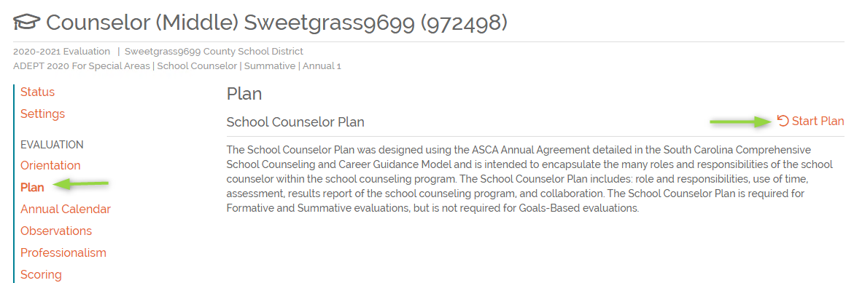
School Counselor Plan
Notes:
SCLead contains all of the components of each evaluation the evaluator and practitioner will need. Here you see where to locate the School Counselor Plan.

Slide 55
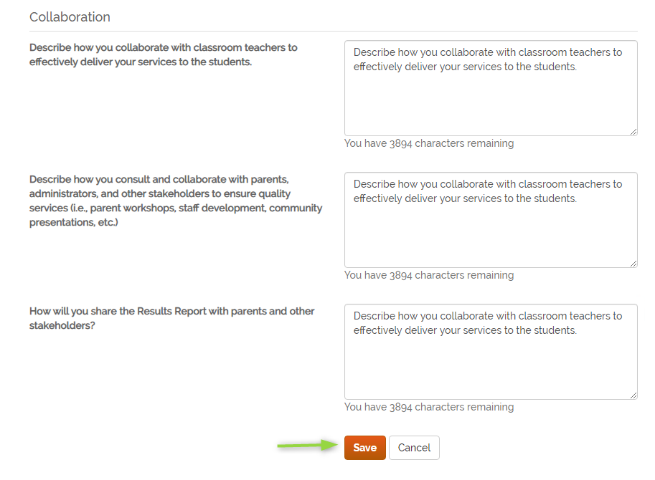
Plan
Notes:
This screenshot shows you the template for the School Counselor Plan.

Slide 56
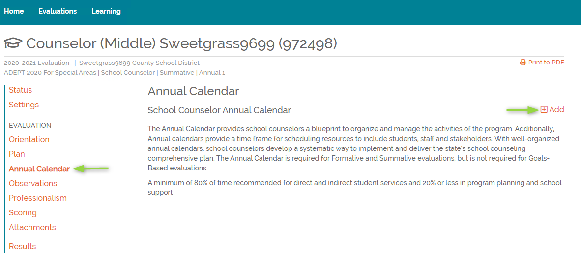
Annual Calendar
Notes:
Counselors will click Annual Calendar in the navigation selections and then click Add.

Slide 57
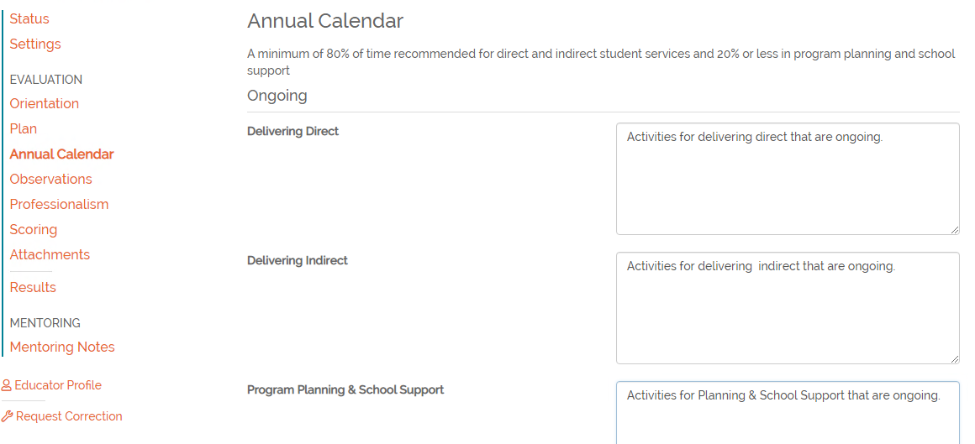
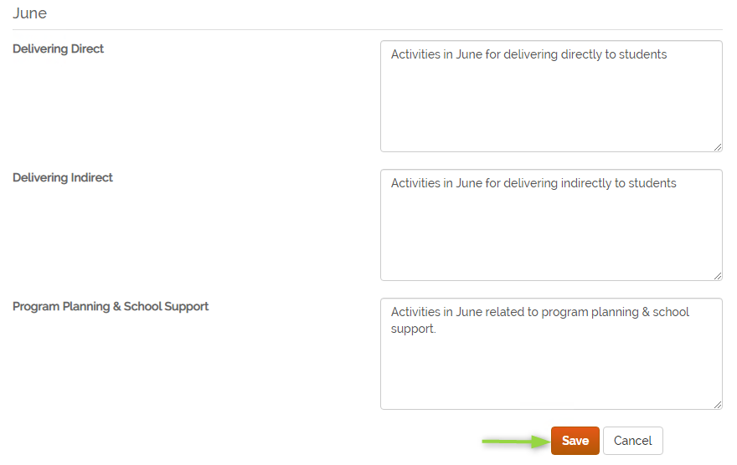
Annual Calendar, cont.
Notes:
SCLead also provides a place for the School Counselor to house their Annual Calendar.

Slide 58
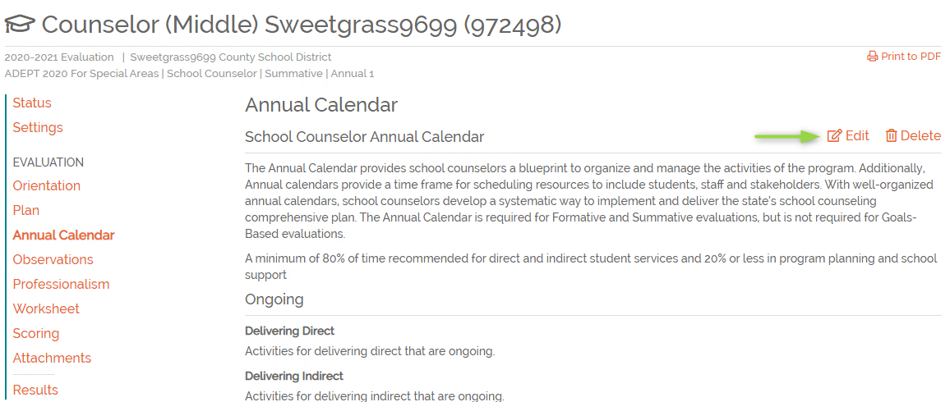
Annual Calendar, Ongoing
Notes:
The annual calendar will remain open throughout the year and the counselor can adjust as needed. There are not signatures on this form as it’s a working document.

Slide 59
School Librarians

Slide 60
Overview for School Librarians
Contract Level | Process
Formative and Summative | Approval Conference School Librarian Plan Preliminary Cycle: POP Preliminary Evaluation Conference Final Cycle: OP Final Evaluation Conference
Goals-Based Evaluation | Professional Goal
Notes:
Generally speaking, the formative and summative evaluations of the school librarians include an Approval Conference at the beginning of the year when the administrative evaluator approved the School Librarian Plan. The POP cycle during the preliminary evaluation cycle during the fall includes a pre-conference, observation, and post-conference. After the Preliminary Evaluation Conference mid-year, the final evaluation cycle includes the OP cycle, which is an observation and post-conference. The Final Evaluation Conference is held at the end of the school year.
Waivers of observations can be granted at the discretion of the evaluation chair for particular years if all criteria are met. These waivers will be explored during the Evaluator Training. Again, please refer to the guidelines for the specific waivers for each area and contract level.
During all other years, school librarians participate in a Goals-Based Evaluation. During the GBE years, school librarians will develop a Professional Goal that impacts student growth. This goal is located within the School Librarian plan.

Slide 61
School Librarians
Orientation
Plan
Goals (Professional – optional)
Observations
Evaluation Conferences
  Worksheets
  Evaluation Conference Scoring
Professionalism
Attachments
Results
Notes:
The components will be included in a school librarian evaluation. However, if a librarian is GBE, only professional goals would be included.

Slide 62
School Librarian Observations
Induction Formative
1 or more Fall Observations
1 or more Spring Observations
Annual and Continuing Summative
Fall
Observation by Administrator
Spring
Observation by Administrator
Observation by Certified Librarian
Consensus form completed by Evaluation Chair
Annual Formative
Fall
Observation by Certified Librarian
Consensus form completed by Evaluation Chair
Observation by Administrator
Observation by Certified Librarian
Consensus form completed by Evaluation Chair
Spring
Observation by Administrator
Observation by Certified Librarian
Consensus form completed by Evaluation Chair
Mentor Required
Mentor is Required
Continuing Formative
1 or more Fall Observations
1 or more Spring Observations
Spring cycle can be skipped if all indicators are rated 3 or 4
Notes:
We’ll review observations in detail in a few moments. The system will include the business rules for observation requirements. Final scores are based on Spring observation/consensus unless Spring cycle can be skipped.

Slide 63
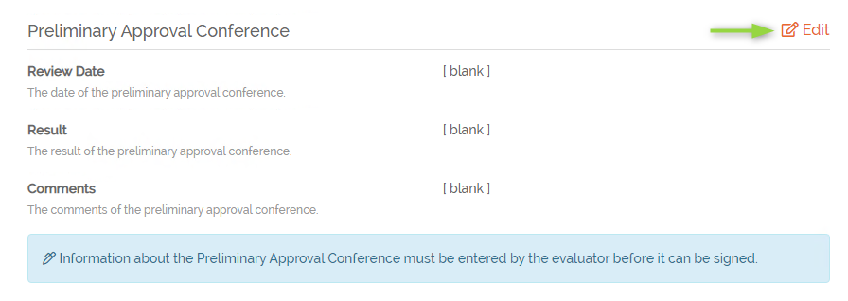
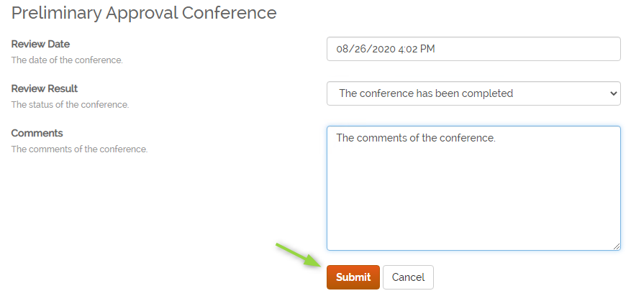
School Librarian Plan
Notes:
Here is a quick look at the template for the School Librarian Plan.

Slide 64
Roles of Evaluation Team Members
Evaluator
Mentor
Communicate regularly with educator to assess needs and provide support
Notify the educator of the date and time for the pre-conference at least three school days in advance
During the pre-conference, ask questions and collect evidence prior to the upcoming observation
Answer clarifying questions about the evaluation rubric and/or specific Indicators within the rubric
Observe the educator in practice and identify an Area of Reinforcement and an Area of Refinement based on observation
Discuss findings and self-reflection during post conference
Communicate regularly with educator to assess needs and provide support
Observe educator in practice and provide feedback
Support through coaching, planning, providing resources, etc.
Maintain confidentiality within the mentor relationship
Submit contact logs or support documents as required by the district
Notes:
As you can see from this slide, the role of the evaluator in the evaluation process is to gather information regarding the educator's professional practice from multiple sources over time and provide timely, actionable, meaningful feedback that will enable the educator to grow professionally.
When a mentor is assigned to the evaluation team, this does NOT mean that the mentor will evaluate the educator. Rather, the mentor's role is to provide support. Mentors must attend a separate mentor training, which is the two-day South Carolina Mentor Training, in order to serve. It is of utmost importance that the evaluator understands the confidentiality that must be respected between the mentor and the educator. The mentor is trained to know when and how to share any information with the evaluator.

Slide 65

Why is the Pre-Conference Important?
Notes:
The pre-conference is a new step in the evaluation of special-area educators. Why is this step important? How does it benefit the educator? How does it benefit the evaluator? Please hop on the mic or use the chat box to share your thoughts.

Slide 66
Purpose of the Pre-Conference
Clarifications for expectations during the observation (evaluator or educator)
Discussions regarding data, artifacts, or other lesson connections.
Opportunities for the educator to request specific feedback or input from the evaluator
Discussions regarding any anticipated issues or concerns – instructional, behavioral, etc.
Other lesson-related elements that may not be directly observable
Creating a common understanding about how student learning will be monitored and assessed.
Connections with past and/or future lessons.
Notes:
In addition to the things you've shared, here are some other benefits of the pre-conference. It is important to note that observations do not have to be classroom based.

Slide 67
Pre-Conferences for School Librarians
Implemented before announced observations
Librarian should be notified of date and time of pre-conference at least 3 school days in advance
Notes:
Before the evaluator observes the librarian, a pre-conference is held. Pre-conferences are held only before announced observations.
The purpose of the pre-conference is to promote reflection and encourage professional growth and development. This is an opportunity for the evaluator to collect evidence through provided questions that align to the rubric. This is also an opportunity for the librarian to ask clarifying questions, provide information, or request support that will be helpful for the upcoming observation.
Librarians should be notified of the date and time of the pre-conference at least 3 school days in advance.
Remember, the responses to specific questions are correlated to specific descriptors in the Rubric, and will inform the evaluation ratings for those indicators, so unlike teacher evaluation, evaluators will need to use the specific questions on the form to help them collect evidence.

Slide 68
Activity 3:
Pre-Conference
Let’s take a few minutes to watch…
Listen to the questions the evaluator asks.
What evidence do you hear in the preconference that supports...
  Promoting Literacy
  Promoting Inquiry
  Motivating Learners
  https://www.kaltura.com/tiny/n7eou
Notes:
The next activity we will do together comes from the school librarian training and focuses on the observation pre-conference.
You will view a pre-conference between a school librarian and an evaluator. Take note of the questions you hear. Consider the school librarians' rubric. Evidence for the three listed indicators, Promoting Literacy, Promoting Inquiry, and Motivating Learners, can come from the pre-conference. Jot down any evidence you hear that supports each as you watch.

Slide 69
Pre-conference Evidence
What evidence did you hear in the preconference that supports...
  Promoting Literacy
  Promoting Inquiry
  Motivating Learners
Notes:
You should have gotten evidence to support each of these three indicators.
The librarian promotes literacy by introducing students to a variety of literature and providing them ways to access this literature. Through data collection and analysis, she has identified that students are not reading as desired. She indicates the use of strategies such as book talks and modeling to support students in identifying reading that interests them.
The librarian promotes inquiry by having students locate information as they navigate book reviews in the planned lesson.
She motivates learners by identifying topics of interest to them and assisting them in locating reading surrounding these topics.

Slide 70
Pre-Conference Form Required
Each observation will have a pre-conference form to be completed by the evaluator.
Notes:
All three Special Areas will have the needed pre- and post-conference forms.

Slide 71
Observations: Scripting & Scoring
Short blocks of evidence
Aligned to each indicator
Intended to facilitate scoring
Notes are not visible to anyone except the observer
Notes:
SCLead provides a space for the observer to script during observations. This is an optional feature for the convenience of the observer. These quick slides show just a sneak peek of all that SCLead.org has to offer for Special Areas Evaluations.

Slide 72
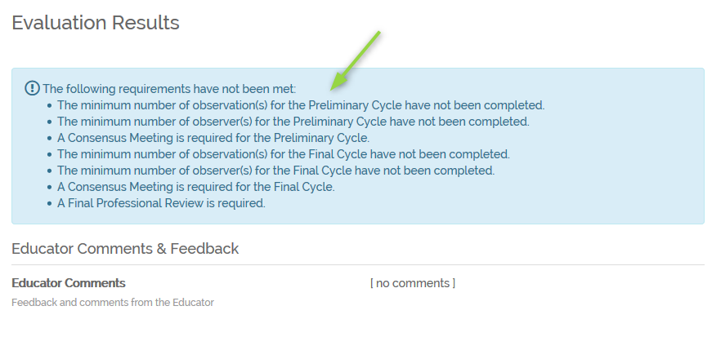
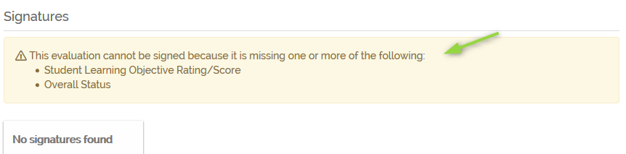
Information Messages: Where is the Edit button?
Information messages help the user know what is required before results can be entered or completed.
Notes:
Information messages are a helpful tool. If items are missing before the next step can be completed, the information messages will let you know what those missing pieces are. The messages could be in a blue or yellow box.
In the screenshots here, this educator is missing the required number of observations, the required number of observations completed by different evaluators and the consensus for both spring and fall.
In addition, the yellow message lets the user know what is preventing the evaluation from being signed.

Slide 73
Examine Your Ending Emoji Emotion
1 2 3 4
Notes:
1 Completely caught off-guard by the information shared
2 Not really sure what direction to go
3 Still pondering questions
4 Prepared to manage evaluators!

Slide 74
Moodle Management
How to Set Up Account in Moodle
How to Set Up Evaluators in Moodle
How Certification Will Work
Notes:
Now let's talk about your next steps. Each district will have one Special Areas Manager to set up and manage the evaluators in Moodle. The only responsibilities of the Special Areas Manager are directly related to Moodle. The Special Areas Manager may be the ADEPT Coordinator for your district, or the ADEPT Coordinator may delegate that role to someone else who must attend this Train-the-Trainer training either today or at another session.
We will show you how the Special Areas Manager needs to set up an account in Moodle, sign up evaluators, and how certification will work so that the evaluators and mentors can be assigned to an evaluation team for your speech-language professionals, school counselors, and school librarians. You are not expected to remember all of these steps we are showing you today. You will be sent a link to a quick guide in a google folder later.

Slide 75
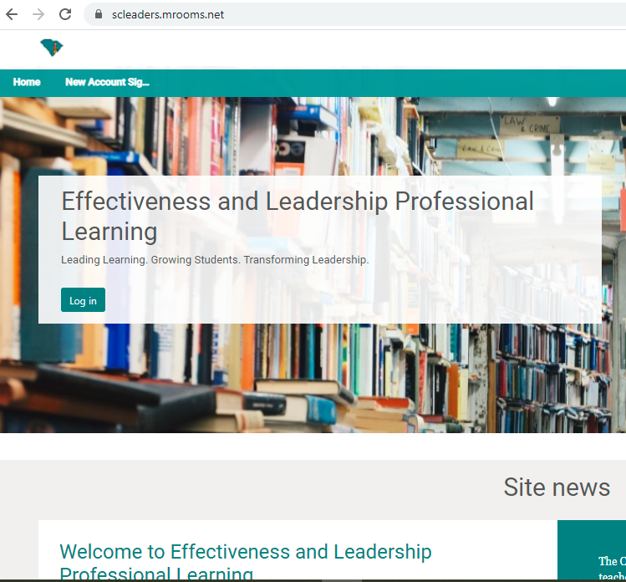
Special Areas Manager: How to Set Up Your Account in Moodle
Go to https://scleaders.mrooms.net
Click on the "New Account Signup" link at the top.
Notes:
To log onto Moodle, you would go to https://scleaders.mrooms.net. At the top, you will see a link that says, "New Account Signup" Click on that link.

Slide 76
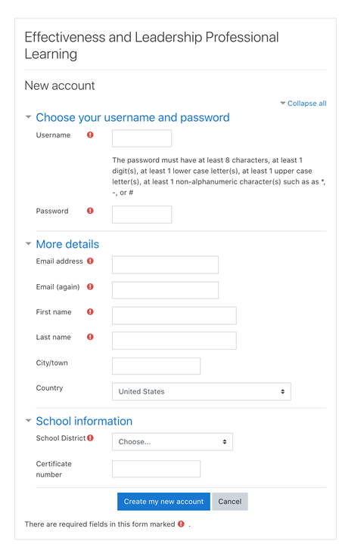
Special Areas Manager: How to Set Up Your Account in Moodle
Fill in the Registration page
Click "Create My New Account" button. Use your work email address.
You will receive an email from no_reply@ed.sc.gov that needs your response. Verify your email. Double check your junk/spam folder.
Send an email to Beverly Flythe at bflythe@ed.sc.gov to tell her you have registered your account. She will grant you the credentials as Special Areas Manager if you have attended this SA Management training.
You will then be able to proceed in Moodle.
Notes:
Fill in the Registration page
Click "Create My New Account" button. Use your work email address.
You will receive an email that needs your response. Verify your email.
Send an email to Beverly Flythe at bflythe@ed.sc.gov to tell her you have registered as the District Special Areas Manager. She will grant you the credentials as Special Areas Manager if you have attended this training.
You will then be able to proceed in Moodle.

Slide 77

Special Areas Manager: How to Set Up Evaluators in Moodle
Tell the evaluators/mentors to:
Go to https://scleaders.mrooms.net
Click on the "New Account Signup" link at the top.
Notes:
Your evaluators will need to set up their own accounts by registering just like you did. Tell them to log onto Moodle, they would go to https://scleaders.mrooms.net. At the top, they will see a link that says, "New Account Signup" .They will click on that link. You will find a Quick Guide for Evaluators PDF in your SAM Resources on the website. We have created this guide for you to send to your evaluators to assist them with setting up their accounts.

Slide 78
Special Areas Manager: How to Set Up Evaluators in Moodle
They need to fill in the Registration page
They will then click "Create My New Account" button. Ask them to use their work email address.
They will receive an email that needs their response. They will verify their email.
They need to send an email to you indicating they have registered their account.
They will need to be able to access Microsoft PowerPoint on their device.
Notes:
They need to fill in the Registration page
They will then click "Create My New Account" button. Ask them to use their work email address.
They will receive an email from no_reply@ed.sc.gov that needs their response. They will verify their email. (This is a frequently encountered issue! They are not registered until they confirm the email!)
They need to send an email to the district Special Areas Manager indicating they have registered their account.
They will need to be able to access Microsoft PowerPoint on their device.

Slide 79
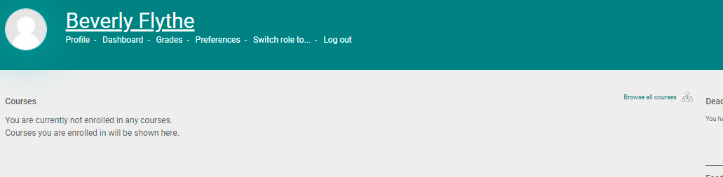

Special Areas Managers: How to Set Up Evaluators in Moodle
Log onto https://scleaders.mrooms.net
Click Browse All Courses
Notes:
Once you have been granted permissions from Beverly, you will be able to log back in and set up your evaluators to be trained. So you would
Log onto https://scleaders.mrooms.net
Click on “Browse All Courses”, scroll down to the categories and click on "Special Areas Evaluator Training"

Slide 80
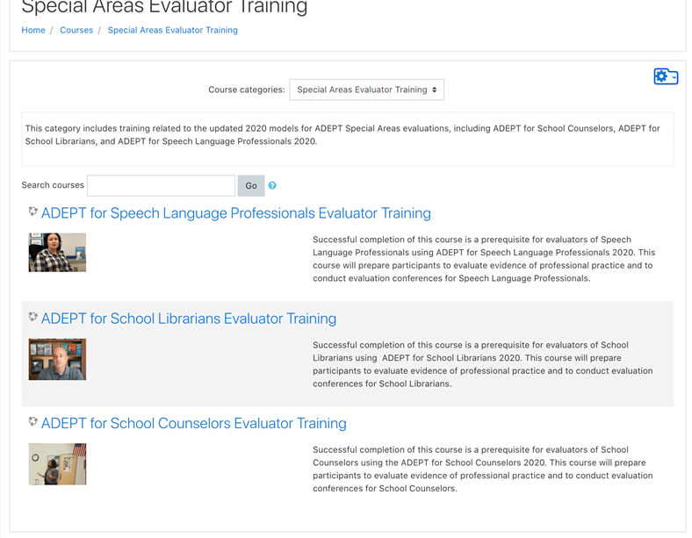
Special Areas Managers: How to Set Up Evaluators in Moodle
Click on the training you want the evaluator to take
Notes:
There are three different training sessions - one for each special area. Remember your special areas mentors must take this training within the first five years in addition to the two-day South Carolina Mentor training. If your principals will be evaluating all three special areas, you will need to assign them to each of those trainings individually.

Slide 81
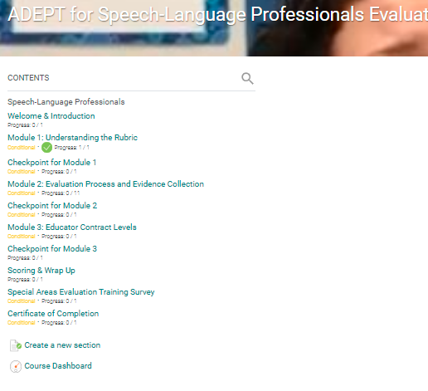
Special Areas Managers: How to Set Up Evaluators in Moodle
Click on the “Course Dashboard" link on the left-hand side of the screen.
Notes:
Next, you will find the option for “Course Dashboard" down the left-hand side of the screen. Click on that link. Again, please refer to the Quick Guide in the Google folder for updated step by step directions.

Slide 82
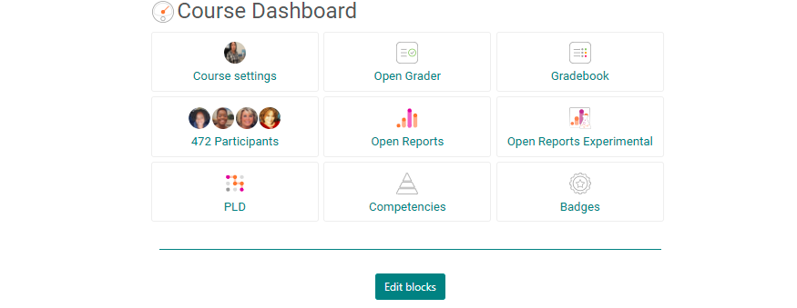

Special Areas Managers: Evaluator Set Up, cont.
On the Course Dashboard, click “Participants”
Notes:
Once in the Course Dashboard, click on Participants.

Slide 83
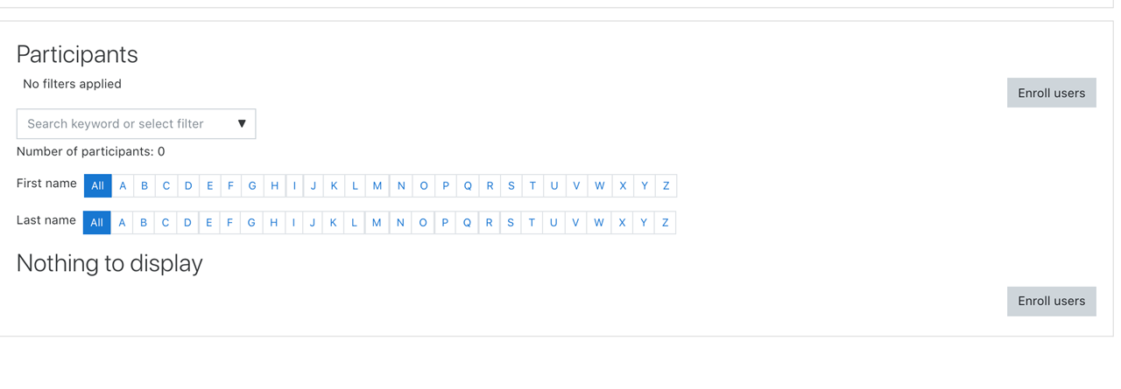
Special Areas Managers: Moodle, cont.
Click on the "Enroll User" button.
Notes:
That takes you to this page where you will click on the "Enroll User" button.

Slide 84
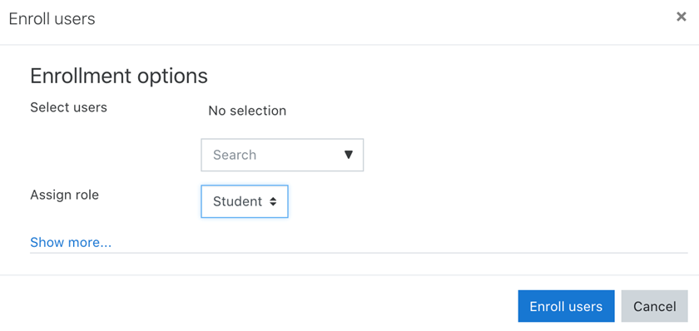
Special Areas Managers: How to Set Up Evaluators in Moodle
Use the "Search" to find the evaluators ("users") you want, making sure their assigned role is "Student", and click "Enroll Users".
Notes:
Use the "Search" to find the registered users you want, making sure their assigned role is "Student", and click "Enroll Users". That is all you need to do to set up your evaluators and mentors.

Slide 85
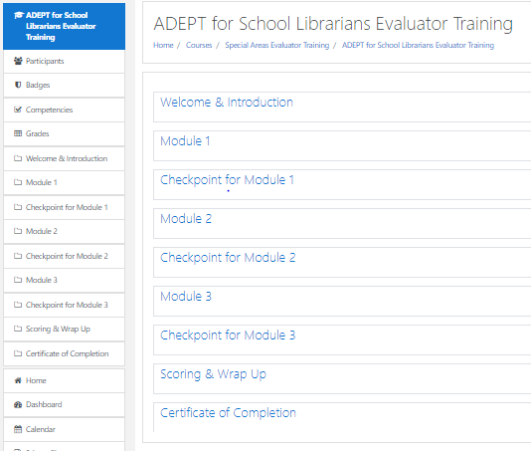
Special Areas Managers: How to Set Up Evaluators in
Moodle
Notes:
Here is an outline of what the evaluator will see in Moodle when they enter their specific training. As you can see, they will work their way through each of these sections in order, taking a quick checkpoint after each of the 3 modules. They will also have practice exercises to complete within the Modules.

Slide 86
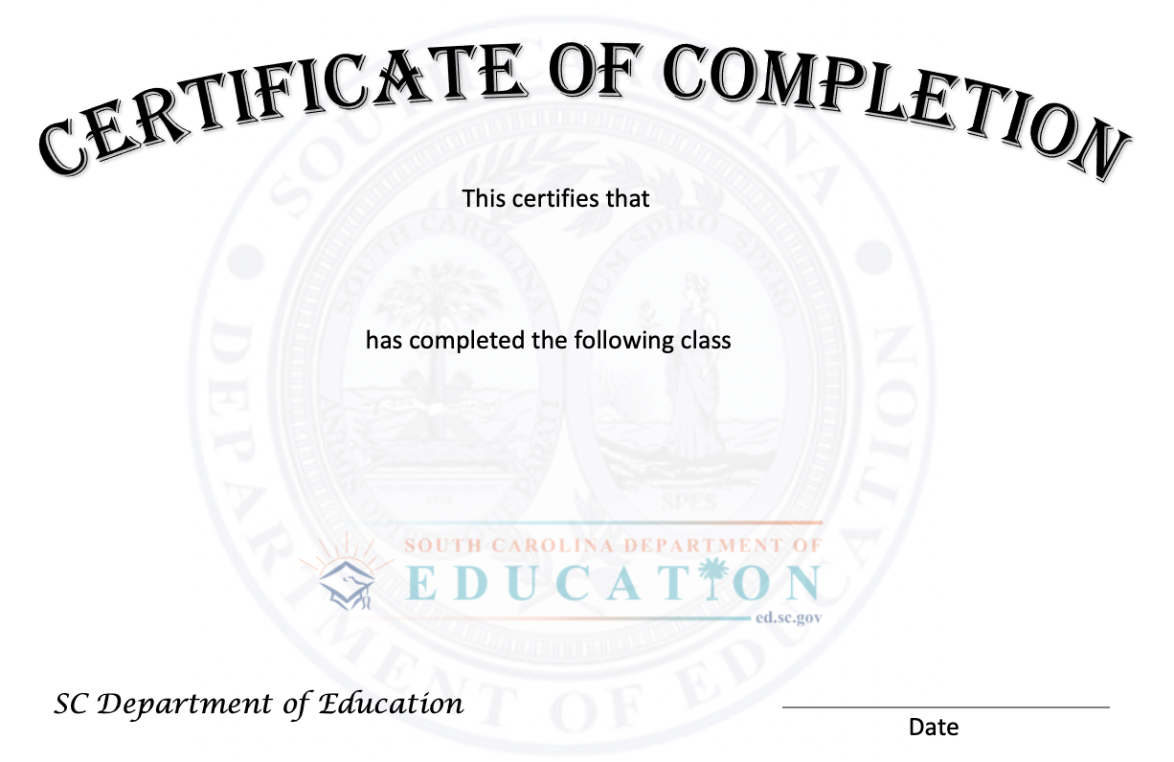
How Certification Will Work
At the end of the Evaluator Training, the evaluator will receive a Certificate of Completion.
They need to send a copy of the certificate to the district Special Areas Manager.
The Special Areas Manager sends their name and CID# to Dr. Kim Howard at khoward@ed.sc.gov using the spreadsheet template you will receive after training. They will then have the evaluator credential in SCLead.org.
Notes:
At the end of the Evaluator Training, the evaluator will receive a Certificate of Completion.
They need to send a copy of the certificate to the district Special Areas Manager.
The Special Areas Manager will send their name, CID#, and date of training to Dr. Kim Howard at khoward@ed.sc.gov, who then will grant their special areas evaluator credential in SCLead.org.

Slide 87
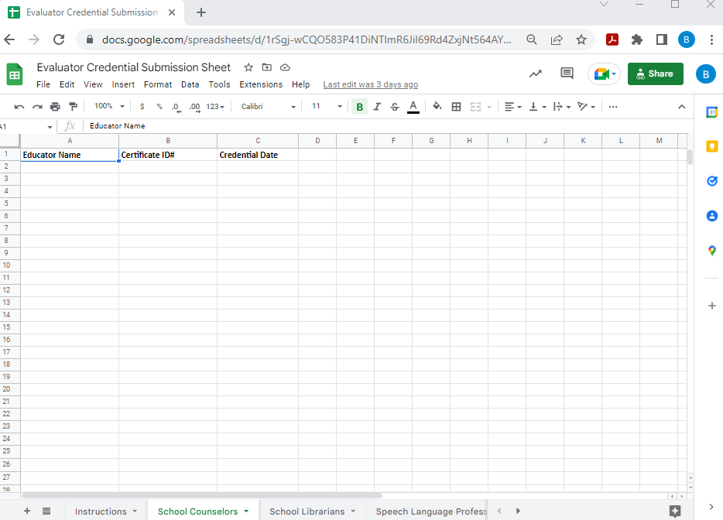
Maintaining a List
Notes:
Instructions for submitting evaluators for credentials in SClead.org. First make a copy of the Google Sheet or you can download the sheet as an Excel workbook and save as your copy. ONLY type or work in your copy!
1. Pay close attention to the tabs located at the bottom of the screen. Please only place the appropriate evaluators on the coordinating sheet.
2. Please highlight new credentials for each new submission or use a different copy of the spreadsheet to submit evaluators who have not previously been submitted.
3. Please verify CID is correct by checking in SClead.org or SCEducator prior to using it in the spreadsheet. This will prevent mix-ups in credentials being assigned to the wrong educators.
4. Submit new evaluators to khoward@ed.sc.gov.
5. MAINTAIN a running spreadsheet for your own records! There is no report in Moodle that can be filtered for just your district.

Slide 88
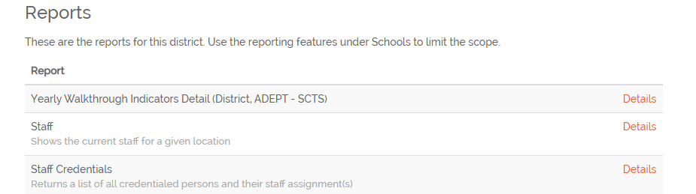
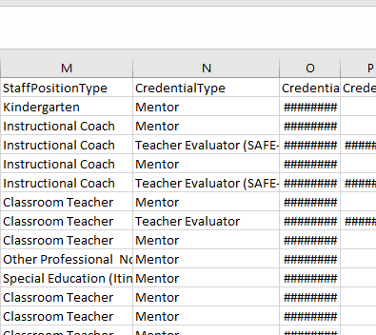
List of Evaluator Credentials
Notes:
There is no master list in Moodle that can be filtered by district or school. Therefore, we recommend you maintain your own spreadsheet. It would be wise to periodically check your Staff Credentials report in SCLead to verify that all evaluators have been submitted to Dr. Howard for import into SCLead. You will not be able to add evaluators to evaluation teams for your educators if they do not have the correct required credential.

Slide 89
Requirements for District Orientations
Those who are being evaluated must be provided a written and oral explanation of the:
Evaluation process
Evaluation rubric
Evaluation timeline
Criteria for successfully completing the evaluation
Intended use of the evaluation results
Name(s) of the evaluator(s)
Notes:
There will be no one-day training for Special Areas practitioners from the SCDE like there is for classroom teachers with the SCTS 4.0. As stated in each of the guidelines documents, districts are responsible for providing an orientation to all Special Areas practitioners at the beginning of the year. Please refer to your guidelines for specific differences in requirements for each of the contract levels.
In general, this is a limited list of required components that must be included in your district orientations that you will provide.
We have developed sample orientations for each special area which can be found on our website. These can be adapted as necessary.

Slide 90
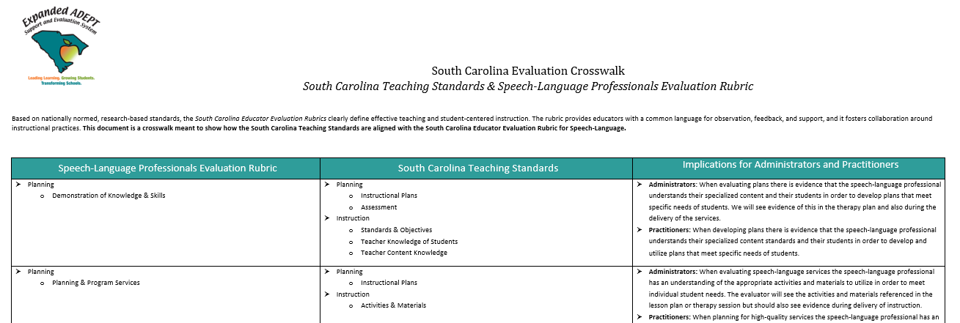
Crosswalks for Special Areas/SCTS 4.0
Notes:
We know that children learn best when everyone works together as a team. We are excited that we will have crosswalks for each of the 3 special areas showing how the SCTS 4.0 rubric is connected to the rubrics for the special areas. These crosswalks should be distributed to all building level administrators, evaluators, mentors, classroom teachers, and special area practitioners. The third column offers implications for connections among classroom teachers, special area practitioners, and administrators to ensure the unique needs of each child are met through collaboration and teamwork. You will receive a link to these crosswalks in the google folder you will receive sometime after this training. We will also post the finalized crosswalks on our website.

Slide 91
Now What?
  If you are the Special Areas Manager:
  Plan your district orientations.
  Make your principals, evaluators, mentors, special area practitioners, and classroom-based teachers aware of the new crosswalks
  set up your account in Moodle.
  send to your evaluators and mentors:
    Quick Guide on setting up a Moodle account
Notes:
We have provided you with a great deal of new information this morning. So what are your next steps? We know that this fall will be an unusual for you, and we understand that your platform, whether it be in person, or virtually, may be uncertain at this time. We understand that you will do what you can do, and we are here to support you along the way. So first, you may want to
Review your Implementation Planning Template and continue the planning phase with your district implementation team.
Plan your district orientations.
Make your principals, evaluators, mentors, special area practitioners, and classroom-based teachers aware of the crosswalks
If you will be the Special Areas Manager,
You will set up your account in Moodle.
and send to your evaluators and mentors:
Quick guide for them to set up a Moodle account
These quick guides will be sent to the Special Areas Managers in a google folder.

Slide 92

Wrap-Up and Questions
Notes:
That concludes our overview of the special areas evaluations.

Slide 93
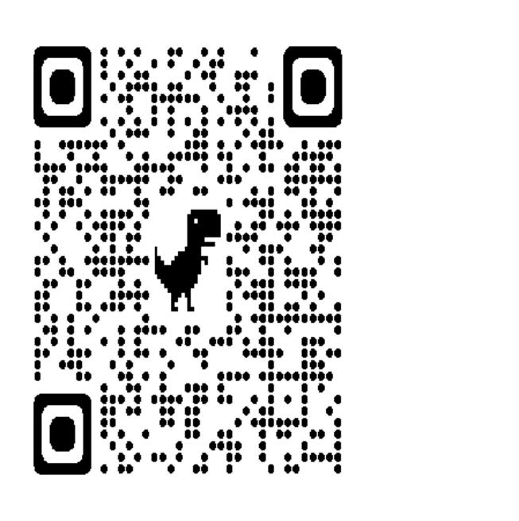
Stay Connected
ADEPT 2020 for Special Areas
Or reach out to:
Beverly Hyatt Flythe, MSEd
803.896.0318
bflythe@ed.sc.gov
Or your district’s ADEPT contact in our office

