Slide 1

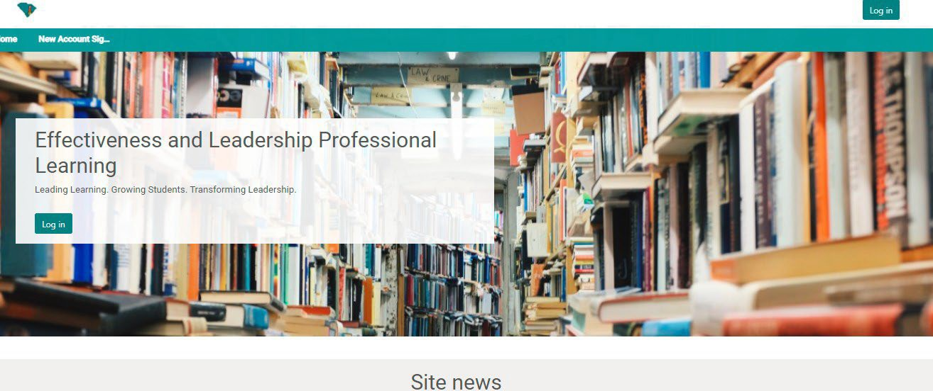
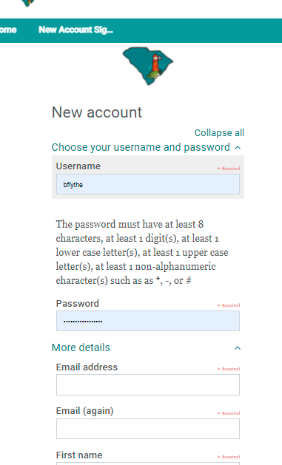
Quick Guide for Special Areas Managers
To Set Up Your Own Account:
1. Log onto Moodle at https://scleaders.mrooms.net. At the top left-hand side, click on “New Account Signup”.
2. Fill in the Registration Page, using your work email address.

Slide 2

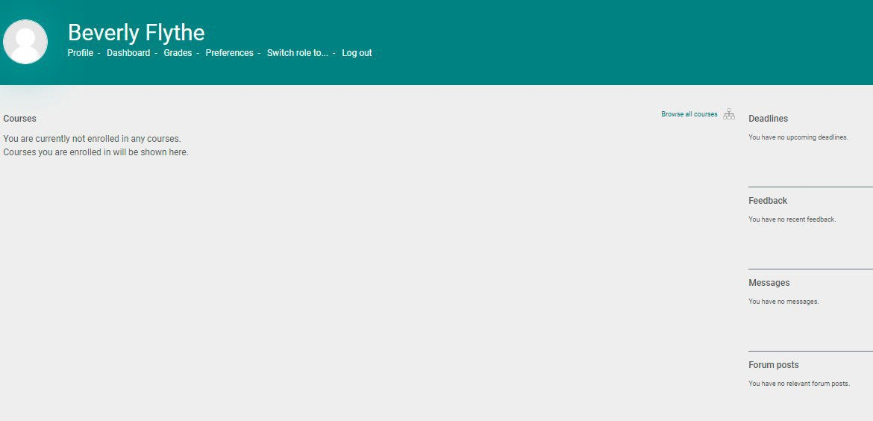
Quick Guide for Special Areas Managers
You will receive an email from no_reply@ed.sc.gov that needs your timely attention. Verify your email.
Send an email to Beverly Flythe bflythe@ed.sc.gov to tell her you have registered as
the District Special Areas Manager. She will grant you the credentials you need as the Special Areas Manager if you have attended the Special Areas Management training.
You will then be able to proceed in Moodle.
Send the Quick Guide for Special Area Evaluators to the evaluators who need to be
trained, and ensure that they have a copy of the 2020 Guidelines for the appropriate Special Areas.
Once the evaluators have verified their work emails and let you know that they have
set up their accounts, you will be able to log back into Moodle to assign them to the appropriate training. To do so, log back into https://scleaders.mrooms.net.
Click on “Browse all courses”.
8. Under “Special Areas Evaluator Training”, you will see 3 different training sessions, one for each Special Area. Remember your mentors must take this training within the first 5 years in addition to the 2-day South Carolina Mentor Training. If your principals will be evaluating all 3 Special Areas, you will need to assign them to each of those trainings individually. Click on the Special Area to be assigned.

Slide 3
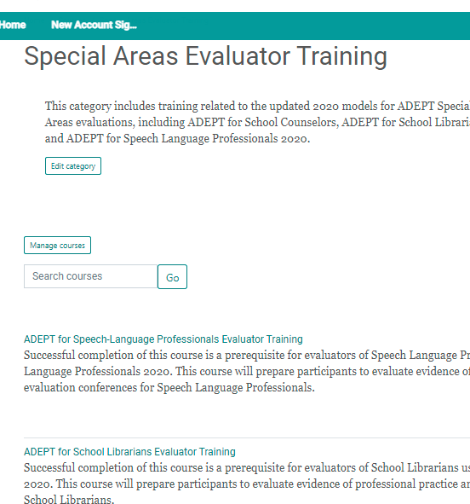
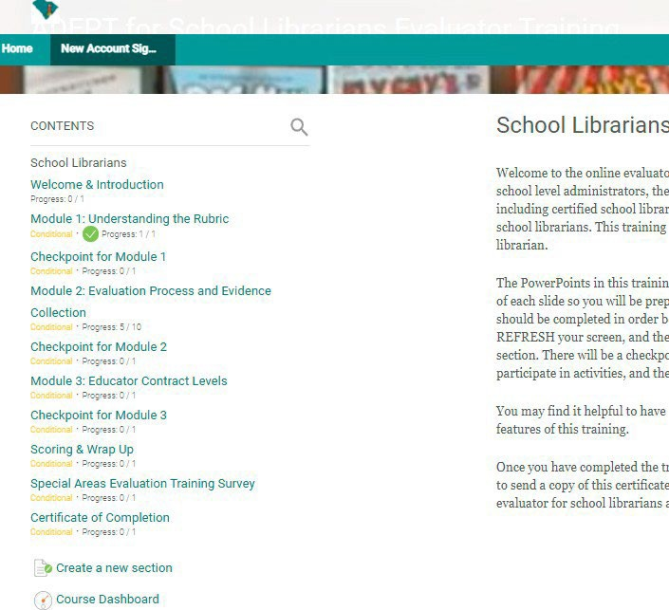
Quick Guide for Special Areas Managers
9. Next, you will scroll down to the bottom of the screen and click on “Course Dashboard”.

Slide 4
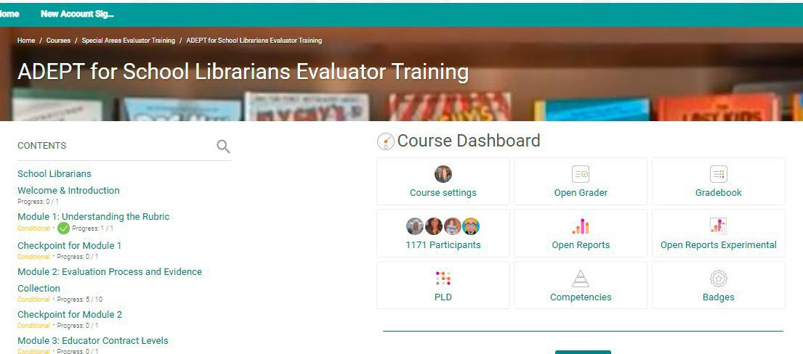
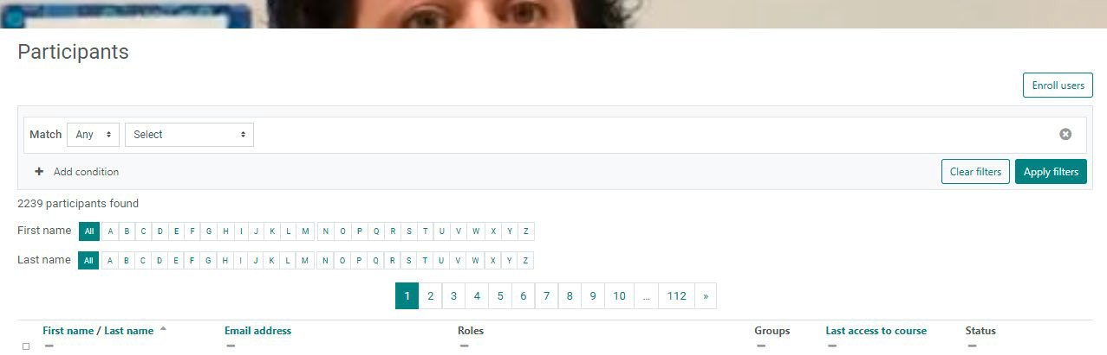
Quick Guide for Special Areas Managers
10.On the Course Dashboard, click “Participants”.
11.Click on “Enroll Users” on the right-hand side of the screen.

Slide 5
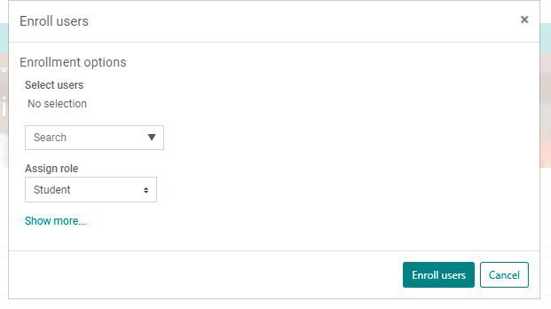
Quick Guide for Special Areas Managers
12.Use the “Search” dropdown menu to locate and select the name(s) of the evaluator(s) you want to assign. If you are shown the “Too Many Users to Show” message, simply type the first few letters of the evaluator’s name into the Search box and a list of users should appear. Make sure their assigned role is “Student”. Click “Enroll users”. Your evaluator(s) will now be able to log back into Moodle and take the training for that Special Area. After the evaluators have completed the training, they will receive a Certificate of Completion. They need to send a copy of the Certificate of Completion to you.
Send the names, CID#s, dates of training, and the name of the Special Areas to Dr. Kim Howard khoward@ed.sc.gov. Dr. Howard will then grant their Special Areas Evaluator credential in SCLead.org where they can be assigned to evaluation teams in those areas.
You may grant district level recertification credit for evaluators who have completed Special Areas Evaluator Training, or you may provide to them the Renewal Credit Activity Form found in the Google folder. We estimate that it takes at least 4 hours to complete each Special Area Evaluator Training.

