Slide 1

NSLP Overview and Procurement for Small SFAs
2/20/2025
Notes:
Slide title should be Aptos Bold font, left-aligned, not smaller than 44pt
Audience – To whom/group you are presenting to
Speaker – Who is giving the presentation (may be by name or by department)
Date – Date of presentation

Slide 2
Agenda
Accountability & Responsibility
Procurement & Policy
NSLP Basics
Resources
Questions
Notes:
Left aligned
Title font is 88pt
Numbered line item 66 pt
Detail/slide item 36 pt

Slide 3
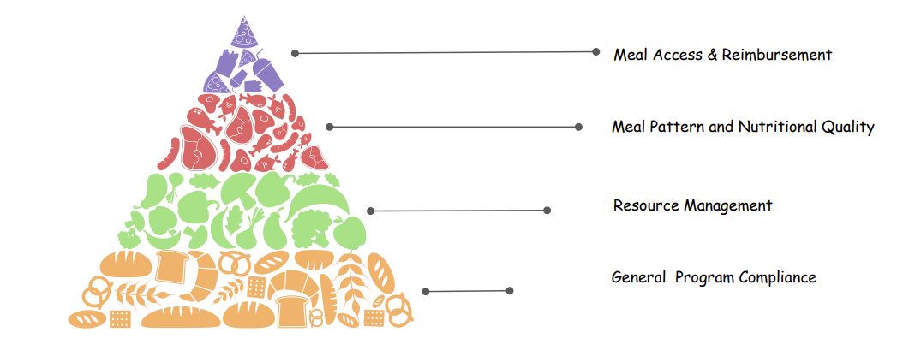
NSLP Basics

Slide 4
NSLP Terms
LOCAL EDUCATIONAL AGENCY (LEA)- A public board of education or other public or private nonprofit authority legally constituted within a state for either administrative control or direction of, or to perform a service function for, public or private nonprofit elementary schools or secondary schools in a city, county, township, school district, or other political subdivision of a state.
SCHOOL FOOD AUTHORITY (SFA)- The governing body responsible for the administration of one or more schools, and has the legal authority to operate the program therein or be otherwise approved by FNS to operate the program.
SCHOOL NUTRITION PROGRAM DIRECTOR- The individual directly responsible for the management of the day-to-day operations of school food service of a participating school under the jurisdiction of the SFA.

Slide 5
The SFA’s responsibilities include:
Implementing the free and reduced-price meal policy.
Preparing and submitting the reimbursement claim.
Hiring employees to plan, prepare, and serve meals.
Supervising operation of the programs.

Slide 6
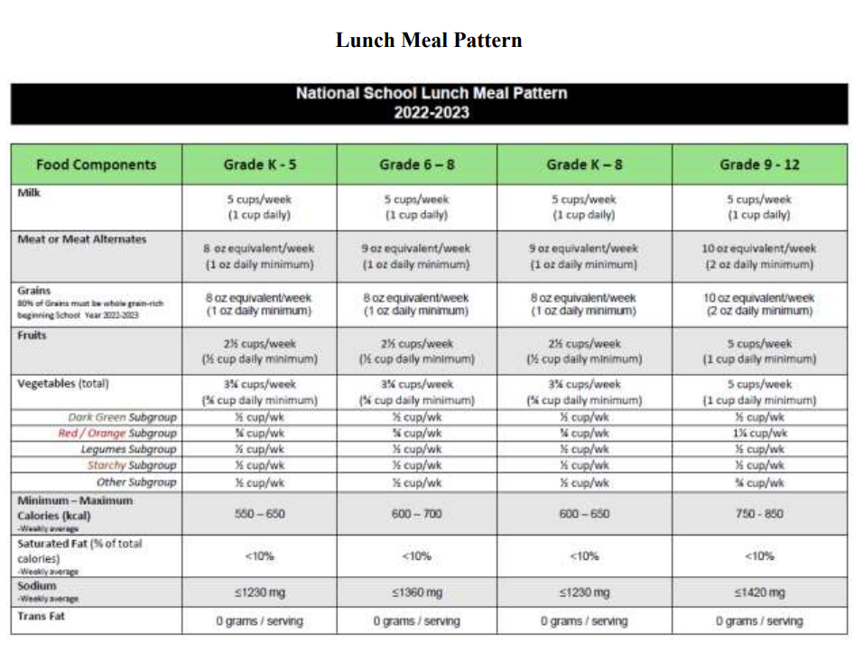
Meal Pattern Requirements
School lunches must meet meal pattern and nutrition standards based on the latest Dietary Guidelines for Americans. The meal pattern dietary specifications set specific calorie limits to ensure age-appropriate meals for grades K-5, 6-8, and 9-12. There are specific requirements for Breakfast, Lunch and Afterschool Snack.

Slide 7
Accountability & Responsibility
-Everyone Plays an Important Part-
Notes:
Agenda is 88 pt
Line item is 66 pt

Slide 8

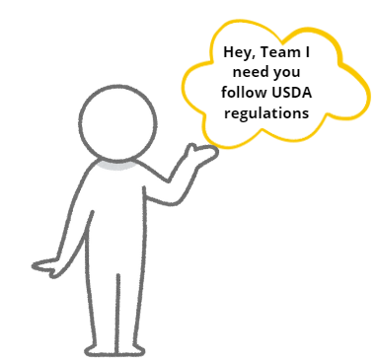

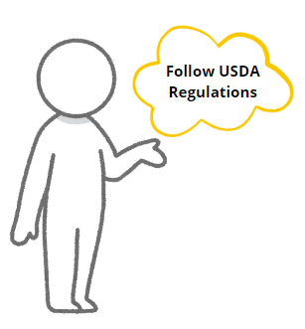

Flow of Accountability and Responsibility
State Agency
Transfers Authority to SFA and Sponsors
SFAs and Sponsors
Is accountable to the State Agency and delegates responsibilities to staff
SFA’s and Sponsor’s Staff
Completes delegated tasks
Notes:
Read Slide
Within child nutrition you have a number of responsibilities that are tied to the accountability of the program. These responsibilities are delegated to different individuals on your team. For Example, the SFA is accountable for the outcome of program compliance when it comes to procurement. This means the SFA must delegate certain tasks and responsibilities to individuals who can effectively complete them.

Slide 9

Ignorantia Juris Non Excusat
Ignorance of the law is no excuse for noncompliance. Regardless of size, SFAs and Sponsors must review Federal and State law as it applies to procurement and child nutrition programs.
Because child nutrition programs are Federally funded, all SFAs and Sponsors must become familiar with program-specific rules.
Notes:
gnorantia juris non excusat is a Latin phrase that means "ignorance of the law excuses no one". It's a legal principle that states that a person can't avoid liability for breaking a law by claiming they didn't know about it. This rule applies to all types of laws, not just those that are based on common sense.

Slide 10
Procurement & Policy
Do you know what procurement code you follow?
Notes:
Agenda is 88 pt
Line item is 66 pt

Slide 11
Are you required to have Written Procurement Policy?
Every school district in South Carolina, regardless of its size or the amount of its annual budget or expenditures, is a “political subdivision,” as that term is used in the Consolidated Procurement Code. S.C. Code Ann. § 11-35-310(24). As discussed below, large school districts are subject to the specific requirements of Section 11-35-5340. Other school districts, like all political subdivisions, are subject to the more general rule imposed by Section 11-35-5320, which requires the adoption of procedures “embodying sound principles of appropriately competitive procurement . . ..”
School districts should also consult Section 59-19-93 of the South Carolina Code of Laws, that requires a school district to adopt a procurement code or have its funding suspended.
"Political subdivision" means all counties, municipalities, school districts, public service, or special purpose districts. This includes Charter Schools, RCCIs, Private Schools, Sponsors and Non-Profits.
Notes:
Are you required to have Written Procurement Policy? In short, the answer is yes. Not only do you have to have written procedures you have adopt a procurement code. So, before we talk about where to find a procurement code lets briefly discuss what a procurement plan is and why its important.

Slide 12

Procurement Plan
A procurement policy is a written document that assures all purchases made with Child Nutrition Program Federal funds are handled fairly and in a manner that encourages full and open competition.
  Summed up this you purchase goods or services
  This policy is not just for Child Nutrition Program federal fund, but applies to the whole entity
Notes:
A procurement plan assures that all purchases made with CNP Federal funds are handled fairly and in a manner that encourages full and open competition.
Why is Procurement Important?

Slide 13

What You Need to Know?
Procurement Code
Which Method of Procurement to Use
What Procurement code will your entity use?
  Internal
  District
  Federal
Is this a; micro, small, or formal purchase?
What steps will you need to go through to secure goods or services?
  Emergency or Sole Source?
  What is the threshold of the service?
Do you need further approval for certain goods and services?
Notes:
In order to conduct a proper procurement:
Sponsor’s need to thoroughly understand and communicate the need for goods, products or services to potential vendors or suppliers. This involves identifying enough detail so that you purchase exactly what is needed from the vendor. Another term for the details is “specifications”. Specifications provide a detailed enough description so that when goods, products or services are compared and purchased, the Sponsor is comparing and purchasing exactly what t
Additionally, Sponsors need to know the potential suppliers of the goods, products or services.
Sponsors need to determine the best price for the goods, products, or services. This includes the total cost of the procured item or items and the frequency of purchase. Knowledge of the total cost of the item or items informs the Sponsor regarding which method of procurement must be used. Additionally, the frequency of purchasing the item or items also determines the procurement method.
Sponsors should know the method of procurement to use based on the cost of the items. Later in this training five procurement methods and the steps involved in conducting the procurement will be introduce.
Document the entire process. The types of documentation needed depends on the procurement method used.

Slide 14

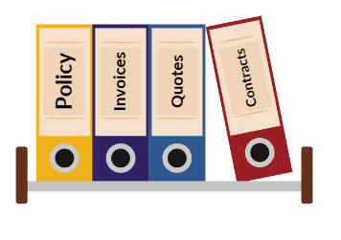
What You Need to Know? Continued
Where Helpful Resources are Located
What Records and Documentation to Maintain
What resources are available?
When will you attend helpful training?
Are you proactive in learning and understanding procurement?
What to document?
What is my retention period?
Where do you retain the documents?
How are documents stored?
Storing Records at the State Records Center | SC Department of Archives and History

Slide 15
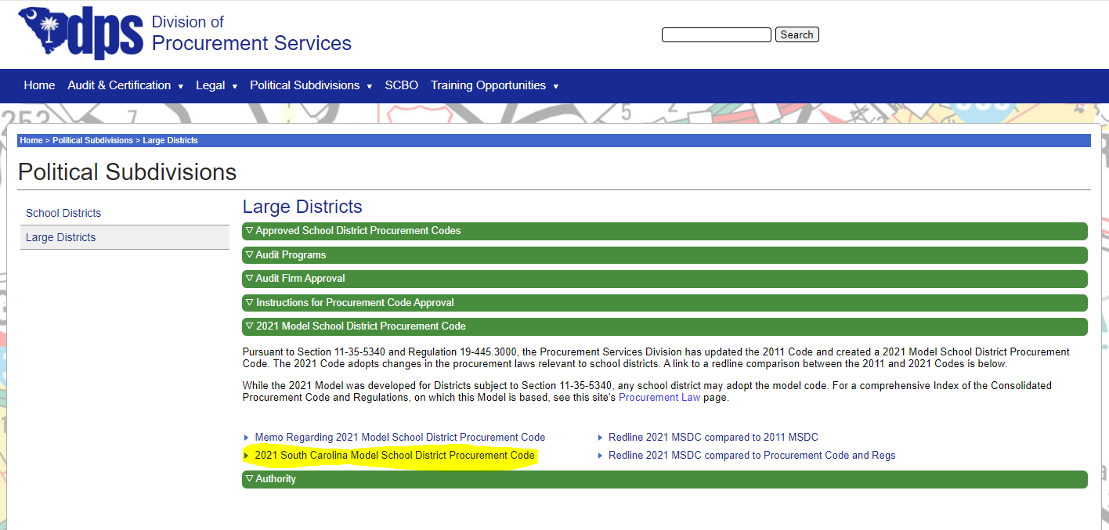
Finding Your Procurement Code
You can find the 2021 SC Model Procurement Code on the State Procurement Website

Slide 16
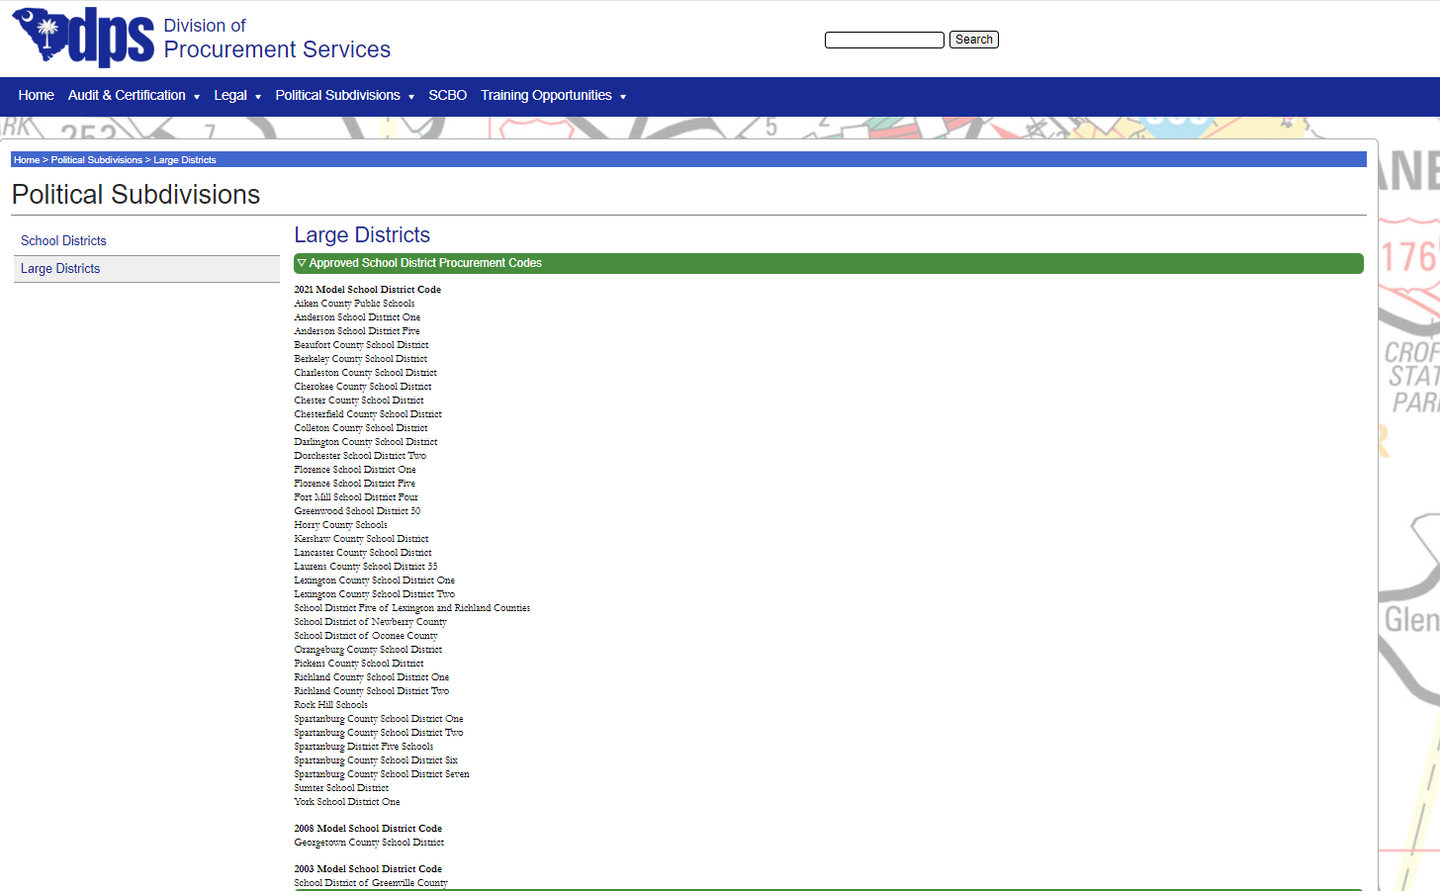
Finding Your Procurement Code Continued
You can also find a list of Approved School District Procurement Codes

Slide 17
Methods of Procurement
Informal Procurements:
Micro Purchase
Small Purchase
Formal Procurements:
Sealed Bids (Invitation for Bid)
Competitive Proposals (Request for Proposal)
Noncompetitive Proposals
Emergency procurements
Sole Source
Notes:
There are five available methods of procurement for each purchase or transaction. These methods of procurement are: read slide

Slide 18

Micro vs Small Purchases
Micro Purchase
Small Purchase
Threshold: $0 - $10,000
Process: One-time purchase OR
“spread the wealth” multiple purchases
(buying the same items among different
vendors/places that offer the same
service and reasonable price)
  Requires equal distribution
  Must be fair and reasonable
Example: A charter school purchases the same office supply items rotating between Office Depot, Staples, and Sam’s Club
Threshold- $10,000.01 - $50,000
Process- Buying the same items from
only one place on a regular basis
  Needs to be advertised on SCBO
Example:
A charter school purchases office supplies repeatedly and only from Staples.
A sponsor purchases a $12,000 piece of equipment for my kitchen.
*Please review your own Thresholds which may differ based on your Procurement policy*
Notes:
Just to recap

Slide 19
Common Findings for Micro Purchases
Record retention
Following micro purchase guidelines instead of small purchase guidelines
Only getting one or two quotes, also not documenting
Using more tools for market research (SCBO)
Recurring purchases procured as small or micro, instead of formal
Not tracking the aggregate total for purchases from the same vendor to determine whether the purchases were under or above the Micro purchase threshold.
Understanding what is a Sole Source and what an Emergency Procurement is

Slide 20

Record Keeping
Keep all Documents:
  Invoices
  Grocery receipts
  Cancelled checks
  Quotes or Bid documents
    Contract term
  Any and all communication with vendors
  Price lists
  Follow up with your retention policy or create one
Notes:
Sponsors must maintain procurement documentation on file for every purchase of goods and services made with Federal funds. Documents must be retained on file for three years plus the current fiscal year. Documentation includes information obtained when comparison shopping, obtaining quotes or requesting and receiving bids, contracts, and proposals.
Examples of documents to maintain are:

Slide 21
Test Your Knowledge
Can you answer these questions?

Slide 22
My charter school's yearly purchases for food are around $90,000. I have a vendor that I have been using for years. The vendor delivers and always has what I need. I do not have any type of contract with them and have not obtained other quotes. Am I procuring properly?
Yes, no quotes are needed when there is a historical relationship with the vendor
No, did not “Spread the Wealth” by purchasing equally from multiple vendors
No, did not obtain quotes from qualified vendors
Notes:
What procurement method should I be using?
Small
What do I need to do differently?
Check with at least 3 vendors, obtain quotes, evaluate, and award

Slide 23
A Food Service Director(FSD) needs to purchase milk for meal service and estimated the cost for the year to be $11,000. The FSD needs the milk delivered weekly because they do not have the capability to store large amounts. What procurement method should they use?
Micro purchase
Small Purchase
Neither
Notes:
What procurement method should I use?
Small
What should my specifications look like?
1% and skim white, skim chocolate, cartons, delivered
I called three companies and obtained quotes and chose the company with the lowest price who can
deliver. Can I continue to buy my milk from this same vendor?
Yes!

Slide 24
You buy groceries for your non-profit once a week. Your weekly purchases are around $350. You rotate purchases between Sam's Club, Food Lion, and Walmart. What procurement method are you using?
Micro Purchase
Small Purchase
Neither
Notes:
What procurement method am I using?
Micro
Do I need to compare prices?
No, but ensure prices are reasonable
What were to happen if I only wanted to purchase my groceries from Costco?
I would have to change to the small purchase method

Slide 25
Key Points
What are you going to do next?
Notes:
Agenda is 88 pt
Line item is 66 pt

Slide 26

Next Steps 1
Evaluate and Research
Develop and Maintain
Review current policy
Research
Forecast
Seek Education and Training on the topic
Develop and maintain written procurement procedures
Implementation best practices that foster a fair, open, transparent and competitive procurement environment.

Slide 27
Next Steps 2
Documentation and Records
Annual Training
Know where your policy is located
Know what documents and records to keep
Organize records and documents
Ensure appropriate staff attend annual training
Document Training

Slide 28
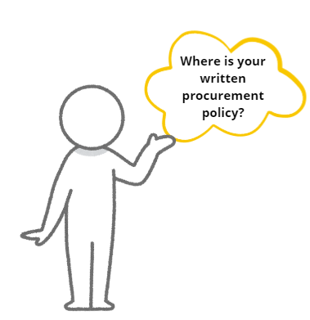
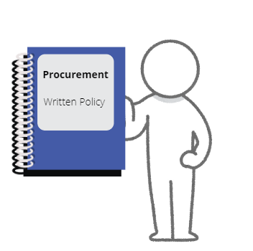

You Got This!

Slide 29
Resources
-Utilize Them-
Notes:
Agenda is 88 pt
Line item is 66 pt

Slide 30


Federal and State Regulations
USDA Procurement Regulations
South Carolina Procurement Regulations
https://www.fns.usda.gov/f2s/usda-procurement-regulations
https://www.scstatehouse.gov/code/title11.php
https://www.scstatehouse.gov/code/t11c035.php

Slide 31


Other Regulations
Buy American Provision
Code of Conduct
https://www.fns.usda.gov/nslp/compliance-enforcement-buy-american
https://www.fns.usda.gov/cn/written-codes-conduct-and-performance-employees-engaged-award-and-administration-contracts

Slide 32
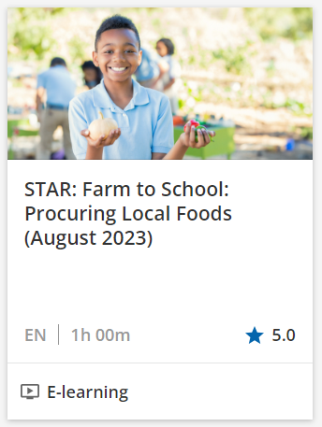
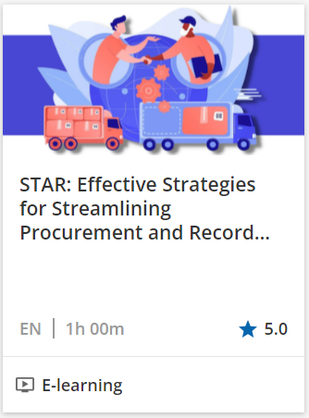


ICN Training
https://theicn.docebosaas.com/learn/external-ecommerce;view=none;redirectURL=?ctldoc-catalog-0=se-procurement

Slide 33

Questions

Slide 34
ed.sc.gov
Notes:
Slide title is hidden from display

