Slide 1

2026 Professional Development Series:
College and Career Readiness
Accountability Coordinators, District Testing Coordinators, Assessment Proxies, and PowerSchool Administrators
Vann Holden, PhD, Era Roberts, EdD, and Wendy Stephens
March 2026
Notes:
Slide title should be Aptos Bold font, left-aligned, not smaller than 44pt
Audience – To whom/group you are presenting to
Speaker – Who is giving the presentation (may be by name or by department)
Date – Date of presentation

Slide 2
Agenda
Update on Dual Enrollment – On-Track
What are the accountability rules for College and Career Readiness?
What are the data submission requirements?
How can we verify our data?
What should we do if data looks inaccurate?
Planning Time
Next Steps
Notes:
Left aligned
Title font is 88pt
Numbered line item 66 pt
Detail/slide item 36 pt

Slide 3
Update on Dual Enrollment
On-Track
Notes:
Agenda is 88 pt
Line item is 66 pt

Slide 4
Dual Enrollment – On-Track – Follow-up
In our February sessions, we stated that due to the variation in how districts handle the approval of Dual Enrollment courses for graduation requirements, SCDE will use the PowerSchool student-level Credit Type field in Stored Grades (i.e., student Historical Course Grades) to identify Dual Enrollment courses that fulfill a graduation requirement, as well as the subject matter associated with those courses. Coding accurate Credit Type information will be important for students' Dual Enrollment courses within F1 Stored Grades in PowerSchool.
We provided initial guidance on February 27.
Full guidance will be provided in the Office of Information Technology's document titled Credit Type Data Entry Instructions.
Guidance Out of Date
– See Updated PPT
Notes:
Header font 50pt
Content/body text font 28pt

Slide 5
Dual Enrollment – On-Track – Coding
Coding requirements:
  For students' Dual Enrollment courses that count toward graduation requirements within F1 Stored Grades in PowerSchool
    a code of LG must be used as the first code listed in the Credit Type field to show that the district has determined the course should be fulfilling a graduation requirement
    A code must also be included in the field to indicate the course subject (such as A for English/Language Arts and C for Mathematics); a code of X may also be used if the course is an elective.
    Codes in the Credit Type field must be separated by commas, for example: LG,HS,C
Guidance Out of Date
– See Updated PPT
Notes:
Header font 50pt
Content/body text font 28pt

Slide 6
Cohorts
Notes:
Agenda is 88 pt
Line item is 66 pt

Slide 7

Who is in a Cohort?
In the accountability context, a cohort is generally a group of students who entered a high school in the United States for the first time on or prior to the 45th day of a given school year.
The 9GR is the student’s 9th grade code. This tells us which high school cohort the student is in for accountability purposes. A student is initially added to the Four-Year Graduation Cohort on the 45th day of their first year in a US High School.
Notes:
Header font 50pt
Content/body text font 28pt

Slide 8
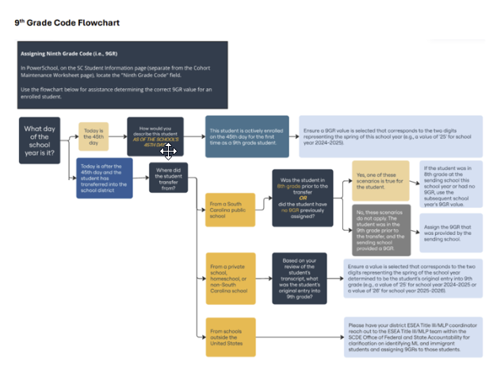
9th Grade Code Flowchart
Update coming soon to provide clarification based on questions received.
Notes:
Header font 50pt
Content/body text font 28pt

Slide 9
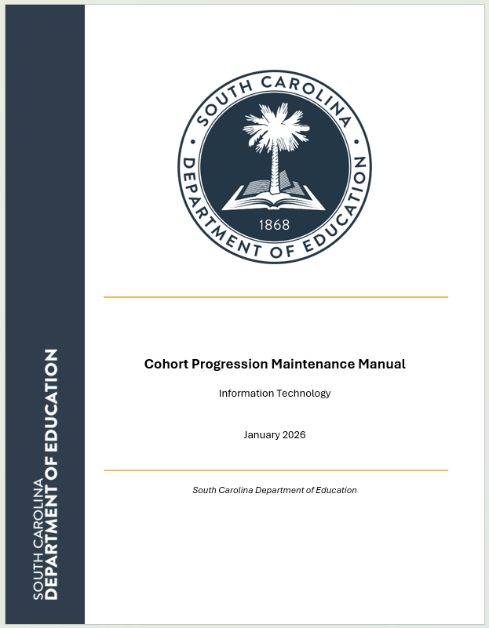
Cohort Maintenance
Please see the Cohort Progression Maintenance Manual for documentation requirements.
March update coming soon to include clarifications based on questions we have received.
https://ed.sc.gov/data/cohort-maintenance-information-and-resources/cohort-progression-maintenance-manual/
Notes:
Header font 50pt
Content/body text font 28pt

Slide 10
High School Ratings
Notes:
Agenda is 88 pt
Line item is 66 pt

Slide 11
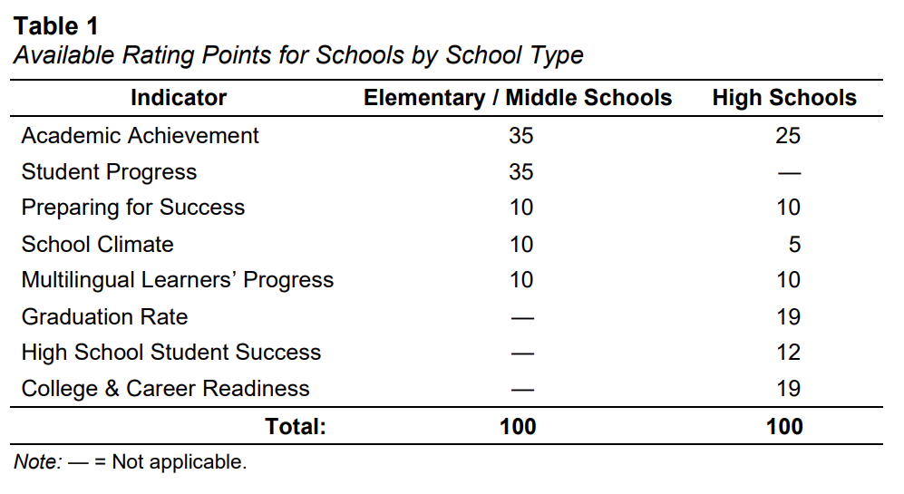
High School Rating Points
College and Career Readiness is worth is worth 19% of a high school’s overall rating.
https://www.eoc.sc.gov/accountability-manuals

Slide 12
College and Career Readiness
Notes:
Agenda is 88 pt
Line item is 66 pt

Slide 13
Reporting College and Career Readiness
The percent of students in a high school’s graduation cohort who are identified as either college or career ready according to one or more of the approved methods of demonstrating readiness are displayed in two ways.
First, report the percent of all students in the current four-year graduation cohort for the school (or within the district or state, as appropriate for comparison metrics or for district or state report cards), regardless of graduation status, who (a) are identified as either College Ready or Career Ready, (b) are identified as both College Ready and Career Ready, (c) are identified as College Ready, and (d) are identified as Career Ready.
https://www.eoc.sc.gov/accountability-manuals
Notes:
Header font 50pt
Content/body text font 28pt

Slide 14
CCR Results: Percentages and Counts
For all four metrics, the percent of students in the 9GR cohort shall be accompanied by the number of students demonstrating readiness displayed as the numerator of a fraction with the total number of students in the 9GR cohort displayed in the denominator, as well as comparison metrics showing the percent of students demonstrating readiness for the district and state
https://www.eoc.sc.gov/accountability-manuals
Notes:
Header font 50pt
Content/body text font 28pt

Slide 15
CCR Results: 4‑Year Graduation Cohort
The CCR metric reports results based on 4-year graduation cohort for the school (or the district or the state, as appropriate for comparison metrics or for district or state report cards) as described in the INDICATOR: Graduation Rate section of the accountability manual.
https://www.eoc.sc.gov/accountability-manuals
Notes:
Header font 50pt
Content/body text font 28pt

Slide 16
CCR: College-Ready Criteria - Assessments
Scores a composite score of 20 or higher on the ACT.
  For students with multiple ACT scores, the highest composite score from any single administration may be used. “Superscores” (defined as a composite score constructed from the highest subject score earned on any administration) are not used.
Scores a total score of 1040 or higher on the SAT.
  For students with multiple SAT scores, the highest total score from any single administration may be used. “Superscores” (defined as a total score constructed from the highest section score earned on any administration) are not used.
Scores a 3 or higher on an Advanced Placement (AP) exam.
Scores a C or higher on any approved Cambridge International Exam
  Approved Cambridge International Exams include Advanced Level (A) exams in any subject, or Advanced Subsidiary Level (AS) exams in the following subjects: Biology, Chemistry, Computer Science, Economics, English, Environmental Science/Management, History, Politics, Psychology, or foreign language (Chinese, French, German, Japanese, or Spanish).
Scores a 4 or higher on any International Baccalaureate (IB) higher learning (HL) exam.
https://www.eoc.sc.gov/accountability-manuals
Notes:
Header font 50pt
Content/body text font 28pt

Slide 17
CCR: College-Ready Criteria - Dual Enrollment
Completes at least six (6) credit hours in approved dual enrollment courses with a grade of C or higher.
  A current list of approved courses can be found in the “Download Data” section of the SC School Report Card website.
    Note: Approved courses will also have “YES” in the “College & Career Ready” field of their entry in the SCDE Course Code Database (linked from the Student Information Systems page on the SCDE website).
https://www.eoc.sc.gov/accountability-manuals
Notes:
Header font 50pt
Content/body text font 28pt

Slide 18
CCR: Career-Ready Criteria - Assessments
Earns a Level 3 Credential or above on the WIN SC Career Ready Test (SCRT).
Earns a scale score of 31 or higher on the ASVAB.
  Note: A student can be deemed career-ready with proper documentation of a qualifying ASVAB score obtained at any time in the past. Although reprinted ASVAB score reports may only be requested up to two years from the date of testing (see https://www.asvabprogram.com/faq), scores do not expire for the purposes of demonstrating career readiness.
https://www.eoc.sc.gov/accountability-manuals
Notes:
Header font 50pt
Content/body text font 28pt

Slide 19
CCR: Career-Ready Criteria Assessment at Adult Education
The Education Oversight Committee (EOC), in partnership with the South Carolina Department of Education (SCDE), will accept SC Career Readiness scores for Adult Education students actively enrolled as a participant in an Adult Education program at the time of the assessment who earn a Level 3 Credential or higher on the updated assessment as eligible evidence for meeting the Career Readiness component of the College and Career Readiness Indicator on the 2026 SC School Report Card.
The agency confirmed that WIN Learning cannot revert Adult Education programs to the previous test forms reserved for K–12 use during the 2025–26 accountability cycle. Because Adult Education programs were required by the vendor to use the updated assessment, Adult Education students did not have the option to test on the same forms used by K–12 students. The steps taken here represent necessary interim actions for this year and may be adjusted as SCDE finalizes and communicates the long‑term plan for next year.
Notes:
Header font 50pt
Content/body text font 28pt

Slide 20
CCR: Career-Ready Criteria – CTE with Credential
Is a CTE completer and earns a national industry credential or a state industry credential as determined by the EOC following the advice and guidance of technical advisory committees 77 composed of educators and members of the business community (see guidelines and additional information posted at https://ed.sc.gov/instruction/career-and-technical-education/).
  Note: On March 17, 2025, the Education Oversight Committee approved a change to begin using a system of Tiered Certifications and Credentials for CTE Completers. This change will go into effect for students who began High School during the 2024-2025 school year (i.e., 9GR25), who are expected to take their earliest CTE courses during the 2025-2026 school year, and who will be reported in the College & Career Readiness indicator on 2028 Report Cards. Current information on the Certifications and Credentials, the tiers determined for these credentials, and the requirements for earning a Career Ready designation as a CTE Completer with three points of aligned certifications may be found on this SCDE webpage.
https://www.eoc.sc.gov/accountability-manuals
Notes:
Header font 50pt
Content/body text font 28pt

Slide 21
CCR: Career-Ready Criteria – WBL
Successfully completes a state-approved work-based learning exit evaluation from an employer. The work-based learning program must:
  Include a training agreement which defines a combination of objectives and a minimum of 40 practical experience hours or the highest number of hours required by industry defined competencies in a career pathway;
  Include a WBL placement aligned to the student’s IGP career goal;
  Include an industry evaluation that is created from the training agreement, which includes the world-class skills from the Profile of the South Carolina Graduate; and
  The student must have earned a minimum of one unit in the pathway related to the work-based placement or completed a personal pathway of study.
https://www.eoc.sc.gov/accountability-manuals
Notes:
Header font 50pt
Content/body text font 28pt

Slide 22
CCR: Career-Ready Criteria – Employability Credential
Is identified as a student with a disability who successfully completes the South Carolina High School Employability Credential (see https://thesccredential.org/ for more details) according to their Individualized Education Plan (IEP).
https://www.eoc.sc.gov/accountability-manuals
Notes:
Header font 50pt
Content/body text font 28pt

Slide 23
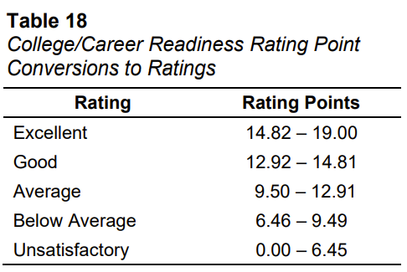
CCR Calculations
Determine the four-year graduation cohort for the school (as described in the INDICATOR: Graduation Rate section).
Determine the number of students in the four-year graduation cohort who have met at least one of the College Ready or Career Ready criteria.
Divide the number found in step 2 by the number found in step 1.
Multiply the quotient obtained in step 3 by 19 and round to the nearest hundredth (e.g., 18.38) to obtain the number of Rating Points.
Finally, total Rating Points earned are converted to Ratings using Table 18.
https://www.eoc.sc.gov/accountability-manuals
Notes:
Header font 50pt
Content/body text font 28pt

Slide 24
Data Submission Requirements
Notes:
Agenda is 88 pt
Line item is 66 pt

Slide 25

Data Submission Requirements - Assessment Data
Assessment Data
Assessments loaded by EA using state files OR by the vendor
SC Ready
SC Alt
EOCEP
MAP Growth (from sftp)
STAR (from sftp)
i-Ready (native vendor integration)
ACCESS
ACCESS Alt
SC Career Ready by WIN Learning
Beacon
Assessments loaded by districts using Runway
Any assessments not shown on the list above
(e.g., SAT, ACT, AP, Cambridge, IB, ASVAB)
District error resolution
ALL assessments!
Administration date must be on or before Day 180 to be included in Accountability.
Notes:
Header font 50pt
Content/body text font 28pt

Slide 26

Data submission requirements: PowerSchool - WBL
Critical fields in PowerSchool
Work-based Learning (WBL)
Fill out the red box!
All WBL experiences must be in PowerSchool by May 29, 2026, for all student experiences completed between July 1, 2025-June 30, 2026.
The current year-related validation will be replaced by a cautionary Level Data validation to ensure that any transfer student data can be entered on the page if needed.
Notes:
Header font 50pt
Content/body text font 28pt

Slide 27
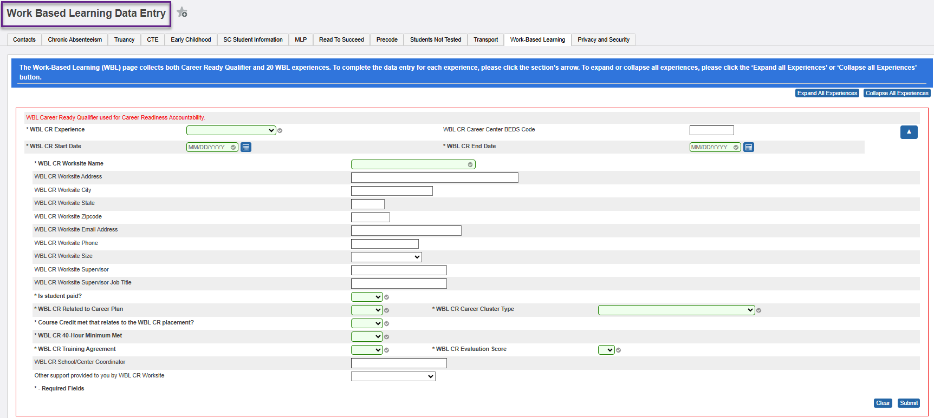
Data submission: PowerSchool - WBL
Notes:
Header font 50pt
Content/body text font 28pt

Slide 28
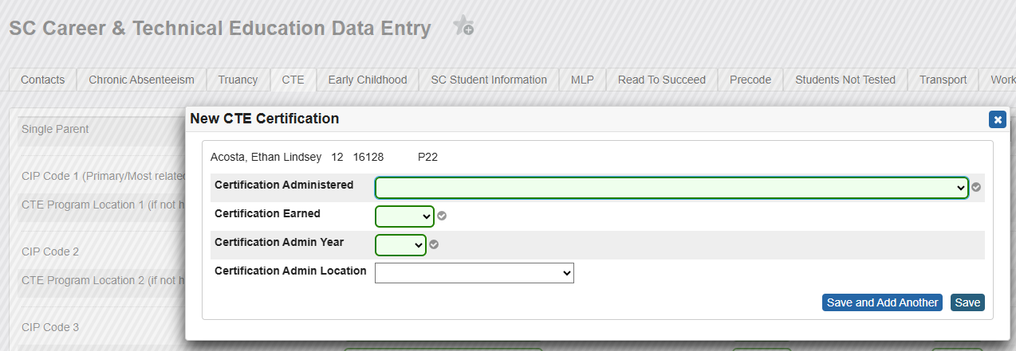
Data submission requirements: PowerSchool - CTE
Critical fields in PowerSchool
Career and Technical Education (CTE)
Fill out all relevant CTE Completer and Certification information!
Notes:
Header font 50pt
Content/body text font 28pt

Slide 29
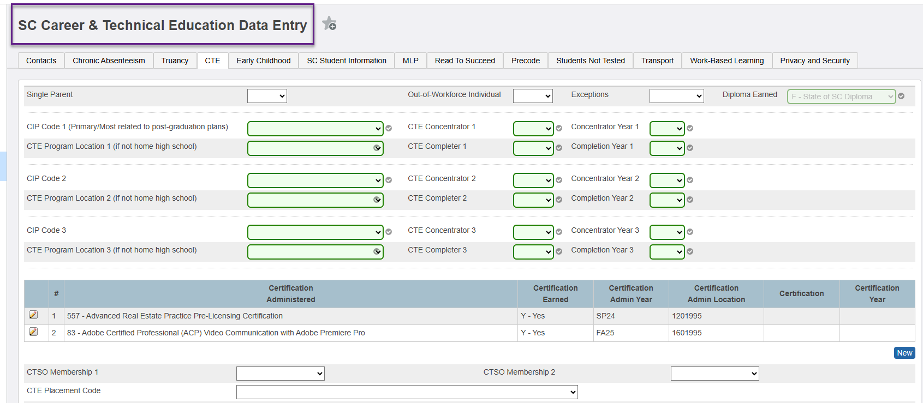
Data submission: PowerSchool - CTE
Notes:
Header font 50pt
Content/body text font 28pt

Slide 30
Data submission requirements: PowerSchool
Also important for CCR
PowerSchool Data Elements
Seeking Diploma Type
Diploma Earned
(for diplomas earned by the expected "on-time" graduation date)
Graduation Date
Course Codes –
(Important Note: see list of CCR-aligned courses for Dual Enrollment)
StoredGrades.Credit Type
(for Dual Enrollment for On-Track, last week's topic)
Employability Credential-related fields
(seeking, earned, and date)
Notes:
Header font 50pt
Content/body text font 28pt

Slide 31
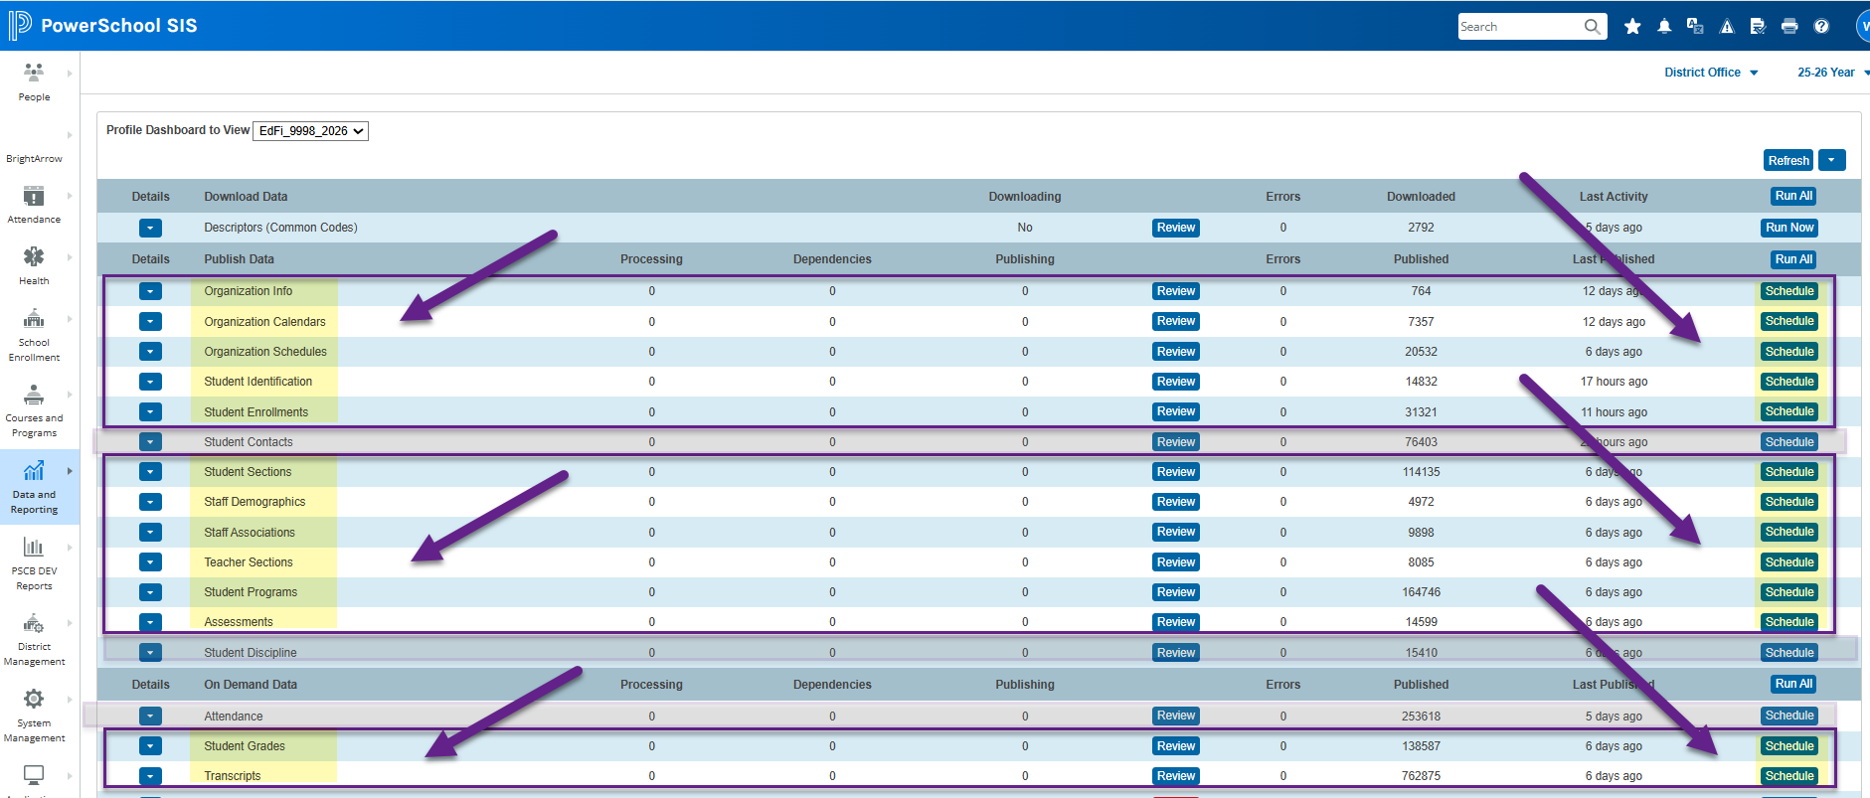
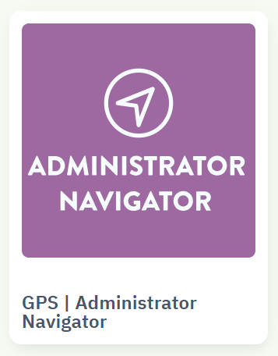
How does data make it to SCDE?
Once data is entered in PowerSchool and published to Ed-Fi by 7:00 p.m., you can verify data in Administrator Navigator the next day!
Notes:
Header font 50pt
Content/body text font 28pt

Slide 32


How does the data make it to SCDE? Spot Checking
1 - Select a student whose data values you wish to verify as "published"/"submitted."
2 - Go to the student's "publishing" page in PowerSchool (Data Exchange > Publishing).
3 - Click the green check mark next to the desired category.
4 - Look for the Ed-Fi element and associated value. The mapping document that we will soon make available will help you identify the Ed-Fi elements in the json that you are looking for.
JSON examples:
"programTypeDescriptor" : "uri://ed.sc.gov/ProgramTypeDescriptor#CTE1 - Career Technology Education Program 1",
"programName" : "CTE Program 1"
},
"assessmentReference" : {
"assessmentIdentifier" : "CTE_80",
"namespace" : "uri://ed.sc.gov/SCDEAssessments"
},
Notes:
Header font 50pt
Content/body text font 28pt

Slide 33
How does the data make it to SCDE? Spot Checking Categories
Look for these subcategories on the student's publishing page in PowerSchool:
  Student Demographics
  Student Programs
  Assessments
  Student Academic Records
  Student Course Transcript
Notes:
Header font 50pt
Content/body text font 28pt

Slide 34
CCR Data for Transfer Students
Notes:
Era

Slide 35
CCR: Transfers Records - Request
Who is responsible for transferring CCR records?
Like other records, the receiving school is responsible for verifying, documenting, and entering all CCR-related information. Districts must maintain internal processes to manage CCR data for transfer students.
When a high school student transfers into your district, the receiving district or school should consider including the following items in the records request sent to the previous school:
CCR-Related Information to Request:
Career and Technical Education (CTE certifications and credentials earned)
Work-Based Learning (WBL) experiences or completed placements documentation
Progress toward or completion of South Carolina High School Employability Credential
Additional CCR-related test scores or documentation such as SAT, ACT, AP, IB, Cambridge, ASVAB, and WIN SC Career Ready Test
Notes:
Header font 50pt
Content/body text font 28pt

Slide 36
CCR: Transfers Records - PowerSchool
Coding CCR Data in PowerSchool
Once CCR documents and records are received, districts or schools should enter all CCR data in PowerSchool exactly as provided by the sending school. This includes credential titles, dates earned, course or program completer status and term, and score values for PowerSchool based fields.
Additional Non-CCR Consideration: Coding Student Not Tested (SNT) for EOCEP Exempt Transfer Credits
During the transfer process, districts may consider reviewing for and entering 009-SNT codes when applicable in PowerSchool for students receiving EOCEP-exempt transfer credits, ensuring all transcript and PowerSchool records align.
Notes:
Header font 50pt
Content/body text font 28pt

Slide 37
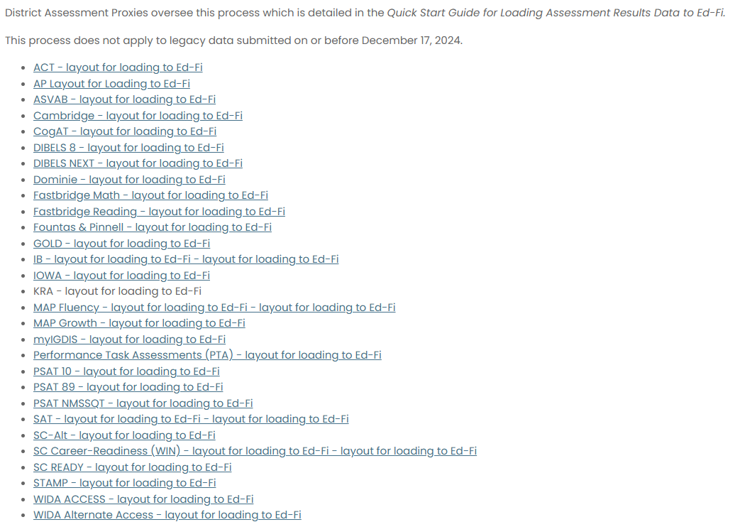
CCR: Transfers Records - Assessments
Submitting CCR Test Score Templates
Districts or schools should continue using the state-issued test score templates for submission of CCR test scores to the district Runway administrator. Once completed, the .csv with transfer student assessment results must be uploaded into Runway. Any errors must be resolved.
EA will provide a list of required fields for CCR assessments. This will be posted with the PD resources on the website once available.
We can load the past three years through Runway.
Note: SC Career Ready scores are loaded via a state score file. Individual or small batch score loading via the template is available to users to support loading assessment scores as needed for visibility in the CCR Metrics Dashboard.
ACT
AP
ASVAB
Cambridge
IB
SAT
SC Career Readiness
Notes:
Header font 50pt
Content/body text font 28pt

Slide 38

CCR: Transfers Records – Inactive Students
It is important to note; when loading to Runway, inactive students will often return an error. Please maintain documentation of those records, such as the Job ID or a note in Runway, to support a future process for inactive loading expected by no later than July 1, 2026.
Palmetto Data Collaborative can also provide assessment loading support.
Notes:
Header font 50pt
Content/body text font 28pt

Slide 39
Verifying Your Data
Notes:
Agenda is 88 pt
Line item is 66 pt

Slide 40
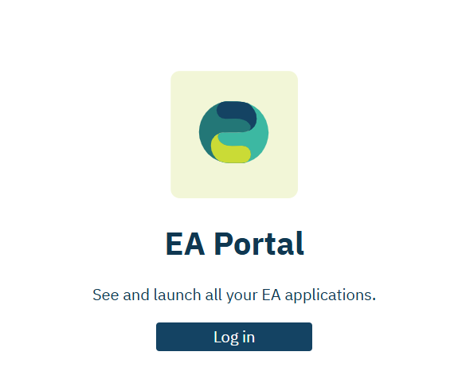
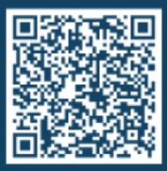
Verifying Data – Admin Navigator
Please go to Admin Navigator.
  https://portal.edanalytics.app/
If you do not have access to Admin Navigator, please scan the QR code below to find out who in your district can provide you with access.
Notes:
Header font 50pt
Content/body text font 28pt

Slide 41
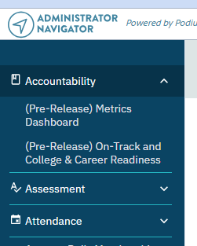
Verifying Data – Accountability Dropdown
In Admin Navigator, look for the Accountability dropdown.
Notes:
Header font 50pt
Content/body text font 28pt

Slide 42
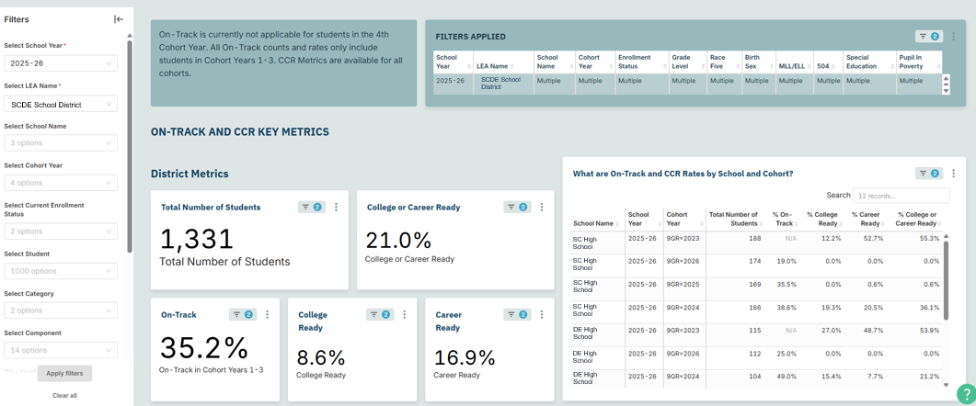
Verifying Data – Metric Dashboard
In Admin Navigator, go to the On-Track and College & Career Readiness Dashboard.
Notes:
Header font 50pt
Content/body text font 28pt

Slide 43
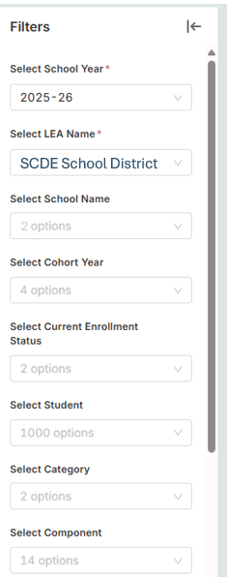
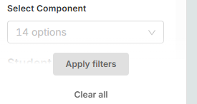
Verifying Data - Filters
In Admin Navigator, go to the On-Track and College & Career Readiness Dashboard.
  Select School Year – 2025-26
  Select LEA Name – Your district
  Select School Name – If needed
  Select Cohort Year – If needed
  Apply filters
Notes:
Header font 50pt
Content/body text font 28pt

Slide 44
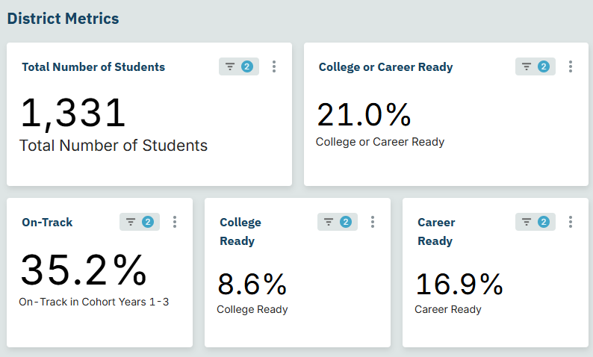
Verifying Data – District Metrics
Notes:
Header font 50pt
Content/body text font 28pt

Slide 45
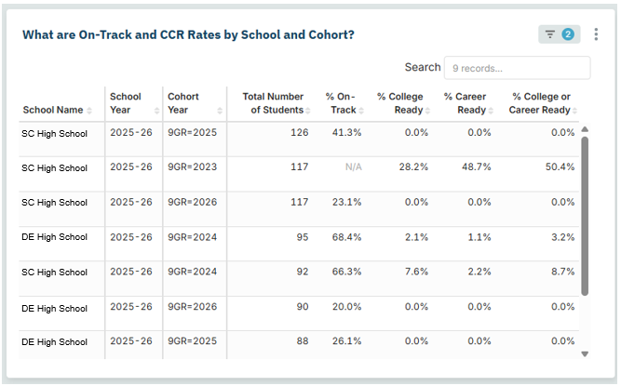
Verifying Data – School and Cohort
Notes:
Header font 50pt
Content/body text font 28pt

Slide 46
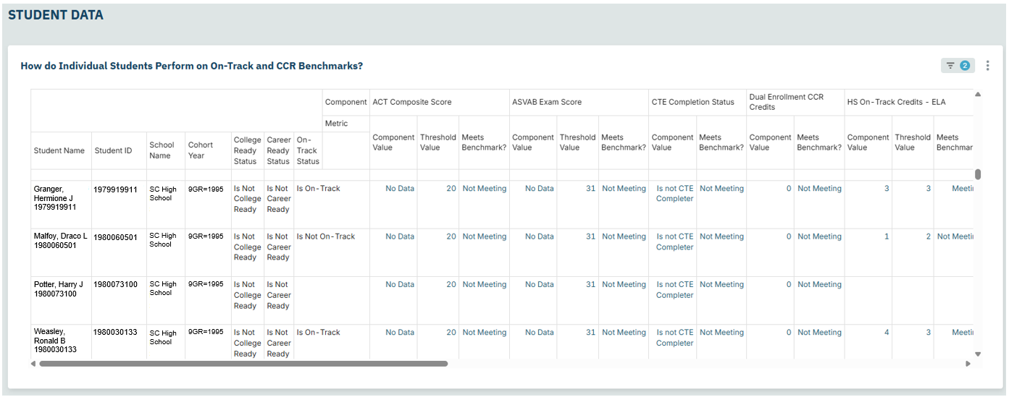
Verifying Data – Student Level
Notes:
Header font 50pt
Content/body text font 28pt

Slide 47
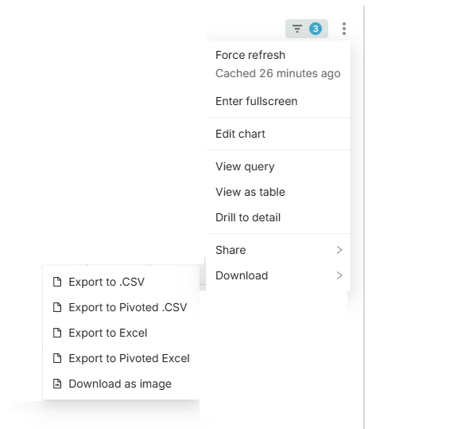
Verifying Data - Export
Interested in exporting the data in that table?
  Click the three dots.
  Select “Download.”
  There are a variety of options.
  You should choose the one that works best for you and your data systems.
Notes:
Header font 50pt
Content/body text font 28pt

Slide 48
Verifying Data – Export Options
Download Option | Headers | Rows per Student
Export to .CSV | Component, Student Name, Student ID, School Name, Cohort Year, College Ready Status, Career Ready Status, On-Track Status, Component Value, Threshold Value, Meets Benchmark? | Multiple per student
Export to Pivoted .CSV | 43 columns – Score/Value, Threshold Value, Meets Benchmark | One row per student
Export to Excel | Component, Student Name, Student ID, School Name, Cohort Year, College Ready Status, Career Ready Status, On-Track Status, Component Value, Threshold Value, Meets Benchmark? | Multiple per student
Export to Pivoted Excel – Most closely resembles the Admin Navigator Dashboard | 46 columns – Score/Value, Threshold Value, Meets Benchmark | One row per student
Notes:
Header font 50pt
Content/body text font 28pt

Slide 49
Verifying Data - Publishing
These reports update nightly as your data updates, but note that depending on when publishing completes. There could be a 1- to 2-day lag between the coding of the data and it showing up in the reports. To minimize the possibility of lag, aim to schedule publishing such that it is completed by 7:00 p.m.
SCDE is running parallel tests to ensure EA and SCDE business rules are aligned.
Data remains dynamic until you begin PowerSchool rollover or June 15 (whichever happens first).
Notes:
Header font 50pt
Content/body text font 28pt

Slide 50
Verifying Data - Visibility
In past years, you could see the students who were included in the cohort as well as the students who were no longer included in your cohort.
In the current version of our dashboard, you can only see the students who are included in your cohort.
We are aware of requests to bring back the prior functionality, but that is not available at this time.
Notes:
Header font 50pt
Content/body text font 28pt

Slide 51
Resolving Potential Issues
Notes:
Agenda is 88 pt
Line item is 66 pt

Slide 52
Inactives not showing?
EA: Inactives/cohort inclusion fix
Logic to include students with any enrollment within cohort window: ETA requested (high priority)
Blank 9GR visibility in Cohort Verification dashboard: Target ETA - 5/15
Districts:
Audit 9GR and denominator flags;
Correct blanks and errors in PowerSchool;
Verify Ed‑Fi publishing overnight.
Weekly until resolved:
  Reconcile district cohort lists to Admin Navigator exports;
  Maintain a tracker of “expected‑in‑cohort but missing” students.
  Report via EA’s Support Portal (see User Quick Guide for instructions on how to submit a ticket)
Notes:
Header font 50pt
Content/body text font 28pt

Slide 53
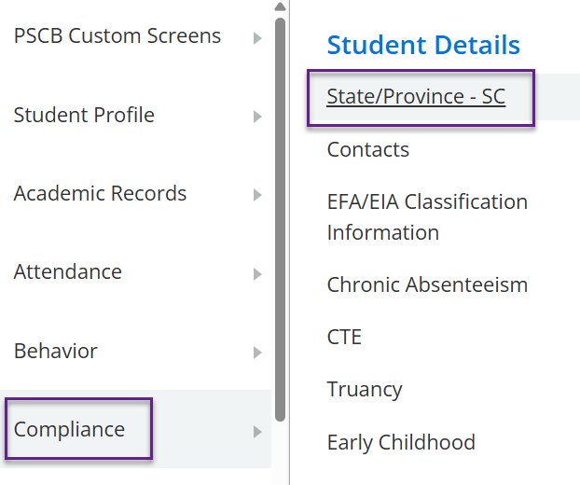
Resolving Potential Issues - Publishing
Work with a district PowerSchool administrator to
check to make sure the data have been correctly coded for each field/data point for the students in question.
check to make sure the correct data for the students has published to Ed-Fi (see the slide on spot checking).
If the students don't seem to be publishing, ensure that they are included in Ed-Fi publishing.
Notes:
Header font 50pt
Content/body text font 28pt

Slide 54
Resolving Potential Issues - Contacts
Who to contact when all that fails?
Publishing issues: PowerSchool Support case
https://help.powerschool.com/t5/Case-Portal/ct-p/Support-CasePortal
Questions about Administrator Navigator: submit a ticket to Education Analytics
https://edanalytics.atlassian.net/helpcenter/products-and-services/user/login
SCDE District and Technology Services
PowerSchool@ed.sc.gov
Note: Forthcoming ticketing system will soon replace the use of the email address above.
Notes:
Header font 50pt
Content/body text font 28pt

Slide 55
Resolving Potential Issues - Resources
Level Data validations (see our team's "Validation Prioritization" resource!):
  Within your Level Data Validations, go to "Informational Lists" and find the rule called "Excluded from Ed-Fi Publishing." This provides a list of active students with ‘Exclude this student from Ed-Fi Publishing’ set to Yes.
Satchel
  https://sc-satchel.commongoodlt.com/
Notes:
Header font 50pt
Content/body text font 28pt

Slide 56
Planning Time
Notes:
Agenda is 88 pt
Line item is 66 pt

Slide 57
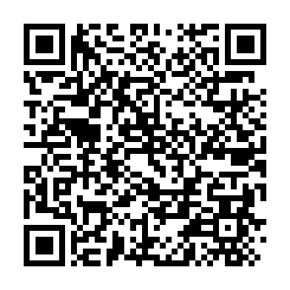
Session Evaluation
Please complete an evaluation of the session using the QR Code.
Notes:
Header font 50pt
Content/body text font 28pt

Slide 58
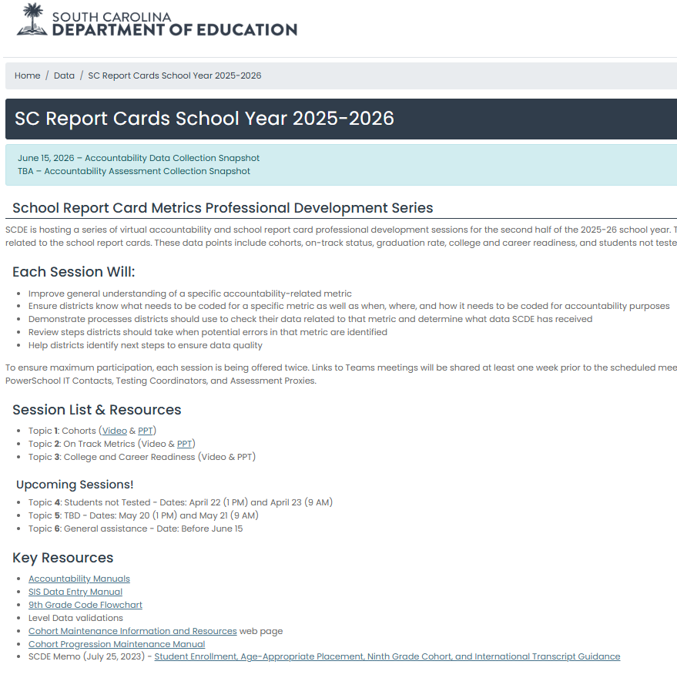
Website
The new SC School Report Cards Professional Development & Resources Website is online!
  https://ed.sc.gov/data/schoolreportcard/
We will add session videos & PowerPoint as available.
Notes:
Header font 50pt
Content/body text font 28pt

Slide 59
Planning Time: Key Concepts
We have covered a lot of information today:
  Basic definitions
  What to code, when, and where
  How to check your data
  How to resolve potential errors
This means you have a lot of information to act on and communicate.
Notes:
Header font 50pt
Content/body text font 28pt

Slide 60
Planning Time: Key Questions
Questions | Priority 1 | Priority 2 | Priority 3
What needs to be communicated?
Who is the audience?
How does it need to be communicated?
When does it need to be communicated?
How do you plan to follow up to ensure implementation is occurring?
Notes:
Header font 50pt
Content/body text font 28pt

Slide 61
Next Steps
In the coming months, we will have more professional development on related topics.
We plan to distribute event links about one week prior to the sessions.
  Topic 4: Students not Tested
    Dates: April 22 (1 PM) and April 23 (9 AM)
  Topic 5: TBD
    Dates: May 20 (1 PM) and May 21 (9 AM)
  Topic 6: General assistance
    Date: Before June 15
Notes:
Header font 50pt
Content/body text font 28pt

Slide 62
Key Documents
Accountability Manuals
SIS Data Entry Manual
9th Grade Code Flowchart
Level Data validations
Cohort Maintenance Information and Resources web page
  Cohort Progression Maintenance Manual
  SCDE Memo (July 25, 2023) - Student Enrollment, Age-Appropriate Placement, Ninth Grade Cohort, and International Transcript Guidance
Mapping document – updates in progress (will be posted, and link will be shared)
Accountability-oriented mapping doc – in progress (will be posted, and link will be shared)
Topic 1: Cohorts (Video & PPT)
Topic 2: On Track Metrics (Video & PPT)
Notes:
Header font 50pt
Content/body text font 28pt

Slide 63
Key Takeaways
The College and Career Readiness Indicator use cohort data to establish which students are included in the metric.
This indicator counts for 19% of a high school’s overall rating.
Districts and schools should use Admin Navigator to check school and student-level data related to the College and Career Readiness Indicators.
As potential errors are identified, districts should lead schools through the processes outlined today to ensure accurate data is reported to SCDE for the 2026 school report cards.

Slide 64

Vann Holden
Era Roberts
Wendy Stephens
cvholden@ed.sc.gov
Chief Research Officer
earoberts@ed.sc.gov
Accountability Program Manager
wstephens@ed.sc.gov
Team Lead, Data Management
Notes:
Insert your picture within the yellow circle (replace the SCDE logo inside circle)
Speaker/person photo should be in a circle frame
Should have a yellow outline
Should be 6 x 6 inches
Firstname/Lastname is font 80pt
Title, Copmany is 36pt (italic)

Slide 65
ed.sc.gov
Notes:
Slide title is hidden from display

