Slide 1

January ORDA Office Hour

Slide 2
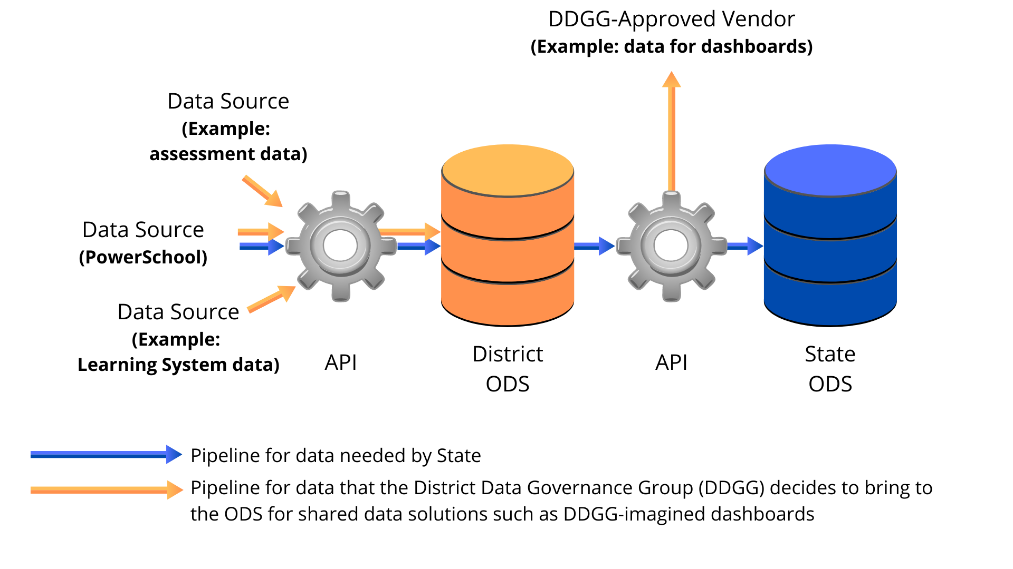
SC Ed-Fi Pipelines

Slide 3
Today’s Demonstration
Make a successful connection between PowerSchool and your district’s ODS/API.
Publish 2021-2022 PowerSchool data to your district’s ODS.

Slide 4
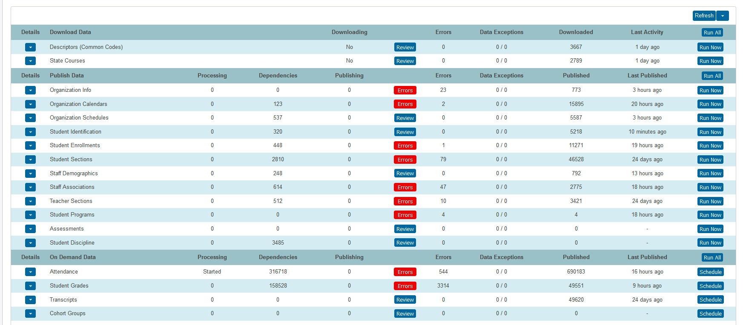
PowerSchool Ed-Fi Data-Publishing Dashboard

Slide 5
Ed-Fi Credentials
for a given year
key, secret, and API URL

Slide 6
State Reporting Version
SR_21.12.1.0

