Slide 1
South Carolina Growth Model Explained
Notes:
Thank you for joining this session. We’ll be discussing how academic growth is calculated in the state of South Carolina.

Slide 2
A Step-by-Step Explanation
Education Analytics (EA) calculates school-level academic growth model results for
  Grades 4-8
  Mathematics and ELA
This presentation explains the way the calculations work as a step-by-step process
For a more complete and detailed explanation of the statistical methodology, please see the full technical report
Notes:
South Carolina has a new partner to create the state’s growth model as of the 2018-19 school year. Education Analytics, a non-profit organization out of Madison, Wisconsin, has years of experience developing growth models for state and district partners.
EA created the state’s growth model in conjunction with representatives from the state department of education and technical staff from South Carolina school districts.
School-level academic growth is calculated for grades 4 through 8 in mathematics and English Language Arts.
[click]
This presentation will explain the step by step process for calculating the growth model.
[click]
More detailed and technical explanations are available through other materials, which you will also have access to.

Slide 3
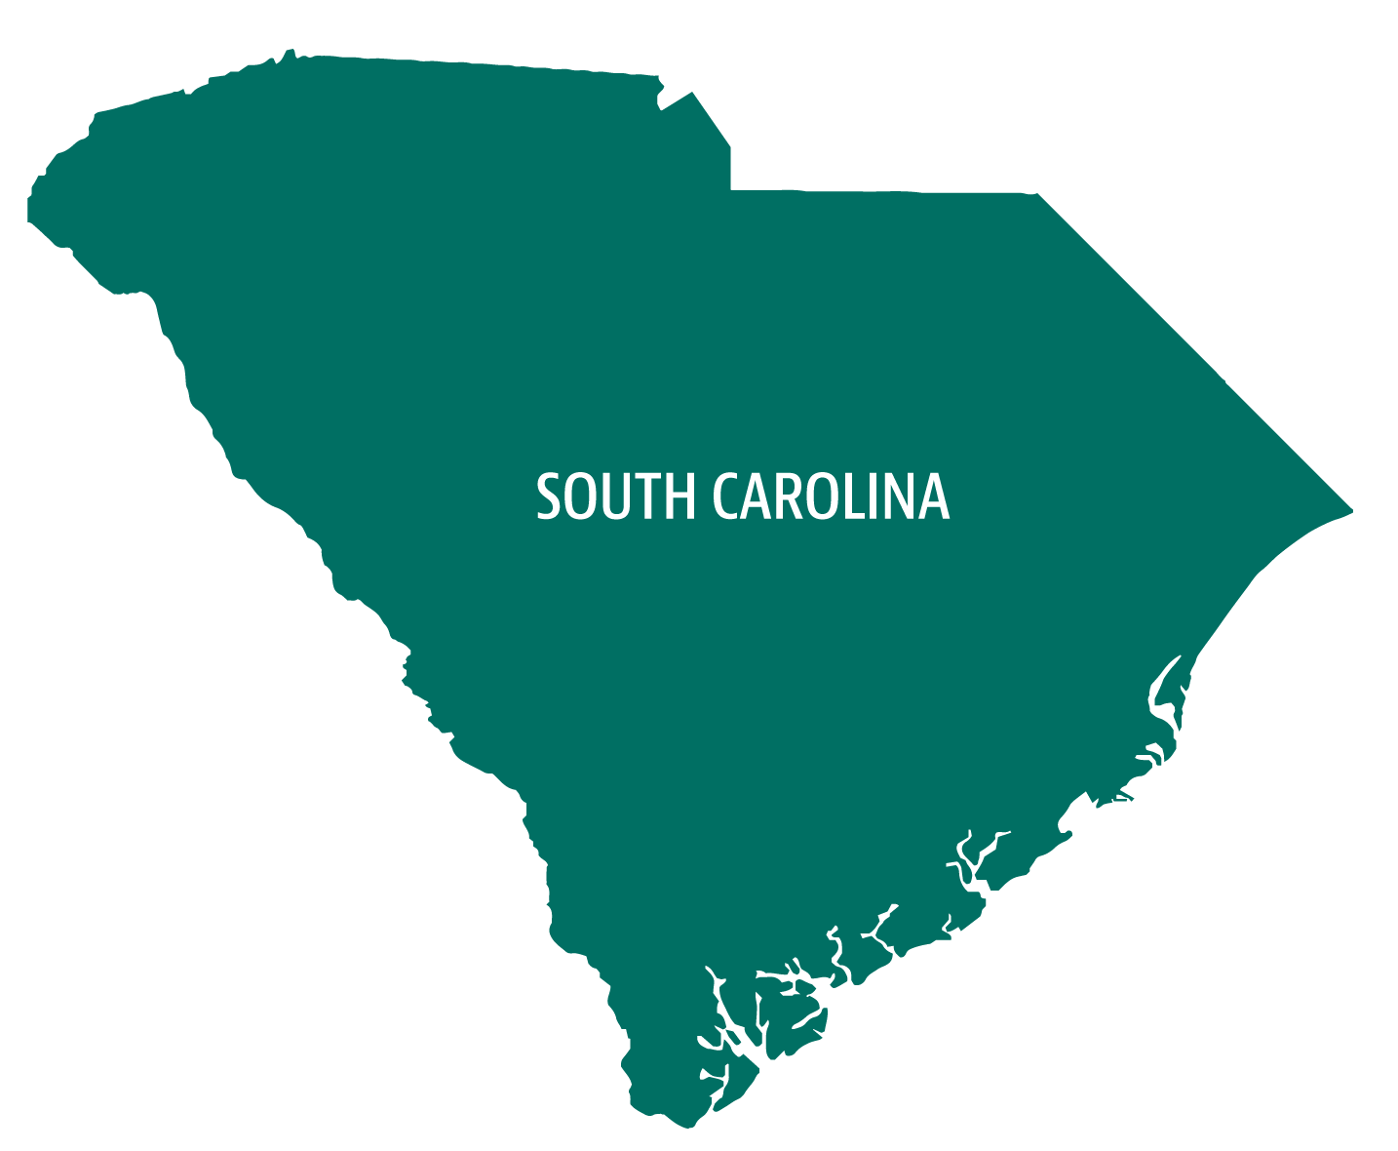
Growth Model – Step 1
After SC READY testing is complete, EA receives student data from across the entire state of South Carolina
EA analyzes the data to find out:
  How fast did students grow academically across the state?
  Were there patterns in how fast different students grew?
Notes:
The first step in the process is data collection.
After SC READY testing is complete, EA receives student data from across the entire state of South Carolina.
[click]
EA analyzes the data to examine two things, one question is “how fast did students grow academically across the state?” The other is “were there patterns in how fast different students grew?”
The answers to these questions help us understand trends across the state that we’ll use in the next step.

Slide 4



Growth Model – Step 2
EA creates a target for each student
The target is the state average growth of similar students, defined as students with the same test history in similarly achieving schools
Target Score
Note:
These numbers are for illustrative purposes.
The actual adjustment amounts are calculated each year and for each grade/subject independently and reflect the actual data patterns across South Carolina.
+35 Average growth for students with the same test history
-5 Adjustment for
school average achievement
_________
+30 points
During the year
SC READY
2017-18
SC READY
2018-19
Notes:
In the second step, EA creates a target for each student.
The target is the state average growth of similar students, which is defined as students with the same test history in similarly achieving schools.
Think of this as the typical growth for a student like this one.
[click]
Here is an example student with their SC READY test score from the 2017-18 school year.
[click]
EA creates a target for this student based on the growth of students with similar SC READY scores in previous school years, as well as the average prior achievement in their school by grade and subject.
In this example case, the student’s target is to grow by 30 points on the SC READY in the 2018-19 school year.
[click]
Please note that these numbers are for illustrative purposes and that actual adjustment amounts are calculated each year and for each grade and subject independently.
It is common to find that students in one grade and subject grow differently than in another grade and subject.

Slide 5
Growth Model – Step 3
Determine whether each student exceeded or did not meet the target, and by how much
Actual Score
Student
Exceeded
Target
by 5 Points
Target Score
Student
Did Not Meet
Target
by 4 Points
Target Score
Actual Score
SC READY
2017-18
SC READY
2018-19
SC READY
2017-18
SC READY
2018-19
Notes:
In the third step, EA determines whether each student exceeded or did not meet the target, and by how much.
[click]
On the left is a student with their target SC READY score.
[click]
This student’s actual SC READY score in 18-19 was higher than the target by 5 points.
[click]
On the right is a different student with their target score.
[click]
This student’s actual SC READY score was lower than the target by 4 points.
It’s important to note that this does not mean that the student didn’t grow. It means they didn’t grow as much as students with the same test history in similarly achieving schools from across the state.

Slide 6
Students with High
Pretest Scores
Actual Score
Student
Exceeded
Target
by 3 Points
Target Score
Student
Did Not Meet
Target
by 4 Points
Target Score
Actual Score
SC READY
2017-18
SC READY
2018-19
SC READY
2017-18
SC READY
2018-19
Students with Low
Pretest Scores
Actual Score
Student
Exceeded
Target
by 3 Points
Target Score
Student
Did Not Meet
Target
by 4 Points
Target Score
Actual Score
SC READY
2017-18
SC READY
2018-19
SC READY
2017-18
SC READY
2018-19
Notes:
Targets for each student take into account the pattern of growth for similarly achieving students from across the state.
To illustrate this, we will look at four example students.
[click]
On the top half of the screen, there are two students with high scores on the 2017-18 test.
[click]
EA may find that on average, students with high scores don’t grow many points on the test. This pattern from across the state is accounted for when creating individual students’ growth targets.
[click]
On the bottom half of the screen, there are two students with low scores on the 2017-18 test.
[click]
EA might find that on average, students with low scores tend to grow more points on the test. Again, this state-wide pattern is accounted for when creating students’ growth targets.
By creating these customized targets for each student, the growth model is accounting for the relative difficulty of demonstrating growth on the test at different points in the scale.
[click]
Students’ actual scores are compared to these customized targets to determine which students exceeded and which students did not meet the targets.

Slide 7
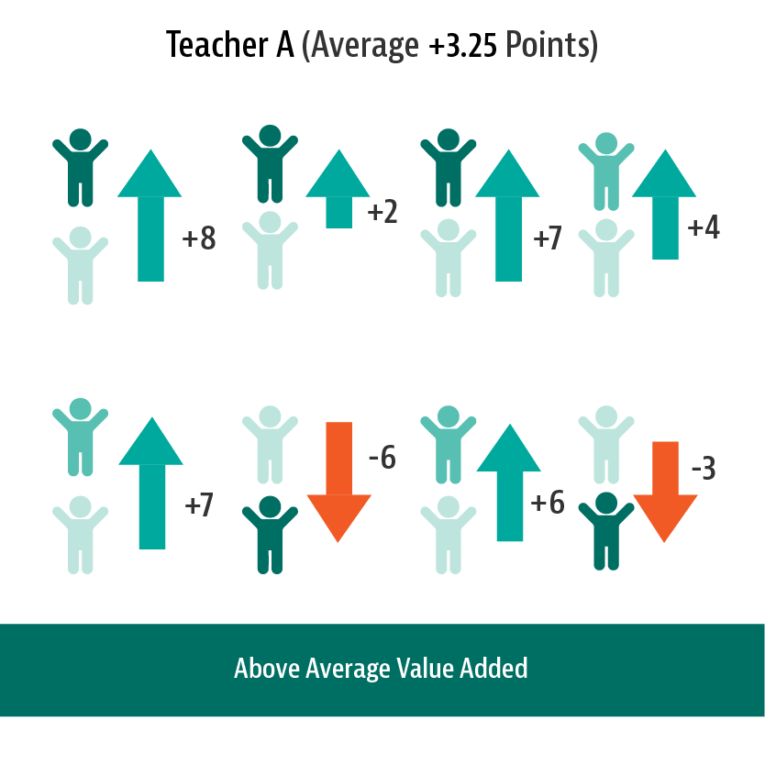
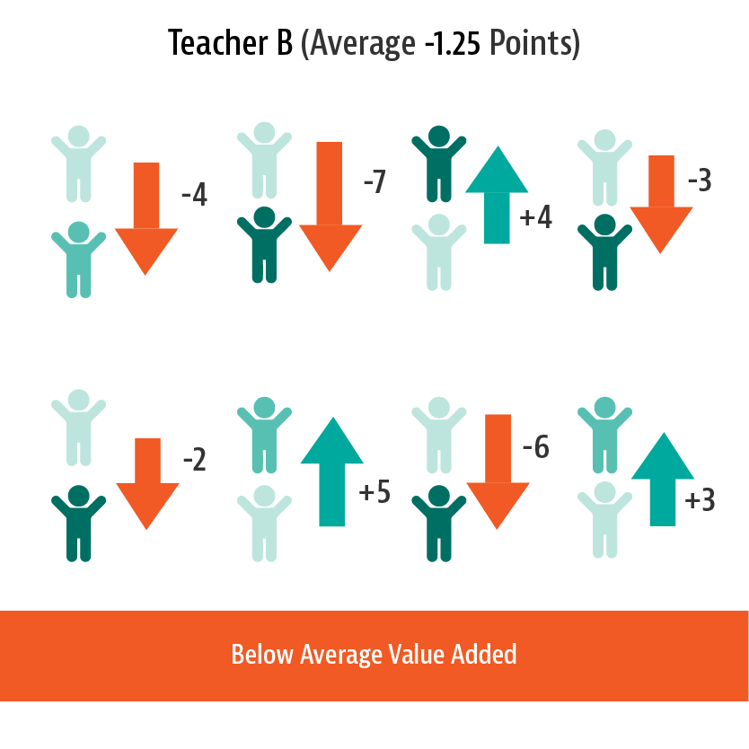
Growth Model – Step 4
On average, did a school’s students tend to exceed or failed to meet their targets, and by how much?
School A
School B
(Average +3.13 Scale Score Points)
(Average -1.25 Scale Score Points)
Notes:
In the fourth step, EA calculates the pattern of results at the school.
On average, did a school’s students tend to exceed their targets or fail to meet their targets? And by how much?
[click]
On the left, School A’s students tended to exceed their targets – on average, by a little over 3 points on the test. This is interpreted as the school having an above average impact on students’ growth.
[click]
On the right, School B’s students tended to not meet their targets – on average, they grew about one point less on the test than their target scores. This is interpreted as the school having a below average impact on students’ growth.

Slide 8

Growth Model – Step 5
Growth results are converted to a number on a 0-40 scale.
School C
School D
School E
School F
-7
-3
-2
-3
+2
+4
+4
+2
-4
+2
-4
-2
-1
+3
+8
+2
0
10
20
30
40
Lower Growth Average Growth Higher Growth
Notes:
In the final step, the growth results are converted to a more easily understood number. In South Carolina the number is on a 0-40 scale if the schools do not have an ELP indicator (meaning they have fewer than 20 students who are English learners). If the schools do have an ELP indicator (meaning they serve 20 or more English learners), student growth will be transformed to a 0-35 scale.
[click]
Here we have four hypothetical schools (which are different from the ones in the previous slide). These schools do not have an ELP indicator, therefore student growth is converted to a 0-40 scale.
In School C, most students are growing quite a bit less than similar students, which results in this school’s growth estimate being low in the scale.
In School D, on average, students are growing just under typical growth for similar students, which results in this school’s growth estimate being slightly below 20.
In School E, on average, students are growing a little more than similar students, which results in this school’s growth estimate being slightly above 20.
In School F, most students are growing far more than similar students, which results in this school’s growth estimate being high in the scale.

Slide 9


Conversion to State Report Cards
Each school receives two growth values
  One for all 4-8th grade students in the school
  One for the lowest performing 20% of students in the school
The two values are averaged to get a total number of points earned
Notes:
Once the growth models have been calculated they are ready for use in South Carolina’s report cards.
Two growth values are actually calculated through the process just described – one for all 4th through 8th graders in the school, and a separate value for the lowest performing 20% of students based on their SC READY scores in 2017-18.
[click]
The two values are added together and divided by two to get a total number of points earned out of 40 (or out of 35 for schools with an ELP indicator).
[click]
The total number of points earned is reported under the Student Progress section of the state’s report cards.

Slide 10
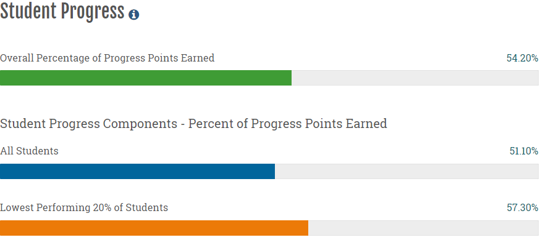
Reporting
For reporting purposes, the numbers on the 0-40 scale also are divided by 40 to get a percentage of points earned
Notes:
In addition to the total number of points earned, the state also reports on the percentage of points earned.
[click]
The percentage of points earned out of 40 is reported for the averaged total, as well as the two components used to create the average – the growth for all students and the growth for the lowest performing 20% of students.
When possible, the state also reports these values for sub-groups of students.

